Slide 1
SCREENING FOR THYROID DYSFUNCTION BEFORE OR DURING PREGNANCY
Dr.BABAEI
ENDOCRINOLOGIST
1396.8.11

Slide 2
Screening
Prevalence
adverse health outcomes
Treatable
effective therapy must exist
Practical treatment
effectively deliverable
cost effective

Slide 3
Screening for thyroid dysfunction in pregnancy fulfills some of these criteria.
Universal vs case finding?

Slide 4
Screening
Prevalence
adverse health outcomes ???
Treatable
effective therapy must exist
Practical treatment
effectively deliverable
cost effective

Slide 5
the most notable impact of a universal screening mandate for thyroid dysfunction would be the identification of the large proportion of patients with subclinical hypothyroidism.

Slide 6
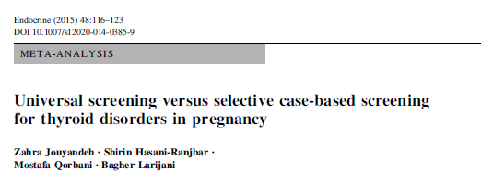

Slide 7
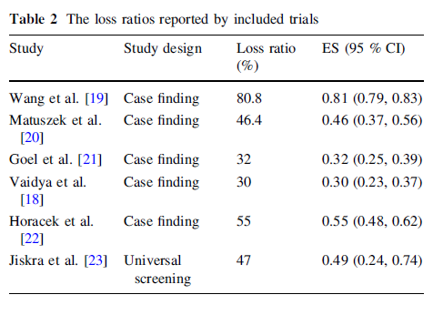

Slide 8
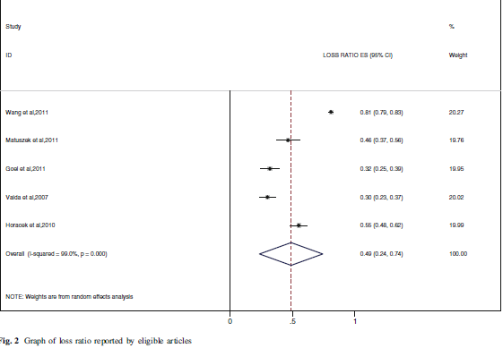
Wang et al,2011
Matuszek et al,2011
Goel et al,2011
Vaida et al,2007
Horacek et al,2010
Overall (I-squared = 99.0%, p = 0.000)

Slide 9
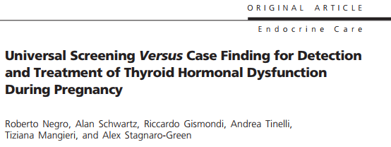
(J Clin Endocrinol Metab 95:1699–1707, 2010)

Slide 10
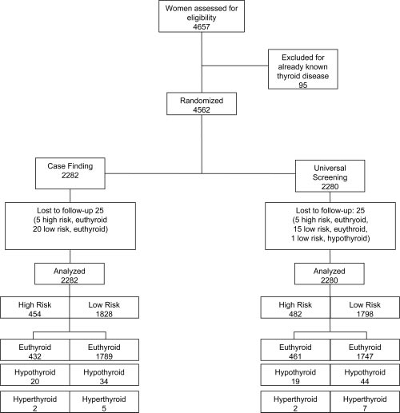
hypothyroid-TSH >2.5 mIU/liter in TPO-Ab positive women
hyperthyroid-undetectable TSH concentration and elevated fT4
spontaneously pregnant women with singletons within the first 11 wk of gestation and no history of thyroid disease.

Slide 12
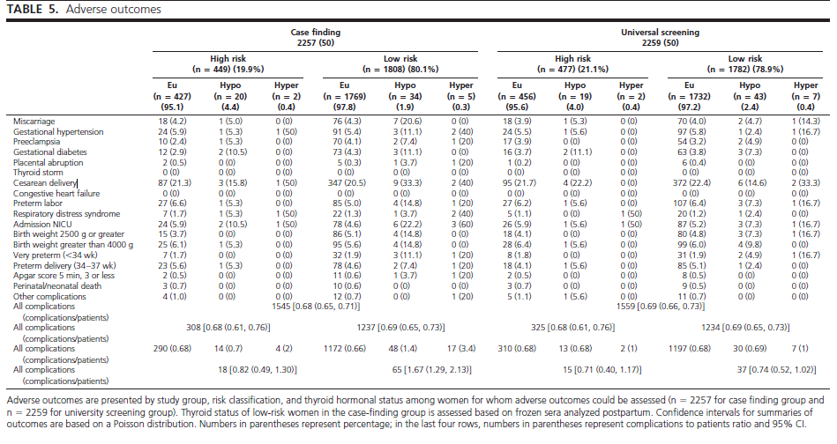

Slide 13
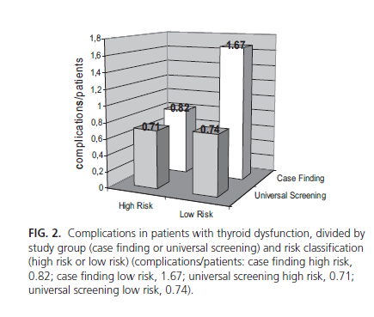

Slide 14
Considering only the cohorts of low-risk women the mixed logistic model revealed:
that adverse outcomes were less likely to occur among women in the universal screening group than women in the case-finding group [odds ratio (OR) 0.43, 95% confidence interval (CI; 0.26, 0.70)].

Slide 15
Considering the likelihood of at least one adverse outcome for all low-risk women screening did not show a significant benefit;
the number needed to screen to prevent one woman from having any adverse outcome was 60(95%CI 21, ͚).

Slide 16
conclusion
Universal screening compared with case finding did not result in a decrease in adverse outcomes.
Treatment of hypothyroidism or hyperthyroidism identified by screening a low-risk group was associated with a lower rate of adverse outcomes.

Slide 18
To evaluate the effect of subclinical hypothyroidism (SCH) screening and intervention on pregnancy outcomes

Slide 19
675 in screening group
996 in control group

Slide 20
167 from screening group was diagnosed as SCH.
252 from control group was diagnosed as SCH.

Slide 21
treating elevated TSH values early in pregnancy reduced pregnancy loss rates (OR 0.343 [CI 0.21–0.56]) and macrosomia .(OR 0.46 [CI 0.28–0.74])

Slide 22
Limitation :
the timing of enrollmen at the two centers varied substantially:
the screening arm enrolled women at week 11 whereas the control arm enrolled women at week 7.

Slide 23
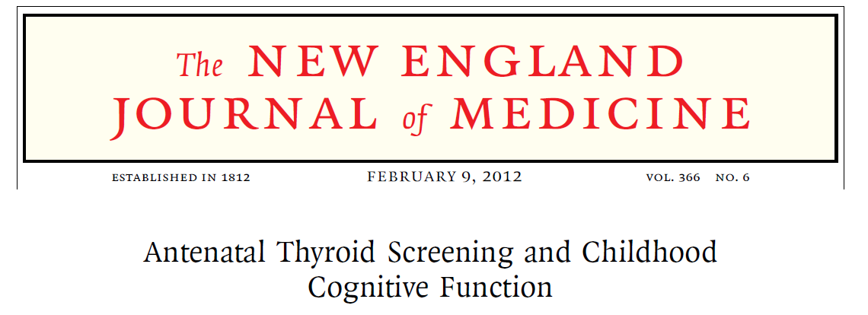

Slide 24
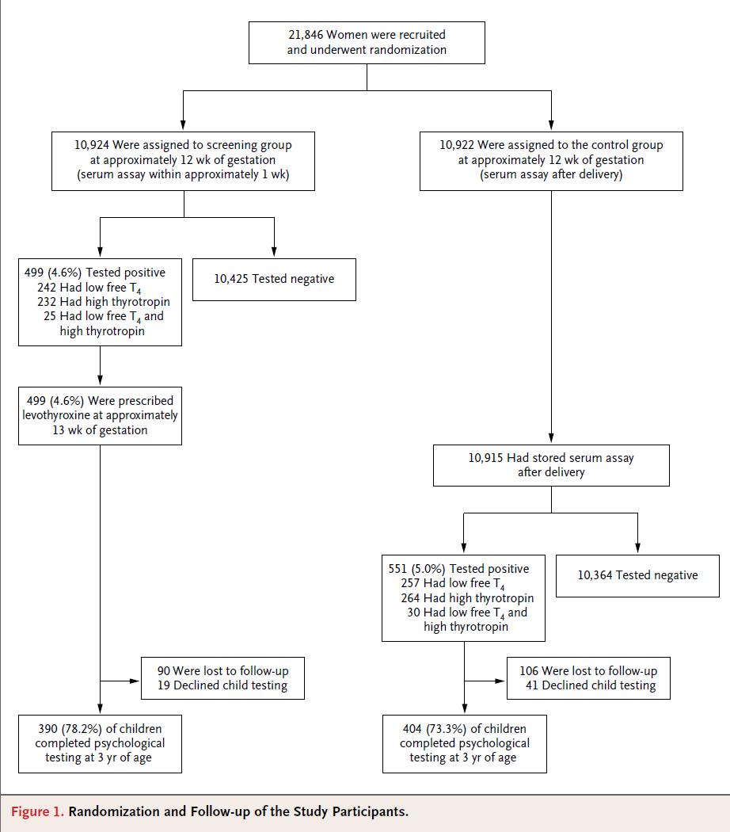

Slide 25
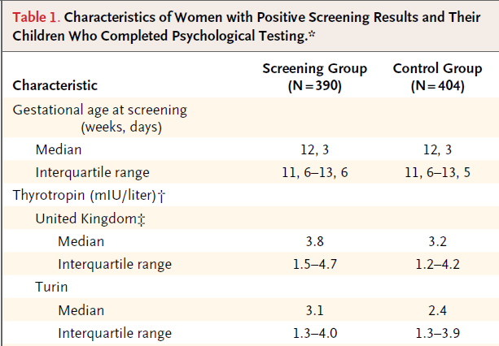

Slide 26
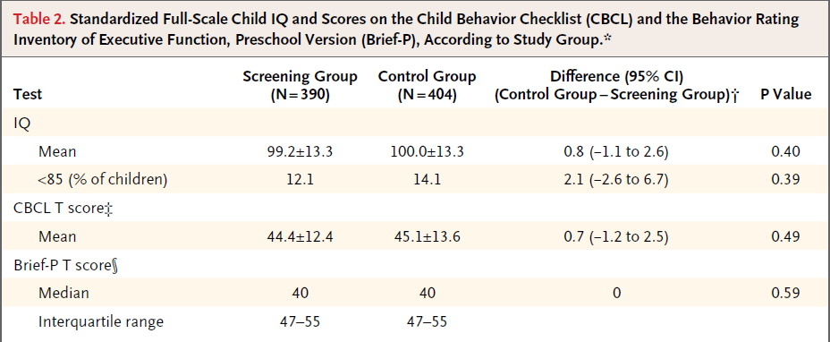

Slide 27
Limitation :
the timing of LT4 administration (median initiation >13 weeks)
mild degree of TSH elevation (median TSH 3.1–3.8 mU/L) in its subjects
predictive value of early IQ testing at age 3 years uncertain

Slide 28
RECOMMENDATION 93
There is insufficient evidence to recommend for or against universal screening for abnormal TSH concentrations in early pregnancy.
No recommendation, insufficient evidence.

Slide 29
RECOMMENDATION 94
There is insufficient evidence to recommend for or against universal screening for abnormal TSH concentrations preconception, with the exception of women planning assisted reproduction or those known to have TPOAb positivity.
No recommendation, insufficient evidence.

Slide 30
RECOMMENDATION 95
Universal screening to detect low FT4 concentrations in pregnant women is not recommended.
Weak recommendation, moderate-quality evidence

Slide 31
RECOMMENDATION 96
All pregnant women should be verbally screened at the initial prenatal visit for any history of thyroid dysfunction, and prior or current use of either thyroid hormone (LT4) or antithyroid medications (MMI, CM, or PTU).
Strong recommendation, high-quality evidence

Slide 32
RECOMMENDATION 97
All patients seeking pregnancy, or newly pregnant, should undergo clinical evaluation. If any of the following risk factors are identified, testing for serum TSH is recommended:

Slide 33
A history of hypothyroidism/hyperthyroidism or current symptoms/signs of thyroid dysfunction | Multiple prior pregnancies (>=2)
Known thyroid antibody positivity or presence of a goiter | Family history of autoimmune thyroid disease or thyroid dysfunction
History of head or neck radiation or prior thyroid surgery | Morbid obesity (BMI >=40 kg/m2)
Age >30 years | Use of amiodarone or lithium, or recent administration of iodinated radiologic contrast
Type 1 diabetes or other autoimmune disorders | Residing in an area of known moderate to severe iodine insufficiency
History of pregnancy loss, preterm delivery, or infertility
Strong recommendation, moderate-quality evidence

Slide 34
THANK YOU

