Slide 1
Insulin Sensetizers in T2DM
BY:
Dr. Majid Valizadeh
Endocrinologist & Associate Professor of SBMU

Slide 2
Scope of this talk
Type 2 Diabetes
Outpatients
Focus on Biguanides, Thiazolindiones
Practical application

Slide 3
Road Map
Background:
  Importance of glycemic control
  Glycemic goals
Overview of the pathogenesis of T2DM
Therapy of Type 2 Diabetes
  Glycemic control
  Insulin Sensetizers
Cases discussion according ADA/EASD consensus & AACE Guideline
Take home message

Slide 4
Relative Risk of Progression of Diabetic Complications
RELATIVE RISK
Mean A1C
        DCCT Research Group, N Engl J Med 1993, 329:977-986.

Slide 5
Glycemic Control and Diabetes Complications
Diabetic patients are at high risk for cardiovascular events
  and evaluation/treatment of all cardiovascular risk factors is essential
Simply focusing on glycemic control
  will not have a major impact to reduce cardiovascular risk
We favor a therapeutic approach based not only on the drug’s glucose-lowering efficacy/durability but also on its effect
  on weight, blood pressure, lipids, cardiovascular protection, and side effect profile, especially hypoglycemia
ADA Diabetes Self-Study Series, Challenges in Type 2 Diabetes Mellitus Management: Self-Assessment Program
Current Status of the Treatment of Type 2 Diabetes
© 2014 American Diabetes Association
Glycemic Control and Chronic Diabetes Complications; p26
Pathophysiologic Approach to Therapy in Patients With Newly Diagnosed Type 2 Diabetes; p48

Slide 6
Primary Objectives of Effective Management
Diagnosis
lGæde P, Vedel P, Larsen N, Jensen GVH, Parving H-H, Pedersen O. Multifactorial intervention and cardiovascular disease in patients with type 2 diabetes. N Engl J Med. 2003;348:383-393.
A1C
%
9
8
7
Reduction
of both
micro- and macro-
vascular
event
rates
…by 75%!
SBP
mm Hg
145
130
LDL
mg/dL
140
100
45
50
55
60
65
70
75
80
85
90
Patient Age
Notes:
Key Points
The primary objectives of effective diabetes management are to reduce A1C to as near-normal levels (ie, 4%–6%) as is possible and safe, to lower systolic blood pressure to <130 mm Hg, and to decrease LDL cholesterol to <100 mg/dL
Achieving target levels of A1C, systolic blood pressure, and LDL cholesterol may reduce the risk of the micro- and macrovascular complications of diabetes by up to 75%
As illustrated in this slide, the objectives of effective diabetes management are to reduce A1C to as near-normal levels as is possible and safe (ie, 4%–6%), lower systolic blood pressure to <130 mm Hg, and to decrease LDL cholesterol to <100 mg/dL. Evidence suggests that achieving these target levels can reduce the risk of both microvascular and macrovascular complications of diabetes by >75%.¹
Most recently, the Steno-2 Study followed 160 patients with type 2 diabetes and microalbuminuria over 7.8 years to determine the effect of intensive treatment on long-term CV and microvascular outcomes. Researchers found that target-driven, intensive treatment consisting of stepwise diet, exercise, and pharmacotherapy for glycemia, microalbuminuria, lipids, and blood pressure resulted in a decreased risk of CV and microvascular events of about 50%. Control group members received conventional treatment in accordance with national guidelines. However, factors leading to diminished degrees of separation between the intensive treatment and control groups (eg, more than 50% of control group members were referred for specialist treatment during the course of the study) led the authors to estimate that the actual risk reduction associated with intensive versus conventional therapy may be even greater than that observed.²
References
American Diabetes Association. Clinical Practice Recommendations. Implications of the United Kingdom Prospective Diabetes Study. Diabetes Care. 2003;26(suppl 1):S28-S32.
Gæde P, Vedel P, Larsen N, Jensen GVH, Parving H-H, Pedersen O. Multifactorial intervention and cardiovascular disease in patients with type 2 diabetes. N Engl J Med. 2003;348:383-393.

Slide 7
A1C Goals
What are A1C goals and are they obtainable?
ADA Diabetes Self-Study Series, Challenges in Type 2 Diabetes Mellitus Management: Self-Assessment Program
Current Status of the Treatment of Type 2 Diabetes
© 2014 American Diabetes Association
Rationale for Management of Hyperglycemia; p6

Slide 8
Clinical Diabetes. 23(2):78-86, 2005.

Slide 9
ADA-EASD Position Statement Update:
Management of Hyperglycemia in T2DM, 2015
3. ANTI-HYPERGLYCEMIC THERAPY
Glycemic targets
  HbA1c < 7.0% (mean PG ∼150-160 mg/dl [8.3-8.9 mmol/l])
  Pre-prandial PG <130 mg/dl (7.2 mmol/l)
  Post-prandial PG <180 mg/dl (10.0 mmol/l)
  Individualization is key:
    Tighter targets (6.0 - 6.5%) - younger, healthier
    Looser targets (7.5 - 8.0%⁺) - older, comorbidities, hypoglycemia prone, etc.
  Avoidance of hypoglycemia
PG = plasma glucose
Diabetes Care 2012;35:1364–1379; Diabetologia 2012;55:1577–1596
Diabetes Care 2015;38:140-149; Diabetologia 2015;58:429-442
Notes:
In general, the goal in diabetes is to reduce glucose so that the glycated hemoglobin (HbA1c) concentration is reduced to 7% or less. Individualization of treatment targets is important, however. Young patients may benefit from tighter control, below 6.5%, since they are apt to have more years of life and exposure to hyperglycemia which can lead to long-term vascular complications. In contrast, in older individuals, especially those with multiple comorbidities, established vascular complications, or with a predisposition to hypoglycemia, more conservative targets are necessary, such as 7.5 – 8.0% or even higher, depending on the patient’s condition.

Slide 10
ADA-EASD Position Statement Update:
Management of Hyperglycemia in T2DM, 2015
  2. BACKGROUND
Overview of the pathogenesis of T2DM
  Insulin secretory dysfunction
  Insulin resistance (muscle, fat, liver)
  Increased endogenous glucose production
  Decreased incretin effect
  Reduced renal glucose excretion
  Deranged adipocyte biology
Diabetes Care 2012;35:1364–1379; Diabetologia 2012;55:1577–1596
Notes:
The pathogenesis of T2DM is complex with multiple defects in multiple organ systems. Insulin resistance appears to be a primary defect, followed by relative beta cell failure with insulin secretory abnormalities, and increased endogenous (hepatic) glucose production. There are also derangements in incretin physiology and in the certain aspects of adipocyte biology.

Slide 11
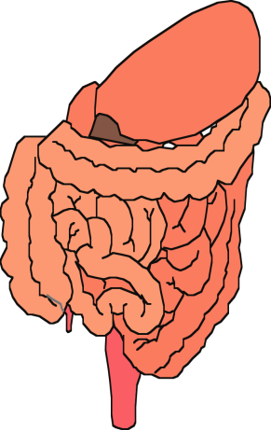
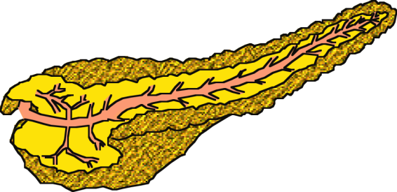


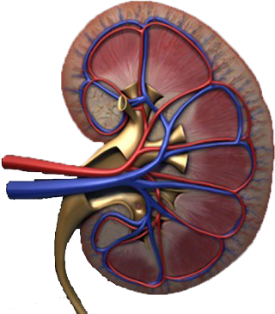
Multiple, Complex Pathophysiological Abnormalities in T2DM
pancreatic
insulin
secretion
incretin
effect
pancreatic
glucagon
secretion
_
?
gut
carbohydrate
delivery &
absorption
HYPERGLYCEMIA
_
+
peripheral
glucose
uptake
hepatic
glucose
production
renal glucose excretion
Adapted from: Inzucchi SE, Sherwin RS in: Cecil Medicine 2011
Notes:
This slide provides a broad overview of the main pathophysiological defects in type 2 diabetes. Insulin resistance is demonstrated in peripheral tissues, such as skeletal muscle and adipocytes. The pancreas develops relative insulin secretory failure and is no longer provide the amount of insulin required for normal glucose. The pancreas also demonstrates a failure of the normal suppression of glucagon after meals. This may be mediated through abnormalities in the incretin axis. Hepatic glucose production is also increased. Renal glucose output is set at a higer threshold than normal. Many of these defects may be influenced by abnormal central control of metabolism.

Slide 12
Multiple, Complex Pathophysiological Abnormalities in T2DM
GLP-1R
agonists
Insulin
pancreatic
insulin
secretion
incretin
effect
Glinides
S U s
DPP-4
inhibitors
Amylin
mimetics
pancreatic
glucagon
secretion
_
DA agonists
?
A G I s
gut
carbohydrate
delivery &
absorption
HYPERGLYCEMIA
Metformin
_
T Z D s
Bile acid
sequestrants
+
peripheral
glucose
uptake
hepatic
glucose
production
renal glucose excretion
Adapted from: Inzucchi SE, Sherwin RS in: Cecil Medicine 2011
Notes:
Anti-hyperglycemic drugs for patients with T2DM are targeted at one or more of the pathophysiological abnormalities of this disease. On this slide, the main sites of action of the currently available 12 individual drug classes is depicted. Combination glucose-lowering therapy has become a standard treatment strategy when patients do not adequately respond to a single agent (often metformin.)

Slide 13
Life style changes in Diabetes :
Nutrition Therapy
increased Physical activity
Behavioral changes
ADA Diabetes Self-Study Series, Challenges in Type 2 Diabetes Mellitus Management: Self-Assessment Program
Current Status of the Treatment of Type 2 Diabetes
© 2014 American Diabetes Association
Medical Nutrition Therapy; p11

Slide 14
Metformin intolerance or
contraindication
HbA1c ≥9%
Uncontrolled hyperglycemia (catabolic features,
BG ≥300-350 mg/dl, HbA1c ≥10-12%)
Diabetes Care 2015;38:140-149; Diabetologia 2015;58:429-442
Notes:
Potential sequences of antihyperglycemic therapy for patients with type 2 diabetes are displayed, the usual transition being vertical, from top to bottom (although horizontal movement within therapy stages is also possible, depending on the circumstances). The figure denotes relative glucose lowering efficacy, risk of hypoglycemia, effect on body weight, other side effects and approximate relative cost for each drug class.
In most patients, begin with lifestyle changes; metformin monotherapy is added at, or soon after, diagnosis, unless there are contraindications.

Slide 15
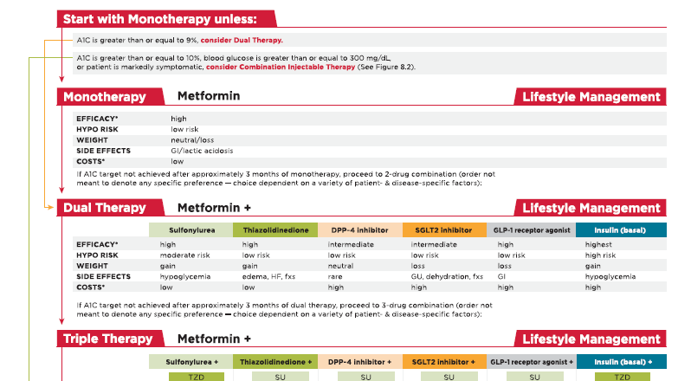

Slide 16
Metformin
DM Treatment
DM Prevention
PCO
GDM
  Pharmacology
  Efficacy
  side effects

Slide 17
MECHANISM OF ACTION
decrease hepatic glucose output by inhibiting gluconeogenesis
increases insulin-mediated glucose utilization in peripheral tissues (such as muscle and liver)
antilipolytic effect that lowers serum free fatty acid concentrations, thereby reducing substrate availability for gluconeogenesis
decrease food intake and body weight

Slide 18
GLYCEMIC EFFICACY
Monotherapy
Combination therapy
  sulfonylureas, insulin, glinides, alpha-glucosidase inhibitors, thiazolidinediones (TZDs), sodium-glucose cotransporter 2 (SGLT2) inhibitors, glucagon-like peptide-1 (GLP-1) agonists, and dipeptidyl peptidase 4 (DPP-4) inhibitors.

Slide 19
WEIGHT LOSS & lipid-lowering activity
In those who are obese, metformin promotes modest weight reduction or at least weight stabilization
↓triglyceride and free fatty acid concentrations,
↓ in serum LDL (a small )
↑ in serum HDL (very modest )

Slide 20
CARDIOVASCULAR EFFECTS
Metformin does not have adverse cardiovascular effects,
It appears to decrease CV events in certain populations

Slide 21
In the United Kingdom Prospective Diabetes Study (UKPDS)
obese patients who were assigned initially to receive metformin rather than sulfonylurea or insulin therapy had a decreased risk of the aggregate diabetes-related endpoint (endpoints included both macrovascular and microvascular complications) and all-cause mortality .
During the post-interventional observation period of the UKPDS, reductions in the risk of macrovascular complications were maintained in the metformin group.

Slide 22
CANCER INCIDENCE
Observational studies
Clinical Trials
  Did not defined as outcome
  Short duration (< 4 Y)

Slide 23
SIDE EFFECTS
Gastrointestinal :
  metallic taste in the mouth
  mild anorexia
  Nausea
  abdominal discomfort,
  soft bowel movements or diarrhea
5% of study subjects discontinue metformin because of the gastrointestinal side effects

Slide 24
Vitamin B12 deficiency :
reduces intestinal absorption of vitamin B12 in up to 30 % of patients
lowers serum vitamin B12 concentrations in 5 to 10 %
only rarely causes megaloblastic anemia
peripheral neuropathy may precede the development of megaloblastic anemia

Slide 25
Lactic acidosis
incidence 9 cases per 100,000 person-years of exposure
Symptoms of lactic acidosis are nonspecific and may include anorexia, nausea, vomiting, abdominal pain, lethargy, hyperventilation, and hypotension.
Serum lactate concentrations are usually < 2 mmol/L in patients taking metformin, values that are not clinically important

Slide 26
CONTRAINDICATIONS
Impaired renal function (estimated glomerular filtration rate [eGFR] <30 mL/min)
Concurrent active or progressive liver disease
Active alcohol abuse
Unstable or acute heart failure at risk of hypoperfusion and hypoxemia
Past history of lactic acidosis during metformin therapy
Decreased tissue perfusion or hemodynamic instability due to infection or other causes

Slide 27
Monitoring
serum creatinine annually
hemoglobin, hematocrit, and red cell indices at diagnosis and at other times if the patient develops symptoms suggestive of anemia, neuropathy, or deteriorating renal function.
If anemia is present, vitamin B12 and folate should be measured

Slide 28
Case Study
خانم 50 ساله، در آزمایشات غربالگری:
FBS: 145 mg/dl
FBS: 130 mg/dl
Hb A1c: 7.5%
PE: BP: 130/80, BMI: 30 Kg/m2
Normal Lipid and Creatinin
اقدام شما چیست؟

Slide 29



ADA-EASD Position Statement Update:
Management of Hyperglycemia in T2DM, 2015
3. ANTI-HYPERGLYCEMIC THERAPY
Therapeutic options: Lifestyle
  Weight optimization
  Healthy diet
  Increased activity level
Diabetes Care 2012;35:1364–1379; Diabetologia 2012;55:1577–1596
Notes:
Non-pharmacological options are critically important – they are cost effective and have no side effects, per se. Patients with T2DM should become more physically active, eat a healthy diet and try to optimize body weight. These efforts will result in less insulin resistance, with better blood glucose control the result. There are also additional health benefits from such interventions.

Slide 30
رژیم غذایی
ورزش
دارو: متفورمین 500 میلی گرم 2 بار در روز پس از غذا

Slide 31
بیمار از تهوع و سوزش سردل شاکی است،
اقدام بعدی شما؟

Slide 32
کاهش دوز و شروع تدریجی
تغییر برند (Glucophage)
استفاده از فرآورده های Extended release

Slide 33
DOSING
We begin with 500 mg once daily with the evening meal and, if tolerated, add a second 500 mg dose with breakfast.
The dose can be increased slowly (one tablet every one to two weeks) as necessary
The usual effective dose is 1500 to 2000 mg/day

Slide 34
3 ماه بعد:
DH: Metformin 500 BD
BP: 120/80, BMI: 29 Kg/m2:
FBS: 110 mg/dl
Hb A1c: 6.9%

Slide 35
بررسی از نظر عوارض میکرو واسکولر
  معاینه چشم
  بررسی میکروآلبومین ادرار
  ارزیابی نوروپاتی

Slide 36
Case Study
خانم 65 ساله، با سابقه بیماری عروق کرونر که یکبار بالون شده و Stent گذاری گردیده
DH: متورال 25 میلی گرم 2 بار در روز + آسپرین 80 + آتورواستاتین 20 میلی گرم
BP: 130/80, W: 78 Kg, BMI: 28 Kg/m2
FBS: 150 mg/dl , Hb A1c: 8.0%
Creatinin: 1.6 mg/dl
LDL: 70 mg/dl
توصیه شما؟

Slide 37
Targeted Hb A1c?
eGFR: 52 ml/hr
( 140 – age) Weight /72 * Creatinin

Slide 38
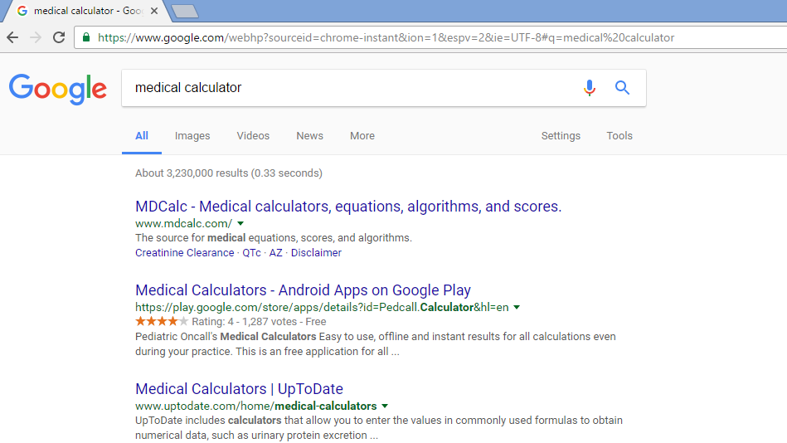

Slide 39
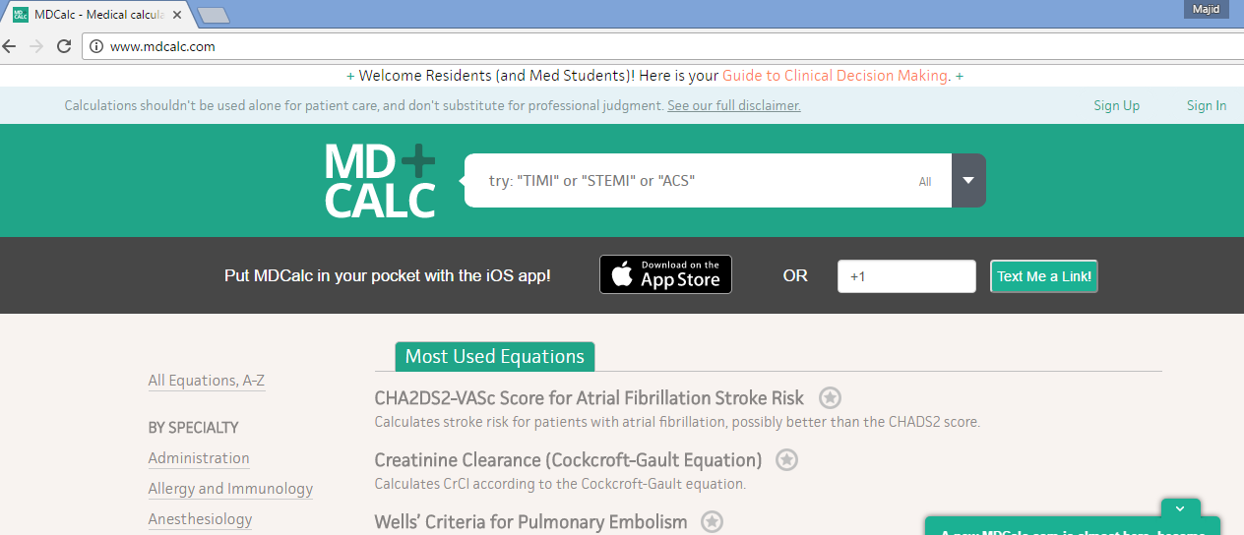

Slide 40
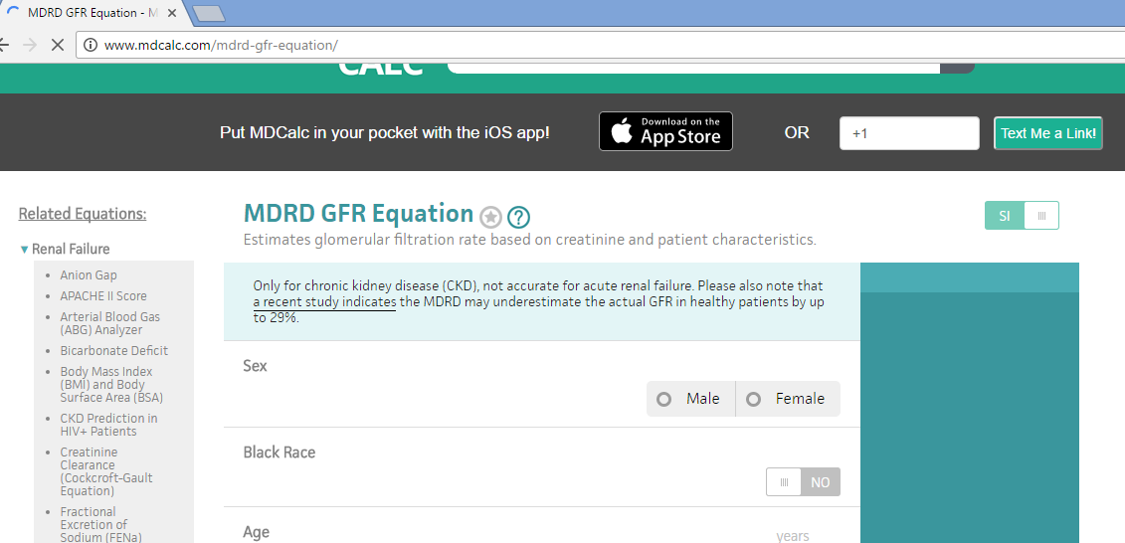

Slide 41


Slide 42
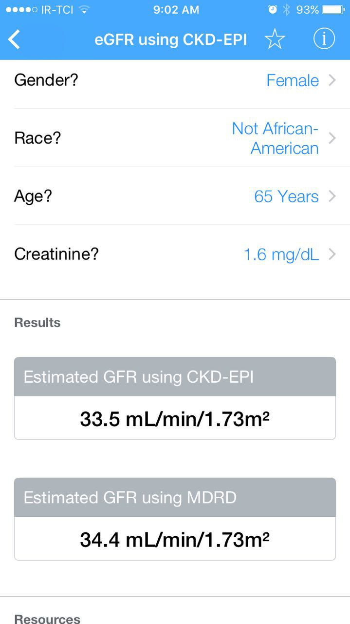

Slide 43
Metformin and CKD
Improved clinical outcomes with metformin have been reported in observational studies of patients with diabetes, heart failure and renal impairment (eGFR 45 to 60 mL/min)
The use of metformin is contraindicated in patients with an eGFR <30 mL/min
The initiation of metformin is not recommended in patients with an eGFR between 30 and 45 mL/min

Slide 44
Thiazolidinediones
DM Treatment
DM Prevention
  Pharmacology
  Efficacy
  side effects

Slide 45
Thiazolidinediones
The thiazolidinediones increase insulin sensitivity by acting on adipose, muscle, and liver to increase glucose utilization and decrease glucose production.
When used as monotherapy, they reduce glycated hemoglobin (A1C) values by approximately 1.5 percentage points.

Slide 46
Multiple, Complex Pathophysiological Abnormalities in T2DM
GLP-1R
agonists
Insulin
pancreatic
insulin
secretion
incretin
effect
Glinides
S U s
DPP-4
inhibitors
Amylin
mimetics
pancreatic
glucagon
secretion
_
DA agonists
?
A G I s
gut
carbohydrate
delivery &
absorption
HYPERGLYCEMIA
Metformin
_
T Z D s
Bile acid
sequestrants
+
peripheral
glucose
uptake
hepatic
glucose
production
renal glucose excretion
Adapted from: Inzucchi SE, Sherwin RS in: Cecil Medicine 2011
Notes:
Anti-hyperglycemic drugs for patients with T2DM are targeted at one or more of the pathophysiological abnormalities of this disease. On this slide, the main sites of action of the currently available 12 individual drug classes is depicted. Combination glucose-lowering therapy has become a standard treatment strategy when patients do not adequately respond to a single agent (often metformin.)

Slide 47
Thiazolidinediones:
  Two thiazolidinediones are currently available in the US.
  Pioglitazone [Actos] : Tab 15 mg-30 mg- 45 mg /Pitoze
    Single dose / administered without regard to meals
    Renal Impairment No dosage adjustment necessary
  Rosiglitazone [Avandia] : Tab 4 mg- 8 mg
In 2010, the European Medicines Agency suspended sales of rosiglitazone, and in June 2011, the French and German Medicines Agencies also suspended the use of pioglitazone, owing to concerns that the overall risks of rosiglitazone and pioglitazone exceed their benefits.
Troglitazone (Rezulin): liver dysfunction and, in some patients, liver failure

Slide 48
concerns with combined thiazolidinedione and insulin therapy because of an increased incidence of HF
several other potential side effects, which make them less appealing as initial or second step therapy
Third line?!

Slide 49
MECHANISM OF ACTION
Insulin sensitivity
  acting on adipose, muscle, and liver to increase glucose utilization and decrease glucose production
  Peroxisome Proliferator-Activated Receptors (PPARs), which regulate gene expression in response to ligand binding
  ……
Insulin secretion
  Preserving pancreatic beta-cell function

Slide 50
PPAR s
PPAR-gamma is found predominantly in adipose tissue, pancreatic beta-cells, vascular endothelium, macrophages, and the central nervous system
In the central nervous system (CNS), PPAR-gamma activation :
  hepatic insulin sensitivity
  promoting increased feeding → weight gain
PPAR-alpha is expressed mostly in liver, heart, skeletal muscle, and vascular walls.
Troglitazone and rosiglitazone are purely PPAR-gamma agonists
Pioglitazone also exerts some PPAR-alpha effects

Slide 51
Dual PPAR agonists
with the hope that they could effectively treat both hyperglycemia and hyperlipidemia
Muraglitazar
  received initial US FDA approval
  Patients who took muraglitazar had an increased incidence of a composite outcome of death, myocardial infarction (MI), stroke, transient ischemic attack (TIA), or heart failure (HF) (relative risk [RR] 2.62, 95% CI 1.36-5.05)
  cardiac safety?
Aleglitazar
  Improved A1C, triglycerides, LDL, and HDL cholesterol compared with placebo.
  it did not reduce cardiovascular morbidity or mortality among patients with type 2 diabetes receiving standard treatment for MI or unstable angina/ in a longer-term (median follow-up 104 weeks) randomized trial,

Slide 52
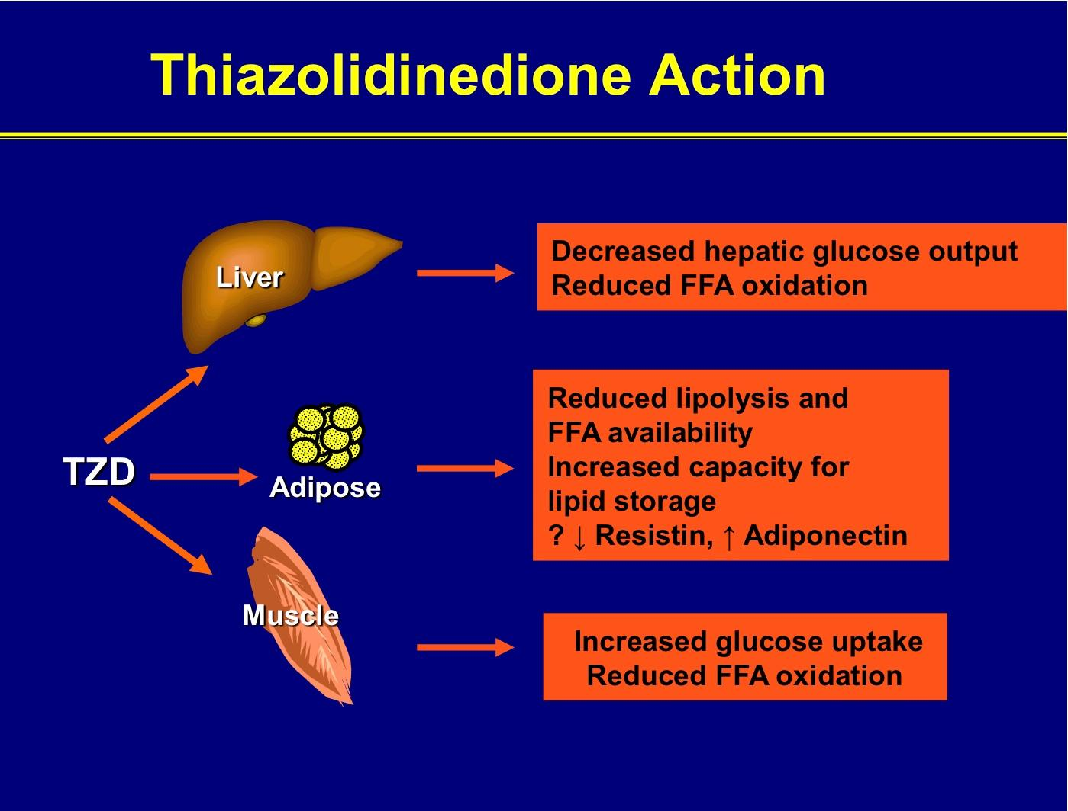

Slide 53
GLYCEMIC EFFICACY
Similar efficacy with metformin
First line // second line // or third line??
Side effects (safety)
Cost
Especially in HF and Low bone mass
In a RCT of rosiglitazone, metformin, and glyburide as initial therapy for type 2 diabetes, rosiglitazone had a lower incidence of monotherapy failure at 5 years
the difference in A1C levels between the rosiglitazone and metformin treated groups was small (about 0.1 percent)
Treatment with rosiglitazone was associated with greater weight gain, peripheral edema, and ↑ in LDL concentrations.

Slide 54
CARDIOVASCULAR EFFECTS of Thiazolidinediones
improve a number of cardiovascular risk factors and surrogate cardiovascular endpoints
(dyslipidemia, markers of inflammation, vascular smooth muscle proliferation, vascular reactivity, endothelial function, carotid intima media thickness, and progression of atherosclerosis on coronary intravascular ultrasound)
data demonstrating their ability to decrease CV events are unimpressive and concerns about side effects (weight gain, fluid retention, HF, MI, and fractures persist.
0000000000000000000000000000000000000000

Slide 55
Lipids
Rosiglitazone and pioglitazone have similar effects on glycemic control, but their effects on serum lipid concentrations are different.
 | Pioglitazone | Rosiglitazone
TG | ↓↓ (53 mg/dl) | ↓ (13mg/dl)
LDL | →↑ (12. mg/dl) | ↑ ↑ (23 mg/dl)
HDL | ↑ (10%-5.2 mg/dl) | ↑ (10%-2.4 md/dl)

Slide 56
SAFETY

Slide 57
Hypoglycemia
monotherapy is less likely to cause hypoglycemia

Slide 58
Anti-hyperglycemic therapy in T2DM:
Avoidance of hypoglycemia
Diabetes Care 2015;38:140-149; Diabetologia 2015;58:429-442

Slide 59
Weight gain
dose-dependent
time-dependent and can be substantial
(average weight gain increases steadily up to 30 months but may plateau (at around 5.3 kg, or 12 pounds) by 36 months)
  fluid retention (75%)
  increased feeding and expanded adipose tissue mass (activation of PPAR-gamma in the central nervous system )
  proliferation of new adipocytes

Slide 60
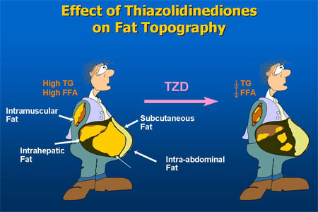

Slide 61
Fluid retention/heart failure
Peripheral edema occurs in 4 to 6 % of patients treated with thiazolidinediones
PPAR-gamma stimulation of sodium reabsorption by sodium channels (called the epithelial sodium channel) in the luminal membrane of the collecting tubule cells

Slide 62
Skeletal
↓ bone density and ↑ fracture risk
bone loss by suppression of osteoblast differentiation and formation
The fractures occurred predominantly in the distal upper or lower extremities (forearm, hand, wrist, foot, ankle, fibula, tibia)
more common in women than in men

Slide 63
Bladder cancer
the risk of bladder cancer was significantly increased in those with the longest exposure to pioglitazone and to those exposed to the highest cumulative dose
In June 2011, the French and German Medicines Agencies suspended the use of pioglitazone because of the potential increased risk of bladder cancer and the concern that the overall risks of pioglitazone exceed its benefits

Slide 64
DIABETES PREVENTION
the benefit or harm of the intervention, independent of the effect on hyperglycemia, must be considered.
Thiazolidinediones are limited by adverse effects (fluid retention, weight gain, heart failure [HF], possibly myocardial infarction [MI] for rosiglitazone, and possibly bladder cancer for pioglitazone).

Slide 65
Hepatotoxicity
Troglitazone → hepatocellular injury , resulting in death or the need for liver transplantation in some patients
The FDA recommends that patients receiving pioglitazone or rosiglitazone undergo baseline testing followed by periodic monitoring of liver function based upon clinical judgment.

Slide 66
Effects of Agents Available for T2D
Q4. How are glycemic targets achieved for T2D?
 | Met | GLP1RA | SGLT2I | DPP4I | TZD | AGI | Coles | BCR-QR | SU/ Glinide | Insulin | Pram
NAFLD benefit | Mild | Mild | Neutral | Neutral | Mod | Neutral | Neutral | Neutral | Neutral | Neutral | Neutral
Hypo-glycemia | Neutral | Neutral | Neutral | Neutral | Neutral | Neutral | Neutral | Neutral | SU: mod to severe Glinide: mild to mod | Mod to severe* | Neutral
Weight | Slight loss | Loss | Loss | Neutral | Gain | Neutral | Neutral | Neutral | Gain | Gain | Loss
AGI = α-glucosidase inhibitors; BCR-QR = bromocriptine quick release; Coles = colesevelam; DPP4I = dipeptidyl peptidase 4 inhibitors; GLP1RA = glucagon-like peptide 1 receptor agonists; Met = metformin; Mod = moderate; NAFLD, nonalcoholic fatty liver disease; SGLT2I = sodium-glucose cotransporter 2 inhibitors; SU = sulfonylureas; TZD = thiazolidinediones.
*Especially with short/ rapid-acting or premixed.
Continued from previous slide

Slide 67
Oral Class | Mechanism | Advantages | Disadvantages | Cost
Biguanides | Activates AMP-kinase (?other) ↓ Hepatic glucose production | Extensive experience No hypoglycemia Weight neutral ? ↓ CVD | Gastrointestinal Lactic acidosis (rare) B-12 deficiency Contraindications | Low
Sulfonylurea | Closes K_{ATP} channels ↑ Insulin secretion | Extensive experience ↓ Microvascular risk | Hypoglycemia ↑ Weight Low durability ? Blunts ischemic preconditioning | Low
Meglitinides | Closes K_{ATP} channels ↑ Insulin secretion | ↓ Postprandial glucose Dosing flexibility | Hypoglycemia ↑ Weight ? Blunts ischemic preconditioning Dosing frequency | Mod.
TZDs | PPAR-g activator ↑ Insulin sensitivity | No hypoglycemia Durability ↓ TGs (pio) ↑ HDL-C ? ↓ CVD events (pio) | ↑ Weight Edema/heart failure Bone fractures ↑ LDL-C (rosi) ? ↑ MI (rosi) | Low
Table 1. Properties of anti-hyperglycemic agents
Diabetes Care 2015;38:140-149;
Diabetologia 2015;58:429-442
Notes:
Here are some of the older oral drug classes used in T2DM. The table describes the mechanism of action of each class, its advantages, disadvantages and cost. Less commonly used classes are denoted in grey font.

Slide 68
Effects of Agents Available for T2D
Q4. How are glycemic targets achieved for T2D?
 | Met | GLP1RA | SGLT2I | DPP4I | TZD | AGI | Coles | BCR-QR | SU/ Glinide | Insulin | Pram
FPG lowering | Mod | Mild to mod* | Mod | Mild | Mod | Neutral | Mild | Neutral | SU: mod Glinide: mild | Mod to marked (basal insulin or premixed) | Mild
PPG lowering | Mild | Mod to marked | Mild | Mod | Mild | Mod | Mild | Mild | Mod | Mod to marked (short/ rapid-acting insulin or premixed) | Mod to marked
AGI = α-glucosidase inhibitors; BCR-QR = bromocriptine quick release; Coles = colesevelam; DPP4I = dipeptidyl peptidase 4 inhibitors; FPG = fasting plasma glucose; GLP1RA = glucagon-like peptide 1 receptor agonists; Met = metformin; Mod = moderate; PPG = postprandial glucose; SGLT2I = sodium-glucose cotransporter 2 inhibitors; SU = sulfonylureas; TZD = thiazolidinediones.
*Mild: albiglutide and exenatide; moderate: dulaglutide, exenatide extended release, and liraglutide.
Continued on next slide

Slide 69
Expected HbA_{1c} reduction according to intervention
Intervention | Expected ↓ in HbA_{1c} (%)
Lifestyle interventions | 1 | to | 2%
Metformin | 1 | to | 2%
Sulfonylureas | 1 | to | 2%
Insulin | 1.5 | to | 3.5%
Glinides | 1 | to | 1.5%¹
Thiazolidinediones | 0.5 | to | 1.4%
α-Glucosidase inhibitors | 0.5 | to | 0.8%
GLP-1 agonist | 0.5 | to | 1.0%
Pramlintide | 0.5 | to | 1.0%
DPP-IV inhibitors | 0.5 | to | 0.8%
Nathan DM, et al. Diabetes Care 2009;32:193-203.
Notes:
69

Slide 70
پوشش بیمه | قیمت (تومان) | تعداد | نام دارو
√ | 7500 (19500) | 100 | متفورمین
√ | 4000 | 100 | گلی بن کلامید
√ | 11000 (19000) | 100 | گلی کلازید
√ | 5500 | 100 | ریپگلیناید
√ | 9000 | 100 | ریپگلیناید
√ | 13000 | 100 | ریپگلیناید
● | 32-40-48000 | 100 | گلوتازون (15-30-45)
● | 22-34000 | 100 | آکاربوز
● | 30000 | 30 | زیپتین 50
√ | 12000 | 1 ویال | NPH
√ | 12000 | 1 ویال | Regular
● | 20000 | 100 عدد | سرنگ

Slide 71
Effectiveness
safety profiles
Side effects
Cost
Patient satisfaction
.extraglycemic effect.

Slide 72
ADA-EASD Position Statement Update:
Management of Hyperglycemia in T2DM, 2015
Patient-Centered Approach
“...providing care that is respectful of and responsive to individual patient preferences, needs, and values - ensuring that patient values guide all clinical decisions.”
Gauge patient’s preferred level of involvement.
Explore, where possible, therapeutic choices. Consider using decision aids.
Shared Decision Making – a collaborative process between patient and clinician, using best available evidence and taking into account the patient’s preferences and values.
Final decisions regarding lifestyle choices ultimately lie with the patient.
Diabetes Care 2012;35:1364–1379; Diabetologia 2012;55:1577–1596
Notes:
There is increasing emphasis on ‘patient-centeredness’ in chronic disease management. This has been described by the Institute of Medicine as “providing care that is respectful of and responsive to individual patient preferences, needs, and values – ensuring that patient values guide all clinical decisions.” Shared decision making (SDM) is a key component of patient-centered care. This is of particular importance in those conditions, like diabetes, that necessitate patient involvement in lifestyle changes.

Slide 74
Anti-hyperglycemic therapy in T2DM: General recommendations
Diabetes Care 2015;38:140-149; Diabetologia 2015;58:429-442
Notes:
Potential sequences of antihyperglycemic therapy for patients with type 2 diabetes are displayed, the usual transition being vertical, from top to bottom (although horizontal movement within therapy stages is also possible, depending on the circumstances). The figure denotes relative glucose lowering efficacy, risk of hypoglycemia, effect on body weight, other side effects and approximate relative cost for each drug class.
In most patients, begin with lifestyle changes; metformin monotherapy is added at, or soon after, diagnosis, unless there are contraindications.

Slide 75
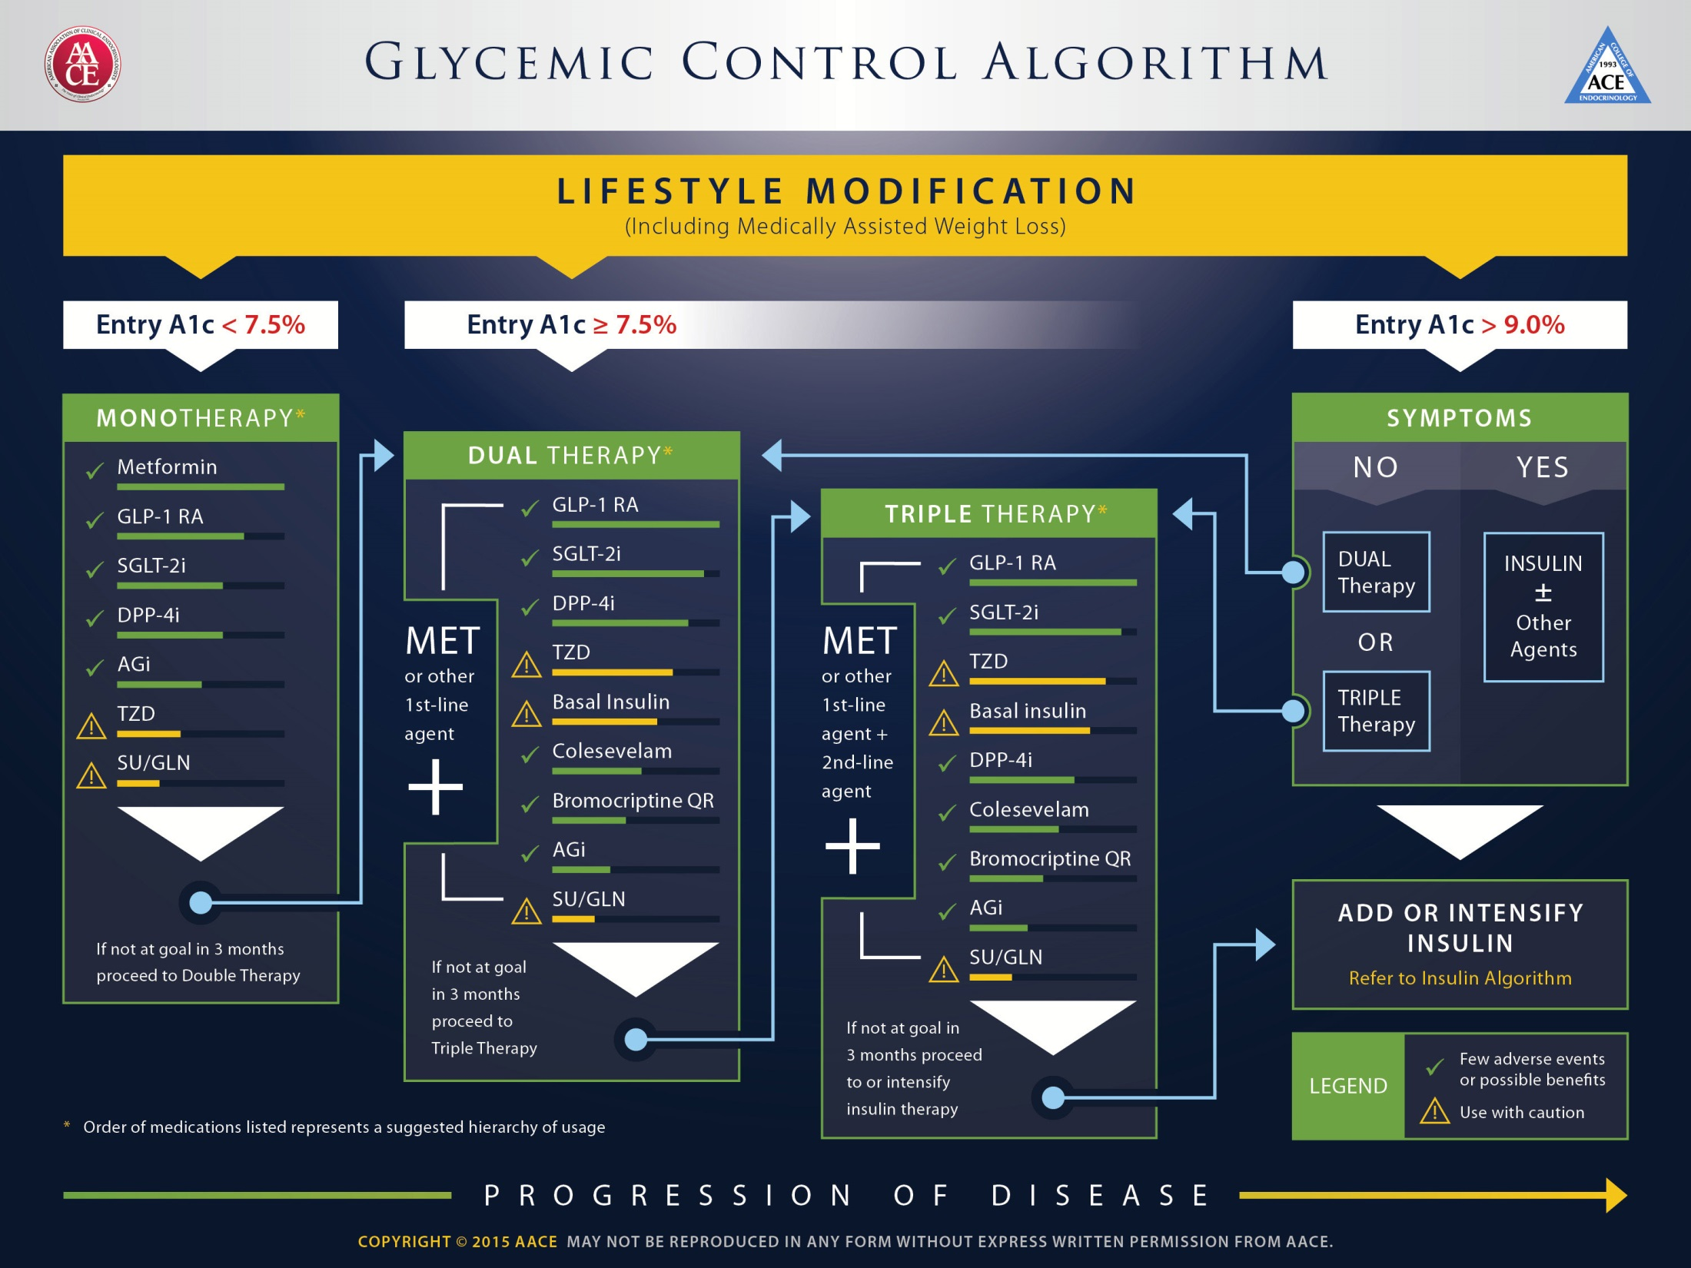

Slide 76
Anti-hyperglycemic therapy in T2DM: General recommendations
Diabetes Care 2015;38:140-149; Diabetologia 2015;58:429-442
Notes:
Potential sequences of antihyperglycemic therapy for patients with type 2 diabetes are displayed, the usual transition being vertical, from top to bottom (although horizontal movement within therapy stages is also possible, depending on the circumstances). The figure denotes relative glucose lowering efficacy, risk of hypoglycemia, effect on body weight, other side effects and approximate relative cost for each drug class.
In most patients, begin with lifestyle changes; metformin monotherapy is added at, or soon after, diagnosis, unless there are contraindications.

Slide 77
Metformin intolerance or
contraindication
HbA1c ≥9%
Uncontrolled hyperglycemia (catabolic features,
BG ≥300-350 mg/dl, HbA1c ≥10-12%)
Diabetes Care 2015;38:140-149; Diabetologia 2015;58:429-442
Notes:
Potential sequences of antihyperglycemic therapy for patients with type 2 diabetes are displayed, the usual transition being vertical, from top to bottom (although horizontal movement within therapy stages is also possible, depending on the circumstances). The figure denotes relative glucose lowering efficacy, risk of hypoglycemia, effect on body weight, other side effects and approximate relative cost for each drug class.
In most patients, begin with lifestyle changes; metformin monotherapy is added at, or soon after, diagnosis, unless there are contraindications.

Slide 78
Anti-hyperglycemic therapy in T2DM:
Avoidance of weight gain
Diabetes Care 2015;38:140-149; Diabetologia 2015;58:429-442

Slide 79
Anti-hyperglycemic therapy in T2DM:
Avoidance of hypoglycemia
Diabetes Care 2015;38:140-149; Diabetologia 2015;58:429-442

Slide 80
Road Map
Background:
  Importance of glycemic control
  Glycemic goals
Overview of the pathogenesis of T2DM
Therapy of Type 2 Diabetes
  Insulin Sensetizers
Real life cases
Take home message

Slide 82
Take home message
A thiazolidinedione may be considered in patients with lower initial A1C values or if there are specific contraindications to sulfonylureas.
If a thiazolidinedione is to be used as initial therapy, pioglitazone is preferred
  because of the greater concern about atherogenic lipid profiles
  potential increased risk for cardiovascular events with rosiglitazone

Slide 83
Add on Therapy
In addition to use as monotherapy, the thiazolidinediones have been studied in combination with metformin, sulfonylureas, and insulin

Slide 84
Take home message
For patients with inadequate glycemic control on metformin (A1C >7.0 percent), we suggest adding other agents, such as insulin or sulfonylureas, before thiazolidinediones (Grade 2B).
The addition of a pioglitazone can be considered in individuals without risk factors for heart failure (HF) or fracture, who do not reach glycemic goals with metformin alone, if there are contraindications to sulfonylureas or patient preference limits the use of sulfonylureas or insulin

Slide 85

از توجه شما متشکرم

Slide 86
Expected HbA_{1c} reduction according to intervention
Intervention | Expected ↓ in HbA_{1c} (%)
Lifestyle interventions | 1 | to | 2%
Metformin | 1 | to | 2%
Sulfonylureas | 1 | to | 2%
Insulin | 1.5 | to | 3.5%
Glinides | 1 | to | 1.5%¹
Thiazolidinediones | 0.5 | to | 1.4%
α-Glucosidase inhibitors | 0.5 | to | 0.8%
GLP-1 agonist | 0.5 | to | 1.0%
Pramlintide | 0.5 | to | 1.0%
DPP-IV inhibitors | 0.5 | to | 0.8%
Nathan DM, et al. Diabetes Care 2009;32:193-203.
Notes:
86

Slide 88
بیمار 3
آقای 60 ساله با شکایت تشنگی، پرادراری، ناکتوری (3 بار در طول شب)از 4 هفته پیش مراجعه کرده/ 2 کیلوگرم ↓ وزن
FBS: 300 mg/dl BS: 450 mg/dl Hb A1c:9%
Creatinin: 1.2 mg/dl
BP: 110/80, BMI: 25 Kg/m2
اقدام بعدی؟

Slide 89
OHA or Insulin?
  Catabolic Sign
  Severity of Symptoms
Glucose Toxicity
Monotherapy or combination (Dual ) Therapy
Which of them?

Slide 90
Metformin intolerance or
contraindication
HbA1c ≥9%
Uncontrolled hyperglycemia (catabolic features,
BG ≥300-350 mg/dl, HbA1c ≥10-12%)
Diabetes Care 2015;38:140-149; Diabetologia 2015;58:429-442
Notes:
Potential sequences of antihyperglycemic therapy for patients with type 2 diabetes are displayed, the usual transition being vertical, from top to bottom (although horizontal movement within therapy stages is also possible, depending on the circumstances). The figure denotes relative glucose lowering efficacy, risk of hypoglycemia, effect on body weight, other side effects and approximate relative cost for each drug class.
In most patients, begin with lifestyle changes; metformin monotherapy is added at, or soon after, diagnosis, unless there are contraindications.

Slide 92
Tab Metformin 500 mg BD
Tab Gliclazide 40 mg/d
Close Monitoring & patient warning
Next visit: Lab test after 1-2 Weeks

Slide 93
بیمار 4
خانم 50 ساله، سابقه 2 ساله دیابت
DH: Metformin 2000 gr/d
PE: BP: 130/80, BMI: 32 Kg/m2
FBS: 155 mg/dl
BS: 210 mg/dl
Hb A1c: 7.9%
اقدام بعدی شما چیست؟

Slide 94
Anti-hyperglycemic therapy in T2DM: General recommendations
Diabetes Care 2015;38:140-149; Diabetologia 2015;58:429-442
Notes:
Potential sequences of antihyperglycemic therapy for patients with type 2 diabetes are displayed, the usual transition being vertical, from top to bottom (although horizontal movement within therapy stages is also possible, depending on the circumstances). The figure denotes relative glucose lowering efficacy, risk of hypoglycemia, effect on body weight, other side effects and approximate relative cost for each drug class.
In most patients, begin with lifestyle changes; metformin monotherapy is added at, or soon after, diagnosis, unless there are contraindications.

Slide 95
Anti-hyperglycemic therapy in T2DM:
Avoidance of weight gain
Diabetes Care 2015;38:140-149; Diabetologia 2015;58:429-442

Slide 96
Tab Metformin 500 mg BD
Tab sitagliptin 50-100 mg/d
  SU or Meglitinides
  Glutazones
  Glp 1 Agonists

Slide 97
بیمار 5
خانم 75 ساله با سابقه دیابت از 6 سال پیش ، ظرف یکماه اخیر 6 بار افت قندخون داشته که یکبار منجر به بیهوشی وی گردیده تنها زندگی می کند
DH: Metformin 500 mg BD/ Glibenclamide 5 mg BD
BP: 130/80, W: 48 Kg/
FBS: 70 mg/dl, Hb A1c: 5.5% Creatnin: 1 mg/dl
توصیه شما چیست؟

Slide 98
Targeted Hb A1c?
eGFR: 37 ml/min

Slide 99
Effects of Agents Available for T2D
Q4. How are glycemic targets achieved for T2D?
 | Met | GLP1RA | SGLT2I | DPP4I | TZD | AGI | Coles | BCR-QR | SU/ Glinide | Insulin | Pram
NAFLD benefit | Mild | Mild | Neutral | Neutral | Mod | Neutral | Neutral | Neutral | Neutral | Neutral | Neutral
Hypo-glycemia | Neutral | Neutral | Neutral | Neutral | Neutral | Neutral | Neutral | Neutral | SU: mod to severe Glinide: mild to mod | Mod to severe* | Neutral
Weight | Slight loss | Loss | Loss | Neutral | Gain | Neutral | Neutral | Neutral | Gain | Gain | Loss
AGI = α-glucosidase inhibitors; BCR-QR = bromocriptine quick release; Coles = colesevelam; DPP4I = dipeptidyl peptidase 4 inhibitors; GLP1RA = glucagon-like peptide 1 receptor agonists; Met = metformin; Mod = moderate; NAFLD, nonalcoholic fatty liver disease; SGLT2I = sodium-glucose cotransporter 2 inhibitors; SU = sulfonylureas; TZD = thiazolidinediones.
*Especially with short/ rapid-acting or premixed.
Continued from previous slide

Slide 100
Effects of Agents Available for T2D
Q4. How are glycemic targets achieved for T2D?
 | Met | GLP1RA | SGLT2I | DPP4I | TZD | AGI | Coles | BCR-QR | SU/ Glinide | Insulin | Pram
Renal impair-ment/ GU | Contra-indicated in stage 3B, 4, 5 CKD | Exenatide contra-indicated CrCl <30 mg/mL | GU infection risk | Dose adjust-ment (except lina-gliptin) | May worsen fluid retention | Neutral | Neutral | Neutral | Increased hypo-glycemia risk | Increased risks of hypo-glycemia and fluid retention | Neutral
GI adverse effects | Mod | Mod* | Neutral | Neutral* | Neutral | Mod | Mild | Mod | Neutral | Neutral | Mod
CHF | Neutral | Neutral | Neutral | Neutral† | Mod | Neutral | Neutral | Neutral | Neutral | Neutral | Neutral
CVD | Possible benefit | Neutral | Neutral | Neutral | Neutral | Neutral | Neutral | Safe | ? | Neutral | Neutral
Bone | Neutral | Neutral | Bone loss | Neutral | Mod bone loss | Neutral | Neutral | Neutral | Neutral | Neutral | Neutral
AGI = α-glucosidase inhibitors; BCR-QR = bromocriptine quick release; Coles = colesevelam; CHF = congestive heart failure; CVD = cardiovascular disease; DPP4I = dipeptidyl peptidase 4 inhibitors; GI = gastrointestinal; GLP1RA = glucagon-like peptide 1 receptor agonists; GU = genitourinary; Met = metformin; Mod = moderate; SGLT2I = sodium-glucose cotransporter 2 inhibitors; SU = sulfonylureas; TZD = thiazolidinediones.
*Caution in labeling about pancreatitis.
†Caution: possibly increased CHF hospitalization risk seen in CV safety trial.
Continued from previous slide

Slide 101
Anti-hyperglycemic therapy in T2DM:
Avoidance of hypoglycemia
Diabetes Care 2015;38:140-149; Diabetologia 2015;58:429-442

Slide 102
بیمار 6
آقای 48 ساله با سابقه دیابت از 10 سال پیش
بدون عوارض
DH: Metformin 500 TDS, Glibenclamide 5 BD, Atorvastatin 20/d, Losar 25 BD
BP: 130/80, BMI: 34 Kg/m2
FBS: 160 mg/dl, BS: 220 , Hb A1c: 8%

Slide 103
Metformin intolerance or
contraindication
HbA1c ≥9%
Uncontrolled hyperglycemia (catabolic features,
BG ≥300-350 mg/dl, HbA1c ≥10-12%)
Diabetes Care 2015;38:140-149; Diabetologia 2015;58:429-442
Notes:
Potential sequences of antihyperglycemic therapy for patients with type 2 diabetes are displayed, the usual transition being vertical, from top to bottom (although horizontal movement within therapy stages is also possible, depending on the circumstances). The figure denotes relative glucose lowering efficacy, risk of hypoglycemia, effect on body weight, other side effects and approximate relative cost for each drug class.
In most patients, begin with lifestyle changes; metformin monotherapy is added at, or soon after, diagnosis, unless there are contraindications.

Slide 105
بیمار 7
آقای 48 ساله با سابقه دیابت از 10 سال پیش
بدون عوارض
DH: Metformin 500 TDS, Glibenclamide 5 BD, Atorvastatin 20/d, Losar 25 BD
BP: 130/80, BMI: 34 Kg/m2
FBS: 140 mg/dl, BS: 280 , Hb A1c: 8%

Slide 106
Effects of Agents Available for T2D
Q4. How are glycemic targets achieved for T2D?
 | Met | GLP1RA | SGLT2I | DPP4I | TZD | AGI | Coles | BCR-QR | SU/ Glinide | Insulin | Pram
FPG lowering | Mod | Mild to mod* | Mod | Mild | Mod | Neutral | Mild | Neutral | SU: mod Glinide: mild | Mod to marked (basal insulin or premixed) | Mild
PPG lowering | Mild | Mod to marked | Mild | Mod | Mild | Mod | Mild | Mild | Mod | Mod to marked (short/ rapid-acting insulin or premixed) | Mod to marked
AGI = α-glucosidase inhibitors; BCR-QR = bromocriptine quick release; Coles = colesevelam; DPP4I = dipeptidyl peptidase 4 inhibitors; FPG = fasting plasma glucose; GLP1RA = glucagon-like peptide 1 receptor agonists; Met = metformin; Mod = moderate; PPG = postprandial glucose; SGLT2I = sodium-glucose cotransporter 2 inhibitors; SU = sulfonylureas; TZD = thiazolidinediones.
*Mild: albiglutide and exenatide; moderate: dulaglutide, exenatide extended release, and liraglutide.
Continued on next slide

Slide 107
Metformin intolerance or
contraindication
HbA1c ≥9%
Uncontrolled hyperglycemia (catabolic features,
BG ≥300-350 mg/dl, HbA1c ≥10-12%)
Diabetes Care 2015;38:140-149; Diabetologia 2015;58:429-442
Notes:
Potential sequences of antihyperglycemic therapy for patients with type 2 diabetes are displayed, the usual transition being vertical, from top to bottom (although horizontal movement within therapy stages is also possible, depending on the circumstances). The figure denotes relative glucose lowering efficacy, risk of hypoglycemia, effect on body weight, other side effects and approximate relative cost for each drug class.
In most patients, begin with lifestyle changes; metformin monotherapy is added at, or soon after, diagnosis, unless there are contraindications.

Slide 109
Road Map
Background:
  Importance of glycemic control
  Glycemic goals
Overview of the pathogenesis of T2DM
Therapy of Type 2 Diabetes
  Oral hypoglycemic agents
Real life cases
Cases discussion according ADA/EASD consensus & AACE Guideline
Take home message

Slide 110
Take home message
Not only glucose centric (HTN, Dyslipidemia)
Management of DM patients must be individualized for each patients
Financial constrains need to be considered to avoid the pitfalls of nonadherence & poor follow up

Slide 111
Take home message
Avoid combination therapy with drugs that have Same pathophysiologic mechanism
Efficacy of the third antidiabetic agents decrease when added to dual therapy

Slide 113
از توجه شما متشکرم

Slide 114
9. Control of Glucose – ACCORD Trial
Tight versus not so tight control of glucose:
the ACCORD Trial?
ADA Diabetes Self-Study Series, Challenges in Type 2 Diabetes Mellitus Management: Self-Assessment Program
Current Status of the Treatment of Type 2 Diabetes
© 2014 American Diabetes Association
Rationale for Management of Hyperglycemia; p6

Slide 115
Control of Glucose – ACCORD Trial
The intensive glycemic control arm of ACCORD, conducted in patients with type 2 diabetes and established cardiovascular disease or multiple risk factors
  did not demonstrate a significant benefit of more intensive glycemic therapy aimed at lowering A1C to ≤6.5% or <6%
ACCORD study was stopped early
  due to an increase in mortality in the more intensively treated arm
The reasons for the lack of results in these intensive glycemic control studies is uncertain
  but seem likely related to the specific strategies for intensive glucose lowering used in the populations studied
  as well as perhaps the duration of the trials
ADA Diabetes Self-Study Series, Challenges in Type 2 Diabetes Mellitus Management: Self-Assessment Program
Current Status of the Treatment of Type 2 Diabetes
© 2014 American Diabetes Association
Rationale for Management of Hyperglycemia; p6

Slide 116
Control of Glucose – ACCORD Trial
Intensive glycemic control initiated in type 2 diabetic patients with far advanced cardiovascular disease
  is not beneficial in reducing additional cardiovascular events
Such results are not surprising as intensive glycemic control decreases the onset and progression of retinopathy, nephropathy, and neuropathy
  but has little or no beneficial effects on proliferative retinopathy, diabetic nephropathy with decreasing glomerular filtration rate
  or diabetic neuropathy after the neurons are degenerated
ADA Diabetes Self-Study Series, Challenges in Type 2 Diabetes Mellitus Management: Self-Assessment Program
Current Status of the Treatment of Type 2 Diabetes
© 2014 American Diabetes Association
Glycemic Control and Chronic Diabetes Complications; p26

Slide 117
Control of Glucose – ACCORD Trial
ACCORD subanalyses showed that individuals with no preexisting cardiovascular disease or those who at study entry had A1C ≤ 8.0%
  did have a statistically significant reduction in cardiovascular events with intensive glycemic control
Intensive glucose lowering increased the risk of cardiovascular disease and total mortality in younger participants
  whereas it had a neutral effect in older participants
The intensive to standard relative risk of severe hypoglycemia was similar in both age subgroups
  with higher absolute rates in older participants within both treatment arms
ADA Diabetes Self-Study Series, Challenges in Type 2 Diabetes Mellitus Management: Self-Assessment Program
Current Status of the Treatment of Type 2 Diabetes
© 2014 American Diabetes Association
Glycemic Control and Chronic Diabetes Complications; p26
Landmark Clinical Trials; p73

Slide 118
Control of Glucose – ACCORD Trial
In a substudy of the ACCORD study, there were no differences in cognitive outcomes between intensive and standard glycemic control
  although there was significantly less of a decrement in total brain volume by magnetic resonance imaging in participants in the intensive arm
ADA Diabetes Self-Study Series, Challenges in Type 2 Diabetes Mellitus Management: Self-Assessment Program
The Basis of Insulin Action, Initiation and Optimization of Basal Insulin, and Intensification of Insulin Therapy in Type 2 Diabetes
c 2014 American Diabetes Association
Assessment of Common Comorbid Conditions; p26

