Slide 1
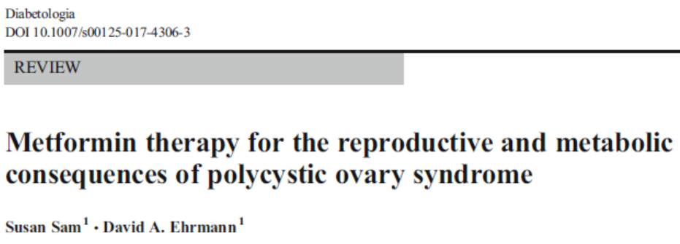
Omid gharooei ahangar

Slide 2
definition
PCOS is the most common form of chronic anovulation associated with androgen excess; it occurs in perhaps 5% to 10% of reproductive-age women.
The diagnosis of PCOS is made by excluding other hyperandrogenic disorders (e.g., nonclassic adrenal hyperplasia, androgen-secreting tumors, hyperprolactinemia) in women with chronic anovulation and androgen excess.

Slide 4
Management of Long-Term Deleterious Effects of Polycystic Ovary Syndrome
The long-term consequences of PCOS include irregular uterine bleeding, anovulatory infertility, androgen excess, chronically elevated levels of free estrogen associated with an increased risk of endometrial cancer, and insulin resistance associated with an increased risk of CVD and diabetes mellitus.

Slide 5
Role of genetic factors in metformin response
There is significant variability in the clinical response to metformin treatment in PCOS.
A meta-analysis of 38 RCTs of metformin use in 3495 women with PCOS revealed significant heterogeneity in its ability to reduce testosterone and insulin levels, regulate menses and improve body weight and composition. This heterogeneity in response remained even after adjustment for many potential confounders.
These findings suggest that unknown or unmeasured factor(s) impact the response to metformin therapy in PCOS.

Slide 6
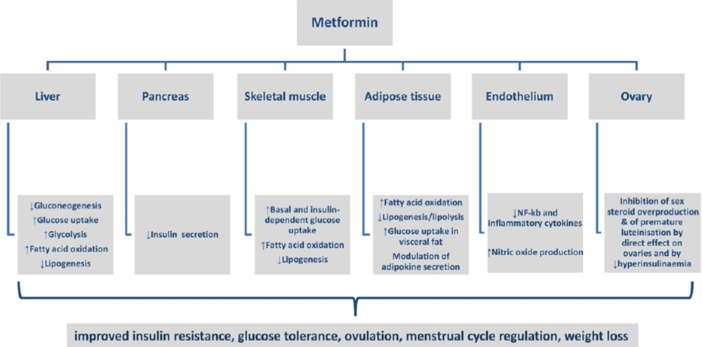

Slide 7
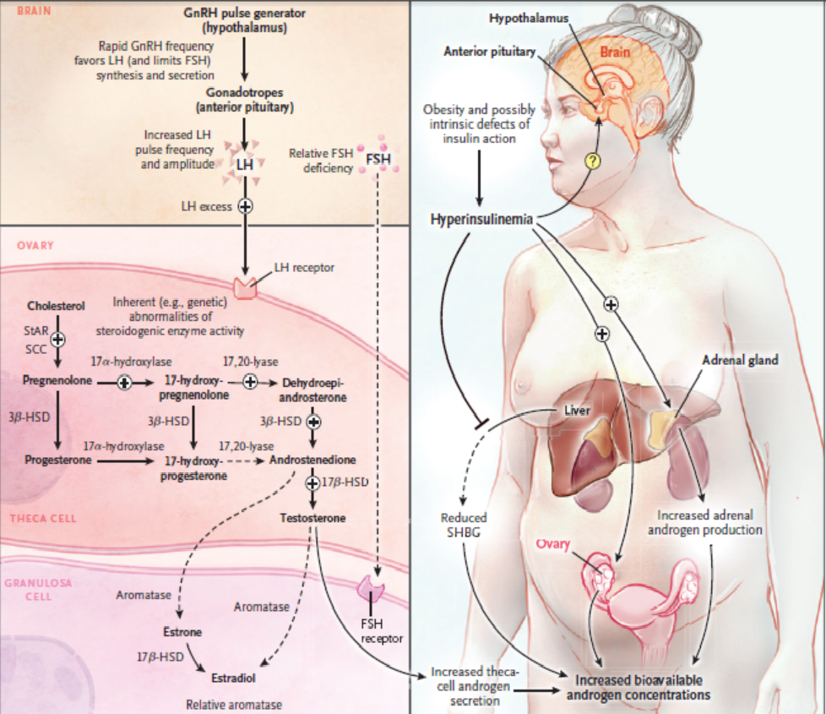

Slide 8
The Cochrane Library 2010, Issue 1

Slide 9
To assess the effectiveness of insulin sensitizing drugs in improving reproductive outcomes and metabolic parameters for women with PCOS and menstrual disturbance.
Randomized controlled trials which investigated the effect of insulin sensitizing drugs compared with either placebo or no treatment, or compared with an ovulation induction agent.

Slide 10
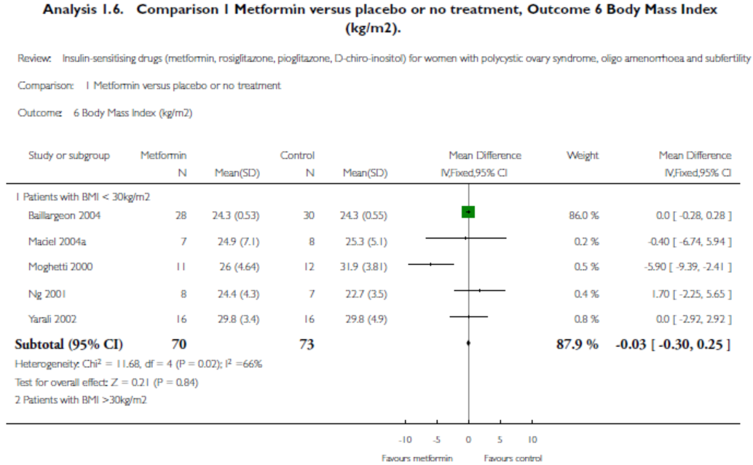

Slide 11
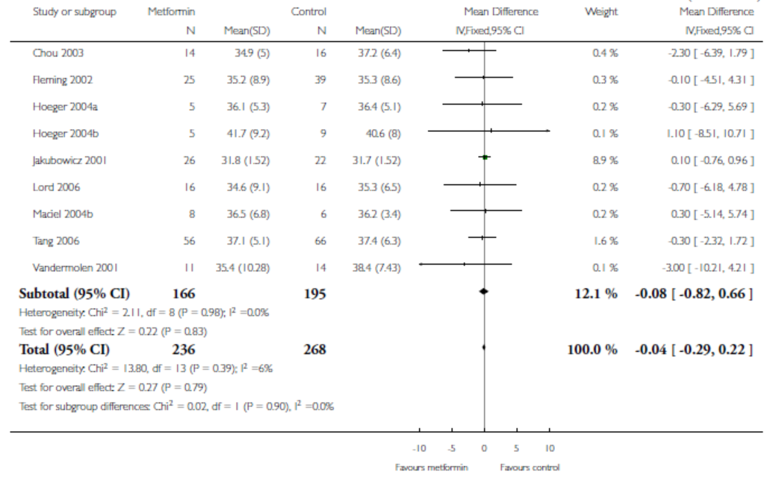

Slide 12
BMI
There was No evidence of an effect of metformin on BMI. (MD=-0.25, 95% CI -0.94 to 0.43). Furthermore, heterogeneity and publication bias were not observed.

Slide 13
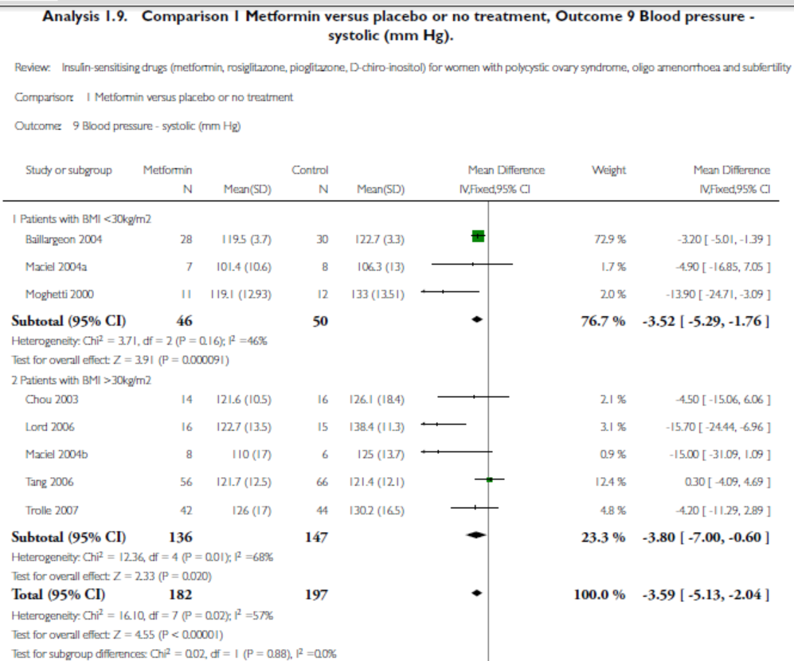

Slide 14
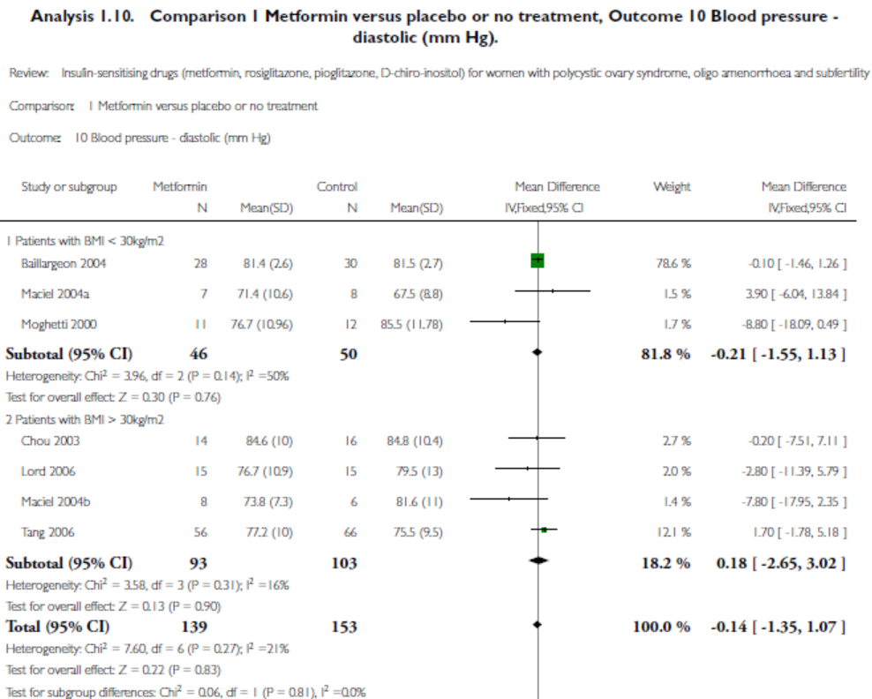

Slide 15
Blood pressure
Metformin reduced systolic blood pressure with a weighted mean difference (MD) of -3.80 mm Hg (95% C.I. -7.00 to -0.60). However, a similar benefit was not observed in the diastolic blood pressure. The degree of heterogeneity in the analysis was acceptable.

Slide 16
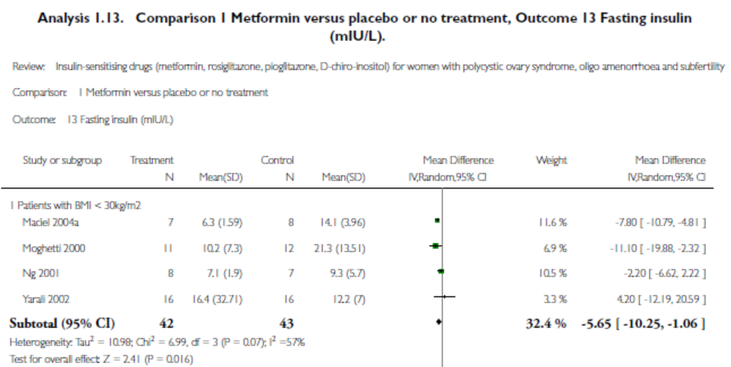

Slide 17
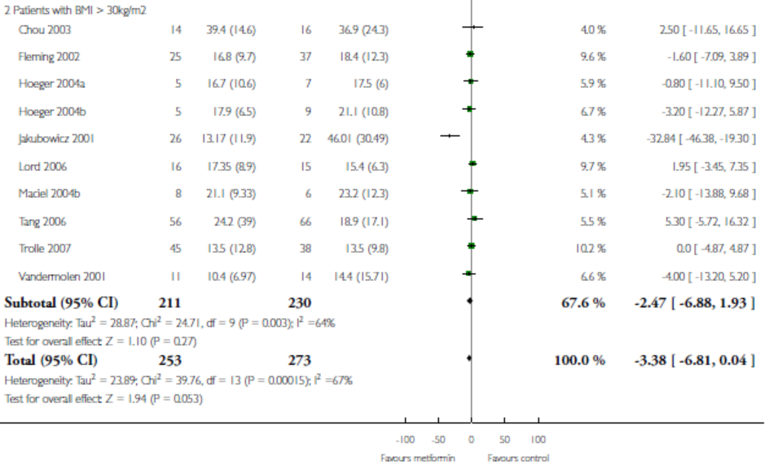

Slide 18
Fasting insulin
Metformin signiﬁcantly reduced fasting insulin concentration in the non-obese group (MD -5.65 mIU/l, 95% C.I. -10.25 to -1.06) , but not in obese women with PCOS (MD -2.47 mIU/L, 95% CI -6.88 to 1.93).

Slide 19
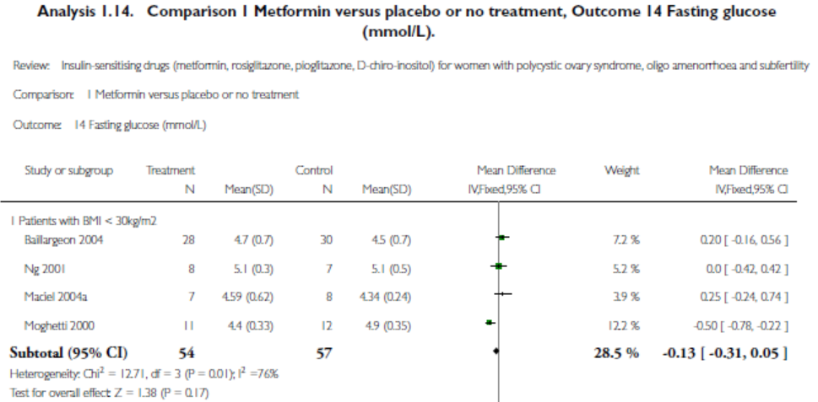

Slide 20
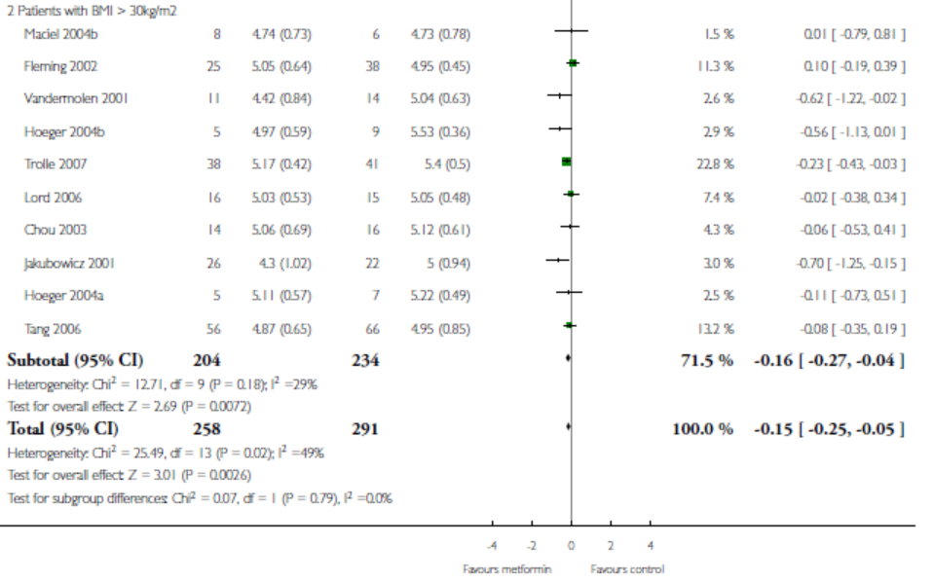

Slide 21
FBS
The effect of metformin on fasting glucose levels was small in both the non-obese and the obese groups with a moderate heterogeneity.

Slide 22
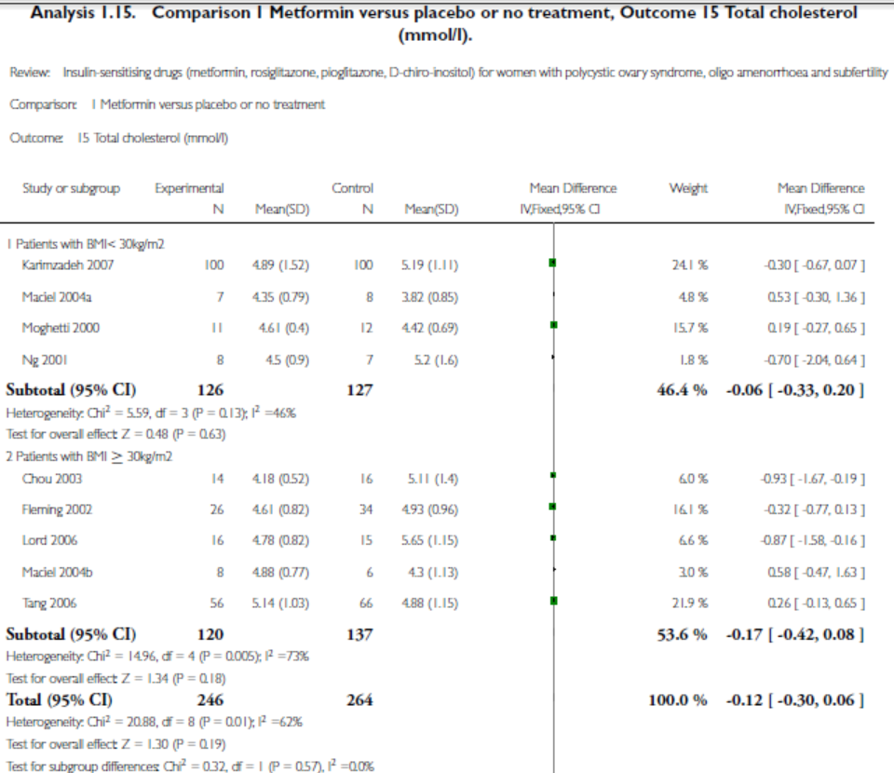

Slide 23
Lipids
In general, the current review showed that metformin had no effect on serum lipids concentrations.

Slide 24
The Cochrane Library 2012, Issue 5

Slide 26
Participants
In total, 3992 women (3495 metformin, 497 other insulin-sensitizing drugs) were included in this updated review
58% had a mean BMI over 30 kg/m2 (range 24.3 to 39.4 kg/m2).
All the women had a menstrual cycle length over 35 days.
The age range of the women was between 24.2 and 32.8 years with the range of fasting insulin concentrations between 6.3 and 54.67 mIU/l and testosterone levels between 1.3 and 4.67 nmol/l.

Slide 28
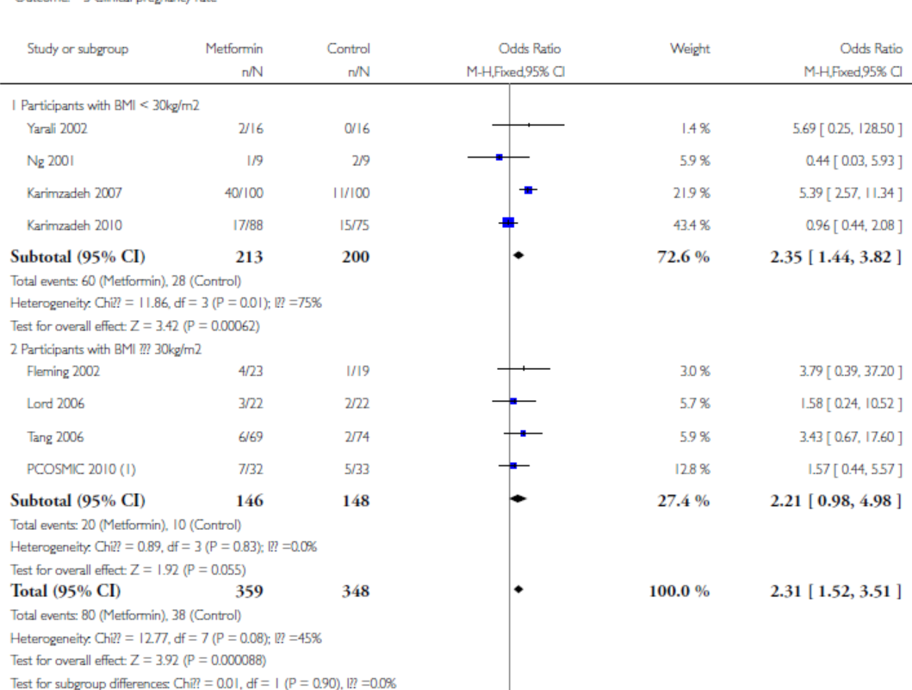

Slide 29
Clinical pregnancy rate
Metformin improved clinical pregnancy rate compared with placebo (8 RCTs, 707 participants; OR 2.31, 95% CI 1.52 to 3.51).
Subgroup analysis showed that the benefit was confined to the non-obese group (4 RCTs, 413 participants; OR 2.35, 95% CI 1.44 to 3.82) with significant heterogeneity (I2 = 75%) compared with the obese group (4 RCTs, 294 participants; OR 2.21, 95% CI 0.98 to 4.98; I2 = 0%).
Sensitivity analysis by study quality included six studies and did not alter the inference nor improve the heterogeneity.

Slide 30
Ovulation rate
A random-effect models was employed in this analysis as the overall heterogeneity was moderately high (I2 = 48%). Metformin appeared to improve the ovulation rate (16 RCTs, 1208 participants; OR 1.81, 95% CI 1.13 to 2.93).
in the subgroup analysis neither the non-obese group (5 RCTs, 441 participants; OR 2.94, 95% CI 0.81 to 10.61) nor the obese group (11 RCTs, 767 participants; OR 1.50, 95% CI 0.95 to 2.37) were found to benefit from using metformin

Slide 31
Menstrual frequency
Metformin improved the menstrual pattern with an OR of 1.72 (95% CI 1.14 to 2.61, 7 RCTs, 427 participants). A significant heterogeneity was seen in the analysis (I2 = 54%).
Due to only one trial in the non-obese group, subgroup analysis did not improve heterogeneity.

Slide 32
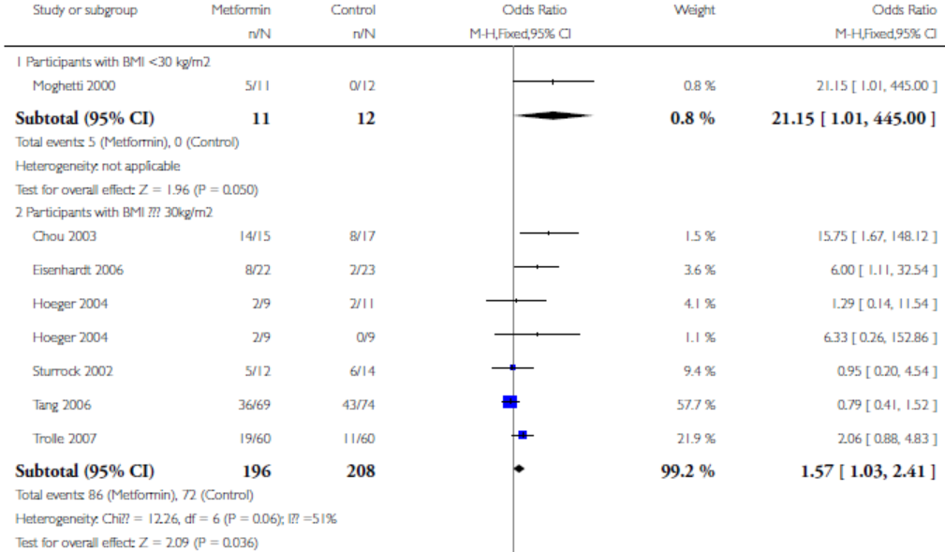

Slide 33
Endocrine outcomes
Testosterone: metformin reduced serum total testosterone levels with a MD of -0.60 nmo/L (14 RCTs, 610 participants; 95% CI -0.73 to -0.48, Analysis 1.11).
However, a significant heterogeneity was observed (I2 = 92%) and the subgroup analysis did not alter the heterogeneity. The magnitude of the reduction appeared to be greater among non-obese women compared with obese women with PCOS (MD -1.68 versus -0.29 nmol/L).

Slide 34
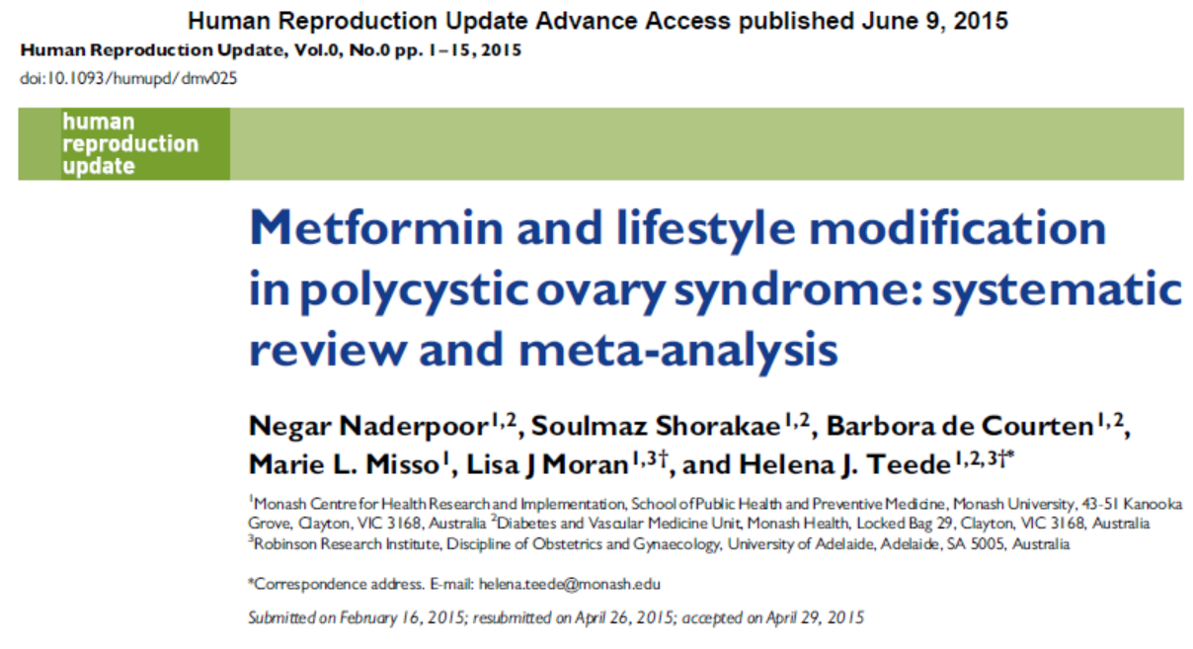

Slide 35
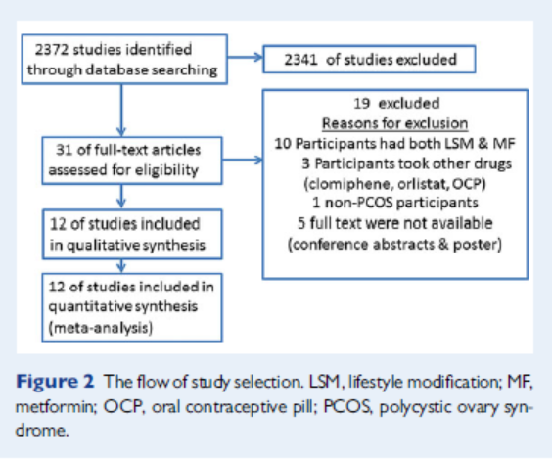

Slide 36
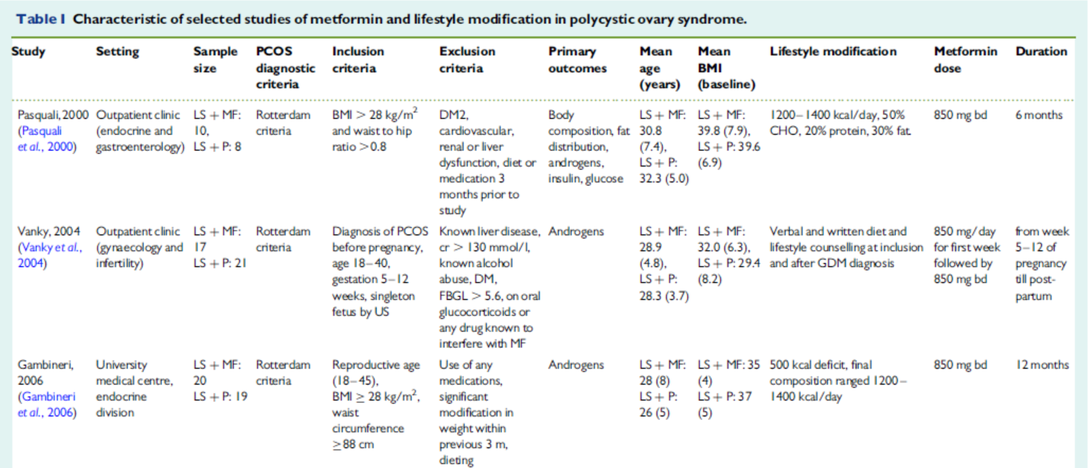

Slide 37
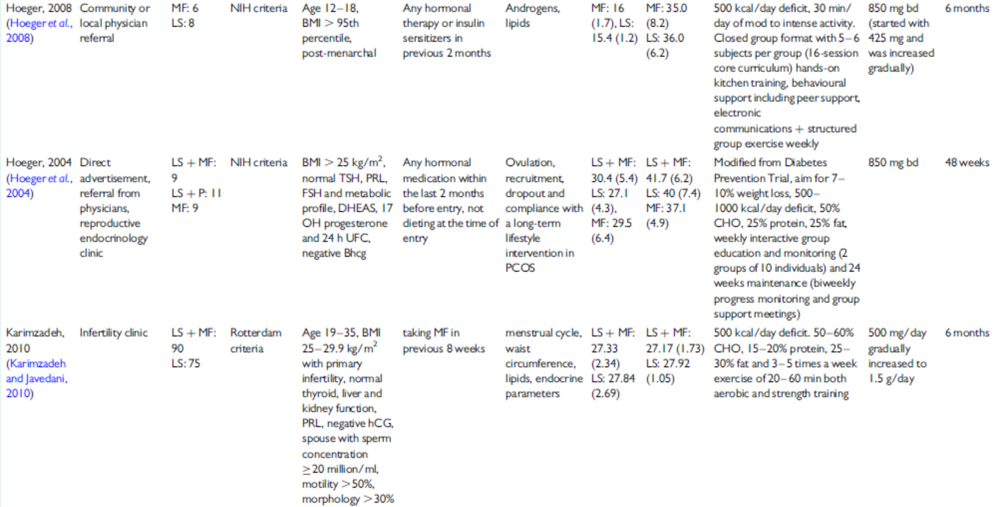

Slide 38
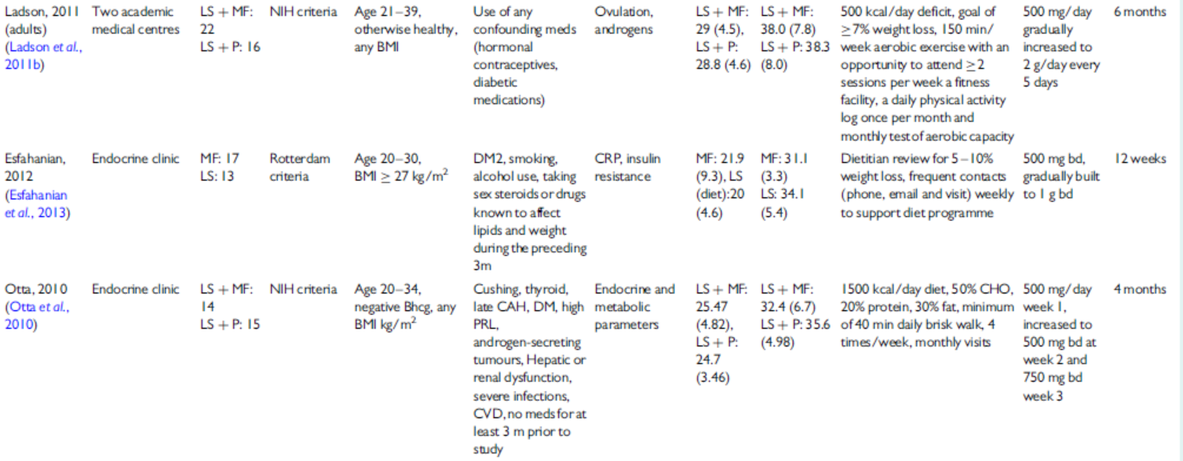

Slide 40
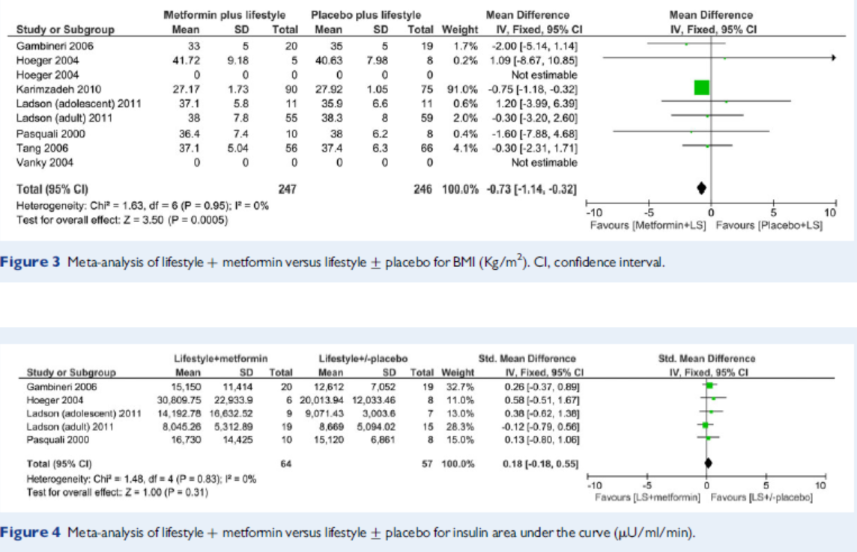

Slide 41
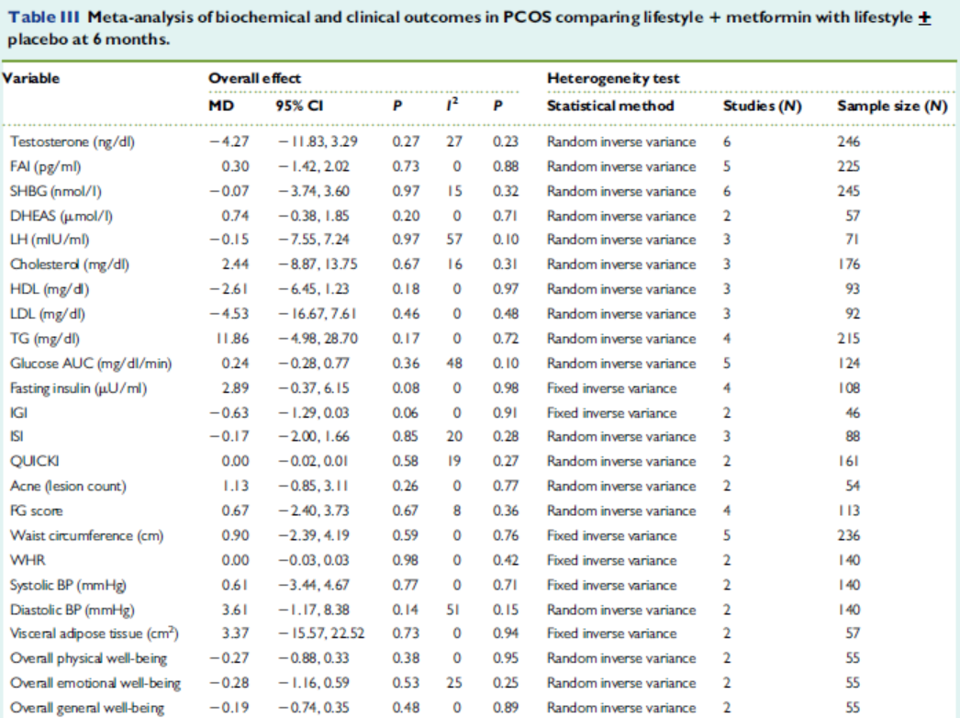

Slide 42
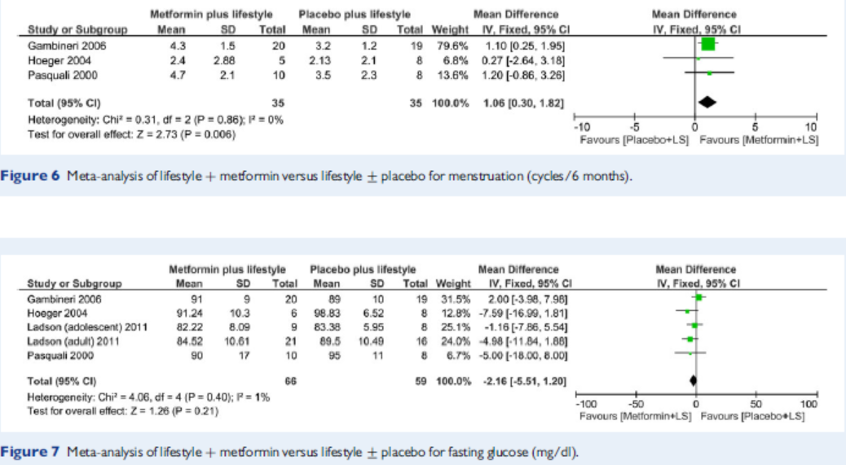

Slide 43
Effects on androgens
Metformin lowers testosterone levels by approximately 20 to 25% in women with PCOS. This effect may be more pronounced among non-obese women with PCOS. metformin is believed to lower testosterone levels by reducing hyperinsulinaemia.
studies suggest other potential mechanisms for the testosterone-lowering actions of metformin in PCOS. Metformin reduces testosterone levels in PCOS within 48 h of therapy, prior to any significant changes in insulin sensitivity or other metabolic variables.

Slide 44
Menstrual irregularity and clinical hyperandrogenism
Despite its testosterone-lowering actions, metformin use in PCOS is not consistently associated with improvements in menstrual irregularity or clinical hyperandrogenism. In a Cochrane review that included a meta-analysis of 38 randomised clinical trials of 3495 women with PCOS, metformin therapy only marginally improved menstrual pattern with significant heterogeneity in this measure.
metformin has not been shown to be an effective therapy for clinical symptoms of hyperandrogenism, such as acne or hirsutism.

Slide 45
In one trial, 23 women with PCOS were randomly assigned to receive metformin (500 mg three times per day) or placebo for six months. Approximately one-half of the women achieved normalization of menstrual function, confirmed by intermenstrual interval and luteal phase serum progesterone monitoring. In a meta-analysis of 13 trials, women treated with metformin had a fourfold higher chance of ovulating than women treated with placebo.
Moghetti P, Castello R, Negri C, et al. Metformin effects on clinical features, endocrine and metabolic profiles, and insulin sensitivity in polycystic ovary syndrome: a randomized, double-blind, placebo-controlled 6-month trial, followed by open, long-term clinical evaluation. J Clin Endocrinol Metab 2000; 85:139.
Tang T, Lord JM, Norman RJ, et al. Insulin-sensitising drugs (metformin, rosiglitazone, pioglitazone, D-chiro-inositol) for women with polycystic ovary syndrome, oligo amenorrhoea and subfertility. Cochrane Database Syst Rev 2012; :CD003053.

Slide 46
Metformin may be used as second-line therapy (particularly in women with contraindications to pill use), but it has not been proven to be endometrial protective.
When metformin is used, cyclic progestin therapy may be added for the first six months of metformin treatment until regular cycles are established.

Slide 47
In a meta-analysis of four trials that included 104 women with PCOS, metformin was less effective than OCs for improving menstrual pattern and in reducing serum total testosterone concentration but more effective for reducing fasting insulin and not increasing fasting triglyceride concentrations.
Costello M, Shrestha B, Eden J, et al. Insulin-sensitising drugs versus the combined oral contraceptive pill for hirsutism, acne and risk of diabetes, cardiovascular disease, and endometrial cancer in polycystic ovary syndrome. Cochrane Database Syst Rev 2007; :CD005552.

Slide 48
Fertility and live birth rate
In a meta-analysis of randomised, placebo-controlled trials, metformin improved clinical pregnancy rates; however, it did not improve live birth rates, whether used alone or in combination with clomifene.
metformin appears to have a limited role in improving fertility and live birth rate in women with PCOS and it is not recommended as a primary treatment for anovulatory infertility in this population.

Slide 49
Head-to-head randomized trials showed that clomiphene alone is clearly superior to metformin only with respect to achieving ovulation and live births in women with PCOS. the ovulatory response to clomiphene was increased in obese women with PCOS by decreasing insulin secretion with the addition of metformin.
Legro RS, Barnhart HX, Schlaff WD, et al. Clomiphene, metformin, or both for infertility in the polycystic ovary syndrome. N Engl J Med. 2007;356:551-566.

Slide 50
Insulin sensitivity and hyperinsulinaemia
A large meta-analysis of 38 studies in women with PCOS revealed that metformin lowers fasting insulin levels but with significant heterogeneity. Sub-analysis based on BMI indicated a lowering of fasting insulin only among non-obese women with PCOS.
A meta-analysis of RCTs comparing the effect of metformin and lifestyle vs lifestyle alone did not demonstrate a significant improvement in fasting or 2 h insulin levels in women with PCOS with the addition of metformin to lifestyle interventions.
Furthermore, it is not clear if the addition of metformin to oral contraceptives has a significant impact on insulin levels in women with PCOS.

Slide 51
There is currently inadequate evidence to recommend the routine addition of metformin to oral contraceptive (OC) therapy.
In one randomized clinical trial, 40 nonobese women with PCOS were treated with either an OC alone (ethinyl estradiol 35 mcg/day plus cyprotrone acetate 2 mg/day) or this OC plus metformin (500 mg three times daily) for four months. Combination therapy of the OC plus metformin resulted in the greatest reduction of the serum androstenedione level and the greatest increase in sex SHBG.Weight loss occurred only in the group taking metformin. Circulating androgen concentrations and Ferriman-Gallwey hirsutism scores decreased to a similar degree in both groups.
Thus, the combination of metformin plus an OC may be useful when weight loss is desired but not when used for other indications.
lter K, Imir G, Durmusoglu F. Clinical, endocrine and metabolic effects of metformin added to ethinyl estradiol-cyproterone acetate in non-obese women with polycystic ovarian syndrome: a randomized controlled study. Hum Reprod 2002; 17:1729.

Slide 52
Metformin at a dose of 500 mg three times daily reduced hyperinsulinemia, basal and stimulated levels of LH, and free testosterone concentrations in overweight women with PCOS.
Velazquez EM, Mendoza S, Hamer T, et al. Metformin therapy in polycystic ovary syndrome reduces hyperinsulinemia, insulin resistance, hyperandrogenemia, and systolic blood pressure, while facilitating normal menses and pregnancy. Metabolism. 1994;43:647-654.
Nestler J, Jakubowicz D. Decreases in ovarian cytochrome P450c 17 alpha activity and serum free testosterone after reduction of insulin secretion in polycystic ovary syndrome. N Engl J Med. 1996;335:
617-623.

Slide 53
Glucose tolerance
Current guidelines for management of PCOS recommend metformin treatment for women with impaired glucose tolerance or type 2 diabetes who do not respond to lifestyle modification.
In type 2 diabetes, metformin is the recommended initial therapy and has also been demonstrated to reduce the risk of type 2 diabetes development in individuals with glucose intolerance.

Slide 54
Body weight and composition
there may be evidence for a beneficial effect of metformin on BMI and abdominal obesity when added to lifestyle modification.
In a metaanalysis published in 2015, comparing nine randomised clinical trials (n = 493 participants) of metformin plus lifestyle vs lifestyle alone, metformin plus lifestyle was more effective in reducing BMI.
consistent with other metaanalyses metformin alone was not associated with any reduction in BMI compared with lifestyle.

Slide 55
In one study, metformin (850 mg twice daily) plus a low-calorie diet (1200 to 1400 kcal daily) was superior to a low-calorie diet alone in facilitating weight loss in obese women with and without PCOS. Other investigators have reported similar results. ●Although metformin is not a weight loss drug per se, it is a reasonable adjunct to diet and exercise for obese women with PCOS. We do not recommend its use in obese women who do not have PCOS.
Pasquali R, Gambineri A, Biscotti D, et al. Effect of long-term treatment with metformin added to hypocaloric diet on body composition, fat distribution, and androgen and insulin levels in abdominally obese women with and without the polycystic ovary syndrome. J Clin Endocrinol Metab 2000; 85:2767.
Kay JP, Alemzadeh R, Langley G, et al. Beneficial effects of metformin in normoglycemic morbidly obese adolescents. Metabolism 2001; 50:1457.
Freemark M, Bursey D. The effects of metformin on body mass index and glucose tolerance in obese adolescents with fasting hyperinsulinemia and a family history of type 2 diabetes. Pediatrics 2001; 107:E55.

Slide 56
Lipid profile
A meta-analysis of ten randomised clinical trials of 562 women with PCOS did not demonstrate an effect on serum cholesterol or triacylglycerol levels with metformin use.

Slide 57
Metformin also improved fasting insulin levels, blood pressure, and levels of LDL cholesterol. These effects were judged to be independent of any changes in weight that were associated with metformin treatment, but controversy persists about whether the beneficial effects of metformin are entirely independent of the weight loss that is typically seen early in the course of therapy.
Palomba S, Falbo A, Zullo F, Orio F Jr. Evidence-based and potential benefits of metformin in the polycystic ovary syndrome: a comprehensive review. Endocr Rev. 2009;30:1-50.
Tang T, Lord JM, Norman RJ, et al. Insulin-sensitising drugs (metformin, rosiglitazone, pioglitazone, D-chiro-inositol) for women with polycystic ovary syndrome, oligo amenorrhoea and subfertility. Cochrane Database Syst Rev. 2010;(1):CD003053.

Slide 58
Conclusions

Slide 59
NO LONGER INDICATED
Hirsutism
Anovulatory infertility

Slide 60
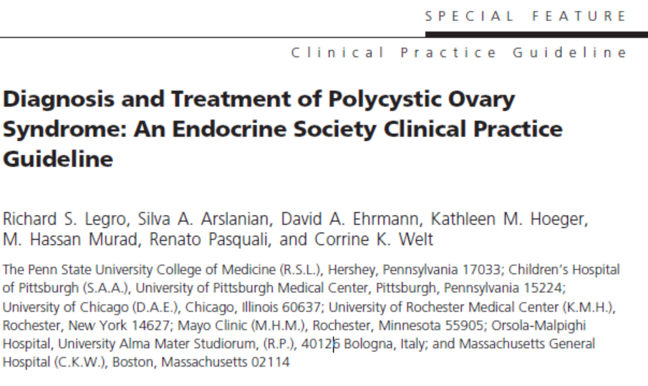
We suggest against the use of metformin as a firstline treatment of cutaneous manifestations, for prevention of pregnancy complications, or for the treatment of obesity.
We recommend metformin in women with PCOS who have T2DM or IGT who fail lifestyle modification.
For women with PCOS with menstrual irregularity who cannot take or do not tolerate HCs, we suggest metformin as second-line therapy.

Slide 61
Metformin is commonly used in young girls and adolescents with PCOS as first-line monotherapy or in combination with OCPs and anti-androgen medications. In lean adolescent girls, a dose as low as 850 mg daily may be effective at reducing PCOS symptoms; in overweight and obese adolescents, dose escalation to 1.5 to 2.5 g daily is likely required.

