Slide 1
Functioning and nonfunctioning pituitary adenomas in pregnancy
December 13,2021
Mahsa Abbaszadeh, MD
Research Institute for Endocrine Sciences, Shahid Beheshti University of Medical Sciences

Slide 3
Outline:
Introduction: The endocrine changes in pregnancy
Morphology of the pituitary gland
Prolactin
GH and IGF-1
TSH
Hypothalamic–pituitary–adrenal (HPA) axis
Pituitary vasopressin
Recommendations
General recommendations: pre-conception stage/ pregnancy/ Delivery and breastfeeding
Nonfunctioning adenomas (NFAs)
Prolactinomas
Acromegaly
Cushing’s disease

Slide 4
Introduction: The pituitary gland and endocrine milieu in pregnancy

Slide 5
Morphology of the pituitary gland
Maternal pituitary gland enlarges up to 33% during the pregnancy.
Reaches its maximal volume in late pregnancy and the first days post-partum.
A height of up to 12 mm.
A gradual decline to normal size within 6 months after delivery.
Vila G & Fleseriu M. Fertility and pregnancy in women with hypopituitarism: a systematic literature review. Journal of Clinical Endocrinology and Metabolism 2020 105 dgz112.

Slide 6
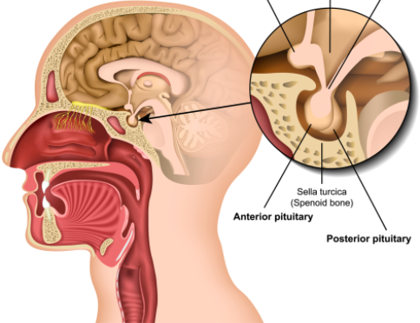
Size of the pituitary gland
children (<12 years): 6 mm (upper surface flat or slightly concave)
puberty: 10 mm (upper surface convex)
young adult
male: 8 mm
female: 9 mm
pregnancy: 12 mm
older adult (>50 years): gradually decreases in size
Weerakkody, Y., Jones, J. Pituitary macroadenoma. Reference article, Radiopaedia.org. (accessed on 28 Nov 2021) https://doi.org/10.53347/rID-9801

Slide 7
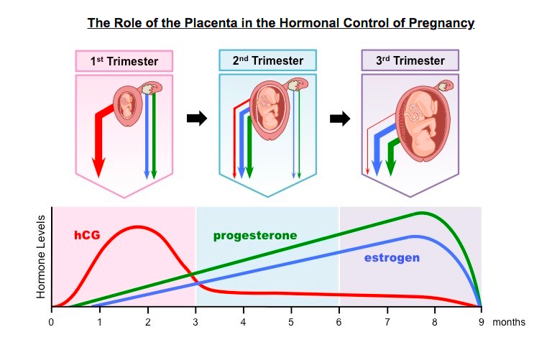
Pituitary growth
Starting in the first weeks of pregnancy, the placenta produces estrogens and progesterone, which increase exponentially until delivery.
increased concentrations of estradiol.
lactotroph hyperplasia starting in the first month of pregnancy
Costa MA. The endocrine function of human placenta: an overview. Reproductive Biomedicine Online 2016 32 14–43.

Slide 8
Baines KJ, Renaud SJ. Transcription Factors That Regulate Trophoblast Development and Function. Prog Mol Biol Transl Sci. 2017;145:39-88. doi: 10.1016/bs.pmbts.2016.12.003. Epub 2017 Jan 16. PMID: 28110754.

Slide 9
Placenta acts as an autonomous endocrine gland producing:
estrogens
Progesterone
human chorionic gonadotropin
placental lactogen
placental growth hormone (PGH)
Vila G & Fleseriu M. Fertility and pregnancy in women with hypopituitarism: a systematic literature review. Journal of Clinical Endocrinology and Metabolism 2020 105 dgz112.

Slide 10
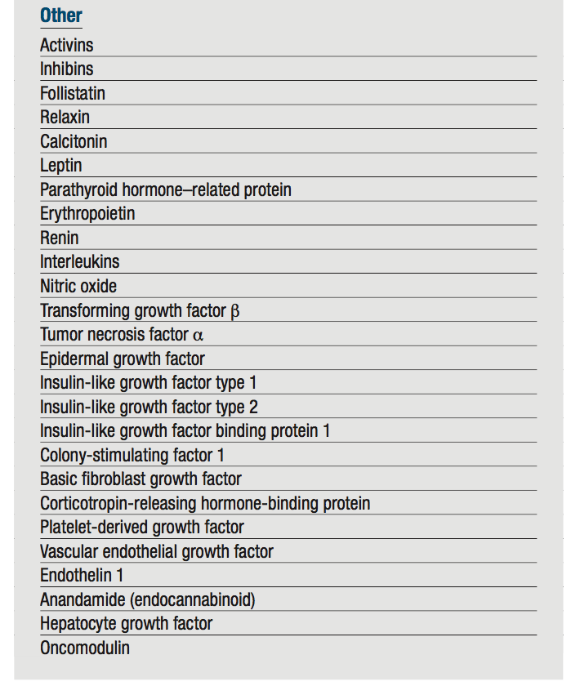
Williams textbook of endocrinology, 14th edition, chapter 22, endocrine changes In pregnancy

Slide 11
Prolactin
The stimulatory effect of oestradiol
An increased prolactin (PRL) production
serum concentrations reaching approximately 6- and 10-fold the upper limit of the reference range of non-pregnant women in the second and third trimester, respectively.
Schock H, et al. Hormone concentrations throughout uncomplicated pregnancies: a longitudinal study. BMC Pregnancy and Childbirth 2016 16 146.

Slide 12
Karaca Z, Tanriverdi F, Unluhizarci K & Kelestimur F. Pregnancy and pituitary disorders. European Journal of Endocrinology 2010 162 453–475. (https://doi.org/10.1530/EJE-09-0923)

Slide 13
Human placental lactogen (hPL)
is structurally related to PRL and GH
is released into the maternal circulation from the first weeks of gestation until delivery.
Costa MA. The endocrine function of human placenta: an overview. Reproductive Biomedicine Online 2016 32 14–43. (https://doi. org/10.1016/j.rbmo.2015.10.005)

Slide 14
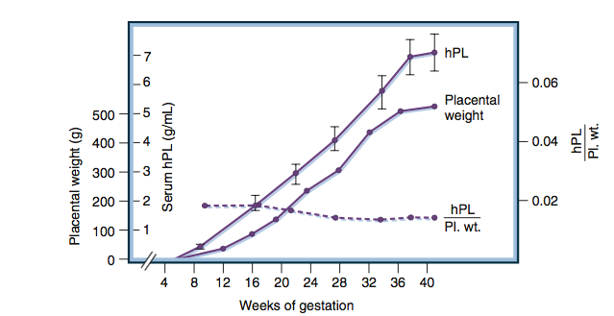
Placental weight (Pl. wt.)
maternal serum concentrations of human placental lactogen (hPL)
the ratio of hPL to Pl. wt.
Williams textbook of endocrinology, 14th edition, chapter 22, endocrine changes In pregnancy

Slide 15
GH and IGF-I
From gestational week 5, the placenta produces increasing amounts of GH, resulting in suppression of circulating pituitary GH to undetectable levels after gestational week 24.
Serum insulin-like growth factor-I (IGF-I) levels increase significantly above the age- specific reference range for non-pregnant women.
Freemark M. Placental hormones and the control of fetal growth. Journal of Clinical Endocrinology and Metabolism 2010 95 2054–2057. (https://doi.org/10.1210/jc.2010-0517)
Asvold BO, Eskild A, Jenum PA & Vatten LJ. Maternal concentrations of insulin-like growth factor I and insulin-like growth factor binding protein 1 during pregnancy and birth weight of o spring. American Journal of Epidemiology 2011 174 129–135. (https://doi.org/10.1093/aje/kwr067)

Slide 16
Karaca Z, Tanriverdi F, Unluhizarci K & Kelestimur F. Pregnancy and pituitary disorders. European Journal of Endocrinology 2010 162 453–475. (https://doi.org/10.1530/EJE-09-0923)

Slide 17
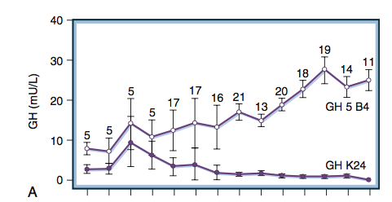
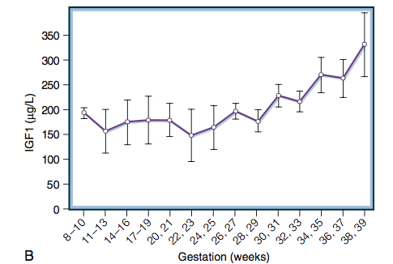
GH 5 B4, placental GH (GH2)
GH K24, pituitary GH (GH1).
Williams textbook of endocrinology, 14th edition, chapter 22, endocrine changes In pregnancy

Slide 18
The GH variant (GH V) is the major hormone responsible for stimulating the production of maternal IGF 1, which inhibits maternal pituitary secretion of normal GH (GH N) through a negative feedback action. In pregnant woman with acromegaly, GH N secretion is autonomous. Both GH N and GH V levels are consistently elevated in the blood throughout pregnancy. Similar to normal pregnancy, IGF 1 levels rise in patients with active acromegaly owing to stimulation by GH V.
Glezer A, et al. Management of pituitary tumors during pregnancy and lactation, Current Opinion in Endocrine and Metabolic Research (2018), doi: 10.1016/j.coemr.2018.02.002.

Slide 19
At term:
85% of the GH biologic activity in maternal serum is due to GH-V,
12% to hPL,
only 3% to pituitary hGH.
Within 48 hours of delivery, pituitary hGH secretion returns to normal.
Williams textbook of endocrinology, 14th edition, chapter 22, endocrine changes In pregnancy.

Slide 20
IGF1 levels (ULN) in ten pregnancies in eight acromegalic patients. Bars (after surgery, before pregnancy, and puerperium) represent the ranges of normal IGF1 values Horizontal lines represent mean values from patients. During pregnancy, in spite of pharmacological treatment withdrawn, mean IGF1 levels in patients remained unchanged.
Dias M, et al. Acromegaly and pregnancy: a prospective study. European Journal of Endocrinology 2014 170 301–310. (https://doi.org/10.1530/ EJE-13-0460)

Slide 21
The paradox in IGF1 levels after midgestation
The apparent paradox of increasing pGH with no further increases in IGF1 levels after midgestation in our acromegalic patients may reflect that the tumoral GH levels of our patients (range 3.7–8.4 μg/l, ≥29 weeks) could not be significant to add somatogenic effect to much higher pGH concentrations (range 2.1–69.8 μg/l, third trimester), in a situation of blunted maximal response of hepatic IGF1 generation.
Dias M, et al. Acromegaly and pregnancy: a prospective study. European Journal of Endocrinology 2014 170 301–310. (https://doi.org/10.1530/ EJE-13-0460)

Slide 22
Estrogen-induced GH resistance
strikingly high estrogen levels (∼200 times )
suppressing GH-dependent activation of the JAK/STAT pathway
inhibit GH signaling
the blockade of IGF1 generation
Dias M, et al. Acromegaly and pregnancy: a prospective study. European Journal of Endocrinology 2014 170 301–310. (https://doi.org/10.1530/ EJE-13-0460)

Slide 23
Human chorionic gonadotrophin and TSH
HCG is detectable in the maternal circulation after embryo implantation, peaks around week 10 and thereafter declines until week 20 to lower levels.
hCG is a potent TSH receptor ligand, and therefore, a reciprocal pattern of circulating TSH and hCG is present in the first trimester.
Alexander EK, et al. 2017 Guidelines of the American Thyroid Association for the diagnosis and management of thyroid disease during pregnancy and the postpartum. Thyroid 2017 27 315–389. (https://doi.org/10.1089/ thy.2016.0457)

Slide 24
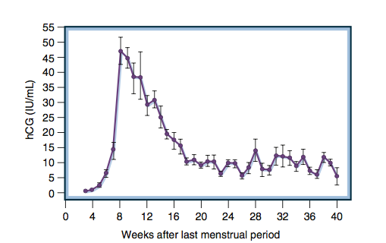
Mean (± standard error) levels of maternal hCG throughout normal pregnancy.
Williams textbook of endocrinology, 14th edition, chapter 22, endocrine changes In pregnancy

Slide 25
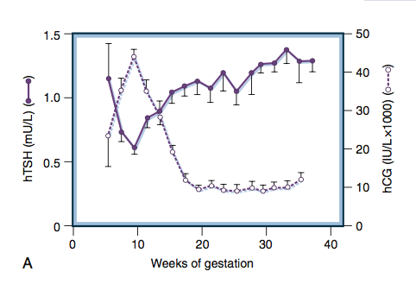
Between 8 and 14 weeks of gestation, there is a significant negative correlation between the individual hTSH and hCG levels (p <0.001).
Williams textbook of endocrinology, 14th edition, chapter 22, endocrine changes In pregnancy

Slide 26
Increased oestradiol increased production of binding proteins
Due to increased concentrations of thyroxine-binding globulin (TBG), circulating levels of total thyroxine (T4) and triiodothyronine (T3) are elevated in pregnancy.
Free T4 levels decline during pregnancy to levels in the low reference range for non-pregnancy.
Feldt-Rasmussen U & Mathiesen ER. Endocrine disorders in pregnancy: physiological and hormonal aspects of pregnancy. Best Practice and Research: Clinical Endocrinology and Metabolism 2011 25 875–884. (https://doi.org/10.1016/j.beem.2011.07.004)

Slide 27
Karaca Z, Tanriverdi F, Unluhizarci K & Kelestimur F. Pregnancy and pituitary disorders. European Journal of Endocrinology 2010 162 453–475. (https://doi.org/10.1530/EJE-09-0923)

Slide 28
Changes in thyroid physiology during pregnancy
Korevaar TIM, et al. Thyroid disease in pregnancy: new insights in diagnosis and clinical management. Nat Rev Endocrinol. 2017 Oct;13(10):610-622. doi: 10.1038/nrendo.2017.93. Epub 2017 Aug 4. PMID: 28776582.

Slide 29
hypothalamic–pituitary–adrenal (HPA) axis
The placenta produces large amounts of corticotropin-releasing hormone (CRH) and its related urocortin peptides, the circulating concentrations of which rise exponentially in the third trimester of pregnancy.
Cortisol and ACTH concentrations increase, especially in the third trimester.
Pregnancy is associated with activation of the maternal hypothalamic–pituitary–adrenal (HPA) axis that leads to increased levels of:
circulating adrenocorticotropic hormone (ACTH)
and cortisol (both free and total)
as well as 24 h urinary-free cortisol excretion.
Smith R, Smith JI, et al. Patterns of plasma corticotropin-releasing hormone, progesterone, estradiol, and estriol change and the onset of human labor. Journal of Clinical Endocrinology and Metabolism 2009 94 2066–2074.

Slide 30
The placenta has also 11β-hydroxysteroid dehydrogenase type 2 activity converting cortisol to cortisone.
Although the concentration of plasma cortisol is elevated during pregnancy, the diurnal pattern is preserved.
Bronstein MD, Machado MC & Fragoso MC. Management of endocrine disease: management of pregnant patients with Cushing’s syndrome. European Journal of Endocrinology 2015 173 R85–R91. (https://doi.org/10.1530/EJE-14-1130)

Slide 31
Karaca Z, Tanriverdi F, Unluhizarci K & Kelestimur F. Pregnancy and pituitary disorders. European Journal of Endocrinology 2010 162 453–475. (https://doi.org/10.1530/EJE-09-0923)

Slide 32
pituitary vasopressin
Increased placental vasopressinase activity
increased pituitary vasopressin release in normal pregnancy
may manifest as transient diabetes insipidus or unmask incipient diabetes insipidus.
Schrier RW. Systemic arterial vasodilation, vasopressin, and vasopressinase in pregnancy. Journal of the American Society of Nephrology 2010 21 570–572. (https://doi.org/10.1681/ ASN.2009060653)

Slide 33
Karaca Z, et al. Pregnancy and pituitary disorders. European Journal of Endocrinology 2010 162 453–475. (https://doi.org/10.1530/EJE-09-0923)

Slide 34
Methods used for guideline development

Slide 35
GRADE
GRADE:
Grading of Recommendations, Assessment, Development, and Evaluation

Slide 36
Williams textbook of endocrinology, 14th edition, chapter 6

Slide 37
the GRADE system provides a systematic framework for an indepth assessment of the quality of the evidence that is based on more than study design (randomized control trial vs. observational studies) or on expert opinion.
this framework was first adopted by the Endocrine Society and is now used by more than 100 other organizations for the development of trustworthy guidelines.
Williams textbook of endocrinology, 14th edition, chapter 6

Slide 38
Steps of GRADE system
Identification of the Clinical Question
Systematic Review of the Literature
Evaluation of the Quality of the Evidence: rating the quality of the evidence and estimated an average effect for specific outcomes where possible.
From Quality of the Evidence to Strength of Recommendation: The quality of the evidence behind the recommendations was classified as very low (⊕◯◯◯), low (⊕⊕◯◯), moderate (⊕⊕⊕◯), or strong (⊕⊕⊕⊕).

Slide 42
Recommendations and rationale for the recommendations

Slide 43
General recommendations: Pre-conception stage

Slide 44
General recommendations: Pre-conception stage
R.1.1. We recommend that women of reproductive age with a diagnosis of a pituitary adenoma be counselled about their potential fertility and pregnancy outcomes as early as possible.

Slide 45
Rationale
In women with hypopituitarism, replacement therapy should be optimised, and assisted reproductive technologies (ART) should be discussed when appropriate.
Women should be given relevant information about their chances of fertility and pregnancy depending on their diagnosis.

Slide 46
Rationale
Timing of pregnancy should be discussed and women should be encouraged to plan pregnancy after control of the underlying disease has been achieved.
If unplanned pregnancy occurs, immediate consultation should take place with a team that should include an endocrinologist, an obstetrician with expertise in managing high-risk pregnancies for maternal indications and, in case of large pituitary adenomas, a dedicated pituitary neurosurgeon.

Slide 47
Vila G & Fleseriu M. Fertility and pregnancy in women with hypopituitarism: a systematic literature review. Journal of Clinical Endocrinology and Metabolism 2020 105 dgz112. (https://doi. org/10.1210/clinem/dgz112)

Slide 48
R.1.2. We recommend that women of reproductive age with a diagnosis of pituitary adenoma, functioning or nonfunctioning, who consider pregnancy, be managed by an endocrinologist.
Rationale
The consulting endocrinologist should inform women seeking pregnancy that:
this is feasible in the majority of cases,
the outcome is generally good
breast feeding is often possible

Slide 49
collaboration between specialists from different fields is required.
An endocrine work-up including all anterior pituitary functions should be performed, with special attention to possible associated metabolic or cardiovascular diseases.

Slide 50
Cecchino GN, et al. Impact of hypogonadotropic hypogonadism on ovarian reserve and response. Journal of Assisted Reproduction and Genetics 2019 36 2379–2384.

Slide 51
R.1.3. We recommend that management of women of reproductive age with a large pituitary adenoma (>1 cm), Cushing’s disease or acromegaly, who consider pregnancy, be discussed in a multidisciplinary team.
An endocrinologist,
an obstetrician,
a pituitary neurosurgeon
a neuroradiologist,
a neuro-ophthalmologist
a reproductive endocrinologist.

Slide 52
Surgical decision
Compression of the optic chiasm with visual field impairment is an indication for pre-pregnancy pituitary surgery.
A tumour in close vicinity to the optic chiasm is a possible indication for surgery.
For women with a nonfunctioning pituitary macroadenoma and no visual field impairment, who are seeking pregnancy, the decision to operate prior to planned pregnancy may also take into account the presence of gonadotrophin deficiency.

Slide 53
Surgical decision
surgery provides pituitary recovery in about 30% of cases, in particular normalisation of ACTH, cortisol and PRL.
The surgical risk of a postoperative gonadotrophin deficiency and also a panhypopituitarism (14%) which could impact on pregnancy course should be considered, and should be taken into account for the surgical decision.
In abstention from surgery, clinical surveillance should be at least 3-monthly, with visual field test and MRI without contrast enhancement in case of visual field impairment.
Castinetti F, Dufour H, ET AL. Non-functioning pituitary adenoma: when and how to operate? What pathologic criteria for typing? Annales d’Endocrinologie 2015 76 220–227.

Slide 54
R.1.4. We recommend that in women with a diagnosis of pituitary adenoma and hypopituitarism, hormone replacement therapy should be initiated or optimised prior to becoming pregnant.

Slide 55
Rationale
In women with hypopituitarism, reported fertility rates range from 47 to 76%, and reached over 80% in women with isolated hypogonadotropic hypogonadism after ART.
Women with childhood onset of hypopituitarism have much lower fertility rates.
Vila G & Fleseriu M. Fertility and pregnancy in women with hypopituitarism: a systematic literature review. Journal of Clinical Endocrinology and Metabolism 2020 105 dgz112. (https://doi. org/10.1210/clinem/dgz112)

Slide 56
The pre-conception consultation should include diagnosis of any pituitary deficiencies, initiation and optimisation of the replacement therapy aiming for mid-normal reference range values.
Women with hypopituitarism and optimal replacement therapy often require ART (78.8%) , but in the absence of gonadotrophin deficiency they may conceive spontaneously.
CorreaFA,BianchiPHM, et al. Successful pregnancies after adequate hormonal replacement in patients with combined pituitary hormone deficiencies. Journal of the Endocrine Society 2017 1 1322–1330. (https://doi.org/10.1210/js.2017-00005)

Slide 57
Initiation and optimisation of GH replacement for at least 3 months prior to conception has been shown to improve the success rate of ART and ovulation stimulation (OS) in women with concomitant gonadotrophin deficiency.
Vila G & Luger A. Growth hormone deficiency and pregnancy: any role for substitution? Minerva Endocrinologica 2018 43 451–457.

Slide 58
Although fertility outcomes and pregnancy rates for women with hypopituitarism are generally good, studies have shown that women require multiple OS and/or ART cycles to achieve a live birth and the 'take home baby rate' per cycle remains reduced.
Stefaniak A, Domitrz J, Siewko K, Szelachowska M, Kretowski A & Stachura-Matyjewicz A. Pituitary adenoma and apoplexy during GnRH agonist treatment for IVF – case report. Gynecological Endocrinology 2020 561–563

Slide 59
General recommendations: Pregnancy

Slide 60
R.2.1. We recommend that pregnant women with known pituitary adenoma, in particular those with a large pituitary adenoma (>1 cm), Cushing’s disease or acromegaly, and those with pituitary deficiencies, should be followed by an endocrinologist and an advanced nurse practitioner where relevant.
The frequency depends on the underlying condition and individualised needs.

Slide 61
Rationale
Pituitary adenomas may cause hypopituitarism, visual impairment or nerve palsies during pregnancy and therefore need special surveillance by an expert endocrinologist.
Individualised management is needed throughout pregnancy, the frequency of consultations is determined by the clinical situation, and in uneventful cases, consultations can be limited.
In patients with acromegaly and Cushing’s disease, special attention to glucose homeostasis and blood pressure is needed.
Patients with a microprolactinoma or a nonfunctioning microadenoma will only need consultation with an endocrinologist during pregnancy if new symptoms such as headache or visual symptoms occur.

Slide 62
R.2.2. We recommend that pregnant women with diagnosed hypopituitarism should have regular clinical and hormonal follow-up by an endocrinologist and an advanced nurse practitioner where relevant.

Slide 63
Women with pituitary adenomas and hypopituitarism require regular follow-up at least every trimester to:
monitor for adequate substitution doses and/or
to identify signs or symptoms of any newly developed pituitary insufficiencies or complications associated with functioning adenomas, mainly GH or ACTH-producing.

Slide 64
levothyroxine replacement therapy
Patients on levothyroxine replacement therapy might require an increase in dose of up to 50%.
Free T4 levels should be used for monitoring, rather than TSH, which is not reliable in patients with pituitary disorders.
Adequate dose should be checked during the first and second trimesters using gestational phase- and assay- specific reference values.
Whereas an interval of 4–6 weeks has been suggested for fT4 measurement throughout pregnancy, not all members of this Clinical Guideline Committee monitor their patients that frequently.
Persani L, et al. 2018 European Thyroid Association (ETA) guidelines on the diagnosis and management of central hypothyroidism. European Thyroid Journal 2018 7 225–237.

Slide 65
glucocorticoid replacement therapy
In women with adrenal insufficiency, there is usually no need to alter the doses of glucocorticoid replacement therapy during the first half of pregnancy, but an increase by 20–40% may be needed from week 22 to 24 onwards, since free cortisol increases during this period in healthy women.
Hydrocortisone is the preferred choice for glucocorticoid replacement during pregnancy; prednisone is also an option as it does not cross the placenta. Only 10–12% of the maternal prednisolone concentration reaches the foetus .
Dexamethasone should be avoided because it is insufficiently inactivated by placental 11β-HSD2 and may therefore cause harm to the foetus.
Beitins IZ, Bayard F, Ances IG, Kowarski A & Migeon CJ. The transplacental passage of prednisone and prednisolone in pregnancy near term. Journal of Pediatrics 1972 81 936–945.

Slide 66
desmopressin dose
The desmopressin dose might need to be increased during the third trimester due to placental vasopressinase activity.
The patient should be informed that in case of polyuria and increase of desmopressin, serum sodium concentration should be checked to avoid hyponatraemia.
Administration of desmopressin appears to be otherwise safe in pregnancy.
Refardt J & Christ-Crain M. Diabetes insipidus in pregnancy: how to advice the patient? Minerva Endocrinologica 2018 43 458–464.

Slide 67
GH replacement
GH replacement is usually stopped after conception or by the end of the first trimester; the benefit–risk balance for GH in pregnancy cannot be assessed.
Large amounts of GH are secreted by the placenta during pregnancy.
One large observational study revealed no relationship between GH replacement therapy regimens and pregnancy outcomes.
Vila G, Akerblad AC, Mattsson AF, Riedl M, Webb SM, Hana V, Nielsen EH, Biller BM & Luger A. Pregnancy outcomes in women with growth hormone deficiency. Fertility and Sterility 2015 104 1210. e1–1217.e1

Slide 68
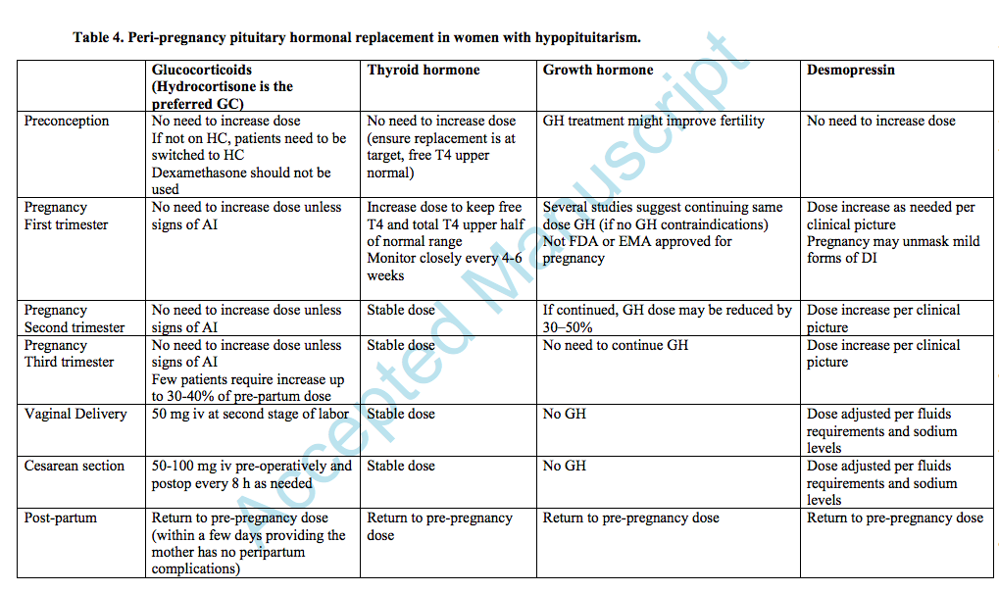
Vila G & Fleseriu M. Fertility and pregnancy in women with hypopituitarism: a systematic literature review. Journal of Clinical Endocrinology and Metabolism 2020 105 dgz112. (https://doi. org/10.1210/clinem/dgz112)

Slide 69
R.2.3. We recommend that women and their partners be provided with education for glucocorticoid stress dose adjustment and measures on how to prevent or manage adrenal crisis during pregnancy.

Slide 70
Rationale
Symptoms such as persistent nausea, hyperemesis, and excessive fatigue are common in pregnancy. These can also be triggers or symptoms of the onset of an adrenal crisis and vigilance is therefore mandated.
Patient and partner education regarding stress-coverage dosage of hydrocortisone, access to a hydrocortisone injection kit and glucocorticoid emergency card, and training on self-injecting are crucial to prevent and promptly manage an adrenal crisis.
In case of an adrenal crisis, fluid replacement (best with 0.9% saline IV) and immediate parenteral administration of hydrocortisone 100 mg (IV, IM, SC) are potentially life-saving for the mother.
Fetal monitoring by cardiotocography (CTG) and ultrasound.
Anand G & Beuschlein F. Management of endocrine disease: fertility, pregnancy and lactation in women with adrenal insu ciency. European Journal of Endocrinology 2018 178 R45–R53

Slide 71
R.2.4. We recommend performing an MRI without contrast in pregnancy in case of symptoms of tumour progression or apoplexy.

Slide 72
Rationale
MRI is considered safe in pregnancy and should be used in symptomatic patients with impairment of visual fields or visual acuity, cranial nerve palsies or severe headache usually after neuro-ophthalmologic evaluation.
Gadolinium can cross the placenta and reach the foetal circulation, its use is therefore to be avoided in most cases, especially in the first trimester.
Routine MRI follow-up during pregnancy is not recommended.
Prayer D, Malinger G, Brugger PC, Cassady C, de Catte L, de Keersmaecker B, Fernandes GL, Glanc P, Gonçalves LF, Gruber GM et al. ISUOG practice guidelines: performance of fetal magnetic resonance imaging. Ultrasound in Obstetrics and Gynecology 2017 49 671–680.

Slide 73
R.2.5. We recommend that neuro-ophthalmologic examination in pregnancy be performed for:
adenomas impinging visual pathways or
in case of suspected tumour progression or pituitary apoplexy.

Slide 74
Rationale
neuro-ophthalmologic evaluation including:
determination of visual acuity, visual fields
if available, optical coherence tomography (OCT), analysing retinal nerve fibre layer (RNFL) and ganglion cell complex (GCC)
should be performed in symptomatic patients, which will aid the decision about whether a MRI is indicated.

Slide 75
Rationale
The frequency of neuro-ophthalmologic evaluations will be determined by signs and symptoms as well as by results of prior examinations.

Slide 76
R.2.6. We recommend considering surgery in pregnant women with deterioration of vision, ophthalmoplegia or severe headache attributable to tumour enlargement if medical tumour treatment is unfeasible or ineffective (⊕⊕◯◯).

Slide 77
Rationale
In situations with chiasmal compression and severe loss of vision (impairment of visual acuity or OCT or severe visual field impairment) surgical decompression should be considered even if there is no detectable radiological enlargement of the tumour.
Surgery provided symptom relief in 89.3% (95% CI: 71.8–97.7%).
In case of other cranial nerve palsies or headache occurrence, particularly related to apoplexy, surgical resection should be individually discussed.
Graillon T, Cuny T, Castinetti F, Courbière B, Cousin M, Albarel F, Morange I, Bruder N, Brue T & Dufour H. Surgical indications for pituitary tumors during pregnancy: a literature review. Pituitary 2020 23 189–199

Slide 78
pituitary surgery during pregnancy
Pituitary surgery was performed in 33 cases during pregnancy. The vast majority of patients had hormone secreting macroadenomas.
Surgery was performed during the first (n= 2), second (n = 24) and third (n = 7) trimester.
The indications for surgery mainly included active Cushing disease, visual deterioration related to tumour growth or apoplexy.
Luger A, et al. ESE Clinical Practice Guideline on functioning and nonfunctioning pituitary adenomas in pregnancy. Eur J Endocrinol. 2021 Aug 23;185(3):G1-G33.

Slide 79
pituitary surgery during pregnancy
Surgery provided symptom relief in 25 cases out of 28 in whom effectiveness was reported (89.3%, 95% CI: 71.8– 97.7%).
In total, nine women experienced surgery-related adverse events (diabetes insipidus, SIADH, cerebrospinal fluid leakage). This high percentage of adverse events might be related to the special indication for pituitary surgery in pregnancy being restricted to emergency situations.
Luger A, et al. ESE Clinical Practice Guideline on functioning and nonfunctioning pituitary adenomas in pregnancy. Eur J Endocrinol. 2021 Aug 23;185(3):G1-G33.

Slide 80
pituitary surgery during pregnancy
In total, nine infants showed adverse outcomes in the course of pregnancy (28.1%; 95% CI: 13.7–46.7%):
one miscarriage soon after surgery during the second trimester.
one intrauterine death
two cases of neonatal death.
Most adverse outcomes for infants occurred in mothers with Cushing’s disease (eight out of nine infants with adverse events).
Luger A, et al. ESE Clinical Practice Guideline on functioning and nonfunctioning pituitary adenomas in pregnancy. Eur J Endocrinol. 2021 Aug 23;185(3):G1-G33.

Slide 81
R.2.7. If surgery is indicated, we suggest to perform transsphenoidal surgery in the second trimester if the clinical course allows this (⊕⊕◯◯).

Slide 82
Rationale
Surgical indications for pituitary tumours are rare during pregnancy and surgery should generally be avoided.
In cases of symptomatic tumour enlargement during pregnancy, medical treatment with dopamine agonists or somatostatin analogues may be attempted before undertaking transsphenoidal surgery.
Severe visual disturbance related to pituitary apoplexy or tumour growth, and uncontrolled Cushing’s disease are the main surgical indications during pregnancy.

Slide 83
Rationale
The first trimester should be avoided if possible.
In the third trimester, preterm delivery before non-obstetrical surgery should be considered.
Emergency operations (e.g. severe loss of vision or ophthalmoplegia) must be considered and performed at any time during pregnancy preferably in expert pituitary centres.
Heesen M & Klimek M. Nonobstetric anesthesia during pregnancy. Current Opinion in Anaesthesiology 2016 29 297–303.

Slide 84
Murad MH, Fernandez-Balsells MM, Barwise A, Gallegos-Orozco JF, Paul A, Lane MA, Lampropulos JF, Natividad I, Perestelo-Pérez L, Ponce de León-Lovatón PG et al. Outcomes of surgical treatment for nonfunctioning pituitary adenomas: a systematic review and meta-analysis. Clinical Endocrinology 2010 73 777–791. (https://doi. org/10.1111/j.1365-2265.2010.03875.x)

Slide 85
R.2.8. We recommend not to perform radiotherapy during pregnancy.
Rationale
their delay in the onset of effects
potential harm to the foetus.

Slide 86
General recommendations: Delivery and breastfeeding

Slide 87
R.3.1. We suggest that pregnant women with pituitary adenomas should receive standard obstetrical care but recommend close maternal and foetal surveillance.

Slide 88
Rationale
A systematic review of 31 pregnancy outcomes in women with hypopituitarism found no neonatal complications or congenital anomalies in the newborns.
had higher rates of caesarean deliveries and small for gestational age neonates compared to controls.
Kubler K, Klingmuller D, Gembruch U & Merz WM. High-risk pregnancy management in women with hypopituitarism. Journal of Perinatology 2009 29 89–95.

Slide 89
Rationale
A recent study showed that women with nonfunctioning adenomas were more likely to have Caesarean delivery compared to controls (relative risk 2.06, 95% CI: 1.26–3.36).
There was no solid evidence that pituitary tumours were associated with adverse pregnancy outcomes such as pregnancy-induced hypertension, pre-eclampsia, pre-term labour or still birth.
Women should be informed early on in their pregnancy about the possibility of Caesarean delivery.
Lambert K, Rees K, Seed PT, Dhanjal MK, Knight M, McCance DR & Williamson C. Macroprolactinomas and nonfunctioning pituitary adenomas and pregnancy outcomes. Obstetrics and Gynecology 2017 129 185–194

Slide 90
Rationale
In rare pregnancies with Cushing’s disease:
the risk for prematurity and intrauterine growth restriction is elevated
individual reports of coarctation of the aorta, transient neonatal jaundice, hypoglycaemia and adrenal insufficiency requiring temporary treatment with hydrocortisone.
Lindsay JR, Jonklaas J, Oldfield EH & Nieman LK. Cushing’s syndrome during pregnancy: personal experience and review of the literature. Journal of Clinical Endocrinology and Metabolism 2005 90 3077–3083.

Slide 91
R.3.2. In general, breastfeeding is feasible and not contraindicated.
Rationale
Individual concerns such as the need to control tumour size and activity as well as type of drug therapy employed need to be considered.

Slide 92
Nonfunctioning adenomas (NFAs)

Slide 93
Nonfunctioning pituitary adenoma: 16 pregnancies in 16 patients
Symptomatic tumour growth (headache or visual defects) occurred in six patients (37.5%, 95% CI: 15.2–64.6%) and radiologically confirmed tumour growth was seen in four patients (25.0%, 95% CI: 7.3–52.4%).
Luger A, et al. ESE Clinical Practice Guideline on functioning and nonfunctioning pituitary adenomas in pregnancy. Eur J Endocrinol. 2021 Aug 23;185(3):G1-G33.

Slide 94
R.4.1. In women with a NFA near the optic chiasm who are planning a pregnancy, surgery may be considered to reduce the risk of chiasmal compression and to enhance fertility.

Slide 95
Rationale
As the pituitary gland expands during pregnancy, surgery should be considered on the basis of NFA size and proximity to the optic pathways.
it has been suggested that for women with a macroadenoma and no visual field impairment, who plan pregnancy, surgery may be considered in order to optimize fertility, since surgery provides recovery of hypopituitarism in about 30%.
The risk of postoperative pituitary deficiency, which is estimated around 14% should be integrated in the surgical decision particularly in case of normal preoperative pituitary function.
Murad MH, et al. Outcomes of surgical treatment for nonfunctioning pituitary adenomas: a systematic review and meta-analysis. Clinical Endocrinology 2010 73 777–791

Slide 96
R.4.2. We suggest that for women with intrasellar nonfunctioning microadenomas and an uneventful pregnancy, there is no need for routine endocrinological follow-up during pregnancy.

Slide 97
R.4.3. We recommend that for macroadenomas and/or extrasellar NFAs, neuro-ophthalmologic and, if indicated, MRI examination should be performed only in case of symptoms of tumour progression or pituitary apoplexy during pregnancy.

Slide 98
Rationale
In contrast to microadenomas, six of eight primiparous patients with macroadenomas (range 1.2–2.5 cm) developed visual field impairment.
In case of macroadenomas in contact or close to the chiasm, systematic visual examination should be considered.
Visual examination frequency and type of tests (with or without optical coherence tomography) depend on the local practices and should be adapted case- by-case.
Kupersmith MJ, Rosenberg C & Kleinberg D. Visual loss in pregnant women with pituitary adenomas. Annals of Internal Medicine 1994 121 473–477.

Slide 99
R.4.4. We recommend that in case of a clinical need to reduce adenoma volume during pregnancy, surgery is the preferred option (⊕◯◯◯).

Slide 100
Rationale
The main indication for pituitary surgery during pregnancy is to protect visual function.
A trial with cabergoline might be considered.
Apoplexy is another rare but acute condition in a patient with NFA that may require surgical intervention.

Slide 101
R.4.5. We recommend awaiting reassessment of pituitary imaging and function until after delivery and breastfeeding.

Slide 102
Rationale
Reassessment of pituitary imaging and function should be done between 3 and 6 months after delivery, preferably after breastfeeding but definitely before planning a following pregnancy, unless the clinical picture suggests otherwise.

Slide 103
Prolactinomas

Slide 104
R.5.1. We recommend treating women with a prolactinoma, who are actively seeking pregnancy, with a dopamine agonist and strive for
normalisation of prolactin concentrations
restoration of regular ovulatory cycles.
(⊕⊕⊕◯).

Slide 105
Rationale
We consider a desire for pregnancy as an indication for strict prolactin normalisation in young women with a prolactinoma, even in those with mild hyperprolactinaemia and apparently regular normal cycles.
It is important to inform patients that restoration of ovulation and fertility may be immediate when they start dopaminergic treatment, even before normal menses return and to counsel patients whether prompt conception is safe.
Melmed S, Casanueva FF, Ho man AR, Kleinberg DL, Montori VM, Schlechte JA, Wass JA & Endocrine Society. Diagnosis and treatment of hyperprolactinemia: an Endocrine Society Clinical Practice Guideline. Journal of Clinical Endocrinology and Metabolism 2011 96 273–288.

Slide 106
R.5.2. We recommend medical treatment as first-choice therapy for women with a prolactinoma and actively seeking pregnancy; transsphenoidal surgery can be considered in individual cases (⊕⊕⊕◯).

Slide 107
Rationale
Dopamine agonists (DA) are the standard treatment for women in reproductive age with a micro- or a macro- prolactinoma, restoring ovulation in 80–90%.
Few studies have directly compared the currently available DA in their efficacy to allow gestation.
We suggest using cabergoline because it is better tolerated and has a higher efficacy than bromocriptine in both normalising prolactin levels and inducing pituitary tumour shrinkage.
Chanson P & Maiter D. Prolactinoma. In The Pituitary, 4th ed., pp. 467–513. Ed S Melmed, 2017.
.

Slide 108
Rationale
Transsphenoidal adenomectomy is an option in selected cases such as intolerance or resistance to DA or personal preference.
It is considered less efficient than medical therapy, leading in expert hands to a sustained normalisation of prolactin levels in 70–80% of microadenomas, but only in 30–40% of macroadenomas.
1 Zamanipoor Najafabadi AH, Zandbergen IM, de Vries F, Broersen LHA, van den Akker-van Marle ME, Pereira AM, Peul WC, Dekkers OM, van Furth WR & Biermasz NR. Surgery as a viable alternative first-line treatment for prolactinoma patients. A systematic review and meta- analysis. Journal of Clinical Endocrinology and Metabolism 2020 105 e32–e41

Slide 109
R.5.3. We recommend cabergoline as medical treatment at the lowest possible effective dose until pregnancy is confirmed (⊕⊕◯◯).

Slide 110
Rationale
Treatment with dopamine agonists should not be withdrawn in women seeking pregnancy and, as discussed above, due to its higher efficacy and better tolerance, cabergoline is considered first choice in this population.

Slide 111
Rationale
We performed a systematic review of reports published until 2019 on pregnancies initiated under cabergoline treatment (n = 1272), of which some patients used cabergoline during a larger part of pregnancy.
The observed rates of spontaneous miscarriage (9.0%), pre-term delivery (8.0%) and neonatal malformations (3.3%) are similar to those reported for bromocriptine and do not clearly deviate from those reported in an age-matched population not on DA therapy.
Lebbe M, Hubinont C, Bernard P & Maiter D. Outcome of 100 pregnancies initiated under treatment with cabergoline in hyperprolactinaemic women. Clinical Endocrinology 2010 73 236–242.

Slide 112
Rationale
some follow-up studies of children for up to 12 years after foetal exposure to cabergoline do not suggest an increased risk of developmental and or/ metabolic abnormalities.
one study with a follow-up of 61 children of up to 16 years reported two children who developed epilepsy (one after distress at birth because of abruptio placentae) and two with a pervasive developmental disorder.
However, the relationship of such disorders with previous cabergoline exposure cannot be proven.
Maiter D. Prolactinoma and pregnancy: from the wish of conception to lactation. Annales d’Endocrinologie 2016 77 128–134.
Stalldecker G, Mallea-Gil MS, Guitelman M, Alfieri A, Ballarino MC, Boero L, Chervin A, Danilowicz K, Diez S, Fainstein-Day P et al. E ects of cabergoline on pregnancy and embryo-fetal development: retrospective study on 103 pregnancies and a review of the literature. Pituitary 2010 13 345–350.

Slide 113
R.5.4. We recommend stopping the dopamine agonist once pregnancy is established.
However, dopamine agonists may be given for a longer gestational period in specific circumstances (⊕◯◯◯).

Slide 114
Rationale
DA cross the placental barrier.
the use of bromocriptine and cabergoline has not been associated with increased teratogenicity,
it is recommended to discontinue treatment as soon as pregnancy is confirmed

Slide 115
Rationale
If adenoma size is not controlled, several options are available:
DA therapy seems to be safe and, in special circumstances, can be continued throughout the pregnancy, particularly if the adenoma is abutting the optic chiasm.
Second, DA can be started later in pregnancy in case of symptomatic tumour growth. Cabergoline is slightly preferable due to its better tolerability, higher efficacy and longer duration of action.
Alternatively, partial or complete resection by transsphenoidal surgery prior to conception can be considered, in particular for cystic lesions that are often considered less responsive to medical therapy and good candidates for surgery. However, one study showed that a large proportion of cystic tumours can also be reduced by DA.
Faje A, Chunharojrith P, Nency J, Biller BM, Swearingen B & Klibanski A. Dopamine agonists can reduce cystic prolactinomas. Journal of Clinical Endocrinology and Metabolism 2016 101 3709–3715

Slide 116
Limited safety data are available regarding the use of bromocriptine throughout gestation in mothers with hyperprolactinaemia (n = 36 pregnancies and n = 36 live infants) with no abnormalities noted in the infants except for one balanced translocation of chromosomes 8 and 12, and one case of testicular ectopy, which corrected spontaneously after 7 months.
The record is even smaller for cabergoline used throughout gestation (n= 34 pregnancies and n= 26 live infants), with no recorded malformations in live infants. There was one foetal death at week 34 in a mother suffering from severe pre-eclampsia.
A report on 25 pregnancies from India with cabergoline therapy throughout pregnancy showed 1 foetal death, 3 missed abortions, 3 pregnancy terminations due to major congenital malformations, 2 premature deliveries and 18 live infants.
Banerjee A, Wynne K, Tan T, Hatfield EC, Martin NM, Williamson C & Meeran K. High dose cabergoline therapy for a resistant macroprolactinoma during pregnancy. Clinical Endocrinology 2009 70 812–813
Rastogi A, Bhadada SK & Bhansali A. Pregnancy and tumor outcomes in infertile women with macroprolactinoma on cabergoline therapy. Gynecological Endocrinology 2017 33 270–273

Slide 117
R.5.5. We recommend not measuring prolactin during pregnancy.

Slide 118
Rationale
Pregnancy is associated with a physiological elevation of prolactin concentrations and serum prolactin levels may increase about 10-fold throughout pregnancy, reaching levels of 150–300 μg/L at term.
However, in some prolactinoma patients, serum prolactin levels may not increase further during pregnancy and prolactin is therefore not a reliable marker of eventual tumour progression.
Therefore, we do not recommend prolactin measurements during gestation in prolactinoma patients.
Molitch ME. Endocrinology in pregnancy: management of the pregnant patient with a prolactinoma. European Journal of Endocrinology 2015 172 R205–R213.

Slide 119
R.5.6. We suggest that for women with a small intrasellar microprolactinoma, and normal pituitary function pre- pregnancy, there is no need for routine endocrinological follow-up during pregnancy.

Slide 120
R.5.7. We suggest careful and regular monitoring for tumour growth in pregnant women with a large macroprolactinoma or a prolactinoma close to the optic chiasm (⊕⊕◯◯).

Slide 121
Rationale
Overall, symptomatic tumour growth during pregnancy occurs in 9.0% (95% CI: 6.8–11.6%) of prolactinomas.
in women with a macroprolactinoma, the risk is reported to be considerably higher, 30.5% (95% CI: 22.4– 39.7%).
A much smaller risk – between 1 and 4% – was observed in cases where the tumour had been operated, irradiated or sufficiently reduced by prolonged DA therapy before pregnancy.
O’Sullivan SM, Farrant MT, Ogilvie CM, Gunn AJ & Milsom SR. An observational study of pregnancy and post-partum outcomes in women with prolactinoma treated with dopamine agonists. Australian and New Zealand Journal of Obstetrics and Gynaecology 2020 60 405–411.

Slide 122
Rationale
Data on 85 viable pregnancies in 46 patients with a macroprolactinoma demonstrated tumour growth-related symptoms 12 times in 9 patients (19.6%) including 3 cases of apoplexy.
Barraud S, Guedra L, Delemer B, Raverot G, Ancelle D, Fevre A, Jouanneau E, Litré CF, Wolak-Thierry A, Borson-Chazot F et al. Evolution of macroprolactinomas during pregnancy: a cohort study of 85 pregnancies. Clinical Endocrinology 2020 92 421–427

Slide 123
Rationale
we recommend careful individualised follow-up with clinical evaluation, including visual field testing, visual acuity, OCT and in case of visual deterioration MRI assessment without gadolinium in pregnant women with a macroadenoma which could not be sufficiently reduced by prior treatment.

Slide 124
R.5.8. We recommend to consider restarting dopamine agonists in pregnancy in case of symptoms of progressive prolactinoma growth.
Surgery should be used only in case of medical failure or symptomatic apoplexy (⊕◯◯◯).

Slide 125
Rationale
In case of symptomatic prolactinoma growth during pregnancy, restarting DA is effective in most cases and is therefore first choice.
Cabergoline is slightly preferable in terms of side effects and efficacy, the doses in pregnant women are similar to those in non- pregnant women and the lowest possible dose should be used.
Karaca Z, Yarman S, Ozbas I, Kadioglu P, Akturk M, Kilicli F, Dokmetas HS, Colak R, Atmaca H, Canturk Z et al. How does pregnancy a ect the patients with pituitary adenomas: a study on 113 pregnancies from Turkey. Journal of Endocrinological Investigation 2018 41 129–141.

Slide 126
Rationale
In case of sudden and severe headache, ophthalmoplegia or limited visual field impairment, surgery should be discussed case-by-case. It may occur both in patients treated with DA and in untreated pregnant women with a prolactinoma.
However, haemorrhagic necrosis of a macroprolactinoma during pregnancy may also be minor or asymptomatic, thus not requiring surgery and having a favourable outcome without treatment.
Barraud S, Guedra L, Delemer B, Raverot G, Ancelle D, Fevre A, Jouanneau E, Litré CF, Wolak-Thierry A, Borson-Chazot F et al. Evolution of macroprolactinomas during pregnancy: a cohort study of 85 pregnancies. Clinical Endocrinology 2020 92 421–427

Slide 127
R.5.9. For women with a prolactinoma, breastfeeding is usually feasible and not contraindicated, but we recommend to take into account individual circumstances like tumour size and symptoms.

Slide 128
Rationale
Lactation is considered safe and feasible.
It is also considered safe to withhold DA treatment as long as breastfeeding is desired.
In individual cases of macroadenoma requiring DA throughout pregnancy, the advice to breastfeed and stop DA should be individualised.
Breastfeeding while taking a DA is not possible and should be avoided anyway.
Maiter D. Prolactinoma and pregnancy: from the wish of conception to lactation. Annales d’Endocrinologie 2016 77 128–13

Slide 129
R.5.10. We recommend reassessing prolactinoma status after every pregnancy before considering restarting therapy.

Slide 130
Rationale
There is a subset of prolactinomas that will involute during pregnancy and lactation.
In various studies, these percentages range from 17 to 68%, on average 40% for a median time of 22 months.
Biochemical remission may coincide with tumour disappearance, but small remnant tissue may also persist.
Maiter D. Prolactinoma and pregnancy: from the wish of conception to lactation. Annales d’Endocrinologie 2016 77 128–13

Slide 131
Rationale
We, therefore, recommend re-evaluating the status of the prolactinoma 1–3 months after the lactation period, with:
clinical assessment,
prolactin measurement,
MRI in cases of previous macroadenomas.
In case of remission, we recommend clinical and hormonal follow-up at 6 months and yearly thereafter, since recurrence may occur in up to 65% of cases.

Slide 132
Acromegaly

Slide 133
Pregnancy is rarely reported in acromegaly.
Many patients are diagnosed in later life and younger patients may have subfertility due to hypopituitarism.
Hannon AM, et al. Pregnancy in acromegaly is safe and is associated with improvements in IGF-1 concentrations. European Journal of Endocrinology 2019 180 K21–K29.

Slide 134
Acromegaly
Acromegaly may be associated with infertility, through several mechanisms:
hypopituitarism
hyperprolactinaemia related to a mixed GH-PRL- secreting adenoma or to pituitary stalk compression.
excess GH/IGF-I secretion may have a direct effect on hypothalamic GnRH secretion or induce polycystic ovary disease-like conditions.
Grynberg M, Salenave S, Young J & Chanson P. Female gonadal function before and after treatment of acromegaly. Journal of Clinical Endocrinology and Metabolism 2010 95 4518–4525.

Slide 135
R.6.1. In women with acromegaly considering pregnancy, we recommend assessment of:
disease activity
comorbidities
fertility status.

Slide 136
complications
Impaired glucose tolerance, diabetes mellitus and hypertension associated with active acromegaly may worsen in pregnancy and thereby harm the foetus.
Glucose tolerance and blood pressure should be monitored during pregnancy.
Tumour mass effect may also be a concern during pregnancy and needs to be carefully evaluated before pregnancy to determine appropriate treatment.
Colao A, Grasso LFS, Giustina A, Melmed S, Chanson P, Pereira AM & Pivonello R. Acromegaly. Nature Reviews: Disease Primers 2019 5 20.

Slide 137
R.6.2. In women with newly diagnosed acromegaly seeking pregnancy, surgery is recommended as first-line therapy.

Slide 138
Rationale
Surgery is first-line treatment in newly diagnosed women with acromegaly seeking pregnancy.
If complete removal of the tumour is not feasible, debulking surgery is frequently indicated, especially if the tumour abuts the optic chiasm and impairs visual function (even if the risk of growth during pregnancy is very low).
Chanson P, Vialon M & Caron P. An update on clinical care for pregnant women with acromegaly. Expert Review of Endocrinology and Metabolism 2019 14 85–96. (https://doi.org/10.1080/17446651.2019.157 1909)

Slide 139
R.6.3. In women with mild acromegaly, no comorbid conditions and regular ovulatory cycles, pregnancy is considered safe and medical or surgical treatment can be postponed until after delivery.

Slide 140
Rationale
In patients with mildly elevated IGF-I levels, either newly diagnosed or after surgical treatment, maternal IGF-I levels usually decrease during pregnancy as the high oestrogen levels induce hepatic resistance to GH and some patients may experience symptom relief during the first half of pregnancy.
This, along with the very low risk of symptomatic tumour growth (7.0%, 95% CI: 3.3–12.9%,), allows postponement or withdrawal of medical or surgical treatment until after delivery unless the mass lesion demands treatment.
in case of infertility, even if cycles are regular and PRL levels are normal, treatment of acromegaly may be useful to restore fertility.
Chanson P, Vialon M & Caron P. An update on clinical care for pregnant women with acromegaly. Expert Review of Endocrinology and Metabolism 2019 14 85–96. (https://doi.org/10.1080/17446651.2019.157 1909)

Slide 141
R.6.4. We suggest that for women with acromegaly seeking pregnancy and who have an indication for medical treatment, somatostatin analogues or cabergoline can be used until confirmation of pregnancy if surgery is not an option.
Pegvisomant should be reserved for selected uncontrolled cases (⊕◯◯◯).

Slide 142
Rationale
If complete surgical removal of the adenoma is unfeasible, primary medical therapy may be considered even though no drug is approved by either EMA or FDA for the treatment of acromegaly during pregnancy.
The potential risks of using these drugs must be weighed against their benefit for fertility and disease control.
Chanson P, Vialon M & Caron P. An update on clinical care for pregnant women with acromegaly. Expert Review of Endocrinology and Metabolism 2019 14 85–96. (https://doi.org/10.1080/17446651.2019.157 1909)

Slide 143
there is no clear indication that treatment with cabergoline, octreotide or lanreotide during pregnancy increases adverse events for mother or child. (congenital malformations).
In 71% of the patients, first-generation somatostatin analogue treatment was stopped before the end of the first trimester; a smaller number of patients continued treatment throughout pregnancy.
Pregnancy was usually uneventful, and most women delivered healthy babies of appropriate height and weight at term, apart from one case of a large newborn.
Lastly, no excess teratogenic risk of octreotide and lanreotide was reported, but the number of exposed pregnancies was too low to allow firm conclusion about the safety of these drugs.
Chanson P, Vialon M & Caron P. An update on clinical care for pregnant women with acromegaly. Expert Review of Endocrinology and Metabolism 2019 14 85–96. (https://doi.org/10.1080/17446651.2019.157 1909)

Slide 144
there is no evidence for preferring octreotide to lanreotide.
There are insufficient data about pasireotide use in pregnancy to make any recommendation about this second generation somatostatin receptor ligand.
The Endocrine Society guideline suggests withdrawal of depot somatostatin analogue 2 months prior to conception and to switch to short-acting octreotide.
With the reassuring safety data reported in this guideline, continuation of depot first-generation somatostatin analogues up to confirmation of pregnancy may, however, be acceptable and preferred by patients.
Wass JA & Endocrine Society. Acromegaly: an Endocrine Society Clinical Practice Guideline. Journal of Clinical Endocrinology and Metabolism 2014 99 3933–3951. (https://doi.org/10.1210/jc.2014-2700)

Slide 145
The experience with pegvisomant is limited.
Data on 35 pregnancies (27 involving maternal and 8 paternal pegvisomant exposures) in which pegvisomant treatment of the mother was interrupted as soon as the pregnancy was diagnosed do not suggest adverse consequences of pegvisomant on pregnancy outcome.
Data are, however, too limited to recommend this treatment during pregnancy unless no other therapy controls severe symptoms of acromegaly.
van der Lely AJ, Gomez R, Heissler JF, Akerblad AC, Jonsson P, Camacho-Hubner C & Kołtowska-Häggström M. Pregnancy in acromegaly patients treated with pegvisomant. Endocrine 2015 49 769–773

Slide 146
R.6.5. We recommend to consider stopping drugs for acromegaly once pregnancy is established (⊕◯◯◯).

Slide 147
Rationale
There is no indication based on available literature that treatment with cabergoline, octreotide or lanreotide during pregnancy results in more congenital malformations (1.3%) than in the general population (2.4% in Europe)
as clinical data on the safety of octreotide, lanreotide or pegvisomant are limited, women of childbearing age who receive these drugs should discontinue the treatment when pregnancy is confirmed as a safety precaution.
Dolk H, Loane M & Garne E. The prevalence of congenital anomalies in Europe. Advances in Experimental Medicine and Biology 2010 686 349–364..

Slide 148
Rationale
Since the high oestrogen levels during pregnancy induce GH resistance, acromegaly symptoms tend to improve, and stopping drugs is generally regarded as safe.
Only severe headache, serious endocrine symptoms or tumour volume issues may require reinstitution of drugs.
In the infrequent cases when this is needed, we suggest to start dose titration with short-acting sc octreotide aiming at the lowest possible effective dose.

Slide 149
R.6.6. We recommend not to measure GH and IGF-I during pregnancy.

Slide 150
Rationale
During normal pregnancy, the placenta produces a GH variant (hPGH), which cross-reacts with pituitary GH in most immunoassays .
During the first trimester of normal pregnancy, maternal IGF-I levels decrease by about 30% and thereafter may increase to reach a peak at 37 weeks of gestation that is two-fold elevated as compared to the pre-pregnancy level; in some cases, this peak is not observed.
Taken together, measurements of serum GH and IGF-I levels do not provide useful clinical information and are therefore not recommended.
Williams textbook of endocrinology, 14th edition, chapter 22, endocrine changes In pregnancy

Slide 151
R.6.7. We suggest that for pregnant women with large adenomas, or adenomas close to the optic chiasm, regular neuro-ophthalmologic and, if necessary, pituitary MRI examination be performed.

Slide 152
Rationale
It is unclear if pregnancy may trigger the growth of a pre-existing GH-secreting pituitary adenoma, but discontinuation of somatostatin analogue treatment may allow regrowth of the tumour.
symptomatic tumour growth during pregnancy in acromegaly is seen in 7.0% of patients (95% CI: 3.3–12.9%).
Kasuki L, Neto LV, Takiya CM & Gadelha MR. Growth of an aggressive tumor during pregnancy in an acromegalic patient. Endocrine Journal 2012 59 313–319

Slide 153
Rationale
Development of visual field defects during pregnancy is rare.
headache is more frequent.
Surveillance with neuroophthalmological evaluation and – in case of visual impairment – MRI without contrast is indicated.
Jallad RS, Shimon I, Fraenkel M, Medvedovsky V, Akirov A, Duarte FH & Bronstein MD. Outcome of pregnancies in a large cohort of women with acromegaly. Clinical Endocrinology 2018 88 896–907

Slide 154
R.6.8. We suggest to consider starting or restarting medical treatment for tumour control and severe clinical symptoms attributable to acromegaly (⊕◯◯◯).

Slide 155
Rationale
Medical treatment with octreotide or lanreotide is suggested as first-line treatment in the event of symptomatic tumour enlargement with visual loss or neurological complications, even though surgery in the second trimester, in general, is considered safe.
Medical treatment with DA has also been used but is probably less effective.
Rudelli C & Chanson P. Acromegaly and pregnancy: a retrospective multicenter study of 59 pregnancies in 46 women. Journal of Clinical Endocrinology and Metabolism 2010 95 4680–4687.

Slide 156
Rationale
The duration of the treatment depends on the severity of symptoms and some patients have been treated throughout with dopamine agonists or first-generation somatostatin analogues.
Treatment of hyperglycaemia and hypertension should follow general guidelines for pregnant women.
Rudelli C & Chanson P. Acromegaly and pregnancy: a retrospective multicenter study of 59 pregnancies in 46 women. Journal of Clinical Endocrinology and Metabolism 2010 95 4680–4687.

Slide 157
R.6.9. In acromegaly, breastfeeding is feasible and not contraindicated, but we recommend to take individual circumstances like drug use and disease activity into account.
As a safety principle, somatostatin analogues and pegvisomant should be avoided in nursing mothers.

Slide 158
R.6.10. We recommend reassessing disease activity after pregnancy.

Slide 159
Rationale
Shortly after delivery, a rebound of disease activity is frequently observed , therefore, early resumption of treatment may be indicated.
A post- partum MRI should be performed in most patients with a previously documented adenoma, timing depending on disease severity, and known remnant.
Gadolinium should not be used if the mother is breastfeeding.
Rudelli C & Chanson P. Acromegaly and pregnancy: a retrospective multicenter study of 59 pregnancies in 46 women. Journal of Clinical Endocrinology and Metabolism 2010 95 4680–4687.

Slide 160
Glezer A, Jallad RS, Machado MC, Fragoso MCBV, Bronstein MD, Management of pituitary tumors during pregnancy and lactation, Current Opinion in Endocrine and Metabolic Research (2018), doi: 10.1016/j.coemr.2018.02.002.

Slide 161
Cushing’s disease

Slide 162
Cushing’s disease
Hypercortisolism leads to hypogonadism and infertility; thus, pregnancy in CD is very rare.
When women with CS do become pregnant, it is most often of adrenal origin (60% of cases).
This is in contrast to non-pregnant women, where CD is responsible for 70% of the cases.
Caimari F, Valassi E, Garbayo P, Ste ensen C, Santos A, Corcoy R & Webb SM. Cushing’s syndrome and pregnancy outcomes: a systematic review of published cases. Endocrine 2017 55 555–563. (https://doi. org/10.1007/s12020-016-1117-0)

Slide 163
Glezer A, Jallad RS, Machado MC, Fragoso MCBV, Bronstein MD, Management of pituitary tumors during pregnancy and lactation, Current Opinion in Endocrine and Metabolic Research (2018), doi: 10.1016/j.coemr.2018.02.002.

Slide 164
R.7.1. We recommend that women with active Cushing’s syndrome be advised not to get pregnant.

Slide 165
Rationale
Pregnancy should be avoided in the presence of Cushing’s syndrome of any aetiology, given the increased incidence of both maternal and foetal complications.
Women with active CS show a high incidence of pre-term deliveries, probably due to more frequent complications during pregnancy such as gestational diabetes mellitus, hypertension or pre-eclampsia.
Women with active CS show a higher rate of Caesarean section in comparison to cured CS (51.7% vs 21.9%).
Bronstein MD, Machado MC & Fragoso MC. Management of endocrine disease: management of pregnant patients with Cushing’s syndrome. European Journal of Endocrinology 2015 173 R85–R91.

Slide 166
foetal morbidities
Foetal risks are also higher, and include deaths, pre-term births, neonatal infections, hypoglycaemia, and respiratory distress.
Foetal loss is higher in non-treated mothers (30.6% of cases), but also increased in women treated during pregnancy, either medically (20.8%) or surgically (12.5%).
pre-term delivery (66.3% in untreated patients, 76.2% if treated medically, 56.1% if treated surgically during pregnancy)
low birth weight (68.3, 68.8 and 73.3%, respectively)
Bronstein MD, Machado MC & Fragoso MC. Management of endocrine disease: management of pregnant patients with Cushing’s syndrome. European Journal of Endocrinology 2015 173 R85–R91.

Slide 167
Caimari F, Valassi E, Garbayo P, Ste ensen C, Santos A, Corcoy R & Webb SM. Cushing’s syndrome and pregnancy outcomes: a systematic review of published cases. Endocrine 2017 55 555–563. (https://doi. org/10.1007/s12020-016-1117-0)

Slide 168
When foetal loss and global foetal morbidity are compared between active and cured CS, both are much higher in active disease (23.6 vs 8.5% and 33.3 vs 4.9%, respectively).
In cured CS, both maternal and foetal risks tend to normalise.
Prior obstetric complications are much more frequent than in the general population; since diagnostic delay in CS is very common in non- pregnant women, this suggests there is a negative effect of undiagnosed hypercortisolism long before the diagnosis of CS.
Bronstein MD, Machado MC & Fragoso MC. Management of endocrine disease: management of pregnant patients with Cushing’s syndrome. European Journal of Endocrinology 2015 173 R85–R91.

Slide 169
R.7.2. Evaluation of hypercortisolism during pregnancy is difficult; we suggest to consider testing only for high clinical suspicion of new diagnosis of Cushing’s disease.

Slide 170
clinical features
Making a new diagnosis of CS during pregnancy can be challenging.
some of the clinical features overlap those occurring in normal pregnancy, including hyperglycaemia, central weight gain, hypertension, fatigue, skin pigmentation, facial plethora and the development of striae.
Clinical features which are not typical of normal pregnancy include striae on sites other than the abdomen and striae that are wider and more purple than usual for pregnancy, easy bruising, skin thinning, spontaneous fractures and proximal myopathy.

Slide 171
biochemical confirmation
biochemical confirmation can be challenging.
The HPA axis is activated during normal pregnancy, producing increased levels of CRH (much of it originating from the placenta), ACTH and serum total and free cortisol.
There is also increased hepatic production of cortisol binding globulin related to high levels of oestrogen, which further increases measured serum cortisol.
Lindsay JR & Nieman LK. The hypothalamic-pituitary-adrenal axis in pregnancy: challenges in disease detection and treatment. Endocrine Reviews 2005 26 775–799

Slide 172
Rationale
Urine free cortisol (UFC) excretion increases up to three-fold during pregnancy and overlaps with CS levels. Therefore, UFC values above this threshold are needed to be confident of the diagnosis.
Suppression of cortisol by dexamethasone is blunted in pregnancy, so the 1 mg overnight dexamethasone suppression test is not advised due to the risk of false-positive results, up to 60% of normal pregnant women may fail to suppress below 50 nmol/L (1.8 μg/dL)
Because cortisol circadian rhythm is maintained in normal pregnancy (although at a higher level of cortisol), late night salivary cortisol or midnight serum cortisol levels have been suggested as possible diagnostic tests.
Lindsay JR & Nieman LK. The hypothalamic-pituitary-adrenal axis in pregnancy: challenges in disease detection and treatment. Endocrine Reviews 2005 26 775–799

Slide 173
Late night salivary cortisol
Late night salivary cortisol levels also increase during pregnancy,
it has been reported that it may prove to be a valuable tool to diagnose CS in pregnancy
sensitivities of >80% and specificities of >93% using an ELISA-Cortisol EIA kit (salimetrics)
the following cutoffs:
0.255 μg/dL (7.0 nmol/L) for the first trimester,
0.260 μg/dL (7.2 nmol/L) for the second trimester,
0.285 μg /dL (7.9 nmol/L) for the third trimester (270).
If confirmed with other assays, this may become the diagnostic test of choice when CS is suspected in a pregnant woman.

Slide 174
Determination of the location
When the diagnosis of CS has been established, biochemical testing to determine the location is also challenging;
insufficient data are available for high dose dexamethasone and CRH testing to make a recommendation.
If a pituitary source is suspected based on high normal to elevated ACTH, pituitary MRI can be performed without gadolinium, although many corticotroph adenomas are small and may be missed.
Bilateral inferior petrosal sinus sampling is not advised during pregnancy due to the radiation involved and the increased potential for venous thrombosis.
When adrenal CS is suspected based on suppressed or low normal ACTH, ultrasound imaging of the adrenals may be performed but abdominal MRI without contrast seems best to characterise the adrenal mass.
Brue T, Amodru V & Castinetti F. Management of endocrine disease: management of Cushing’s syndrome during pregnancy: solved and unsolved questions. European Journal of Endocrinology 2018 178 R259–R266

Slide 175
R.7.3. We recommend that in women with Cushing’s disease, medically treated and considering pregnancy, pros and cons of different therapeutic options to reduce cortisol concentrations should be carefully considered (⊕◯◯◯).

Slide 176
Rationale
Treatment during pregnancy has been reported in less than 100 cases of endogenous CS of any origin, either surgery (24%), medical treatment (11%) or both (4.7%).
Only ten cases of Cushing’s disease with medical treatment during pregnancy were found in the literature.
Drugs most often reported were cabergoline, ketoconazole and metyrapone. However, none is approved for use in pregnancy.
Adverse event rates were high for both mother (60%, 95% CI: 26–88%) and infant (58%, 95% CI: 28–85%), although no congenital malformations were reported.
Caimari F, Valassi E, Garbayo P, Ste ensen C, Santos A, Corcoy R & Webb SM. Cushing’s syndrome and pregnancy outcomes: a systematic review of published cases. Endocrine 2017 55 555–563

Slide 177
The limited number of cases described precludes any definite conclusion as to the best management for CS during pregnancy; it depends on the cause, the stage of pregnancy and the severity of hypercortisolism.
untreated CS is associated with more maternal and foetal morbidity.
While medical or surgical treatment decreased the risk of perinatal mortality and maternal morbidity, it did not protect from prematurity or intrauterine growth restriction.
Caimari F, Valassi E, Garbayo P, Ste ensen C, Santos A, Corcoy R & Webb SM. Cushing’s syndrome and pregnancy outcomes: a systematic review of published cases. Endocrine 2017 55 555–563

Slide 178
If treatment is considered necessary, surgery in the second trimester has been recommended as a first-choice treatment, but the evidence is limited.
No specific congenital malformations appear to be more frequent in babies delivered from CS patients.
Caimari F, Valassi E, Garbayo P, Ste ensen C, Santos A, Corcoy R & Webb SM. Cushing’s syndrome and pregnancy outcomes: a systematic review of published cases. Endocrine 2017 55 555–563

Slide 179
R.7.4. We recommend that pregnant women with active or medically treated Cushing’s disease should be managed by a multidisciplinary team expert in high-risk pregnancies.

Slide 180
Rationale
Mild cases of CS, especially those discovered late in pregnancy, may be treated conservatively by controlling comorbidities.
In women who become pregnant while on anticortisolic treatment (exception cabergoline), there should be a discussion about the fact that little is known about possible teratogenic effects as well as maternal risk and pregnancy termination.

Slide 181
In women who develop severe CD while pregnant, the first option to consider is surgery (pituitary adenomectomy or laparoscopic adrenalectomy)
In a systematic review of pregnancies in women diagnosed with CS, 61 underwent surgery at a gestational age of 21 (range 17–26) weeks.
Among these, 11 were transsphenoidal pituitary surgeries, 44 unilateral adrenalectomies and 6 bilateral adrenalectomies.
Seventy-seven percent attained remission, 12% were still active and in 10% information was not available.
Foetal loss (6.7% vs 28.6%), pre-term birth (56.1% vs 80%), and low birth weight (70.6% vs 100%) were lower if remission was attained after surgery compared to those not in remission
Caimari F, Valassi E, Garbayo P, Ste ensen C, Santos A, Corcoy R & Webb SM. Cushing’s syndrome and pregnancy outcomes: a systematic review of published cases. Endocrine 2017 55 555–563

Slide 182
Medical therapy can be contemplated when surgery is contraindicated, or initially after diagnosis for symptomatic control.
Metyrapone has been most commonly used; as it may worsen hypertension and/or decrease potassium, blood pressure and potassium should be regularly monitored.
Ketoconazole is another option for treatment, although fewer outcome data are available.
Cabergoline has only been reported in three cases of CD with good maternal–foetal outcome, but breast feeding would not be possible.
No reports of pasireotide or osilodrostat use during pregnancy in CS are available.
Mifepristone, a glucocorticoid receptor blocker available in some countries, is contraindicated as it is also a progesterone blocker used to terminate a pregnancy.
Caimari F, Valassi E, Garbayo P, Ste ensen C, Santos A, Corcoy R & Webb SM. Cushing’s syndrome and pregnancy outcomes: a systematic review of published cases. Endocrine 2017 55 555–563

Slide 183
The possibility of premature delivery should be anticipated in CD, and consideration given to induced early delivery, if indicated.
When control is not possible, with life-threatening risks for the mother and the foetus, pregnancy termination for medical reasons should be discussed.

Slide 184
R.7.5. We suggest to consider treating pregnant women with active Cushing’s disease with prophylactic anticoagulation (low molecular weight heparin).

Slide 185
Rationale
CS increases the risk of thrombotic events up to 10-fold, which has been attributed to an increase in plasma clotting factors and impaired fibrinolysis.
A recent cohort study of 208 patients with CS (89.4% of pituitary origin) showed an overall thrombotic rate of 18%.
ivonello R, Isidori AM, de Martino MC, Newell-Price J, Biller BM & Colao A. Complications of Cushing’s syndrome: state of the art. Lancet: Diabetes and Endocrinology 2016 4 611–629.

Slide 186
Rationale
Anti-thrombotic prophylaxis has been shown to reduce morbidity and mortality in Cushing’s syndrome.
Separate from this, the risk of thrombosis is also increased in pregnancy.
Therefore, the risk might be even higher in pregnant women with CS.
However, there are currently no data addressing the question of whether thromboprophylaxis would be beneficial and safe in pregnant women with CS.
Given the clearly increased thrombosis risk, the panel concluded it is reasonable to consider prophylactic treatment with low molecular weight heparin.
Boscaro M, Sonino N, Scarda A, Barzon L, Fallo F, Sartori MT, Patrassi GM & Girolami A. Anticoagulant prophylaxis markedly reduces thromboembolic complications in Cushing’s syndrome. Journal of Clinical Endocrinology and Metabolism 2002 87 3662–3666.

Slide 187
R.7.6. We recommend to reassess disease activity after pregnancy.

Slide 188
Rationale
A reassessment of cortisol excess should be conducted after delivery in women with Cushing’s disease.
In a woman without CS, the pregnancy-related HPA axis activation subsides within days after delivery and is typically back to non-pregnant levels within a few weeks .
Restoration of normal dexamethasone suppressibility of cortisol, however, may take over a month after delivery
and CBG elevations may be seen up to 3 months post-partum
Therefore, reassessment of disease state after delivery in a woman with CD is generally advised 2–3 months post-partum.
8 Jung C, Ho JT, Torpy DJ, Rogers A, Doogue M, Lewis JG, Czajko RJ & Inder WJ. A longitudinal study of plasma and urinary cortisol in pregnancy and postpartum. Journal of Clinical Endocrinology and Metabolism 2011 96 1533–1540.

Slide 189
R.7.7. We recommend that breastfeeding be considered.
Breastfeeding is not contraindicated if
the mother’s general condition allows it,
she is not taking steroid synthesis inhibiting drugs, pasireotide or cabergoline.

Slide 190
Glezer A, Jallad RS, Machado MC, Fragoso MCBV, Bronstein MD, Management of pituitary tumors during pregnancy and lactation, Current Opinion in Endocrine and Metabolic Research (2018), doi: 10.1016/j.coemr.2018.02.002.

