Slide 1
Case study
Somayeh Hosseinpour-Niazi, PhD
Nutrition and Endocrine Research Center
Research Institute for Endocrine Sciences
Shahid Beheshti University of Medical Sciences

Slide 2

Weight management
General recommended goals for weight management:
Achieve and maintain body weight goals
FBS <126 mg/dl
Blood pressure <140/80 mmHg
LDL cholesterol <100 mg/dL
Triglycerides <150 mg/dL
HDL cholesterol > 40 mg/dL for men; HDL cholesterol > 50 mg/dL for women
Lifestyle management. Diabetes care 2017; 40: S33-S43

Slide 3
Case study
آقای م.ع برای ویزیت سلامتی به شما مراجعه کرده است. بررسی های انجام شده به شرح ذیل می باشد:
وزن: 123کیلوگرم
قد: 180 سانتیمتر
فشار خون: 15/10 میلیمتر جیوه
تری گلیسرید سرم: 250 میلی گرم در دسی لیتر
LDL کلسترول: 150 میلی گرم در دسی لیتر
HDL کلسترول: 40 میلی گرم در دسی لیتر
قند خون ناشتا: 250 میلی گرم در دسی لیتر
میزان فعالیت بدنی: کم
رژیم غذایی و توصیه های تغذیه ای پیشنهادی شما برای این فرد چیست؟

Slide 4
Case study
محاسبه BMI
123/(180*180) = 37 کیلوگرم بر مترمربع
کاهش 0/5 کیلوگرم در هفته در BMI 27 تا 35 کیلوگرم بر مترمربع کاهش 500 کیلوکالری در روز
کاهش 1 کیلوگرم در هفته در BMI بیشتر از 35 کیلوگرم بر مترمربع کاهش 750 تا 1000 کیلوکالری در روز

Slide 5
Case study
هدف اول: کاهش وزن به میزان 5 تا 7 درصد در سه ماهه اول
8/6 = 7% × 123
kg
114 = 9 - 123
kg
6 = (کیلوگرم در هفته) 0/5 × (ماه)3 × 4 (هفته در ماه) 0/5 500
کیلوکالری
کیلوگرم
9 = (کیلوگرم در هفته) 0/75 × (ماه)3 × 4 (هفته در ماه) 0/75 750
کیلوکالری
کیلوگرم

Slide 6
Case study
محاسبه انرژی مورد نیاز این فرد
1) Mifflin – st- jeor Equation
Men
10 x weight (kg) + 6.25 x height (cm) – 5 x age (y) + 5
Women
10 x weight (kg) + 6.25 x height (cm) – 5 x age (y) – 161
Men
10 x 123(kg) + 6.25 x 180 (cm) – 5 x 38(y) + 5 2170 =
kcal

Slide 7
Case study
2) کالری مورد نیاز برای فعالیت بدنی
651 = 30% × 2170
kcal
3) مجموع انرژی پایه و انرژی فعالیت بدنی
2821 = 2170 + 651
kcal

Slide 8
Case study
4) محاسبه انرژی گرمازایی غذا
282= 10% × 2821
kcal
3) کل انرژی مورد نیاز فرد
3103= 282+ 2821
kcal

Slide 9
Case study
روش دوم محاسبه انرژی مصرفی
انرژی متابولیسم پایه × فاکتور فعالیت = کل انرژی مورد نیاز
2604 = 2170 × 1/2
kcal
میانگین انرژی مورد نیاز به دو روش
2853 = 2/ (3103 + 2604)
kcal

Slide 10
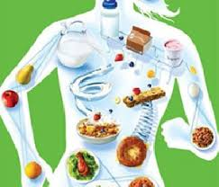
Case study
انرژی مورد نیاز این فرد جهت کاهش وزن به میزان 9 کیلوگرم در مدت سه ماه
2100 = 750 - 2850
kcal

Slide 11
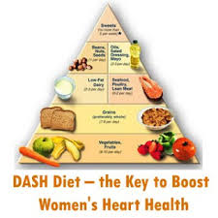
DASH diet and obesity
Gadgil MD. Diabetes Care. 2013 ;36(5):1132-7.

Slide 12
Case study
محاسبه گرم درشت مغذی ها بر اساس میزان انرژی دریافتی روزانه 2100 کیلوکالری
252 گرم کربوهیدرات = 4 ÷ 1008 = 48 × 2100
131 گرم پروتئین = 4 ÷ 525= 25× 2100
63 گرم چربی= 9 ÷ 567= 27× 2100
30 گرم چربی= 9 ÷ 273= 13× 2100
18 گرم چربی= 9 ÷ 168= 8× 2100
14 گرم چربی= 9 ÷ 126= 6× 2100

Slide 13
Case study
محاسبه تعداد واحدهای مورد نیاز برای این فرد
تعداد واحد مورد نیاز | کل انرژی دریافتی | چربی | پروتئین | کربوهیدرات | گروه غذایی
3 واحد | 240 = 120 × 2 | 10 = 5 × 2 | 16 = 8 × 2 | 36 = 12 × 3 | شیر و لبنیات
5 واحد | 240 = 60 × 4 | ------ | ---- | 75= 15 × 5 | میوه
5 واحد | 125 = 25 × 5 | ---- | 10 = 2 × 5 | 25 = 5 × 5 | سبزیجات
 |  |  |  | 136= 24 + 60 + 25 116 = 136 – 252
7 واحد | 560 = 80 × 7 | ----- | 21 = 7 × 3 | 7 = 15÷ 116 | غلات

Slide 14
Case study
محاسبه تعداد واحدهای مورد نیاز برای این فرد
 |  |  | 47 = 16 + 10 + 21 84 = 47 - 131
12 واحد | 660 = 12 × 55 | 36 = 12 × 3 | 12= 7 ÷ 84 | ------ | گوشت و ماهی و ماکیان، مغزها و حبوبات
 |  | 46 = 36 + 10 17 = 46 - 63
4 | 180 = 4 × 45 | 4 = 5÷ 17 |  |  | چربی ها
 | 2000

Slide 15
Gadgil MD. Diabetes Care. 2013 ;36(5):1132-7.

Slide 16
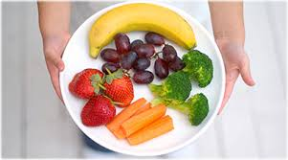
DASH diet and obesity
What makes the OmniHeart diet potent?
10 daily servings of fruits and vegetables
2 servings of low-fat dairy foods
4 or 5 servings of grains (bread, pasta, rice, etc.).
Gadgil MD. Diabetes Care. 2013 ;36(5):1132-7.

Slide 17
توزیع مناسب واحدهای توصیه شده گروه های غذایی در یک روز
قبل از خواب | شام | عصرانه | ناهار | نیم چاشت | صبحانه | تعداد واحدها
1 |  |  | 1 |  | 1 | 3 | شیر و لبنیات کم چرب
1 |  | 2 |  | 2 |  | 5 | میوه ها
 | 2 |  | 3 |  |  | 5 | سبزی ها
 |  |  |  |  | 1 | 1 | قند، شکر، عسل و مربا
 | 2 |  | 2 |  | 2 | 6 | نان و غلات
 |  |  | 3 |  | 1 | 4 | گوشت لخم، ماکیان و ماهی و پنیر

Slide 18
توزیع مناسب واحدهای توصیه شده گروه های غذایی در یک روز
قبل از خواب | شام | عصرانه | ناهار | نیم چاشت | صبحانه | تعداد واحدها
1 |  |  |  | 1 | 2 | 3 | مغزها
 |  | 1 | 1 |  | 1 | 3 | دانه ها
 | 2 |  |  |  |  | 2 | حبوبات
 | 2 |  | 2 |  |  | 4 | چربی و روغن ها

Slide 19
Weight management
Diet therapy
Glycemic index and glycemic load, dietary fiber and whole grains
Dietary guideline for American 2011

Slide 20
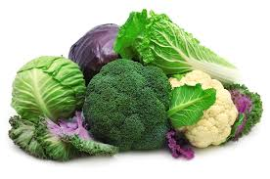
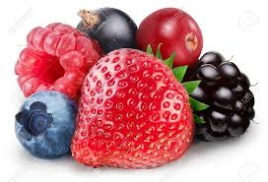

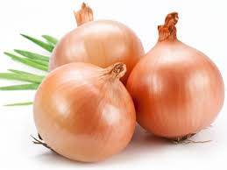
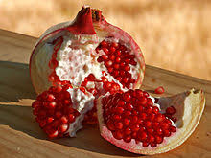
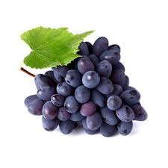
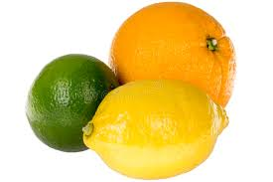
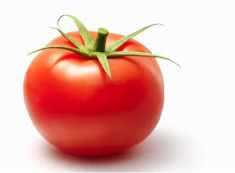
Dietary Inflammatory Index (DII) and obesity
1. CONSUME AN ABUNDANCE OF FRUITS,VEGETABLES, HERBS AND SPICES
The most anti-inflammatory fruit and vegetables:
Cruciferous vegetables, onions, berries, purple grapes, cherries, citrus fruits, tomatoes, and pomegranates

Slide 21
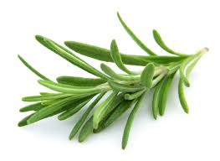
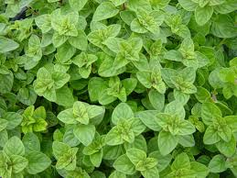
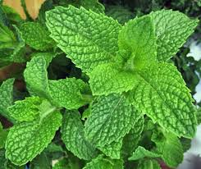

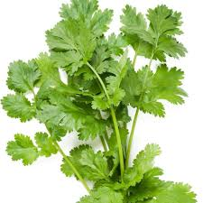
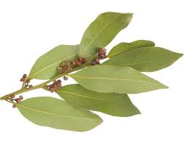
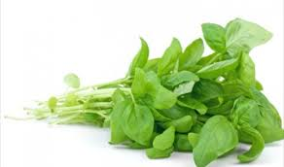
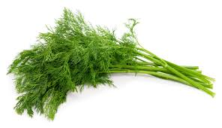
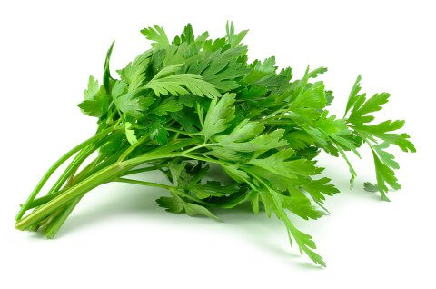
Dietary Inflammatory Index (DII) and obesity
1. CONSUME AN ABUNDANCE OF FRUITS,VEGETABLES, HERBS AND SPICES
The most anti-inflammatory fruit and vegetables:
rosemary, oregano, mint, coriander, parsley, sage, dill, Bay leaf, and basil.

Slide 22
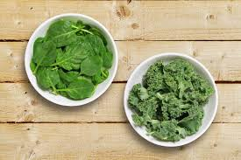
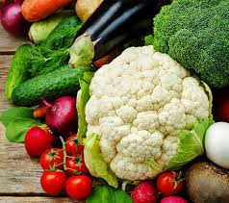
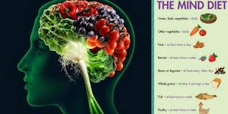
10 Foods to Eat on the MIND Diet
MIND diet and obsity
1) Green, leafy vegetables
Six or more servings per week
Includes kale, spinach, cooked greens and salads
2) All other vegetables
Try to eat another vegetable in addition to the green leafy vegetables at least once a day.
It is best to choose non-starchy vegetables because they have a lot of nutrients with a low number of calories

Slide 23
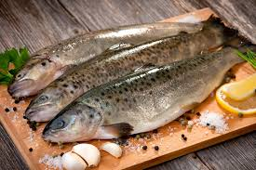
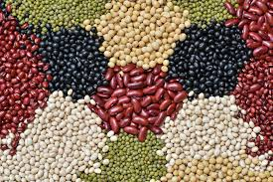
10 Foods to Eat on the MIND Diet
MIND diet and obsity
7) Fish
Eat fish at least once a week
It is best to choose fatty fish like salmon, sardines, trout, tuna and mackerel for their high amounts of omega-3 fatty acids.
8) Beans
Include beans in at least four meals every week
This includes all beans, lentils and soybeans.

Slide 24
برنامه غذایی یک روز آقای م.ع
یک قاشق مربا خوری شیره انگور+ یک قاشق مرباخوری ارده+ 2 کف دست نان سنگگ یک لیوان شیر یک قوطی کبریت پنیر+ 2 عدد گردو | صبحانه: ساعت 30: 7
2 واحد میوه فصل + 10 عدد پسته | نیم چاشت: 00: 10
زرشک پلو : 10 قاشق غذاخوری برنج + نصف سینه مرغ + یک کاسه ماست خوری ماست به همراه نصف قاشق غذاخوری نعنای خشک + یک قاشق غذاخوری روغن آفتابگردان سالاد : یک لیوان کاهو + ا عدد خیار + یک عدد گوجه + یک قاشق غذاخوری کنجد + 1 قاشق غذاخوری روغن زیتون | ناهار: 30: 12
دو واحد میوه فصل + یک قاشق غذاخوری تخمه آفتابگردان | عصرانه: 30: 6
خوراک لوبیا: 2 کف دست نان + یک لیوان لوبیای پخته شده + 2 قاشق غذاخوری روغن گلزا 2 بشقاب کوچک سبزی خوردن | شام: 30: 8
یک واحد میوه + یک کاسه ماست خوری میوه+ 6 عدد بادام | قبل از خواب: 00 : 10

Slide 25

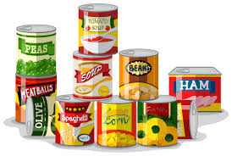
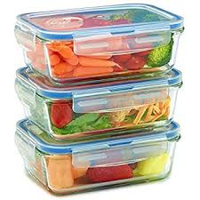
7. AVOID CHEMICALS
Dietary Inflammatory Index (DII) and obesity
Many industrial chemicals and pesticides can irritate or disrupt the immune system and cause inflammation
Choose organic or low pesticide foods and “green” personal care and cleaning products to reduce exposure.
Many canned foods contain bisphenol A in their linings.
Bisphenol A (aka “BPA”), which is also found in many plastic bottles and food containers, is an endocrine disruptor, impairs the action of insulin in the body, and up-regulates inflammatory pathways.
Seek out “BPA-Free” cans, and use glass containers and bottles as often as possible.

Slide 26


8. STRESS AND SLEEP
Dietary Inflammatory Index (DII) and obesity
High stress levels and lack of adequate sleep are both associated with inflammation.
Elevated circulating cortisol levels found under conditions of psychological stress are associated with elevated inflammatory cytokines.
Sustained sleep restriction has also been associated with an inflammatory state and an elevation of TNF- a, IL -1b, IL-2, IL-4 and monocyte chemo-attractant protein-1 (MCP-1).
Intentionally practicing stress reduction techniques such as meditation has been shown to reduce the inflammatory response in human experimental models

Slide 27
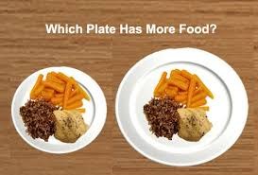
In the Look AHEAD study, weight loss strategies associated with lower BMI in overweight or obese individuals :
Weekly self weighing
Regular consumption of breakfast
Reduced intake of fast foods
Increasing physical activity
Reducing portion sizes
Using meal replacements (as appropriate)
Encouraging individuals to eat those foods with the greatest consensus for improving health
Emphasizing a variety of nutrient dense foods in appropriate portion sizes
American Diabetes Association. Diabetes care 2017; 40: S57-S63.

Slide 28
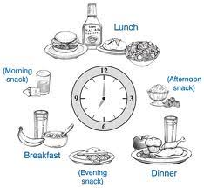
Eat frequent meals
Strategies for weight management
Eating five to six small meals: speed up your metabolism
Eating large meals only once or twice a day: slow down your metabolism.
American Diabetes Association. Diabetes care 2017; 40: S57-S63.

Slide 29

Eat frequent meals
Strategies for weight management
Don’t skip breakfast.
Fasting:
Activates the starvation response
Slowing your metabolism
Increasing the chances that excess fat will be stored to fuel your nutrient-depleted body.
Studies now show that women who eat cereal for breakfast maintained their weight better than those who skipped breakfast.
The plus of whole grain cereal is that it is a low-calorie, fiber-rich food.
American Diabetes Association. Diabetes care 2017; 40: S57-S63.

Slide 30

Increasing physical activity
Strategies for weight management
The U.S. Department of Health and Human Services’ physical activity guidelines for Americans:
Adults over age 18 years engage in 150 min/week of moderate-intensity or 75 min/week of vigorous-intensity aerobic physical activity, or an equivalent combination of the two.
Fortunately, studies show that long, brisk walks are very effective in losing weight.
In addition, the guidelines suggest that adults do muscle-strengthening activities that involve all major muscle 2 or more days/week.
Krause food nutrition and diet therapy, 14th Edittion, 2017

Slide 31

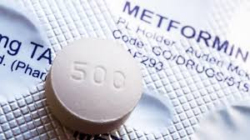
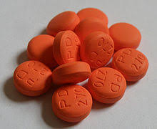


Evaluating pharmacological treatments
Strategies for weight management

Slide 32
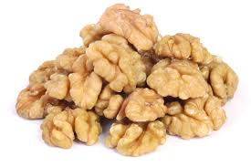
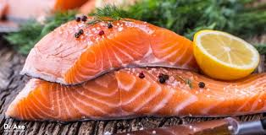
Weight management
Diet therapy
Omega-3 fatty acids
Evidence does not support recommending omega-3 (EPA and DHA) supplements for the prevention or treatment of cardiovascular events
As recommended for the general public, an increase in foods containing long-chain omega-3 fatty acids (EPA and DHA) (from fatty fish) and omega-3 linolenic acid (ALA) is recommended because of their beneficial effects on lipoproteins, prevention of heart disease, and associations with positive health outcomes
The recommendation for the general public to eat fish (particularly fatty fish) at least two times (two servings) per week is also appropriate
American Diabetes Association. Diabetes care 2017; 40: S57-S63.

Slide 33
Mediterranean diet and obesity
Feature of Mediterranean diet
Enjoying meals with family and friends
Getting plenty of exercise

Slide 34
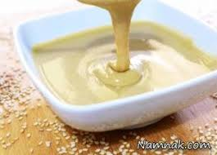
Mediterranean diet and obesity
FAT and OILS
Try olive or canola oil as a healthy replacement for butter or margarine
Use it in cooking
Dip bread in flavored olive oil or lightly spread it on whole-grain bread for a tasty alternative to butter.
Try tahini as a dip or spread
Mediterranean-style diet rich in monounsaturated fats can be an effective alternative to a diet low in total fat but relatively high in carbohydrates.
The type of fats consumed is more important than total amount of fat when looking at metabolic goals and CVD risk

Slide 35
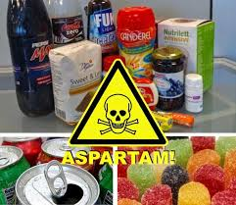
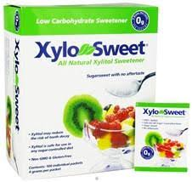
Foods to AVOID when treating obesity:
Weight management
All foods containing refined sugar or synthetic sugar-substitutes such as aspartame, Splenda®, etc.
These may actually contribute to weight gain, rather than aid in weight loss.
Studies now show that artificial sweeteners trick the body into associating sweetness with zero calories.
As a result, there’s a tendency to splurge on the “real thing,” because the body loses its ability to associate sweetness with a sense of fullness.
Choose a natural sweetener like Xylosweet instead.

Slide 36
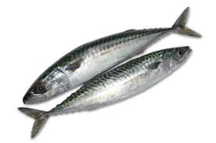


Foods to AVOID when treating obesity:
Weight management
Carbonated soft drinks that cause blood pH levels to become acidic
Bottom crawlers such as oysters, clams, and lobster that may contain toxic levels of mercury.
Deep-sea fish such as tuna, mackerel, and swordfish that may contain toxic levels of mercury. Choose minimal-mercury tuna instead.
Farm-raised fish that contain PCBs and not enough omega-3 essential fatty acids, due to their land-based diets. Choose wild-caught salmon instead.

Slide 37

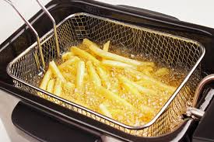
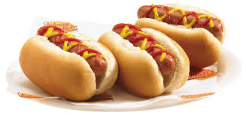
Foods to AVOID when treating obesity:
Weight management
Sodium nitrite found in processed foods such as hot dogs, lunch meats, and bacon
Monosodium glutamate (MSG) found in many foods as a flavor enhancer
Hydrogenated or partially hydrogenated oils (trans fats) found in many processed foods, deep-fried foods, fast foods, and junk food.
Excessive caffeine intake. While moderate amounts of caffeine may be beneficial in boosting metabolism, excessive caffeine consumption can disrupt the body’s systems, causing insomnia and digestive irregularity (constipation or diarrhea).

Slide 38


Dietary tips for combating obesity:
Skip the low-fat food products
Most of the low-fat, processed foods in grocery stores: Typically high-carb foods that are loaded with sugar, salt, artificial sweeteners, and synthetic fat substitutes.
Many of these ingredients cause weight gain, rather than reduce it.

Slide 39


Dietary tips for combating obesity:
Watch out for fruit juices
They often contain added sugars that can increase your calorie intake dramatically.
Opt for water, or diluted fruit juice (three quarters water and one quarter juice).

Slide 40

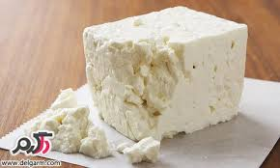
MIND diet and obsity
5 Foods to Avoid on the MIND Diet
Butter and margarine
Try to eat less than 1 tablespoon (about 14 grams) daily
Instead, try using olive oil as your primary cooking fat, and dipping your bread in olive oil with herbs.
2) Cheese
limiting your cheese consumption to less than once per week

Slide 41
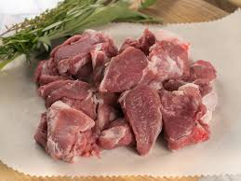
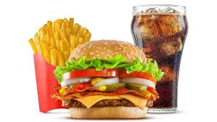
MIND diet and obsity
5 Foods to Avoid on the MIND Diet
3) Red meat
Aim for no more than three servings each week
4) Fried food
Discourages fried food, especially the kind from fast-food restaurants
Limit your consumption to less than once per week.

Slide 42
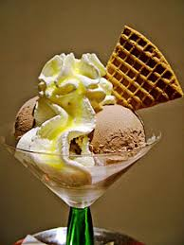

MIND diet and obsity
5 Foods to Avoid on the MIND Diet
5) Pastries and sweets
This includes most of the processed junk food and desserts you can think of. Ice cream, cookies, brownies, snack cakes, donuts, candy and more.
Try to limit these to no more than four times a week

Slide 43
از توجه شما سپاسگزارم

