Slide 1
in the name of God

Slide 2
Case Study
prepared by dr fatemeh kokabeh
19/2/1400

Slide 3
ID:
Patient: 16 years old man (17/5/85)
born in tehran, live in malard
he is a student
Source of history:patient’s mather ,reliable
cc: Known case of CAH, referral to investigate the cause of hypokalemia

Slide 4
PI:
A 16 year old man ,known case of CAH of 4 that :
Pre-diagnosis history(Before 4)
PLAN
History from birth to diagnosis
History at birth
Premature newborn (35w+2d) Birth weight:2/2kg Birth height:44cm C/S History of respiratory distress and intubation and hospitalization of NICU
Due to genital hyperpigmentation request cortisol and 17 oH progesterone
Height taller than peers
Extra hair under two years
Change the tone of voice from the age of three History of recurrent infections

Slide 5
PI:
At the age of 4, following a mumps infection, they referred to a pediatrician, who referred them to the pediatric endocrinologist, and the following measures:
Symptoms when hospitalized?
P/E
LAB
Bp:140/90
w:27percentile‌ above 97%
H:127 percentile above 97% SDS:7
25/6/89
Hyperpigmentation and tall and puberty from 3 years old
4
BS:84_cortisol:2/9-
LH:0/8-FSH:0/9-
ACTH:140pg/ml
testestron:0/4ng/ml
TFT:NL
anderstandion:⅝ ng/ml
p3G2
test size:⅖ cm
17OHpro:8/1 ng/ml
Bone age:12 Y
NA:142,K:4/2

Slide 6
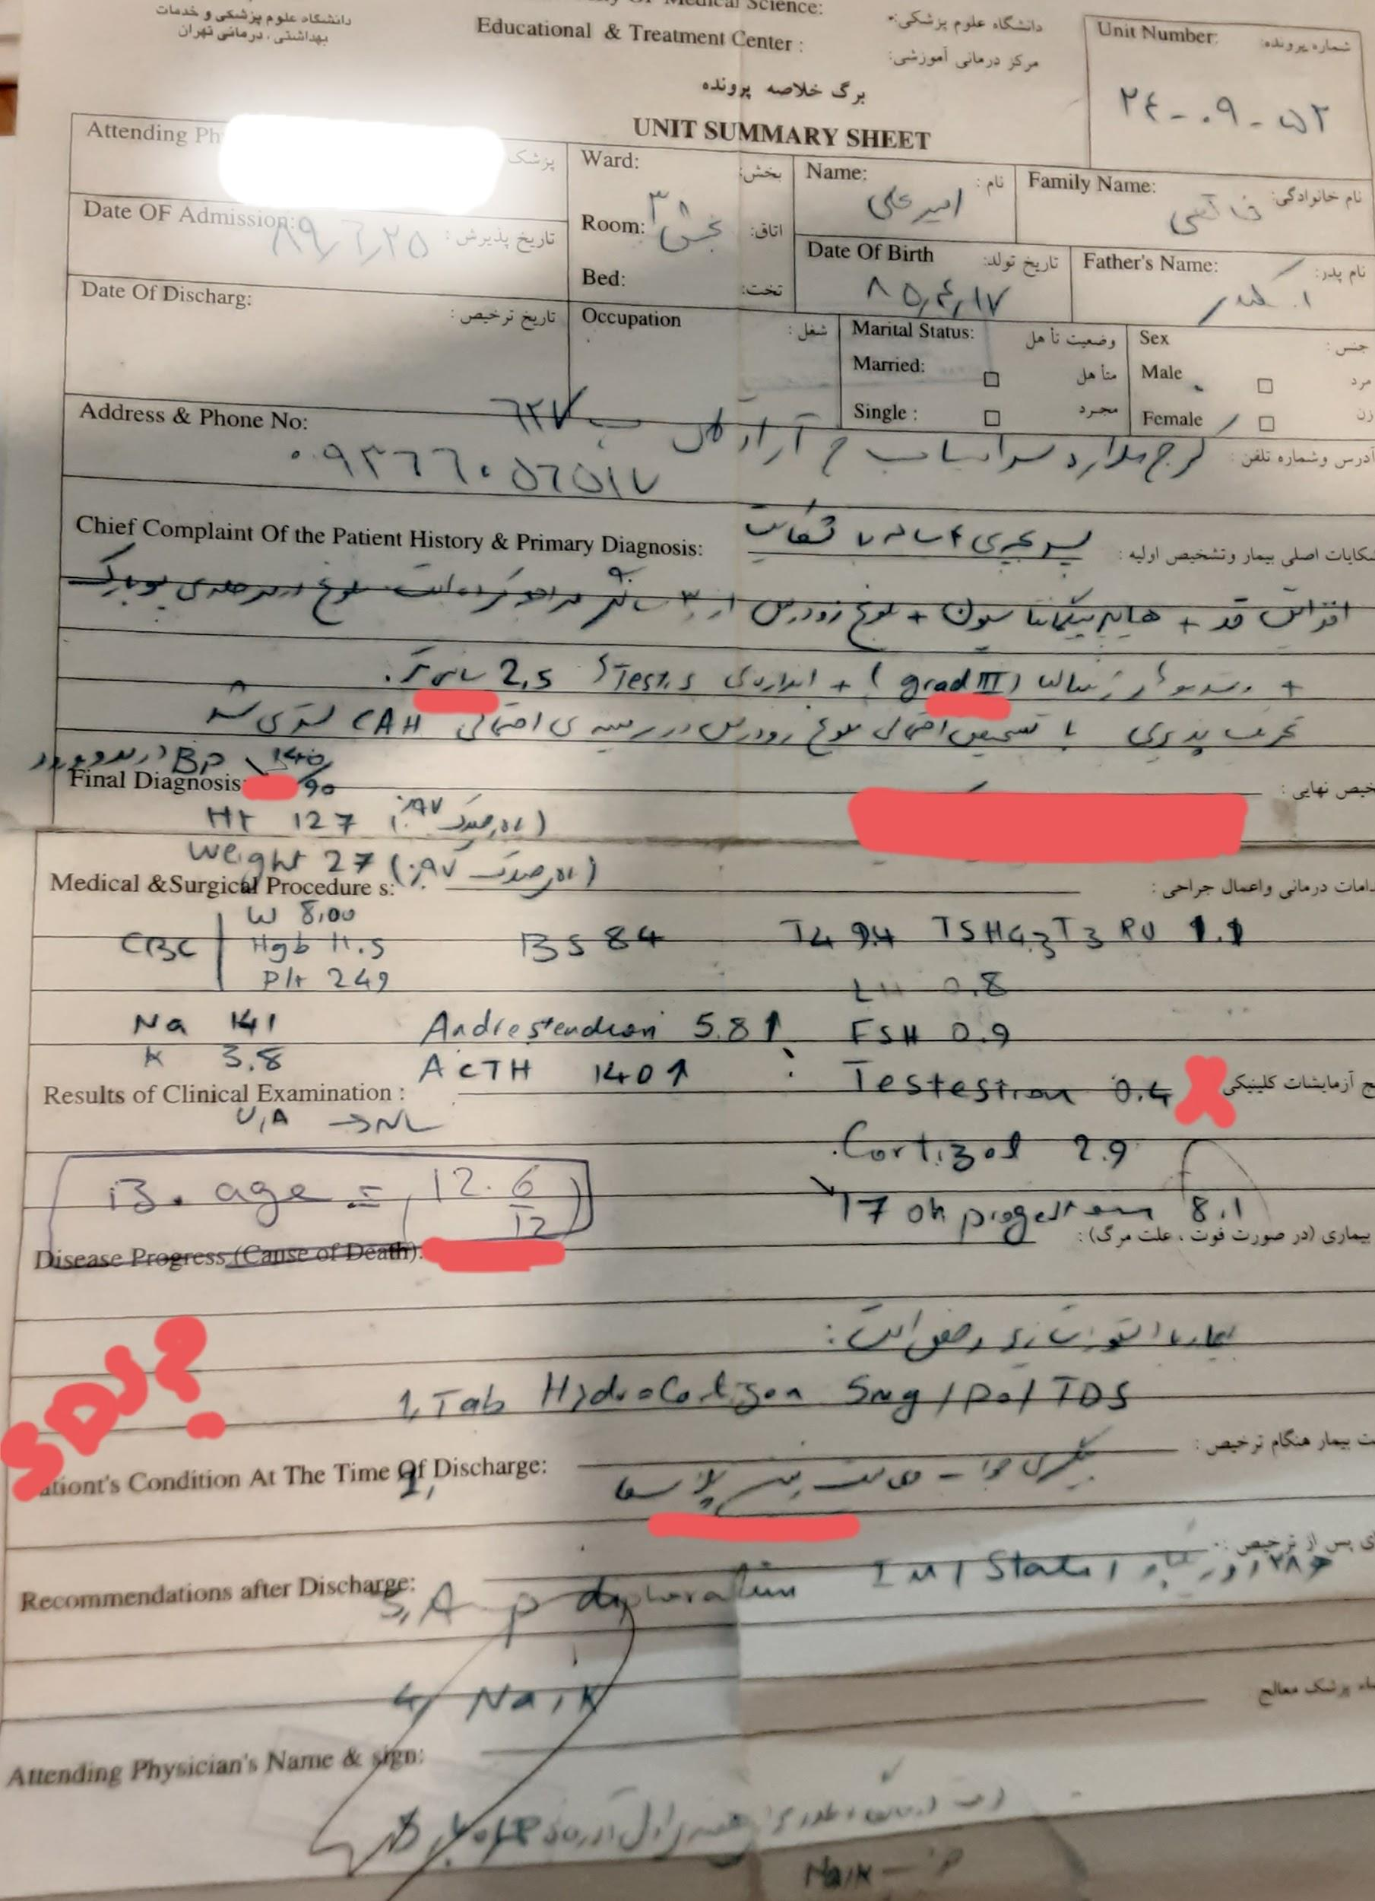

Slide 7
pmh:
History of recurrent infections in childhood
Multiple hospitalizations due to weakness and paresis
CAH

Slide 8
DH:
hydrocortisone
citrate potassium
HB:
neg
FH: neg

Slide 9
P/E
Young patient with normal appearance
V/S
BP:140/90
w:57
H:159/5
paternal h 179
maternal H:159
target H:175

Slide 10
P/E
genitalia :p5 G 5 without abnormality and hyperpigmantation +
skin :hyperpigmanted skin
skeletal force :5/5

Slide 11
Whats the diagnosis?
????????

Slide 12
Whats the diagnosis?
11 hydroxylase deficiency

Slide 13
PLAN:

Slide 14
What went wrong?(From diagnosis to treatment?)
?

Slide 15
FLOW UP

Slide 16
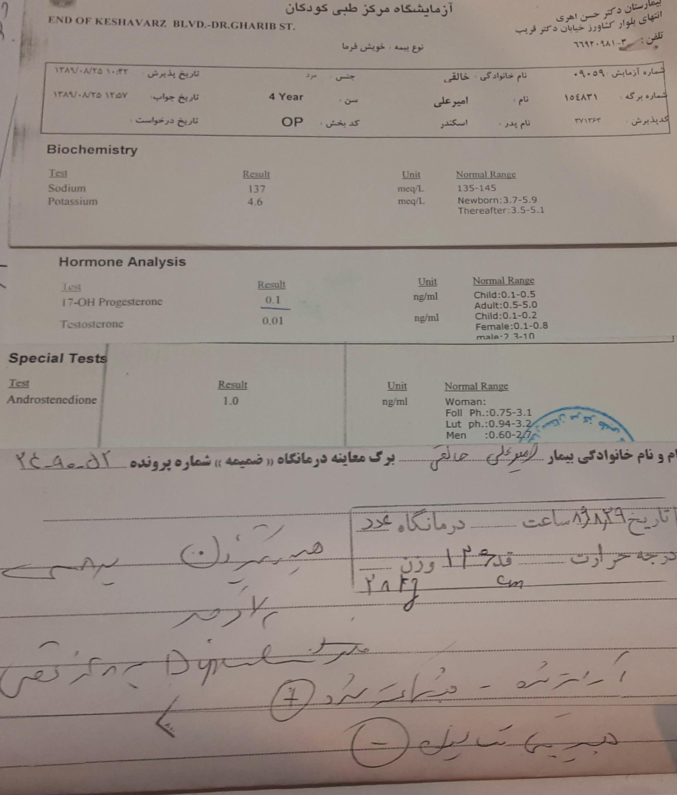
What went wrong?
?

Slide 17
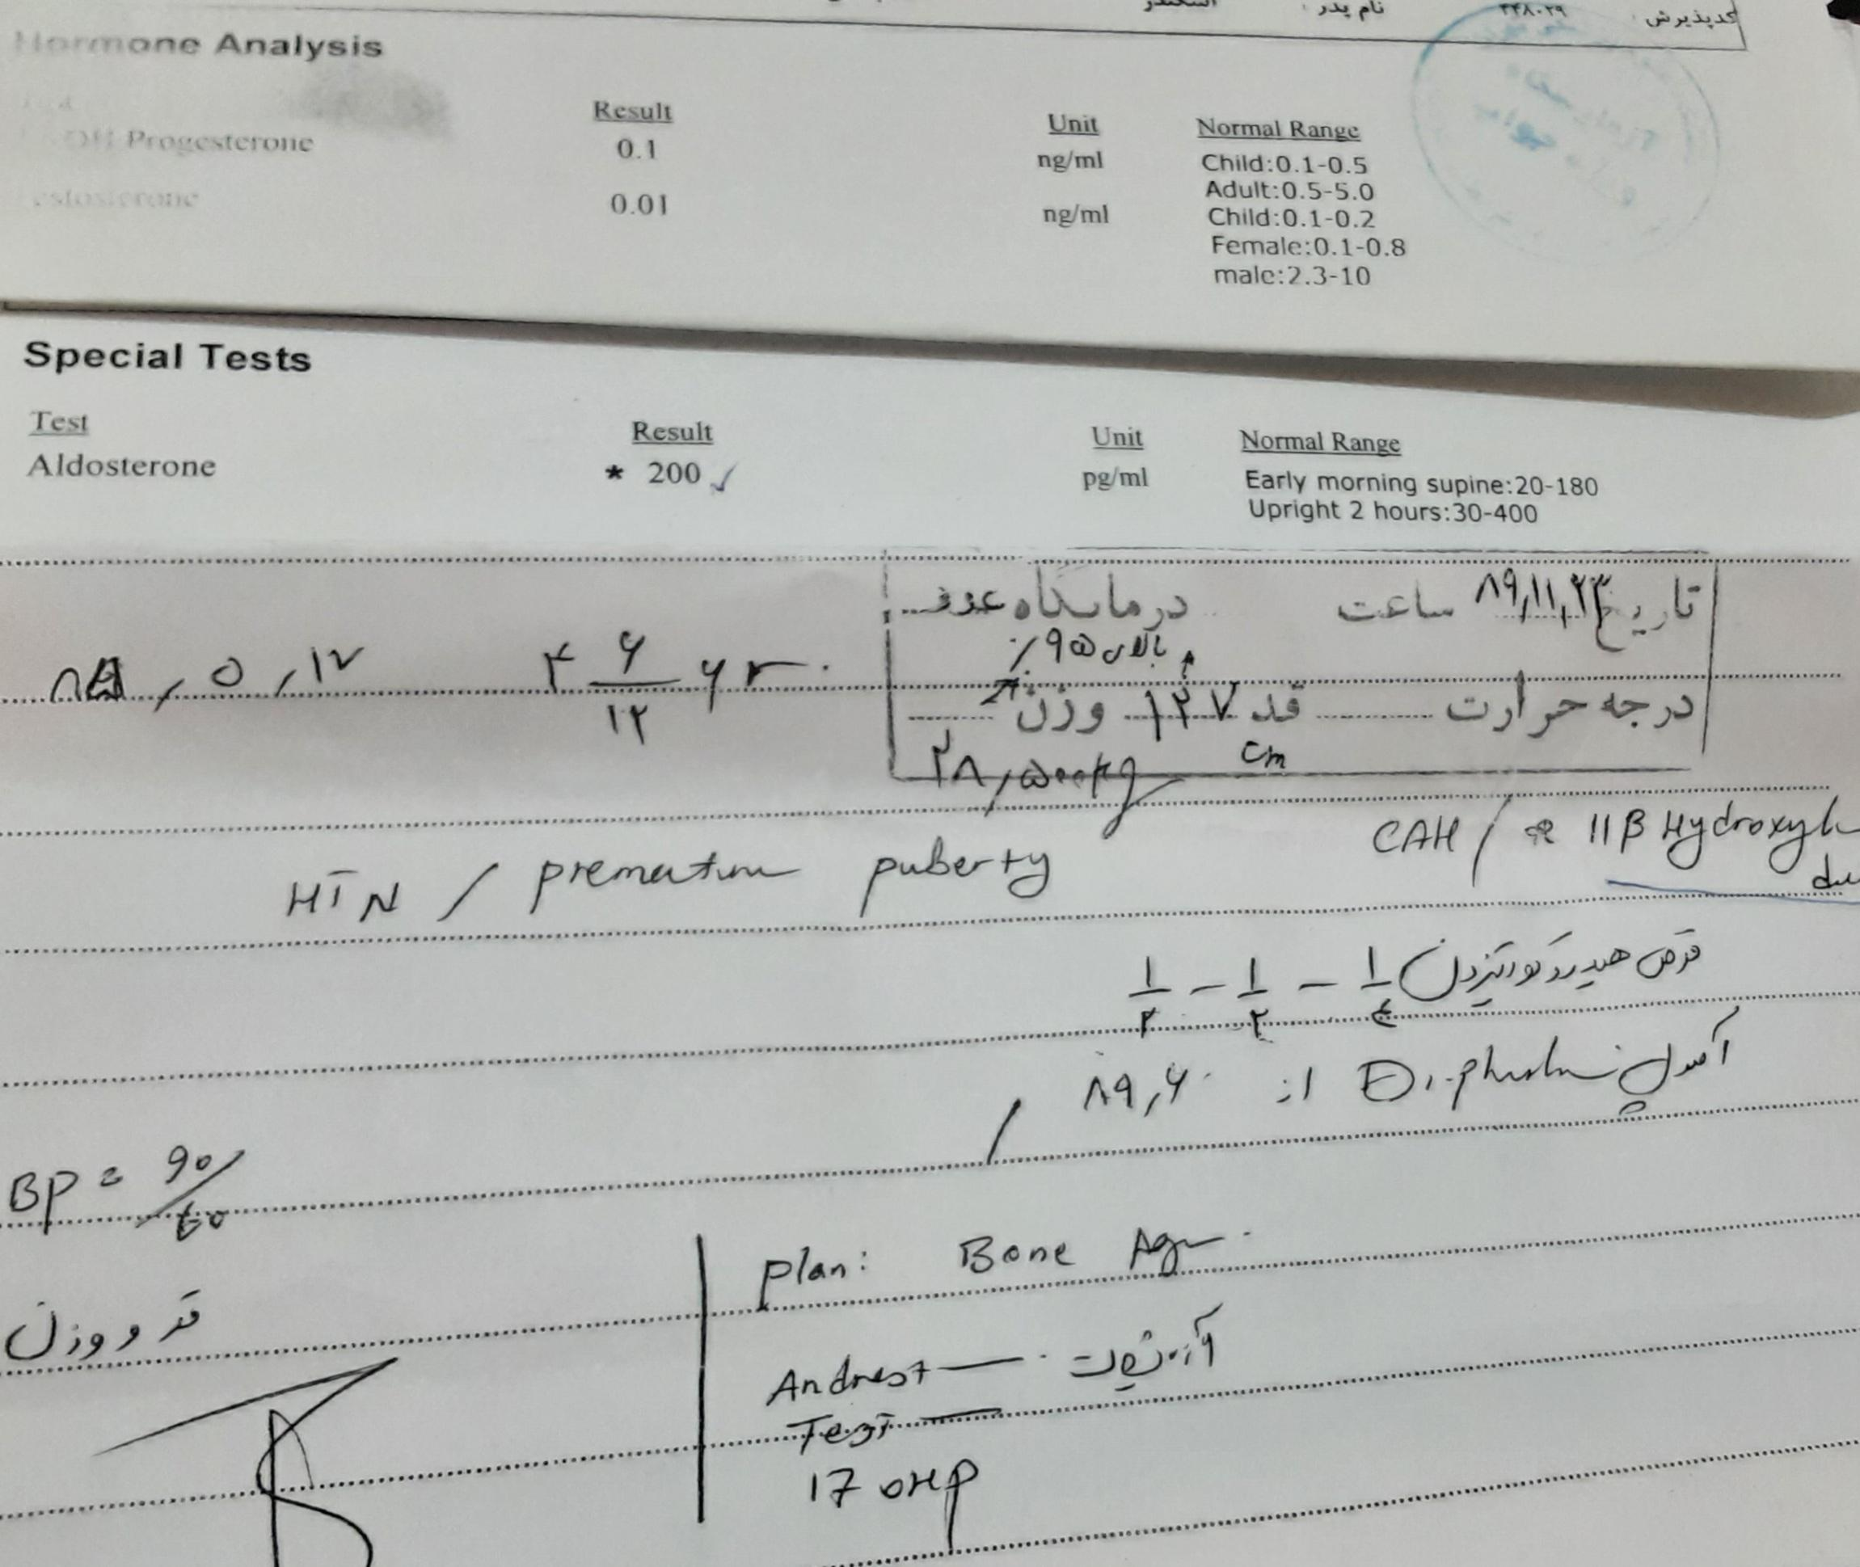
What went wrong?
?

Slide 18
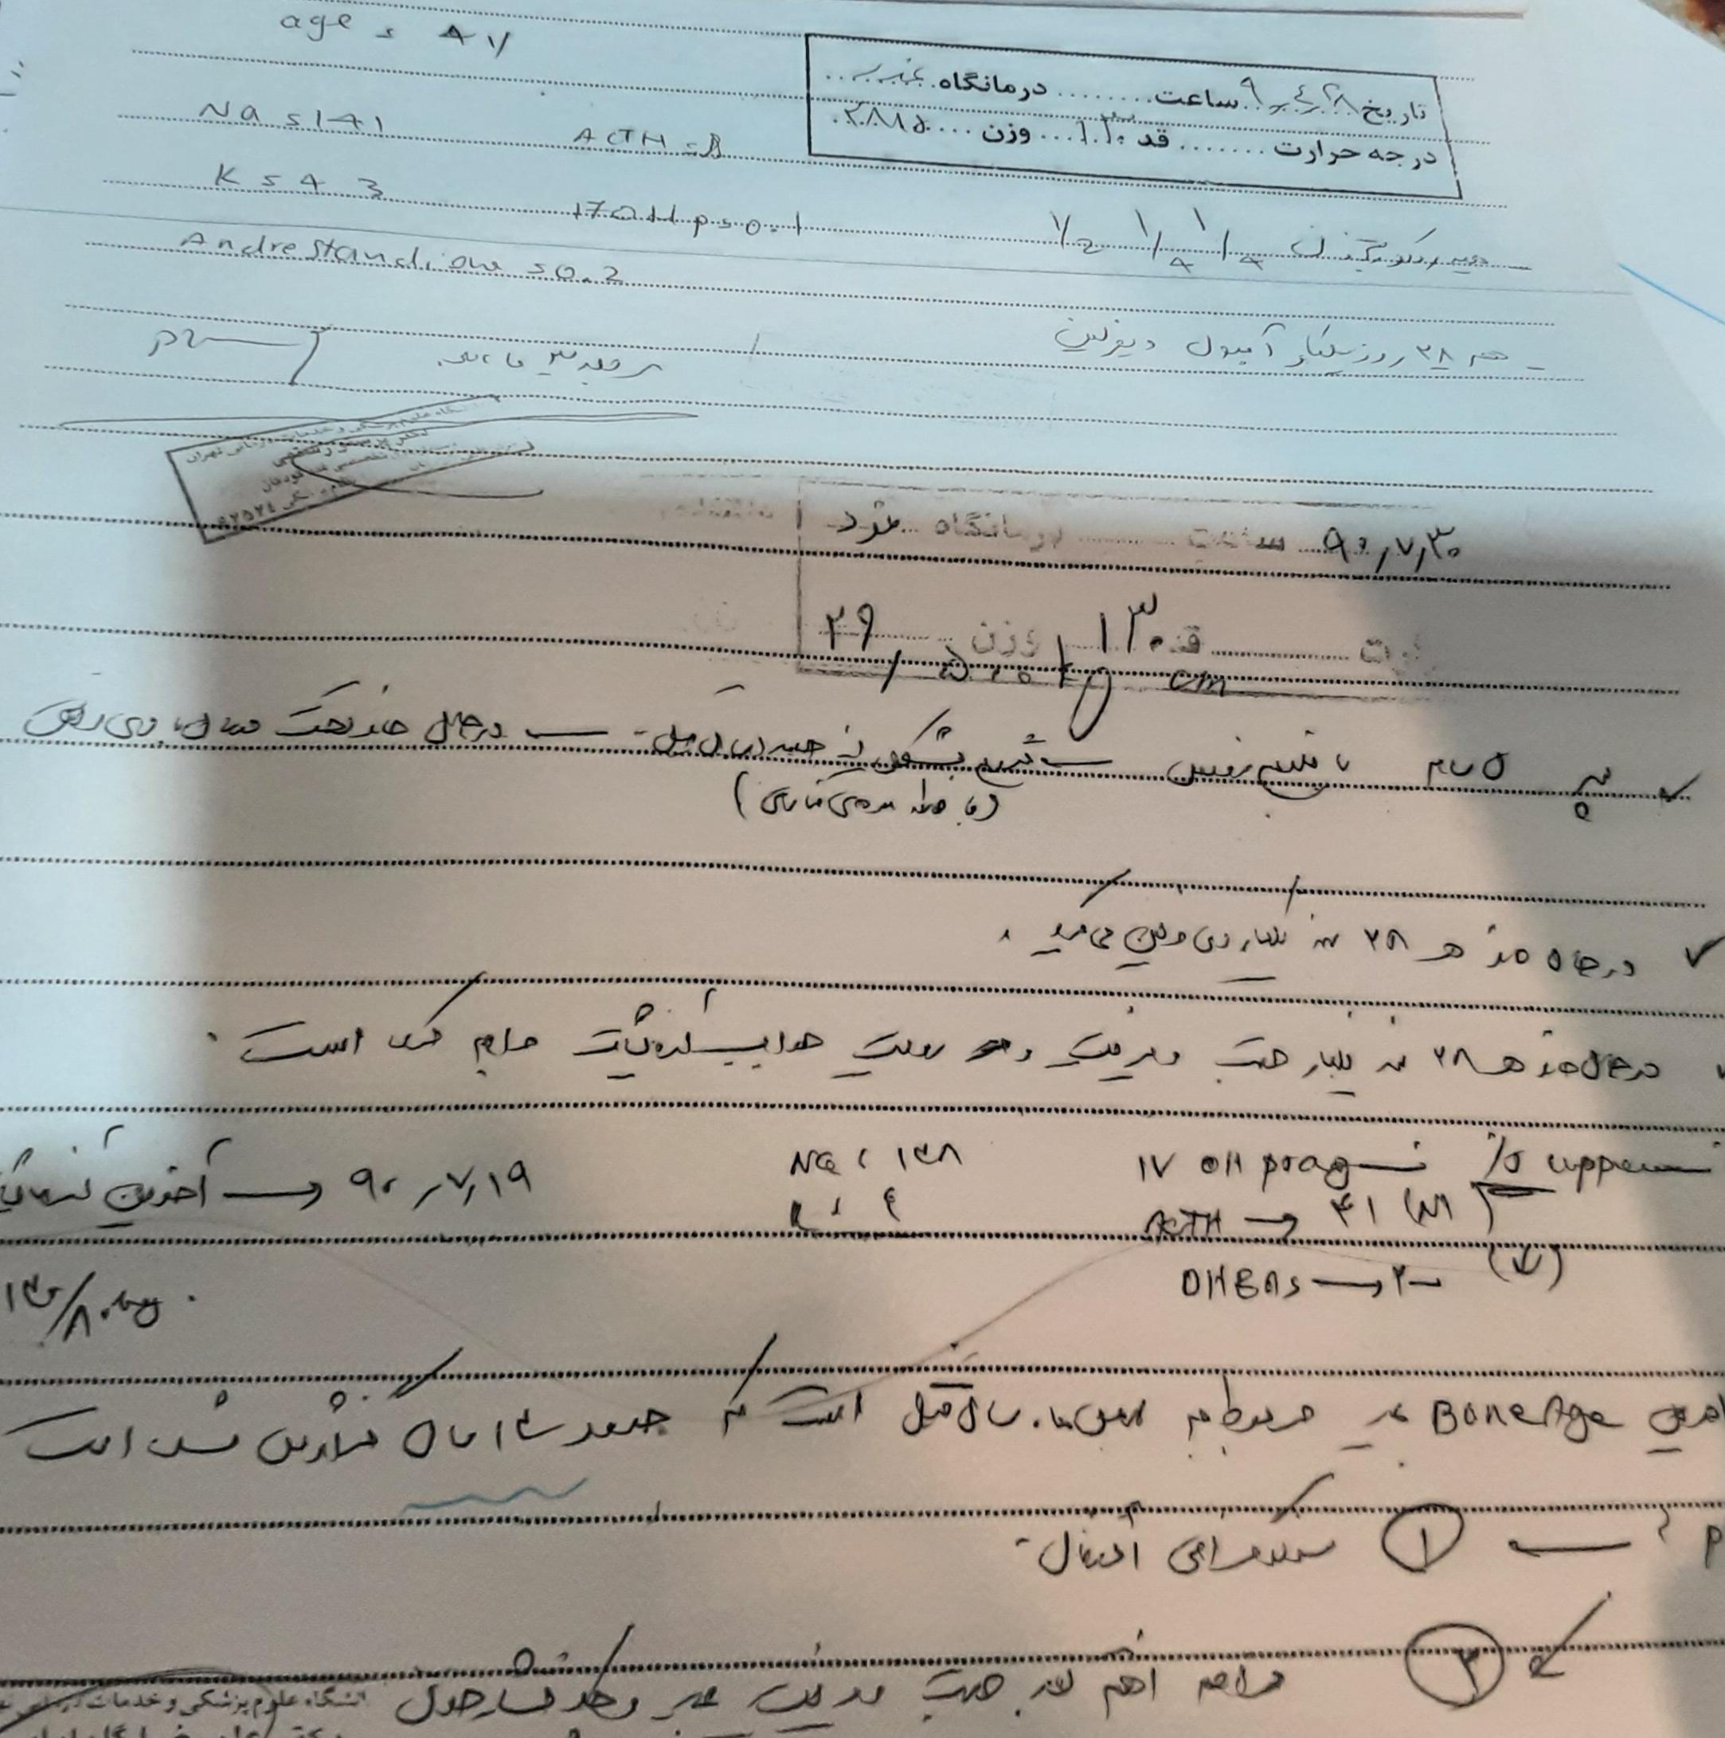
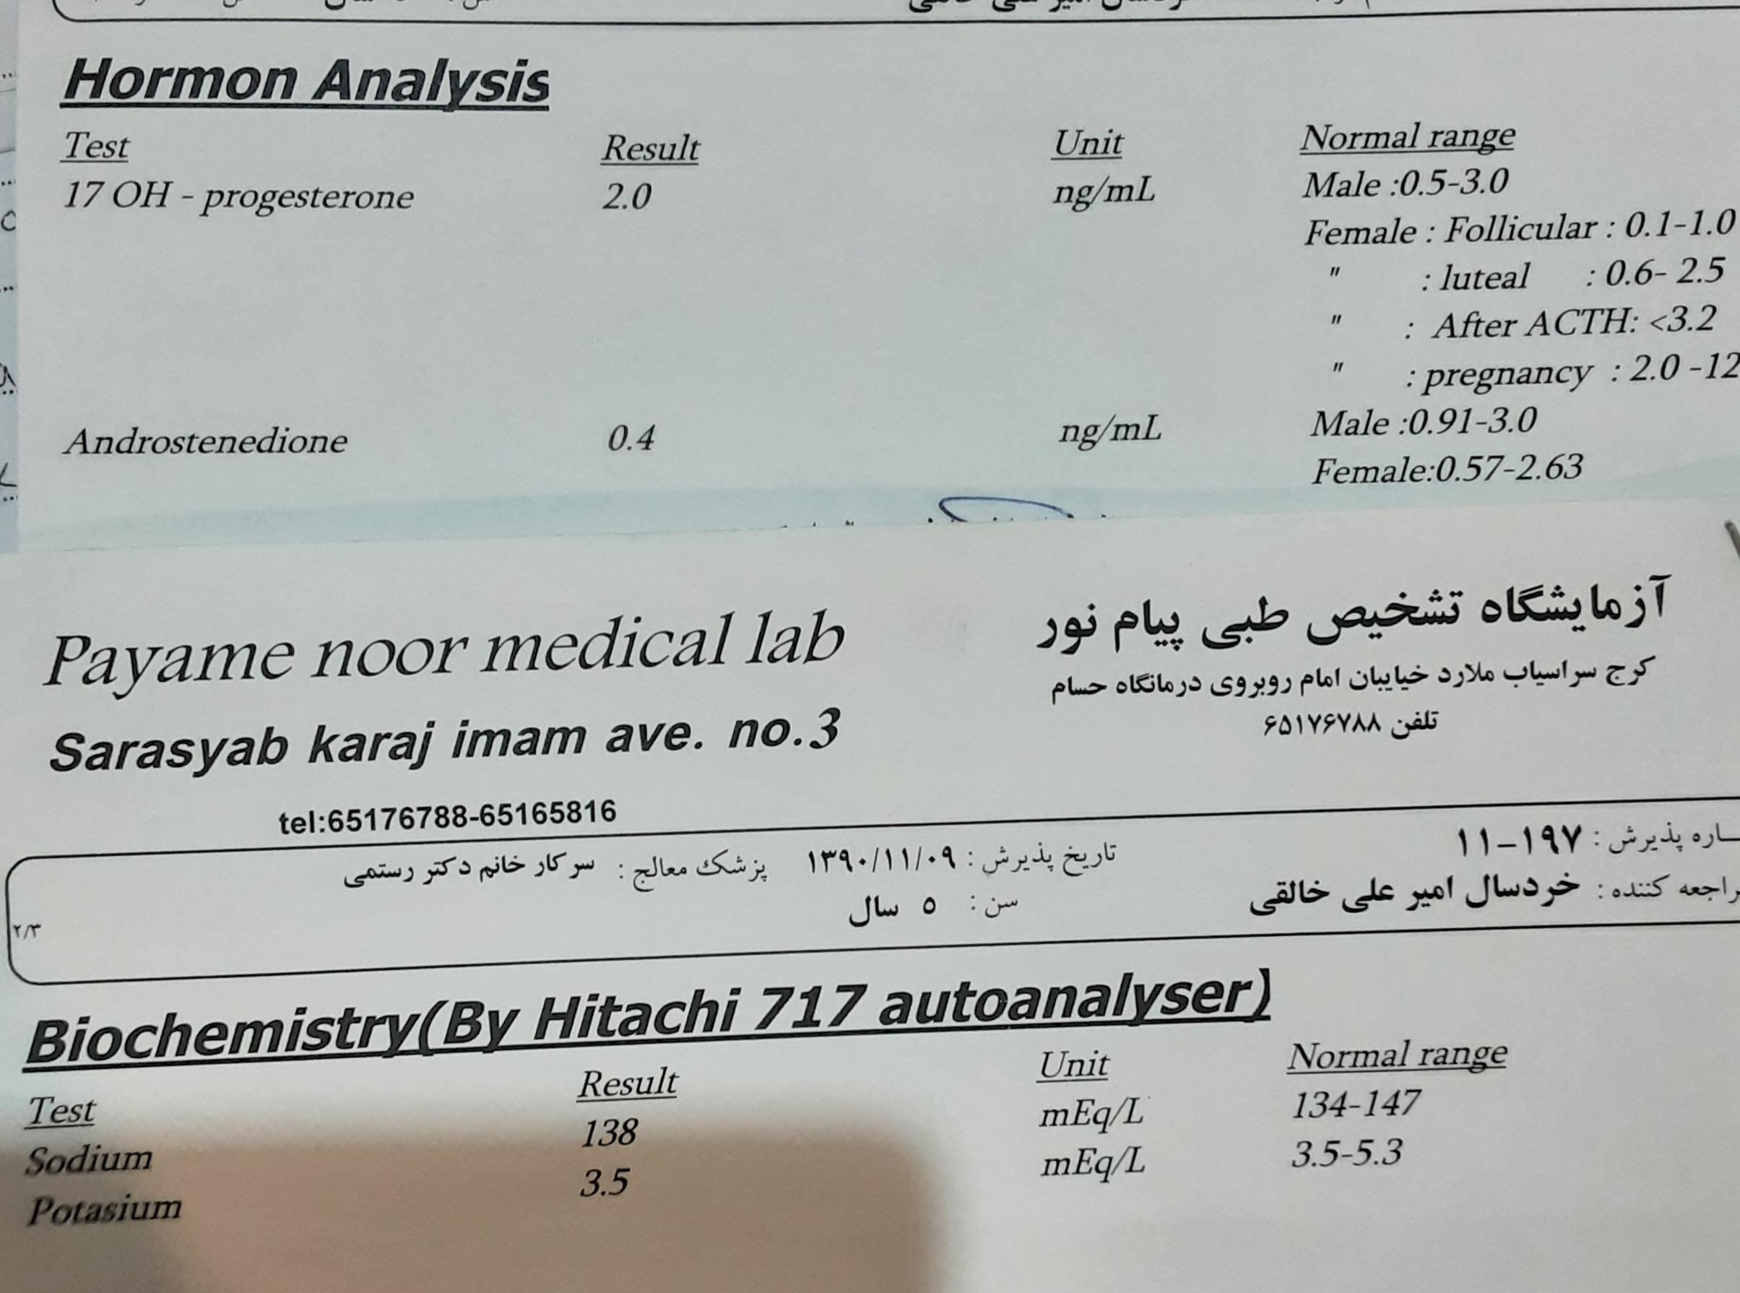
What went wrong?and 91 In the same way

Slide 19
Likewise, hydrocortisone and deferlin will continue until 1397 based on 17oHprogestron and ACTH

Slide 20
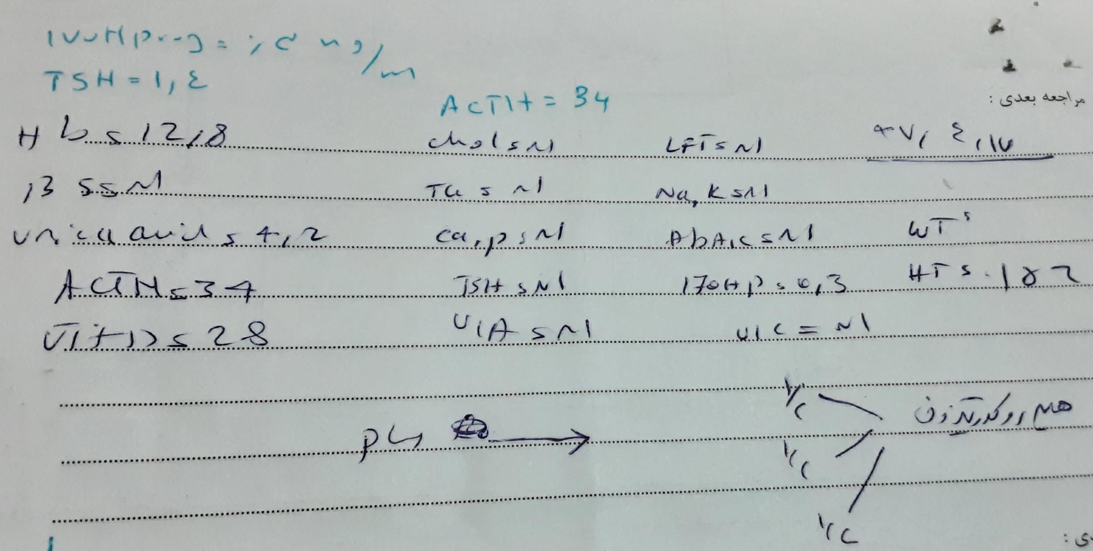
97:Deferlin was discontinued

Slide 21
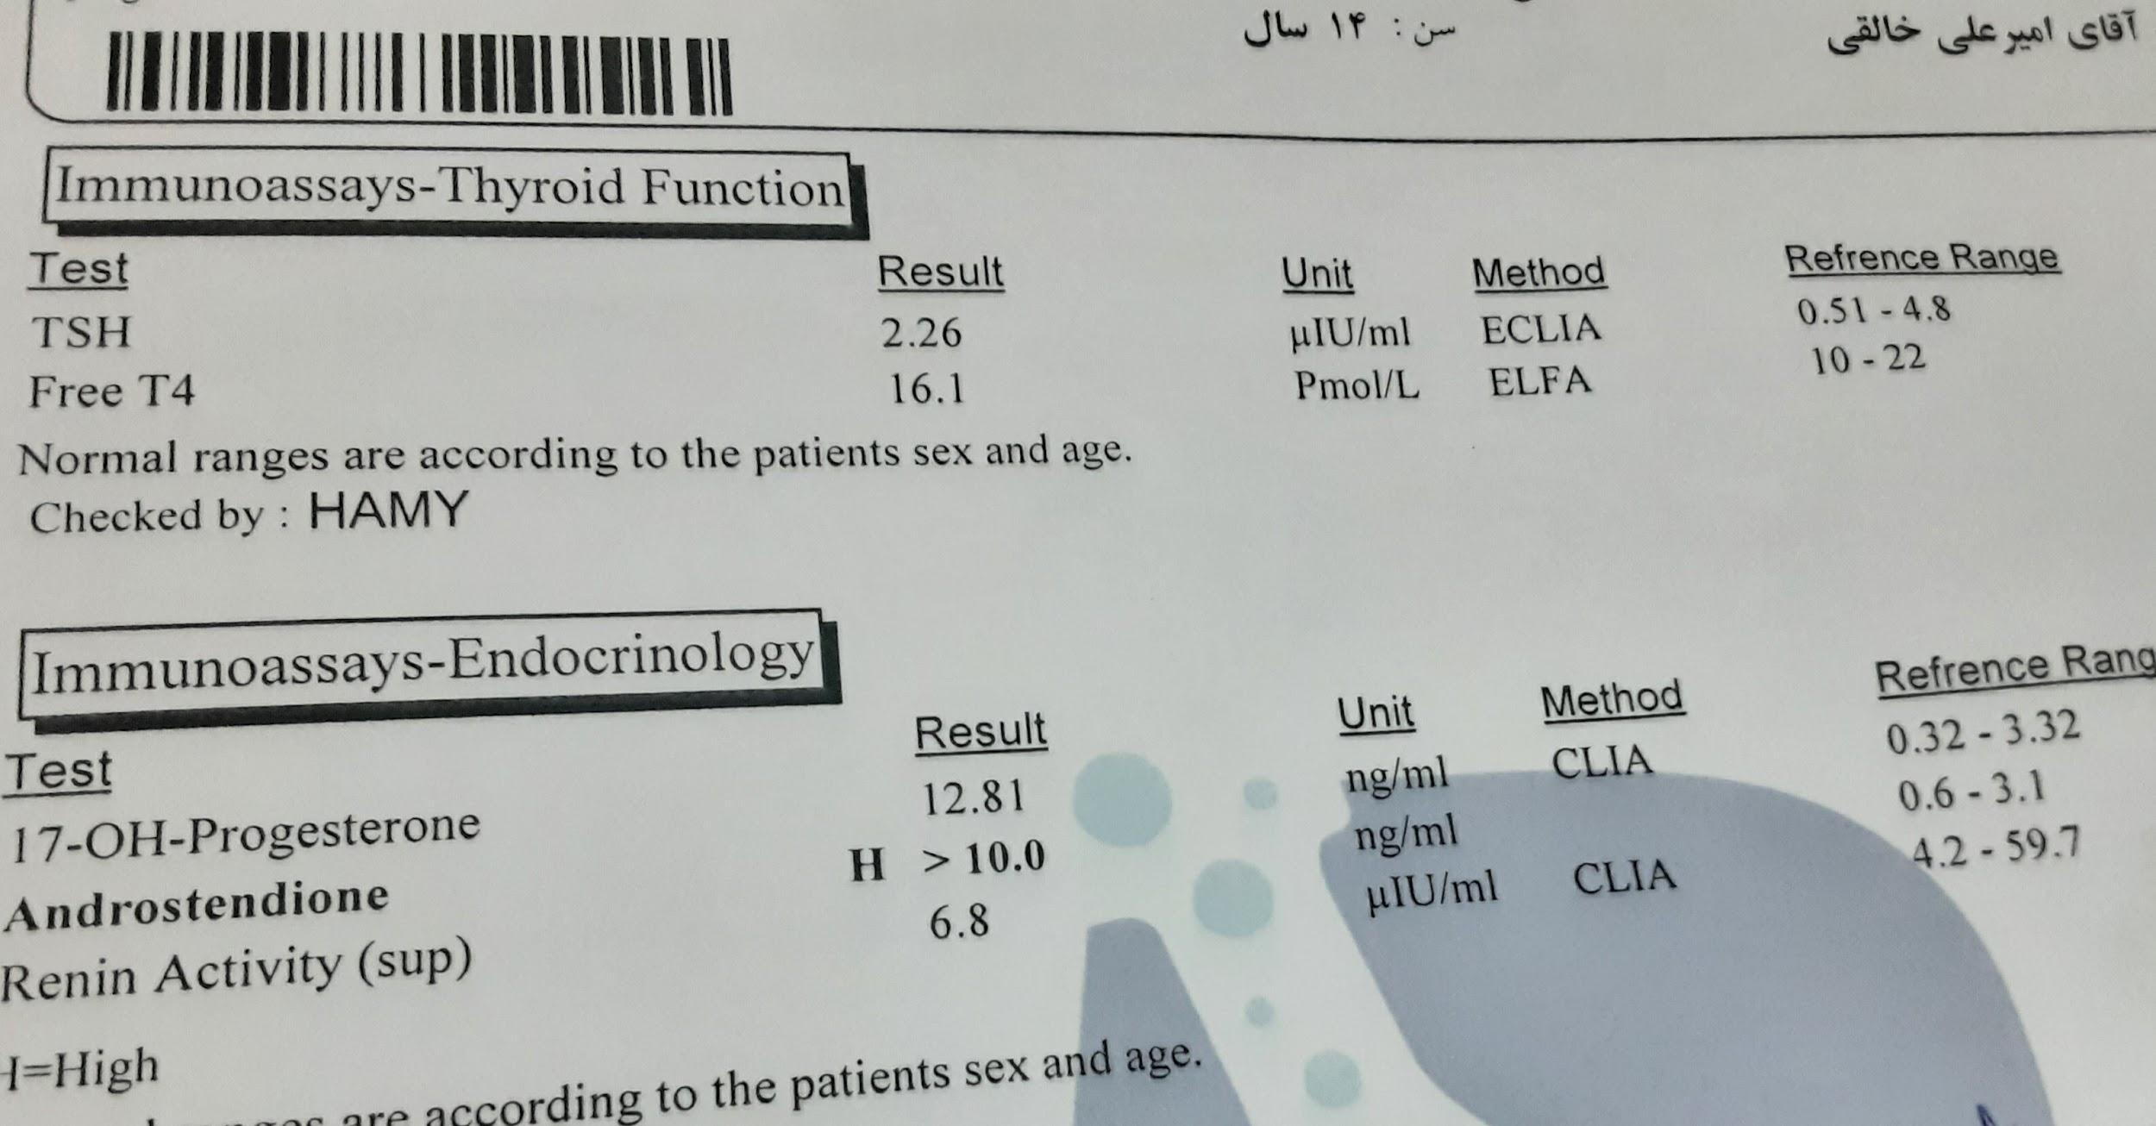
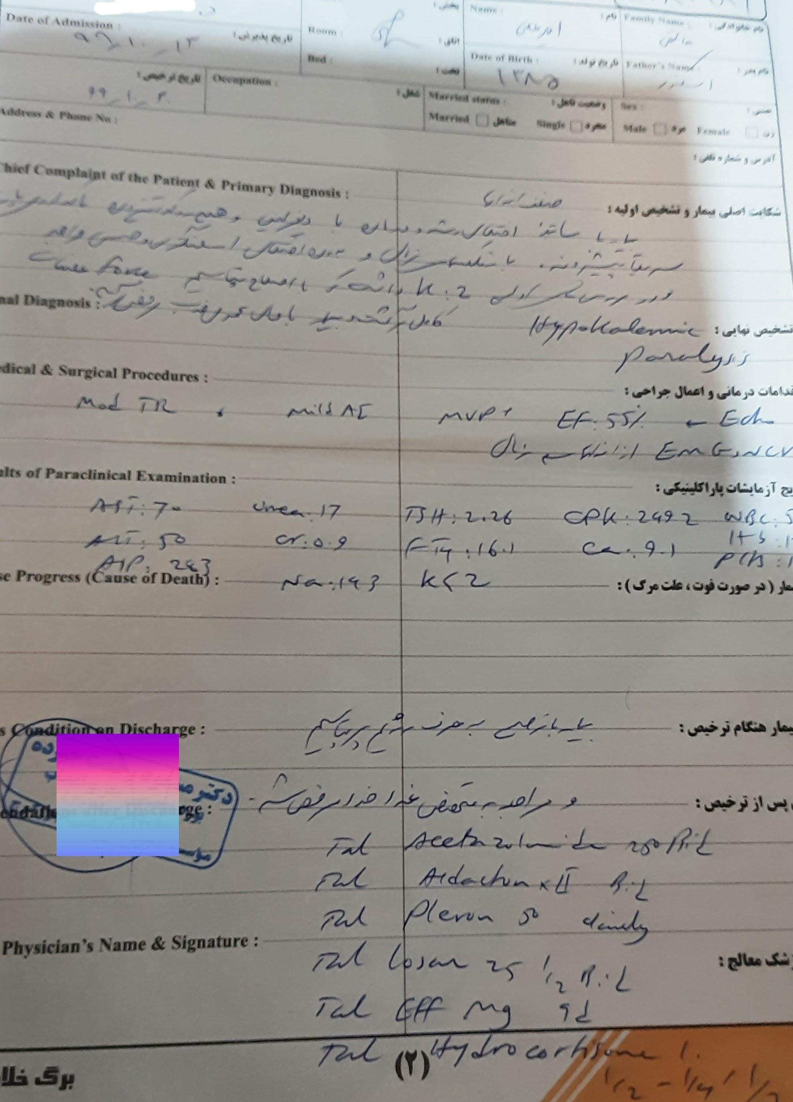
99

Slide 22
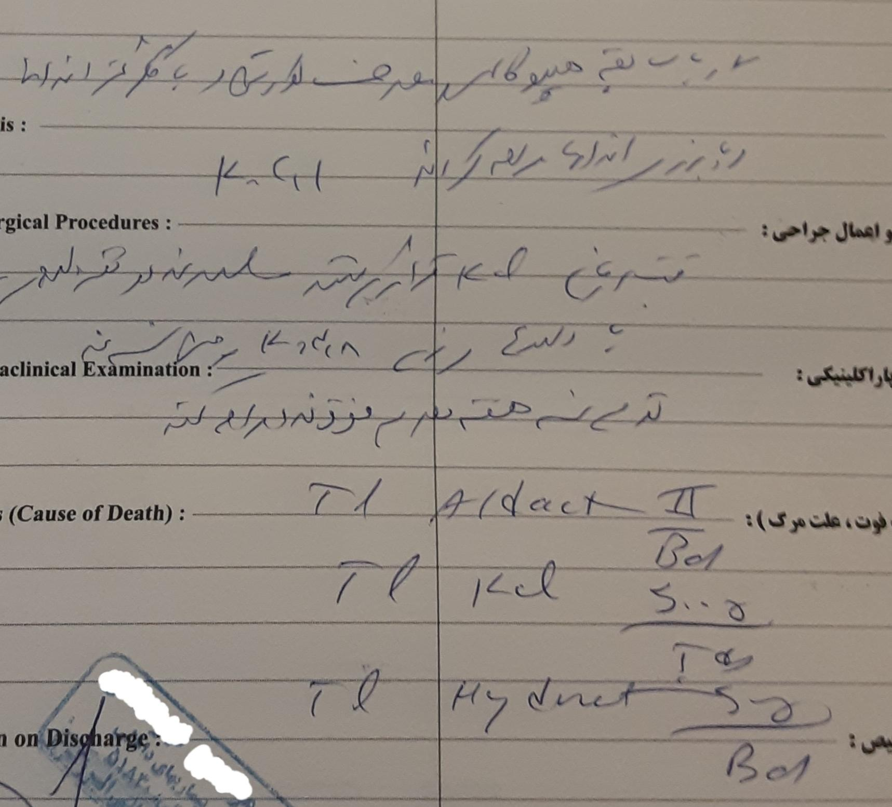
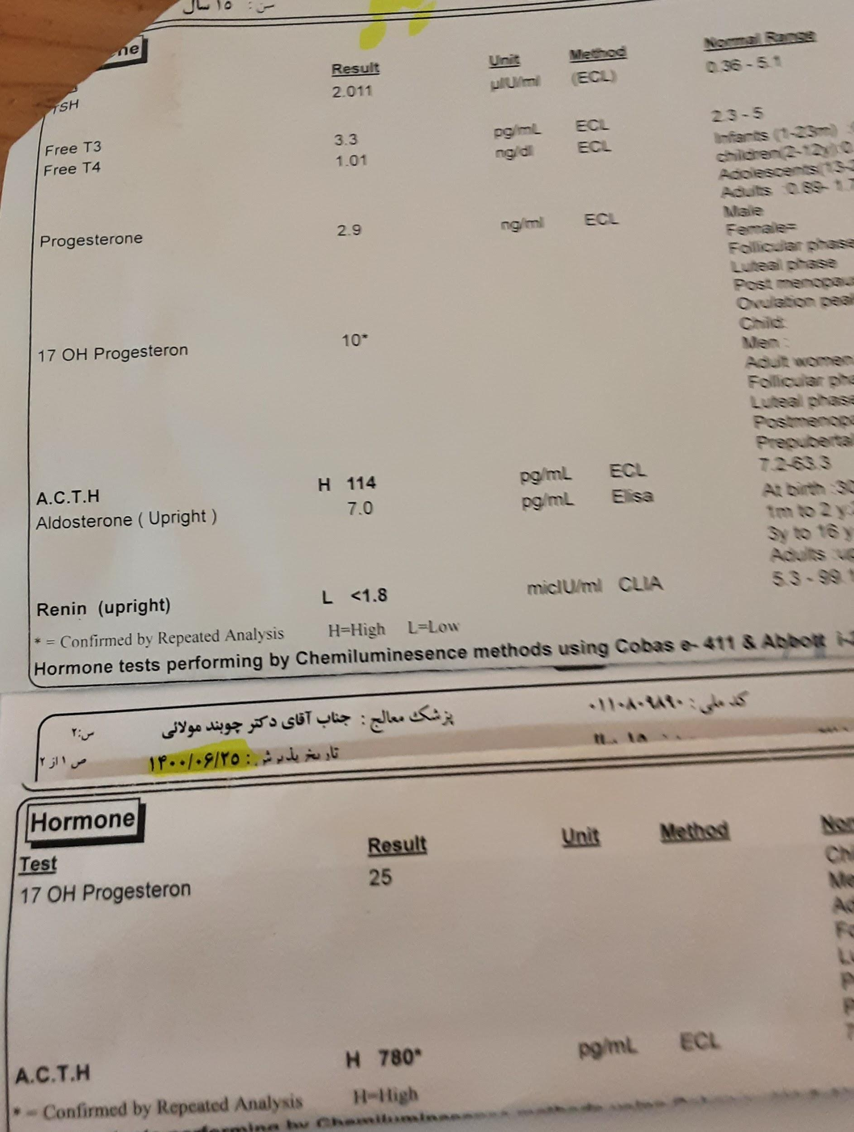
1400:

Slide 23
11 hydroxylase deficiency

Slide 24
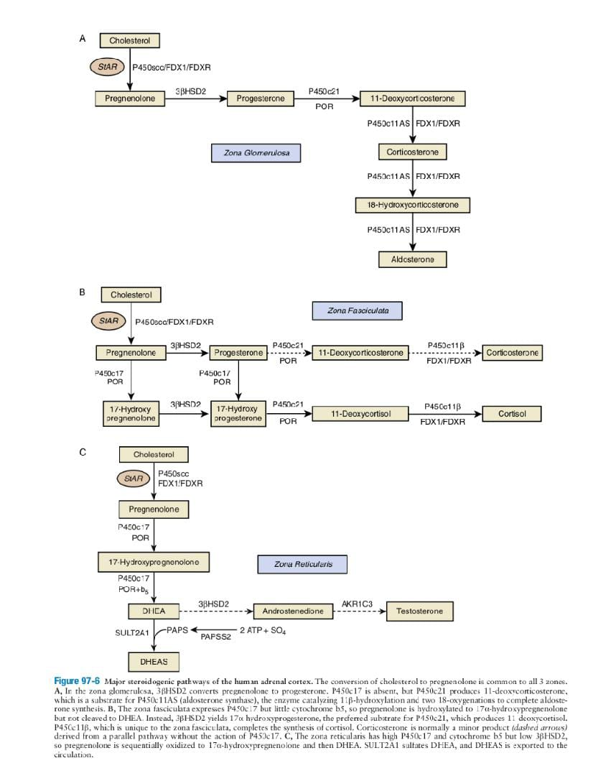
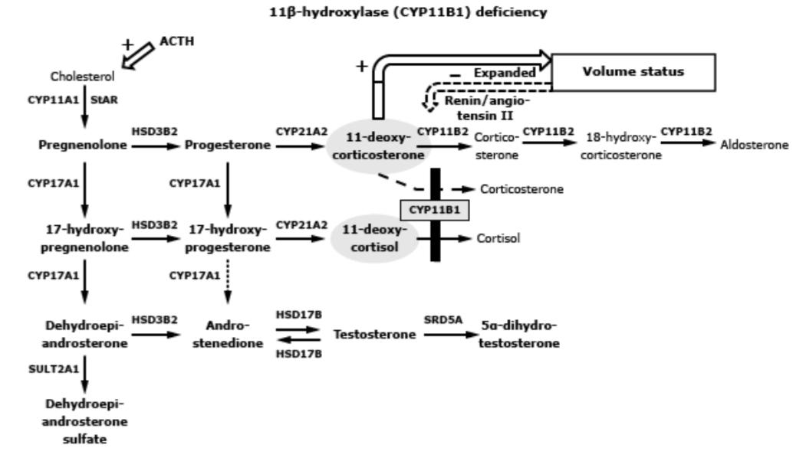

Slide 25
HTN and hypokalaemia
decreased renin and PRA and Ald
increase 11 DOC
increase 11 deoxycorticostron
Prevent adrenal crisis under normal circumstances

Slide 26
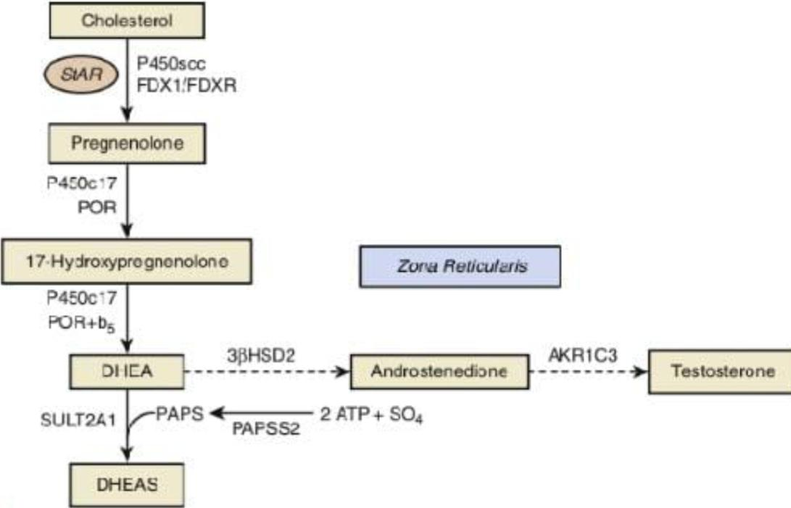

Slide 27
points:
Deficiency of CYP11B1 (P450 11B1 or 11-beta-hydroxylase) (11OHD), affects 1 in 100,000 live births and accounts for up to 5 percent of adrenal steroidogenic defects . In Jews of Moroccan ancestry, 11OHD prevalence is as high as 1 in 5000 due to the R4448H founder mutation
Hypertension occurs in approximately two-thirds of patients, often early in life Although it is ascribed to DOC excess, the correlations between blood pressure and serum DOC concentrations or severity of the deficiency based on genotype are poor.

Slide 28
POINTS:
A few patients with 11OHD have salt-wasting or hypotensive crises, but the reasons for this phenotypic heterogeneity are not known. As with 11OHD, hypertension is often accompanied by hypokalemia with suppression of plasma renin activity and aldosterone due to volume expansion.
Increased urinary excretion of 11-deoxysteroid metabolites, most prominently tetrahydro metabolites of 11-deoxycortisol and DOC, which are normally present in trace quantities . Urinary excretion of 17-ketosteroids and of all 19-carbon steroids, which reflects integrated androgen synthesis, is also increased.

Slide 29
POINTS:
In adolescents and young adults, basal serum 11-deoxycortisol values may be normal, and cosyntropin stimulation testing is often required to establish the diagnosis . The diagnosis of mild or nonclassic 11OHD requires normal or near-normal cortisol plus 11-deoxycortisol >1800 ng/dL (>52 nmol/L). All diagnoses are preferably confirmed with genetic testing

Slide 30
Points treatment and flow up:
The goals of therapy in children with 11OHD are to reduce mineralocorticoid and adrenal androgen precursor synthesis sufficiently to ameliorate the hypertension, hypokalemia, and androgen excess
Children are generally treated with glucocorticoids only, typically hydrocortisone (10 to 25 mg/m2), which is preferred over prednisolone (approximately 0.1 mg/kg) or dexamethasone (up to 0.01 mg/kg), to lower ACTH secretion. Despite the proclivity for hypertension in 11OHD, hypotensive adrenal crises due to glucocorticoid deficiency occur during significant illness.

Slide 31
Points treatment and flow up:
Fludrocortisone acetate is not necessary, and spironolactone is sometimes added to antagonize both androgens and mineralocorticoids, allowing reduced glucocorticoid dosing, particularly in adults. Given the phenotypic variability in this disease, treatment must be tailored to minimize the dose of glucocorticoid so as to prevent iatrogenic Cushing's syndrome.
The response to therapy should be monitored both biochemically and clinically:

Slide 32
Points treatment and flow up:
Blood pressure should be normal, normokalemia should be restored, and 11-deoxycortisol concentrations should decrease although not necessarily to normal.
Serum androstenedione and testosterone concentrations should be brought to age- and gender-specific normal range. In postpubertal boys and men, a serum androstenedione concentration higher than testosterone indicates that the androgens are adrenal derived and disease control is poor.

Slide 33
Points treatment and flow up:
A measurable plasma renin activity indicates suppression of mineralocorticoid synthesis, which can take months after starting therapy
Clinical monitoring includes assessment of virilization, growth velocity, and skeletal maturation (bone age) with attention to glucocorticoid-related side effects such as bruising, weight gain, and glucose intolerance.

Slide 34
Points treatment and flow up:
In adolescent girls, facial hair growth and acne should be examined. Genital malformations in affected females may require surgical correction with one or more surgeries and vaginal dilation.
In adult women with 11OHD, growth and bone age advancement are no longer concerns, but androgen excess and hypertension remain indications for treatment.

Slide 35
Points treatment and flow up:
Spironolactone, 25 to 200 mg/day, treats both the mineralocorticoid-mediated hypertension with hypokalemia and the androgen excess by blocking both the mineralocorticoid and androgen receptors.
The main drawbacks of spironolactone are vaginal bleeding or spotting between menses and contraindication during pregnancy.
If pregnancy is not desired, spironolactone and an oral contraception pill can be combined with replacement doses of hydrocortisone as a glucocorticoid-sparing regimen, as in 17OHD.

Slide 36
Points treatment and flow up:
In adult males, at a minimum, replacement doses of hydrocortisone should be administered to avoid the development of adrenal rest tumors.
Spironolactone can cause gynecomastia and sexual dysfunction in males, whereas eplerenone and the potassium-sparing diuretics triamterene and amiloride are alternatives. As with other forms of mineralocorticoid excess, the hypertension may persist even after adequate treatment.

Slide 37
Points treatment and flow up:
Prenatal diagnosis of 11OHD may be established by measuring tetrahydro-11-deoxycortisol in amniotic fluid or by sequencing the CYP11B1 gene amplified from DNA in chorionic villus biopsy samples . As in 21OHD, prenatal dexamethasone reduces genital virilization in affected girls, but experience is much more limited than in 21OHD.

Slide 38
In one report, a woman with two affected daughters was treated with dexamethasone (20 mcg/kg daily in three divided doses) from the fifth week of pregnancy to term and delivered a female infant with normal external genitalia
Cerame BI, Newfield RS, Pascoe L, Curnow KM, Nimkarn S, Roe TF, New MI, Wilson RC. Prenatal diagnosis and treatment of 11beta-hydroxylase deficiency congenital adrenal hyperplasia resulting in normal female genitalia. J Clin Endocrinol Metab. 1999 Sep;84(9):3129-34. doi: 10.1210/jcem.84.9.5976. PMID: 10487675.

Slide 39
Genetic findings:
The autosomal recessive disorder 11OHD is caused by mutations of the CYP11B1 gene, located on chromosome 8q21-q22. Most mutations completely abolish the activity of the enzyme and include missense mutations that reduce enzyme activity , frameshifts, and nonsense mutations , that prevent synthesis of the enzyme. The founder mutation R448H is by far the most common and explains the high prevalence of 11OHD in Jews of Moroccan origin .

Slide 41
What went wrong?(From diagnosis to treatment?)
at birth
to diagnosis
at diagnosis
At birth 17ohpro and cortisol are requested by the doctor but not followed up by the family
Pediatricians do not pay attention to GV and Pubarche and change the patient's voice
Failure to register a proper genital examination
Start diferlin???
was the onset of diferlin indicated?

Slide 42
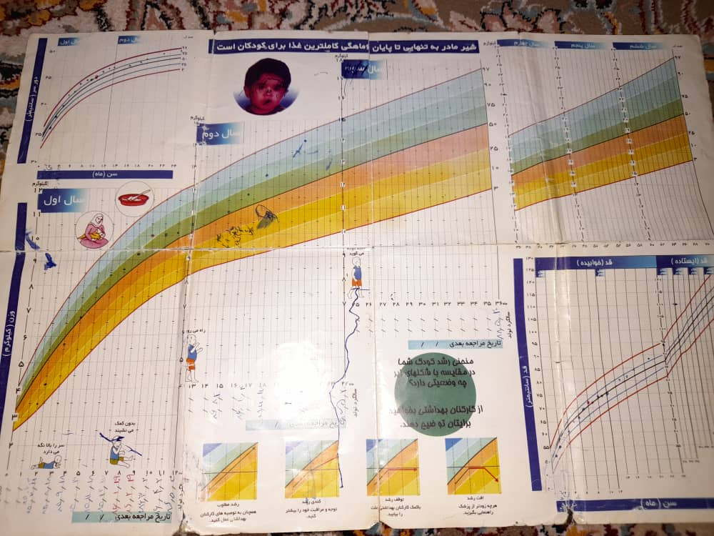

Slide 43
When was the indication for the start of Deferlin?
With fsh and LH less than half the indication did not start diferlin.
But in this patient, how could fsh and LH increase?
High BA can trigger fsh and lh
Treatment reduces androgens and stimulates fsh and lh

Slide 44
What were the mistakes in the follow-up?
Summary in Followup?
BP
GV
BA
viriliza..
11Doc
anderstandi..
testesrron
k
PRA
Acth

Slide 45
Lack of attention to GV
89
94
96
127
136
145
149
152
92
95

Slide 46
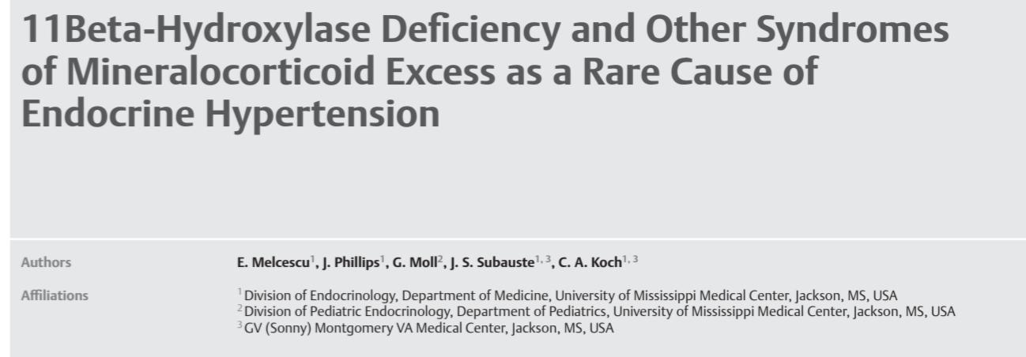
What percentage of 11BOHD patients have hypokalemia before starting treatment?
Melcescu, Eugen, et al. "11Beta-hydroxylase deficiency and other syndromes of mineralocorticoid excess as a rare cause of endocrine hypertension." Hormone and metabolic research 44.12 (2012): 867-878.

Slide 47
Breil, Thomas, Yakovenko, Vira, Inta, Ioana, Choukair, Daniela, Klose, Daniela, Mittnacht, Janna, Schulze, Egbert, Alrajab, Abdul, Grulich-Henn, Jürgen and Bettendorf, Markus. "Typical characteristics of children with congenital adrenal hyperplasia due to 11β-hydroxylase deficiency: a single-centre experience and review of the literature" Journal of Pediatric Endocrinology and Metabolism, vol. 32, no. 3, 2019, pp. 259-267. https://doi.org/10.1515/jpem-2018-0298

Slide 48
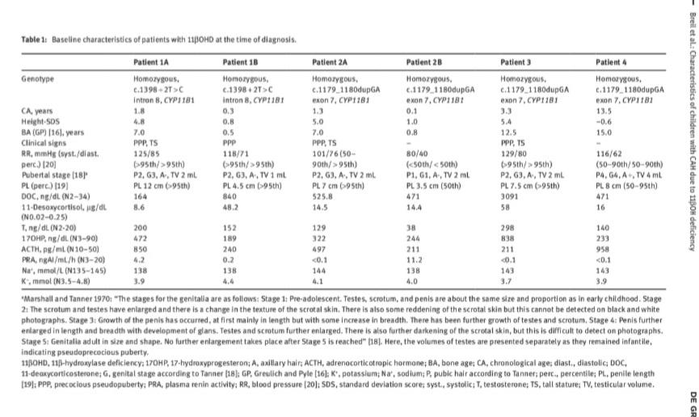

Slide 49
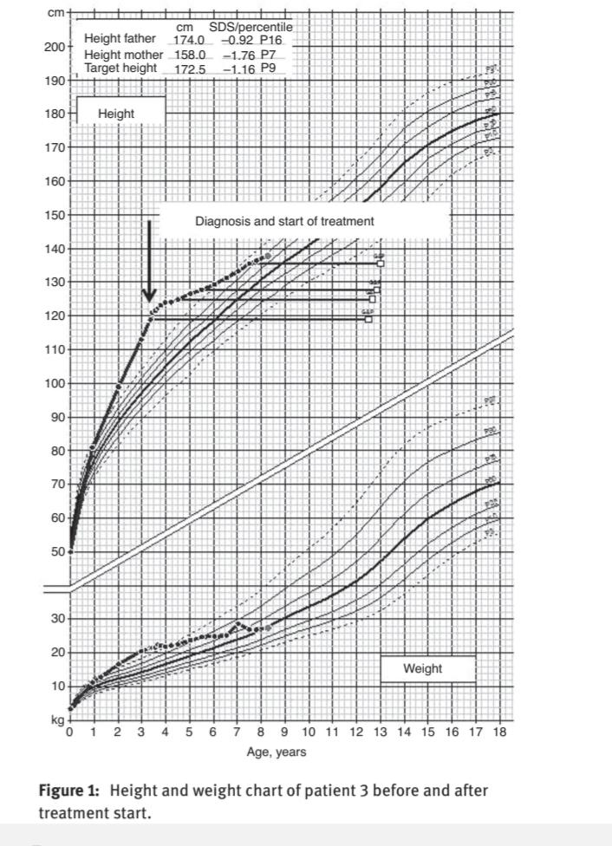
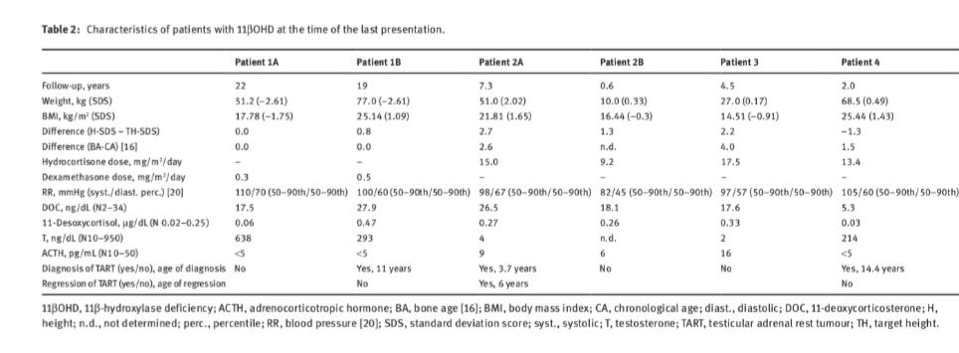

Slide 50
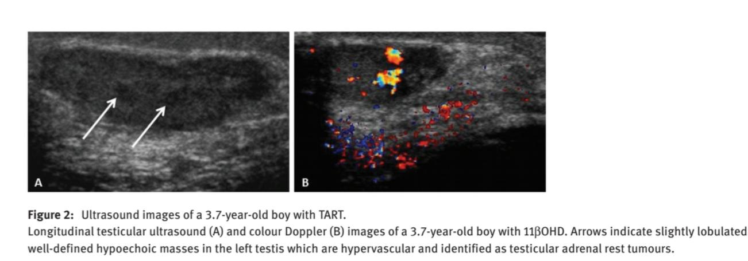

Slide 51
Recent lab:
17oHprogestron | 9/11ng/dl
ACTH | 913 pg/ml
k | 2/9
PRA | 1/68 ng/ml/h
Ald | 3/7 ng/dl
cr | 0/8

Slide 52
Our treatment plan in this patient?
Start 0.5 mg dexamethasone every night
Follow-up with BP, k and AcTH, PRA
sonographic study

