Slide 1
In The Name of God

Slide 2
Pharmacotherapy In Childhood and Adolescent Obesity
Mahtab Niroomand M.D.
Assistant professor of Endocrinology
SBUMS

Slide 3
Outlines
Pharmacotherapy in childhood and adolescent obesity:
Why ?
What?
When?

Slide 4
Pharmacotherapy in childhood obesity-WHY?
Why do obese people have difficulty losing weight or sustaining weight loss?
Time commitments
Costs of lifestyle changes
Biological considerations
short-term weight loss cannot be sustained without considerable effort

Slide 5
Biological effect of weight re-gain

Slide 6
J Clin Endocrinol Metab 93: 4600–4605, 2008

Slide 7
(J Clin Endocrinol Metab 93: 4600–4605, 2008)

Slide 8
(J Clin Endocrinol Metab 93: 4600–4605, 2008)

Slide 9
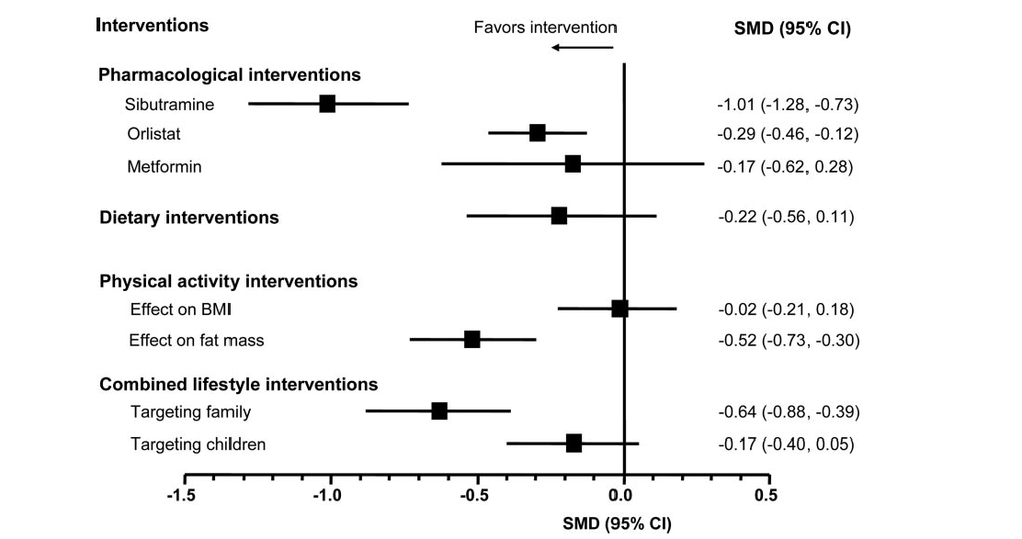
(J Clin Endocrinol Metab 93: 4600–4605, 2008)

Slide 10
Pharmacotherapy in childhood obesity-What?
Sibutramin
Orlistat
Metformin

Slide 11
The literature comprises 11 randomized placebo-controlled studies in obese Adolescents
One major study with orlistat
Four with sibutramine
Five with metformin

Slide 12
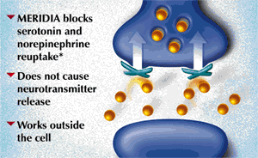
Sibutramine

Slide 13
Sibutramine
Sibutramine acts:
Centrally to:
Inhibit reuptake of serotonin, norepinephrine,
and, to a lesser extent, dopamine. It reduces hunger and increases satiety,
In brown adipose tissue:
Promotes thermogenesis,which increases energy expenditure
Rapid absorption , peak plasma concentration are reached within one or two hours
DIABETES CARE, VOLUME 30, NUMBER 2, FEBRUARY 2007

Slide 14
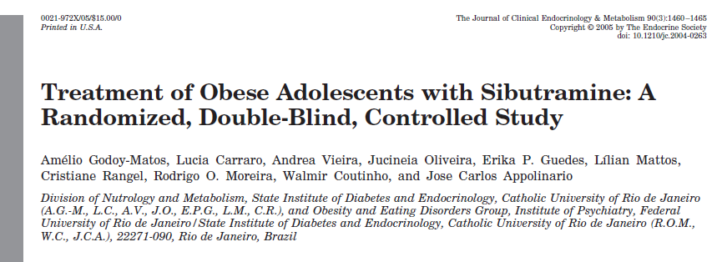
J Clin Endocrinol Metab 90: 1460–1465, 2005

Slide 15
Design: RCT
Sample size: 60 adolescents, aged 14–17 yr
F/U: 6 months
Intervention: sibutramine (10 mg/d) or matching placebo
Outcome: weight, waist, Hip, BP, lipid profile, echocardiogram

Slide 16
Baseline characteristics of study participants
J Clin Endocrinol Metab 90: 1460–1465, 2005

Slide 17
Absolute changes in anthropometrical parameters in patients treated with sibutramine or placebo at wk 24
J Clin Endocrinol Metab 90: 1460–1465, 2005

Slide 18
Mean percent change in initial BMI for adolescents treated with sibutramine or placebo
J Clin Endocrinol Metab 90: 1460–1465, 2005

Slide 19
Mean percent change in body weight for adolescents treated with sibutramine or placebo
J Clin Endocrinol Metab 90: 1460–1465, 2005

Slide 20
J Clin Endocrinol Metab 90: 1460–1465, 2005

Slide 21
Mean changes in SBP,DBP, and HR in patients treated with sibutramine or placebo at wk 24
J Clin Endocrinol Metab 90: 1460–1465, 2005

Slide 22
Changes in biochemical parameters in patients treated with sibutramine or placebo at wk 24
J Clin Endocrinol Metab 90: 1460–1465, 2005

Slide 23
Adverse events reported by patients treated with sibutramine or placebo for 24 wk
J Clin Endocrinol Metab 90: 1460–1465, 2005

Slide 24
Ann Intern Med. 2006;145:81-90.
Ann Intern Med. 2006;145:81-90.

Slide 25
Design: RCT
Participants: 498 participants 12 to 16 years of age with a body mass index (BMI) that was at least 2 units more than the U.S. weighted mean of the 95th percentile based on age and sex, to the upper limit of 44 kg/m2.
Setting: 33 U.S. outpatient clinics.
Interventions: Site-specific behavior therapy plus 10 mg of sibutramine or placebo. Blinded study medication dose was up titrated to 15 mg or placebo at month 6 if initial BMI was not reduced by 10%
Length of F/U: 12 mo.
Measurements: Body mass index, waist circumference, body weight, fasting lipid and glycemic variables, safety, and tolerability.
Ann Intern Med. 2006;145:81-90

Slide 26
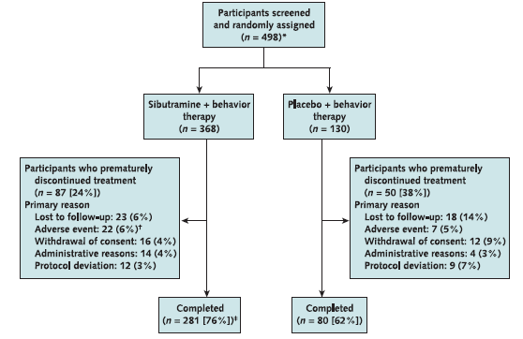
Ann Intern Med. 2006;145:81-90.

Slide 27
Ann Intern Med. 2006;145:81-90.

Slide 28
Ann Intern Med. 2006;145:81-90.

Slide 29
Ann Intern Med. 2006;145:81-90.

Slide 30
Ann Intern Med. 2006;145:81-90.

Slide 31
Ann Intern Med. 2006;145:81-90.

Slide 32
Cautions
Only 76% and 62% of the sibutramine and placebo recipients, respectively, completed the trial.

Slide 33
Implications
Sibutramine plus behavioral therapy for 1 year can reduce weight and improve metabolic risk factors in some very obese adolescents.
FDA Approved for patients over age 16 yrs

Slide 34
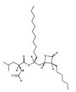
Orlistat

Slide 35
Orlistat is a gastrointestinal tract lipase inhibitor which decreases intestinal fat absorption by up to 30%.
JAMA. 2005;293:2873-2883

Slide 36
Effect of Orlistat on Weight and Body Composition in Obese Adolescents
Design: Multicenter, randomized, double-blind study at 32 centers in the United States and Canada
Participants: 539 obese adolescents aged 12-16 years with BMI 2 units above the 95th percentile
F/U: 54 weeks
Interventions :A 120-mg dose of orlistat (n=357) or placebo (n=182) 3 times daily for 1 year, plus a mildly hypocaloric diet (30% fat calories), exercise, and behavioral therapy.
Main Outcome: Measures Change in BMI
Secondary measures: changes in waist and hip circumference, weight loss, lipid measurements, and glucose and insulin responses to oral glucose challenge
JAMA. 2005;293:2873-2883

Slide 37
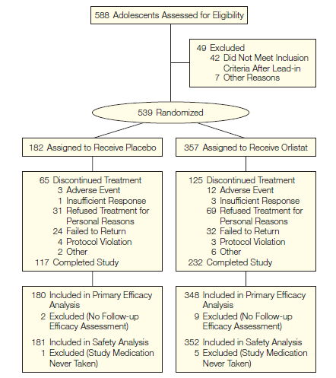
JAMA. 2005;293:2873-2883

Slide 38
JAMA. 2005;293:2873-2883

Slide 39
JAMA. 2005;293:2873-2883

Slide 40
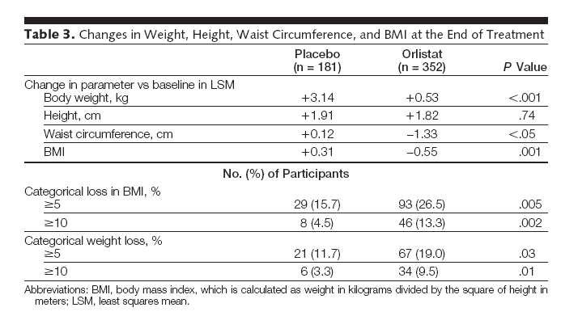
JAMA. 2005;293:2873-2883

Slide 41
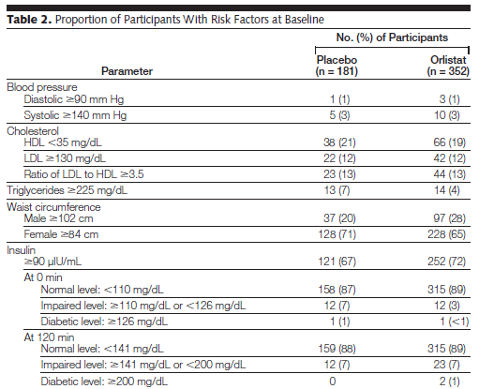
JAMA. 2005;293:2873-2883

Slide 42
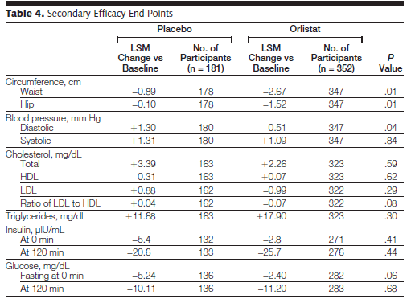
JAMA. 2005;293:2873-2883

Slide 43
JAMA. 2005;293:2873-2883

Slide 44
FDA approved for children over age 12 yrs
Generally mild to moderate gastrointestinal tract adverse events occurred in 9% to 50% of the orlistat group and in 1% to 13% of the placebo group.
JAMA. 2005;293:2873-2883

Slide 45
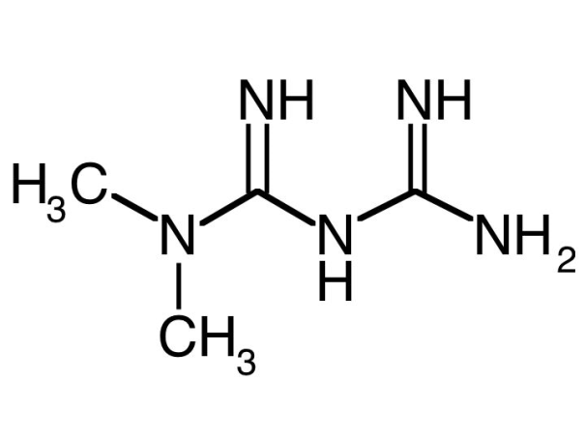
Metformin

Slide 46
Mechanism of action
Metformin through activation o AMP-activated protein kinase (AMPK):
Reduces hepatic glucose production
Reduce plasma insulin concentrations
Inhibits fat cell lipogenesis
Increase peripheral insulin sensitivity
May reduce food intake by raising levels of glucagon-like peptide 1

Slide 47
PEDIATRICS Vol. 107 No. 4 April 2001

Slide 48
Participants: 32 obese adolescents with insulin resistance and positive family history of T2DM (29 completed) and BMI >30
Design: Double-blind, randomized to metformin (500 mg twice daily) vs. placebo
Follow up duration: 6 months
No dietary restriction
PEDIATRICS Vol. 107 No. 4 April 2001

Slide 49
PEDIATRICS Vol. 107 No. 4 April 2001

Slide 50
PEDIATRICS Vol. 107 No. 4 April 2001

Slide 51
PEDIATRICS Vol. 107 No. 4 April 2001

Slide 52
PEDIATRICS Vol. 107 No. 4 April 2001

Slide 53
PEDIATRICS Vol. 107 No. 4 April 2001

Slide 54
PEDIATRICS Vol. 107 No. 4 April 2001

Slide 55
J Clin Endocrinol Metab 91: 2074–2080, 2006

Slide 56
Design: Randomized, double-blind, crossover trial.
Participants: Twenty-eight patients (13 males) aged 9–18 yr
Intervention: Metformin (1 g twice daily) and placebo for 6 months, each with a 2-wk washout period.
Outcome: Body composition (anthropometry ,DEXA, MRI), and insulin sensitivity (Si; minimal model, fasting insulin and glucose) were measured at baseline and 6 and 12 months.

Slide 57
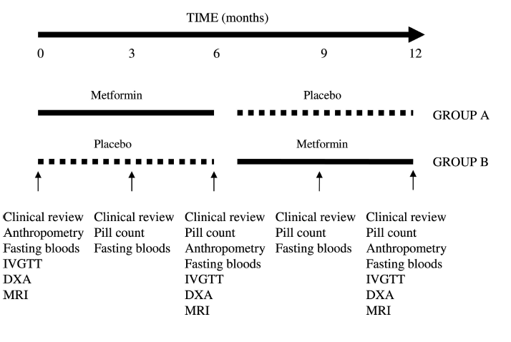

Slide 58
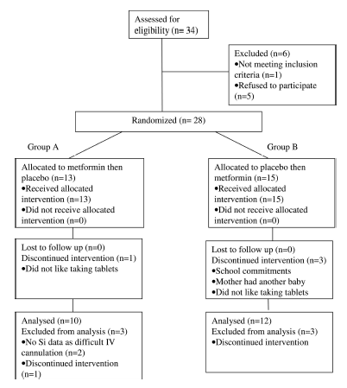
J Clin Endocrinol Metab 91: 2074–2080, 2006

Slide 59
J Clin Endocrinol Metab 91: 2074–2080, 2006

Slide 60
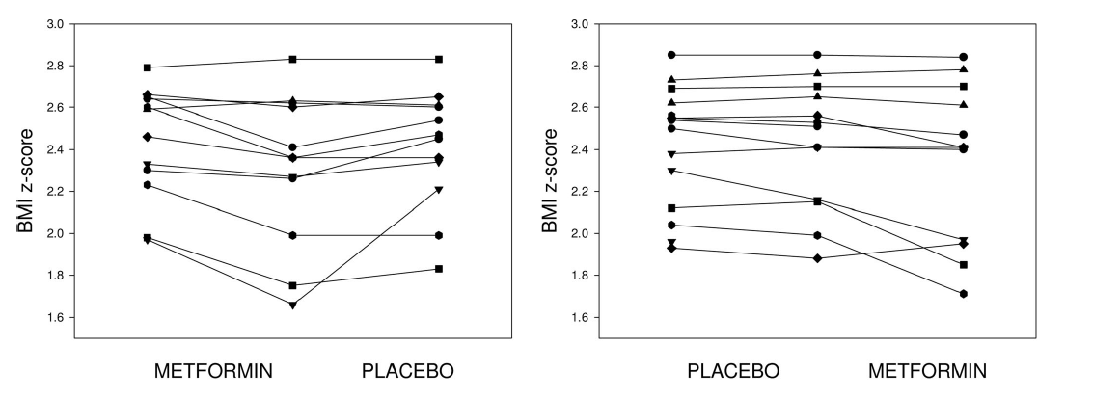

Slide 61
J Clin Endocrinol Metab 91: 2074–2080, 2006)

Slide 62
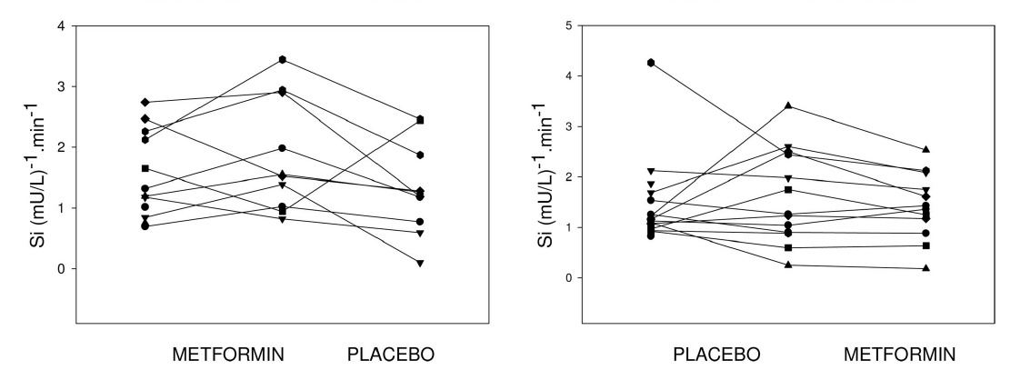

Slide 63
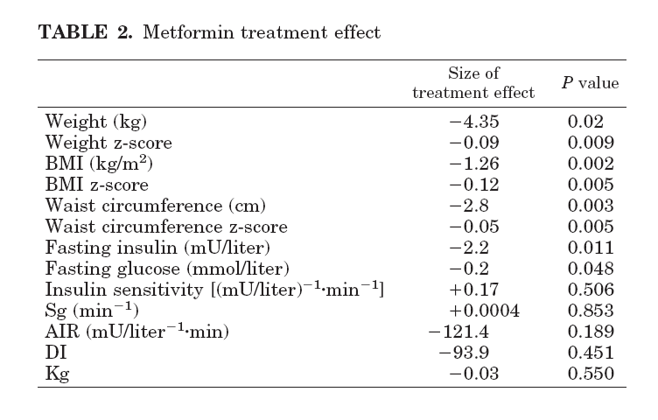

Slide 64
Conclusion
Metformin had a greater treatment effect over placebo for weight (4.35 kg, P= 0.02), body mass index (1.26 kg/m2, P= 0.002), waist circumference (2.8 cm, P= 0.003), sc abdominal adipose tissue (52.5 cm2, P= 0.002), and fasting insulin (2.2 mU/liter, P= 0.011).
Si improved in 45% of subjects while metformin and 27% of subjects while on placebo (P= 0.21).
Approved for Type 2 diabetes mellitus, not yet approved for obesity

Slide 65
Diabetes Care 32:1743–1745, 2009

Slide 66
Design: systematic review and meta-analysis of randomized controlled trials (RCTs). Double-blind RCTs of 6 months duration
Participants: obese subjects age< 19 years without diabetes
Outcome: changes in BMI and measures of insulin sensitivity
Diabetes Care 32:1743–1745, 2009

Slide 67
Diabetes Care 32:1743–1745, 2009

Slide 68
Conclusion
This meta-analysis provides some support for a beneficial metformin effect on obesity outcomes among hyperinsulinemic children and adolescents.
Treatment over 6 months may be efficacious in reducing BMI by 1.42 kg/m2 (equivalent to 0.4 SD, based on SD for BMI in U.K. and U.S. adolescents) and HOMA-IR score by 2.01(0.6 SD)
Diabetes Care 32:1743–1745, 2009

Slide 69
Limitation of study
Short-term and based on small samples
Participants were mainly from the U.S.,and large portions were from ethnic backgrounds known to be at increased risk of metabolic disorders, limiting the generalizability of findings
The studies presented unadjusted measures without intention-to-treat analyses, which may have overestimated treatment effects
Diabetes Care 32:1743–1745, 2009

Slide 70
Diabetes 60:477–485, 2011

Slide 71
Design: randomized double-blind placebo-controlled trial
Participant: 100 severely obese (mean BMI 34.6 ± 6.6 kg/m2) insulin-resistant children aged 6–12 years
Duration of study: 12 months
Intervention: randomized to 1,000 mg metformin (n = 53) or placebo (n = 47) twice daily for 6 months, followed by open-label metformin treatment for 6 months.
Outcome: weight loss and improves obesity-related comorbidities in obese children, who are insulin resistant
Diabetes 60:477–485, 2011

Slide 72
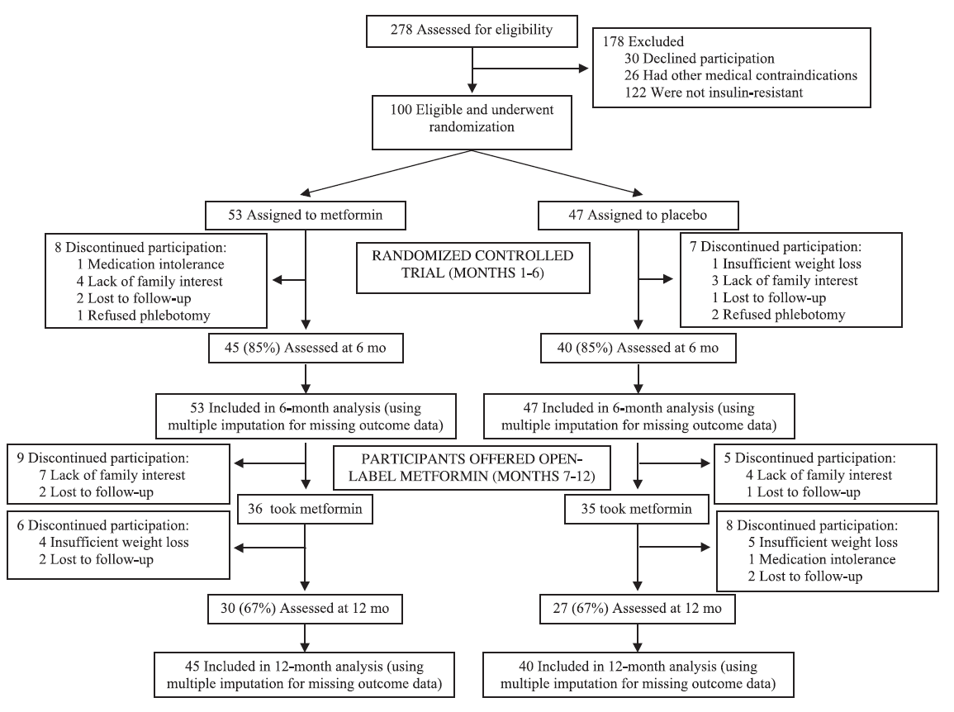
Diabetes 60:477–485, 2011

Slide 73
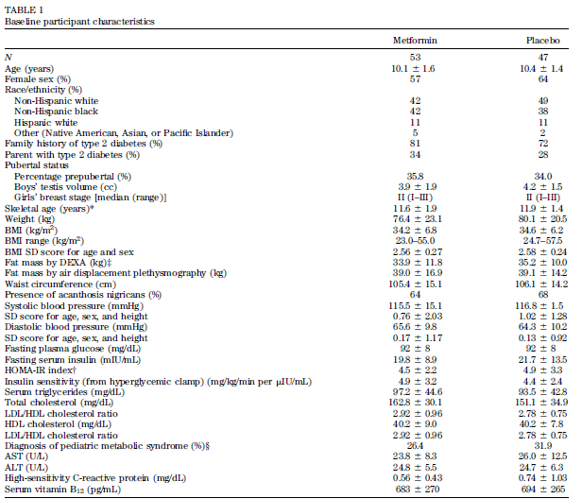
Baseline participant characteristics
Diabetes 60:477–485, 2011

Slide 74
Diabetes 60:477–485, 2011

Slide 75
Diabetes 60:477–485, 2011

Slide 76
Diabetes 60:477–485, 2011

Slide 77
Diabetes 60:477–485, 2011

Slide 78
Conclusion
Metformin treatment modestly reduced body weight and adiposity and improves measures of glucose homeostasis in obese insulin-resistant 6- to 12-year-old children.
Although the weight loss produced is small, metformin treatment may hold promise as a method to prevent or delay the appearance of impaired glucose homeostasis in children at high risk for the development of type 2 diabetes.
Diabetes 60:477–485, 2011

Slide 79
DIABETES CARE, VOLUME 30, NUMBER 2, FEBRUARY 2007

Slide 80
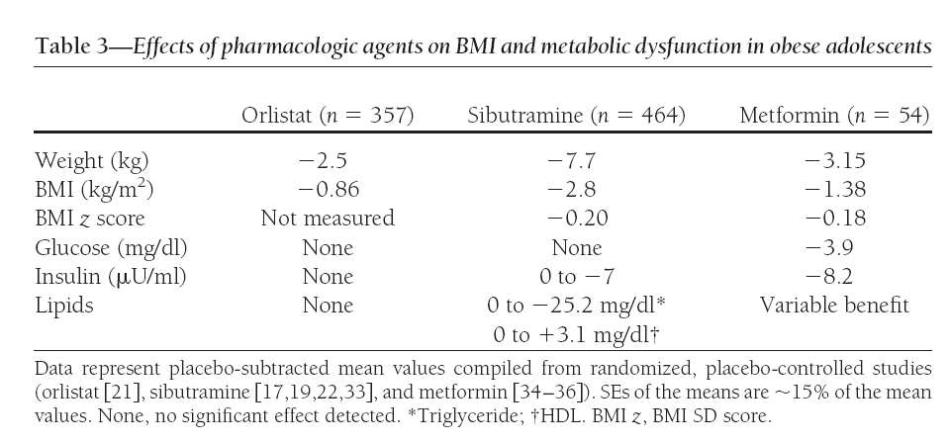
DIABETES CARE, VOLUME 30, NUMBER 2, FEBRUARY 2007

Slide 81
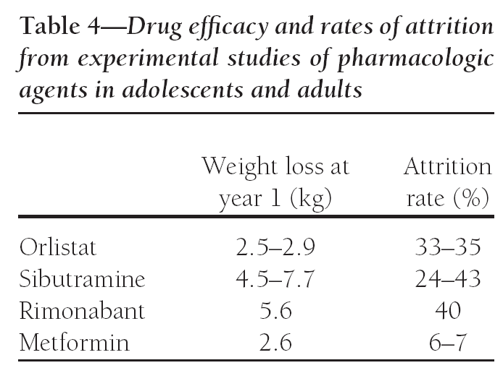
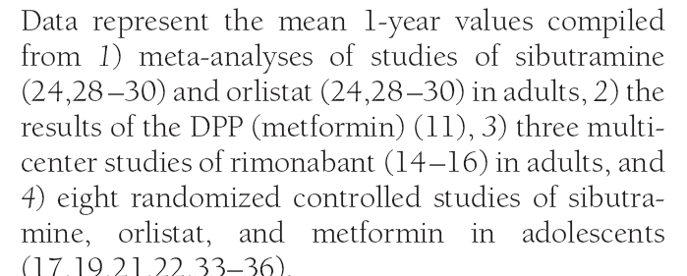
DIABETES CARE, VOLUME 30, NUMBER 2, FEBRUARY 2007

Slide 82
DIABETES CARE, VOLUME 30, NUMBER 2, FEBRUARY 2007

Slide 83
Conclusion
limited evidence supports short-term efficacy of pharmacological interventions (sibutramine and orlistat in adolescents) on BMI
The long-term impact of obesity treatments on the health of children and adolescents remains unclear.

Slide 84
Pharmacotherapy in childhood obesity-WHEN?
The Endocrine Society has suggested limiting pharmacotherapy to those with :
BMI over 95th percentile who have failed diet and life style intervention
BMI over the 85th percentile and severe comorbidity
Endocrinol Metab Clin North Am.2009 september; 389(3):525-548

Slide 85
Summary
The most well-studied medications are sibutramine , orlistat and metformin
Weight loss attributable to these medications are modest
Sibutramine is most effective at reducing body weight, at least in the short term. However, its tendencies to raise blood pressure and pulse are concerning
There are no published reports of medical treatment for adolescent obesity that last longer than 1 year
The long-term safety of medication in children has not been established

Slide 86
Summary….
Orlistat and sibutramin have been approved for children over age 12 and 16 respectively
Metformin not yet approved for treatment of obesity
Drug selection should be tailored to the individual patient, with strong attention paid to the family history and potential adverse effects

Slide 87
Thanks for your attention

