Slide 1
IN THE NAME OF GOD
A 20-year-old girl with
Primary Amenorrhea
Presentation By Dr. Ali Golshaian
6th Day 1400

Slide 2
Patients ID:
20 yrs. old girl
Born & live in Rafsanjan
House keeper
Diploma

Slide 3
Chief Complaint:
Primary amenorrhea

Slide 4
Present Illness:
A 19 years & 10 months old girl
Without any history of problems during her mother`s pregnancy and delivery
Without any history of ambiguous genitalia at birth
Her breast budding started at the age of 14 yr
Her axillary & pubic hair growth started at the age of 13 yr

Slide 5
Present Illness:
Leukemia (?) at age of 3
Chemotherapy + cranial radiotherapy at age 3
Recurrence at age of 7
So chemotherapy + cranial radiotherapy was done again
BMT was done at age 9, from her brother
She used immunosuppressive drugs for 6 m

Slide 6
Present Illness:
Headache (Neg), Olfactory dis. (Neg), Vision problem (Neg)
Abnormal movement (Neg), Abnormal eating (Neg),
Mood disturbance (Neg), Insomnia (Neg), Short stature (Neg)
Underlying systemic dis. (Neg), Weakness (Neg)
Hirsutism (Neg), Hair loss (Neg), Acne (Neg)
Weight loss or gain (Neg), Strenuous physical activity (Neg)
Emotional or physical trauma (Neg)
Hot flashes (Neg), Sweating (Neg)

Slide 7
Past medical and Drug history:
PMH:
DM (-) HTN (-) FTT (-) CKD (-) Liver Dis. (-)
Leukemia (+) BMT (+)
No hx of pelvic radiation or trauma
DH:
Hx of chemotherapy 2 times + 6 m immunosuppressive therapy
Conjugated estrogen + Medroxyprogesterone for 2 month (sequential hormone therapy) but without any effect on menstruation
Levothyroxine 50 / daily for recent 3 months

Slide 8
Habitual and Social History:
HH:
Neg
Social History :
Neg

Slide 9
Family History:
She has 2 healthy sisters & 1 healthy brother
Her mother & sister`s onset of menstruation was about 14-15 yrs.
DM (in her mother under treatment with OA)

Slide 10
Review of Systems:
Constitutional symptoms: (-), No hair loss
Skin: No hirsutism, No acne, No pigmentation, No vitiligo
Ears, nose, mouth, throat: Nl
No any low set ear
No webbed neck
No smelling disturbance
Cardiovascular: Nl
Respiratory: Nl
Gastrointestinal: Nl
Musculoskeletal: Nl
Neurological: Nl, No abnormal movement, No visual problems
Psychiatric: depression(-), anxiety(-)

Slide 11
Physical Examination:
GENERAL APPEARANCE:
She seems lesser than 20 yrs. old, awake and alert
Vital Sign:
BP: 110/80 mmHg
Weight: 84 Kg (percentile 95)
Height: 161.5 cm (percentile 25-50) (WHO)
Arm Span: 166 cm
Upper segment: 87 cm Lower segment: 74.5 cm
BMI: 30.4 kg/m²

Slide 12
Physical Examination:
Head and NECK : Nl, No low-set ear, No webbed neck
High pitch & Nl feminine voice
Thyroid: Nl
Thorax: Nl
Lungs : Clear
Heart : Normal
Abdomen : No striae , no organomegaly
Skin: No hirsutism, No acne, No pigmentation, No vitiligo, Normal villus body hair
Extremities :
Upper : Normal (force, range of motion , muscle tone , pulses)
Lower : Normal (force, range of motion, muscle tone , pulses)

Slide 13
Physical Examination:
Genitalia:
Normal infantile female pattern; without ambiguity
Normal labia major appearance, but clitoris wasn`t seen
No palpable gonads
B3 P3

Slide 14
PROBLEM LIST
A 20-year-old girl; was referred for primary amenorrhea
History of leukemia at age 3, 2 times chemotherapy + cranial radiotherapy, BMT at age 9
Breast budding at 14 yrs. old
Axillary & pubic hair growth starting at 13 yrs. old
Normal infantile female pattern genitalia; with any ambiguity
No palpable gonads
B3 P3

Slide 15
 | Result | Normal Range | Date
AMH | < 0.01 ng/ml | 2.2 – 4.0 (Satisfactory fertility) | 1400/02/25
T3 | 146 nmol/L | 66 - 181 | 1400/06/02
T4 | 1.24 ng/ML | 0.8 – 2.1 | 1400/06/02
TSH | 4.32 mIU/L | 0.3 – 4.2 | 1400/06/02
Anti TPO | < 5 IULml | < 39.2 | 1400/06/02
TSH | 2.91 mIU/L | 0.27 – 4.3 | 1400/09/18
Cr | 0.75 mg/dl |  | 1400/09/18
ALT | 33 U/L |  | 1400/09/18
AST | 27 U/L |  | 1400/09/18
FSH | 29.61 IU/L | 4.7 – 21.5 (Ovulation phase) | 1400/09/18
LH | 13.46 | 2.4 – 12.6 (Follicular phase) | 1400/09/18
Prolactin | 10.38 ng/ml | 5.18 – 26.53 | 1400/09/18

Slide 17
Sonography
1400/03/23
Small uterine 35x16x17 mm, No obvious gonad
1400/09/15
Fatty Liver G I, Nl spleen, kidney,
Uterine 40x15 mm, Thin endometrium (1-2 mm)
1400/09/17
Small uterine, Both ovarian smaller than Nl range
1400/09/20
Nl fibroglandular tissue in both breasts

Slide 18
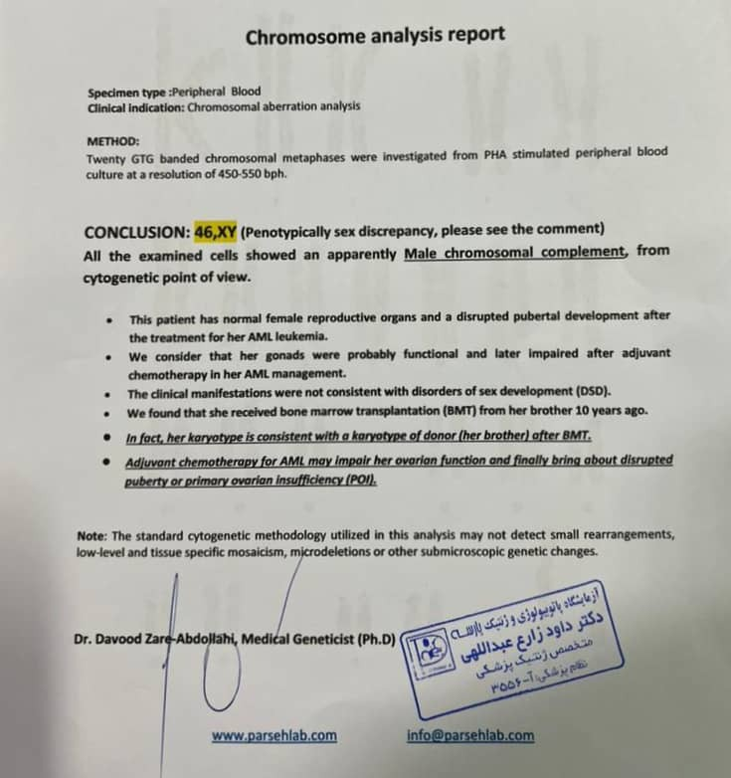

Slide 19
Differential Diagnosis Approach:
Primary amenorrhea
Delayed Puberty and Sexual Infantilism

Slide 20
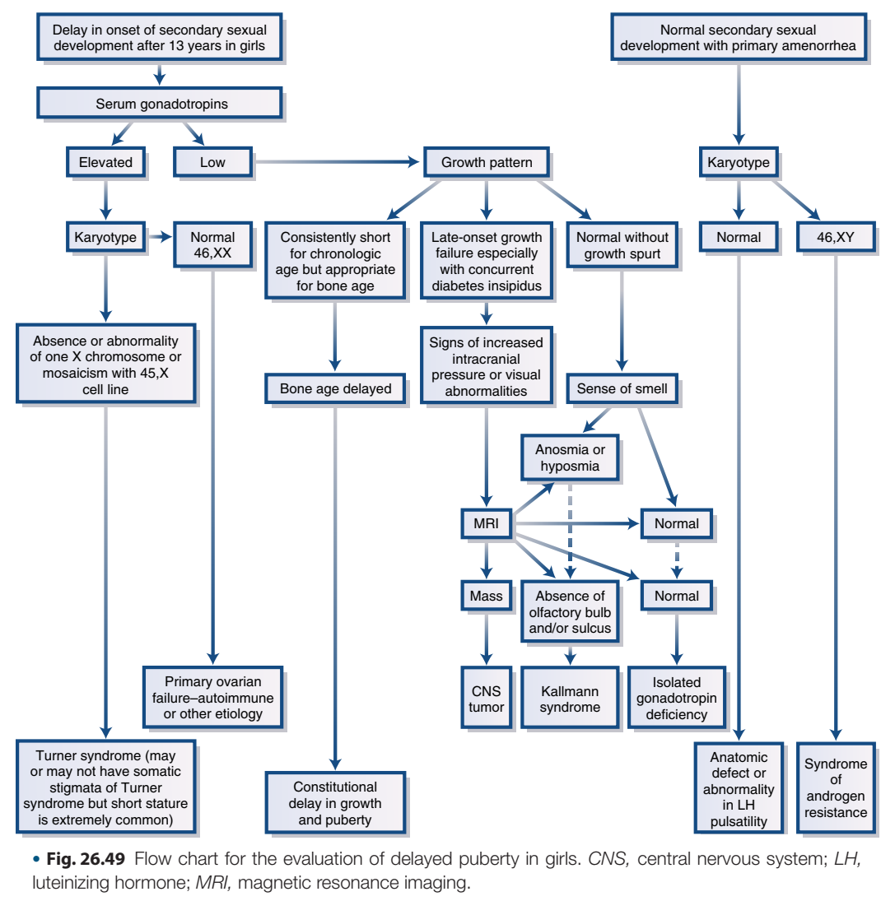
(2020) Williams Textbook of Endocrinology, 14th edition; 1114

Slide 21
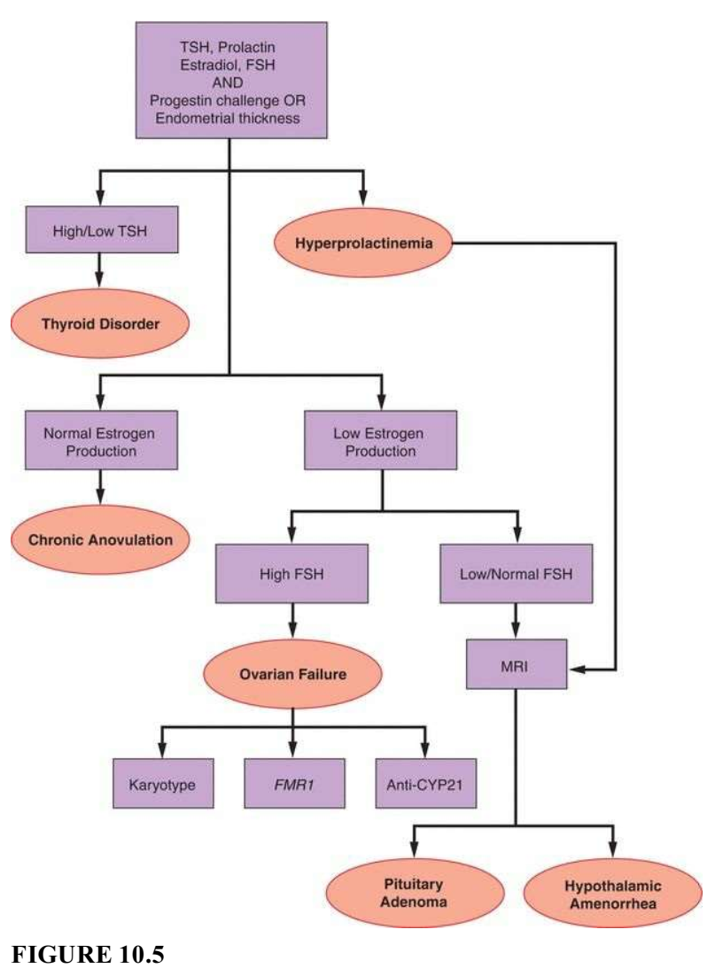
(2020) Speroff’s Gynecologic Endocrinology, 9th edition

Slide 22
The same case reports
We report the case of an 18-year-old girl with primary amenorrhea and 46 XY karyotype misdiagnosed as Y-chromosome-related DSD.
The breast developed automatically since the age of 12 and physical examination showed developed breasts of Tanner stage III.
Her medical history included bone marrow transplantation (BMT) from her brother and chemotherapy because of acute myeloid leukemia (AML) when she was 12 years old.
The present case serves as a reminder that a correct diagnosis depends on the comprehensive collection of present and past medical history, complete physical examination, and careful evaluation of related adjuvant tests.
(2016) Huang H, Tian Q. Primary amenorrhea after bone marrow transplantation and adjuvant chemotherapy misdiagnosed as disorder of sex development: A case report. Medicine (Baltimore). 2016 Nov;95(44):e5190

Slide 23
The same case reports
A 17-year-old girl presented with secondary amenorrhoea. She developed normal age-appropriate secondary sexual characteristics and attained menarche at the age of 13 years.
One year following her menarche, she was diagnosed with acute myeloid leukemia and was treated with chemotherapy, total body radiation and BMT.
Peripheral leucocyte karyotype as part of routine hypogonadism workup was found to be 46 XY.
The differential diagnosis of Swyer syndrome, which entails surgical removal of gonads due to the high risk of gonadoblastoma, was raised.
Karyotyping could be misleading especially if the patient suffered from graft-versus-host reaction post gender mismatched bone marrow transplant.
(2021) Tambawala ZY, Al Ani K, Abdelgadir E, Alawadi F. Amenorrhoea with XY karyotype postbone marrow transplant. BMJ Case Rep. 2021 Feb 5;14(2):e239767

Slide 24
The same case reports
The result 46, XY usually indicates two syndromes: complete androgen insensitivity or pure gonadal dysgenesis.
We report a case of a patient,who due to acute lymphoblastic leukemia in childhood was treated with total body irradiation and bone marrow transplantation.
A 24-year-old woman, with primary amenorrhea, whose lymphocytes karyotype result (46, XY) could have wrongly directed the diagnosis toward disorders of sexual differentiation
The cytogenetic examination for peripheral cells showed normal female karyotype. (This time containing fibroblasts (swab from the cheek) was taken and the karyotype was reassessed. It appeared to be 46, XX.)
(2020) Kruszewska J, et al. POI after chemotherapy and bone marrow transplant may mimic disorders of sexual differentiation - a case report of a patient with primary amenorrhea and 46, XY karyotype. Gynecol Endocrinol. 2020 Jun;36(6):564-566

Slide 25
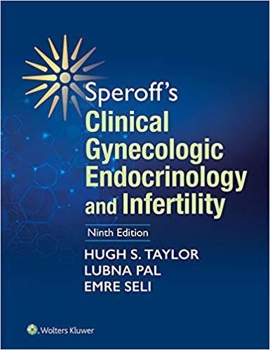
A karyotype should be obtained in all girls with hypergonadotropic hypogonadism to detect chromosomal abnormalities, except when a history of previous chemotherapy or gonadal radiation provides an obvious explanation.
(2020) Speroff’s Gynecologic Endocrinology, 9th edition

Slide 26
Differential Diagnosis:
Primary Ovarian Insufficiency
Due to previous chemotherapy & BMT

Slide 27
AGENDA:
Case Presentation & Differential Diagnosis Approach
The same case reports
Chemotherapy, BMT & subsequent POI
How to determine ovarian reserve?
Does POI lead to increased Morbidity/Mortality?
Bone Health
Hormone replacement therapy
What intervention must did for fertility preservation in this case?

Slide 28
AGENDA:
Case Presentation & Differential Diagnosis Approach
The same case reports
Chemotherapy, BMT & subsequent POI
How to determine ovarian reserve?
Does POI lead to increased Morbidity/Mortality?
Bone Health
Hormone replacement therapy
What intervention must did for fertility preservation in this case?

Slide 29
Chemotherapy, BMT & subsequent POI

Slide 30
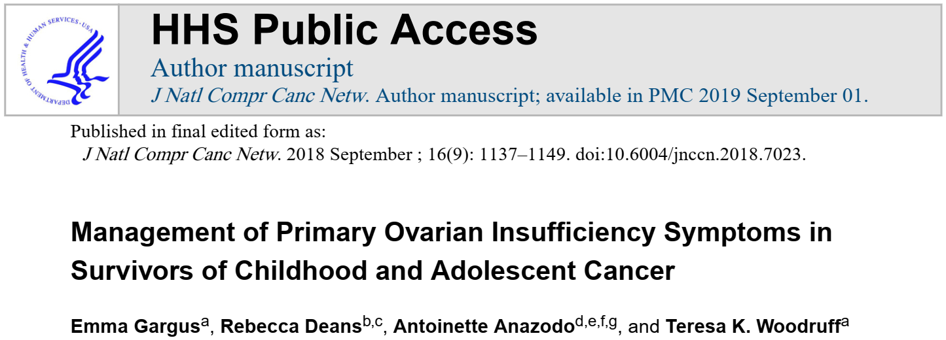
Chemotherapy, BMT & subsequent POI
(2018) Gargus E, et all. Management of Primary Ovarian Insufficiency Symptoms in Survivors of Childhood and Adolescent Cancer. The National Comprehensive Cancer Network® (NCCN®). 2018;16(9):1137-1149

Slide 31
Chemotherapy, BMT & subsequent POI
A total of 36 studies were included in the final review. (aged 0–24 years)
The prevalence of POI ranged from 2.1% to 82.2%
Risk factors for POI included alkylating agents and abdominal/pelvic radiation
Effects depend on
The dose of treatment
Age of the individual
Radiotherapy field
Ovarian reserve of the individual
(2018) Gargus E, et all. Management of Primary Ovarian Insufficiency Symptoms in Survivors of Childhood and Adolescent Cancer. J Natl Compr Canc Netw. 2018;16(9):1137-1149

Slide 32
Chemotherapy, BMT & subsequent POI
A recent report from the St. Jude Lifetime Cohort reported the prevalence of POI to be 10.9%.
Of 1644 potentially eligible participants, 988 (60.1%) were available for study.
In this study POI status was determined with hormone measurements (estradiol level <17 pg/mL and FSH level >30 IU/L before age 40 years), vs self-report of menopausal status, in which true rates of POI can be obscured by factors such as use of combined oral contraceptive pills
(2017) Wassim Chemaitilly, et all, Premature Ovarian Insufficiency in Childhood Cancer Survivors: A Report From the St. Jude Lifetime Cohort, The Journal of Clinical Endocrinology & Metabolism, Volume 102, Issue 7, 1 July 2017, Pages 2242–2250

Slide 33
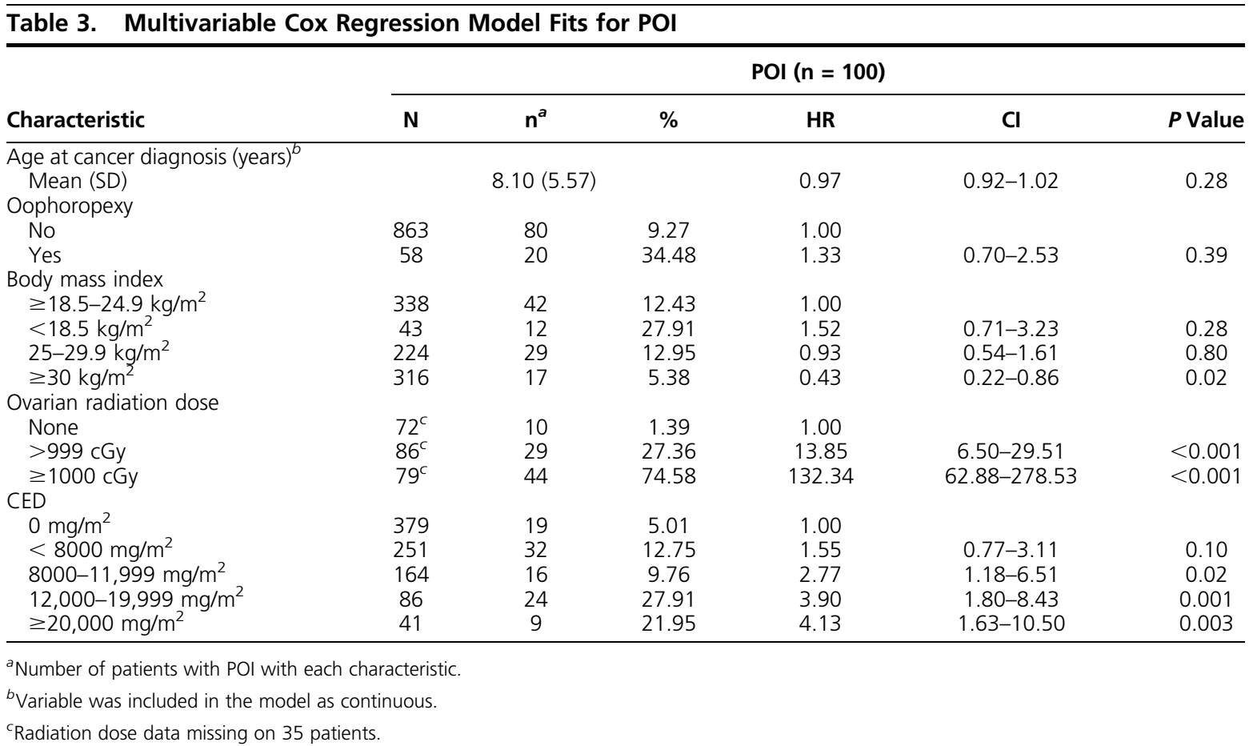
Chemotherapy, BMT & subsequent POI
(2017) Wassim Chemaitilly, et all, Premature Ovarian Insufficiency in Childhood Cancer Survivors: A Report From the St. Jude Lifetime Cohort, The Journal of Clinical Endocrinology & Metabolism, Volume 102, Issue 7, 1 July 2017, Pages 2242–2250

Slide 34
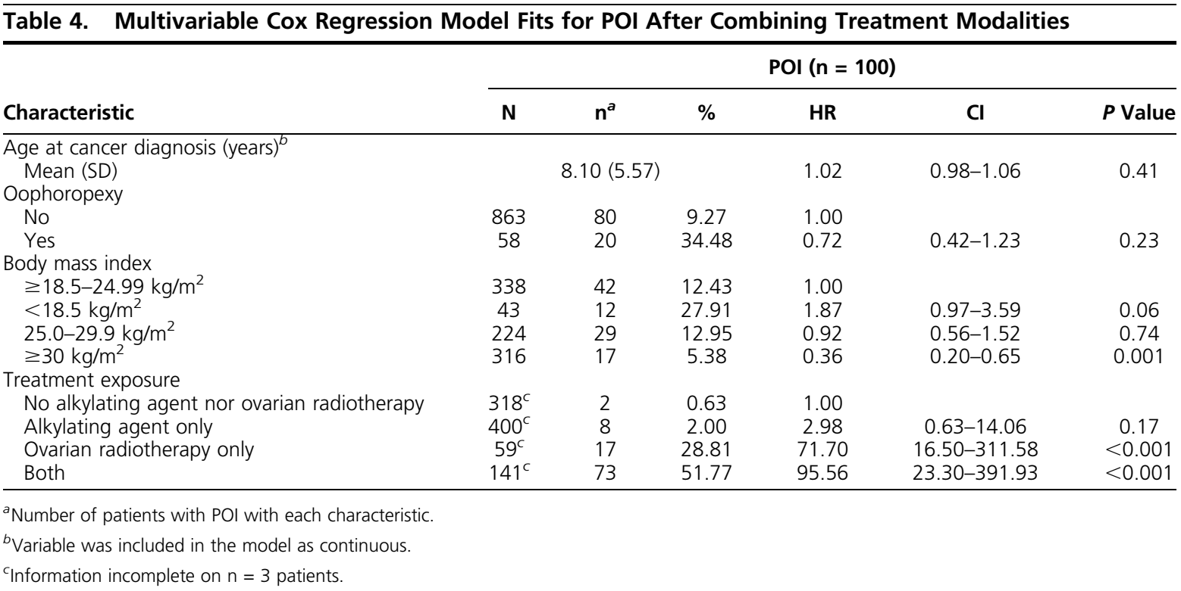
Chemotherapy, BMT & subsequent POI
(2017) Wassim Chemaitilly, et all, Premature Ovarian Insufficiency in Childhood Cancer Survivors: A Report From the St. Jude Lifetime Cohort, The Journal of Clinical Endocrinology & Metabolism, Volume 102, Issue 7, 1 July 2017, Pages 2242–2250

Slide 35
Chemotherapy, BMT & subsequent POI
The Childhood Cancer Survivor Study
The CCSS is a 26 center retrospective cohort study with longitudinal follow-up of 14,364 long term survivors of childhood cancer in North America diagnosed before the age of 21 and between January 1st 1970 and December 31st 1986.
Menopausal status of 2930 survivors diagnosed 1970–1986, (median age 6, range 0– 20); older than 18 at study (median age 35, range 18–58) was compared to 1399 siblings. NSPM was defined as menses cessation ≥six months 5 years after diagnosis prior to age 40 not due to pregnancy, surgery or medications.
(2018) Levine JM, et all. Nonsurgical premature menopause and reproductive implications in survivors of childhood cancer: A report from the Childhood Cancer Survivor Study. Cancer. 2018 Mar;124(5):1044-1052. DOI: 10.1002/cncr.31121. PMID: 29338081; PMCID: PMC5869021

Slide 36
Chemotherapy, BMT & subsequent POI
110 survivors developed NSPM (median age 32, range 16–40), prevalence at age 40: 9.1% (95% confidence interval [CI] 4.9%–17.2%), odds ratio (OR) 10.5 (95% CI 4.2–26.3) compared to siblings.
Independent risk factors included:
Exposure to procarbazine ≥ 4,000mg/m2 OR 8.96 (95% CI 5.02–16.00)
Any dose of ovarian radiation (OvRT) (OvRT<500 cGy, OR 2.73 (95% CI 1.33–5.61); OvRT ≥500 cGy, OR 8.02 (95% CI 2.81–22.85)
Receipt of a stem cell transplant OR 6.35 (95% CI 1.19–33.93)
(2018) Levine JM, et all. Nonsurgical premature menopause and reproductive implications in survivors of childhood cancer: A report from the Childhood Cancer Survivor Study. Cancer. 2018 Mar;124(5):1044-1052. DOI: 10.1002/cncr.31121. PMID: 29338081; PMCID: PMC5869021

Slide 37
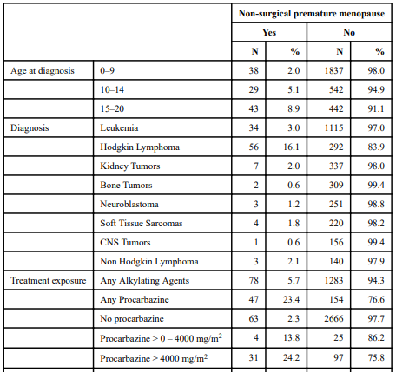
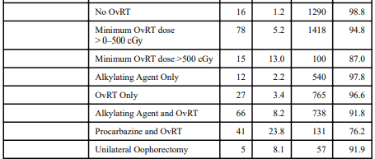
Chemotherapy, BMT & subsequent POI
Frequency of non surgical premature menopause by diagnosis, treatment and demographics
(2018) Levine JM, et all. Nonsurgical premature menopause and reproductive implications in survivors of childhood cancer: A report from the Childhood Cancer Survivor Study. Cancer. 2018 Mar;124(5):1044-1052. DOI: 10.1002/cncr.31121. PMID: 29338081; PMCID: PMC5869021

Slide 38
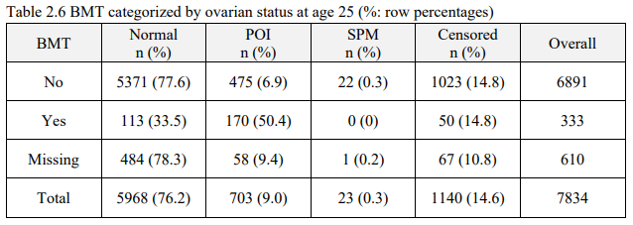
Chemotherapy, BMT & subsequent POI
Study included 7,891 female survivors who are participants in the Childhood Cancer Survivor Study.
It is estimated that about one in seven female survivors develops POI before age 40.
A higher proportion (50.4%) of survivors who experienced BMT developed POI comparing to those who did not experience BMT (6.9%), suggesting BMT was an important risk factor for POI.
(2021) A thesis submitted in partial fulfillment of the requirements for the degree of Master of Science in Epidemiology School of Public Health University of Alberta © Zhe Lu, 2021

Slide 39
Chemotherapy, BMT & subsequent POI
14 SCA-SC (14.5 ± 2.7 years), 33 SCA-HU (14.4 ± 2.4 years) and 9 SCA-BMT (14.3 ± 2.7 years)
AMH was undetectable in all SCA-BMT subjects and <5th percentile
FSH was menopausal (>40 IU/L) in 88.9% of SCA-BMT subjects ¹
Post-HSCT, all (24 female individuals) of the female individuals had diminished ovarian reserve on the basis of low AMH values and 10 of the pubertal female individuals (71%) had premature ovarian insufficiency defined as follicle-stimulating hormone >40 mIU/mL ×2. ²
1 = (2015) Elchuri SV, et all. The effects of hydroxyurea and bone marrow transplant on Anti-Müllerian hormone (AMH) levels in females with sickle cell anemia. Blood Cells Mol Dis. 2015 Jun;55(1):56-61
2 = (2020) Elchuri SV, et all. Longitudinal Description of Gonadal Function in Sickle-cell Patients Treated With HSCT Hematopoietic Stem Cell Transplant Using Alkylator-based Conditioning Regimens. J Pediatr Hematol Oncol. 2020 Oct;42(7):e575-e582

Slide 40
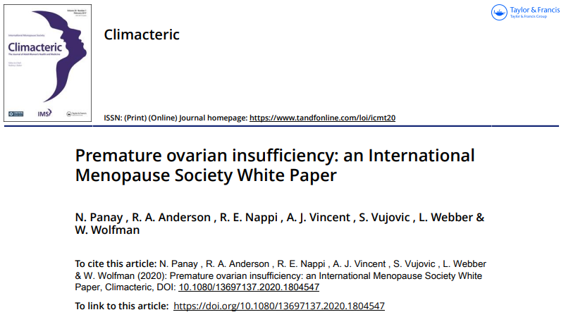
Chemotherapy, BMT & subsequent POI
The effects of chemotherapy depend on the type, previous ovarian reserve, dosage, and age at administration.
The commonest responsible chemotherapies include cyclophosphamide, cisplatinum, and doxorubicin.
Those who undergo allogeneic stem cell transplants are at very high risk of POI (>90%)
(2020) Panay N, et al. Premature ovarian insufficiency: an International Menopause Society White Paper. Climacteric. 2020 Oct;23(5):426-446

Slide 41
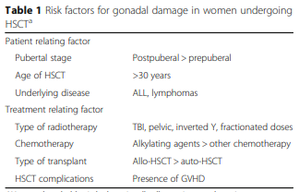
Chemotherapy, BMT & subsequent POI
POF is the most frequent complication after stem cell transplantation for haematological malignancies, occurring in more than 90 % of women.
Conditioning regimens consisting of high-dose antiblastic treatments precede both auto- and allo-HSCT procedures, causing gonadal damage.
(2016) Guida M, Castaldi MA, Rosamilio R, Giudice V, Orio F, Selleri C. Reproductive issues in patients undergoing Hematopoietic Stem Cell Transplantation: an update. J Ovarian Res. 2016 Nov 1;9(1):72

Slide 42
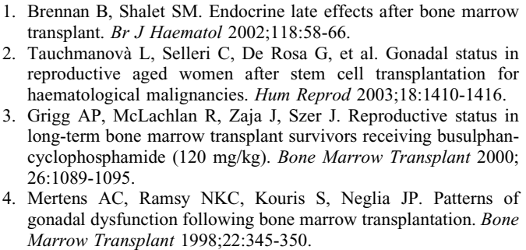
Chemotherapy, BMT & subsequent POI
Ovarian failure is the most frequent complication after stem cell transplantation (SCT) for or hematological malignancies, occurring in more than 90% of women. 1-4
(2007) Tauchmanovà L, et al. Estrogen-progestin therapy in women after stem cell transplant: our experience and literature review. Menopause (New York, N.Y.). 2007 Mar-Apr;14(2):320-330

Slide 43
Chemotherapy, BMT & subsequent POI
270 patients (109 female) underwent bone marrow transplantation (BMT) between 1974 and 1988. Age at transplant ranged from 6 to 54 years (mean 25.6 years).
Ninety-two percent of the males and 99% of the females developed evidence of gonadal dysfunction.
Older age at BMT was correlated with an increased risk in the development of elevated gonadotrophin levels.
Individuals who received radiation were more likely to develop an elevated FSH level over time.
Males were more likely to experience gonadal recovery than females.
(1998) Mertens AC, et al. Patterns of gonadal dysfunction following bone marrow transplantation. Bone Marrow Transplant 1998;22:345-350.

Slide 44
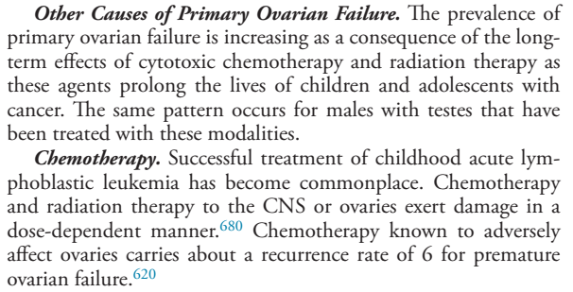
Chemotherapy, BMT & subsequent POI
(2016) Mostoufi-Moab S, Seidel K, Leisenring WM, et al. Endocrine abnormalities in aging survivors of childhood cancer: a report from the Childhood Cancer Survivor Study. J Clin Oncol. 2016;34(27):3240–3247

Slide 45
Chemotherapy, BMT & subsequent POI
This study used participants from the Childhood Cancer Survivor Study (CCSS), a multi institutional cohort of long-term survivors of various childhood cancers.
Female survivors exposed to high-risk therapies for primary ovarian dysfunction had a six-fold increased risk of developing POI (RR, 6.3; 95% CI, 5.0 to 8.0) when compared with survivors who did not receive such therapies.
(2016) Mostoufi-Moab S, Seidel K, Leisenring WM, et al. Endocrine abnormalities in aging survivors of childhood cancer: a report from the Childhood Cancer Survivor Study. J Clin Oncol. 2016;34(27):3240–3247

Slide 46
Chemotherapy, BMT & subsequent POI
Individualized prediction of a patient’s risk of premature ovarian insufficiency (POI) after chemotherapy is challenging.
Currently, chemotherapy regimens are stratified as ‘‘minimally increased’’ risk of POI (< 20% risk), ‘‘intermediate’’ (30-70%) or ‘‘high’’ risk (>80%). ¹
Based on the suggestions from endocrinologists and pediatric oncologists, the predicted risks were stratified into four categories:
< 5% - 5 to < 20% - 20% to < 50% - >= 50% representing low, medium-low, medium, and high-risk groups, respectively ²
1 = (2021) Chung, Esther H. et al. “Development of a fertility risk calculator to predict individualized chance of ovarian failure after chemotherapy.” Journal of Assisted Reproduction and Genetics 38 (2021): 3047 – 3055
2 = (2021) A thesis submitted in partial fulfillment of the requirements for the degree of Master of Science in Epidemiology School of Public Health University of Alberta © Zhe Lu, 2021

Slide 47
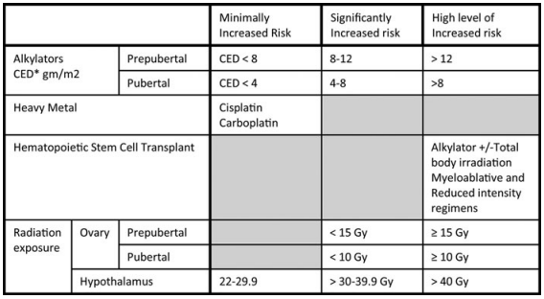
Chemotherapy, BMT & subsequent POI
FIG. 1. Female level of risk for gonadal failure/infertility above that for the general population. *CED.6 CED, cyclophosphamide equivalent dose
(2020) Meacham LR, et al. Standardizing Risk Assessment for Treatment-Related Gonadal Insufficiency and Infertility in Childhood Adolescent and Young Adult Cancer: The Pediatric Initiative Network Risk Stratification System. J Adolesc Young Adult Oncol. 2020 Dec;9(6):662-666

Slide 48
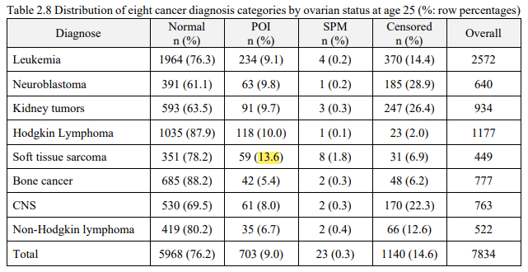
Chemotherapy, BMT & subsequent POI / Diagnosis
(2021) A thesis submitted in partial fulfillment of the requirements for the degree of Master of Science in Epidemiology School of Public Health University of Alberta © Zhe Lu, 2021

Slide 49
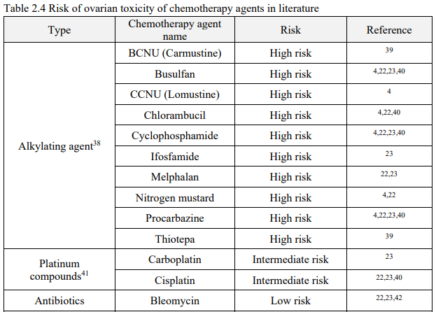
Chemotherapy, BMT & subsequent POI / Diagnosis
(2021) A thesis submitted in partial fulfillment of the requirements for the degree of Master of Science in Epidemiology School of Public Health University of Alberta © Zhe Lu, 2021

Slide 50
Chemotherapy, BMT & subsequent POI
Importantly, many of menopause symptoms mirror common chemotherapy and radiation side effects. It may be easy to dismiss these symptoms as side effects, but they may be a harbinger of ovarian damage.
Given that these studies were performed in cohorts treated >20 years ago (before risk adapted protocols and new, potentially gonadotoxic agents, such as tyrosine kinase inhibitors and PD-L1 inhibitors), it is difficult to predict how the prevalence of POI will compare in today’s and tomorrow’s survivors of childhood cancer.
(2018) Gargus E, et all. Management of Primary Ovarian Insufficiency Symptoms in Survivors of Childhood and Adolescent Cancer. J Natl Compr Canc Netw. 2018;16(9):1137-1149

Slide 51
AGENDA:
Case Presentation & Differential Diagnosis Approach
The same case reports
Chemotherapy, BMT & subsequent POI
How to determine ovarian reserve?
Does POI lead to increased Morbidity/Mortality?
Bone Health
Hormone replacement therapy
What intervention must did for fertility preservation in this case?

Slide 52
Chemotherapy, BMT & subsequent POI
Iatrogenic POI may be transient;
Contraception counseling / How to determine ovarian reserve?
Antral follicle count (AFC), require the use of transvaginal sonography
Ovarian volume or surface area, require the use of transvaginal sonography
Serum anti-Müllerian hormone (AMH)
(2018) Gargus E, et all. Management of Primary Ovarian Insufficiency Symptoms in Survivors of Childhood and Adolescent Cancer. J Natl Compr Canc Netw. 2018;16(9):1137-1149

Slide 53
Chemotherapy, BMT & subsequent POI
AMH produced by developing antral follicles in the ovaries is currently thought to be the most reliable measure of impaired ovarian reserve.
An AMH test could be performed to support the diagnosis of POI, although no diagnostic cut-off is established and AMH can be undetectable for as long as 5 years before periods cease.
Additionally, lack of universal availability, especially in primary care, and cost preclude this from being used routinely as a diagnostic test for POI. ¹
AMH could be detected at all ages; ranging from 0.3 to 15 years of age. ²
AMH can be used to diagnose and predict loss of ovarian function following iatrogenic interventions (e.g. chemotherapy for breast cancer). ¹
1 = (2020) Panay N, et al. Premature ovarian insufficiency: an International Menopause Society White Paper. Climacteric. 2020 Oct;23(5):426-446
2 = (2018) Gargus E, et all. Management of Primary Ovarian Insufficiency Symptoms in Survivors of Childhood and Adolescent Cancer. J Natl Compr Canc Netw. 2018;16(9):1137-1149

Slide 54
AGENDA:
Case Presentation & Differential Diagnosis Approach
The same case reports
Chemotherapy, BMT & subsequent POI
How to determine ovarian reserve?
Does POI lead to increased Morbidity/Mortality?
Bone Health
Hormone replacement therapy
What intervention must did for fertility preservation in this case?

Slide 55
Does POI Lead to Increased Morbidity/Mortality?
The best evidence for long-term effects of POI is from the Mayo Clinic Cohort Study. In this cohort, women who had bilateral oophorectomy before age 45 years had increased mortality compared with age-matched control women.
Primary causes of death were cardiovascular disease and osteoporotic fracture, and the study also reported cognitive impairment, dementia, parkinsonism, sexual dysfunction, and reduced psychological well-being.
In a Dutch cohort of 12,000 women followed over 17 years, life expectancy of women with POI was 2 years less than that of controls.
(2018) Gargus E, et all. Management of Primary Ovarian Insufficiency Symptoms in Survivors of Childhood and Adolescent Cancer. J Natl Compr Canc Netw. 2018;16(9):1137-1149

Slide 56
Does POI Lead to Increased Morbidity/Mortality?
No long-term prospective studies have examined the safety and efficacy of estrogen replacement therapy in terms of mortality in patients with POI.
Evidence regarding the use of hormone replacement therapy (HRT) in survivors of childhood cancer is even more limited.
However, evidence suggests that women who do not receive HRT have increased mortality compared with those who receive treatment.
(2018) Gargus E, et all. Management of Primary Ovarian Insufficiency Symptoms in Survivors of Childhood and Adolescent Cancer. J Natl Compr Canc Netw. 2018;16(9):1137-1149

Slide 57
Does POI Lead to Increased Morbidity/Mortality?
In meta-analysis showed that POI women had a higher risk of death from all causes (pooled relative risk (RR) 1.39, 95% confidence interval (CI) 1.10-1.77) and ischemic heart disease (IHD) (pooled RR 1.48, 95% CI 1.02-2.16) ¹
To date, there no are established guidelines for managing cardiovascular risk in women with POI, but evidences demonstrate the protective effect of estrogen in maintaining cardiovascular health in young female cancer survivors.
The importance of regular screening for cardiovascular risk factors should be emphasized, including monitoring of blood pressure, lipids, fasting glucose, and body mass index, and counseling for smoking cessation and maintaining a balanced diet and regular physical activity. ²
1 = (2016) Tao XY, et all. Effect of primary ovarian insufficiency and early natural menopause on mortality: a meta-analysis. Climacteric. 2016;19(1):27-36. doi: 10.3109/13697137.2015.1094784. Epub 2015 Nov 17. PMID: 26576012.
2 = (2018) Gargus E, et all. Management of Primary Ovarian Insufficiency Symptoms in Survivors of Childhood and Adolescent Cancer. J Natl Compr Canc Netw. 2018;16(9):1137-1149

Slide 58
AGENDA:
Case Presentation & Differential Diagnosis Approach
The same case reports
Chemotherapy, BMT & subsequent POI
How to determine ovarian reserve?
Does POI lead to increased Morbidity/Mortality?
Bone Health
Hormone replacement therapy
What intervention must did for fertility preservation in this case?

Slide 59
Does POI Lead to Increased Morbidity/Mortality?
Estrogen replacement has shown clear benefits for postmenopausal women in increasing BMD and reducing fracture risk.
There are no trials on the uses of non-hormonal pharmacotherapies for women with POI, such as bisphosphonates, selective estrogen receptor modulators, or strontium/denosumab
No consensus exists on the optimal intervals for repeated screening, both in the cancer survivor population and in postmenopausal women.
Scans should therefore be repeated as clinically indicated based on individual risk factors, such as: exposure to glucocorticoids, cranial radiation, methotrexate, or hematopoietic stem cell transplantation, or if DEXA results would alter treatment.
(2018) Gargus E, et all. Management of Primary Ovarian Insufficiency Symptoms in Survivors of Childhood and Adolescent Cancer. J Natl Compr Canc Netw. 2018;16(9):1137-1149

Slide 60
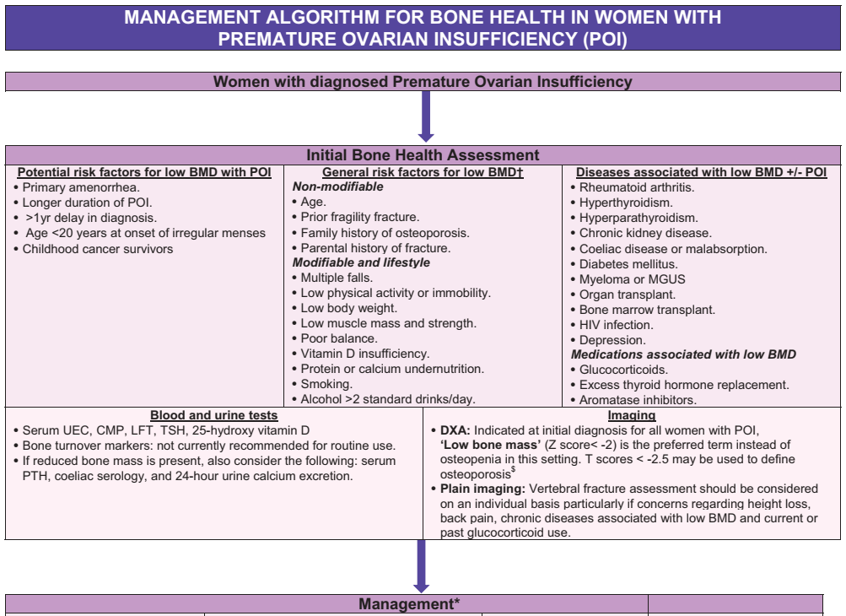
Does POI Lead to Increased Morbidity/Mortality?
(2020) Panay N, et al. Premature ovarian insufficiency: an International Menopause Society White Paper. Climacteric. 2020 Oct;23(5):426-446

Slide 61
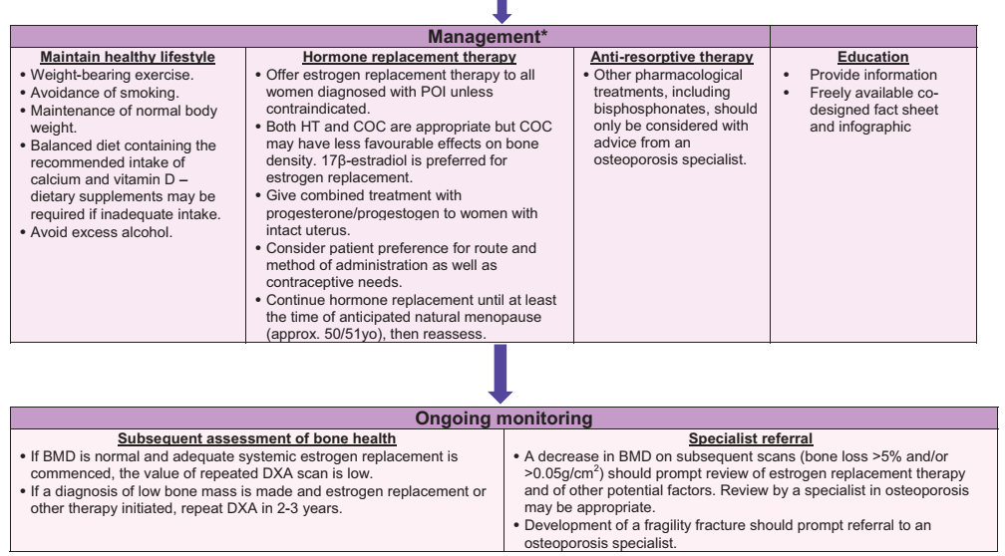
(2020) Panay N, et al. Premature ovarian insufficiency: an International Menopause Society White Paper. Climacteric. 2020 Oct;23(5):426-446

Slide 62
AGENDA:
Case Presentation & Differential Diagnosis Approach
The same case reports
Chemotherapy, BMT & subsequent POI
How to determine ovarian reserve?
Does POI lead to increased Morbidity/Mortality?
Bone Health
Hormone replacement therapy
What intervention must did for fertility preservation in this case?

Slide 63
Hormone replacement therapy
Regimens
Route of administration
Dose
Duration
1= (2017) Update on the Pathophysiology and Risk Factors for the Development of Malignant Testicular Germ Cell Tumors in Complete Androgen Insensitivity Syndrome
2= (2006) Consensus statement on management of intersex disorders.

Slide 64
Hormone replacement therapy
Regimens
Continuous combined regimen
Sequential hormone therapy
Route of administration
Dose
Duration
1= (2017) Update on the Pathophysiology and Risk Factors for the Development of Malignant Testicular Germ Cell Tumors in Complete Androgen Insensitivity Syndrome
2= (2006) Consensus statement on management of intersex disorders.

Slide 65
Hormone replacement therapy
Regimens
Route of administration
Transdermal estrogen administration is presently recommended to avoid the first pass effect and hepatic clotting factor production.
Dermal estrogen is administered in lower dosages and reaches its therapeutic targets relatively unchanged and in lower, more physiologic concentrations. ¹
In older postmenopausal women, transdermal estrogen has a lower risk of myocardial infarction, VTE, stroke and breast cancer.
Subcutaneous implants, nasal sprays and injectable estrogen preparations are also available, although not in all countries. ²
Dose
Duration
1= (2020) Williams Textbook of Endocrinology, 14th edition; 1119
2= (2017) Webber L, Anderson RA, Davies M, Janse F, Vermeulen N. HRT for women with premature ovarian insufficiency: a comprehensive review. Hum Reprod Open. 2017 Jul 12;2017(2):hox007

Slide 66
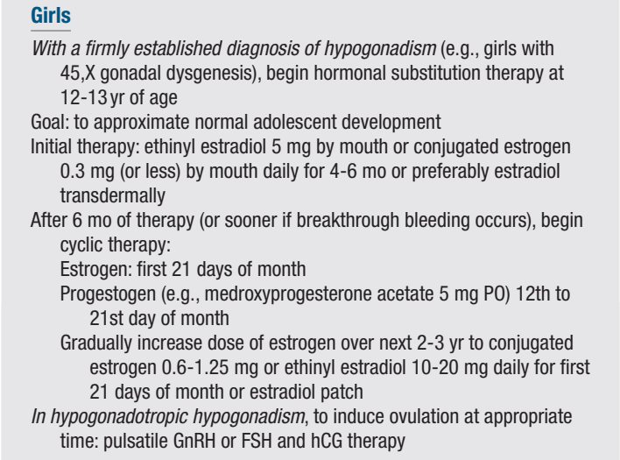
HRT
Regimens
Route of administration
Dose
Duration
(2020) Williams Textbook of Endocrinology, 14th edition; 1118

Slide 67
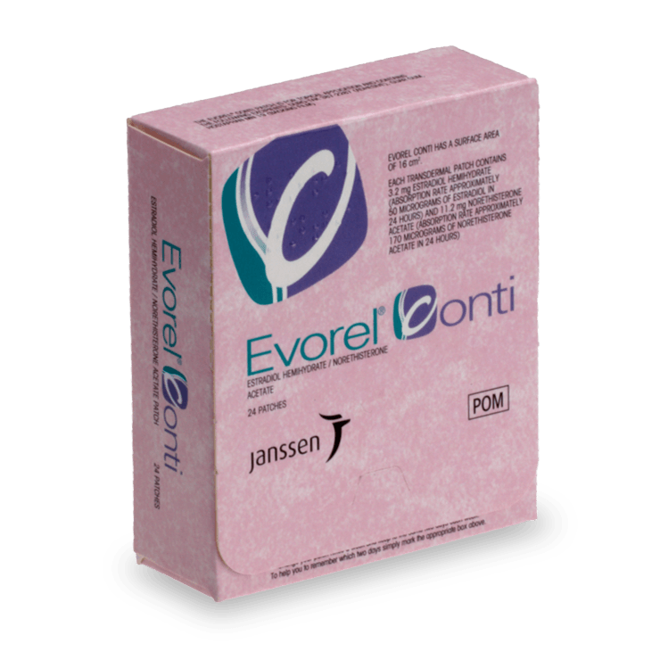
Hormone replacement therapy
Regimens
Route of administration
Dose
Initially, girls 12 to 13 years old are given estradiol alone
Estrogen patches, fractions of Evorel patches (0.05–0.07 μg/kg in younger girls or 0.08–0.12 μg/kg in older girls every night)
Increase every 6 months until an adult dose of 100 to 200 μg daily
Dermal estrogen preparations are not approved for teenagers
Estradiol gel in an increasing dose from 0.1 to 1.5 mg given over a 5-year period is reported to be safe and effective
Duration
(2020) Williams Textbook of Endocrinology, 14th edition; 1119

Slide 68
Hormone replacement therapy
Regimens
Route of administration
Dose
Progestational agents are added after breakthrough bleeding / Tanner stage 4
Progestational agents may be initiated as 5 to 10 mg of progesterone first given 5 days per month increasing to 14 days per month toward
Estradiol might be administered the first 21 days of the cycle with progesterone added the last 14 days of the artificial cycle
The maintenance dose should be the minimal amount to maintain secondary sexual characteristics, sustain withdrawal bleeding, and prevent osteoporosis
Duration
(2020) Williams Textbook of Endocrinology, 14th edition; 1119

Slide 69
Hormone replacement therapy
Regimens
Route of administration
Dose
The goals of short-term hormone therapy are to foster age-appropriate secondary sexual development and to induce a growth spurt and a normal adolescent increase in bone density without causing premature epiphyseal closure, which requires that bone age be monitored at 6-monthly intervals during treatment.
A progestin should not be added to the treatment regimen until there is substantial breast development and full contour breast growth has plateaued, because premature progestin treatment can adversely affect breast growth or contours.
Duration
(2020) Speroff’s Gynecologic Endocrinology, 9th edition

Slide 70
Hormone replacement therapy
Regimens
Route of administration
Dose
Duration
The consensus is that HRT should be continued at least until the age of natural menopause, i.e. around 50 years.
With additional consideration of patient-specific issues such as preexisting bone density
(2017) Webber L, et al. HRT for women with premature ovarian insufficiency: a comprehensive review. Hum Reprod Open. 2017 Jul 12;2017(2):hox007

Slide 71
Hormone replacement therapy
HRT has not been found to increase the risk of breast cancer before the age of natural menopause. ¹
The estrogen doses used should be generally higher than that used in natural menopause. ²
Recent evidence suggests that 2 mg of 17β-estradiol orally is sufficient to maintain BMD (study in TS patients), and the effects are equal to 4 mg ³
1 = (2016) European Society for Human Reproduction and Embryology (ESHRE) Guideline Group on POI, Webber L, et al. ESHRE Guideline: management of women with premature ovarian insufficiency. Hum Reprod. 2016 May;31(5):926-37
2 = (2020) Panay N, et al. Premature ovarian insufficiency: an International Menopause Society White Paper. Climacteric. 2020 Oct;23(5):426-446
3 = (2017) Webber L, et al. HRT for women with premature ovarian insufficiency: a comprehensive review. Hum Reprod Open. 2017 Jul 12;2017(2):hox007

Slide 72
AGENDA:
Case Presentation & Differential Diagnosis Approach
The same case reports
Chemotherapy, BMT & subsequent POI
How to determine ovarian reserve?
Does POI lead to increased Morbidity/Mortality?
Bone Health
Hormone replacement therapy
What intervention must did for fertility preservation in this case?

Slide 73
Fertility preservation
STRONG / Low
Clinicians should provide information to patients regarding
impact of cancer, other diseases and treatments on reproductive function
impact of cancer, other diseases and their treatment on fertility
Fertility preservation options
Issues related to cryopreservation storage after FP
Infertility and fertility treatments
Pregnancy after gonadotoxic treatment or underlying condition; and
Other childbearing and parenting options
(2020) ESHRE Guideline Group on Female Fertility Preservation, Anderson RA, et all. ESHRE guideline: female fertility preservation. Hum Reprod Open. 2020 Nov 14;2020(4):hoaa052

Slide 74
Fertility preservation
Fertility preservation in the prepubertal child is challenging. The majority of proposed treatment modalities are thus far experimental and without proven efficacy.
Shielding of the ovaries during radiotherapy
Oophoropexy; only approximately 15% of patients treated with transposition and wishing to become pregnant ever achieve this goal
In prepubescent girls, the ovaries cannot be stimulated to produce mature eggs. Ovarian tissue cryopreservation has been proposed as a method to preserve fertility.
This technique has been performed in children as young as 2.7 years of age, and the chance of later restoring fertility should theoretically be higher because the ovarian cortex contains more primordial and primary follicles in younger children.
(2020) Sigal Klipstein, et all, COMMITTEE ON BIOETHICS, SECTION ON HEMATOLOGY/ONCOLOGY, SECTION ON SURGERY; Fertility Preservation for Pediatric and Adolescent Patients With Cancer: Medical and Ethical Considerations. Pediatrics March 2020; 145 (3): e20193994

Slide 75
Fertility preservation
Numerous studies in mice have proved the efficacy of bone marrow transplantation (BMT) in resuming the ovarian function after chemotherapy-induced ovarian insufficiency. ¹
Mechanical disruption of the Hippo signaling pathway, in combination with Akt stimulation paved the way to studies on its potential application for fertility treatments.
Another approach involved autologous stem cell ovarian transplantation (ASCOT).
Intraovarian injection of autologous platelet-rich plasma, resulted in live births and ongoing pregnancies both spontaneously and via in vitro fertilization (IVF). ²
1 = ClinicalTrials.gov Identifier: NCT02779374
2 = (2021) Reig A, et al. Emerging follicular activation strategies to treat women with poor ovarian response and primary ovarian insufficiency. Curr Opin Obstet Gynecol. 2021 Jun 1;33(3):241-248

Slide 76
Fertility preservation
A 45-year-old perimenopausal female, who was infrequently menstruating for the last 3 years, came to our fertility clinic. Her AMH level was low 0.4 ng/mL.
Her bone marrow aspiration was done from posterior iliac crest under local anesthesia. Aspiration was done using Jamshidi needle.
Laparoscopic instillation of ABMDSC in ovaries was done.
After 8 weeks ABMDSCT, the ultrasound revealed two follicles in each ovary. In addition, the AMH improved to 0.9 ng/mL.
Considering the age of the patient, the first cycle of egg pooling was planned immediately.
(2018) Gupta S, et all. Role of Autologous Bone Marrow-Derived Stem Cell Therapy for Follicular Recruitment in Premature Ovarian Insufficiency: Review of Literature and a Case Report of World's First Baby with Ovarian Autologous Stem Cell Therapy in a Perimenopausal Woman of Age 45 Year. J Hum Reprod Sci. 2018 Apr-Jun;11(2):125-130

Slide 77
Fertility preservation
We retrieved three eggs and one Grade A compacting embryo was frozen on day 3.
we went ahead with frozen embryo transfer in subsequent cycle instead of second sitting of ABMDSCT.
Her beta-human chorionic gonadotropin was 1280 on day 14 of embryo transfer, and a single intrauterine viable gestation was seen at 6 weeks on ultrasound.
A 2.7 kg female baby was delivery by cesarean birth at 38 weeks.
This is not only India's first baby with this novel therapy but also may be the world's first baby with ABMDSC therapy
(2018) Gupta S, et all. Role of Autologous Bone Marrow-Derived Stem Cell Therapy for Follicular Recruitment in Premature Ovarian Insufficiency: Review of Literature and a Case Report of World's First Baby with Ovarian Autologous Stem Cell Therapy in a Perimenopausal Woman of Age 45 Year. J Hum Reprod Sci. 2018 Apr-Jun;11(2):125-130

Slide 78
Thanks for your attention

