Slide 1
Gestational Diabetes:
Insulin Therapy
F.Hadaegh MD.
Prevention of Metabolic Disorders Research Center, Research Institute for Endocrine Sciences,
Shahid Beheshti University
Tehran ,Iran ,2/25/2016

Slide 2
Agenda:
Does treatment reduces outcomes of mothers and their offspring ?
Is treatment of GDM associated with any harms?
Exercise
Insulin therapy
Agenda

Slide 3
Identifying women with GDM is important
Because meta-analysis of randomized trials has shown that appropriate therapy can decrease maternal and fetal morbidity, particularly macrosomia

Slide 4
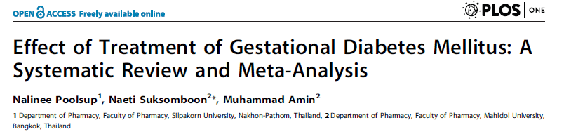

Meta-Analysis-2014
Agenda

Slide 5
0.47[0.38, 0.57]
Agenda
0.55[0.45, 0.67]
0.42[0.23, 0.77]

Slide 6
1.1.4 Perinatal/Neonatal Mortality
1.1.5 Birth Tranuma
1.1.6 Neonatal Hypoglycemia
Agenda
1.1.7 Preterm Birth
1.1.8 SGA

Slide 7
Agenda
0.68[0.53, 0.87]

Slide 8
Conclusion
However, no significant difference was observed between the two groups regarding perinatal/neonatal mortality, neonatal hypoglycemia, birth trauma, preterm births, pre-eclampsia, caesarean section and labor induction.
Agenda

Slide 9
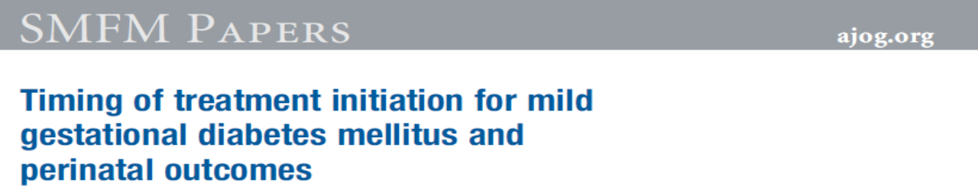
Mild GDM treatment
2015
Agenda

Slide 10
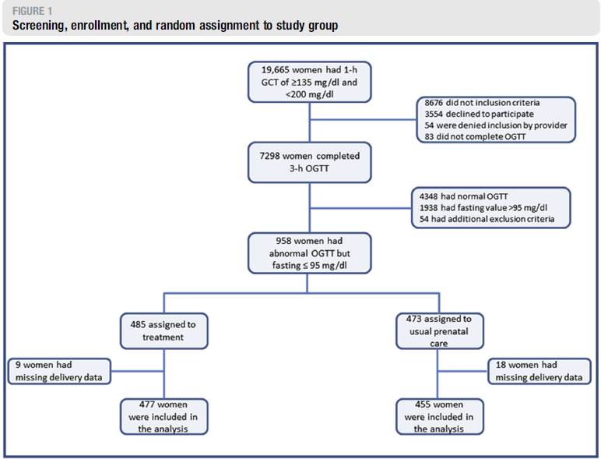
Agenda

Slide 11
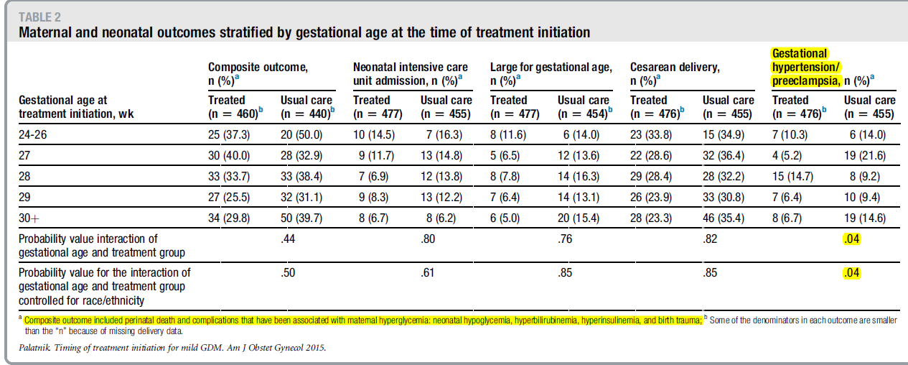
Gestational
Hypertension/
Preeclampsia,
Agenda
Composite outcome included perinatal death and complications that have been associated with maternal hyperglycemia: neonatal hypoglycemia, hyperbilirubinemia, hyperinsulinemia, and birth trauma

Slide 12
COMMENT
The earlier initiation of treatment for mild GDM was not associated with a stronger effect of treatment on perinatal outcomes.
women who started treatment earlier had no difference in the composite primary outcome that included perinatal death, hypoglycemia, hyperbilirubinemia, neonatal hyperinsulinemia, and birth trauma compared with women who started treatment later in gestation
Agenda

Slide 13
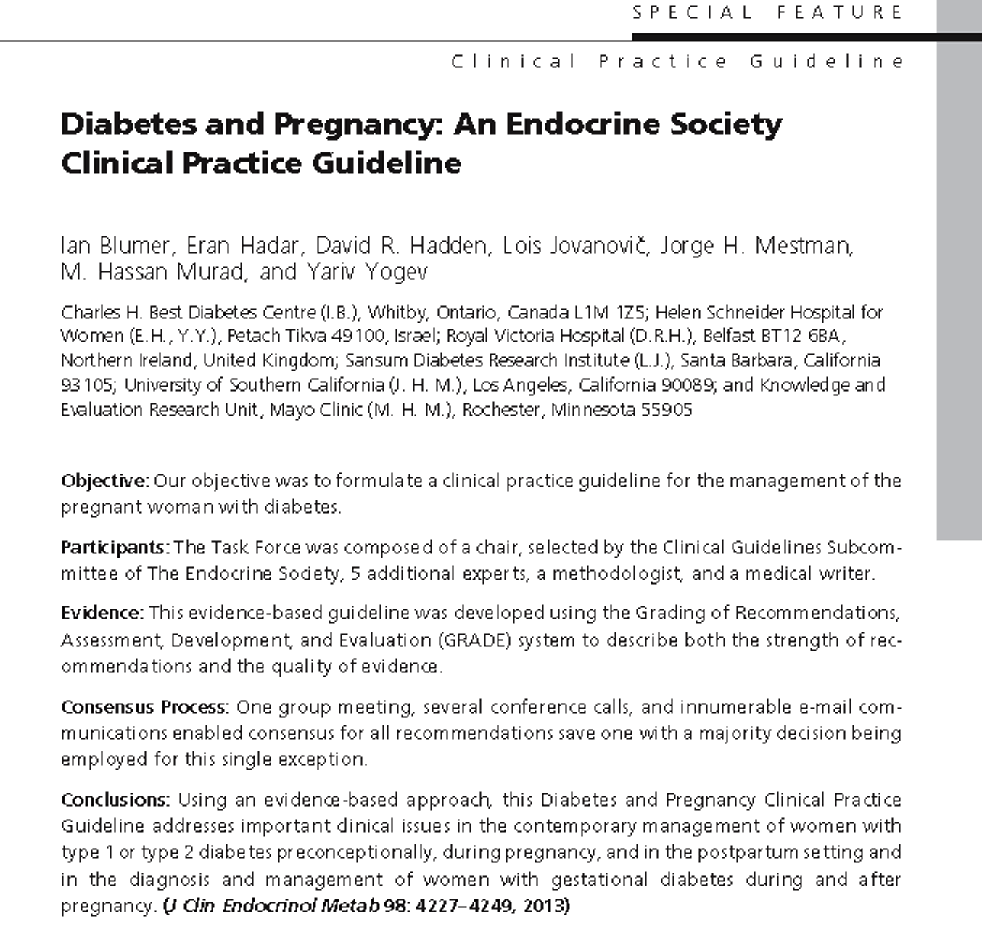
Agenda

Slide 14
1.0.
Preconception care
of women with diabetes
Agenda

Slide 15

1.2. Preconception Glycemic Control
We suggest that women with diabetes seeking to conceive strive to achieve blood glucose and HbA1C levels as close to normal as possible when they can be safely achieved without undue hypoglycemia. (2 OO) (i.e. HbA1C <6.5% ADA 2016)
Agenda

Slide 16
1.3. Insulin Therapy-1 Regimens
a. We recommend that insulin-treated women with diabetes seeking to conceive be treated with multiple daily doses of insulin or continuous sc insulin infusion in preference to split-dose, premixed insulin therapy, because the former are:
more likely to allow for the achievement and maintenance of target blood glucose levels preconceptionally.
in the event of pregnancy, are more likely to allow for sufficient flexibility or precise adjustment of insulin therapy. (1 OO)
Agenda

Slide 17
1.3. Insulin Therapy-2 Change Time
b. We suggest that a change to a woman’s insulin regimen, particularly when she starts continuous sc insulin infusion, be undertaken well in advance of withdrawing contraceptive measures or otherwise trying to conceive to allow the patient to acquire expertise in, and the optimization of, the chosen insulin regimen. (Ungraded recommendation)
Agenda

Slide 18

c. We suggest that insulin-treated women with diabetes seeking to conceive be treated with rapid-acting insulin analog therapy (with insulin aspart or insulin lispro) in preference to regular insulin. (2 OO)
d. We suggest that women with diabetes successfully using the long-acting insulin analogs insulin detemir or insulin glargine preconceptionally may continue with this therapy before and then during pregnancy.
(2 OO)

Slide 19

a. We recommend that all women with diabetes who are seeking pregnancy have a detailed ocular assessment by a suitably trained and qualified eye care professional in advance of withdrawing contraceptive measures or otherwise trying to conceive. (1 )
  If retinopathy is documented, the patient should be apprised of the specific risks to her of this worsening during pregnancy.
  If the degree of retinopathy warrants therapy, we recommend deferring conception until the retinopathy has been treated and found to have stabilized. (1 )
b. We recommend that women with established retinopathy be seen by their eye specialist every trimester, then within 3 months of delivering, and then as needed. (1 OOO)
c. We suggest that pregnant women with diabetes not known to have retinopathy have ocular assessment performed soon after conception and then periodically as indicated during pregnancy. (2 OO)

Slide 20
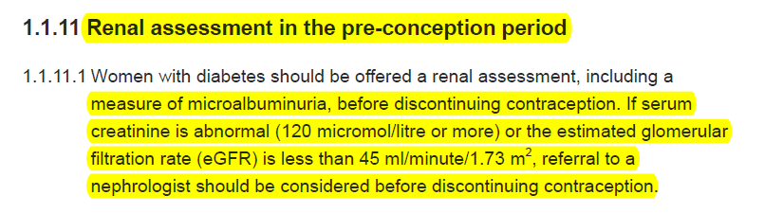
NICE 2015

Slide 21
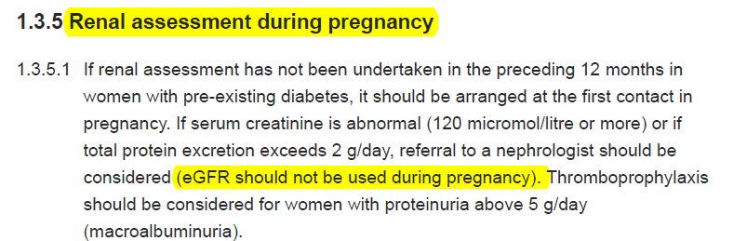
NICE 2015

Slide 22
2.0.
Gestational diabetes (GDM)
Agenda

Slide 23
2.3. Management of Elevated Blood Glucose
a. We recommend that women with GDM target blood glucose levels as close to normal as possible. (1 OO)
b. We recommend that the initial treatment of GDM should consist of MNT and daily moderate exercise for ≥30 minutes. (1 O)
c. We recommend using blood glucose-lowering pharmacological therapy if lifestyle therapy is insufficient to maintain normoglycemia in women with GDM. (1 )

Slide 24
2.3. Management of Elevated Blood Glucose
Education is the cornerstone of GDM management.
Trained nurses and dieticians are the most effective in this regard.
The aim of dietary therapy is to avoid large meals and simple carbohydrates rich foods.

Slide 25
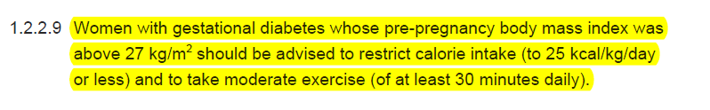
Importance of Diet and Exercise
It is important to note that 80–90% of women being treated for MILD GDM could be managed with
lifestyle therapy alone (ADA 2016)
NICE 2015

Slide 26
Glucose monitoring:
  When GDM initially diagnosed: SMBG 4 times daily (Fasting & 1-2 h postprandial) for recognition of women that need anti-hyperglycemic agents
  Insulin resistance gradually increased during pregnancy
  Can decrease the frequency of glucose monitoring when good glycemic control with MNT (every other day or every third day in mild GDM saving money and increasing convenience for patients especially after new criteria)

Slide 27
Exercise:
Exercise → ↑ insulin sensitivity → ↓ FBS, PPG
ADA encourage a program of moderate exercise as part of treatment plan for women with GDM and no medical & obstetrical contraindication

Slide 28
Continue
Same as nonpregnant women:
  Warm-ups and stretching (5-10)
  Exercise program (30-45 min)
  Cool down (5-10 min)
  But avoid from abdominal trauma: activities with a high risk of falling or abdominal trauma undesirable

Slide 29
What type of exercise?
Arm ergometry 6 weeks (20-30 min. 3 times a week
Recumbent bicycle

Slide 30


arm ergometry & recumbent bicycle

Slide 31
3.0.
Glucose Monitoring and Glycemic Targets
Agenda

Slide 32
3.1. Self-monitoring of blood glucose (SMBG)
We recommend SMBG in all pregnant women with GDM or overt diabetes (1 ) and suggest testing before and either 1 or 2 hours after the start of each meal (choosing the post meal time when it is estimated that peak postprandial blood glucose is most likely to occur) and, as indicated, at bedtime and during the night. (2 OO)

Slide 33
3.2. Glycemic Targets-1 FPG
a. We recommend pregnant women with overt or GDM strive to achieve a target pre-prandial blood glucose 95 mg/dl. (1 OO for fasting target, 1 OOO for other meals)
b. We suggest that an even lower FPG target of 90 mg/dl be strived for (2 OOO) if this can be safely achieved without undue hypoglycemia.

Slide 34
3.2. Glycemic Targets-2 Post Prandials
c. We suggest pregnant women with overt or GDM strive to achieve target blood glucose levels 1 hr after the start of a meal 140 mg/dl and 2 hrs after the start of a meal 120 mg/dl (2 OOO) when these targets can be safely achieved without undue hypoglycemia.
d. We suggest pregnant women with overt diabetes strive to achieve a HbA_{1C} 7% (ideally 6.5%). (2 OOO)

Slide 35
NICE 2015
If it is safely achievable, women with diabetes should aim to keep FPG between 63 and 106 mg/dl and 1-hour postprandial blood glucose below 140 mg/dl during pregnancy.
Women with insulin-treated diabetes should be advised of the risks of hypoglycaemia and hypoglycaemia unawareness in pregnancy, particularly in the first trimester.

Slide 36
3.3. Continuous Glucose Monitoring System (CGMS)
We suggest that CGMS be used during pregnancy in women with overt or GDM when SMBG levels (or, in the case of the woman with overt diabetes, HbA_{1C} values) are not sufficient to assess glycemic control (including both hyperglycemia and hypoglycemia). (2 OO)

Slide 37
5.0.
Blood Glucose Lowering Pharmacological
Therapy During Pregnancy
Agenda

Slide 38
5.1. Insulin Therapy-1
Basal Insulin Analogues
a. We suggest that the insulin analog detemir may be initiated during pregnancy for those women who require basal insulin and for whom NPH insulin, in appropriate doses, has previously resulted in, or for whom it is thought NPH insulin may result in, problematic hypoglycemia.
  Insulin detemir may be continued in those women with diabetes already successfully taking insulin detemir before pregnancy. (2QQQQ)
b. We suggest that those pregnant women successfully using insulin glargine before pregnancy may continue it during pregnancy. (2QQOO)

Slide 39
5.1. Insulin Therapy-2
Prandial Insulins
c. We suggest that insulin analogs lispro and aspart be used in preference to regular insulin in pregnant women with diabetes. (2QQQO)
d. We recommend the ongoing use of CSII during pregnancy in women with diabetes when this has been initiated before pregnancy. (1QQQO)
  but suggest that CSII not be initiated during pregnancy unless other insulin strategies including multiple daily doses of insulin have first been tried and proven unsuccessful. (2QQOO)

Slide 40
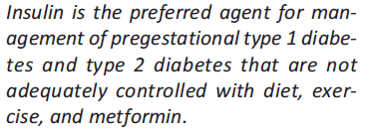
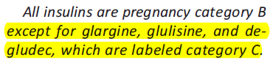
ADA 2016

Slide 41
Prandial Insulins

Slide 42
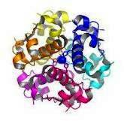
Regular Human Insulin
After SQ injection regular insulin tends to
dissociate from its normal hexameric form, first
into dimers and then monomers.
  Only dimeric & monomeric forms can pass through the endothelium.
The resulting delay in the onset and duration of action, limits its effectiveness in controlling postprandial glucose.
Dose dependent pharmacokinetics, with prolonged onset, peak, duration of action with higher doses.
Med Clin North Am 1998

Slide 43
Pharmacokinetic Properties of
Regular Insulin
Regular Insulin
Onset of action: 0.5-1 hr
Peak activity: 2-4 hrs
Duration of activity: 6-8 hrs
Med Clin North Am 1998

Slide 44
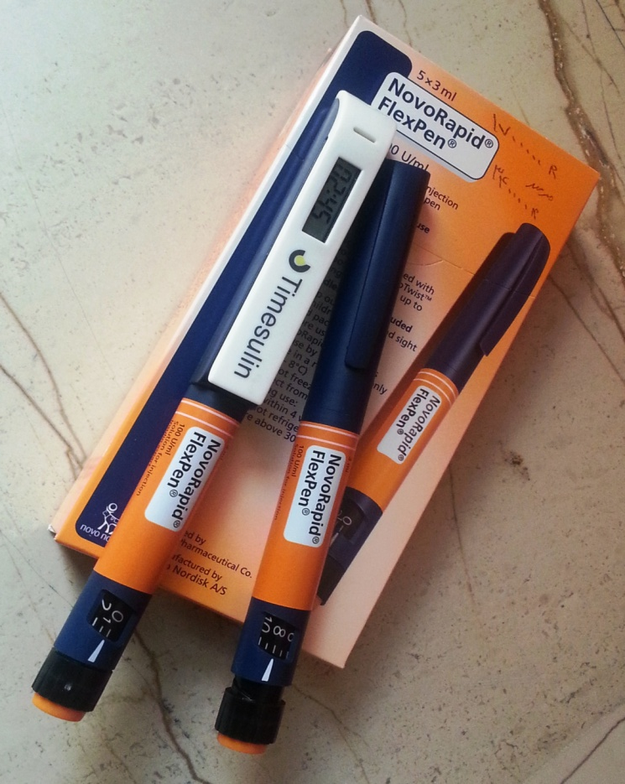
Pharmacokinetic Properties of
Rapid acting insulin Preparations
Rapid acting insulins
Onset of action: 15 minutes
Peak activity: 1 hr
Duration of activity: 3-4 hrs
Lancet 1997 Jan

Slide 45
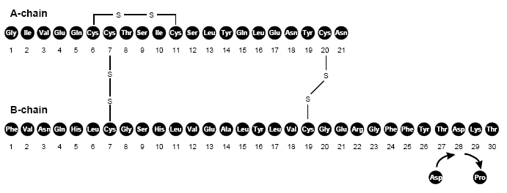
Structural Formula of Insulin Aspart

Slide 46
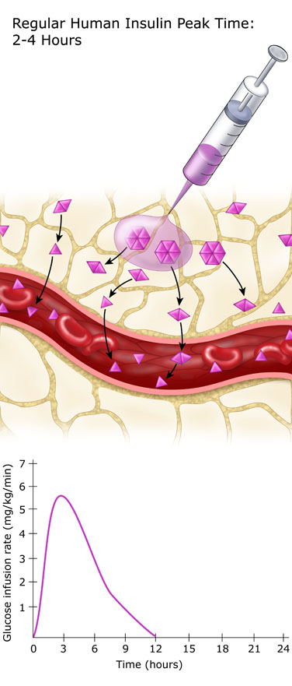
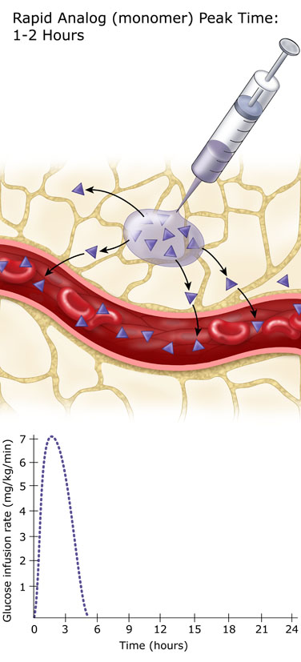
Regular Insulin vs. Rapid Analogue

Slide 47
Similar glucose excursions for post-meal insulin Asp. and pre-meal HRI in T1DM
Randomised, double-blind, double-dummy, four-period crossover study, 20 patients with type 1 diabetes
15
14
13
HI_{(–15 min)}
12
HI_{(0 min)}
11
Insulin aspart _{(0 min)}
Plasma glucose (mmol/L)
Insulin aspart _{(+15 min)}
10
9
n=20
8
7
6
0
–30
0
30
60
90
120
150
180
210
240
270
Test meal
Brunner et al. Diabet Med 2000;17:371–5
Notes:
1098 – Brunner et al. Diabet Med. 2000 May;17(5):371-5.
This was a randomised, double-blind, double-dummy, four-period crossover study, 20 Type 1 diabetic patients were investigated. Prandial insulin was administered 15 min before the start of the meal (HI(-15 min)), immediately before the meal (HI(0min); IAsp(0min)) and 15 min after the start of the meal (IAsp(+15 min)).
This slide shows mean plasma glucose levels throughout the study for each insulin/administration time.
Mean plasma glucose excursions were not statistically different for insulin aspart (0 min, +15 min) and HI (–15 min), (11.9, 14.2, 13.6 mmol.l^{–1}.h, respectively). The plasma glucose excursion for HI (0 min) was 17.9 mmol.l^{–1}.h. (p<0.05 versus other treatments).
Mean maximum plasma glucose concentration was also not significantly different for insulin aspart (+15 min) and HI (–15 min, 0 min), (13.2, 13.3, 14.1 mmol, respectively). Maximum plasma glucose for insulin aspart (0 min) was 11.2 mmol (p<0.05 versus other treatments).
Mean time to maximum concentration of plasma glucose for insulin aspart (0 min, +15 min) and HI (–15 min, 0 min), was 75, 80, 99, 94min, respectively.
n=20 for all measurements.

Slide 48
Insulin Asp. vs. HRI in 322 pregnant women with T1DM
6-week follow-up
Conception
Delivery
Insulin aspart /NPH
Insulin aspart /NPH
Screening
and consent
Human insulin/NPH
Human insulin/NPH
Blood glucose optimisation
and conception
Pregnancy
Randomisation
12 months
6 w
Visit
1
2
3
4
5
6
GW10
GW14
GW24
GW36
T
EOT
Mathiesen et al. Diabetes Care 2007;30:771–6
Notes:
417 subjects; 63 centres in 18 countries; 2002–2005
Randomised, open-label, parallel-group study
Eligible subjects:
≥18 years of age
with insulin treatment for ≥12 months
either pregnant (singleton) with gestational age
≤10 weeks or planning pregnancy
HbA_{1c} ≤12.0% (planning pregnancy) and ≤8.0% at confirmation of pregnancy
Insulin was titrated to optimal levels based on SMBG targets: preprandial 4.1–6.1 mmol/L; 1 h postprandial <8.6; 2 h postprandial <7.5; HbA_{1c}<6.5%
Primary study endpoint:
major hypoglycaemia (3rd party help or reversal of symptoms after food, glucagon or IV glucose)
minor (PG<3.1 mmol/L±symptoms)
nocturnal (midnight-0600 h)
Efficacy endpoints: HbA_{1c}, 8 point glucose profile
Treatment was assessed using Diabetes Treatment Satisfaction Questionnaire at baseline and follow up visits
Central laboratory measurement for HbA_{1c}
Statistical analysis: episodes of maternal hypoglycaemia were analysed using a γ frailty model with treatment as covariate
305 subjects were required to be randomised to detect difference of 40% with 80% power (p<0.05)

Slide 49
Similar glycaemic control with
insulin Asp. as with HRI
8.5
Insulin aspart (mean ± SD)
8.0
Human insulin (mean ± SD)
HbA_{1c} (%)
7.5
7.0
6.5
6.0
5.5
0
Screening
<10 weeks*
12 weeks
24 weeks
36 weeks
Follow-up
Visit
*Only subjects pregnant after screening
Mathiesen et al. Diabetes Care 2007;30:771–6
Notes:
Treatment with IAsp was noninferior to treatment with HI as assessed by A1C at the end of the second and third trimesters (mean difference [95% CI]) (IAsp minus HI: 0.04% [0.18 to 0.11], P NS; 0.08% [0.23 to 0.06], P NS). In both treatment groups, A1C decreased during the first two trimesters then increased toward delivery and follow-up

Slide 50

Insulin Asp. provide better postprandial control compared to HRI
Visit P2
Visit P4
Plasma glucose (mmol/l)
p = 0.04 in favour of insulin Asp.
p = 0.003 in favour of insulin Asp.
Mathiesen et al. Diabetes Care 2007;30:771–6
Notes:
During Visits P2 and P4, pregnancy assessments are performed
Mean prandial plasma glucose increments (mean of difference in pre- and postprandial plasma glucose at breakfast, lunch, and dinner) during pregnancy were lower with NovoRapid® than HI
Between-treatment differences were statistically significant at visits P2 and P4 (NovoRapid® minus HI [in mmol/l] P2: –0.75 [95% CI –1.25 to –0.25], P = 0.003; P4: –0.40 [–0.80 to –0.01], P = 0.044)
Visit P1=first-pregnancy assessment/randomisation
Visits P2-P4=clinic visits at the end of the first, second, and third trimester

Slide 51
Better postprandial control with insulin Asp. 8-point plasma glucose profile
Insulin aspart (mean ± SD)
Human insulin(mean ± SD)
12
*p < 0.05
10
8
Plasma glucose (mmol/l)
6
4
2
0
BB
B90
BL
L90
BD
D90
BE
2AM
Time point
Mathiesen et al. Diabetes Care 2007;30:771–6
Notes:
Mean 8-point PG profile is shown here.
Overall profiles were similar at P3 and P4 although estimated mean values of 24-h PG increased from visit P2 to P3 then decreased to visit P4.
Postprandial PG levels were consistently lower with NovoRapid® after breakfast (B90) with statistically significant between-treatment differences at P2 (P=0.044) and P4 (P=0.0007) but not at P3 (P=0.153).
Pre-prandial (pre-breakfast, pre-lunch and pre-dinner) PG levels were comparable between treatments at all visits.

Slide 52
Hypoglycaemic episodes during pregnancy: observed rates
Insulin aspart
Human insulin
All differences NS
Mathiesen et al. Diabetes Care 2007;30:771–6
Notes:
Observed rates of hypoglycaemia are consistently lower with insulin aspart than with human insulin.

Slide 53
Severe hypoglycaemia in subjects randomised prior to pregnancy
Insulin aspart
Human insulin
Rate of hypoglycaemia (episodes/patient/year)
Pre-conception
1st half
pregnancy
2nd half
pregnancy
Post-partum
All differences NS
Subjects were randomised prior to pregnancy
Heller et al. Diabetes Care 2010;33:473–77
Notes:
Observed rates of severe hypoglycaemia in subjects randomly assigned preconception or early in pregnancy treated with either IAsp or human insulin (HI).

Slide 54
Perinatal Outcomes
 | Insulin aspart | Human insulin
 | n | n
Live births | 137 | 131
Perinatal mortality (/1000) | 14 | 22
Fetal loss | 14 | 21
Miscarriage Late spontaneous abortion Termination of pregnancy Stillbirth | 12 1 0 1 | 15 1 4 1
Neonatal death | 1 | 0
Hod et al. Am J Obstet Gynecol 2008;198:186.e1–7
Notes:
Comparison of pregnancy outcomes showed no significant between-treatment difference in live births (IAsp, 87.3%; HI, 79.4%), fetal losses (IAsp, 8.9%; HI, 12.1%), and congenital malformations (IAsp, 4.3%; HI, 6.6%).
Number of infants (IAsp n=138 and HI n=136), Including liveborn and stillborn infants as well as outcome of terminations of pregnancy due to antenatally diagnosed congenital malformations

Slide 55
Congenital Malformations
 | Insulin aspart | Human insulin
 | n | n
Total (n=15) | 6/138* | 9/136*
Percentage | 4.3% | 6.6%
Cardiac-related malformations | 5 | 4
Anencephaly/CNS malformations | 1 | 1
Congenital hydronephrosis | 0 | 1
Congenital tongue anomaly | 0 | 1
Talipes | 0 | 1
Fetal chromosomal abnormality | 0 | 1
*Including liveborn and stillborn infants and terminations of pregnancy due to antenatally diagnosed congenital malformations
Hod et al. Am J Obstet Gynecol 2008;198:186.e1–7

Slide 56
Insulin Asp. In Pregnancy:
Summary
Insulin aspart compared to human insulin in pregnant patients with type 1 diabetes mellitus has
  Similar glycaemic control¹
  Better postprandial control¹
  A tendency to less severe hypoglycaemia²
  No significant between-treatment difference in live births, fetal losses, and congenital malformations³
Mathiesen et al. Diabetes Care 2007;30:771–6
Heller et al. Diabetes Care 2010;33:473–77
Hod et al. Am J Obstet Gynecol 2008;198:186.e1–7

Slide 57
Basal Insulins

Slide 58
Pharmacokinetic Properties of
Basal Insulin Preparation
NPH Insulin
  Onset of action: 1-4 hrs
  Peak activity: 6-10 hrs
  Duration of activity: 10-16 hrs
Long Acting Insulin Analogous: Glargine & Detemir
  Were designed to provide a reliable, constant basal insulin concentration to control basal metabolism.
  They are more predictable than conventional insulins and allow simplified insulin-replacement strategies.

Slide 59
Types Of Basal Insulin
 | Intermediate-Acting NPH | Long-Acting Analogues Glargine, Detemir
Onset | 1-3 hrs | 1.5 - 3 hrs
Peak | 5-8 hrs | Glargine: No peak Detemir: dose-dependent peak
Duration | Up to 18 hrs | Detemir: 9-24 hrs Glargine: 20-24 hrs

Slide 60
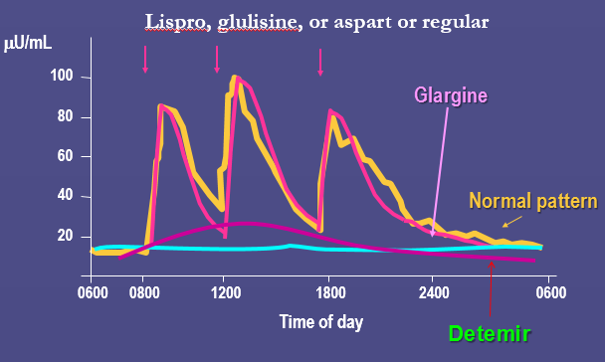
The new analogues are more predictable than conventional insulins and allow simplified insulin replacement strategies

Slide 61
Insulin Analogous Vs. Human insulin Safety

Slide 62
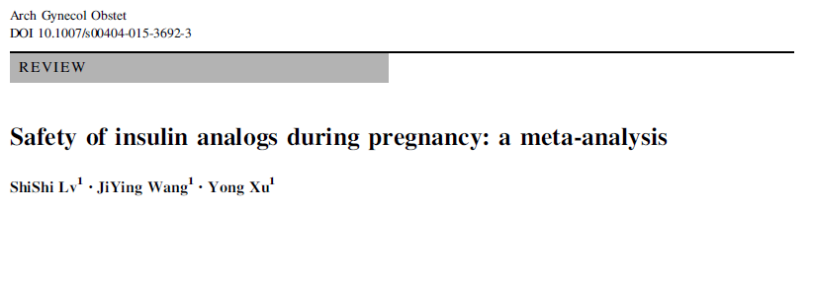
Meta-Analysis (2014)

Slide 63
Meta-analysis of Aspart studies
These studies reported on a total of 1143 women with GDM or Pre-GDM treated with either insulin Aspart (n = 567) or regular insulin (n = 516) during pregnancy.
Baseline characteristics were similar in the Aspart and control groups in terms of age ,BMI and HbA1C at entry.

Slide 64
Aspart vs. Regular insulin
The risk for macrosomia was not significantly increased in the Aspart group (RR = 0.81, 95 % CI 0.42 to 1.58) [13, 14].
No significant difference was observed in the rate of C/S rate in women receiving aspart compared to women receiving regular insulin (RR = 1.00, 95 % CI ,0.92 to 1.08).

Slide 65
Meta-analysis of glargine studies
702 women with GDM or pre-GDMtreated with either glargine (n = 331) or NPH insulin (n = 371) during pregnancy.
Baseline characteristics of women treated with glargine and NPH were similar in terms of age ,duration of diabetes, BMI and HbA1C at conception.

Slide 66
Glargin vs. NPH insulin
There were no significant differences in birth weight observed between the glargine and NPH groups.
Glargine was not related with higher rates of neonatal hypoglycemia, NICU admission, RDS, neonatal jaundice , LGA, preterm delivery, malformations, or macrosomia.

Slide 67
0.39 [0.11, 1.40]

Slide 69
Practical Insulin Therapy

Slide 70
Initiation of Insulin therapy
Insulin, which does not cross the placenta, can achieve tight metabolic control
If FPG levels are persistently ≥ 95 mg/dL, if 1-hour levels ≥140 mg/dL, or if 2-hour levels are persistently ≥ 120 mg/dL.
These thresholds have been largely extrapolated from recommendations for managing pregnancy in women with preexisting diabetes.

Slide 71

The physiology of pregnancy requires frequent titration of insulin to match changing requirements.
In the 1 trimester, there is often a in daily insulin requirements, and women, particularly those with T1DM, may experience increased hypoglycemia.
In the 2 trimester, rapidly increasing insulin resistance requires weekly or biweekly increases in insulin dose to achieve glycemic targets.

Slide 72
Insulin therapy
The dose of insulin varies in different populations because of varied rates of obesity, ethnic characteristics, and other demographic criteria
the majority of studies have reported a total insulin dose ranging from 0.7 to 2 U/Kg (present pregnant weight) to achieve glucose control

Slide 73
Cont
If insulin is required because the fasting blood glucose concentration is high, an intermediate (NPH) insulin or long acting- acting insulin (determir) , is given before bedtime
An initial dose of 0.2 unit /kg body weight

Slide 74
Total Dose
Insulin total dose | week
0.7 unit/kg | up to week 12
0.8 unit/kg | for weeks 13 to 26
0.9 unit/kg | for weeks 26 to 36
1.0 unit/kg | for weeks 36 to term

Slide 75
Cont
If postprandial blood glucose concentrations are high, we suggest insulin aspart or insulin lispro before meals at a dose calculated to be 1.5 units per 10 grams CHO in the breakfast meal and 1 unit per 10 grams CHO in the lunch and dinner meals (or 0.1 IU/Kg)

Slide 76
4 injections a day, combining 3 doses of regular/Aspart insulin before each meal, and an NPH insulin dose before bedtime.
2 injections regimen involves giving 2/3 of the total insulin dose in the morning, made up of 2/1 (NPH/regular or Aspart).
4 injections per day regimen improved glycemic control and perinatal outcome compared to a twice-daily injections regimen in one randomized trial.

Slide 77

Take Home Message- 1
Team work!
Education:
  structured program, experienced educators
    Gabric Diabetes Education Association: +98 21 82433
    Iran Diabetes Society: +98 21 8827 5274
  Discuss the fundamental principals in each visit
    Supervise self-adjustments
Importance of SMBG
    Have a contact with the patient to assess SMBG chart
Discuss with the patient: OAD or Insulin?

Slide 78
Take Home Message- 2
Dealing with the “Insulin Fear”!
Type of insulin to be used?
  SMBG patterns
  Prandial vs. Basal?
  Analogues vs. Human insulins
    Availability?
    Cost?
    Insurance?
    The physician’s experience with insulin therapy
Number of injections?
Starting dose? 0.5-1 IU/kg/day ?
Which part of the body to be injected in?
  Rapid absorption in the abdominal wall
  Delayed absorption in the thigh

Slide 79

Take Home Message- 3
Individualization of therapy is key, incorporating the degree of hyperglycemia needing to be addressed and the overall capacities of the patient.

Slide 80
Thanks for your patience,
dear colleagues!

