Slide 1
Hypoglycemia in diabetic patients
F. Hosseinpanah, M.D.
Obesity Research Center
Research Institute for Endocrine sciences
Shahid Beheshti University
of Medical Sciences
October 28, 2015

Slide 2
Agenda
Definition
Symptoms
Pathophysiology
Prevalence
Risk factors
Clinical impact
Prevention
Treatment
Conclusion

Slide 3
Objective: To review the evidence about the impact of hypoglycemia on patients with diabetes that has become available since the past reviews of this subject by the American Diabetes Association and The Endocrine Society and to provide guidance about how this new information should be incorporated into clinical practice
J Clin Endocrinol Metab 98: 1845–1859, 2013

Slide 4
Definition
All episodes of an abnormally low plasma glucose concentration that expose the individual to potential harm
A single threshold value for plasma glucose concentration that defines hypoglycemia in diabetes cannot be assigned because there are varying threshold for symptoms

Slide 6
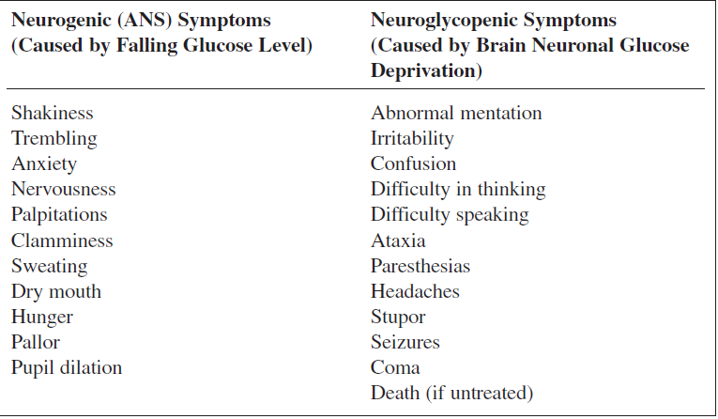
Symptoms of Hypoglycemia

Slide 7
Pathophysiology

Slide 9
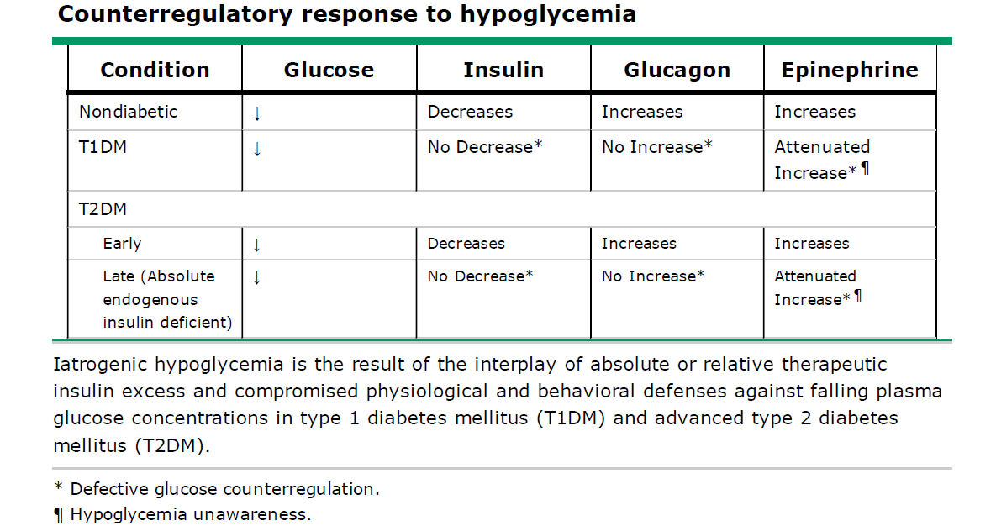

Slide 10
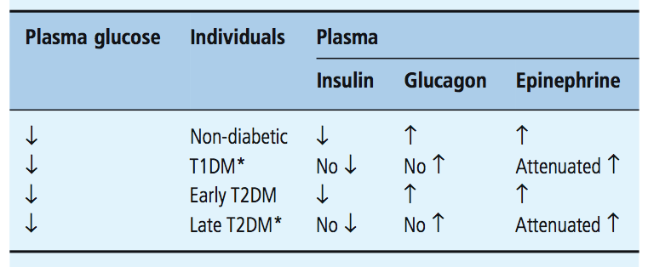
Pathophysiology of glucose counter-regulation
Notes:
The hypoglycemia unwareness is the result of reduced release of the neurotransmitter norepinephrine and acetylcholine
There is evidence of decrease beta-adrenergic sensitivity, specifically reduced cardiac chronotrpic senstivity to isoproterenal

Slide 11
Hypoglycemia-Associated Autonomic Failure (HAAF)
Reduced counterregulatory hormone responses, which result in impaired glucose generation
Hypoglycemia unawareness, which precludes appropriate behavioral responses, such as eating

Slide 12
HAAF
Recent antecedent hypoglycemia – as well as sleep and prior exercise – causes both defective glucose counterregulation (by reducing the adrenomedullary epinephrine response in the setting of absent decrements in insulin and absent increments in glucagon)
And
Hypoglycemia unawareness (by reducing the sympathetic neural and the resulting neurogenic symptom responses)

Slide 13
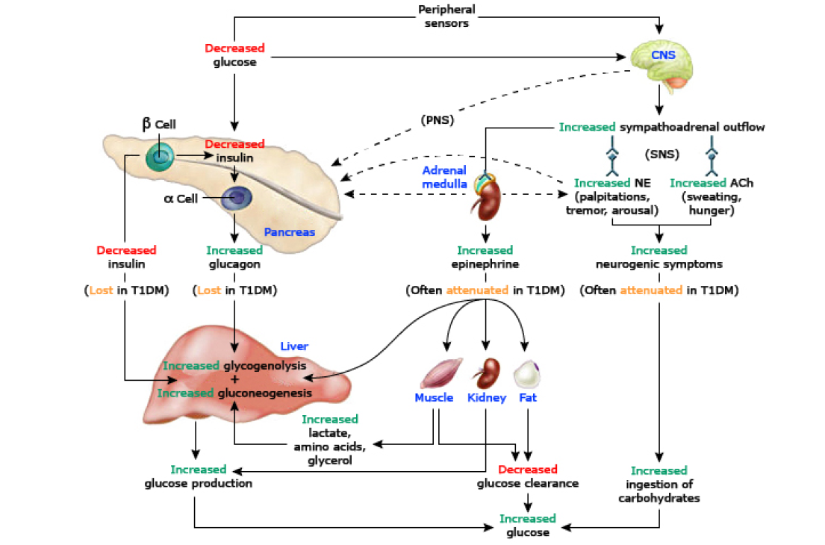

Slide 14
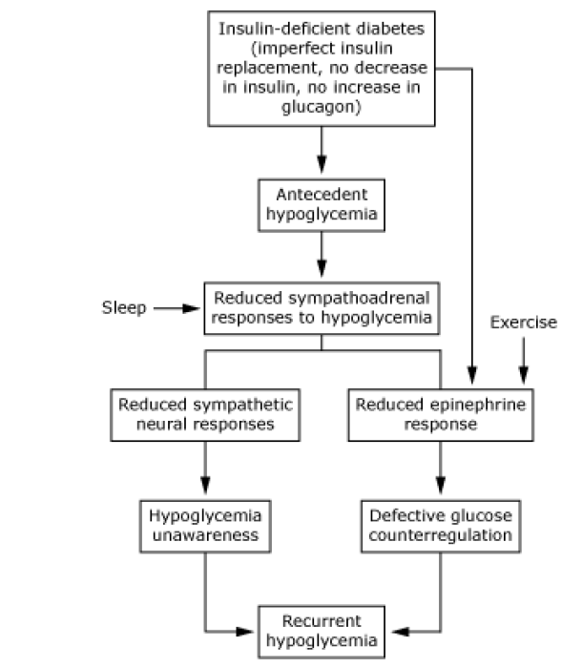

Slide 15
HAAF
Patients with impaired counterregulation have at least a 25-fold increased risk for severe hypoglycemia compared with patients with a defective glucagon response but normal epinephrine responses
Hypoglycemia unawareness occurs in 20–25% of adults T1DM and is associated with 6-fold increased risk for severe hypoglycemia

Slide 16
Risk factors for HAAF
Absolute endogenous insulin deficiency
History of severe hypoglycemia, hypoglycemia unawareness, or both (as well as recent antecedent hypoglycemia, prior exercise, or sleep)
Aggressive glycemic therapy per se (lower HbA1c, lower glycemic goals)

Slide 17
Vicious cycle!
A defective autonomic counterregulatory response results primarily from prior exposure to hypoglycemia per se; a situation that occurs most frequently during intensive insulin therapy
This sets up a vicious cycle whereby hypoglycemia increases the likelihood of subsequent hypoglycemia
Diabetes 1991;40:223–226

Slide 18
Nocturnal hypoglycemia
Longest interprandial period and time between SMBG
Time of maximum sensitivity to insulin
Sympathoadrenal responses are reduced further during sleep

Slide 19
Sleep-Related HAAF
Sleeping patients with T1DM have both increased defective glucose counterregulation (a further reduced epinephrine response, in the setting of absent insulin and glucagon responses) and a form of hypoglycemia unawareness (reduced arousal from sleep), the two components of HAAF in diabetes.
Jones TW, et al. N Engl J Med 338:1657, 1998
Banarer S, et al. Diabetes 52:1195, 2003

Slide 20
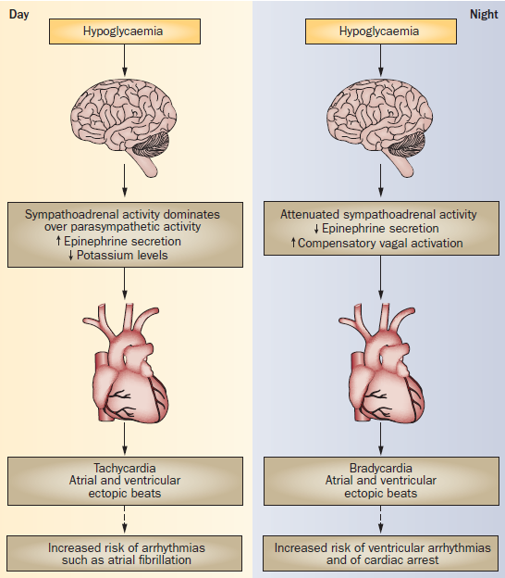
Frier, B. M. Nat. Rev. Endocrinol. 10, 711–722 (2014)

Slide 21
HAAF is largely preventable and/or reversible
A little as 2–3 week of scrupulous avoidance of treatment-induced hypoglycemia reverses hypoglycemia unawareness, and improves the reduced epinephrine component of defective glucose counterregulation in most affected patients
Diabetes,1994, 43:1426–1434
Lancet , 1994,344:283–287

Slide 22
Prevalence

Slide 24
Hypoglycemia is Frequently Unrecognized by Patients
Many episodes are asymptomatic; CGMS data show that unrecognized hypoglycemia is common in people with insulin-treated diabetes
In one study, 63% of patients with type 1 diabetes and 47% of patients with type 2 diabetes had unrecognized hypoglycemia as measured by CGMS (n=70)¹
74% of all events occurred at night
CGMS, continuous glucose monitoring system
Chico et al. Diabetes Care 2003;26(4):1153–7
Notes:
Hypoglycemic episodes often go unrecognised by patients
Key message: CGMS data have demonstrated that unrecognised hypoglycaemic episodes are common and often occur at night.
Chico study: This study evaluated the usefulness of a continuous glucose monitoring system (CGMS) for identifying unrecognised hypoglycaemia in patients with T1DM and T2DM. A total of 70 patients were monitored using CGMS, and the frequency of asymptomatic hypoglycaemia detected by the CGMS (glucose values <3.3 mmol/L) was calculated. Unrecognised hypoglycaemia was identified in 63% of patients with T1DM and 47% of patients with T2DM, as measured by CGMS (n=70) — 74% of all events occurred at night.¹
Weber study: CGMS was used for ≥3 days to identify hypoglycaemia in patients with T2DM (n=31). Similar to the Chico study, there were a substantial number of hypoglycaemic episodes that went unrecognised by patients. Hypoglycaemic events were categorised as ≤2.79 mmol/L and borderline events as 2.8–3.9 mmol/L — duration and time of day were also recorded. A total of 83% of hypoglycaemic episodes were recognised by CGMS and unnoticed by patients. Of the total classified hypoglycaemic and borderline events, 54% were nocturnal, and all of these went unnoticed by patients.²
References
Chico A, Vidal-Ríos P, Subirà M, Novials A. The continuous glucose monitoring system is useful for detecting unrecognized hypoglycemias in patients with type 1 and type 2 diabetes but is not better than frequent capillary glucose measurements for improving metabolic control. Diabetes Care 2003;26(4):1153–7.
Weber KK, Lohmann T, Busch K, Donati-Hirsch I, Riel R. High frequency of unrecognized hypoglycaemias in patients with type 2 diabetes is discovered by continuous glucose monitoring. Exp Clin Endocrinol Diabetes 2007;115(8):491–4.

Slide 25
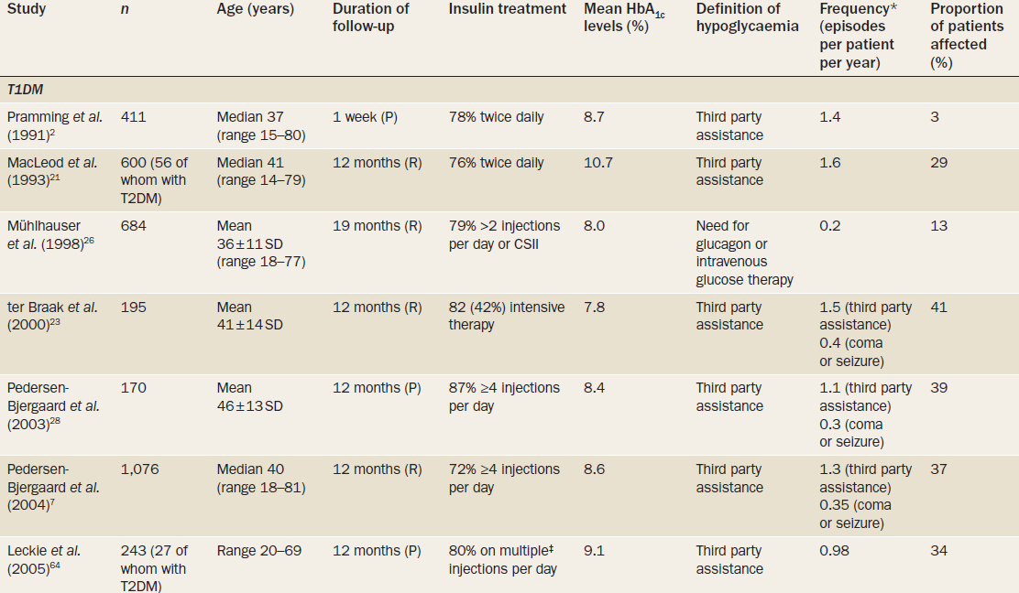

Slide 27
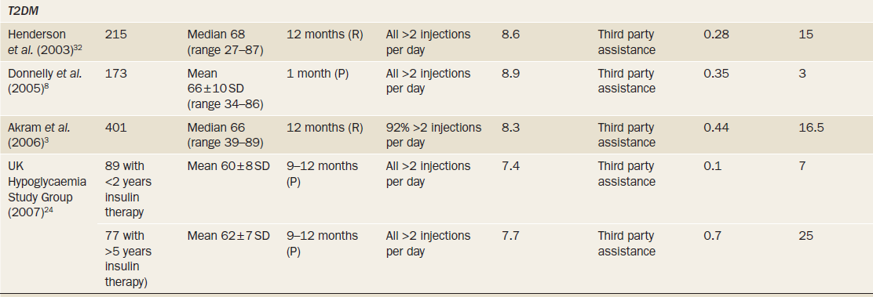

Slide 28
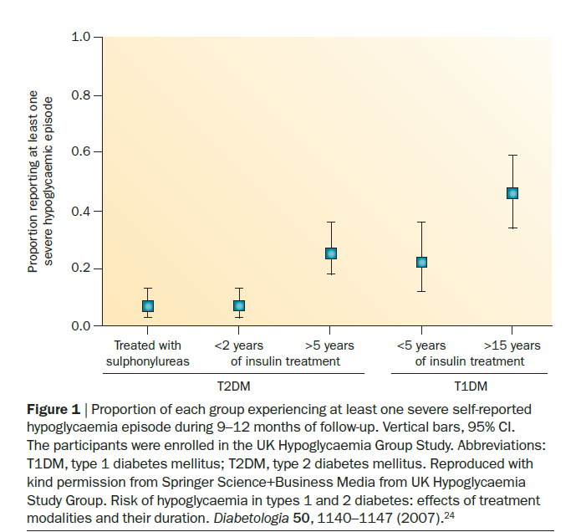

Slide 29
Hypoglycemia causes and risk factors

Slide 30
Absolute or relative insulin or insulin secretagogues excess
Excessive doses
Decreased clearance (eg, renal impairment, liver failure, and hypothyroidism)
Decreased glucose production (eg, liver or kidney disease and alcohol ingestion)
Increased glucose use (eg, exercise)
Increased insulin sensitivity (eg, exercise, weight loss, and use of insulin sensitizers)
Intentional hypoglycemia (overdose)

Slide 31
Mismatch between insulin or insulin secretagogues and food absorption
Ill-timed insulin doses
Missed meals
Gastroparesis
Post gastric bypass surgery
Gastrointestinal disease with malabsorption (eg, celiac disease)

Slide 32
Glucose Counterregulation factors
Defective hypoglycemia counterregulation
Hypoglycemia unawareness
Autonomic neuropathy
Deficiency of hormones needed for hypoglycemia counterregulation (eg, adrenal insufficiency and growth hormone deficiency

Slide 33
Drugs
Drugs capable of causing hypoglycemia by themselves (eg, alcohol, insulin, sulfonylureas)
Drugs that could cause hypoglycemia only in combination with insulin or insulin secretagogues (eg, metformin, angiotensin-converting enzyme inhibitors)
Drugs that can compromise hypoglycemia awareness (eg, b-blockers)
Sudden decrease in drugs that cause hyperglycemia (eg, discontinuing glucocorticosteroids or glucose infusion during hospitalization in insulin-treated patients)

Slide 34
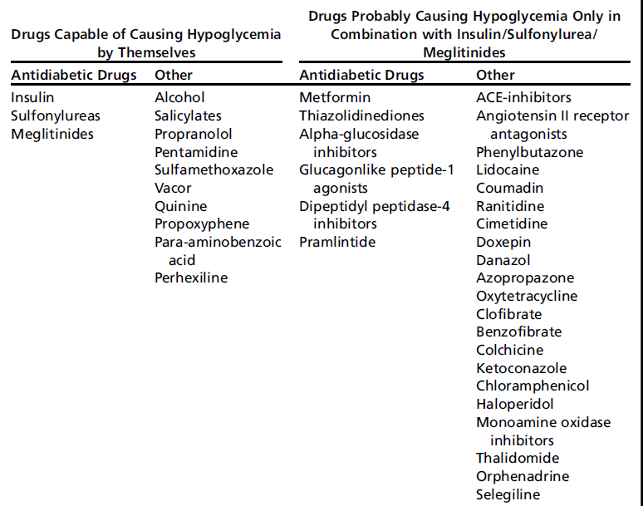
Drug induced hypoglycemia

Slide 35
Errors and medication administration issues
Lack of diabetes education (eg, injecting insulin into lipohypertrophy or intramuscularly)
Poor adherence to regimen or distraction (eg, miscalculated carbohydrate content or taking wrong type of insulin)
Functional neurologic deficit (eg, cognitive or visual impairment leading to incorrect dosing)

Slide 36
Impact of hypoglycemia

Slide 37
Severe hypoglycemia is associated with major clinical outcomes
In the ADVANCE study, severe hypoglycemia was associated with increased risk of adverse clinical outcomes: major macrovascular events, major microvascular events, all-cause mortality and CV death (all P<0.001)
Clinical outcome | Adjusted HR (95% CI) for outcomes among patients who had severe hypoglycemia vs those who did not | P value
Major macrovascular events | 2.88 (2.01–4.12) | <0.001
Major microvascular events | 1.81 (1.19–2.74) | <0.001
Death from CV cause | 2.68 (1.72–4.19) | <0.001
Death from any cause | 2.69 (1.97–3.67) | <0.001
ADVANCE analysis
T2DM
N=11,140
5 year follow-up
SAGLB.DIA.14.06.0065a / 2014.06

Slide 38
Severe hypoglycemia is associated with major CV outcomes
In ORIGIN*, severe hypoglycemia was associated with a greater risk for the major CV events, mortality, CV death and arrhythmic death
Severe hypoglycemia
Adjusted HR (95% CI) P value
CV death or nonfatal MI or stroke
Total mortality
CV death
Arrhythmic death
1.58 (1.24–2.02) <0.001
1.77 (1.39–2.19) <0.001
1.71 (1.27–2.30) <0.001
1.77 (1.17–2.67) 0.007
0.5
1.0
1.5
2.0
2.5
3.0
3.5
ORIGIN
IGT, IFG or early T2DM at high CV risk; N=12,537
Randomized to Lantus® (target FPG ≤95 mg/dL [5.3 mmol/L]) vs standard care for 6.2 years
Lantus was associated with a neutral effect on CV outcomes vs standard care
SAGLB.DIA.14.06.0065a / 2014.06
Notes:
38

Slide 39
Nonsevere nocturnal hypoglycemia event (NSNHE) impacts daily function
International survey of 2,108 patients with T1DM or T2DM who reported a NSNHE in the prior month
Impact on well-being
10.4% woke up from the NSNHE and did not go back to sleep
79.3% said the event impacted their functioning the following day
60.7% reported moderate to severe impact on next day functioning
63.7% said emotional functioning was impacted
43.7% said social functioning was impacted
74.2% used insulin
The rest took monotherapy with oral agents
32.1% had several
NSNHE events
The rest did not report experiencing several NSNHE events
SAGLB.DIA.14.06.0065a / 2014.06

Slide 40
Fear of hypoglycemia reduces patient adherence
Proportion of patients modifying insulin dose to avoid future hypoglycemia
Patients, %
90
T1DM
80
T2DM
70
74.1
78.2
60
50
57.9
40
43.3
30
20
10
0
Following mild episodes
Following severe episodes
Leiter LA et al. Can J Diabetes 2005;29:186-192.
SAGLB.DIA.14.06.0065a / 2014.06
Notes:
40

Slide 41
Prevention

Slide 42
Strategies to prevent hypoglycemia
Patient education
Dietary intervention
Exercise management
Medication adjustment
Glucose monitoring
Clinical surveillance
J Clin Endocrinol Metab 98: 1845–1859, 2013

Slide 43
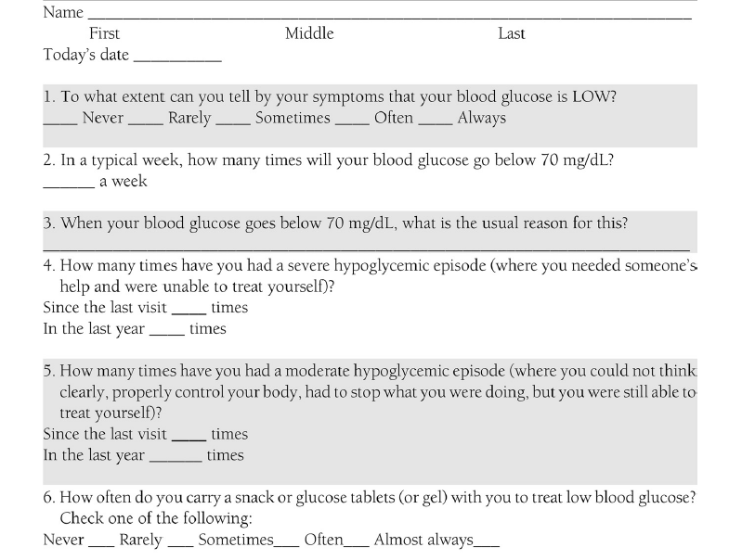
Hypoglycemia Patient Questionnaire

Slide 44
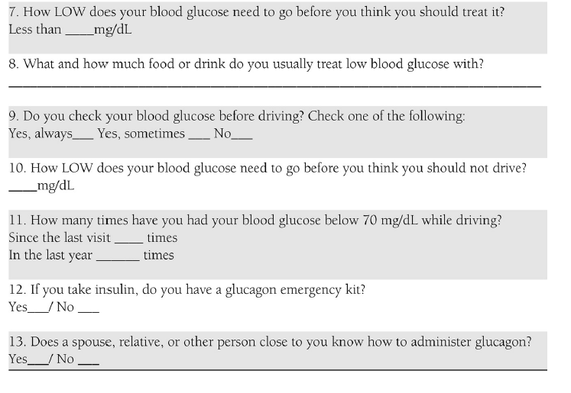
Hypoglycemia Patient Questionnaire

Slide 45
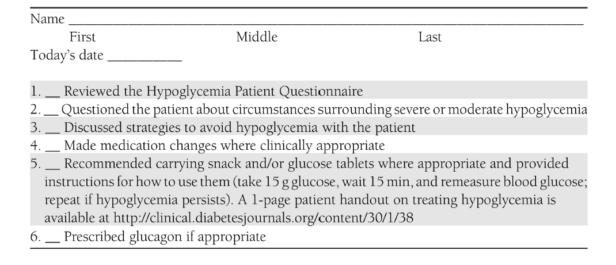
Hypoglycemia Provider Checklist

Slide 46
Diabetes Care 2015;38:1583–1591

Slide 47
Treatment

Slide 49
Examples of 15–20 g oral carbohydrates for treatment of hypoglycemia

Slide 50
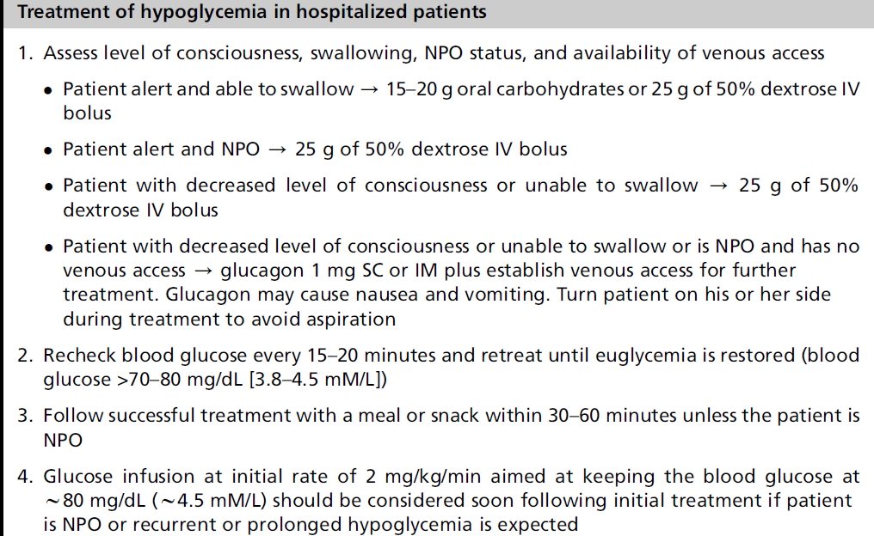

Slide 53
Conclusions
Adults with type 1 diabetes mellitus have nearly 2 episodes of mild hypoglycemia per week; the annual prevalence of severe hypoglycemia is 30%, with several factors, such as long disease duration, increasing its incidence
Adults with insulin-treated type 2 diabetes mellitus experience a lower frequency of mild and severe hypoglycemia episodes than those with type 1 diabetes mellitus, but frequency rises progressively with increasing duration of insulin therapy

Slide 54
Conclusion..
Never occurs in patients on diet and exercise
Rarely occurs in patients on α glucosidase inhibitors, biguanides and thiazolidinediones
More frequently occurs in patients on insulin secretagogues and especially insulin

Slide 55
Conclusions..
Prevention of hypoglycemia depends on effective patient education, diet, exercise, frequent glucose monitoring and appropriate adjustment of therapies; new technologies, such as real-time continuous glucose monitoring and insulin pumps, might also help

Slide 56
Thank you

