Slide 2
Omega-3 Fatty Acids for the Management of Hypertriglyceridemia

Slide 3
Elevated plasma triglycerides are the result of an excess of triglyceride-rich lipoproteins of several different types, most commonly very-low-density
lipoproteins (VLDLs) but also intermediate-density
lipoproteins (or VLDL remnants), chylomicrons, or chylomicron remnants

Slide 4
The 2011 statement cited epidemiological evidence that a moderate elevation in triglycerides is often associated with increased atherosclerotic cardiovascular disease (ASCVD) risk. More recent evidence from mendelian randomization studies has shown that elevated triglycerides associated with genetic variants may be a causal factor for ASCVD and possibly for premature all-cause mortality.

Slide 5
Fasting plasma triglyceride concentrations may be categorized as normal (<150 mg/dL*), borderline (150– 199 mg/dL), high triglyceride (HTG; 200–499 mg/dL), and very HTG (VHTG; ≥500 mg/dL).1,8 Risk of acute pancreatitis is increased in patients with VHTG, especially those with triglycerides ≥1000 mg/dL.9 For VHTG, the primary goal of therapy is to reduce triglycerides to <500 mg/ dL,10 whereas there is no specific treatment goal for HTG. For all degrees of triglyceride elevation, treatment or elimination of secondary causes and intensive diet and lifestyle changes are recommended before direct pharmacotherapy.11 Such changes include weight loss, increased physical activity, limited alcohol consumption, and adoption of various healthy dietary practices such as decreased consumption of refined carbohydrates and simple sugars, substitution of saturated and trans fats with unsaturated fats, and increased consumption of seafood (especially species high in omega-3 fatty acids [n-3 FAs]).

Slide 6
The 2002 AHA scientific statement on fish and n-3 FAs recommended increased dietary omega-3 intake plus dietary supplements to achieve 2 to 4 g/d n-3 FA (referring to the total amount of eicosapentaenoic acid [EPA] plus docosahexaenoic acid [DHA]) for triglyceride-lowering treatment (ie, medical management of HTG) under the supervision of a physician. (No prescription n-3 FAs were available at the time).12 A recent AHA science advisory has addressed the use of n-3 FA supplementation to reduce ASCVD risk.13 This advisory focuses specifically on the use of n-3 FA agents to treat HTG and VHTG
The 2002 AHA scientific statement on fish and n-3 FAs recommended increased dietary omega-3 intake plus dietary supplements to achieve 2 to 4 g/d n-3 FA (referring to the total amount of eicosapentaenoic acid [EPA] plus docosahexaenoic acid [DHA]) for triglyceride-lowering treatment (ie, medical management of HTG) under the supervision of a physician. (No prescription n-3 FAs were available at the time).12 A recent AHA science advisory has addressed the use of n-3 FA supplementation to reduce ASCVD risk.13 This advisory focuses specifically on the use of n-3 FA agents to treat HTG and VHTG

Slide 7
Since 2004, several types of prescription n-3 FA agents have been approved by the US Food and Drug Administration (FDA) for the treatment of VHTG. The typical dose is four 1-g capsules daily, providing >3 g/d EPA+DHA. Dietary supplements containing n-3 FA are also widely available in a variety of chemical forms
. However, because these supplements are neither reviewed nor approved by the FDA, they are not indicated for triglyceride lowering in patients with any degree of triglyceride elevation

Slide 8
FDA-approved prescription n-3 FA products include Lovaza and its generic (n-3-acid-ethyl esters [O3AEE]; EPA 0.465 g and DHA 0.375 g/capsule), Omtryg (a similar O3AEE product but not clinically available), Vascepa (an ethyl ester product consisting of EPA without DHA, chemical term icosapent ethyl [IPE]; EPA 0.98 g/capsule), and Epanova (n-3-carboxylic acid [O3CA]; EPA 0.55 g and DHA 0.2 g/capsule, not clinically available).

Slide 9
MODIFIABLE CAUSES OF ELEVATED TRIGLYCERIDES SHOULD BE ADDRESSED BEFORE PHARMACOTHERAPY IS INITIATED

Slide 10
As extensively reviewed and discussed in the 2011 “Triglycerides and Cardiovascular Disease: A Scientific Statement From the American Heart Association”1 (summarized in Table 1)

Slide 11
Table 1. Clinical Conditions and Drugs Associated With HTG
Clinical conditions
Overweight or obesity*
Insulin resistance or metabolic syndrome*
Diabetes mellitus, especially with poor glycemic control*
Alcohol consumption, especially if in excess*
Excess sugar intake, especially if added in food processing
High saturated fat intake
Hypothyroidism†
Chronic kidney disease
Nephrotic syndrome*
Sedentary lifestyle
Pregnancy (especially third trimester)*
Lipodystrophy*
Systemic inflammatory diseases (eg , rheumatoid arthritis, systemic lupus erythematosus, many infections)

Slide 12
Drugs
Oral estrogen* (contraceptives or postmenopausal replacement)
Tamoxifen*
orSystemic glucocticoids*
Retinoic acid derivatives*
Nonselective β-blockers
Thiazide and loop diuretics
Antiretroviral protease inhibitors*
Atypical antipsychotics (eg, clozapine, olanzapine, risperidone)
Sirolimus,* cyclosporine A,† and tacrolimus
Cyclophosphamide

Slide 13
When HTG or VHTG appears to be caused, at least in part, by the medications noted in Table 1, treatment options include eliminating or lowering the dose of the inciting agent (eg, dose reduction or elimination of a thiazide diuretic or a retinoid), substituting within the same drug class (eg, carvedilol in place of metoprolol for post–myocardial infarction cardio protection), or switching to a different drug class (eg, angiotensin-converting enzyme inhibitor or angiotensin II receptor blocker in place of metoprolol for congestive heart failure). If these changes are not possible or not effective, initiating triglyceride-lowering pharmacotherapy may be required

Slide 14
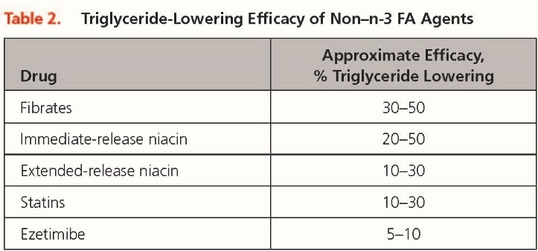

Slide 15
EFFECTS OF PRESCRIPTION N-3 FA AT FDA-APPROVED DOSES IN INDIVIDUALS WITH VHTG (≥500 MG/DL)

Slide 16
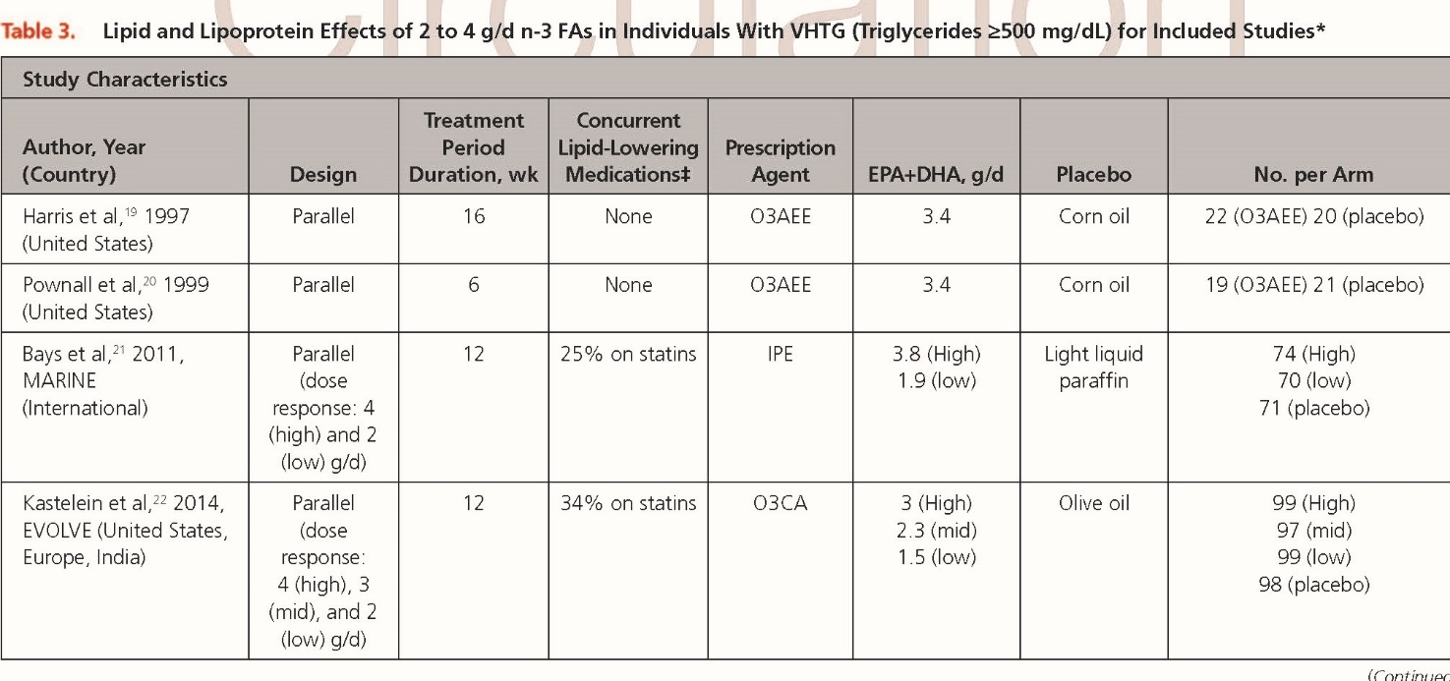

Slide 17
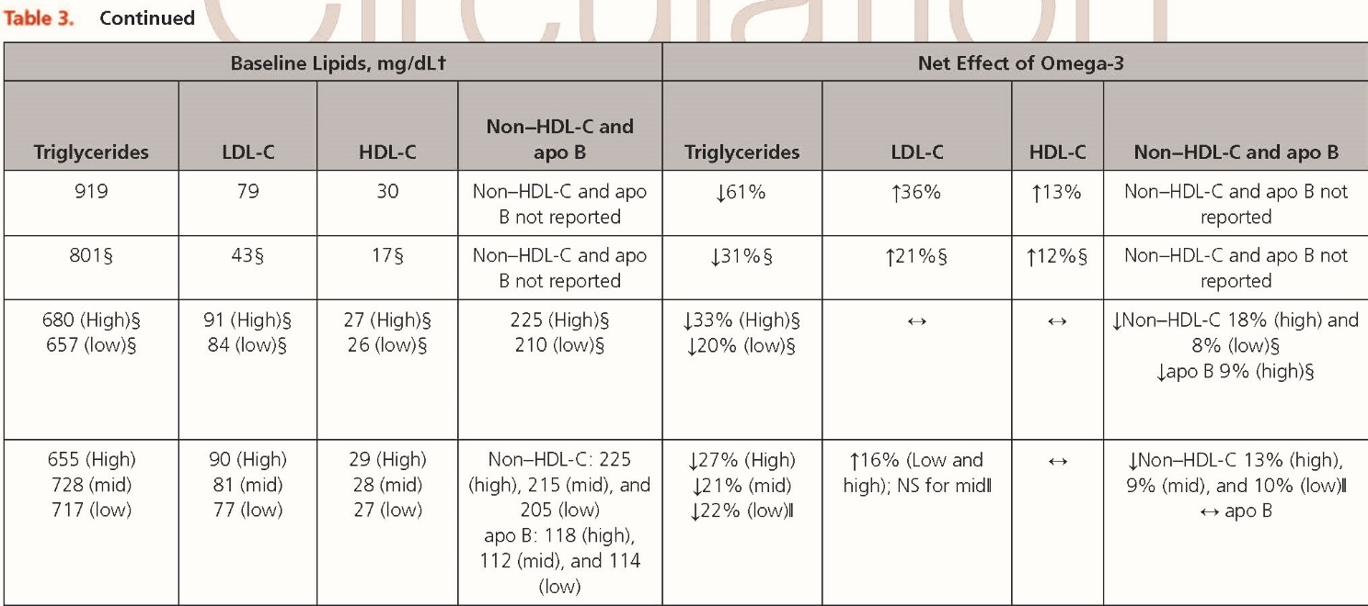

Slide 18
Changes in other lipoprotein classes are also important considerations for evaluating the effects of n-3 FA products; however, it should be noted that measurement of low-density lipoprotein (LDL) cholesterol (LDLC) in the context of elevated triglycerides may not be accurate, as discussed further in the Appendix. In patients with VHTG treated with prescription EPA+DHA products, LDL-C increased by ≈15% to 36%† (similar to fenofibrate; Table 3).19,20,22 However, there was no increase in apo B (apolipoprotein B) in the 1 study in which it was reported,22 suggesting that the increase in LDL-C may reflect an increase in the average size of the LDL particles rather than an increase in LDL particle concentration

Slide 19
In patients with VHTG (triglycerides, 500–2000 mg/dL), treatment with IPE did not raise LDL-C, and apo B decreased, suggesting differing effects from those of EPA+DHA.21 With regard to high-density lipoprotein cholesterol (HDL-C), 2 studies from the 1990s using O3AEE19,20 reported net %increases of ≈12. In contrast, neither IPE21 nor O3CA22 significantly changed HDL-C. Trials with head-to-head comparisons of these 3 prescription n-3 FA agents are not available

Slide 20
Many patients with VHTG will require multiple medications to reduce triglycerides to acceptable levels (in addition to diet, lifestyle, and potentially medication changes). Limited evidence is available from randomized controlled trials on the effects of n-3 FA in combination with non statin therapy for the treatment of VHTG. In patients treated with a combination of 130 mg/d fenofibrate and 4 g/d O3AEE, triglyceride lowering of 61% was observed, which was only marginally better (P=0.06) than the 54% reduction achieved with fenofibrate alone.

Slide 21
EFFICACY OF N-3 FA AT FDA APPROVED
DOSES IN INDIVIDUALS
WITH HTG (200–499 MG/DL)
To evaluate and summarize the existing clinical evidence
for n-3 FA effects on HTG, we identified and
compared studies meeting the following criteria: administration
of 4 g/d prescription n-3 FA or an equivalent
amount of EPA+DHA from dietary supplements
(>3 g/d EPA+DHA), mean/median baseline triglyceride
values between 200 and 499 mg/dL, results reported
from at least 20 people per study arm, and inclusion of
a placebo-control group.

Slide 22
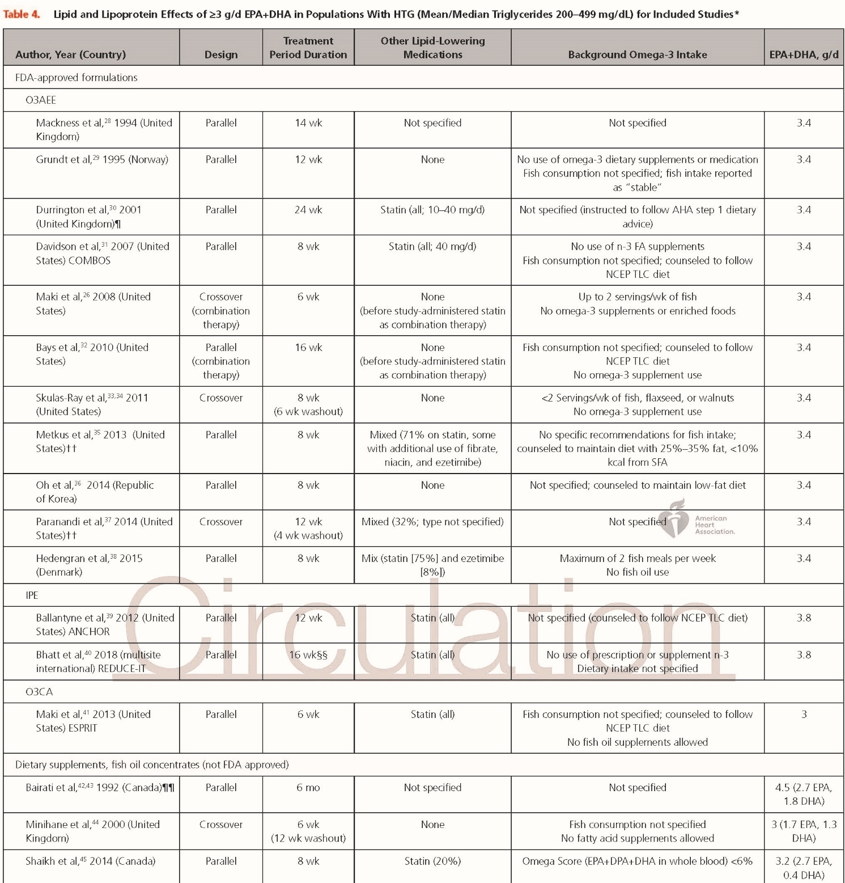

Slide 23
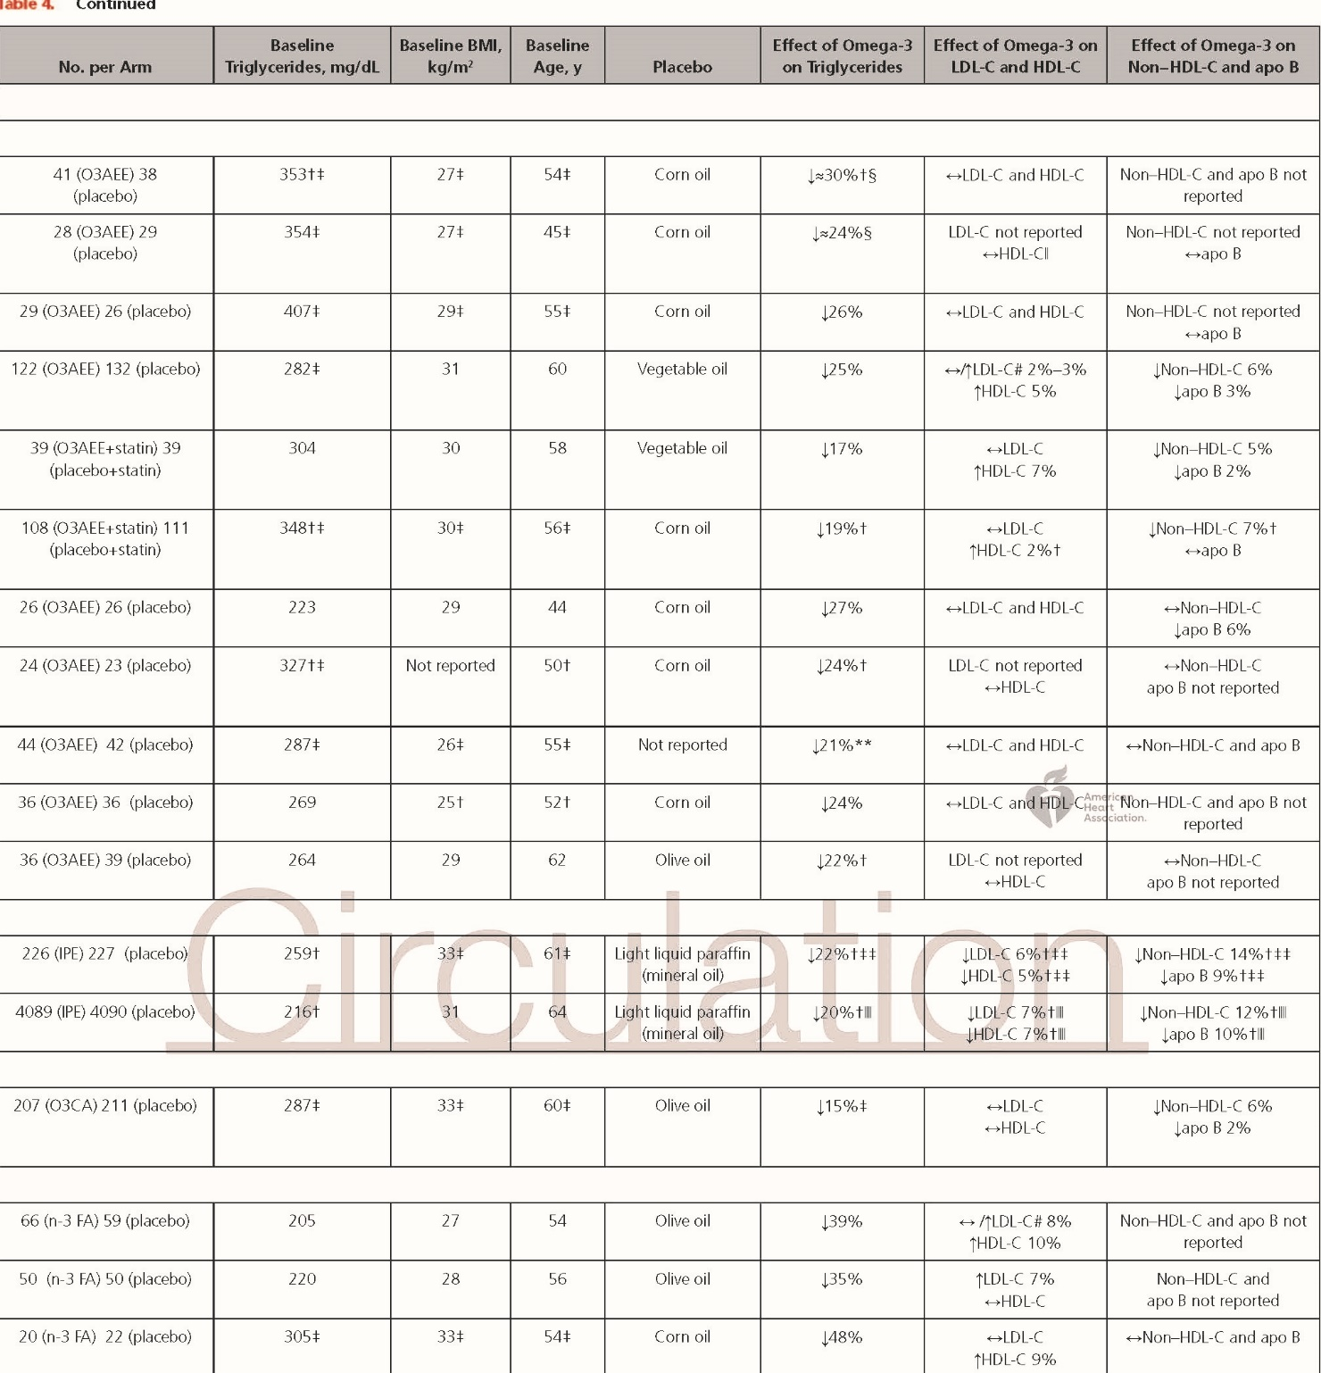

Slide 24
n-3 FA as Monotherapy
Six published trials in which 3 to 4 g/d n-3 FA was administered
to people with HTG not taking other lipid lowering
medications were identified as meeting the
inclusion criteria listed above.28,29,33,36,44–46‡ Four studies
used 4 g/d O3AEE (providing 3.4 g/d EPA+DHA), and
2 studies used similar doses of EPA+DHA from an n-3
FA medical food (n=1) or dietary supplement (n=1).§
On average,
the triglyceride reduction was ≈27% (range, 21%–
35%), apart from the study of a medical food (3.2 g/d
EPA+DHA), which specifically recruited people with very
low blood levels of n-3 FA and reported a 48% reduction.
45 In 4 trials, 4 g/d O3AEE averaged a 26% reduction
in triglycerides, whereas the reduction in a dietary
supplement study of 3 g/d EPA+DHA was 35%.44 An
earlier study of a dietary supplement that used a higher dose (4.5 g/d EPA+DHA) reported a 39% reduction in
triglycerides after 6 months.

Slide 25
n-3 FA Added to Other Lipid-Lowering
Therapies
Eight trials evaluated 4 g/d prescription n-3 FA in people with HTG on background statin therapy.26,30–32,38–41 Five of these trials tested O3AEE; 2 trials used IPE; and 1 trial
used O3CA. The triglyceride decrease was ≈21% (range,15%–25%). Of the 5 O3AEE studies, 2 administered O3AEE in combination with statin therapy as part of the
trial design,26,32 and triglycerides were reduced 17% to19% beyond the reduction achieved by statins, non–HDLC was decreased 5% to 7%, and LDL-C was unchanged
versus the statin-only control.26,32 In a third study, in which all patients were on a stable dose of statin before beginning O3AEE treatment, there was a 25% reduction in
triglycerides and a marginally significant increase in LDL-C relative to placebo (median, 3.5% increase; P=0.052).31
In this study and another of O3AEE, there was a modest increase in LDL particle size.25,26 When IPE (4 g/d) was administered with statins, there were placebo-adjusted
decreases of 22% in triglycerides, 5% in HDL-C, 14% in non–HDL-C, 9% in apo B, and 6% in LDL-C,39 and LDL particle size was modestly increased.47 In the recently
published results of REDUCE-IT (Reduction of Cardiovascular Events With EPA Intervention Trial), similar effects on lipids were reported

Slide 26
Studies of combination therapy of omega-3 agents
with fibrates and niacin in patients with HTG are limited.
In 1 study of patients with HTG, combination treatment
with fenofibrate and 2 g/d O3AEE resulted in a
significant 11% greater triglyceride reduction compared
with fenofibrate alone.50 In a smaller study (n<20 per
arm), patients with metabolic syndrome and HTG were
treated with O3AEE (4 g/d), extended-release niacin (2
g/d), a combination of both, or placebo for 16 weeks.51
Triglycerides decreased by 13% in the O3AEE group, by
21% in the extended-release niacin group, and by 33%
in the combination arm. Niacin alone also reduced both
non–HDL-C and apo B, whereas O3AEE did not; however,
non–HDL-C was significantly lower at baseline in the
O3AEE monotherapy group compared with the niacin
and combination therapy groups. Overall, these results
demonstrate that in patients with HTG, the combination
of n-3 FA with fenofibrate or niacin can result in additive
triglyceride reductions, but more research is needed.

Slide 27
COMPARISON OF EPA+DHA VERSUS
EPA-ONLY AGENTS ON LIPIDS AND
LIPOPROTEINS IN INDIVIDUALS
WITH HTG
Head-to-head comparisons of EPA alone and EPA+DHA
agents at FDA-approved doses are not available. However,
a descriptive comparison of the triglyceride and
LDL-C effects in major studies of the 3 n-3 FA agents
in patients with HTG is shown in the Figure. The lack of studies directly comparing the 3 prescription
n-3 FA agents limits firm conclusions about the comparative
effects of these agents on triglycerides and other
lipid measures.

Slide 28
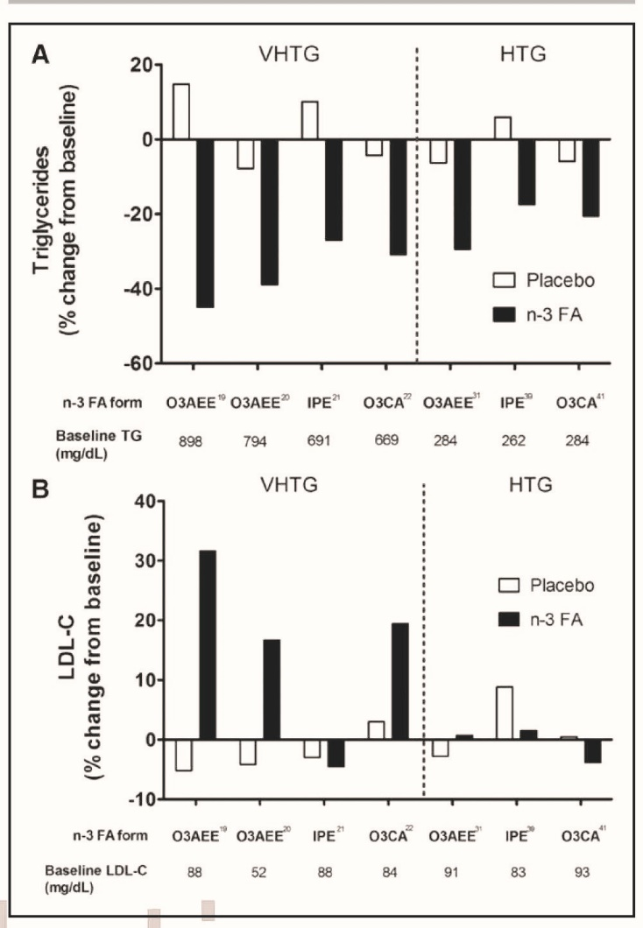

Slide 29
Concerns have been raised that DHA-containing
prescription agents may raise LDL-C in patients with
HTG.53–58 We identified 9 trials of patients with HTG
that reported effects on LDL-C with 4 g/d of DHA containing
prescription n-3 FA (8 studies of O3AEE
and 1 study of O3CA). In 8 of these 9 studies, there was no change in LDL-C versus placebo (4 of which
used n-3 FA as an adjunct to statin therapy), whereas
in 1 study, the median LDL-C was marginally increased
by 3.5% versus placebo (P=0.052).31 This is similar to
the change reported in REDUCE-IT, with a median increase
in LDL-C of 3.1% from baseline (P<0.001) for
EPA-only.40 In conclusion, there is no strong evidence
that DHA-containing prescription n-3 FA agents used
as monotherapy or in combination with statins raise
LDL-C in patients with HTG.

Slide 30
OTHER N-3 FAs FOR MANAGEMENT
OF ELEVATED TRIGLYCERIDES
The majority of research has focused on the evaluation
of EPA and DHA, which are the 2 predominant n-3
FAs in fish and omega-3 agents. The carbon length
of the n-3 FA appears to be important for physiological
effects. EPA has a carbon length of 20; DHA has
a carbon length of 22; and docosapentaenoic acid,
the metabolic intermediate of EPA and DHA, is a
22-carbon n-3 FA (obtained from ruminant animals
and some marine sources). Docosapentaenoic acid
may have significant potential for treating HTG and
VHTG,63,64 but research on this fatty acid remains limited.
In a 2-week open-label cross over comparison of
4 g/d MAT9001 (containing unspecified amounts of
free docosapentaenoic acid and EPA) versus 4 g/d IPE
in people with HTG, plasma triglycerides were reduced
33% by MAT9001, which was significantly more than
the 11% reduction with IPE.

Slide 31
DOSING CONSIDERATIONS
The 2002 AHA scientific statement recommended 2 to 4 g/d EPA+DHA taken under a physician’s
supervision to reduce elevated triglycerides.12 Since then the FDA has approved prescription n-3 FA agents, and
their lipid dose-response data have been published.
In studies of O3AEE in patients with HTG, 4 g/d (3.4g/d EPA+DHA) has demonstrated greater efficacy
(20%–30% reduction) than the 2-g/d dose (1.7 g/d EPA+DHA), which resulted in modest reductions of
11% to 15%50,67 or no significant triglyceride reduction.
36,68 Trials of other prescription n-3 FA agents have reported a similar dose-response effect for triglyceride
reduction. For instance, 4 g/d IPE (≈3.8 g/d EPA) resulted in a 22% decrease versus 10% with 2 g/d
IPE (≈1.9 g/d EPA).39 An earlier open-label study of 2 g/d IPE found that triglycerides decreased only 5%.69
With regard to O3CA, the 2-g/d dose examined in the ESPRIT trial (Epanova Combined with a Statin in Patients
with Hypertriglyceridemia to Reduce Non-HDL Cholesterol; ≈1.5 g/d EPA+DHA) reduced triglycerides
by 9% versus 15% with 4 g/d.41 Clinical research has further established that doses of <2 g/d EPA+DHA
are not effective for reducing triglycerides compared with higher doses, even in people with HTG.33 O3CA
(alone) is approved by the FDA at 2 g/d. However , doses >4 g/d have not been systematically studied for
any of the n-3 FA agents. Regardless of the type of agent, 4 g/d prescription n-3 FA agents (providing >3
g/d EPA+DHA) have consistently reduced triglyceride levels in patients with elevated triglycerides.

Slide 32
TREATMENT OF MEDICATIONI NDUCED
HTG WITH N-3 FAs
The effects of n-3 FA on drug-induced
HTG have received relatively little attention, but n-3
FAs have uniformly been reported to lower triglycerides
when used with interferon-α,70 antipsychotics,71,72
l-asparaginase,73 oral estrogens,74 protease inhibitors,
35,75 retinoic acid,76 and sirolimus.77 Hence, n-3 FAs
appear to be effective for lowering triglycerides in patients
with drug-induced HTG.

Slide 33
EFFECTS IN CHILDREN AND
ADOLESCENTS WITH ELEVATED
TRIGLYCERIDES
Prescription doses of n-3 FA appear to be as safe for the
management of elevated triglycerides in adolescents
and children as young as 10 years of age as they are
for adults.78,79 However, n-3 FAs are little studied in this
population, and the FDA-recommended use of n-3 FAs
for triglyceride lowering remains limited to adults (≥18
years of age).80 Compared with the clearly established
benefits of n-3 FAs in adults with hypertriglyceridemia,
the few studies of n-3 FA supplementation in children/
adolescents with HTG have not shown a significant
triglyceride-lowering effect.78,79,81 However, these trials
used lower doses (<2 g/d EPA+DHA)81 or had relatively
small sample sizes (<20 participants per study arm)79,81
that in some cases included patients with only mildly
elevated triglycerides.8

Slide 34
Kinetic studies have demonstrated that n-3 FAs
reduce hepatic secretion of triglyceride-rich lipoproteins,
Inhibition of diacyl-glycerol acyl
transferase, the major triglyceride-synthesizing enzyme
in the liver, has also been reported with n-3 FA use
MECHANISMS OF N-3 FA EFFECTS ON
LIPOPROTEIN METABOLISM
Others have suggested inhibition of phosphatidic acid
phosphatase.
Furthermore, EPA reduces de novo lipogenesis
by inhibiting transcription of the gene for SREBP
(sterol regulatory element binding protein)-1c
increased peripheral triglyceride
clearance (by upregulation of lipoprotein lipase) and
a reduction in intrahepatic fatty acid pools, which are
the primary source for hepatic triglyceride synthesis.

Slide 35
SAFETY AND TOLERABILITY OF
PRESCRIPTION N-3 FA PRODUCTS
General
All forms of n-3 FA products have relatively benign
side-effect profiles and are generally safe; however, the
evidence for safety of FDA-approved prescription n-3
FA agents comes primarily from short-term randomized
clinical trials. In clinical trials of prescription n-3 FA
agents, tolerability issues have generally been relatively
minor (see sections titled Gastrointestinal, Bleedin Fish/Seafood Allergies, and Glycemic Control) and resulted
in drug discontinuation in only a small percentage
of subjects (usually <5%).

Slide 36
Gastrointestinal
Side effects of FA can include fishy taste, eructation , diarrhea, and nausea. n-3 Absorption of the ethy l ester formulations (O3AEE and IPE), although low in a fasting state, is greatly increased by taking them with food, and they are so labeled.93 Although head-to head comparisons of the 3 prescription agents are not
available,

Slide 37
Bleeding
Because of the known antiplatelet effect of all n-3 FA
products, FDA prescribing information suggests that patient taking both n-3 FAs and an anticoagulant or antiplatelet agent should be monitored periodically. However,
no specific monitoring is suggested. It is also stated
that n-3 FAs in combination with such agents do not produce clinically significant bleeding episodes. This is consistent
with trials reporting no increased risk of bleeding
with n-3 FA added to either anticoagulants or antiplatelet drugs94,95

Slide 38
Fish/Seafood Allergies
n-3 FAs are highly purified oils and do not appear to be allergenic.97 Patients allergic to seafood need not avoid these products, although the FDA labels state to use
with caution

Slide 39
Glycemic Control
Early reports suggested that using n-3 FA worsened
glycemic control, but meta-analyses of older studies
and more recent publications have shown that 4 g/d
prescription n-3 FA does not adversely affect glucose
metabolism.98–100 REDUCE-IT did not find an increase in
hemoglobin A1c or in new-onset diabetes mellitus.40

Slide 40
SUMMARY OF LIPID EFFECTS FOR N-3
FA AT FDA-APPROVED PRESCRIPTION
DOSES
Prescription n-3 FA at a dose of 4 g/d has consistently
produced significant reductions in triglyceride levels in patients with HTG or VHTG, and this effect is greater in
patients with VHTG than in those with HTG (as for triglyceride
lowering agents in general). doe Statin treatment s not appear to influence the degree of triglyceride
reduction with n-3 FA administration in patients with
HTG (≈20%–30% triglyceride reduction), although this has not been thoroughly evaluated. Increased LDLC
with prescription n-3 FA treatment is uncommon in
individuals with HTG, regardless of the agent used When triglyceride reductions exceed 30% with n-3 FA prescription therapy, as is more common in the treatment
of VHTG, increases in LDL-C have been reported for products that contain DHA. Modest reductions in
non–HDL-C (5%–14%) and apo B (2%–9%) have been
reported with n-3 FA therapy in HTG, which may reflec t improved athergenic risk. Prescription n-3 FAs at doses of 2 g/d
provided roughly one-half the triglyceride-lowering efficacy of 4 g/d, the former in some cases not differing significantly from placebo.

Slide 41
