Slide 1
49 years old woman with hypertension and paraaortic mass
Dr ghasemzade
JUNE 2015
TIR 1394

Slide 2
A paraganglioma is a tumor derived from extra-adrenal chromaffin cells of the sympathetic paravertebral ganglia of thorax, abdomen, and pelvis.
About 80 to 85% of chromaffin-cell tumors are pheochromocytomas,
whereas 15 to20%are paragangliomas.
The prevalence of PPGL in patients with hypertension in general outpatient clinics varies between 0.2 and 0.6%.
Malignancy is defined as the presence of metastases in nonchromaffin tissue; the prevalence varies between 10 and 17%.

Slide 3
Biochemical Testing for Diagnosis of Pheochromocytoma and Paraganglioma (PPGL)
1.1 We recommend that initial biochemical testing for PPGLs should include measurements of plasma free metanephrines or urinary fractionated metanephrines.(high)
1.2 We suggest using liquid chromatography with mass spectrometric or electrochemical detection methods rather than other laboratory methods to establish a biochemical diagnosis of PPGL. (low)
1.3 For measurements of plasma metanephrines, we suggest drawing blood with the patient in the supine position and use of reference intervals established in the same position. (low)
1.4 We recommend that all patients with positive test results should receive appropriate follow-up according to the extent of increased values and clinical presentation.(low)

Slide 4
2.0 Imaging Studies
2.1We recommend that imaging studies to locate PPGL should be initiated once there is clear biochemical evidence of a PPGL. (low)
2.2We suggest CT rather than MRI as the first-choice imaging modality because of its excellent spatial resolution for thorax, abdomen, and pelvis. (low)
2.3 We recommend MRI in patients with metastatic PPGL, for detection of skull base and neck paragangliomas, in patients with surgical clips that cause artifacts when using CT, in patients with an allergy to CT contrast, and in patients in whom radiation exposure should be limited (children, pregnant women, patients with known germline mutations, and those with recent excessive radiation exposure. (1,low)

Slide 5
2.0 Imaging Studies
2.4 We suggest the use of 123I-metaiodobenzylguanidine (MIBG) scintigraphy as a functional imaging modality in patients with metastatic PPGL detected by other imaging modalities when radiotherapy using 131I-MIBG is planned, and occasionally in some patients with an increased risk for metastatic disease due to large size of the primary tumor or to extra-adrenal, multifocal (except skull base and neck PPGLs), or recurrent disease. (2,very low)
2.5 We suggest the use of 18F-fluorodeoxyglucose (18FFDG) PET/CT scanning in patients with metastatic disease.
18F-FDGPET/CT is the preferred imaging modality over 123I-MIBG scintigraphy in patients with known metastatic PPGL. (2,moderate)

Slide 6
Genetic Testing
Paraganglioma
Bilateral adrenal pheochromocytoma
Unilateral adrenal pheochromocytoma and a family history of pheochromocytoma/paraganglioma
Unilateral adrenal pheochromocytoma with onset at a young age(<30 years)
Other clinical findings suggestive of one of the previously discussed syndromic disorders

Slide 7
3.0 Genetic Testing
3.1We recommend that all patients with PPGLs should be engaged in shared decision making for genetic testing.(1,moderate)
There are several reasons to consider genetic testing in all patients who present with PPGLs:
1) at least one-third of all patients with PPGLs have disease-causing germline mutations.
2) mutations of SDHB lead to metastatic disease in 40% or more of affected patients.
3) establishing a hereditary syndrome in the proband may result in earlier diagnosis and treatment of PPGLs and other syndromic manifestations in relatives.

Slide 8
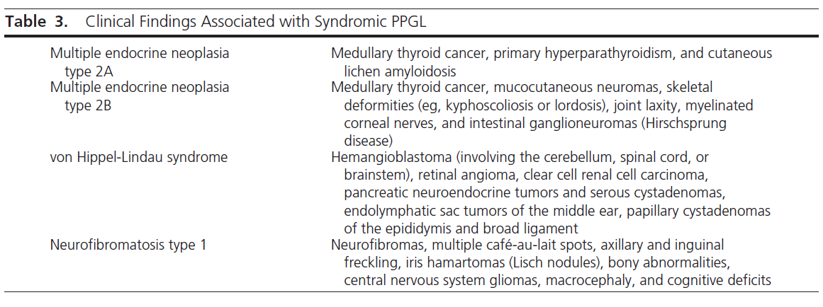
features that indicate a high likelihood of a hereditary cause:
1)positive family history (based on family pedigree or identification of a PPGL susceptibility gene mutation in a relative),
2) syndromic features,
3) Multifocal (5 fold), bilateral, extra adrenal (4 fold) or metastatic disease.

Slide 9
3.2 We recommend the use of a clinical feature-driven diagnostic algorithm to establish the priorities for specific genetic testing in PPGL patients with suspected germline mutations. (1,moderate)
3.3 We suggest that patients with paraganglioma undergo testing of SDH mutations and that patients with metastatic disease undergo testing for SDHB mutations. (2, moderate)

Slide 11
4.0 Perioperative Medical Management
4.1 We recommend that all patients with a hormonally functional PPGL should undergo preoperative blockade to prevent perioperative cardiovascular complications. (1,low) We suggest -adrenergic receptor blockers as the first choice. (2,low)
4.2 We recommend preoperative medical treatment for 7 to 14 days to allow adequate time to normalize blood pressure and heart rate. Treatment should also include a high-sodium diet and fluid intake to reverse catecholamine- induced blood volume contraction preoperatively to prevent severe hypotension after tumor removal. (1,low)
4.3 We recommend monitoring blood pressure, heart rate, and blood glucose levels with adjustment of associated therapies in the immediate postoperative period.(1,low)
4.4 We suggest measuring plasma or urine levels of metanephrines on follow-up to diagnose persistent disease. We suggest lifelong annual biochemical testing to assess for recurrent or metastatic disease. (2,low)

Slide 12
Target blood pressure of less than 130/80mmHg while seated and greater than 90 mm Hg systolic while standing seems reasonable, with a target heart rate of 60–70 bpm seated and 70–80 bpm standing.
These targets should be modified in each patient according to age and accompanying cardiovascular disease
To document successful tumor removal, biochemical testing should be performed upon recovery of the patient from surgery (eg, 2–4 wk after surgery).

Slide 14
Chemotherapy is chosen in case of rapidly progressive metastatic
pheochromocytoma or in those patients where functional imaging with MIBG is negative.
Combination chemotherapy with cyclophosphamide, vincristine and dacarbazine shows transient partial remission in one third of patients ,other regimens include etoposide and cisplatin or etoposide and lomustine with 5-fluorouracil.
50% of patients that are successfully operated remain with hypertension and overall 16% of patients operated for pheochromocytoma/paraganglioma have recurrence within 10 years post-surgery
Furthermore, in a large cohort of patients with pheochromocytoma mortality from a second neoplasia was fourfold higher compared to the general population.

