Slide 2
What are FNA changes after iodine therapy?
Grave’s or toxic MNG?
Risk of cancer in follow up of graves disease or toxic MNG?
Risk of cancer in follow up after I131 therapy?
How suspicious thyroid nodules should be managed?

Slide 3
What are FNA changes after iodine therapy?
Grave’s or toxic MNG?
Risk of cancer in follow up of graves disease or toxic MNG?
Risk of cancer in follow up after I131 therapy?
How suspicious thyroid nodules should be managed?

Slide 4
What are FNA changes after iodine therapy?
Grave’s or toxic MNG?
Risk of cancer in follow up of graves disease or toxic MNG?
Risk of cancer in follow up after I131 therapy?
How suspicious thyroid nodules should be managed?

Slide 6
Diagnosis of thyrotoxicosis ethiology
If the diagnosis of hyperthyroidism is not apparent based on the clinical presentation and initial biochemical evaluation, diagnostic testing is indicated and can include, depending on available expertise and resources:
(1)determination of the radioactive iodine uptake (RAIU)
(2)measurement of thyroidal blood flow on ultrasonography
(3) measurement of TRAb
Strong recommendation, moderate-quality evidence.

Slide 7
The choice of initial diagnostic testing depends on cost, availability, and local expertise.
In the setting of overt thyrotoxicosis, newer TRAb binding and bioassays
have a sensitivity of 96–97% and a specificity of 99% for GD

Slide 8
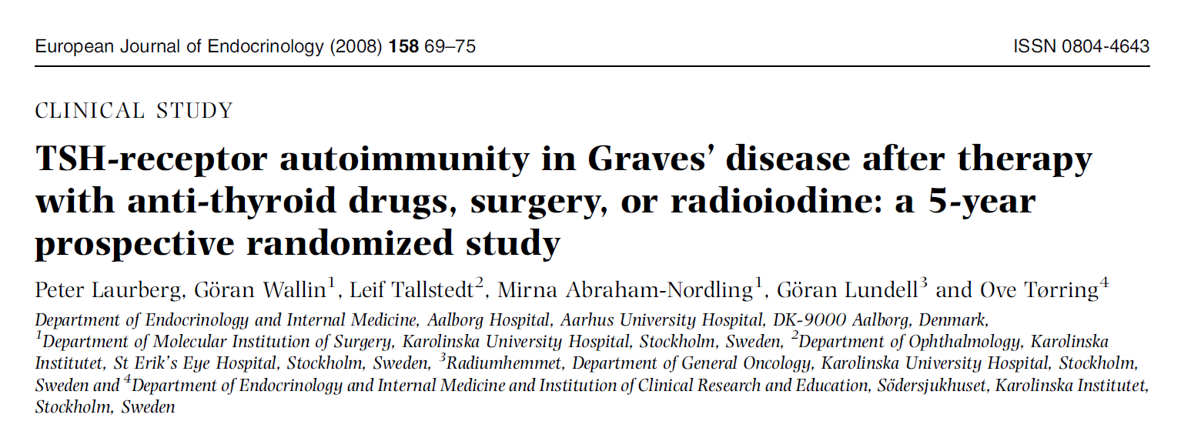

Slide 9
Notes:
The TRAb assay used in the study period was a commercial third-generation TSH receptor autoantibody enzyme linked immunosorbent assay (ELISA) kit

Slide 10
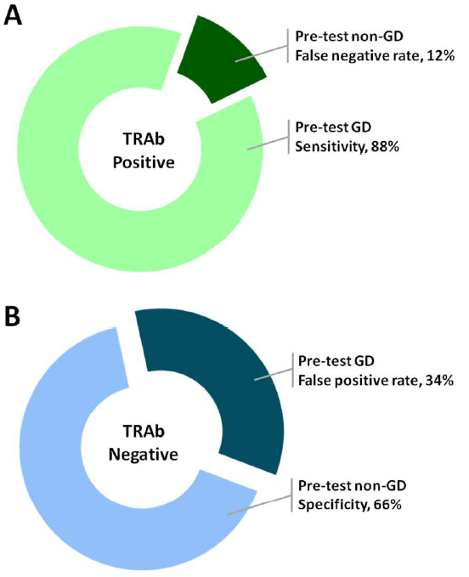

Slide 13
What are FNA changes after iodine therapy?
Grave’s or toxic MNG?
Risk of cancer in follow up of graves disease or toxic MNG?
Risk of cancer in follow up after I131 therapy?
How suspicious thyroid nodules should be managed?

Slide 15
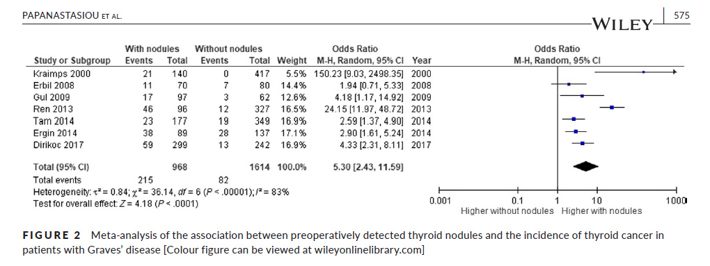

Slide 17
Results: The systematic review and meta‐analysis included 7 studies with 2582 patients overall. The prevalence of any thyroid cancer was 11.5%. The presence of at least one thyroid nodule in patients with GD was associated with higher risk for thyroid cancer (odds ratio [OR] 5.3, 95% confidence interval [CI] 2.4‐11.6, I2 83%). A subgroup analysis showed no difference in thyroid cancer risk in patients with GD according to the number of nodules (solitary versus multiple) (OR 1.4, 95% CI 0.9‐2.3, I2 0%).
Conclusions: The presence of thyroid nodules is positively associated with the prevalence of thyroid cancer in surgically treated patients with GD. However, further prospective research is needed as the heterogeneity among the studies is high.

Slide 18
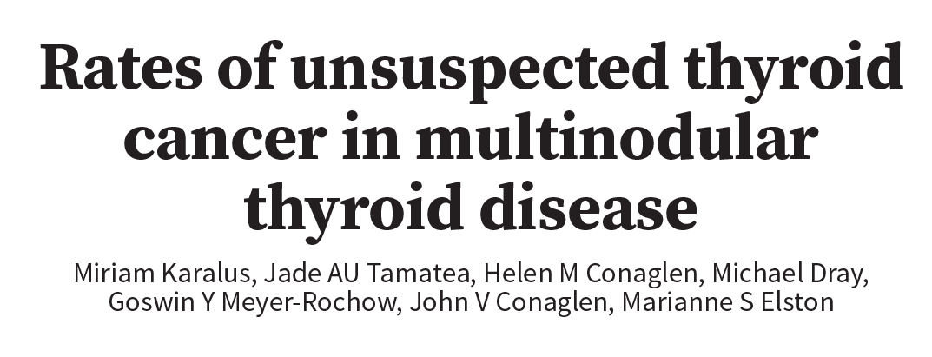

Slide 19
12%
17%

Slide 20
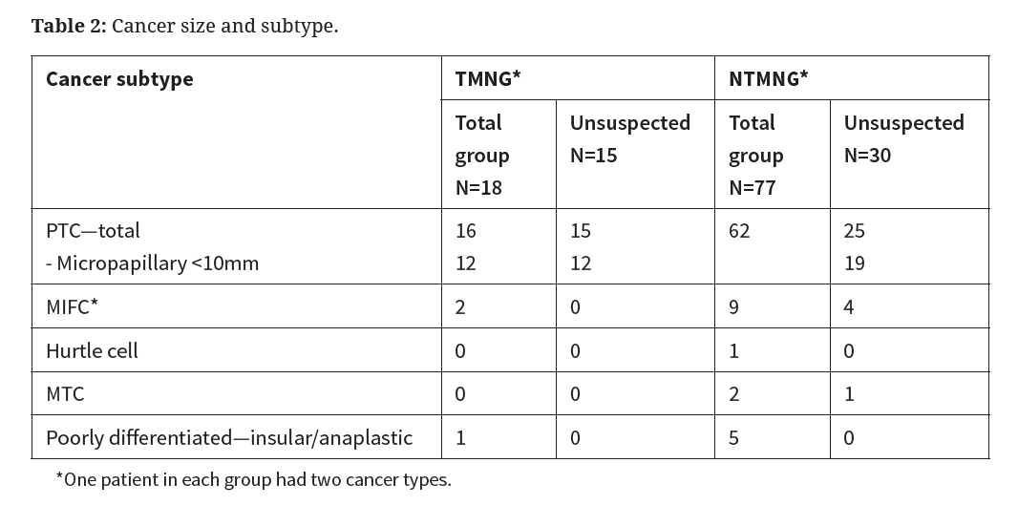

Slide 21
What are FNA changes after iodine therapy?
Grave’s or toxic MNG?
Risk of cancer in follow up of graves disease or toxic MNG?
Risk of cancer in follow up after I131 therapy?
How suspicious thyroid nodules should be managed?

Slide 24
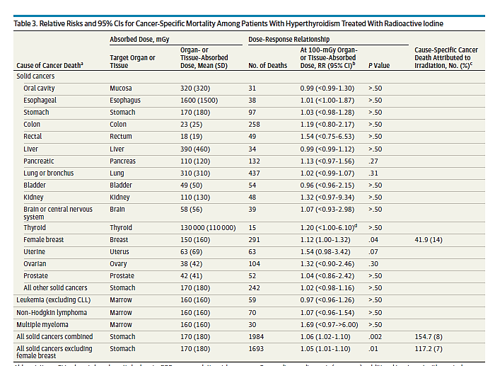

Slide 25
What are FNA changes after iodine therapy?
Grave’s or toxic MNG?
Risk of cancer in follow up of graves disease or toxic MNG?
Risk of cancer in follow up after I131 therapy?
How suspicious thyroid nodules should be managed?

Slide 27
AACE = American Association of Clinical Endocrinologists
ACE = American College of Endocrinology
ACR = American College of Radiology
AME = Associazione Medici Endocrinologi
ATA = American Thyroid Association
BTA = British Thyroid Association

Slide 28
For the indeterminate categories:
→the European consensus group advocates for surgery.
→The BTA recommends repeating FNA or core biopsy under
ultrasound guidance, and if the result is still indeterminate
then the next option is surgery.
→The AACE/ACE/AME recommends repeating the FNA while
considering the ultrasound features and the clinical data for TIR
3A, and surgery or careful follow-up for TIR 3B.
→The ATA recommends that an indeterminate result be
correlated with the ultrasound and clinical findings in order to
decide on close observation, repeating the FNA, or surgery.

Slide 29
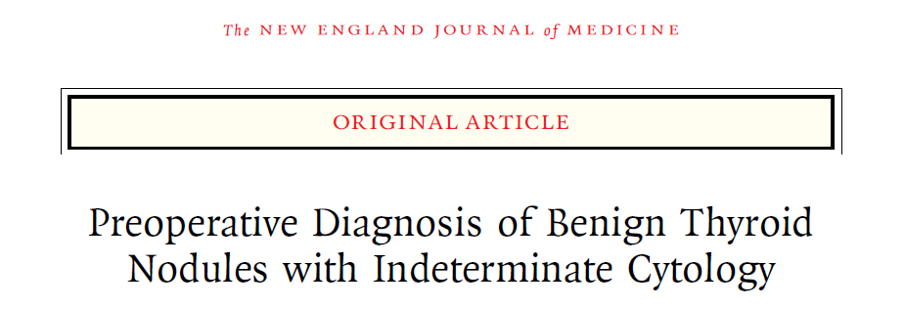

Slide 31
