Slide 2
Bariatric surgery preop preparation
Z.Zarghamifard
General surgeon & fellowship of MIS

Slide 3
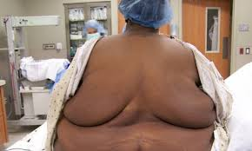
Bariatric surgery preop preparation WHY?
Planning the surgery
Patient safety

Slide 4
Preop preparation
Cardiac status
VTE & PE
Sleep apnea & obesity hypoventilation syndrome(OHS)
GI evaluation
Psychiatric evaluation
Lab test
US

Slide 5
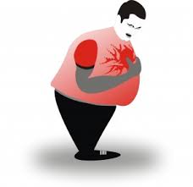
Cardiac status
Increased risk of CAD in obesity especially in:
Age >50
Hx of CAD
DM
Hyperlipidemia
HTN

Slide 6
Cardiac status
Hx & Ph Exam
ECG: increased QT interval in obesity =>arrhythmia =>sudden death
In selected patients:
Echo
Stress tests

Slide 7
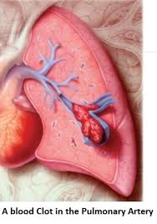
Venous thromboembolism (VTE) & pulmonary emboli (PE)
Second cause of death after leak in bariatric surgery
In 0.2 to 3.5 %
High risk patients:
Male
High BMI
op time>3h
hypercoagulable state
Very high risk patients:
BMI>55
OHS

Slide 8
Venous thromboembolism & pulmonary emboli
Reducing the risk
Increasing ambulation
Smoking cessation
W reduction
Prevention
Thromboembolism deterrent hose (TED)
IPCD
Anticoagulant( heparin or LMWH)
IVC filter: not recommended

Slide 9
Cardiologist consult

Slide 10
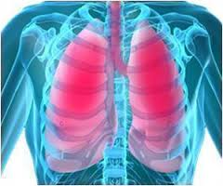
Pulmonary status
Obesity:
Reduced
Chest wall
Lung compliance
Gas exchange
Increased
V/P mismatch
Airway resistance
Work of breathing

Slide 11
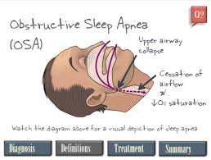
Pulmonary status
Sleep apnea
HOS
Asthma
COPD
Dyspnea by walking less than 200f)

Slide 12
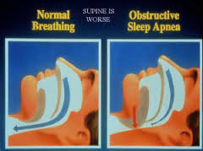
Obstructive sleep apnea
In 88% of candidates for bariatric surg
Mechanism: stenosis & obs of airways in sleep=>sleep hypoxia=>arrhythmia & pul HTN
Narcotic & anesthetic drugs =>severe hypoxia & respiratory arrest
Symptom:
Ioud snoring/tiredness on walking/sleep during driving or sitting
DX: polysomnography (PSG) routin or selective
Tx:
Continuous positive airway pressure(CPAP) before & after surg

Slide 13
Obesity hypoventilation syndrome OHS
Severe pul dysfunction: co2 retention=>hypersomnolence=>co2 narcosis & arrest=>=>need to ICU
Severe hyoxia during sleeping
Symp:
Severe dyspnea
excessive day time sleepiness
Dx: BMI>30/ Pco2>45 without res or neuromuscular dis/po2<55/polycytemia
Screening:
Day time pulse oxymetry <94%
Serum bicarbonate >27
ABG if above tests are abnormal: pco2>45/po2<70

Slide 14
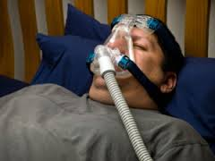
Pulmonary function test
For Dx of COPD
For oxygen users at home

Slide 15
Pulmonary specialist consult

Slide 16
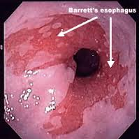
GI evaluation
Symptomatic patient
EGD(preferred) or UGI (barret es/lesion of UGI/ hiatal hernia/ HP)
Non symptomatic:
LAGB & sleeve:
Nothiong orUGI for hiatal hernia & esophageal dismotility
RYGB & BPD & DS:
Routin UGI or EGD
Revisional op:EGD &/or UGI
Colon cancer screening
HP screening
For high prevalence areas
By stool Antigen & UBT
Tx especially before RYGB & MGB

Slide 17
Psychological evaluation
Interview
Form filling test: rarely
Selective evaluation is recommended
Contraindications:
Active drug users
Schizophrenia
Not understanding the risk & benefit of surg medication after operation

Slide 18
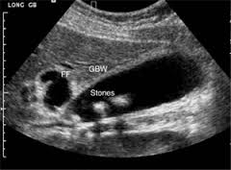
Ultrasonography
Abdominopelvic US
Liver size
Gallstone
Cholecystectomy at the same operation or after weight loss (controversy)

Slide 19
LAB tests
CBC/diff/FBS/Hb A1c/BUN/CREAT/Uric Acid/TG/Cholestrol/HDL/LDL
Alb/Prot/SGOT/SGPT/LDH/ALKPh/Bili DR&TOTAL/PT/PTT/INR
T3/T4/TSH/PTH/CORTISOL
Na/K/Ca/Ph/Iron/Ferritin/TIBC/Vit D3/Zinc/Vit B12
HBS Ag & Ab/HCV/HIV
BHCG/BG & Rh
U/A

Slide 20
Inform consent

Slide 21
SUMMERY
Consult:
Cardiologist
Pulmonologist
Psychiatrist
Dietitian
Sport specialist
Endocrinologist if need
GI evaluation
LAB Tests
US
Mammography & pap smear??
Inform consent

Slide 22
Thank You

