Slide 1
M. Bozorgmanesh M.D
Prevention of Metabolic Disorders Research Center,
Research Institute for Endocrine Sciences (RIES),
Shahid Beheshti University (M.C.), Tehran, Iran
E-mail: mr_bozorgmanesh@endocrine.ac.ir

Slide 2
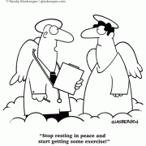
There is no doubt that
Diabetes must be regarded as one of the Penalties of
Advanced Civilization
Robert Saundby, the Birmingham Physicain, 1897, Medical Annual
Stop Resting in Peace and
Start Getting Some Exercise

Slide 3
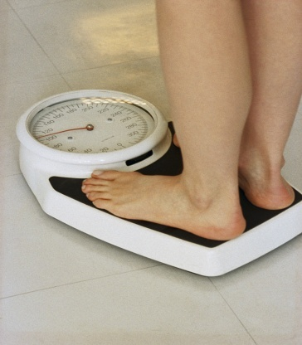

Diabetes Treatments
Lifestyle treatments
Diet
Weight control if overweight or obese
Physical Activity
Pharmacological treatments
Oral anti-diabetic agents
Insulin
Anti-hypertensives, statins, etc….

Slide 4
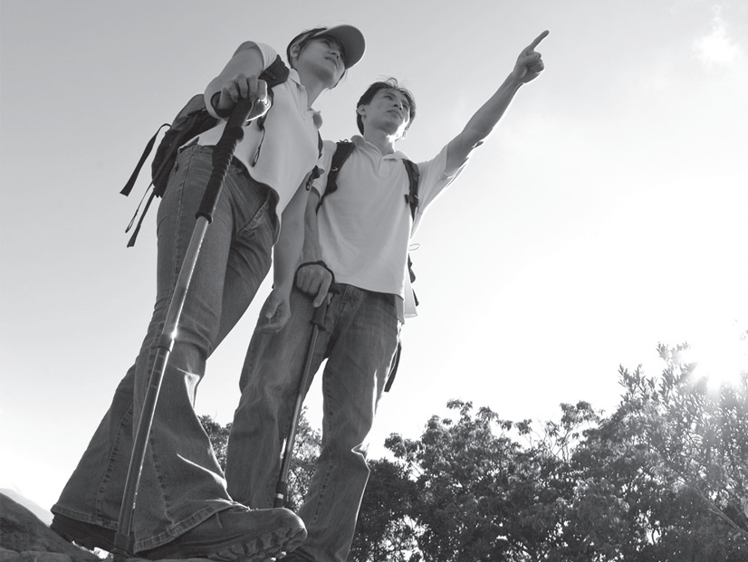

Slide 5

Benefits of physical activity
Physical activity has been shown to have favourable effects on all
components of the metabolic syndrome
Reduce adiposity
Improve lipid profile (↑ HDL, ↓ LDL)
Reduce blood pressure
Increase muscle mass
Improved insulin sensitivity (up to 25%)
Reduce morbidity/mortality
Stroke
Osteoporosis
Cancer
All cause mortality
Cardiovascular disease
Parliamentary Office of Science and Technology. Health Benefits of physical activity, 2001, Number 162.
Around 40% of CHD deaths are associated with inadequate physical activity

Slide 6
Benefits of physical activity
In patients who do have Diabetes
Lower blood glucose concentration
Reduce HbA1C
Reduced the dose of oral hypoglycemic agents and/or insulin needed
Increase the chance that the diabetes can be managed without any pharmacologic intervention
Increase insulin sensitivity
Reduces hyperinsulinemia
Parliamentary Office of Science and Technology. Health Benefits of physical activity, 2001, Number 162.

Slide 7
The purpose of this position statement is to
Update and Crystallize Current Thinking
on
The Role of Exercise
in patients with
Types 1 and 2 Diabetes.

Slide 8
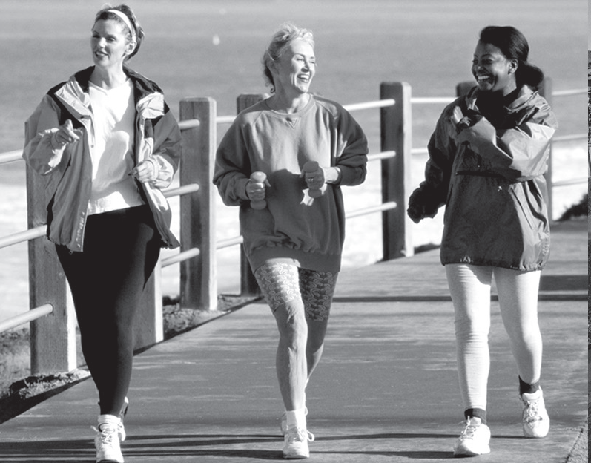

Slide 9
Any one setting out to deliver a lecture on diabetes and exercise, must come to grips with the fact that the risk and benefits are very different for the two types
We’ll be congratulated for having got the balance right

Slide 10
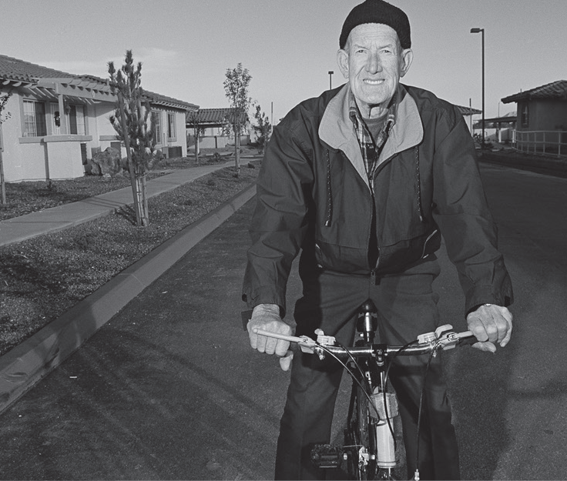

Slide 11
We hope
that it will aid health professionals faced with the need to provide
people with type 1 and 2 diabetes
detailed advice
to help them
Exercise Safely
and with maximum enjoyment

Slide 12
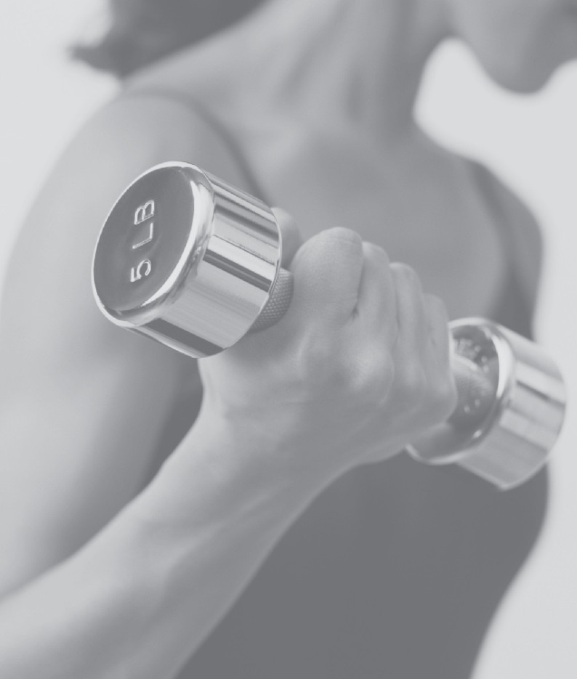

Slide 13
An important distinction to make is
Physical Activity
And
Exercise

Slide 14
Physical Activity
A behavior, specifically a body movement that occurs from skeletal muscle contraction and results in
Increased Energy Expenditure
above
Resting Metabolic Rate.

Slide 15
Exercise or
"Exercise Training,"
A specific type of physical activity that is performed with
The Intention
of
Enhancing Physical Fitness

Slide 16
The major component of physical fitness that has been related to the primary prevention of diabetes is
Aerobic Power
or
"Cardio-Respiratory Fitness."

Slide 17
Types of exercise
Aerobic/anaerobic
Short, <30 min
  intermediate 30-60 min
  prolonged >60 min
Intensity
  HR MAX = 220 - AGE

Slide 18
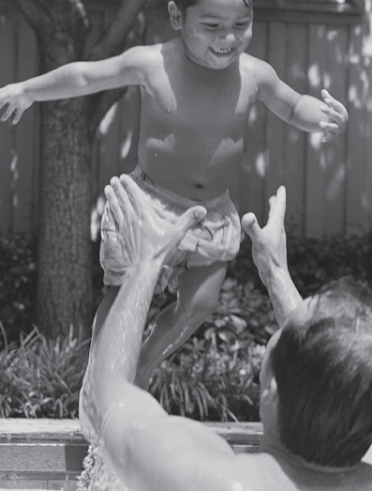

Slide 19
Grading of Exercise Intensity
Intensity | HR MAX (%)
Very mild | <35
Mild | 35-54
Moderate | 55-69
Heavy | 70-90
Very heavy | >90
Maximal | 100

Slide 20
Different heart rate for a 33 y/o person
Level of Intensity | Formula | Heart Bit
Very light | (220-33)*(<0.35) | <65 Bit/Min
Light | (220-33)*(0.35-0.54) | 65-101 Bit/Min
Moderate | (220-33)*(0.55-60.69) | 102-129 Bit/Min
Hard | (220-33)*(0.70-0.89) | 130-166 Bit/Min
Very hard | (220-33)*(>0.90) | >= 167 Bit/Min

Slide 21
Rating of Perceived Exertion Scale
No exertion at all
Extremely light
Very light - (easy walking slowly at a comfortable pace)
Light
Somewhat hard (It is quite an effort; you feel tired but can continue)
Hard (heavy)
Very hard (very strenuous, and you are very fatigued)
Extremely hard (You can not continue for long at this pace)
Maximal exertion

Slide 22
Extra carbohydrate amount and insulin dose reduction for different sessions
-10
20
30
0 | 10 | 20
 | Duration (min)
Intensity (% of Max HR) | Short (<30) | Intermediate (30-60) | Long (>60)
Light (<60) | 0-10 g | 10-20 g | 10-20 g/h
Moderate (60-75) | 10-20 g | 20-60 g | 20-100 g/h
Hard (>75) | 0-30 g | 30-100 g | 30-100 g/h
 | Duration (min)
Intensity (% of Max HR) | Short (<30) | Intermediate (30-60) | Long (>60)
Light (<60) | 0 serving | 1 serving | 1 serving /h
Moderate (60-75) | 2 serving | 2-4 serving | 4 serving/h
Hard (>75) | 3 serving | 3-6 serving | 6 serving /h

Slide 23
Decrease in insulin dosage for efforts of different intensity and duration
 | Duration (min)
Intensity (% of Max HR) | Short (<30) | Intermediate (30-60) | Long (>60)
Light (<60) | - | - | Prandial insulin: 5-10% /h exercise Basal insulin: 5-10% /h exercise
Moderate (60-75) | - | Prandial insulin: 10-50% Basal insulin: 10-20% | Prandial insulin: 5-10% /h exercise Basal insulin: 5-10% /h exercise
Hard (>75) | - | Prandial insulin: 10-50% Basal insulin: 10-20% | Prandial insulin: 5-20% /h exercise Basal insulin: 5-20%/h exercise

Slide 24
Physical Activity and
Type 2 Diabetes
Notes:
The benefits from regular physical activity in people with diabetes are tremendous. Today we’ll try to convince you that your time and effort will give you rewards that far outweigh any risks or negative feelings you have about physical activity.

Slide 25
Physical Activity Is Like Magic for Type 2 Diabetes
Notes:
Regular physical activity can do more for type 2 diabetes than any pill could ever do. Like a magic wand, exercise can transform your body, your health and you.

Slide 26
What Can Physical Activity Do For You?
Give you more energy
Notes:
Some people feel like they don’t have enough energy to exercise. But, if you give it a chance, you’ll find that physical activity gives you more energy than you’ve ever had – allowing you to do the things you previously felt you didn’t have enough energy to do.

Slide 27
What Can Physical Activity Do For You?
Help you lose weight and keep it off
Notes:
Exercise boosts your metabolism and helps you burn extra calories, even after you’re done exercising.
Exercise combined with eating less can help you lose weight and keep if off. The pounds come off faster and stay off if you add exercise.
Even a small amount of weight loss (10-20 lbs) can improve your blood glucose levels if you’re overweight.

Slide 28
What Can Physical Activity Do For You?
Increase flexibility and strength
Slow bone loss
Provide better quality of life
Notes:
Exercise can help you stay independent as you get older. It decreases the risk of muscle and joint injury, aches and pains. It slows bone loss as you age.

Slide 29
What Can Physical Activity Do For You?
Build muscle
Notes:
We naturally lose muscle as we age. Physical activity helps not only prevent muscle loss, but also build muscle and lose fat.

Slide 30
What Can Physical Activity Do For You?
Improve your sex life
Notes:
Studies show that regular physical activity can help prevent some of the sexual problems that can be caused by aging, lack of physical activity, and high blood glucose levels.

Slide 31
What Can Physical Activity Do For You?
Lift your mood
Treat depression
Notes:
Regular physical activity can improve your self-image, make you feel better about yourself, and lift your mood. You can not only make yourself happier, but also those around you. In fact, exercise training has been shown to be comparable to seeing a therapist or taking medication for depression.

Slide 32
What Can Physical Activity Do For You?
Reduce stress and anxiety
Notes:
Stress and anxiety can lead to overeating. If you overeat as a way to cope with stress, you’ll find that exercise is a better coping mechanism.

Slide 33
What Can Physical Activity Do For You?
Improve blood glucose control
(lowers A1C)
Notes:
If you have type 2 diabetes, exercise can improve your blood glucose control.
Let’s look at how it does that.

Slide 34
Physical activity lowers blood glucose in type 2 diabetes by helping:
muscle cells become more sensitive to insulin
keep the liver from producing too much glucose
build more muscle
you lose weight and keep it off
Notes:
Physical activity helps your muscles use insulin more efficiently, so you need less insulin. This blood-glucose lowering effect only lasts a few days after exercise, so to get the most out of your exercise, try to do some physical activity every day (or at least 3-5 days a week).
Your liver begins making less glucose as it becomes more sensitive to insulin.
More muscle means lower glucose. Muscle uses more glucose, even at rest.
Exercise helps you lose weight and keep it off. A loss of even 10-20 lbs can really improve your blood glucose.
Exercise is also beneficial for type 1 diabetes, but usually does not improve blood glucose control unless insulin and food intake are well balanced with physical activity.

Slide 35
What Can Physical Activity Do For You?
Keep your heart healthy
Notes:
When you have diabetes, you have a much higher risk of heart disease, so exercise is especially beneficial to your heart.

Slide 36
Physical activity helps your heart by:
Strengthening heart muscle
Lowering resting heart rate
Lowering blood pressure
Improving cholesterol
Reducing risk of heart attack and stroke
Notes:
1. A strong heart does a better job of pumping blood throughout the body.
2. Reducing the resting heart rate and blood pressure put less work on the heart.
3. Exercise lowers total cholesterol, raises HDL (good) cholesterol, and lowers triglycerides
4. All of these help reduce your risk of heart attack and stroke.

Slide 37
“Sitting” through life increases your risk of:
heart disease
high blood pressure
high cholesterol
overweight
type 2 diabetes
Notes:
Modern technology like elevators, dishwashers, washing machines, remote controls, and computers has eliminated the daily chores and activities of your grandparents era.
Inactivity has made us sitting ducks for diseases like heart disease, high blood pressure, high cholesterol and other blood fats, obesity and overweight, and type 2 diabetes.
(Ask audience to stop and figure how much time each day is spent sitting and being inactive.)

Slide 38
We now must plan physical activity into our schedule
Notes:
It’s not a leisure activity that you do only if you have time. It’s necessary if you want to stay healthy.

Slide 39
Getting Started
Check with your doctor if you:
  Are over age 35
  Have had diabetes more than 10 years
  Have high blood pressure, heart disease, poor circulation, or other diabetes complications
Notes:
It’s been said that instead of checking with your doctor to see if you can exercise, people with diabetes should check with their doctor if they are thinking of NOT exercising.
It is recommended to find out if you have any limitations (we don’t mean excuses!) and if you should emphasize certain types of activities over others if you are over 35 years old, have had diabetes for more than 10 years, or have certain medical conditions. This does NOT mean you shouldn’t exercise! It simply means talk to your doctor so they can support you in your effort and help you come up with safe and enjoyable ways of increasing your activity level.

Slide 40
Aerobic Activity
Walking briskly
Dancing
Bicycling
Hiking
Jogging/running
Skating
Stair climbing
Swimming
Water exercise
Notes:
When you do activities like walking, mowing the lawn, dancing, swimming, biking, or vacuuming, you use the large muscles in your body in a continuous, repetitive way. These types of activities can improve your health by strengthening your muscles (including your heart), promoting weight loss, reducing blood glucose, and improving your stamina and energy level.

Slide 41
Resistance Activities
“Push, Pull, and Lift” Activities
  increase muscle strength
  prevent falls
  increase mobility
  improve blood glucose control
Notes:
Activities that require pushing, pulling, and lifting – or resistance activities – can help strengthen specific muscles or groups of muscles. They also improve balance and reduce risk of falls, reduce your risk of osteoporosis and bone fracture, increase your energy level and increase your body’s sensitivity to insulin.

Slide 42
Stretching
Improves your balance and coordination
Makes you more flexible
Reduces stiffness
Reduces your risk of injury
Notes:
You can do stretching anytime, anywhere. Stretching improves your balance and coordination. Stretch during breaks throughout the day and after you complete your exercise during the cool-down to increase flexibility and prevent soreness and injury.

Slide 43
How Can You Begin?
Choose activity (example: brisk walking)
Set a long-term goal - at least 30 minutes a day, 3-5 days a week
Buy comfortable walking shoes
Get a partner
Notes:
First choose a type of activity that you will enjoy and that’s convenient for you. Walking is the most popular type of exercise and it’s safe for most people to do. If you are unable to walk, you might choose swimming, chair exercises, or water exercises.
Set your long-term goal – to get the most benefit from physical activity, it’s recommended to be moderately active at least 30 minutes, 3-5 days a week.
Be sure to wear appropriate clothing and shoes for the activity you select.
Walking with a partner can help keep you motivated and provide some support. But, don’t rely on a partner who is not totally committed – that can actually be detrimental to your success.

Slide 44
Start Slowly
Set short-term goal for one week
Do less than you think you can
No Pain
No Gain
Notes:
Ignore the old saying “No Pain, No Gain.” Doing too much too fast is one of the major reasons people quit their exercise program after the first few weeks. They experience soreness or injury and give up.
Set your first goal for one week and start slowly.

Slide 45
Gradually Increase Activity
Beginning Exercisers:
First Week - 3 times a week
Morning: Walk 5-10 minutes
Lunch: Walk 5-10 minutes
After dinner: Walk 5-10 minutes
Keep track of how long and how far you walk each day
Notes:
If you’re not used to walking, begin very slowly. Start with 3 days a week. You can break up the time into 5-10 minute increments if that’s easier for you. After the first week, gradually increase the length of time and frequency every 1-2 weeks.
Be sure to write in a book or on your log sheet how far and how long you walk each day.

Slide 46
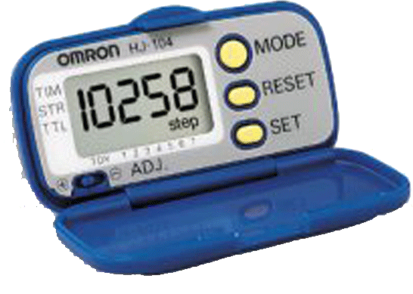
Keep Track of Your Steps
Use a pedometer
Keep track of how many steps you normally take in a day for one week
Gradually add 500-1,000 steps a day
Set a goal of at least 3,000 to
4,000 steps more than your baseline
Notes:
1. A pedometer is a good motivator to let you know how many steps you’re taking each day and to let you know how you’re progressing toward reaching your daily goals. It also helps you determine what types of activities give you more steps and therefore more exercise.
You can purchase a pedometer at a sporting goods store for $15 to $50.
2. Find out first how many steps you typically take in a day, then add 500-1000 steps/day as your first week’s goal. 3. Gradually add steps every 1-2 weeks until you reach your longer-term goal (at least 3,000-4,000 steps more than your baseline)
Agent Note: The 10,000 steps goals used in many programs may be too unrealistic for some adults, especially if they are very sedentary - and may discourage rather than encourage them.)

Slide 47
Vary Your Activities
Monday | Tuesday | Wed | Thursday | Friday
Walk | Swim/ Water Aerobics | Walk | Swim/ Water Aerobics | Walk
Monday | Tuesday | Wed | Thursday | Friday
Exercise bike | Dance class | Exercise Bike | Dance Class | Exercise Bike
Notes:
To avoid boredom and overusing the same muscles, vary your type of activity.

Slide 48
Keep A Record of Physical Activity
 | Breakfast |  |  | Lunch |  |  | Activity
 | Pre BG | Post BG | Carb (g) | Pre BG | Post BG | Carb (g)
Sun | 211 | 220 | 75 | 79 | 120 | 68 | Walked 30 min at 10:00am
Mon | 123 |  | 70 |  | 138 | 85 | Vacuumed 20 min at 4:00 pm
Tues | 115 |  | 72 |  | 170 | 68 | None
Notes:
Review your blood glucose results in your log book and note the amazing effect your physical activity has on your blood glucose levels. This can be very motivating to continue your physical activity plan.
(The Pre BG is blood glucose before meals; the Post BG is blood glucose 2 hours after a meal; Carb is the number of grams of carbohydrate at the meal).

Slide 49
Reward Yourself
Use non-food rewards for reaching goals such as:
  New book
  Ticket to a play or ballgame
  New clothes or walking shoes
  Bubble bath
  Get-away weekend
Notes:
Reward yourself for reaching your goals. Use smaller rewards for reaching shorter term goals such as walking 30 minutes a day for 5 days a week. Use larger rewards for reaching larger goals such as walking 5 days a week for a month.
Avoid using food for rewards. Instead, give yourself rewards specific to your interests – whether you enjoy taking a luxurious bubble bath or a night on the town with your spouse or friend.

Slide 50
Beginning A Physical Activity Plan
Type of activities
List your long-term goal
List your goal for first week
Notes:
Use the handout entitled “Beginning a Physical Activity Plan” and ask participants to complete their goals and sign.

Slide 51
Effect of Physical Activity on Blood Glucose
Depends on:
  your blood glucose level before you exercise
  diabetes medication
  when and how much you ate last
  your physical fitness
  type of activity
Notes:
There are no specific rules about how much your blood glucose will drop with exercise. How your body reacts to your activity depends on several things.

Slide 52
Effect of Physical Activity on Blood Glucose
Blood glucose checks before and after exercise are the key
Notes:
The most important thing in finding how your body responds to your activity is to check your blood glucose before and after exercise – and during exercise if it lasts 45 minutes or longer. Be sure to record it in your log book so you can go back and find a pattern.

Slide 53
Effect of Physical Activity on Blood Glucose
Physical activity usually lowers blood glucose
Physical activity can raise your blood glucose if:
  your BG is >250 mg/dl before your exercise and you have ketones
  you’re starting a new vigorous exercise program
Notes:
Since exercising muscles use glucose for energy, your blood glucose will usually decrease with physical activity.
However, if your blood glucose is over 300 or over 250 and you have ketones in your urine or blood, it means your body does not have adequate insulin for your muscles to use glucose for energy. Instead, it is breaking down fat for energy, producing ketones. Consequently, if you take insulin and have ketones, your blood glucose level can increase.
In some cases during very intense exercise, especially in people who are normally sedentary, blood glucose levels can increase during and after exercise due to the release of hormones in response to the stress of intense exercise. This is usually temporary and often occurs when someone first begins an exercise program.

Slide 54
Physical Activity and Low Blood Glucose
Low blood glucose can result from exercise only if you take:
  insulin
  oral diabetes medication (pills)
    sulfonylureas (DiaBeta, Amaryl, Glucotrol, micronase)
    nateglinide (Starlix) or repaglinide (Prandin)
Notes:
These are the medications that can cause low blood glucose reactions. If you take other types like Glucophage (metformin), Avandia, Actos, or Precose, your blood glucose is not likely to drop too low.

Slide 55
What Is Happening to Sandra?
Sandra takes insulin and is walking briskly in her neighborhood in the late afternoon. She becomes shaky, is unable to think clearly, and has changes in her vision.
What should Sandra do?
Notes:
What are these symptoms indicating? (let audience answer)
Yes, low blood glucose or hypoglycemia. Sweating would usually also be a symptom of low blood glucose, but she already may be sweating from walking briskly. So, that wouldn’t necessarily be a clue.
How should she treat herself? (answers on next slide)

Slide 56
Treatment for Low Blood Glucose
Equal to about 15 grams of carbohydrate:
½ cup fruit juice
½ cup soft drink (not diet)
3 glucose tablets
8 Lifesavers
Glucose Tablets
Notes:
If Sandra has symptoms of low blood glucose, she should ideally check her blood glucose if she has her meter with her.
She should then eat or drink something containing about 15 grams of carbohydrate and wait 15 minutes. If her blood glucose is still less than 70 or she doesn’t feel better, she should take 15 grams of carbohydrate again.

Slide 57
Physical Activity and Hypoglycemia
More common after physical activity
Body is replenishing stored carbohydrate (glycogen)
Check your blood glucose after you exercise
Notes:
Low blood glucose does not only occur during exercise, but can also occur for up to 24-48 hours after exercising depending on how long and how intensely you exercise. This is the time your body is replenishing the stored carbohydrate in your muscles and liver that you used during exercise.
Therefore, it’s also important to check your blood glucose after you exercise.
If you exercise in the evening and you take insulin, you may need to add an extra snack after you exercise to prevent night-time hypoglycemia.

Slide 58
How Can Sandra Prevent Low Blood Glucose Next Time?
Adjust Insulin
For planned, regularly scheduled physical activity
Eat Snack
For unplanned physical activity
When exercising for an extended period of time
Check blood glucose before, during, and after exercise
Notes:
Ask audience the question to elicit some discussion.
Click mouse twice: If Sandra plans on walking in the afternoon at a particular time each day, she should adjust her insulin dose based on her individual response to the intensity and time of her walks. She should use her blood glucose readings to determine how much her blood glucose tends to drop during and after she walks. She should talk to her doctor or diabetes educator about how to adjust her insulin for exercise.
Click mouse twice: The choice between decreasing her insulin or adding a snack will depend on several things.
If she is trying to lose weight, she will want to avoid eating extra snacks if she can adjust her medication instead. If her activity is unplanned and she was unable to adjust her medication, she would likely need a snack, depending on her blood glucose level.
If she plans exercise for longer than about 30-45 minutes, she will need a carbohydrate snack.
Mouse click: She should always check her blood glucose before and after exercise and during prolonged exercise.

Slide 59
Carbohydrate Snacks for Physical Activity
Intensity | Time (minutes) | Carbohydrate
Mild | Less than 30 | May not be needed
Moderate | 30-60 | 15 grams
High | Over 60 | 30-50 grams
Notes:
The amount of additional carbohydrate you need for exercise will depend the time of activity, the type, intensity, and duration and your blood glucose level.
If you’re exercising at a moderate level for 45 minutes, you may need about 15 grams of carbohydrate.
However, you may not need any extra carbohydrate if your activity is within 1-3 hours after a meal.

Slide 60


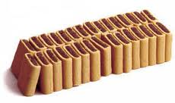


Carbohydrate Snacks for Physical Activity
Examples of 15 gram carbohydrate snacks
6 saltine-type crackers
1 cup yogurt
2 fig bars
1 ounce sport or energy bar
8 ounces sports drink - ideally with less than 8% carbohydrate
Notes:
These are examples of snacks that contain 15 grams of carbohydrate that could be used before or during physical activity.
If you drink sports drinks, it’s best to use those with less than 8% carbohydrate. Otherwise, they can cause stomach cramping during the activity.

Slide 61
Beware of Too Many Snacks
Avoid routinely eating extra food if you’re trying to lose weight
  ask about adjusting your medication dosages
  change the time of day you exercise
Notes:
If you’re trying to lose weight, you should not routinely eat a snack prior to exercise or you will limit your success with weight loss.
If you find you have to eat extra food due to hypoglycemia frequently, discuss this with your diabetes educator or physician. They will give you suggestions on how to adjust your medication or change your schedule to prevent low blood glucose during exercise.

Slide 62
Exercising With Diabetes Complications
If you have diabetes complications:
  An exercise stress test is recommended
  Don’t consider diabetes a barrier to exercise
    Most moderate lifestyle activities are safe
    Some activities may need to be modified
Notes:
If you have diabetes-related complications, an exercise stress test is recommended.
Some activities may be safer for you to do than others, and the way you do the activities may be modified so you can perform them safely.
Most moderate lifestyle activities, the type that are encouraged to fit into your daily routine, are safe to do when you have complications.
Following are some general guidelines for exercising if you have diabetes complications.

Slide 63
Exercising With Heart Disease
Caution:
Very strenuous activity
Heavy lifting or straining
Exercise in extreme cold or heat
Choose:
Moderate activity such as walking, swimming, biking, gardening
Moderate lifting, stretching
Notes:
If you have heart disease, exercise is still beneficial, but can also be unsafe if it’s too strenuous. Your doctor may suggest that you enter a supervised cardiac rehabilitation program when you first begin your physical training. Definitely get your doctor’s okay to do more than just moderate walking or water exercises.

Slide 64
Exercising with Hypertension
(high blood pressure)
Caution
Very strenuous activity
Heavy lifting or straining
Choose
Moderate activity like:
  walking
  weight lifting with light weights
  stretching
Make sure your blood pressure is in control first
Notes:
If you have hypertension, make sure your blood pressure is in control before you begin a new exercise program since your blood pressure response to exercise will be greater.
If you have high blood pressure, it’s best to avoid very strenuous activities like heavy weight lifting and straining which can increase your blood pressure significantly. But, keep in mind that walking and moderate activity can lower your blood pressure.
Some medications like beta-blockers change your heart-rate response to physical activity and can mask the signs and symptoms of hypoglycemia. Be sure to monitor your blood glucose and blood pressure.

Slide 65
Exercising with Retinopathy
(eye disease)
Caution
Strenuous exercise
Heavy lifting and straining
High-impact aerobics, jogging
Bending your head below your waist – toe touching
Choose
Moderate, low-impact activities:
  walking
  cycling
  water exercise
Moderate daily chores that don’t require lifting or bending your head below your waist
Notes:
If you have advanced diabetic retinopathy, you should avoid activities that increase pressure to your eyes or head. Mild or background retinopathy is not a concern with most exercise. If you’re not sure, ask your doctor is you should limit these types of activities.
This includes any activities that require your head to be below your waist, such as touching your toes, weight lifting, and high-impact activities that cause jarring or bouncing like jumping, jogging and high-impact aerobics.

Slide 66
Consideration for activity restriction in Diabetic Retinopathy
Level of DR | Acceptable activities | Discouraged activities
No | Dictated by medical status | Dictated by medical status
Mild | Dictated by medical status | Dictated by medical status
Moderate | Dictated by medical status | Power lifting, heavy valsalva
Severe | Dictated by medical status | Jarring, Boxing
PDR | Walking , Low impact aerobic, Swimming, Stationary cycling | Weight lifting, High impact, aerobic , Racquet sports ,

Slide 67
Exercising with Nephropathy (kidney disease)
Caution
Strenuous activity
Choose
Light to moderate activity like walking, light housework, gardening, water exercise
Notes:
If you have kidney disease, choose less strenuous activities like walking and water exercises that do not increase your blood pressure.
(Exercise is known to temporarily increase protein excretion.)

Slide 68
Exercising with Neuropathy
(nerve disease)
Caution
Weight-bearing, high impact, strenuous, or prolonged exercise:
  jogging/running
  step exercise
  jumping
  exercise in heat/cold
Choose
Low impact, moderate activities:
  biking
  swimming
  chair exercises
  stretching
  light to moderate daily activities
Check feet after exercise
Notes:
If you have diabetic neuropathy, you may have decreased sensation to your feet. This can result in injury to your feet during exercise.
If you don’t feel blisters and soreness in your feet, you may continue exercising without realizing that you’re hurting your feet.
Avoid high-impact, weight-bearing exercise like running, jogging, or walking long distances. Choose activities that put less stress on your feet, like biking, swimming, chair exercise and light household chores.
Check your feet after exercise for blisters, reddened areas, or injuries. Call your doctor if they don’t improve within 24 hours.

Slide 69
Exercise Safely
Check your blood glucose before and after exercise
Don’t exercise if your blood glucose is too high or too low
Carry carbohydrate to treat low blood glucose if you are at risk
Notes:
To Exercise Safely:
Check your blood glucose before exercise – if it’s over 250-300, don’t exercise and check your ketones if you’ve been taught. If it’s less than 100, eat a snack first. Check BG during exercise when longer than 45 minutes. Check after exercise as your body is using glucose to replenish stored carbohydrate.
Carry glucose tablets or other convenient sources of carbohydrate if you take insulin or oral meds that can cause low blood glucose. Other examples include Lifesavers 8-10, Raisins 2 tablespoons.

Slide 70
Exercise Safely
Stop exercising if you feel pain, lightheaded, or short of breath
Avoid strenuous activity in extremely hot, humid, or cold weather
Wear proper shoes for the activity to reduce the risk of injury
Notes:
Stop exercising if you feel dizzy, light-headed, or have any type of unusual pain.
Exercising in extremely hot or cold weather can be dangerous.
Wear proper shoes that fit well.

Slide 71
Exercise Safely
Wear diabetes identification
Include warm-up and cool-down sessions
Drink plenty of fluid
Notes:
Wear an ID bracelet or necklace when you are exercising away from home so that paramedics will know you have diabetes in an emergency
Include a warm-up before you exercise: do a slower version of the activity you plan to do. Then after exercise, gradually reduce the intensity until your heart rate returns to normal. Then stretch the muscles you’ve used during the activity (as muscles contract during exercise).

Slide 72
Words of the Wise...
One step and another step. I am slow but I am steady.”
“One step, another step. One step and another. Slow and steady.”
“One step and another.
I can do it!”
“ I am slow but I am steady. And I am the winner !”
The Tortoise in The Tortoise and the Hare

Slide 73
Words of the Unwise...
“ I can take a little rest.”
“ Zzzzzzzzzzzzzzzzzzzz.”
The Hare
in The Tortoise and the Hare

Slide 74
