Slide 1
رویکرد سایکوسوماتیک به دیابت
دکتر سید شهاب بنی هاشم
متخصص روانپزشکی فلوشیپ سایکوسوماتیک
استادیار دانشگاه علوم پزشکی شهید بهشتی
بیمارستان طالقانی

Slide 2
GENERAL CONSIDERATIONS IN PSYCHOSOCIAL CARE

Slide 3
GENERAL CONSIDERATIONS IN PSYCHOSOCIAL CARE
integrated with collaborative, patient-centered medical care

Slide 4
GENERAL CONSIDERATIONS IN PSYCHOSOCIAL CARE
integrated with collaborative, patient-centered medical care
assessment of symptoms of

Slide 5
GENERAL CONSIDERATIONS IN PSYCHOSOCIAL CARE
integrated with collaborative, patient-centered medical care
assessment of symptoms of
Diabetes distress

Slide 6
GENERAL CONSIDERATIONS IN PSYCHOSOCIAL CARE
integrated with collaborative, patient-centered medical care
assessment of symptoms of
Diabetes distress
Depression

Slide 7
GENERAL CONSIDERATIONS IN PSYCHOSOCIAL CARE
integrated with collaborative, patient-centered medical care
assessment of symptoms of
Diabetes distress
Depression
Anxiety

Slide 8
GENERAL CONSIDERATIONS IN PSYCHOSOCIAL CARE
integrated with collaborative, patient-centered medical care
assessment of symptoms of
Diabetes distress
Depression
Anxiety
Disordered eating

Slide 9
GENERAL CONSIDERATIONS IN PSYCHOSOCIAL CARE
integrated with collaborative, patient-centered medical care
assessment of symptoms of
Diabetes distress
Depression
Anxiety
Disordered eating
Cognitive capacities

Slide 10
GENERAL CONSIDERATIONS IN PSYCHOSOCIAL CARE
integrated with collaborative, patient-centered medical care
assessment of symptoms of
Diabetes distress
Depression
Anxiety
Disordered eating
Cognitive capacities
caregivers and family members

Slide 11
GENERAL CONSIDERATIONS IN PSYCHOSOCIAL CARE
integrated with collaborative, patient-centered medical care
assessment of symptoms of
Diabetes distress
Depression
Anxiety
Disordered eating
Cognitive capacities
monitoring patient performance of self-management behaviors
caregivers and family members

Slide 12
GENERAL CONSIDERATIONS IN PSYCHOSOCIAL CARE
integrated with collaborative, patient-centered medical care
assessment of symptoms of
Diabetes distress
Depression
Anxiety
Disordered eating
Cognitive capacities
monitoring patient performance of self-management behaviors
life circumstances that can affect physical and psychological health outcomes
caregivers and family members

Slide 13
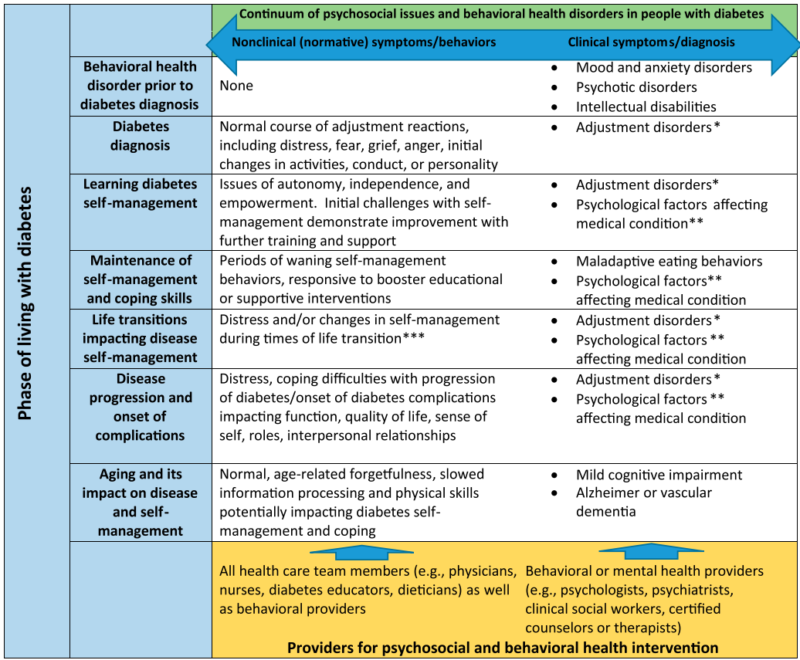

Slide 21
referral of a person with diabetes to a mental health

Slide 22
referral of a person with diabetes to a mental health
If self-care remains impaired after tailored diabetes education

Slide 23
referral of a person with diabetes to a mental health
If self-care remains impaired after tailored diabetes education
If a person has a positive screen depressive symptoms

Slide 24
referral of a person with diabetes to a mental health
If self-care remains impaired after tailored diabetes education
If a person has a positive screen depressive symptoms
In the disordered eating behavior, an eating disorder, patterns of eating

Slide 25
referral of a person with diabetes to a mental health
If self-care remains impaired after tailored diabetes education
If a person has a positive screen depressive symptoms
In the disordered eating behavior, an eating disorder, patterns of eating
If omission of insulin or oral medication to cause weight loss

Slide 26
referral of a person with diabetes to a mental health
If self-care remains impaired after tailored diabetes education
If a person has a positive screen depressive symptoms
In the disordered eating behavior, an eating disorder, patterns of eating
If omission of insulin or oral medication to cause weight loss
If positive screen for anxiety

Slide 27
referral of a person with diabetes to a mental health
If self-care remains impaired after tailored diabetes education
If a person has a positive screen depressive symptoms
In the disordered eating behavior, an eating disorder, patterns of eating
If omission of insulin or oral medication to cause weight loss
If positive screen for anxiety
If a serious mental illness is suspected

Slide 28
referral of a person with diabetes to a mental health
If self-care remains impaired after tailored diabetes education
If a person has a positive screen depressive symptoms
In the disordered eating behavior, an eating disorder, patterns of eating
If omission of insulin or oral medication to cause weight loss
If positive screen for anxiety
If a serious mental illness is suspected
In youth and families self-care difficulties, repeated hospitalizations for diabetic ketoacidosis, or significant distress

Slide 29
referral of a person with diabetes to a mental health
If self-care remains impaired after tailored diabetes education
If a person has a positive screen depressive symptoms
In the disordered eating behavior, an eating disorder, patterns of eating
If omission of insulin or oral medication to cause weight loss
If positive screen for anxiety
If a serious mental illness is suspected
In youth and families self-care difficulties, repeated hospitalizations for diabetic ketoacidosis, or significant distress
If a person screens positive for cognitive impairment

Slide 30
referral of a person with diabetes to a mental health
If self-care remains impaired after tailored diabetes education
If a person has a positive screen depressive symptoms
In the disordered eating behavior, an eating disorder, patterns of eating
If omission of insulin or oral medication to cause weight loss
If positive screen for anxiety
If a serious mental illness is suspected
In youth and families self-care difficulties, repeated hospitalizations for diabetic ketoacidosis, or significant distress
If a person screens positive for cognitive impairment
Declining or impaired ability to perform diabetes self-care behaviors

Slide 31
referral of a person with diabetes to a mental health
If self-care remains impaired after tailored diabetes education
If a person has a positive screen depressive symptoms
In the disordered eating behavior, an eating disorder, patterns of eating
If omission of insulin or oral medication to cause weight loss
If positive screen for anxiety
If a serious mental illness is suspected
In youth and families self-care difficulties, repeated hospitalizations for diabetic ketoacidosis, or significant distress
If a person screens positive for cognitive impairment
Declining or impaired ability to perform diabetes self-care behaviors
Before undergoing bariatric surgery

