Slide 1
An Introduction to Lipid Metabolism and Dyslipidemia
Hengameh Abdi
Endocrine Research Center
Research Institute for Endocrine sciences
Shahid Beheshti University of Medical Sciences
24 January 2019
Symposium of Nutrition in Dyslipidemia
Tehran

Slide 2
Outlines
Classification of lipid particles
Brief overview of lipid metabolism
Diabetic dyslipidemia
Classification of dyslipidemia
Screening and treatment of dyslipidemia at a glance
Conclusions

Slide 3
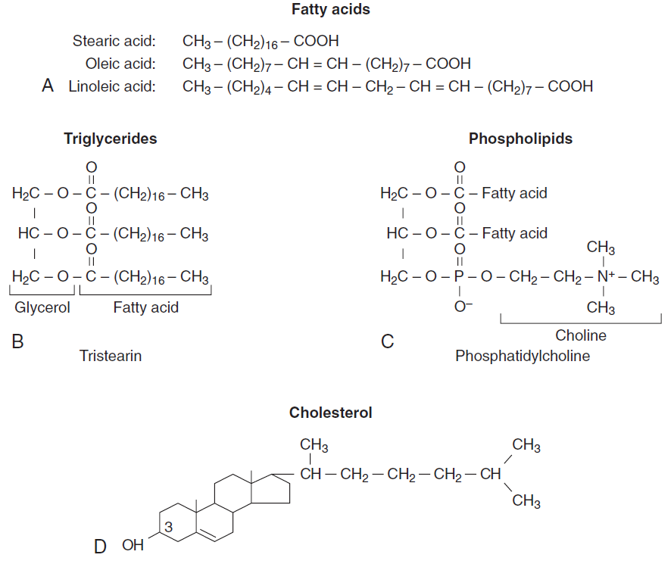
Structures of common lipids
Simple lipid
Complex lipid
Complex lipid
Simple lipid

Slide 4
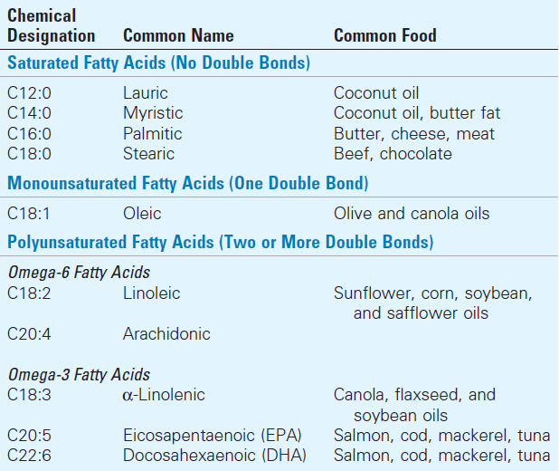
Major fatty acids
Notes:
Saturated fatty acids and some unsaturated fatty acids such as oleic acid are nonessential (i.e., they can be synthesized). Most ω-6 and ω-3 fatty acids are essential; they cannot be synthesized and are usually required for health, especially during development and in times of physiologic stress.

Slide 5
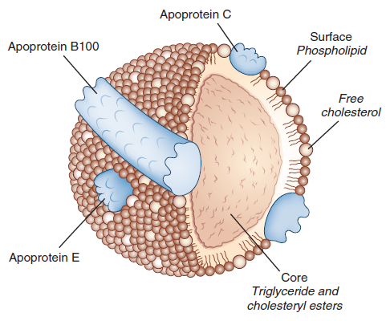
General structure of lipoproteins

Slide 6
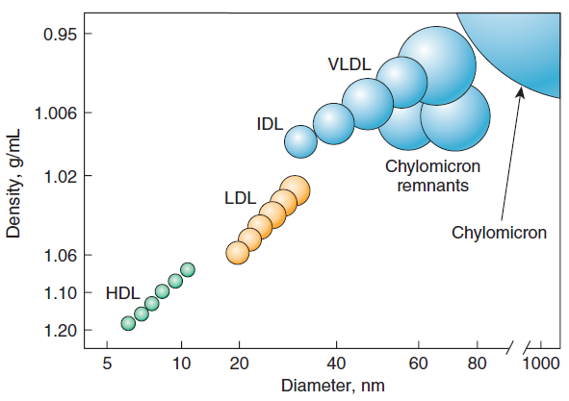
Density and size distribution of the major classes of lipoprotein particles
HDL, high-density lipoprotein
LDL, low-density lipoprotein
IDL, intermediate-density lipoprotein
VLDL, very-low-density lipoprotein

Slide 7
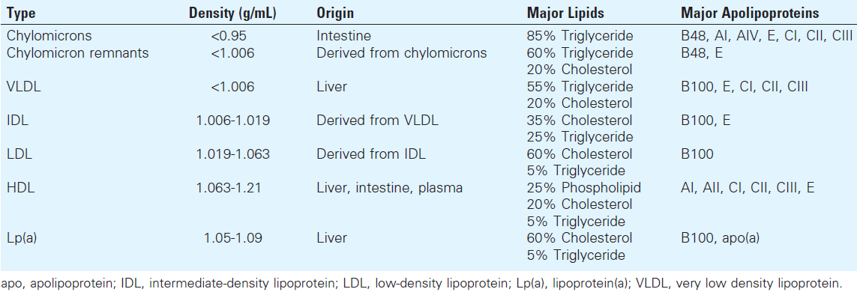
Major classes of lipoprotein particles

Slide 8
Outlines
Classification of lipid particles
Brief overview of lipid metabolism
Diabetic dyslipidemia
Classification of dyslipidemia
Screening and treatment of dyslipidemia at a glance
Conclusions

Slide 9
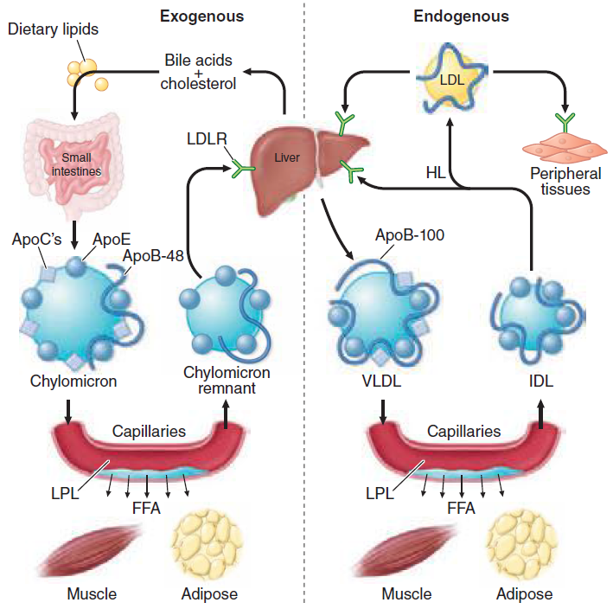
Exogenous and endogenous lipoprotein metabolic pathways
(Lipoprotein lipase)
Notes:
Exogenous Lipid Transport:
Dietary fat and cholesterol (top left) absorbed by the duodenum and proximal jejunum are used to generate chylomicrons that are secreted at the lateral borders of enterocytes and enter mesenteric lymphatics. They access the plasma via the thoracic duct and are rapidly metabolized by LPL to yield chylomicron remnants. These are taken up by remnant receptors (LRP1/HSPG) and by LDL receptors in the liver. Free fatty acids liberated by the action of LPL are available to adipose tissue for storage and to other tissues (e.g., skeletal muscle, heart) for use as energy substrates.

Slide 10
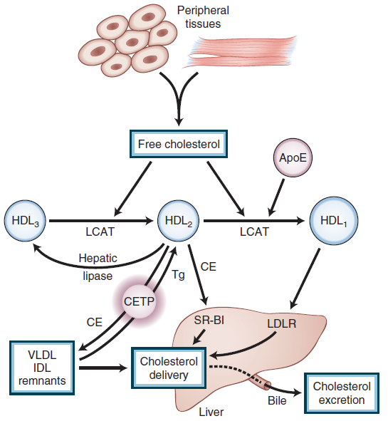
HDL metabolism and reverse cholesterol transport
HDL, high-density lipoprotein
LDLR, low-density lipoprotein receptor
IDL, intermediate-density lipoprotein
VLDL, very-low-density lipoprotein
LCAT, lecithin:cholesterol acyl transferase
CE, cholesteryl ester
Tg, triglyceride
CETP, cholesteryl ester transfer protein
SR-BI, scavenger receptor class B, type 1
Notes:
Cholesterol cannot be metabolized by peripheral tissues and must be returned to the liver for excretion. This process, known as reverse cholesterol transport, is dependent on HDL and its precursors.

Slide 11
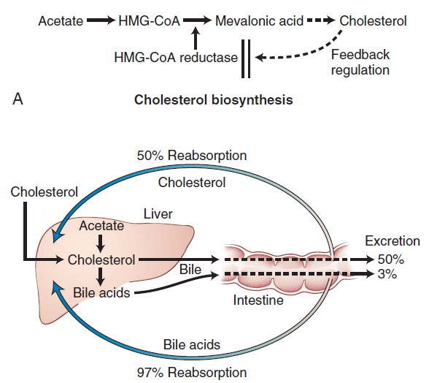
Cholesterol biosynthesis

Slide 12
Outlines
Classification of lipid particles
Brief overview of lipid metabolism
Diabetic dyslipidemia
Classification of dyslipidemia
Screening and treatment of dyslipidemia at a glance
Conclusions

Slide 13
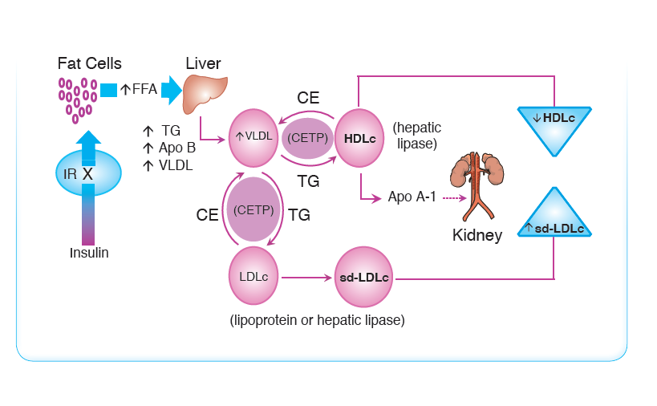
Diabetic dyslipidemia
Insulin resistance
Notes:
Wikimedia commons.

Slide 14
Diabetic dyslipidemia

Slide 15
Outlines
Classification of lipid particles
Brief overview of lipid metabolism
Diabetic dyslipidemia
Classification of dyslipidemia
Screening and treatment of dyslipidemia at a glance
Conclusions

Slide 16
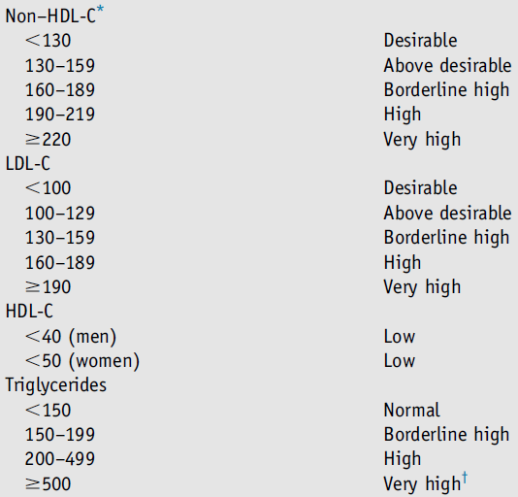
Classifications of cholesterol and triglyceride levels in mg/dL

Slide 17
Recent classification for hypertriglyceridemia
Moderate hypertriglyceridemia:
Fasting or nonfasting triglycerides 175 to 499 mg/dL
Severe hypertriglyceridemia:
Fasting triglycerides ≥ 500 mg/dL

Slide 18
Primary hyperlipoproteinemias
Hypertriglyceridemia
Lipoprotein lipase deficiency
Familial apoC-II deficiency
ApoA-V deficiency
GPIHBP1 deficiency
Combined hyperlipidemia
Familial dysbetalipoproteinemia
Familial hepatic lipase deficiency
Hypercholesterolemia
Familial hypercholesterolemia
Familial defective apoB-100
Autosomal dominant hypercholesterolemia, type 3
Autosomal recessive hypercholesterolemia
Sitosterolemia

Slide 19
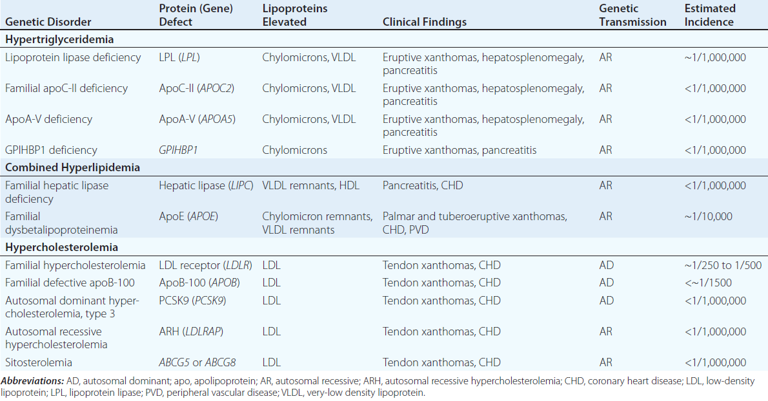
Primary hyperlipidemias

Slide 20
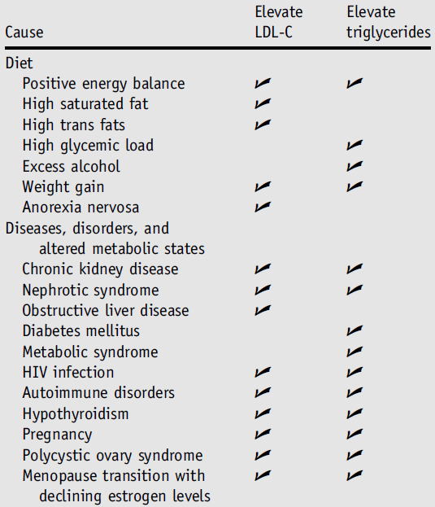
Secondary causes of dyslipidemia

Slide 21
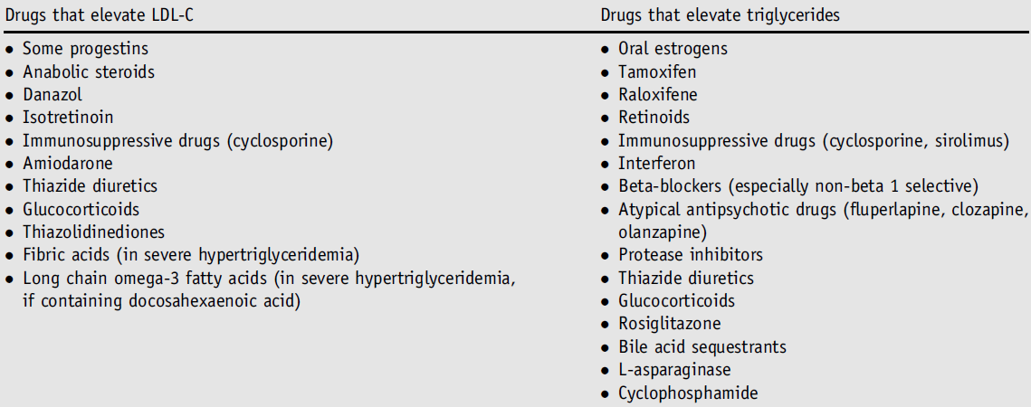
Medication- induced dyslipidemia

Slide 22
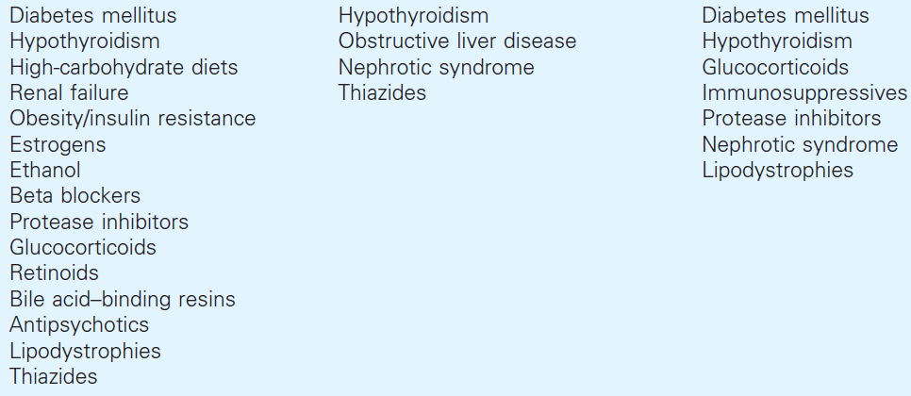
Secondary causes of dyslipidemia
Hypertriglyceridemia
Hypercholesterolemia
Combined

Slide 23
Outlines
Classification of lipid particles
Brief overview of lipid metabolism
Diabetic dyslipidemia
Classification of dyslipidemia
Screening and treatment of dyslipidemia at a glance
Conclusions

Slide 24
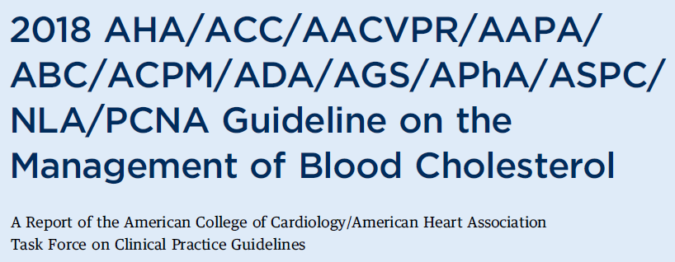
2015

Slide 25
Screening of initial lipoprotein lipid levels
All adults aged ≥ 20 years
Fasting or non-fasting
Total cholesterol, HDL-C, LDL-C, triglycerides (TG)
TG ≥ 400 mg/dL in the non-fasting state repeat lipid profile in the fasting state
In adults with a family history of premature atherosclerotic cardiovascular disease (ASCVD) or genetic hyperlipidemia, a fasting lipid profile is reasonable.
If atherogenic cholesterol levels (non–HDL-C and LDL-C) are in the desirable range, lipid measurement and ASCVD risk assessment should be repeated in 5 years, or sooner based on clinical judgment.
Notes:
AACE 2017: In the absence of ASCVD risk factors, screen middle-aged individuals (Men Aged 45-65 Years, Women Aged 55-65 Years) for dyslipidemia at least once every 1 to 2 years. More frequent lipid testing is recommended when multiple global ASCVD risk factors are present.

Slide 26
Lifestyle modification is always the backbone of treatment strategies.

Slide 27
Primary lipid-lowering drug classes
Cholesterol:
HMG-CoA reductase inhibitors (statins)
Cholesterol absorption inhibitors (ezetimibe)
PCSK9 (Proprotein convertase subtilisin/kexin type 9) inhibitors (evolocumab)
Bile acid sequestrants (cholestyramine)
Triglycerides:
Fibric acid derivatives (gemfibrozil, fenofibrate)
Niacin (nicotinic acid)
Omega-3 fatty acids (icosapent ethyl, omega-3-acid ethyl esters)

Slide 28
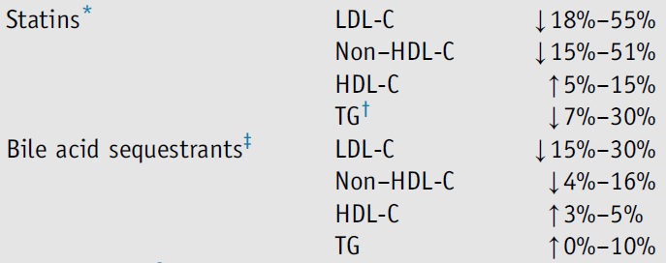
Effects of lipid-lowering drugs

Slide 29
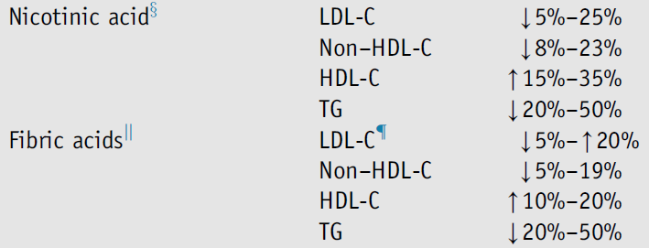
Effects of lipid-lowering drugs

Slide 30
Patient management groups regarding cholesterol:
Patients with clinical atherosclerotic cardiovascular disease (ASCVD)-Secondary ASCVD prevention
Patients with primary severe hypercholesterolemia
(LDL-C ≥ 190 mg/dL)
Patients with diabetes mellitus
Primary ASCVD prevention
Other populations at risk

Slide 31
Adults with hypertriglyceridemia
In adults with severe hypertriglyceridemia (fasting triglycerides ≥ 500 mg/dL), especially fasting triglycerides ≥ 1000 mg/dL, if triglycerides are persistently elevated or increasing, it is reasonable to further reduce triglycerides by implementation of a very low-fat diet, avoidance of refined carbohydrates and alcohol, consumption of omega-3 fatty acids, and, if necessary to prevent acute pancreatitis, fibrate therapy.

Slide 32
Concluding remarks:
Understanding the integrative physiology of lipid metabolism helps for a logical approach to the patient with dyslipidemia.
Lifestyle modification (medical nutrition therapy and physical activity) is always the backbone of treatment strategies for dyslipidemia.
Regarding cholesterol management, consider your patient belongs to which management group and then treat.
Regarding triglyceride management, remember that lifestyle modification can be the only therapeutic strategy in serum triglyceride levels up to 500 mg/dL.

Slide 33
References:
Harrison's Principles of Internal Medicine, 20th edition-2018
Williams Textbook of Endocrinology, 13th edition-2016
National Lipid Association Recommendations for Patient-Centered Management of Dyslipidemia-2015
American Association of Clinical Endocrinologists and American College of Endocrinology Guidelines for Management of Dyslipidemia and Prevention of Cardiovascular Disease-2017
AHA/ACC/AACVPR/AAPA/ABC/ACPM/ADA/AGS/APhA/ASPC/NLA/PCNA Guideline on the Management of Blood Cholesterol-2018

Slide 34
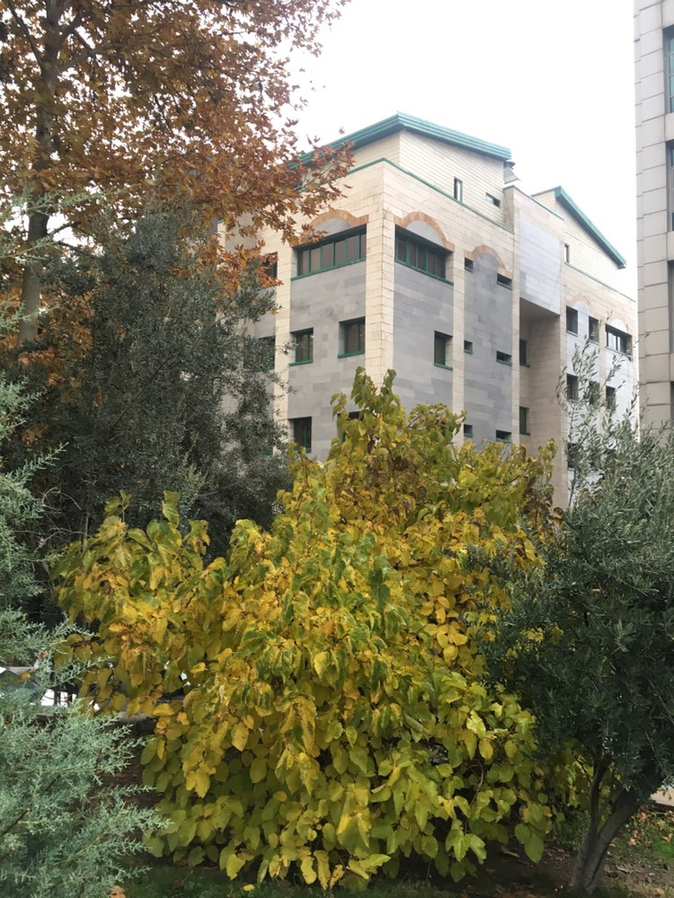
Thanks for your attention.
Photo by Majid Valizadeh, MD.

