Slide 1
Dysmetabolic Aspects in PCOS
F. Hosseinpanah, M.D.
Obesity Research Center
Research Institute for Endocrine sciences
Shahid Beheshti University
of Medical Sciences
January 1, 2015

Slide 2
Characteristics of PCOS
Chronic anovulation
Hyperandrogenemia
Metabolic abnormalities

Slide 3
Points to address in this lecture:
Is there any association between PCOS and metabolic abnormalities?
Is there any causal relationship between PCOS and development of CVD?
Screening for metabolic risk factors, Is it evidence based?

Slide 4
IR and PCOS
Studies with the euglycaemic clamp technique indicate that insulin resistance is a common feature of the syndrome, and both obese and non obese women with the syndrome are more insulin-resistant and hyperinsulinaemic than age- and weight-matched normal women (Chang et al 1983; Dunaif et al 1989, 1992).

Slide 5
Obese PCOS women had signiﬁcantly decreased insulin sensitivity compared with
nonobese PCOS women (Dunaif, 1995)

Slide 6
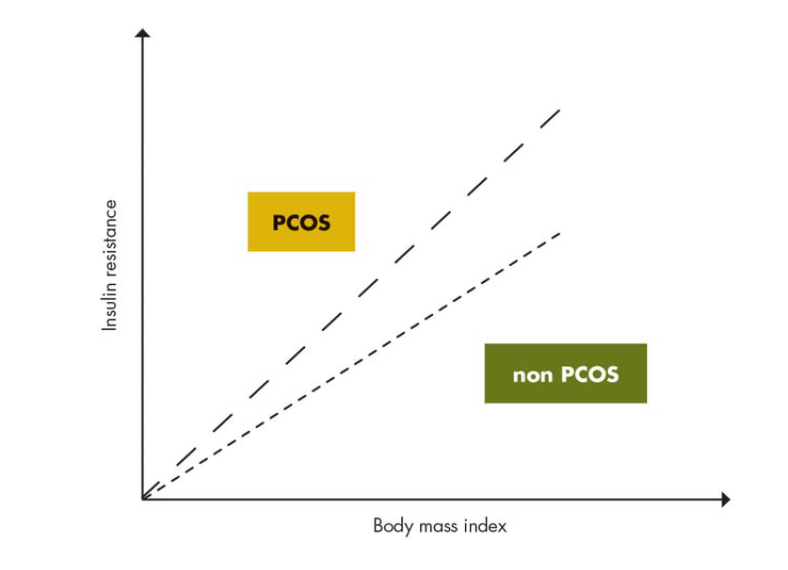
With increasing BMI, women with PCOS, compared with BMI-matched non-PCOS women, appear to accrue more insulin insensitivity
Modified from N. Sattar: Polycystic ovary syndrome. The metabolic syndrome, 2nd
ed. (edited by C. D. Byrne and S. H. Wild), Wiley-Blackwell, Oxford, UK, 2011

Slide 7
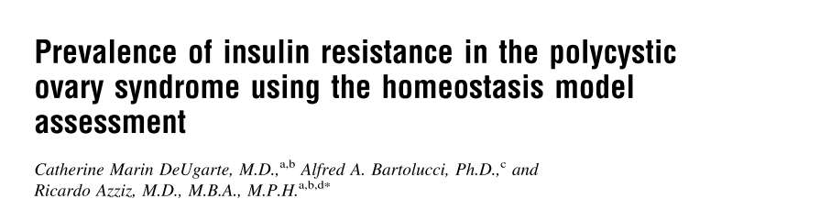
Objective: To determine the prevalence of insulin resistance (IR) in a large population of patients with the polycystic ovary syndrome (PCOS)
Design: Prospective, case-control
Setting: University medical center
Fertility and Sterility, Vol. 83, No. 5, May 2005

Slide 8
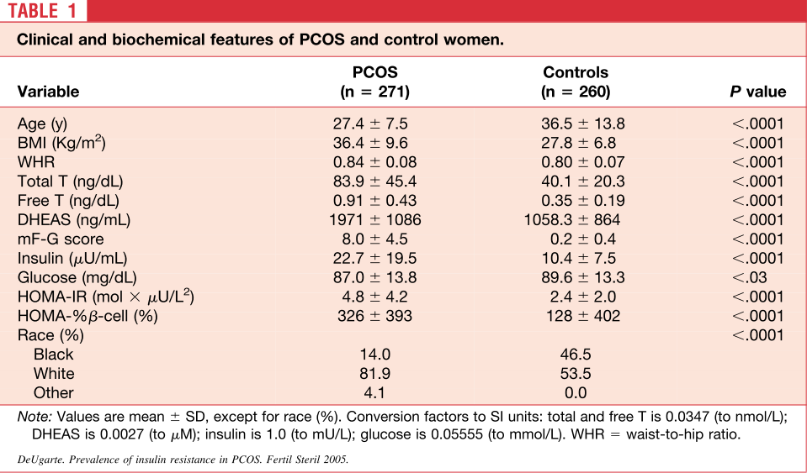
After adjustment, 64.4% of PCOS patients were noted to be insulin resistant, and 2.6% had β-cell dysfunction

Slide 9
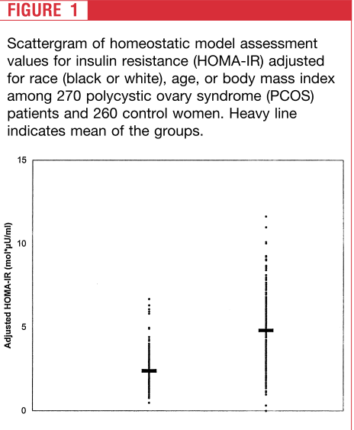
Control PCOS

Slide 10
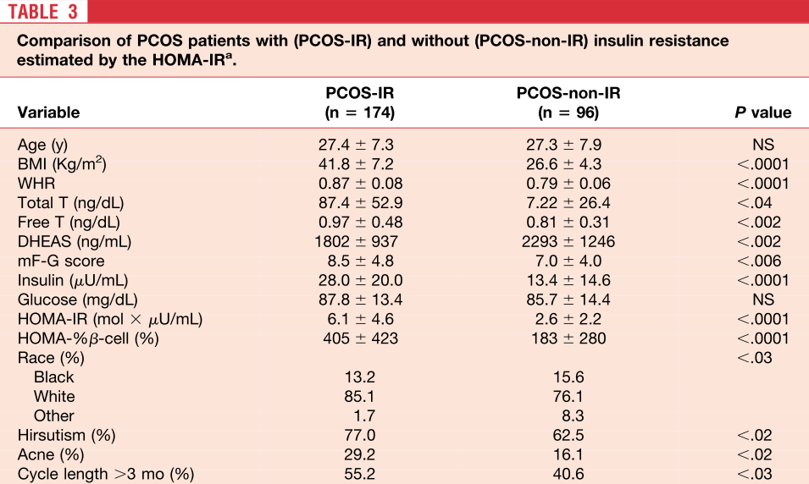

Slide 11
Key messages
In patients with PCOS, the prevalence of IR was 64% according to the HOMA-IR measurement, after adjustment
Patients with IR were more clinically affected
Although IR is a common abnormality in PCOS, it does not seem to be a universal feature

Slide 12
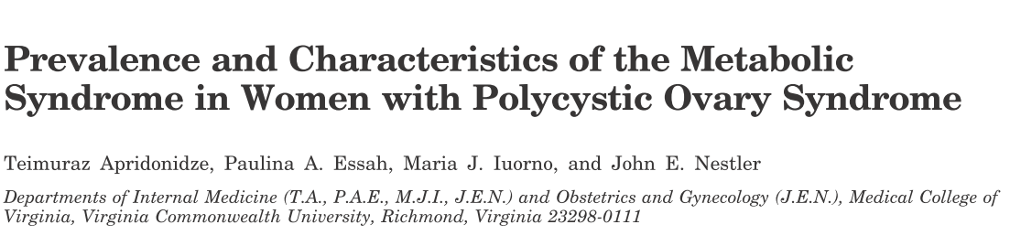
Retrospective medical chart review of women with PCOS
seen in an Endocrine Clinic
NCEP ATP III criteria was used for definition of Mets
Of the 161 PCOS cases reviewed, 106 met the inclusion criteria.
The women were divided into two groups: 1) women with
PCOS and the Mets (n =46); and 2) women with PCOS lacking the Mets(n =60)
Apridonidze T et al, JCEM 2005;90:1929-35

Slide 13
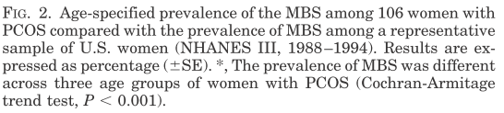
53
45
21
15
6
Overall prevalence of MS was 43% (2-fold higher than in the general population)
.

Slide 14
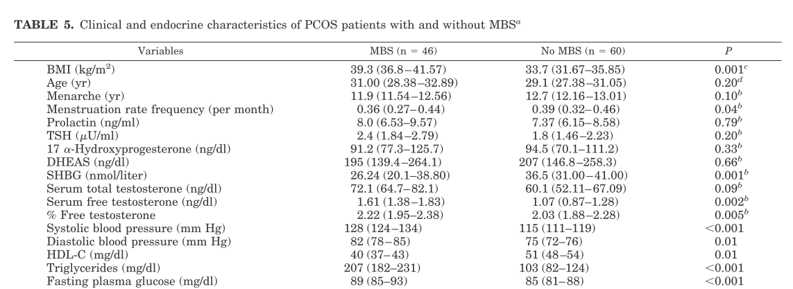

Slide 15
Key messages
Mets and its components are common in women with PCOS, placing them at increased risk for cardiovascular disease
Women with PCOS and the Mets differ from their counterparts lacking the Mets in terms of increased hyperandrogenemia, lower serum SHBG, and higher prevalence of acanthosis nigricans, all features that may reflect more severe insulin resistance

Slide 16
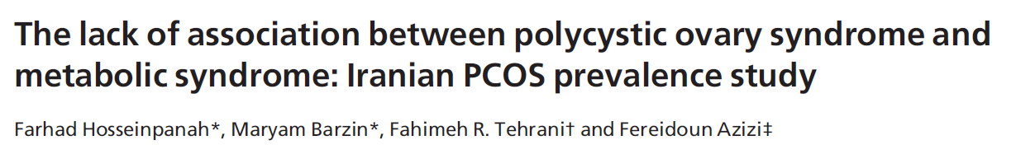
Objective: To evaluate the prevalence of the metabolic syndrome and insulin resistance in a large population-based study in Iran
One hundred and thirty six PCOS subjects and 423 healthy controls recruited from among 1126 reproductive aged women (18–45 year) were compared
Clinical Endocrinology (2011) 75, 692–697

Slide 17
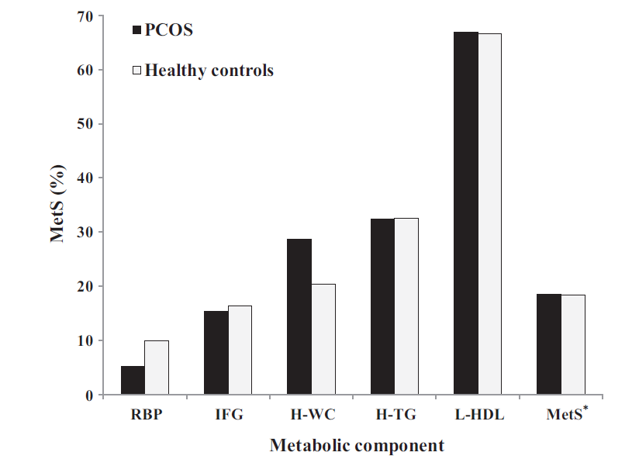
Metabolic syndrome was no more frequent in a representative sample of PCOS Iranian population than in healthy controls
.
18.5% Vs 18.3%

Slide 18
Important message
Method of recruitment of PCOS women and controls can seriously influence the estimates of metabolic abnormalities

Slide 19
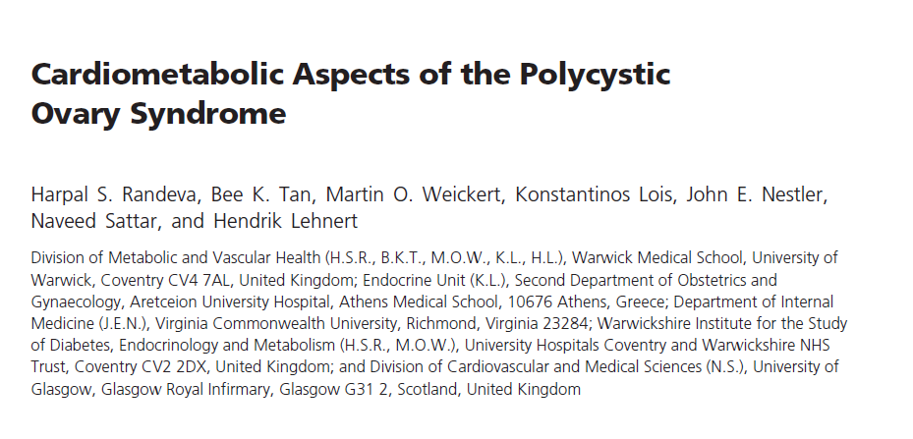
Endocr Rev.2012 Oct;33(5):812-41

Slide 20
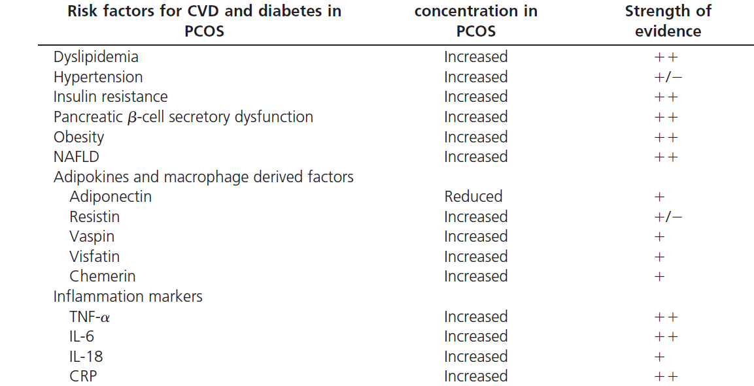
Incidence of well-established and novel risk factors for CVD and diabetes in PCOS

Slide 21

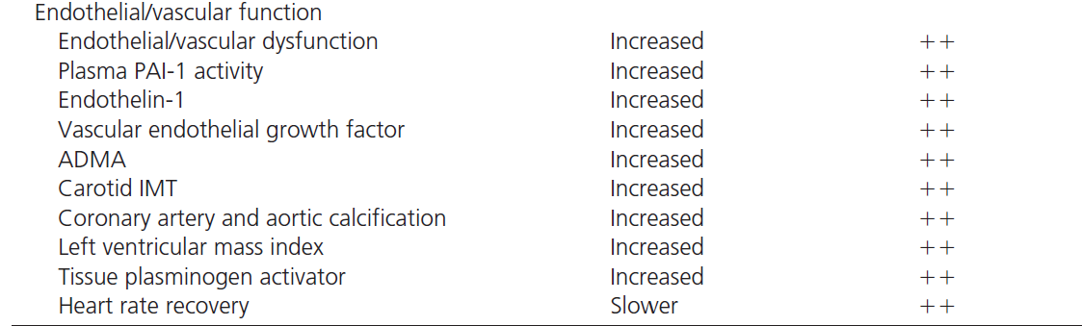
Continued..

Slide 22
PCOS and CVD
  Women with PCOS may be at increased risk of heart disease with increased prevalence of CHD risk factors: (LDL, HDL, triglycerides, hypertension and diabetes)
  However, the literature to date has been inconsistent

Slide 23
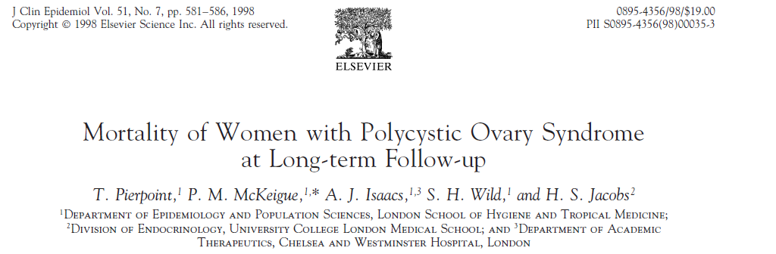

Slide 24
Study design
Design: Prospective
Length of F/U: 30 years (through 1997)
Sample size : 786 PCOS
SMR was calculated(standardized mortality ratio)

Slide 25
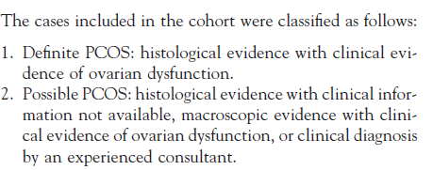
Inclusion criteria

Slide 26
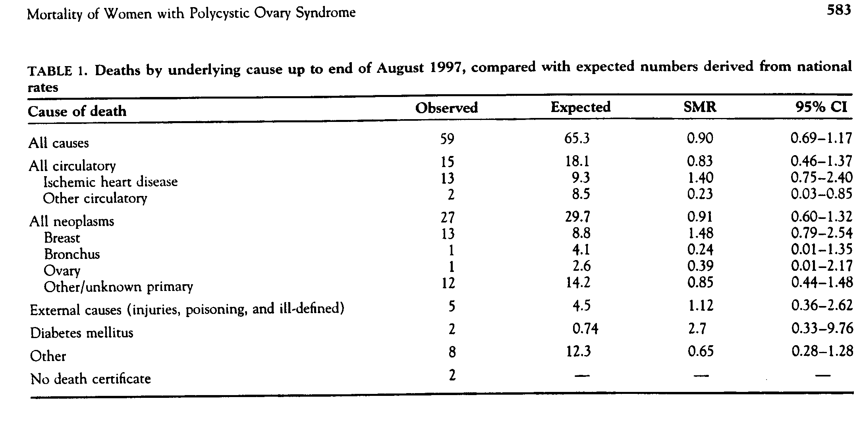

Slide 27
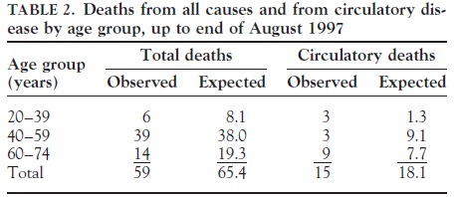

Slide 28
Key message
Women with PCOS do not have markedly higher than average mortality from cardiovascular disease

Slide 29
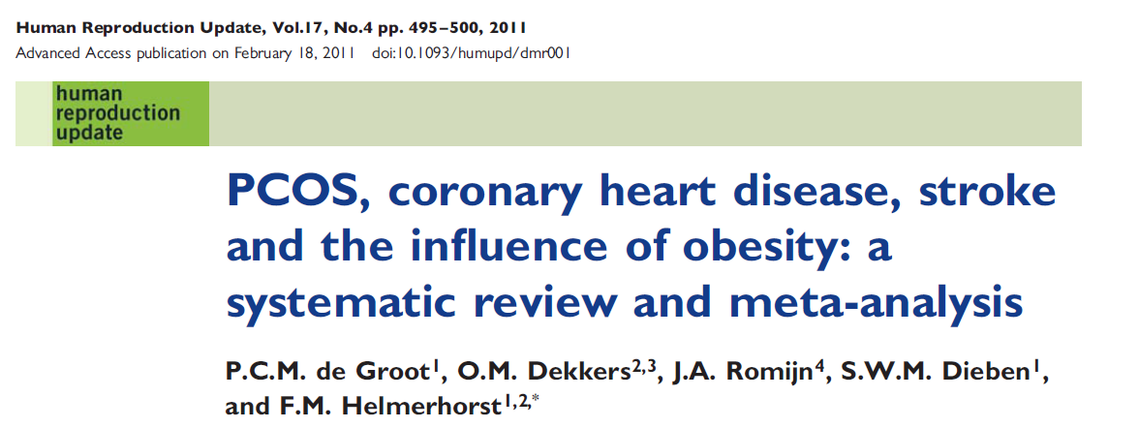

Slide 30
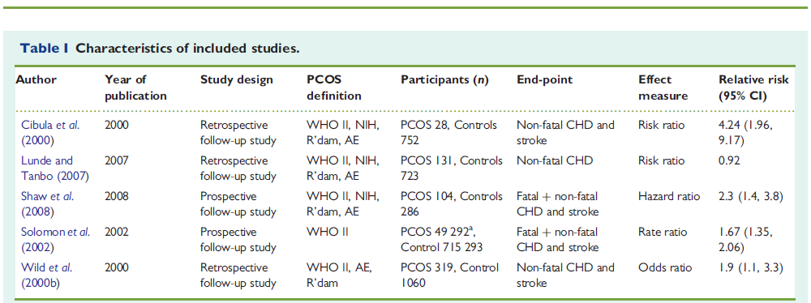

Slide 31
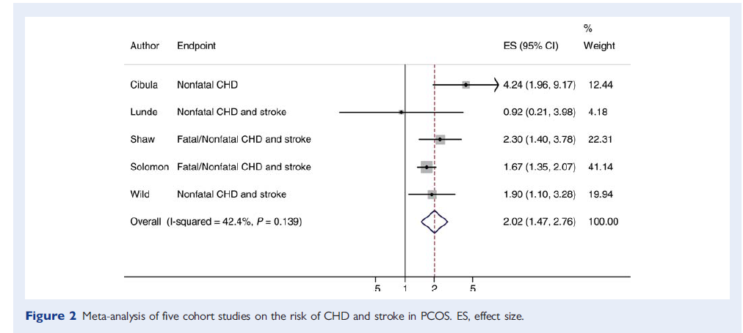

Slide 32
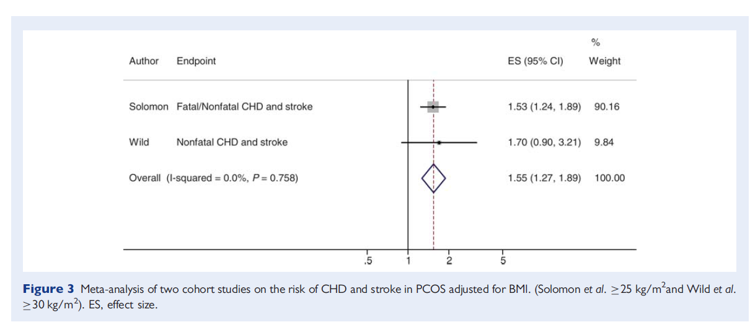

Slide 33
Key messages
A significant 2-fold risk of CHD and stroke for patients with PCOS relative to women without PCOS was found, 2.2(95% CI 1.46-2.76)
Risk was still increased by 55% in the studies that adjusted for BMI, 1.55(95%CI 1.27-1.89)
It means that increased BMI is not the sole cause of the increased cardiovascular risk in women with PCOS

Slide 34
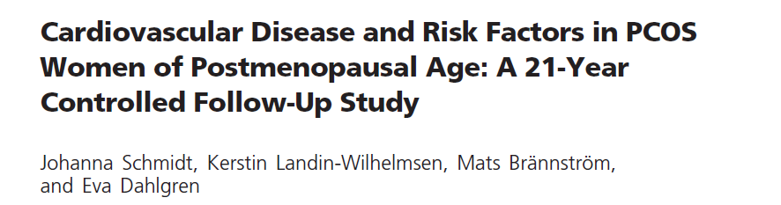
Objective: To examine whether postmenopausal PCOS women differ from controls regarding cardiovascular risk factors, myocardial infarction (MI), stroke and mortality
Design : A prospective study of 35 PCOS women (61–79 yr) and 120 age-matched controls
Length of F/U: 21 years
J Clin Endocrinol Metab 96: 3794–3803, 2011

Slide 35
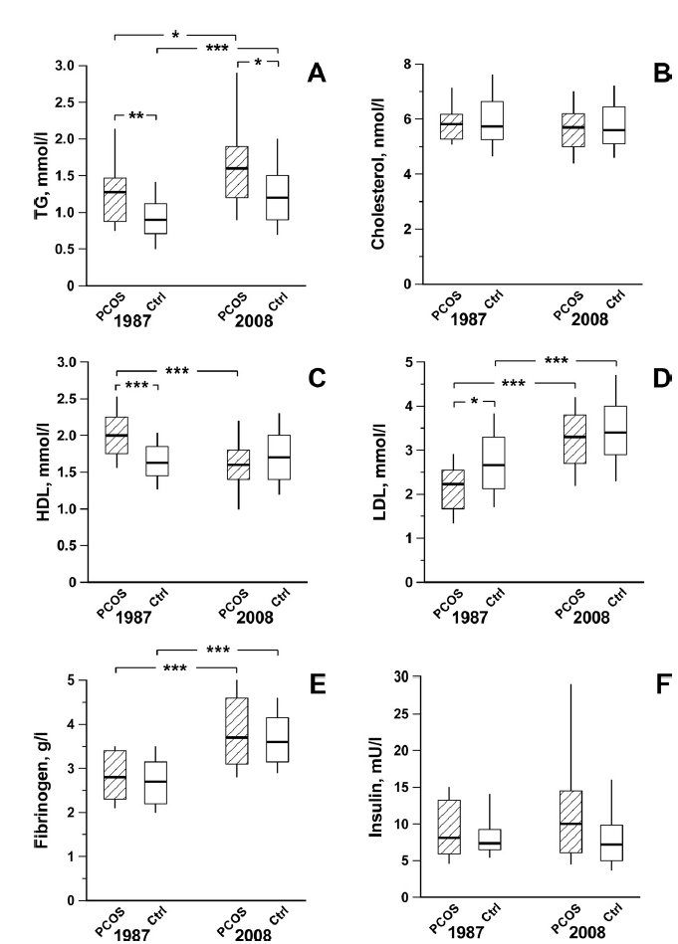

Slide 36
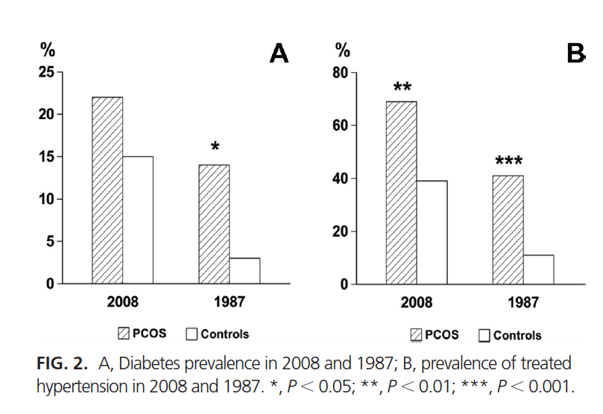

Slide 37
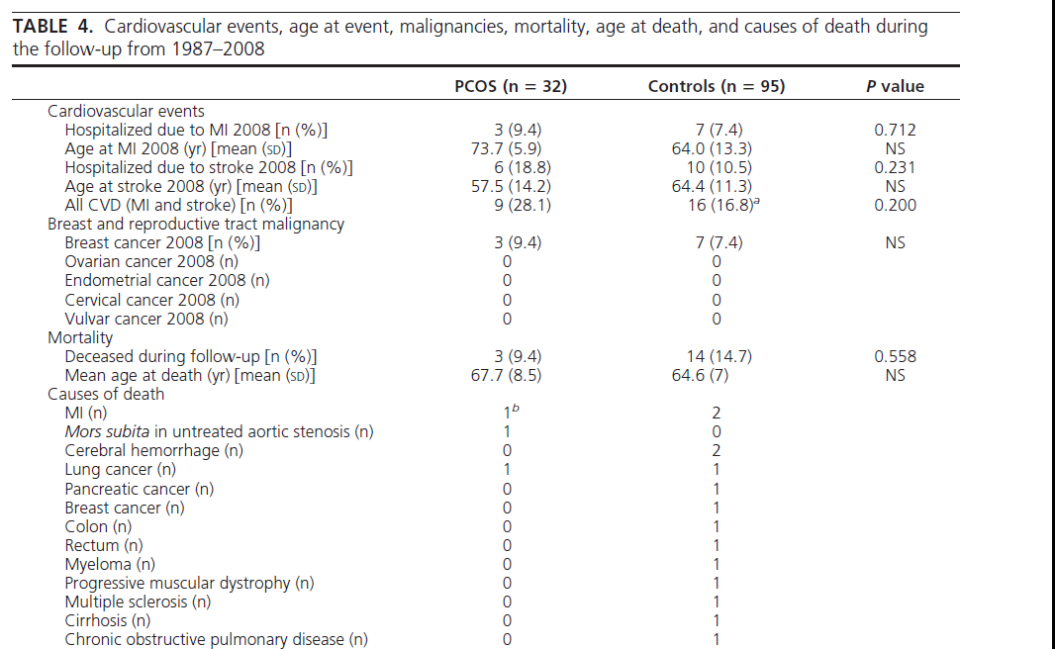

Slide 38
Key messages
Hypertension and hypertriglyceridemia were the only cardiovascular risk factors that persisted more frequently in postmenopausal PCOS women than in controls after 21 yr of follow-up
The proposed increase in CVD events could not be detected at this follow-up of elderly PCOS women with similar weight and BMI as controls

Slide 39

Objective: To determine the relative risk of type 2 diabetes, cancer, large-vessel disease and all-cause mortality for women with PCOS
Setting: General Practice Research Database in UK
Primary outcome: first incident record of diabetes
Median follow-up: 4.7yr (IQR 2.0–8.6 yr) in those with PCOS and 5.8yr (2.7–9.6) in the reference group
J Clin Endocrinol Metab 97: 3251–3260, 2012

Slide 40
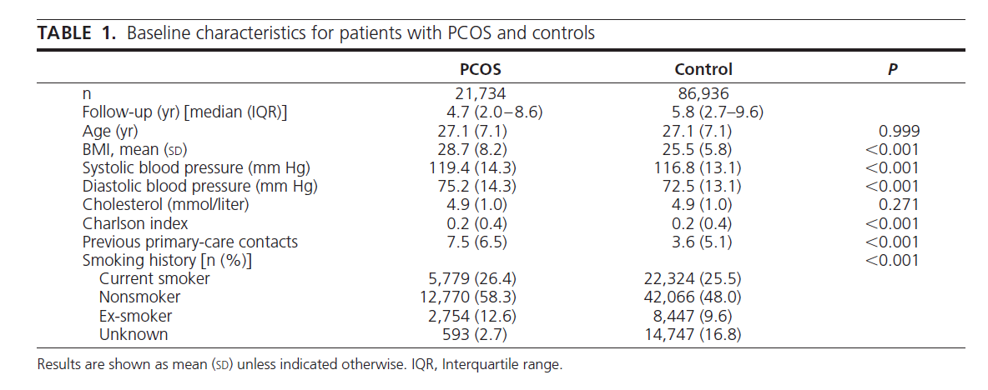

Slide 41
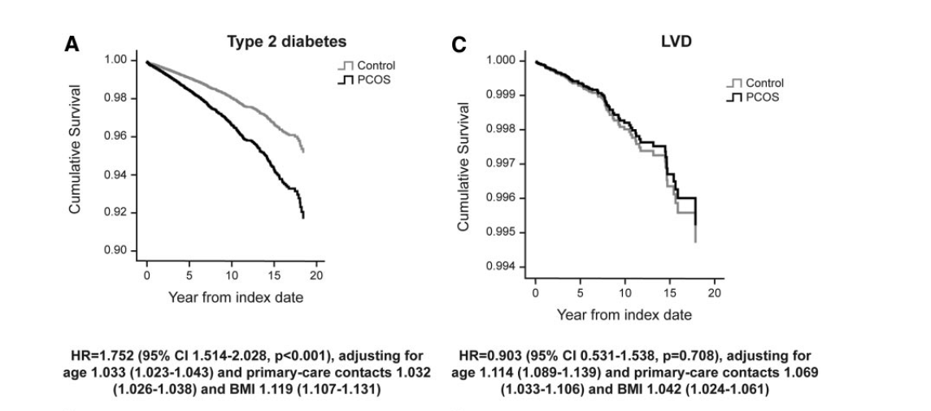

Slide 42
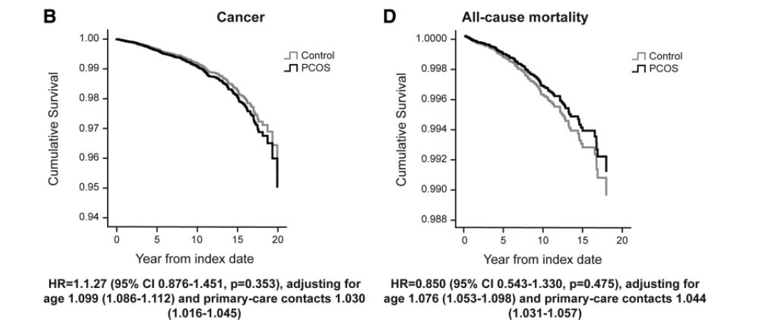

Slide 43
Key messages
Our findings confirm that young women with PCOS have a substantially increased risk for the development of type 2 diabetes, which remained significant after adjustment for BMI, age, and previous primary-care contacts
The results did not show any increased risk of cancer, LVD, or all-cause mortality
longer-term studies are still needed to establish whether these risks emerge at a later age

Slide 44
Cardiovascular risk factors
We recommend that adolescents and women with PCOS be screened for the following cardiovascular disease risk factors :
Family history of early cardiovascular disease,
Cigarette smoking,
IGT/T2DM, hypertension,
Dyslipidemia
OSA
Obesity (especially increased abdominal adiposity)
An Endocrine Society Clinical Practice
Guideline, J Clin Endocrinol Metab 98: 4565–4592, 2013

Slide 45
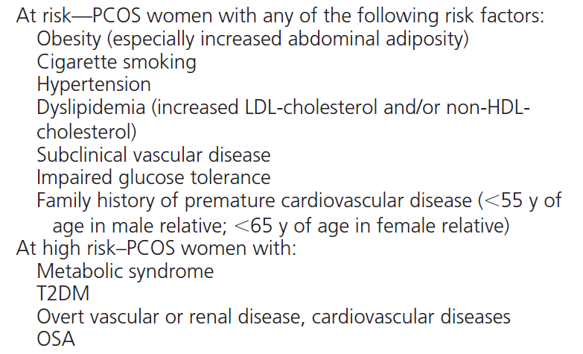
Cardiovascular Risk Stratification in Women with PCOS

Slide 46
Obesity
Increased adiposity, particularly abdominal, is associated with hyperandrogenemia and increased metabolic risk
Therefore, we recommend screening adolescents and women with PCOS for increased adiposity, by BMI calculation and measurement of waist circumference.
An Endocrine Society Clinical Practice
Guideline, J Clin Endocrinol Metab 98: 4565–4592, 2013

Slide 47
Nonalcoholic fatty liver disease (NAFLD) and nonalcoholic steatohepatitis (NASH)
We suggest awareness of the possibility of NAFLD and NASH but recommend against routine screening
An Endocrine Society Clinical Practice
Guideline, J Clin Endocrinol Metab 98: 4565–4592, 2013

Slide 48
Type 2 diabetes mellitus
We recommend the use of an OGTT (consisting of a fasting and 2-hour glucose level using a 75-g oral glucose load) to screen for impaired glucose tolerance (IGT) and T2DM in adolescents and adult women with PCOS because they are at high risk for such abnormalities .
HgbA1c test may be considered if a patient is unable or unwilling to complete an OGTT
Rescreening is suggested every 3–5 years, or more frequently if clinical factors such as central adiposity, substantial weight gain, and/or symptoms of diabetes develop
An Endocrine Society Clinical Practice
Guideline, J Clin Endocrinol Metab 98: 4565–4592, 2013

Slide 49
Screening
A. Criteria for disease/condition
1. Relatively common
2. Seriously disabling
3. Recognized identifiable preclinical phase
4. Natural history of condition should be understood

Slide 50
Screening
A. Criteria for disease/condition
5. Treatment of preclinical disease more effective than treatment begun after symptom development
6. Recognized treatment available
7. Facilities for treatment
8. Treatment acceptable to population

Slide 51
Conclusions
Insulin resistance is a common feature of the syndrome, (both obese and non obese women)
The prevalence of the metabolic syndrome is two to three times as high among women with the polycystic ovary syndrome as among normal women matched for age and body-mass index
Some population based studies, involving less severe variants of PCOS women, reported that Metabolic syndrome are no more frequent in PCOS than in healthy control subjects

Slide 52
Conclusions
  Women with PCOS may be at increased risk of heart disease However, the literature to date has been inconsistent
  It is important to note that establishing a relationship between abnormal biochemical markers at a young age and CV disease decades later is not an easy task
  The ongoing controversy around the increased occurrence of CV events in PCOS despite the presence of many risk factors at a young age raises some debates on screening of PCOS women for metabolic and cardiovascular risk factors

Slide 53
Thank you for attention

Slide 54
Scenario resolution
Cardiovascular risk stratification appears to be important in this case
To do this, additional information is needed, such as WC, BP, Smoking, family history of premature CAD
I would advise intensive life style program
If it fails, metformin should be considered

