Slide 1
In The Name Of GOD

Slide 2
Individualised management of acromegaly
SOHEILA SADEGHI

Slide 3
Surgery Indications 4.1 -We recommend transsphenoidal surgery as the primary therapy in most patients. (1|QQQE)
4.2 -We suggest that repeat surgery be considered in a patient with residual intrasellar disease following initial surgery. (2|QQEE)
Preoperative medical therapy 4.3 -We suggest against the routine use of preoperative medical therapy to improve biochemical control after surgery. (2|QQEE)
4.4- For patients with severe pharyngeal thickness and sleep apnea, or high-output heart failure, we suggest medical therapy with somatostatin receptor ligands (SRLs) preoperatively to reduce surgical risk from severe comorbidities. (2|QEEE)

Slide 4
Surgical debulking
4.5 -In a patient with parasellar disease making total surgical resection unlikely, we suggest surgical debulking to improve subsequent response to medical therapy. (2|QQEE)
Postoperative testing
4.6 -Following surgery, we suggest measuring an IGF-1 level and a random GH at 12weeks or later (2|QQQE).We also suggest measuring a nadir GH level after a glucose load in a patient with a GH greater than 1 g/L. (2|QQQE)
4.7 -We recommend performing an imaging study at least 12weeks after surgery to visualize residual tumor and adjacent structures (1|QQQE). We suggest MRI as the imaging modality of choice followed by CT scan when MRI is contraindicated or unavailable. (2|QQEE)

Slide 5
Medical therapy
5.1 -We recommend medical therapy in a patient with persistent disease following surgery. (1|QQQQ)
5.2 - In a patient with significant disease (ie, with moderate-to-severe signs and symptoms of GH excess and without local mass effects), we suggest use of either a SRL or pegvisomant as the initial adjuvant medical therapy. (2|QQEE)
5.3 - In a patient with only modest elevations of serum IGF-1 and mild signs and symptoms of GH excess, we suggest a trial of a dopamine agonist, usually cabergoline, as the initial adjuvant medical therapy. (2|QQEE)
5.4 - We suggest against routine abdominal ultrasound to monitor for gallstone disease in a patient receiving a SRL (2|QQEE). Ultrasound should be performed if the patient has signs and symptoms of gallstone disease. (2|QQEE)
5.5 - We suggest serial imaging with MRI scan to evaluate tumor size in a patient receiving pegvisomant. (2|QQEE)
5.6 - We suggest monitoring liver function tests monthly for the first 6 months and then every 6 months in a patient receiving pegvisomant, with consideration of discontinuation of pegvisomant if the transaminases are greater than 3-fold elevated. (2|QQEE)
5.7 - We suggest addition of pegvisomant or cabergoline in a patient with inadequate response to an SRL. (2|QQEE)
5.8 - We suggest use of an SRL as primary therapy in a patient who cannot be cured by surgery, has extensive cavernous sinus invasion, does not have chiasmal compression, or is a poor surgical candidate. (2|QQQE)

Slide 6
Radiotherapy (RT)/Stereotactic Radiotherapy (SRT) 6.1 - We suggest use of radiation therapy in the setting of residual tumor mass following surgery, and if medical therapy is unavailable, unsuccessful, or not tolerated. (2|QQEE)
6.2 - We suggest use of stereotactic radiotherapy (SRT) over conventional radiation therapy in patients with acromegaly, unless the technique is not available, there is significant residual tumor burden, or the tumor is too close to the optic chiasm resulting in an exposure of more than 8 Gy. (2|QQEE)
6.3 - To monitor the efficacy of radiation therapy, we recommend annual GH/IGF-1 reassessment following medication withdrawal. (1|QQQE)
6.4 - We recommend annual hormonal testing of patients following RT for hypopituitarism and other delayed radiation effects. (1|QQQQ)

Slide 7
The literature survey confirmed signifcant associations of all three factors with SSA responsiveness
1) SSTR expression appears necessary for the SSA response; however, it is not sufficient, as approximately half of SSTR2-positive tumors failed to respond clinically to fg-SSAs
2) MRI findings (T2-hypo-intensity) correlate with SSA efficacy
3) Densely granulated phenotype correlate with SSA efficacy
Glucometabolic control declines with SSA monotherapy, whereas GH receptor antagonist (GHRA) monotherapy may restore normoglycemia

Slide 8
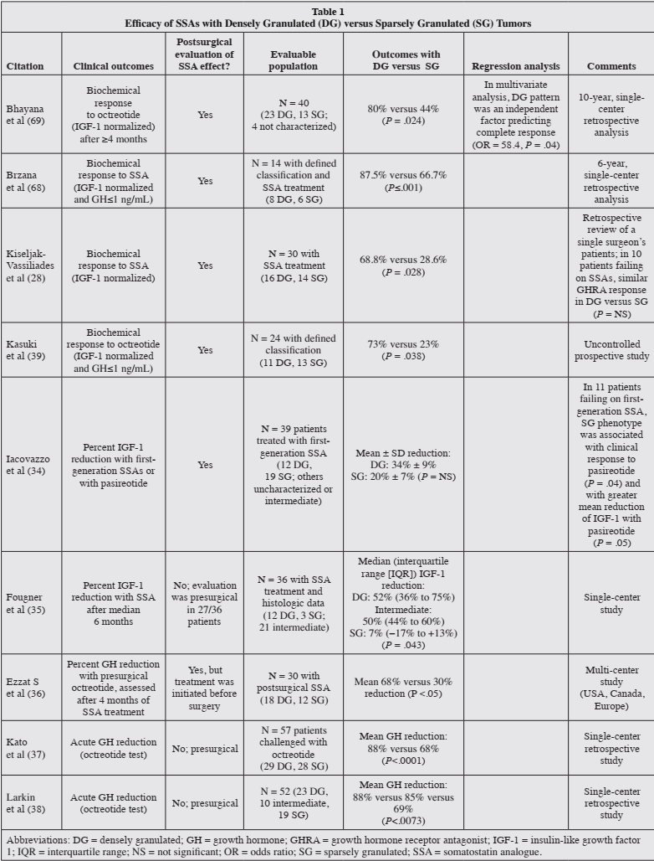

Slide 9
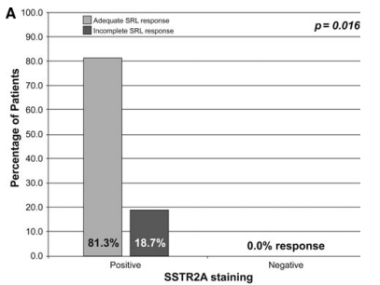
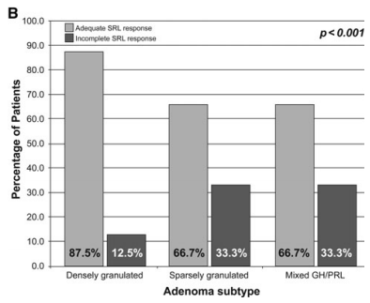
retrospective cohort (59 patients )
older than 18 years of age who underwent surgery
A Biochemical normalization to SRL therapy in adenomas with/without staining for SSTR2A. b In densely granulated/sparsely granulated and mixed GH/PRL adenomas

Slide 10
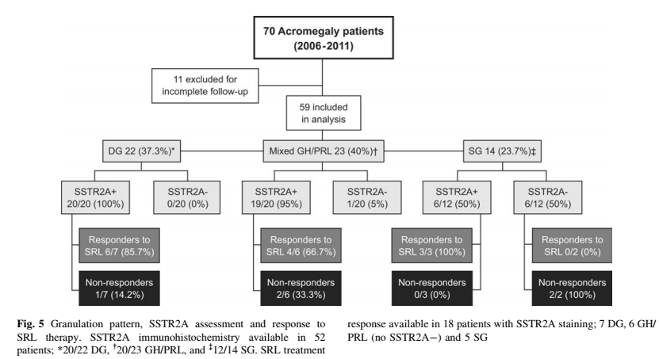

Slide 11
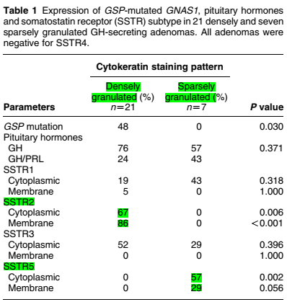
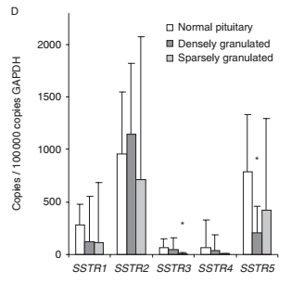
28 patients
studied the GH granulation pattern, the expression of somatostatin receptor subtypes (SSTR)
Only six of 28 patients received medical therapy after surgery for persistent hormone excess

Slide 12
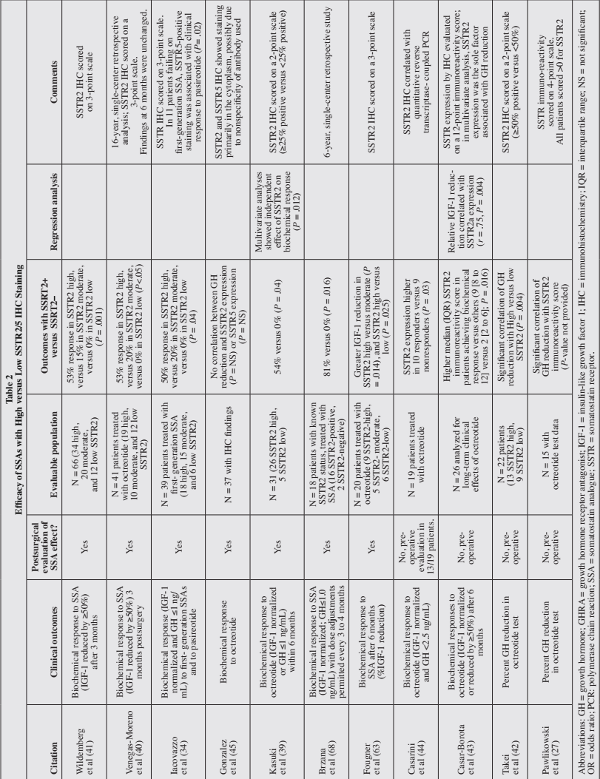

Slide 13
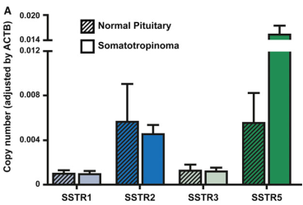
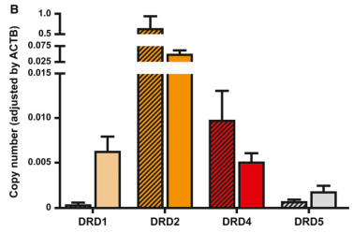
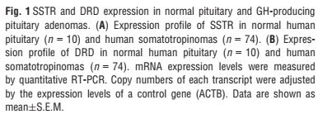
74 acromegalic patients treated with SSAs (octreotide or lanreotide) while waiting for surgery
retrospective study

Slide 14
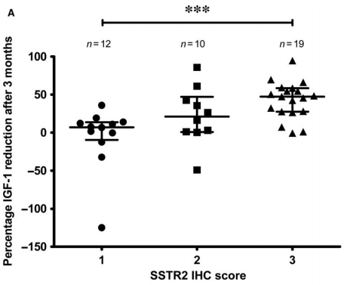
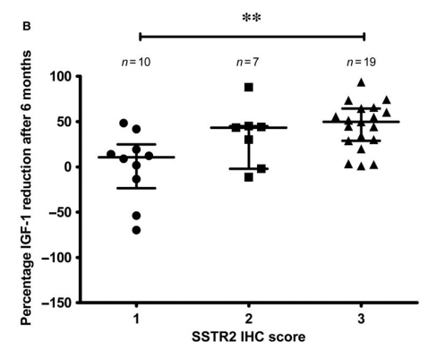
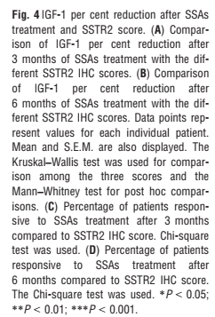
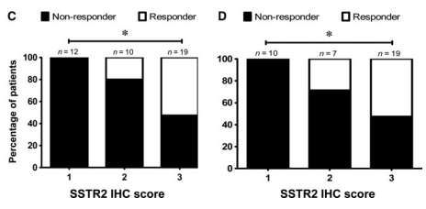

Slide 15
Optimize patients’ management and, consequently, reduce the burden of health care costs, as well as of side effects
OCT and LAN, are considered the first-line medical treatment in acromegaly when surgery fails to control the disease
In general, 9–12 months are necessary to assess treatment outcome
However, 20–25% of patients present resistance to OCT and LAN treatment
Resistant patients are defined as those who show a reduction <50% in GH and IGF1 levels, a decrease of <20% in tumor mass or an increase in size during treatment
SSTR2 has proved to be the most frequently expressed SSTR reported in acromegaly studies
SSTR3 as the predominant SSTR expressed in certain acromegaly cases resistant to first-generation SSA

Slide 16
SSTR2 expression as a biomarker to predict PT response to first-generation SSA
A positive correlation was found between SSTR2 expression levels and decreased hormone secretion at 3 months, as well as tumor volume reduction after 6 months of treatment.
SSTR5 negatively correlated with the decrease in hormone levels
Interestingly, densely granulated tumors, which are better responders to SSA, have higher SSTR2A expression levels as compared to sparsely granulated tumors
low SSTR2 and lower SSTR2/SSTR5 ratio at mRNA level were better responders to this novel SSTR ligand (pasireotide )
SSTR5 was found to be a predictor of response to pasireotide in patients whose disease was not controlled by treatment with first-generation SSA
In fact, measurement of SSTR expression may be promising, but it is difficult, and its utility for the prediction of clinical outcomes is not so straightforward

Slide 17
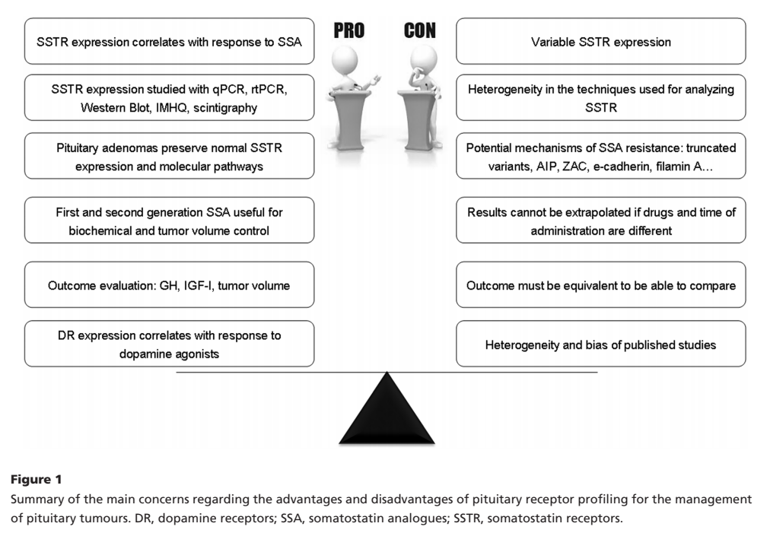

Slide 18
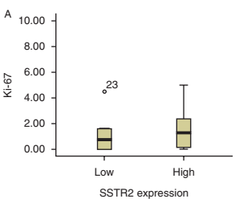
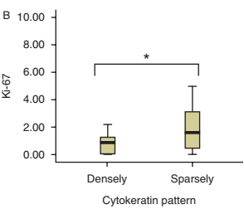
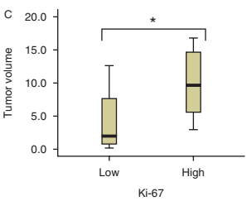
31 patients (retrospective)
SSTR2 expression was considered high when ≥25%, and a cutoff of 2.3% was designated for Ki-67
Ki-67 is a predictor of response to OCT-LAR in acromegaly, independent of SSTR2 expression and relates to cytokeratin patterns

Slide 19
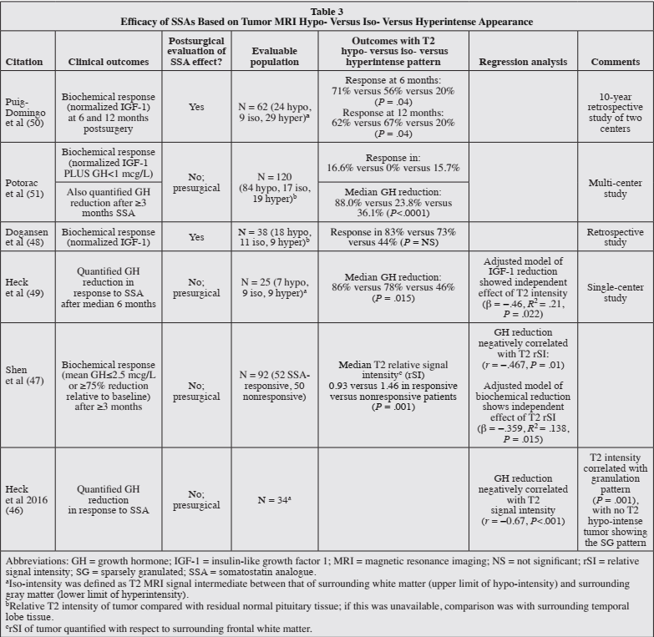

Slide 20
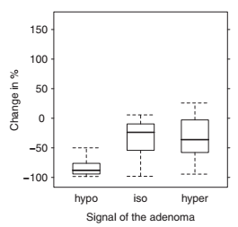
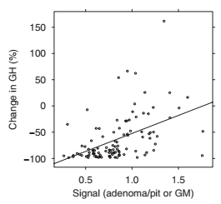
120 patients
At diagnosis, 84, 17 and 19 tumors were T2-hypo-, iso- and hyper-intense
primary SSA for at least 3 months
The decrease in random GH with SSA treatment was signifcantly greater in the T2-hypo-intense group(88%) as compared with T2-iso-intense(23.8) and T2-hyper-intense groups(36.1)
This decrease also correlated with the quantitative measurement of T2-weighted signal intensity (lower signal intensity adenomas had a greater GH decrease)

Slide 21
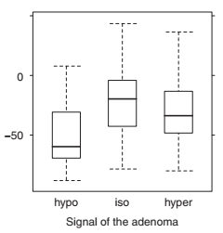
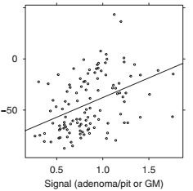
The decrease in IGF-1% with SSA treatment also was signifcantly greater in the visually assessed T2-hypo-intense (59.1%) as compared with T2-iso-intense (19.8%)and T2-hyper-intense groups (33.2%)
As with GH, the quantitative measurement of T2-weighted signal intensity correlated with the decrease of IGF-1% (lower T2 intensity adenomas had a signifcantly greater IGF-1% decrease)

Slide 22
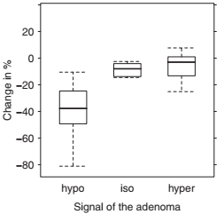
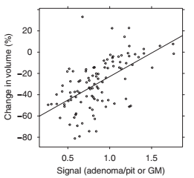
There was signifcantly greater tumor shrinkage with SSA therapy in the T2-hypo-intense adenoma group (volume decrease: 37.8) as compared with T2-iso-intense (8.0%) and T2-hyper-intense (3.0% )
Quantitative measurement of adenoma signal intensity confrimed the visual findings and found a signifcant positive correlation between T2 intensity and volume reduction with lower intensity adenomas having a signifcantly greater volume reduction

Slide 23
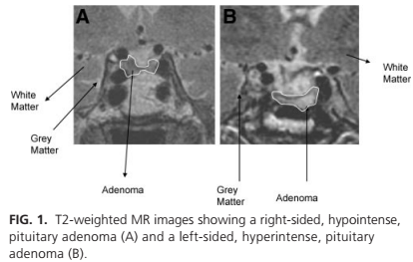
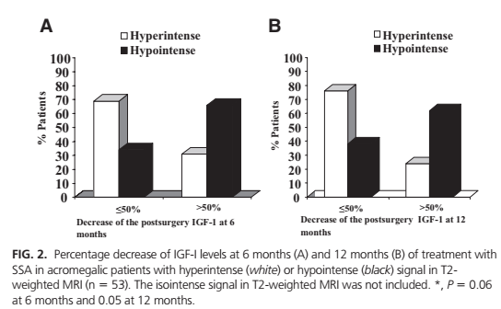
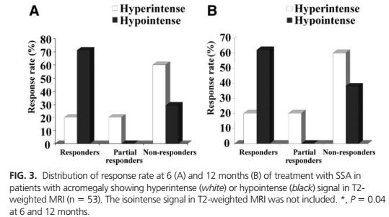
Sixty-two patients after surgery
retrospective study
pituitary tumor was classified as hyper-, iso-, or hypointense by evaluating T2-weighted MRI signal
Treatment with SSA at maximal effective doses
evaluated at 6 and 12 months by monitoring IGF-I, GH, and T2 MRI

Slide 24
European Journal of Endocrinology (2019)
Acromegaly is a rare (estimated prevalence of 28–137 cases/million and the incidence between 2 and 11 cases/million per year ) and challenging disease calling for management in highly specialised multidisciplinary teams (MDTs)
By today, multimodal treatment can bring every patient in remission, but still almost a third of all patients are undertreated according to large, international registries.
Untreated disease has severe morbidity and a clearly increased mortality
modern, multimodal treatment seems to have normalised mortality, but still the patients suffer from a high multi-organ morbidity and often multipharmacy

Slide 25
European Journal of Endocrinology (2019)
Prediction of response to medical treatment : First-generation SRLs
1) T2-weighted MRI signal intensity of the adenoma
2) granulation pattern
3) somatostatin receptor (SSTR) status and Ki-67
Prediction of response to medical treatment : second -generation SRLs
SSTR5 receptor status is a predictor for pasireotide responsiveness

Slide 26
European Journal of Endocrinology (2019)
Prediction of response to DAs
- Cabergoline is a treatment option in patient with mild acromegaly with moderate elevated IGF-I levels
- Patients with IGF-I elevation up to 1.5× of upper limit of normal (ULN) can expect IGF-I normalisation in about half of the cases
Prediction of the optimal dose of GH receptor antagonist pegvisomant
- Weight and BMI are the most consistent factors predicting the dose
- Pre-treatment IGF-I levels and younger age are associated with higher pegvisomant doses

Slide 27
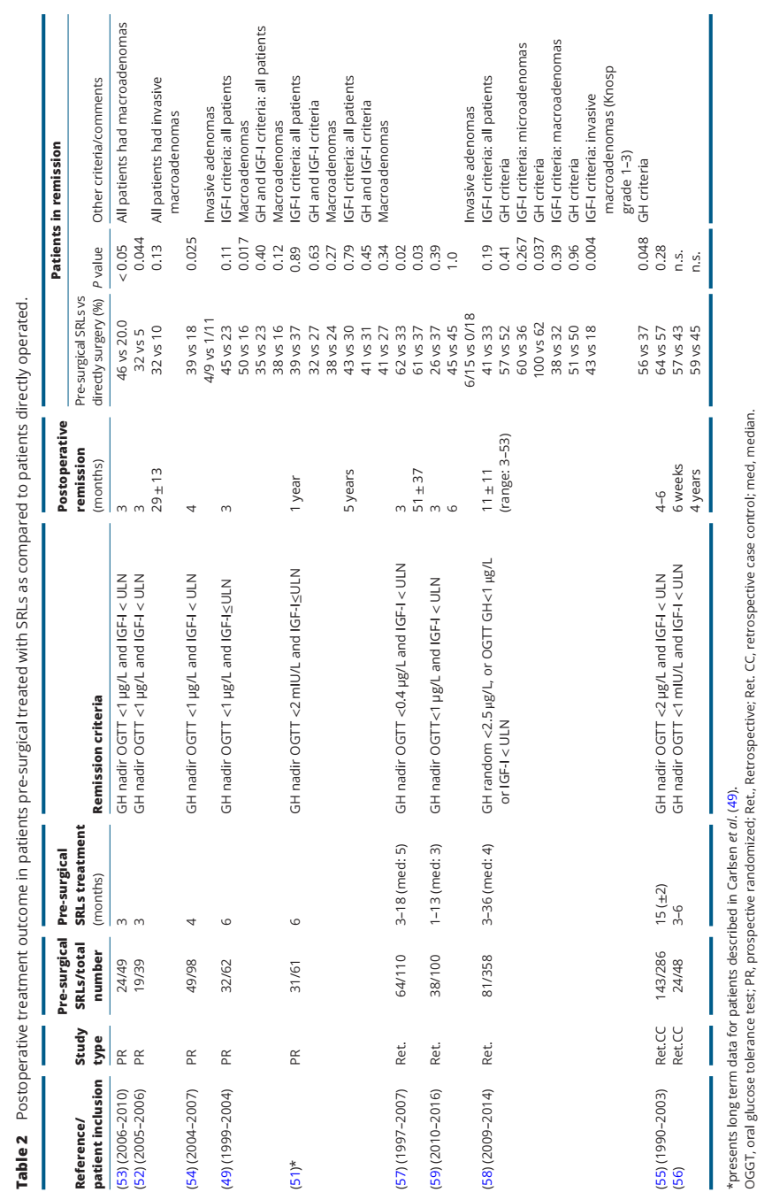
European Journal of Endocrinology (2019)

Slide 28
Personalized medicine in the treatment of acromegaly 2018 European Society of Endocrinology
Three drug classes are currently used for the treatment of acromegaly:
1) somatostatin receptor ligands (SRL) = first and second generation
2) dopamine agonists = cabergoline
3) growth hormone (GH) receptor antagonists =pegvisomant
Pasireotide (sg SRL) and pegvisomant can be used in monotherapy for patients who present resistance to fg-SRL
CAB is usually added to treatment with fg-SRL (combination therapy) when there is a partial response to the latter drug class
Pegvisomant can also be used in combination therapy with fg-SRL with increased efficacy
personalized medicine refers to the stratification of patients into subgroups in accordance with their disease evolution and response to specific treatments

Slide 29
Personalized medicine in the treatment of acromegaly 2018 European Society of Endocrinology
A biomarker is a characteristic that is objectively measured and evaluated as an indicator of normal biological processes, pathogenic processes, or pharmacologic responses to a therapeutic intervention
The expression of sst2 at both the mRNA and protein levels has been analyzed in somatotropinomas and correlated with the long-term response to fg-SRL . As expected, tumors that express a higher level of sst2 present a greater chance of disease control with fg-SRL treatment
Another characteristic of somatotropinomas with a worse response to fg-SRL treatment is a sparsely granulated pattern on immunohistochemistry
Sparsely granulated present lower sst2 expression than densely granulates tumors, which is probably why they present a worse response to treatment

Slide 30
Personalized medicine in the treatment of acromegaly 2018 European Society of Endocrinology
The granulation pattern can also have an expression in the T2-wheighted sequence of the magnetic resonance imaging (MRI)
A hyperintense signal on the T2-wheighted sequence was associated with a poorer response to fg-SRL and with the sparsely granulated pattern in the immunohistochemistry
Some demographic characteristics, such as younger age, male gender and high pretreatment GH levels were associated with a poor response to fg-SRL in some studies
The change to a personalized medicine approach to treating the disease will allow an optimization of therapy, reduce the GH burden (as disease control can be achieved more quickly with the right treatment for each individual patient) and lead to a reduction of costs (by avoiding the use of ineffective, expensive treatments for a considerable period of time for patients who are resistant to them)

Slide 31
Personalized medicine in the treatment of acromegaly 2018 European Society of Endocrinology
The main limitation of the use of biomarkers to guide medical treatment for acromegaly is the small number of patients included in the studies and the heterogeneity of the data in the literature
Standardization of the methodology for analyzing sst2 expression and its application to the different pituitary centers will be fundamental for establishing sst2 expression as a biomarker of acromegaly patients’ response to fg-SRL treatment in clinical practice

Slide 32
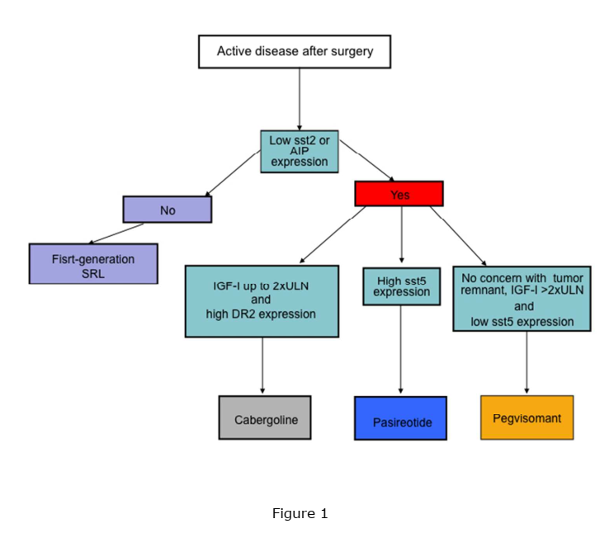
Personalized medicine in the treatment of acromegaly 2018 European Society of Endocrinology
Proposed algorithm for a personalized acromegaly treatment guided by biomarkers of response. AIP: aryl hydrocarbon receptor interacting protein; sst2: somatostatin receptor type 2; sst5: somatostatin receptor type 5; DR2: dopamine receptor type 2; fg-SRL: first-generation somatostatin receptor ligands; CAB: cabergoline.

Slide 33
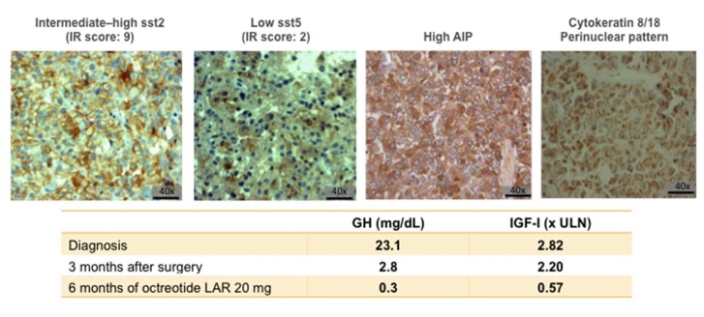
Personalized medicine in the treatment of acromegaly 2018 European Society of Endocrinology
A 53-year-old female patient with typical signs and symptoms of acromegaly. At diagnosis, she presented a macroadenoma of 1.8x0.9x1.0 cm and underwent surgery without cure. The histopathology and IHC analyses revealed a densely granulated somatotropinoma with high sst2 expression, low sst5 expression and high AIP expression
The patient was treated with octreotide LAR 20 mg every four weeks, and GH and IGF-I levels normalized after three months of treatment

Slide 34
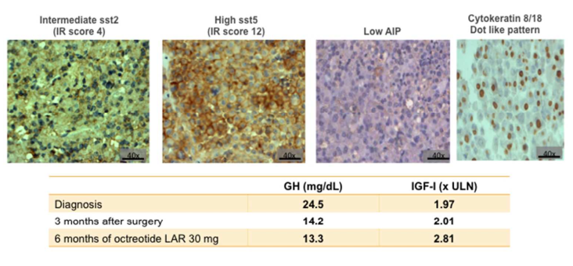
Personalized medicine in the treatment of acromegaly 2018 European Society of Endocrinology
A 42-year-old female patient with a clinical and biochemical diagnosis of acromegaly who presented with a macroadenoma of 3.2x2.1x2.2 cm. She underwent surgery without cure, and the histopathology and IHC analyses revealed a sparsely granulated adenoma with low sst2 expression, high sst5 expression and low AIP expression
The patient was treated with octreotide LAR 30 mg every four weeks for six months and showed resistance to the drug
pasireotide LAR could have been selected as the first-line treatment because it can be more effective in tumors with low sst2 expression, high sst5 expression and low AIP expression

Slide 35
DG tumors typically express SSTRs, particularly SSTR2 , whereas SG tumors may express SSTR5 at a higher level ; such SSTR5-positive tumors may be sensitive to pasireotide, particularly if refractory to first-generation SSAs
Clinically, SG tumors are associated with relatively aggressive growth but more subtle biochemical abnormalities relative to DG tumors
T2-hypo-intensity correlates significantly with DG tumor phenotype
An inverse relationship between T2 signal intensity and SSA clinical and biochemical response, with hypo-intense tumors showing a similar or better response rate relative to iso-intense tumors, and both being superior to hyperintense tumors

Slide 36
Selection of Therapeutics
SSAs directly reduce tumor size, an important clinical target in some patients with extensive or fast-growing residual tumor mass, and for those who experience headaches or compressive symptoms associated with pituitary tumor mass effects and their use is favored when tumor regrowth is a major concern
Dopamine agonists (DAs) are preferred for tumors causing a modest increase in insulin-like growth factor 1 (IGF-1)
GH receptor antagonist (GHRA) treatment is preferred for patients with major IGF-1 elevation and the potential for an inadequate SSA response and for whom tumor location is not a major concern. It is also preferred for patients with comorbid diabetes, because it is associated with improved insulin sensitivity and reduced hyperglycemia, whereas SSAs may have the opposite effects

Slide 37
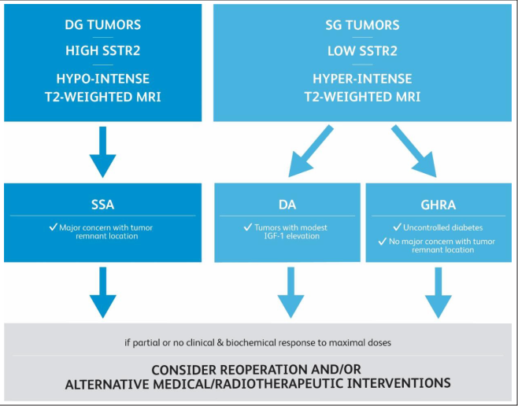

Slide 38
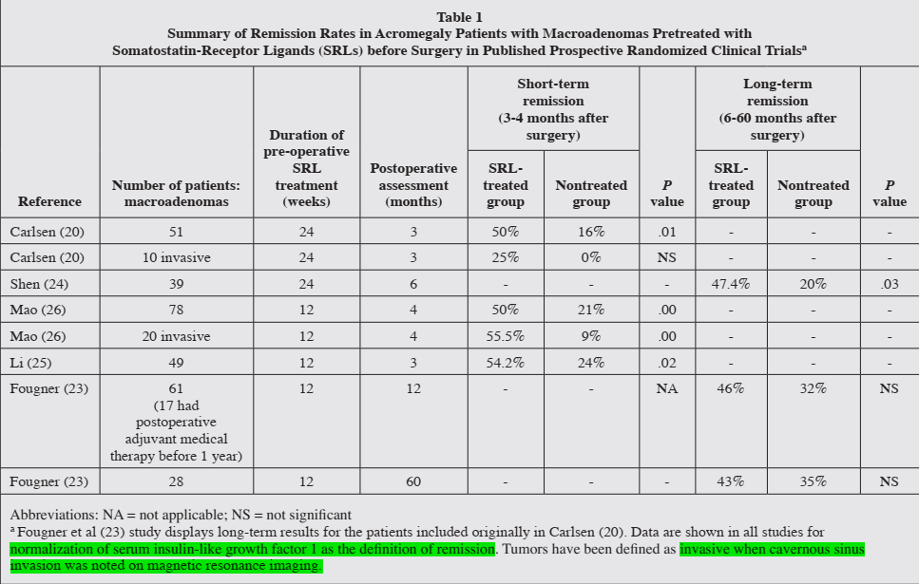

Slide 39
DGSA are found in 40% of acromegaly tumours, while SGSA are found in 30%
SGSA are usually larger at diagnosis than DGSA (21.6 mm versus19.2 mm), have lower somatostatin receptor subtype 2 positivity (50% versus 100%) and higher Ki-67 proliferation index (>3% in 67% of SGSAs versus <3% in 89% in DGSA)
Sparse granulation pattern has been also correlated with adenoma hyperintensity signal on T2-weighted MRI
Patients with SGSA usually require more surgeries, more radiotherapy, multiple different medications, a higher number of combined treatments and show medication resistance more often than DGSA
Median time for biochemically controlled acromegaly, using age-adjusted IGF-1 levels, was 9.7 years versus 16 years, in SGSA and DGSA

Slide 40
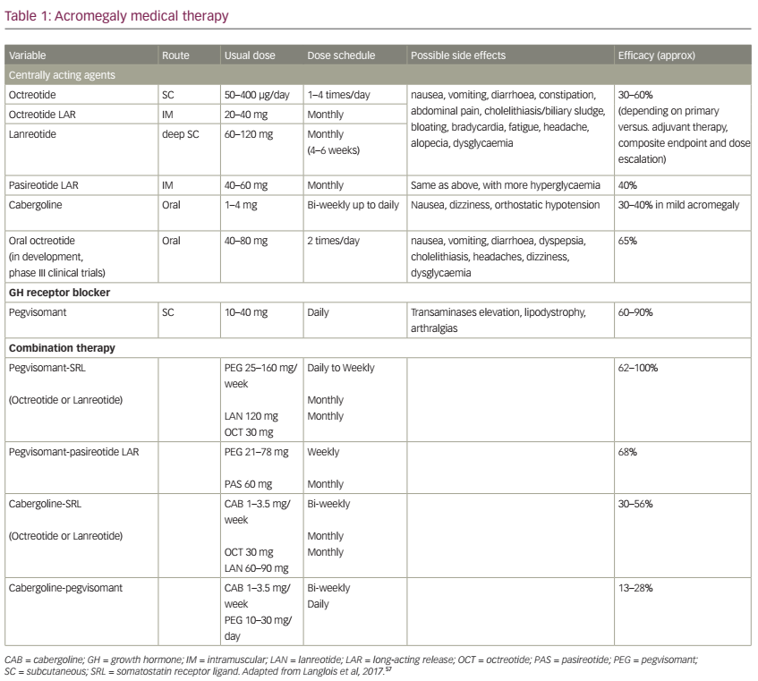

Slide 41
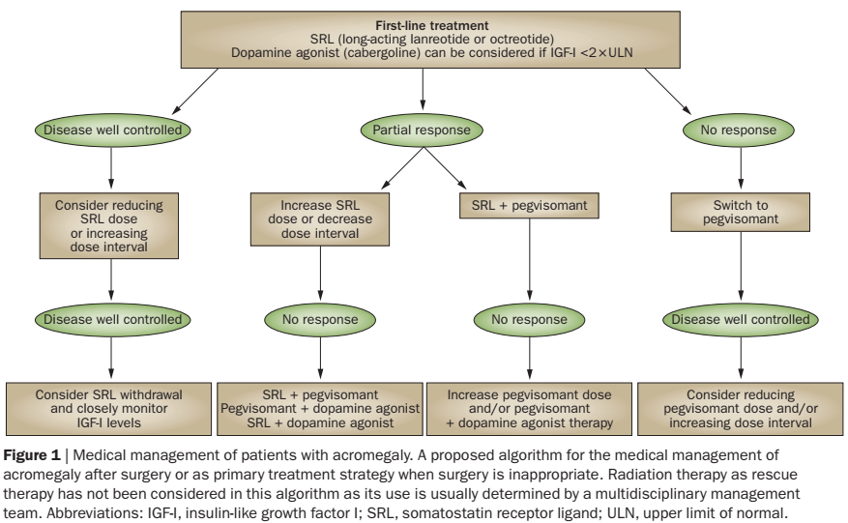

Slide 42
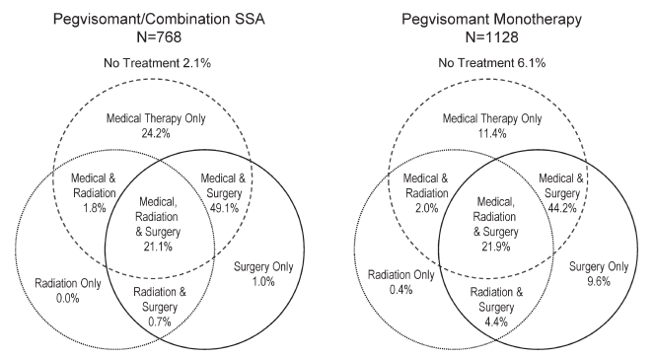
European Journal of Endocrinology (2018)
In this analysis of ACROSTUDY, a longterm non-interventional study, the use of combination regimens was evaluated
2043 patients were retrospectively categorized as:
1) long-acting SSA combined with pegvisomant, ‘Combo SSA’ 768 patients (38%)
2) DA combined with pegvisomant, ‘Combo DA’ 123 (6%)
3) pegvisomant monotherapy, ‘Peg mono’ 1128 (55%)

Slide 43
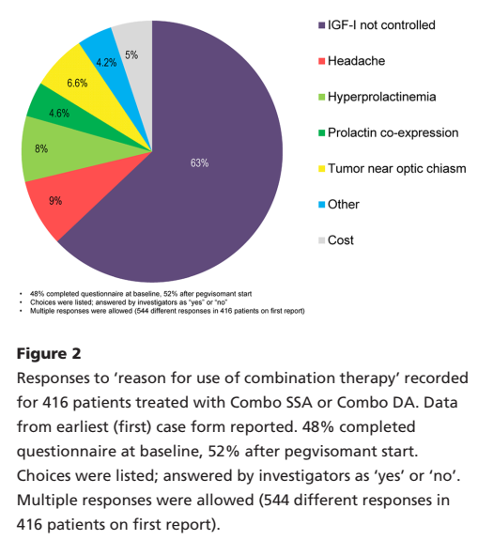
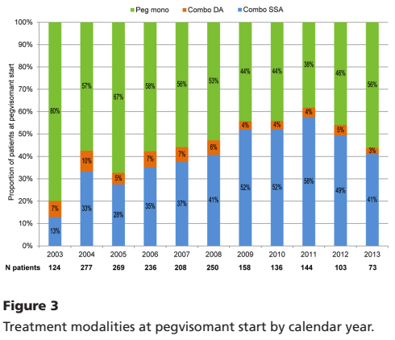
At year 4, IGF-I was normal in 62% of Combo SSA, 63% of Combo DA and 65% of Peg mono groups
The reported incidence of serious AEs and treatment-related non-serious AEs were similar among the three treatment modalities

