Slide 1
Pituitary tumors Classification & Immunohistochemistry
M. Tohidi, MD, APCP
Research Institute for Endocrine Sciences

Slide 2
History
Over the years, several classification schemes have evolved.
Simple tinctorial-based classification was accepted as dogma & dominated pituitary pathology for several decades.
A classification based on tinctorial characteristics of tumor cell cytoplasm fails to provide information regarding cytogenesis, hormone content, cellular composition, endocrine activity & biologic behavior.

Slide 3
General classification of pituitary Tumors
Benign adenoma
Invasive adenoma
Carcinoma
Oncocytic tumors
Metastatic tumors (breast, lung & GI)
Others: craniopharyngiomas, meningiomas, germ cell tumors; rare granular cell tumors, pituicytomas, and gangliogliomas; and the even rarer gangliocytomas, lymphomas, astrocytomas, and ependymomas

Slide 4
General classification of pituitary Tumors
Pituitary adenomas are the most common lesions in the sella region;
they represent approximately 10–15% of intracranial neoplasms in most neurosurgery series.
depending on the sections examined they are noted in
3–24% of unselected autopsies.

Slide 5
Classification of pituitary adenomas according to different parameters
Pituitary adenomas can be classified according to:
Biologic behavior
staining affinities of the cell cytoplasm
size
endocrine activity
histologic characteristics
hormone production and contents
ultrastructural features
granularity of the cell cytoplasm
cellular composition
cytogenesis
growth pattern

Slide 6
Classification of pituitary adenomas by an anatomical approach
Principle: size based on radiological findings
Microadenomas (the greatest diameter is <10 mm)
Macroadenomas (the greatest diameter is ≥I0 mm)
Four grades of this radio-anatomical:
Stage I: microadenomas (<1 cm) without sella expansion
Stage II : macroadenomas (≥1 cm) and may extend above the sella
Stage III: macroadenomas with enlargement and invasion of the floor or suprasellar extension
Stage IV: destruction of the sella

Slide 7
Size of adenomas by immunophenotype
Microadenoma | 85% Macroadenoma | Nearly 100% Macroademoa
Prolactinomas in females | Densely granulated GH cell adenoma | FSH/LH adenomas
ACTH-Secreting adenomas (80% microadenoma) | Sparsely granulated GH cell adenoma | TSH adenomas
 | Plurihormonal adenoma | Acidophil stem cell adenomas
 | Mixed GH/PRL tumors | Null cell adenoma
 | Prolactinomas in males | Silent type 3 adenoma

Slide 8
Classification of pituitary adenomas by histological criteria
Immunohistological characterization of the tumors in terms of hormone production.
IHC staining for pituitary hormones generally correlates with hormone serum levels.
Some pituitary adenomas have no readily identifiable hormone production.
Ultrastructural criteria which is especially useful for non-functional lesions :
Confirm the pituitary origin
Characterize the cytological differentiation of
tumor cells in terms of anterior pituitary cell types.

Slide 9
Classification of pituitary adenomas by functional criteria
Principle: endocrine activity of the tumor
PRL-producing (lactotroph ) adenomas
ACTH-producing (corticotroph) adenomas
GH-producing (somatotroph) adenomas
TSH–producing (thyrotroph) tumors
Mixed PRL- and GH-producing adenomas
Clinically non-functioning (the endocrine-inactive) adenomas
This group is comprised predominantly of gonadotroph adenomas which synthesize :
FSH
LH
The alpha or beta subunits

Slide 10
Silent versus null call adenoma
Silent adenomas
* Positive immuno-staining for one or more pituitary hormones
Unassociated with clinical and biochemical evidence of hormone excess.
immuno-staining reactive but lacks biologic activity
a defect may exist in the secretory machinery.
Null cell adenoma
* Immuno-negative for all adenohypophysial hormones.
* Unaccompanied clinically and biochemically by hormone over secretion.

Slide 11
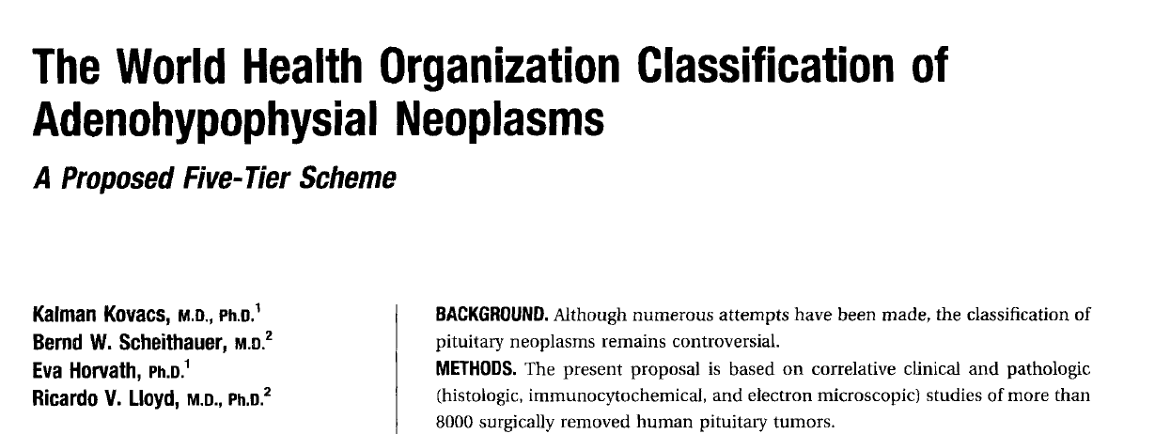
A five-tier classification, clinico-pathologic in nature, which focuses on endocrine activity, imaging, operative findings, histology, immunocytochemistry, and ultrastructure.
The collected data provide valuable information to the clinical endocrinologist, neurosurgeon, and oncologist involved in the assessment of a tumor's biologic behavior, growth potential, therapeutic responsiveness, and prognosis.

Slide 12
Level 1: Functional classification of adenohypophysial tumors
A. Endocrine hyperfunction
1. Acrornegalyig/gantism, elevated GH levels
2. Hyperprolactinemia and sequela
3. Cushing's disease, elevated ACTH, and cortisol levels
4. Hyperthyroidism with inappropriate hypersecretion of TSH
5. Significantly elevated FSH and LH and/or alpha subunit
6. Multiple hormonal overproduction
B. Clinically nonfunctioning
C. Functional status undetermined
D. Endocrine hyperfunction due to ectopic sources
1. Clinical acromegaly secondary to ectopic GH-releasing hormone overproduction (hyperplasia/adenoma]
2. Cushing's disease secondary to ectopic corticotropin-releasing hormone overproduction (hyperplasia/adenoma)

Slide 13
Level 2: Imaging/Surgical Classification of Adenohypophysial Tumors
Based on location
1. lntrasellar
2. Extrasellar extension (suprasellar, sphenoid sinus, nasopharynx, cavernous sinus, etc.)
3. Ectopic (rare)
B. Based on size
1. Microadenoma (< 10 mrn)
2. Macroadenoma (≥ 10 mml
C. Based on growth pattern
1. Expansive
2. Grossly invasive of dura, bone, nerves, and brain
3. Metastasizing (craniospinal or systemic)

Slide 14
Level 3: Histologic Classification of Adenohypophysial Tumors
Adenoma
1. Typical
2. Atypical (pleomorphism, enhanced mitotic activity, high MIB-1 labeling index)
If growth pattern can be evaluated:
1. Expansive
2. Histologically invasive (bone, nerve, vessels, etc.)
B. Carcinoma (metastasis and/or brain invasion)
C. Non-adenoma
1. Primary or secondary non-adenohypophysial tumors
2. Pituitary hyperplasia mimicking adenoma

Slide 15
Atypical adenoma
Atypical morphologic features such as :
Nuclear pleomorphism
Elevated mitotic index
Elevated a ki-67 (MIB-1) labeling index > 3%
Extensive nuclear staining for P53
Tumors with these features without documented metastases named as atypical adenoma.

Slide 16
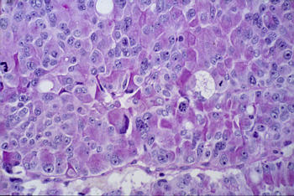
Basophilic and atypical (anaplastic) pituitary adenoma (PAS x100). The basophilic cells are also PAS-positive. Basophilic adenomas secrete ACTH, more rarely TSH or sometimes a gonadotropic hormone (FSH or LH). Note the presence of large or pleomorphic nuclei and especially the numerous mitoses indicative of rapid growth (anaplastic adenoma).

Slide 17
Level 4: Immunohistochemical Classification of Adenohypophysial Tumors
Principle immunoreactivity
A. GH
B. PRL
C. GH and PRL,
D. ACTH
E. FSU/LH/alpha-SU
F. TSH
G. Rare hormone combinations
H. Immuno-negative
Secondary immunoreactivity
PRL, alpha-SU(f), TSH, FSH, LH
Alpha- SU(i)
Alpha- SU(f), TSH(i)
LH, alpha-SU(i)
PRL, GH, ACTH(i)
Alpha-SU, GH(f), PRL(i)

Slide 18
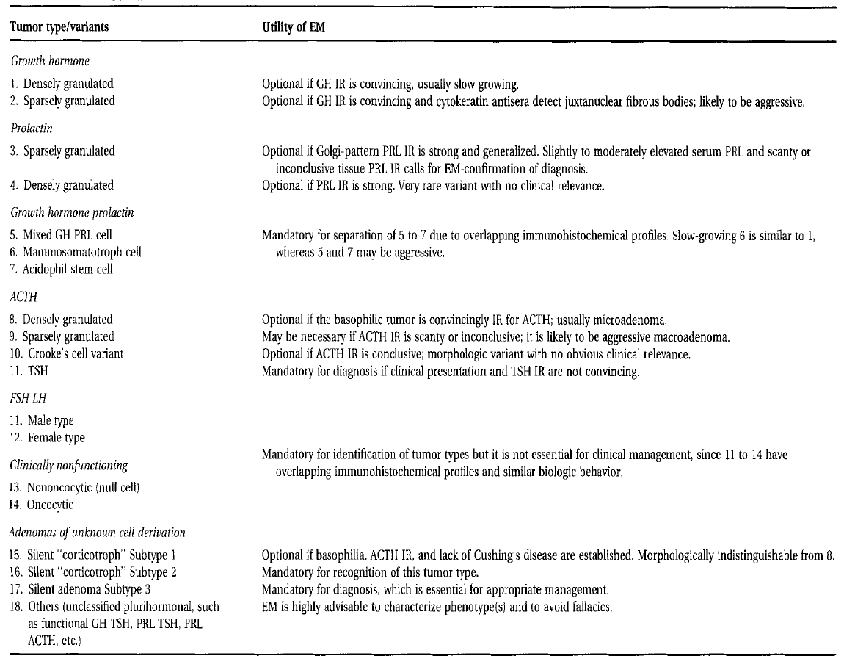
Level 5: EM options based on ultra-structural features of tumor cells
Mandatory for separation of 5 to 7 due to overlapping irnmunohistochemical profiles. Slow-growing 6 is similar to 1, whereas 5 and 7 may be aggressive.
Mandatory for diagnosis if clinical presentation and TSH IR are not convincing.
Mandatory for identification of tumor types but it is not essential for clinical management, since 11 to 14 have overlapping immunohistochemical profiles and similar biologic behavior.

Slide 19
Sample report format
Doe, John 43 years, male
Source: Sella, Cavernous sinus
--------------------------------------
Acromegaly
Macro-, invasive
Pituitary adenoma, typical
Growth hormone, prolactin, alpha-Subunit
Densely granulated somatotroph adenoma

Slide 20
Immunohistochemistry

Slide 21
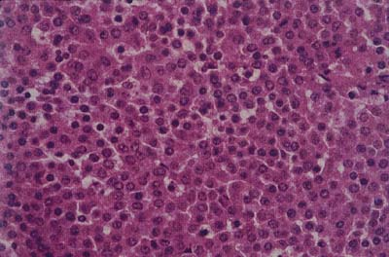
Solid sheets of uniform cells with round nuclei and neuro-endocrine nuclear features.

Slide 22
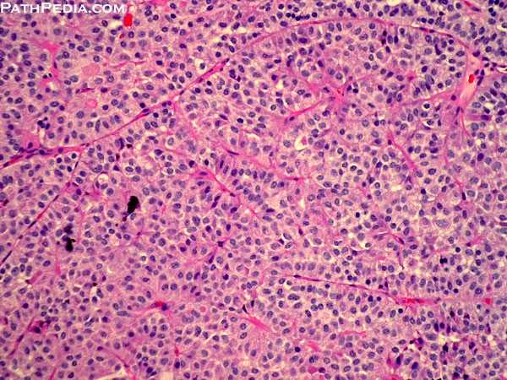
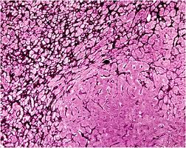
Pituitary adenoma
H & E stain
Reticulin stain

Slide 23
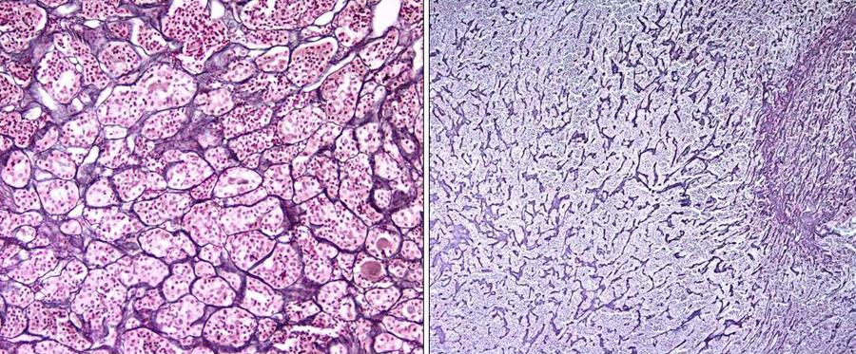
Normal pituitary versus pituitary adenoma. Note the delicate acinar pattern of a normal pituitary gland (left), in contrast with disruption of the normal reticulin network in adenoma (right) (Wilder's reticulin stain).

Slide 24
Development of immunohistochemical methods allowed the distinction of cell types based on their contents of specific hormones.
The major cell types and their corresponding products include :
Somatotrophs (GH), 50% of the cells & predominantly in the lateral wings
Lactotrophs (PRL), 15-25% & predominate at the postero-lateral edges
Mammosomatotrophs (GH, PRL)
Thyrotrophs (TSH) 5% of the cells and are located in the antero-medial regions of the gland.
Corticotrophs (adrenocorticotropin, betaendorphin, melanocyte-stimulating hormone), 15-20% of the cells & primarily in the central mucoid wedge
Gonadotrophs (FSH, LH) approximately 5-10 of the cell populations and are scattered throughout the anterior lobe

Slide 25
In addition to the hormone-producing cells, a second cell population is also present (folliculo-stellate cells) in the normal gland.
The latter cells have a dendritic shape and typically encircle the hormone-positive cells.
The folliculostellate cells are positive for :
S-100 protein
variably positive for GFAP.
In contrast to their presence in the normal anterior
pituitary, S-100 protein-positive folliculostellate cells are
generally absent from pituitary adenomas.

Slide 26
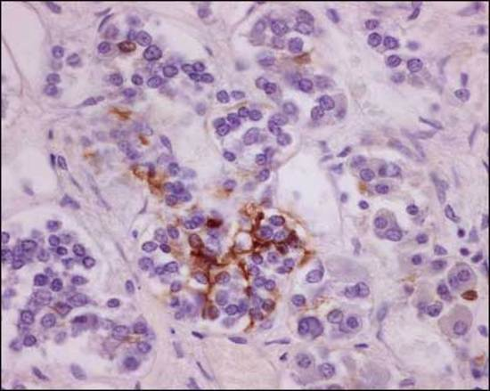
Folliculostellate cells are stromal sustentacular cells that surround acini of the normal gland; they are immunoreactive for S100 protein.

Slide 27
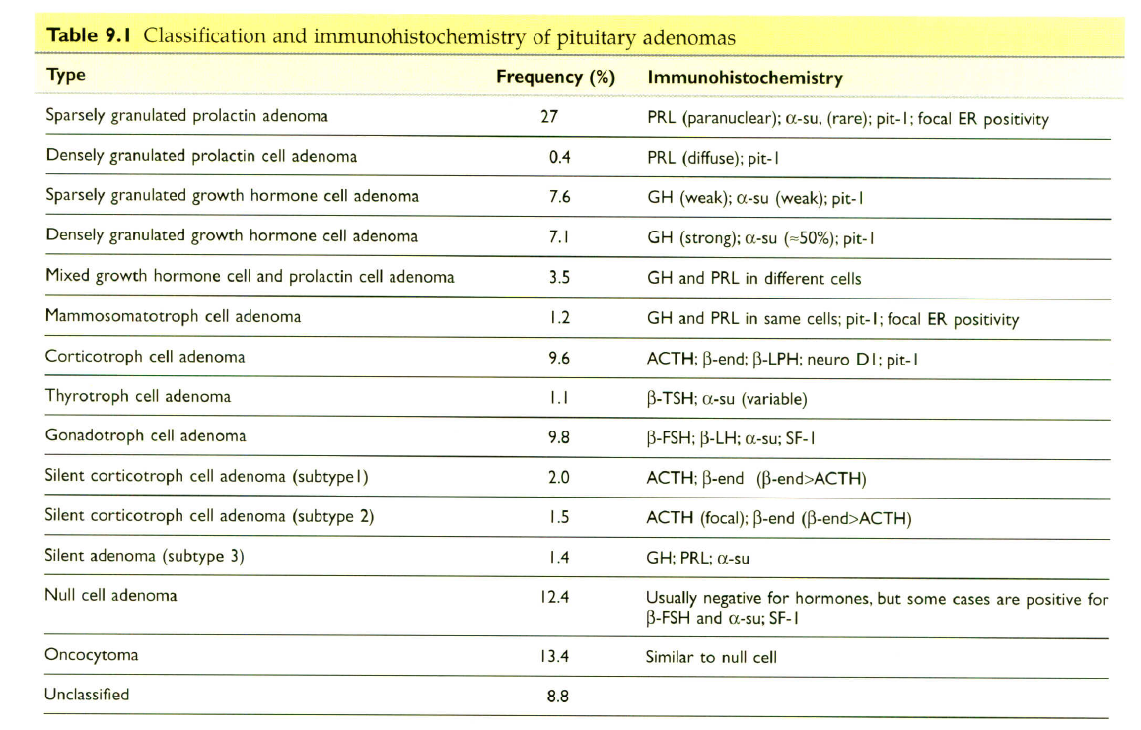

Slide 28
Neuroendocrine markers
Pituitary adenomas are typically positive for neuroendocrine markers, including:
Chromogranin (100%)
Synaptophysin (92%)
N5E (80%).
The use of synaptophysin IHC has obviated the need for EM to document infrequent neurosecretory granules to verify adenoma diagnosis.

Slide 29
Cytokeratins
More than 90% of adenomas contain CK8 .
The use of CAM 5.2 has the added advantages that highlights the difference between small fragments of normal compressed gland & the adenoma.
It also allow separation of densely from sparsely granulated GH adenomas predicting the response to somatostatin analogs.
In sparsely granulated GH cell adenomas, the staining is globular, corresponding to the presence of fibrous bodies.
Perinuclear staining is typical of densely granulated GH
cell and mammo-somatotroph adenomas
Corticotroph cell adenomas exhibit more diffuse cytoplasmic staining for CK8.
CK20 is uniformly negative in adenomas, except for :
Corticotroph adenoma
Sparsely granulated GH adenomas
Always CK 20 positive

Slide 30
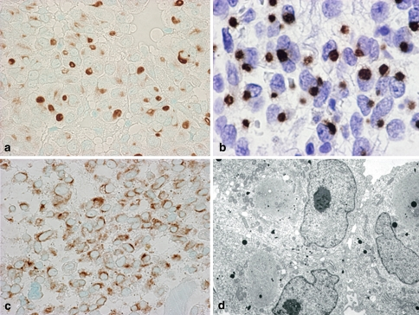
he IHC of CAM 5.2 keratin (CK8). In some GH omas, the tumor cells shows globules of keratin, which are called as fibrous bodies, by IHC (a). b Shows magnified image of dot type fibrous bodies. In densely granulated adenomas, keratin is immunostained in cytoplasm (c). In electron microscopy, fibrous bodies shows smooth endoplasmic reticulum located in the Golgi region (d)

Slide 31
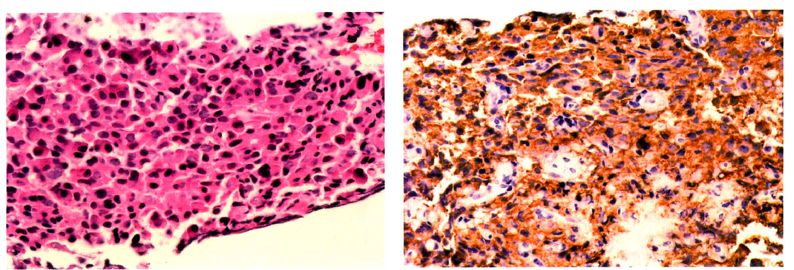
Pituitary adenoma
Immunoperoxidase staining for GH

Slide 32
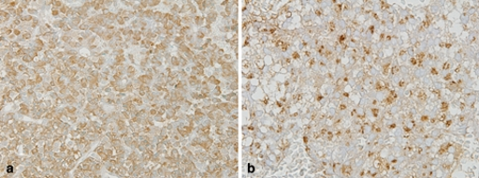
GH-producing adenoma
he IHC of GH of densely and sparsely granulated adenomas. Densely granulated adenoma shows strong and diffuse cytoplasmic immunoreactivity for GH (a). Sparsely granulated adenomas show weak GH immunostaining (b)

Slide 33
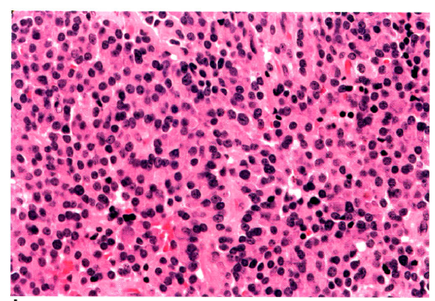
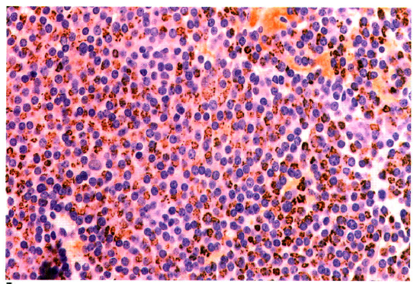
sparsely granulated prolactinoma
H&E stain
immunoperoxidase stain for prolactin.

Slide 34
Pituitary carcinoma
Pituitary carcinomas are rare.
Diagnosis rests on the demonstration of metastases.
These tumors are typically positive for generic neuroendocrine markers and for one or more anterior pituitary hormones.
The most frequently synthesized hormones are prolactin and ACTH while the production of growth hormone, TSH, and FSH/LH is rare.

Slide 35
Ki-67 (MIB-1) index
Usually < 3% in noninvasive tumors
Generally higher in invasive adenoma but does not correlate perfectly.
Significantly higher ki67 index in invasive adenoms than noninvasive ones when suprasellar extension was considered but this difference did not hold up for tumors with cavernous sinus extension. ∗
Silent ACTH- cell adenoma & PRL-producing adenoma have highest index & null cell adenoma & gonadotroph cell adenomas have the lowest proliferation values.∗∗
The use of MIB-1 & P53 IHC for pituitary adenomas has been contraversial.
∗Braz J Med Biol Res. 2004 Measurement of Ki-67 antigen in 159 pituitary adenomas using the MIB-1 monoclonal antibody. Pizarro CB et al
** Acta Neurochir (Wien). 2004 Expression of cell proliferation markers in pituitary adenomas--correlation and clinical relevance of MIB-1 and anti-topoisomerase-IIalpha.
Wolfsberger S et al.

Slide 36
Ki-67 (MIB-1) index
There is statistically significant, but numerically minimal difference in MIB-1 labeling indices between primary (1.25%) versus recurrent adenomas (1.9%). *
∗Acta Neuropathol. 2001 Increased chromosomal imbalances in recurrent pituitary adenomas. Rickert CH et al.

Slide 37
Adapted from 2004 version of the WHO fascicle on endocrine disease
Atypical morphologic features such as :
Nuclear pleomorphism
Elevated mitotic index
Elevated a ki-67 (MIB) labeling index > 3%
Extensive nuclear staining for P53
Tumors with these features without documented metastases named as atypical adenoma

Slide 38
Despite this statement, routine use of MIB-1 & P53 IHC is not utilized in many laboratories for pituitary adenomas simply because it is not clear to the clinical team what specifically to do with the information that an adenoma is histologically “atypical”.

Slide 39
Electron microscopy
Today , use of a full IHC panel of pituitary Abs (PRL,GH, αSU, FSH, LH, TSH & ACTH), plus synaptophysin & CAM 5.2 has made EM infrequently necessary for classification.
The best policy may be to set a small sample in Glutaraldehyde that can be used in the unlikely event that EM becomes necessary.

