Slide 1
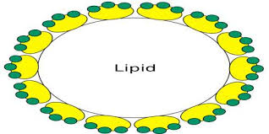
In The Name Of God
Dyslipidemia/Lipid management in
Diabetes
Dr.Zahra davoudi
Endocrinology department of Loghman Hakim Hospital, Shahid Beheshti University of Medical Sciences

Slide 2
A 65 year-old woman with medical history of Type II diabetes, obesity, and hypertension comes to your office for the first time. She has been told her cholesterol was elevated in the past and states that she has been following a “low cholesterol diet” for the past 6 months after seeing a dietician. She had a normal exercise stress test last year prior to knee replacement surgery and has never had symptoms of CHD. A fasting lipid profile was performed and revealed a LDL 130, HDL 30 and a total triglyceride of 300. Her HbA1c is 6.5%.

Slide 3
What is this patient’s goal LDL and TG?
What medication would you consider starting in this patient?

Slide 4
CVD is a major cause of morbidity and mortality in the world.
A common cluster of CVD risk factors:
Dyslipidemia
Hypertension
Hyperglycemia
Insulin resistance
Prothrombotic state
proinflammatory state
Obesity

Slide 5
Hyperlipidemia refers to increased levels of lipids (fats) in the blood, including cholesterol and triglycerides.
Although hyperlipidemia does not cause symptoms, it can significantly increase your risk of developing cardiovascular disease, cerebrovascular disease, and peripheral vascular disease.

Slide 6
Mechanisms Relating Insulin Resistance and Dyslipidemia
Fat Cells
Liver
↑FFA
CE
↑ TG
↑ Apo B
↑ VLDL
(hepatic lipase)
↑VLDL
(CETP)
HDL
IR
X
TG
Apo A-1
CE
(CETP)
TG
Kidney
Insulin
SD LDL
LDL
(lipoprotein or hepatic lipase)
Notes:
Mechanisms Relating Insulin Resistance and Dyslipidemia (IV)
On the last slide in this series, we see a similar phenomena leading to small, dense LDL. Increased levels of VLDL triglyceride in the presence of CETP can promote the transfer of triglyceride into LDL in exchange for LDL cholesteryl ester. The triglyceride-rich LDL can undergo hydrolysis by hepatic lipase or lipoprotein lipase, which leads to a small, dense, cholesterol-depleted—and, in general, lipid-depleted—LDL particle.

Slide 7
The most common pattern of dyslipidemia is hyperTG and reduced HDLcholesterol levels.
DM itself does not increase levels of low-density lipoprotein (LDL), but the small dense LDL particles found in type 2 DM are more atherogenic because they are more easily glycated and susceptible to oxidation.

Slide 8
Dyslipidemia in the Insulin Resistance Syndrome
Elevated total TG
Reduced HDL-C
Small, dense LDL-C
Notes:
Dyslipidemia in the Insulin Resistance Syndrome
Dyslipidemia in patients with the insulin resistance syndrome is characterized by an elevated level of total triglyceride, a reduced level of HDL cholesterol, and the presence of heterogeneity within LDL particles, with an increased proportion of LDL found as small, dense, cholesterol-poor particles.

Slide 9
Small Dense LDL and CHD: Potential Atherogenic Mechanisms
Increased susceptibility to oxidation
Increased vascular permeability
Glycation of LDL may be enhanced in diabetes, impairing recognition of the lipoprotein by its hepatoreceptor and extending its half-life.
Notes:
Small, Dense LDL and CHD: Potential Atherogenic Mechanisms
Data from in vitro and in vivo studies suggest that small, dense LDL may be particularly atherogenic. In vitro, small, dense LDL appears to be more susceptible to oxidative modification. Because they are smaller, these particles appear to penetrate the endothelial layer of the arterial wall more easily. The apo B molecule in small, dense LDL undergoes a conformational change that leads to decreased affinity for the LDL receptor, therefore allowing this LDL particle to remain in the circulation longer and be more liable to oxidative modification and uptake into the vessel wall. Finally, in population studies and small clinical studies, small, dense LDL is associated with the insulin-resistance syndrome as well as with high triglycerides and low HDL cholesterol.
Reference:
Austin MA, Edwards KL. Small, dense low density lipoproteins, the insulin resistance syndrome and noninsulin-dependent diabetes. Curr Opin Lipidol 1996;7:167-171.

Slide 10
“The Lower, the Better”
3.7
1
2.9
Relative Risk for CHD (Log Scale)
2.2
1.7
1.3
1.0
0
40
70
100
130
160
190
LDL-C (mg/dL)
Grundy SM et al. Circulation 2004;110:227–239.
Notes:
"The lower, the better"
The results of HPS and PROVE IT suggest that reducing LDL-C substantially below 100 mg/dL may provide additional benefit in high-risk patients. Neither of these trials indicated a lower threshold for LDL-C below which further LDL-C reduction did not provide further risk reduction.
Reference:
Grundy SM, Cleeman JI, Bairey Merz CN, et al., for the Coordinating Committee of the National Cholesterol Education Program. Implications of recent clinical trials for the National Cholesterol Education Program Adult Treatment Panel III guidelines. Circulation 2004;110:227-239.

Slide 11
When to check lipid panel
In most adult patients with diabetes, measure fasting lipid profile at least annually
ADA
At the time of diabetes diagnosis,
At an initial medical evaluation,
And every 5 years thereafter if under the age of 40 years, or more frequently if indicated

Slide 12
points
Total cholestrol Nonfasting / Fasting
HDL Nonfasting / Fasting
LDL Friedewald equation
(LDL-C = (Total cholesterol − HDL-C) − Triglycerides/5)
TG>400 mg/dl –dysbetalipoproteinemia *
TG 12-14 hr Fasting

Slide 13
Goals of therapy for diabetes mellitus
Eliminate symptoms related to hyperglycemia,
Reduce the long-term microvascular and macrovascular complications of DM

Slide 14
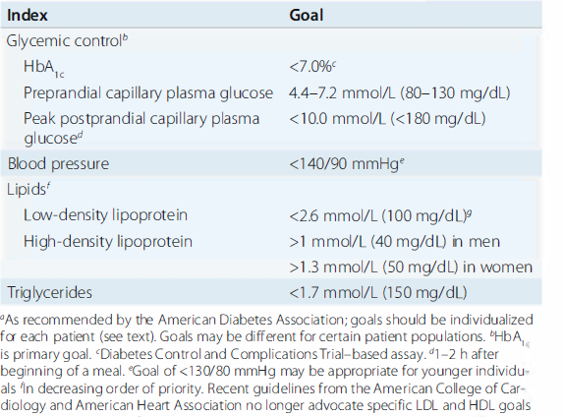

Slide 15
Treatment of Hyperlipidemia
Lifestyle modification
Lifestyle modification focusing on the reduction of saturated fat, trans fat, and cholesterol intake; increase of n-3 fatty acids, viscous ,
weight loss (if indicated);
and increased physical activity
Medications

Slide 16
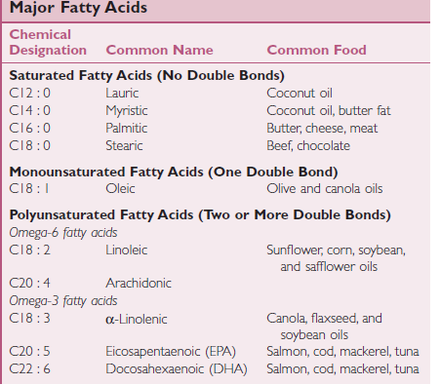

Slide 17
ADA
If individuals with diabetes have elevated triglyceride levels >150 mg/dL or low HDL cholesterol < 40 mg/dL in men and (< 50 mg/dL in women,
lifestyle modification and improved glycemic control should be further emphasized

Slide 18
For most patients with diabetes,
The first priority of dyslipidemia therapy (unless severe hypertriglyceridemia with risk of pancreatitis is the immediate issue) is to lower LDL cholesterol to a target goal
Therapy targeting HDL cholesterol or triglycerides lacks the strong evidence base of statin therapy

Slide 20
Recommendations for statin and combination treatment in adults with diabetes
†Moderate-intensity statin may be considered based on presence of ASCVD risk factors
ASCVD risk factors :::::::::
include LDL cholesterol >100 mg/dL ,,,high blood pressure, ,,smoking, chronic kidney
disease, albuminuria, and family history of premature ASCVD.

Slide 21
High-intensity and moderate-intensity statin therapy

Slide 22
For patients with DM and CVD,
if LDL cholesterol is> 70 mg/dL on maximally tolerated statin dose, consider adding additional LDL-lowering therapy (such as ezetimibe or PCSK9 inhibitor).
A Ezetimibe may be preferred due to lower cost.
Statin therapy is contraindicated in pregnancy

Slide 29
Indication of statin therapy
Diabetic 20-39 yr + diabetic risk enhancer…..moderate statin
( ADA: Age<40 yr + ASCVD risk factors…..moderate statin)
ASCVD >20%....high statin
Diabetic 40-75 yr=moderate statin
(ADA: Age 40–75 yr + ASCVD risk factors….high statin)
ASCVD >20%....high statin

Slide 30
The evidence is lower for patients aged >75 years; relatively few older patients with diabetes have been enrolled in primary prevention trials.
Moderate-intensity statin therapy is recommended in patients with diabetes >75 years or older.
However, the risk-benefit profile should be routinely evaluated in this population, with downward titration of dose performed as needed.

Slide 31
Hypertriglyceridemia
Hypertriglyceridemia should be addressed with dietary and lifestyle changes (obesity and metabolic syndrome), secondary factors (diabetes, chronic liver or kidney disease and/or nephrotic syndrome, hypothyroidism), and medications
Severe hypertriglyceridemia (fastingTG>500 mg/dL and especially >1000 mg/dL) may warrant pharmacologic therapy (fibric acid derivatives and/or fish oil) to reduce the risk of acute pancreatitis.
In addition, if 10-year ASCVD risk is 7.5%, it is reasonable to initiate moderate-intensity statin therapy or increase statin intensity from moderate to high.
In patients with moderate hypertriglyceridemia (>150- <500 ), lifestyle interventions, treatment of secondary factors, and avoidance of medications that might raise triglycerides are recommended.

Slide 32
The Major Approved Drugs Used for the Treatment of Dyslipidemia

Slide 33
The Major Approved Drugs Used for the Treatment of Dyslipidemia

Slide 34
The Major Approved Drugs Used for the Treatment of Dyslipidemia

Slide 35
Thanks for your attention

