Slide 2
Evaluation of physical fitness
دکتر امیر حسین عابدی یکتا
متخصص پزشکی ورزشی

Slide 3
COMPONENTS
OF
FITNESS
Aerobic
Capacity
Muscle Strength/
endurance
Flexibility
Body
Composition

Slide 4
Aerobic Capacity
Ability of the Cardiovascular system to deliver oxygen rich blood to body tissues.
Muscles ability to process and utilize oxygen to produce energy.

Slide 5
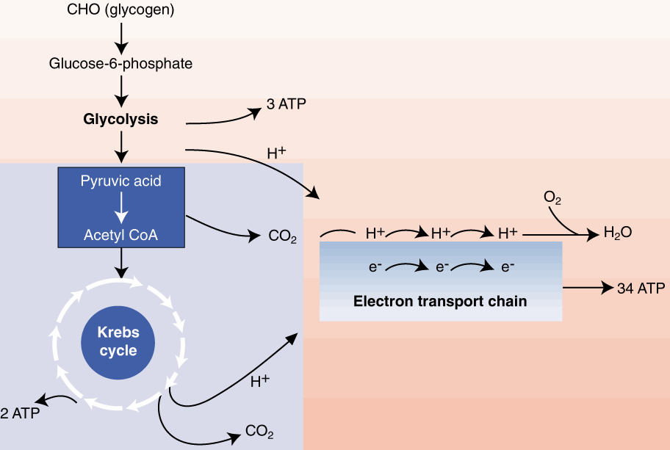
AEROBIC GLYCOLYSIS AND THE ELECTRON TRANSPORT CHAIN

Slide 6
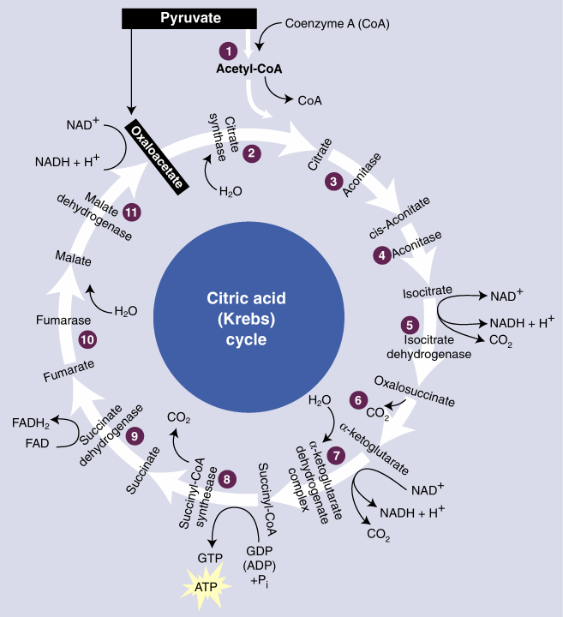
KREBS CYCLE

Slide 7
Evaluating Aerobic Capacity
Measure
VO_{2max} via spirometry / graded exercise stress test
Estimate
Sub-maximal graded exercise test
Step test
Based on the fact that individuals with higher SV will recover faster
Recovery HR will be lower in individuals w/ higher VO_{2max}

Slide 8
VO₂ max
Units
liters/minute or ml/minute (absolute)
ml/kg/min (relative to body weight)
ml/kg of FFM/min (relative to FFM)
Range 15 (sedentary with disease) to 75 (young endurance runner) ml/kg/min
Women about 10-20% lower than men

Slide 9
Sub-Max Graded Test
Age Predicted HR ^{max}
Predicted VO_{2max}
45 ml/kg/min

Slide 10
Heart Rate Response to Step Test

Slide 11
GXT
Graded Exercise Testing - GXT (incremental increases in workload)
General Guidelines
measure the subject’s HR and BP and RPE at regular intervals (near the end of each stage [HR, BP, RPE] or every minute [HR])
if HR does not reach steady state during the stage extend stage 1 minute

Slide 12
GXT
General Guidelines
All testing begins with a 2-3 min warm-up
Cool- down at a low intensity for at least 4 minutes - continue measuring HR, BP and RPE
increase intensity in .5-2 MET increments
closely observe subject for contraindications

Slide 13
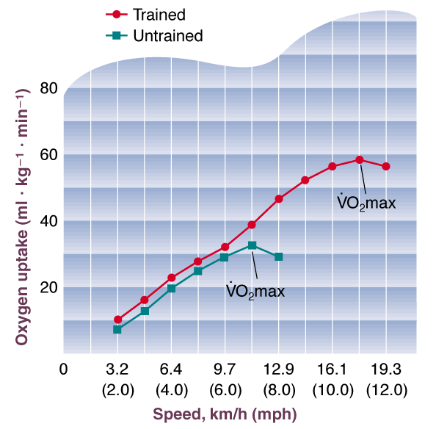
EXERCISE INTENSITY AND OXYGEN UPTAKE

Slide 14
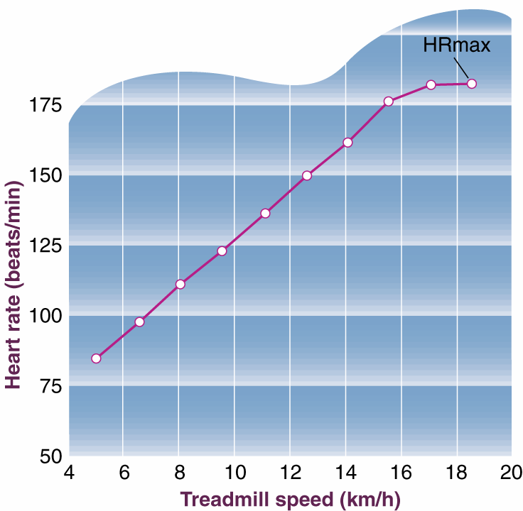
HEART RATE AND INTENSITY

Slide 15
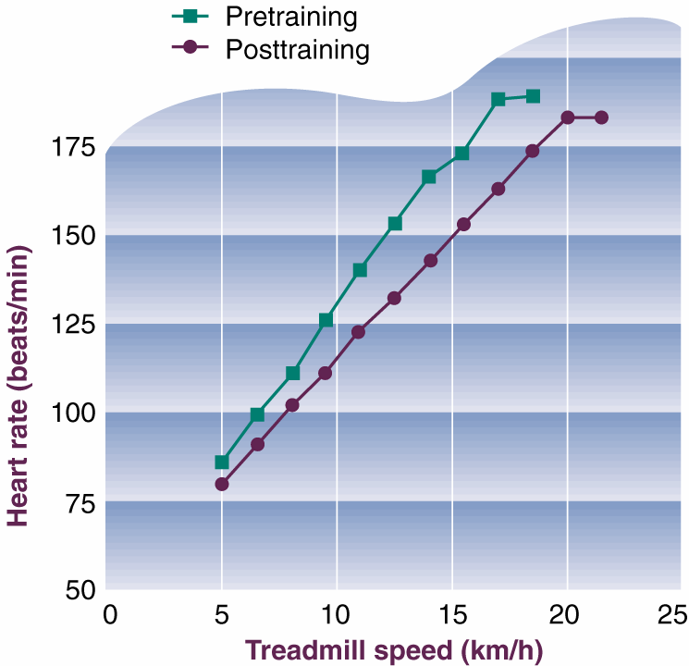
HEART RATE AND TRAINING

Slide 16
ACSM Bike Test
1. 2-3 minute warm-up
2. Take HR twice during each stage (3 minute stages) and RPE/BP once
3. If HRs are greater than 110, steady state should be reached (HRs within 6bpm) before increasing the workload

Slide 17
Treadmill Tests
Bruce Protocol
Balke
Ellestad
Others……….

Slide 18
Treadmill Protocols
Bruce and Ellestad
larger increments
use on younger and/or more physically active
Balke-Ware
smaller increments (1MET/stage or lower)
use on older, deconditioned, and/or diseased subjects

Slide 19
Bruce Treadmill Protocol
1. Measure resting BP and HR while standing on the belt of the treadmill
2. Ask subject to straddle the belt while starting treadmill at 1.7 mph and 0% grade
3. Ask subject to begin walking and when comfortable release handrails
4. This is a warm-up and should continue until subject is comfortable

Slide 20
Bruce Treadmill Protocol
5. Stage 1
Increase grade to 10%
3 minutes long
Measure HR at end of each minute and BP at end of each stage

Slide 21
Bruce Treadmill Protocol
6. The objective is to reach a steady state HR between 115 and 155 bpm (usually occurs during the first 6 minutes of exercise or by the end of the 2nd stage) – Page 98 guidelines
7. Once subject reaches proper HR terminate the test at the end of that stage

Slide 22
Bruce Treadmill Protocol
8. Reduce treadmill speed to 1.7mph and 5% grade and cool-down for 4 minutes.
9. VO2 is estimated from the last minute of a fully completed stage

Slide 23
Treadmill Protocol
10. Calculate VO₂ from the gender specific equations
Males
VO₂=SM_{VO2} [(HR_{max}-61)/(HR_{SM}-61)]
Females
VO₂=SM_{VO2}[(HR_{max}-72)/(HR_{SM}-72)]
SM_{VO2} = submaximal VO₂ from table or ACSM equations
HR_{SM} = submax HR from test

Slide 24
McCardle’s Step Test
Bench ht. = 41.25 cm
Step Rate = 24 step/min (metronome = 96) for men and 22 step/min (metronome=88) for women
3 minutes of stepping
Record HR from the first 15seconds after the stepping has stopped

Slide 25
McCardle
Men
VO₂ = 111.33 - (0.42 x HRrec)
Women
VO₂ = 65.81 - (0.1847 x HRrec)
value is ml/kg/min

Slide 26
Maximal Protocols
Field Tests
12 minute run
1.5 mile run
Rockport Walking Test

Slide 27
12 minute run

Slide 28
12 minute run
The further you can run in 12 minutes the higher your VO_{2max}

Slide 29
1.5 mile run/Rockport Walking

Slide 30
1.5 Mile Run/1 Mile Walk
The faster you can run 1.5 miles or walk 1 mile the higher your VO_{2max}

Slide 31
Field Tests
12 min run
VO₂ = 3.126 (meters in 12 min) - 11.3
1.5 mile run
VO₂ = 3.5 + 483/(time in minutes)
Rockport Walking Test (1 mile walk)
VO₂ = 132.853 - 0.1692 (BW in kg) - 0.3877 (age in y) + 6.315 (gender) - 3.2649 (time in min) - 0.1565 (HR)
0 for female; 1 for male; HR at end of walk

Slide 32
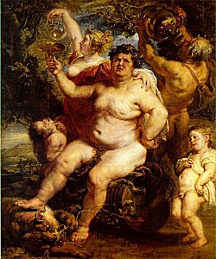
Body Composition

Slide 33
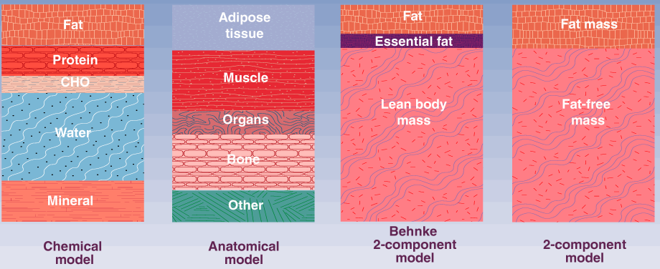
MODELS OF BODY COMPOSITION

Slide 34
Hydrostatic Weighing - ACSM
Based on Archimedes’principle – when a body is immersed in water, it is buoyed by a counterforce equal to the weight of the water displaced. This loss of weight in water, corrected for the density of water, allows calculation of body volume.
However, the volume of air in the lungs at the time of measurement (usually residual volume) must be accounted for.
Bone and muscle tissue are more dense than water, whereas fat tissue is less dense. Therefore, a person with more FFM for the same total body mass weighs more in water and has a higher body density and lower percentage of body fat.
Although hydrostatic weighing is a standard method for measuring body volume, several sources of error are inherent in the procedure

Slide 35
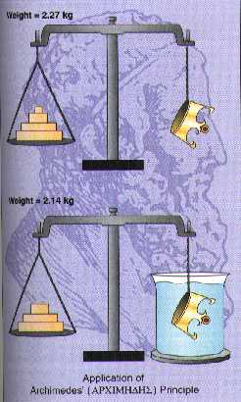
Hydrostatic Weighing

Slide 36
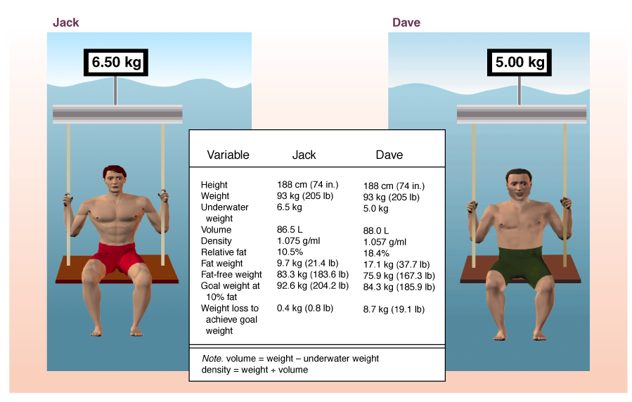
Dr. Pritschet
Dr. Emmett
BP
JE

Slide 37
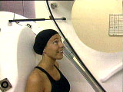
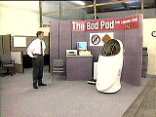
Air Plethysmography (Bod Pod)

Slide 38
Plethysmography - ACSM
Body volume can also be measured by air displacement rather than water displacement (hydrostatic weighing).
One commercial system uses a dual-chamber plethysmograph that measures body volume by changes in pressure in a closed chamber.
This new technology shows great promise and can more easily accommodate individuals who cannot perform the procedures associated with underwater weighing.

Slide 39
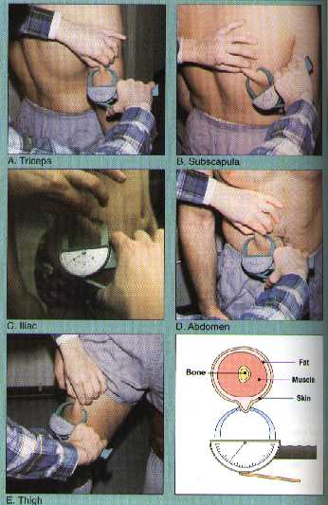
Skin Fold Measurements - ACSM
Abdominal – vertical fold; 2 cm to the right of the umbilicus
Triceps – Vertical fold; halfway between the acromion and olecranon process
Chest – Diagonal fold; 1/2 the distance between the anterior axillary line and the nipple (men) or 1/3 of the distance for women

Slide 40
Skin Fold Measurements - ACSM
Subscapular – Diagonal fold (45° angle); 1 to 2 cm below the inferior angle of the scapula
Suprailiac – Diagonal fold; in line with the naturla angle of the iliac crest taken in the anterior axillary line immediately superior to the iliac crest
Thigh – Vertical fold; on the anterior midline of the thigh, ½ between the proximal border of the patella and the inguinal crease (hip)

Slide 41
EIU ATP/AFP Equations
Body Density (BD) Equations
Males. BD = 1.1125025 - (0.0013125 x SK. FLD. SUM) + (0.0000055 x SK. FLD. SUM²) - (0.000244 x age)
Males - Triceps, Subscapular, and Chest
Females. BD = 1.089733 - (0.0009245 x SK. FLD. SUM) + (0.0000025 x SK. FLD. SUM²) - (0.0000979 x age)
Females – Triceps, Suprailiac, and Abdominal
Percent body fat = [(4.95/BD)-4.5] x 100

Slide 42
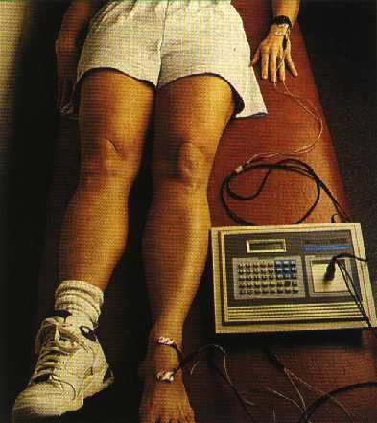
Bioelectric Impedance
Measurement of body water.
Impedance or (resistance) decreases with body water.
Assumption that body water is at a constant value.
4-5% error

Slide 43
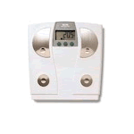
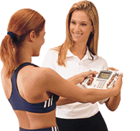
Bioelectric Impedance

Slide 44
Bioelectical Impedance Analysis (BIA) - ACSM
Abstain from eating or drinking with 4 hours of the assessment
Avoid moderate or vigorous physical activity within 12 hours of the assessment
Void completely before the assessment
Abstain from alcohol consumption within 48 hours of the assessment
Ingest no diuretic agents, including caffeine, prior to the assessment unless prescribe by a physician

Slide 45
Dual Energy X-Ray Absorptiometry - ACSM
Can be used to assess total bone mineral as well as regional estimates of bone, fat, and lean tissue.
It uses a three component model to predict body fatness and offers advantages over densitometry techniques.
DEXA is typically found in clinical setting and can be used to measure body composition across the life span

Slide 46
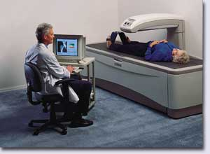
Duel-Energy X-Ray Absorptiometry (DEXA)
New gold standard?
Comparison
Error = ±1-5% (software)
Very costly
Very high tech
Quick
Subject friendly

Slide 47
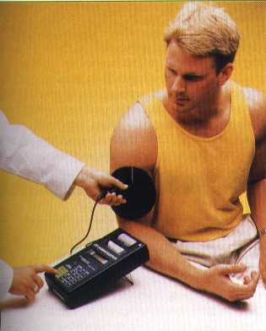
Infrared Interactance - ACSM
Based on the principle of light absorption and reflection using near-infrared spectroscopy to provide information about the chemical composition of the body
Further research is needed to develop and cross-validate gender-specific equations for infrared interactance and to determine whether this is an accurate method for assessing body composition

Slide 48
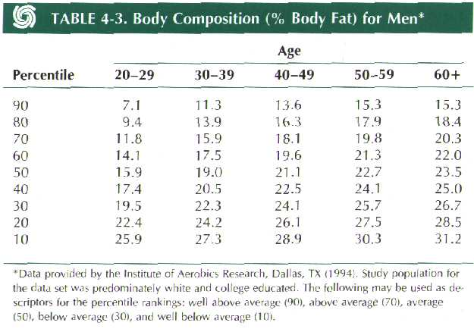
Men

Slide 49
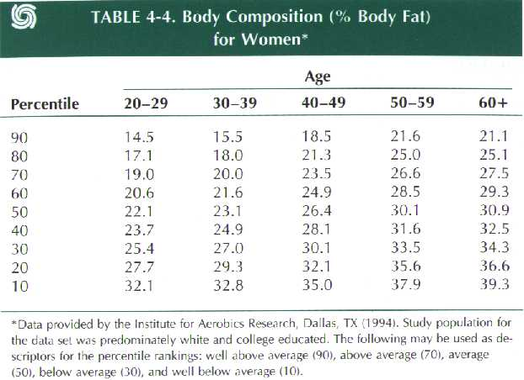
Women

Slide 50
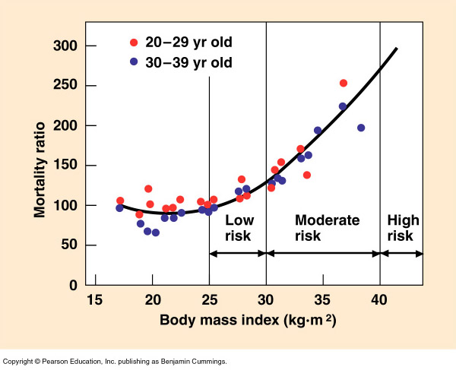
Body Mass Index
BMI = wt (kg) / ht (m)²
BMI = (704.4 x wt (lb) / ht (in) ².

Slide 51
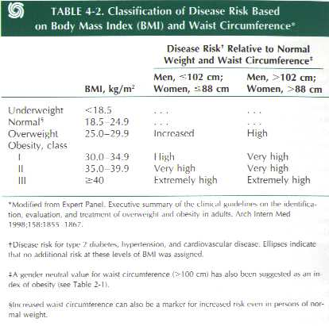
Body Mass Index

Slide 52
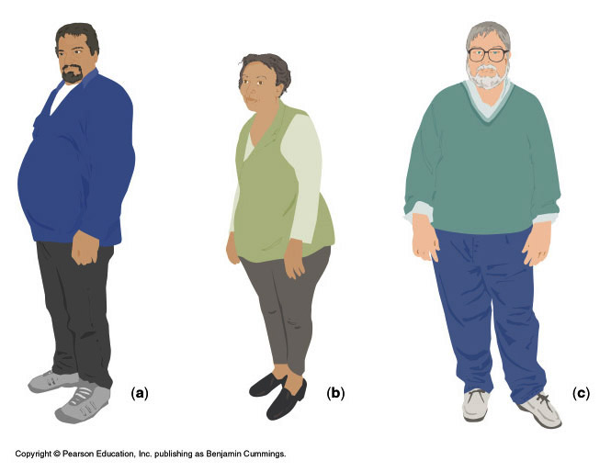
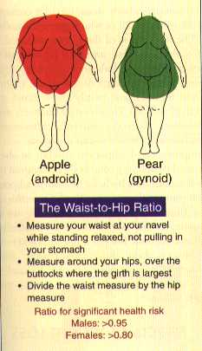
Waist-to-Hip Ratio

Slide 53
Waist-to-Hip Ratio - ACSM
Individuals with more fat on the trunk, especially abdominal fat are at increase risk for various diseases.
The waist to hip ratio has been used as a simple method for determining body fat patterns
Waist to hip ratio = circumference of waist divided by the circumference of the hips

Slide 54
Waist Circumference - ACSM
The waist circumference can be used alone as an indicator of health risk because abdominal obesity is the issue.

Slide 55
Muscular strength

Slide 56
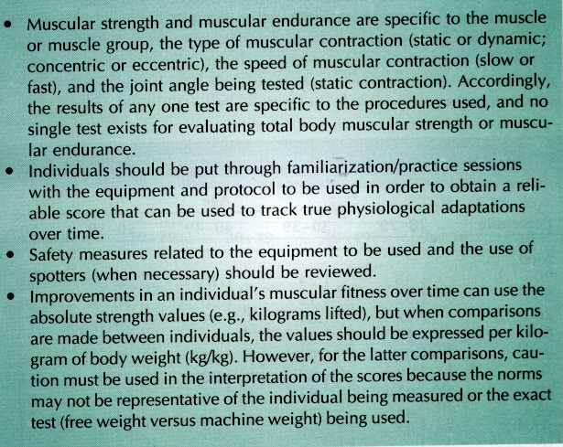

Slide 57
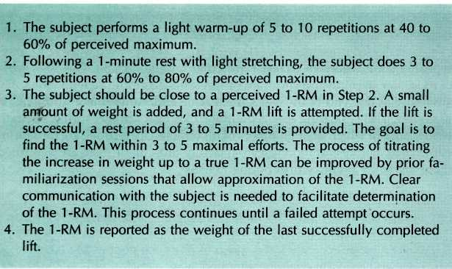
Muscular Strength

Slide 58
Muscular Strength – 1 RM
The subject performs a light warm-up of 5-10 reps at 40 to 60% of perceived maximum.
Following a 1-minute rest with light stretching, the subject does 3 to 5 repetitions at 60 to 80% of perceived maximum.
The subject should be close to a perceived 1-RM in step 2.
A small amount of weight is added, and a 1-RM lift is attempted.

Slide 59
Muscular Strength – 1 RM
If the lift is successful, a rest period of 3 to 5 minutes is provided.
The goal is to find the 1-RM within 3 to 5 maximal efforts.
The process of titrating the increase in weight up to a true 1-RM can be improved by prior familiarization sessions that allow approximation of the 1-RM.

Slide 60
Muscular Strength – 1 RM
Clear communication with the subject is needed to facilitate determination of the 1-RM.
The process continues until a failed attempt occurs.
The 1-RM is reported as the weight of the last successfully completed lift.

Slide 61
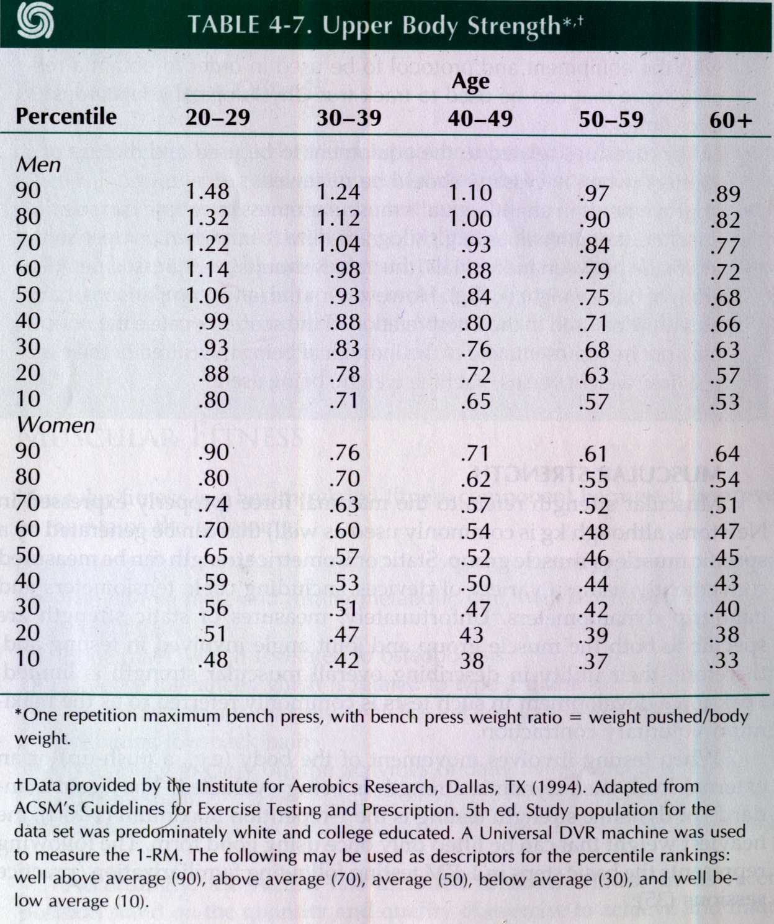

Slide 62
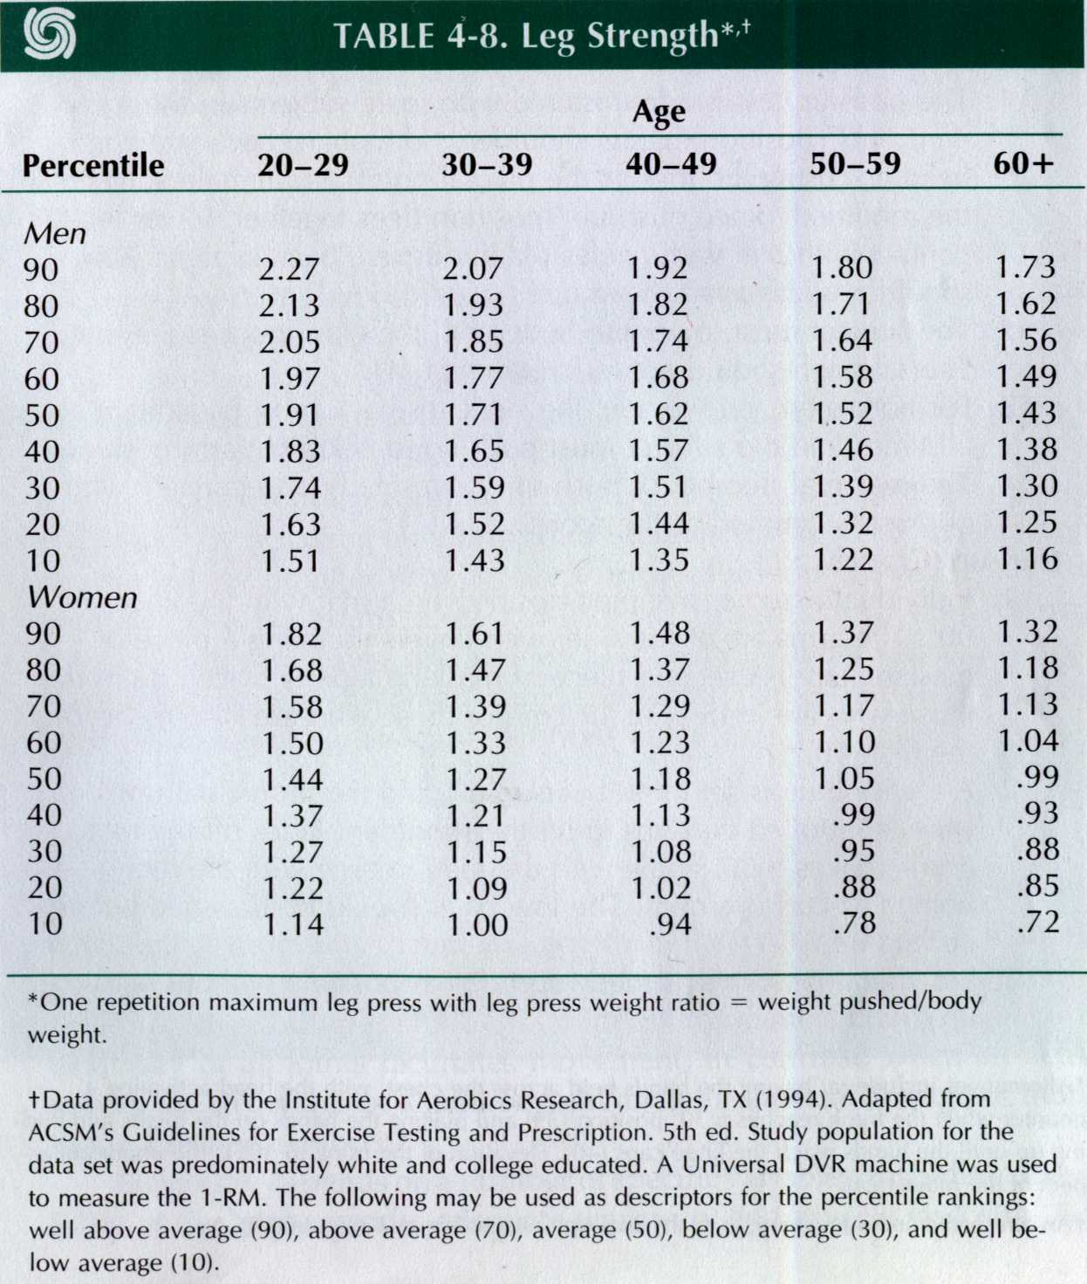

Slide 63
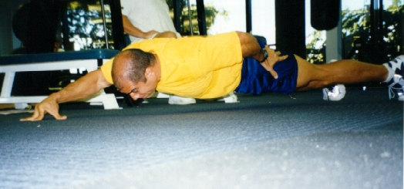
Muscular Endurance

Slide 64
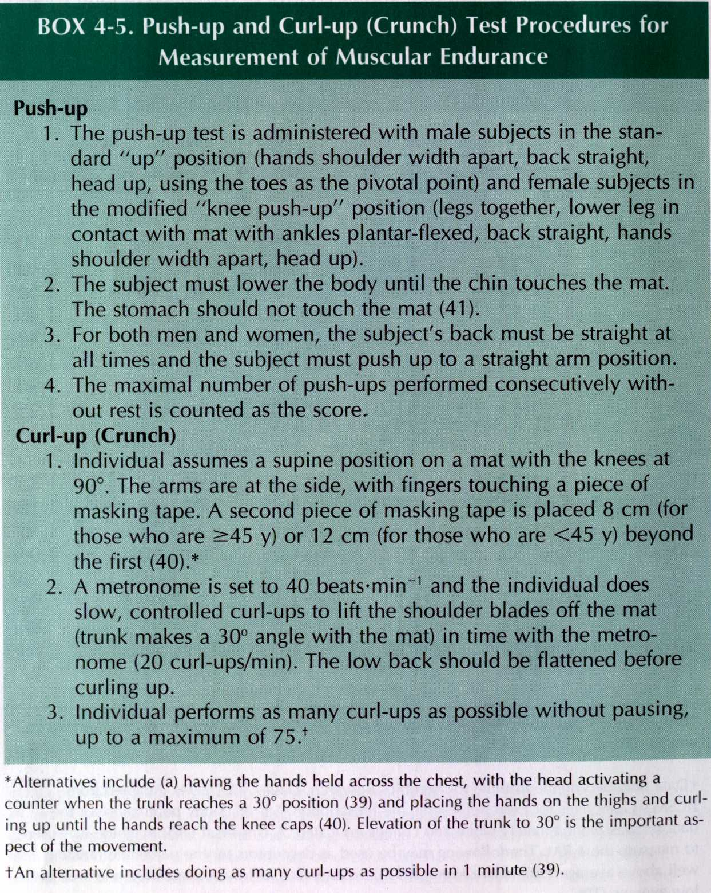

Slide 65
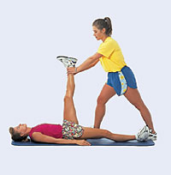
Flexibility

Slide 66
Flexibility - ACSM
The ability to move a joint through its complete range of motion (ROM)
Importance in athletics and the ability to carry out activities of daily living
Maintaining flexibility facilitates movement
Movement beyond a joint’s shortened range of motion can cause tissue damage.
Factors that determine flexibility:
Joint capsule
Body (joint) temperature
Ligaments and tendons

Slide 67
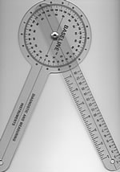
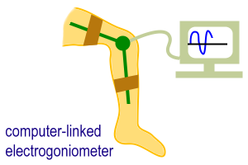
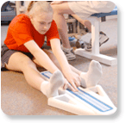
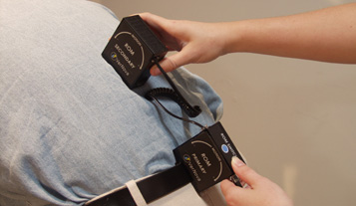
Flexibility
A.
Devices
Goniometer
Electogoniometer
Flexometer
Inclinometers
Tape measures
Joint specific
There is not one good test for over-all flexibility
B.
C.
D.

Slide 68
YMCA Sit and Reach Test
Place a yard stick on the floor
At a right angle, place a piece of tape at the 15 inch mark
Have participant sit with the yard stick between their legs
Heals of the feet should touch the edge of the taped line and be 10 to 12 inches apart

Slide 69
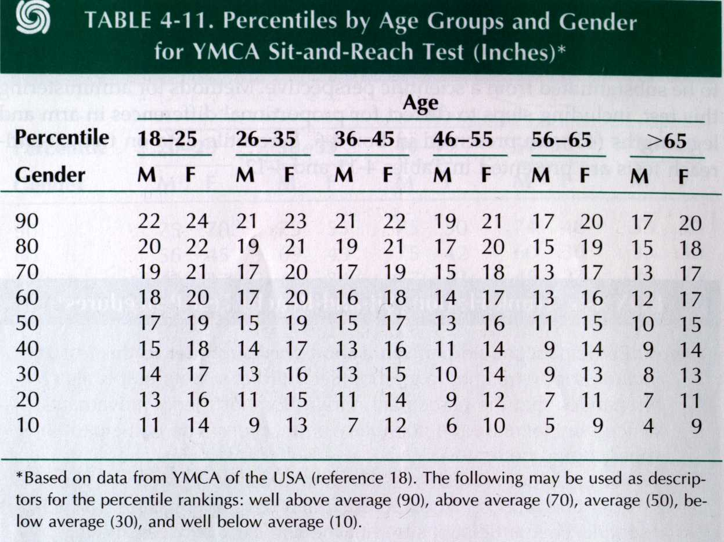

Slide 70
Sit and Reach Box
If a standard sit-and-reach box is available, heels should be place against the edge of the box
The participant slowly reaches forward with both hands as far as possible, holding this position momentarily
Knees remain extended
Participant should not hold their breath
This norms are based on a sit-and-reach box in which the “zero” point is set at 26 cm. When using a box in which the “zero” point is set at 23 cm, subtract 3 cm from each value in the tables

Slide 71
