Slide 1
Acromegaly ???
Fatemeh Rahmani

Slide 2
Elevated IGF-1 with GH suppression after an oral glucose overload: incipient acromegaly ??
●Epidemiology of acromegaly (then and now )
●Discrepancies in GH /IGF1 levels
●Clinicaly silent somatotropin adenoma
●Micromegaly with apparent normal GH secration
●Utility of OGTT in Acromegaly

Slide 3
Over the years ,diagnostic criteria for acromegaly have changed dramatically, and the numbers of patients diagnosed with this disease have increased in parallel
Older studies have estimated an incidence of about 3–4 cases per million patient -years ,but the newest data found it to be 11cases per million patient-years
●in 1926, 62 % of acromegalic patients had visual disturbances
●in 1975, the presence of visual field deficiets decreased to 27 %
●in 1996, it further dropped to 15.4 %
●in 2006, it decreased to only 5.2 %

Slide 4
Discrepancies in GH /IGF-1 levels
●sampling of GH /IGF-1
●Lack of assay standardization
●Hormone half life
●Pulsatility
●Age
●Gender
●Genetic differences
●Co-morbidity

Slide 5
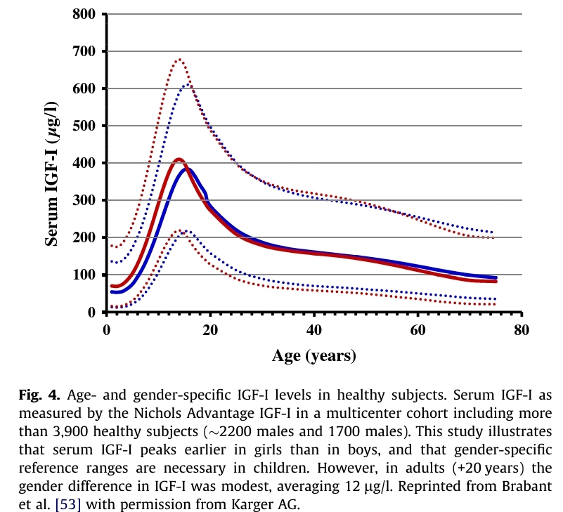

Slide 6
●Discordant value may originate from inaccurate assessment of
GH status and lack of agreement between GH and IGF- when
GH output is too high or too low
●OGTT may have very high false negative rate in patients with relatively low GH output
●The characteristics of GH pulsatility are also important .patients with acromegaly have indeed a reduced proportion of pulsatile
GH secretion and instead show persistantly high GH value throught the day to more continuous secretion

Slide 7
● GH receptor (GHR) polymorphism also seems to be involved in the
GH/IGF1 relationship
●d3-GHR carriers did shown significantly lower GH levels compared to the subjects with flfl-GHR , despite similar circulating IGF- 1 level
●so,patients carrying d3-GHR allele may need lower GH concentration to produce a given increase in serum IGF-1

Slide 8
Normal” GH suppression with an elevated IGF-1 level
●Falsely elevated IGF-1
•Adolescence
•Pregnancy
•Hyperthyroidism (mild elevation)
•IGF-1 assay problems
●Early postoperative period
●Patient with active disease
●Cutoff for GH suppression too high for the GH assay used

Slide 9
Abnormal” GH suppression with a normal IGF-1 level
●Causes of abnormal GH suppression other than acromegaly
•Chronic renal insufficiency
•Liver failure
•Active hepatitis
•Anorexia nervosa
•Malnutrition
•Hyperthyroidism
•Diabetes mellitus
•Adolescence
•Oral oestrogen use
●Cut off for GH suppression inappropriately low for the GH assay used
●Inaccurate IGF-1 normal range – upper limit too high

Slide 10
IGF-I Assay
●with 3%–36% individual biological imprecision of IGF-I assays , caution should be exercised in the interpretation of a single IGF-I value, particularly if it is close to a reference limit
●Assays for samples that yield borderline results should be repeated with a separate blood sample
●Technical factors affecting assay :
●use of serum
●use of anticoagulants in the collection tube
●preventing IGFBP interference(gel chromatography at low pH)

Slide 11
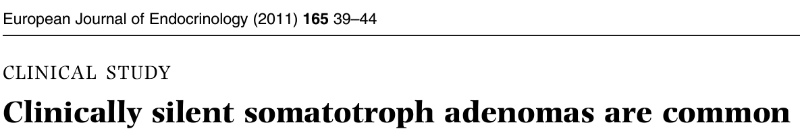
Somatotroph adenomas are typically recognized when secrete GH excessively and cause the clinical syndrome of acromegaly
■classic :obvious clinical features of acromegaly and elevated serum IGF1
■subtle :subtle clinical features of acromegaly and elevated IGF1
■clinically silent :no clinical features but elevated IGF1
■silent :no clinical features of acromegaly and normal IGF1

Slide 12
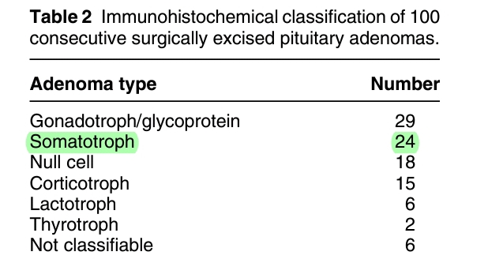
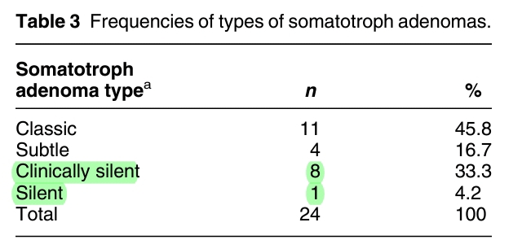
The mean serum IGF1 concentrations were 768 ng/ml in the classic, 533 ng/ml in the subtle, and 451 ng/ml in the clinically silent adenomas.

Slide 13
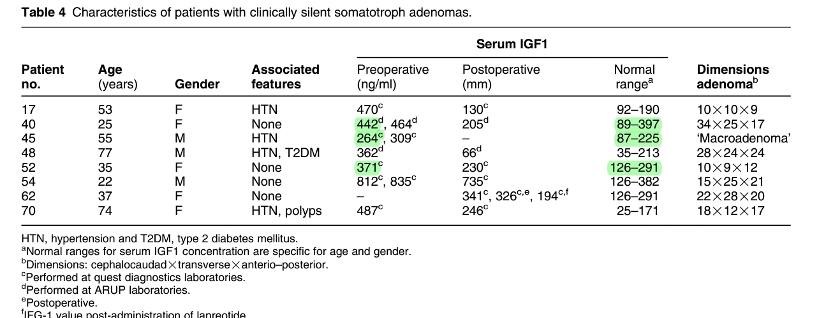

Slide 14
The explanation for the lack of clinical manifestations of some somatotroph adenomas is not certain
■Even the most experienced endocrinologist may miss subtle features of acromegaly
■lesser duration of excessive GH secretion(such patients in whom excessive GH secretion has been documented for several years)
■Inefcient GH secretion or secretion of biologically inactive GH
(clear elevation of serum IGF1 in all of the patients presented here)
■Differential IGF1 concentrations(3 of the 8 patients with clinically silent adenomas reported had IGF1 more than twice the upper limit of normal, the mean IGF1 were higher in classic and subtle than in clinically silent

Slide 15
The clinical signicance of finding that a third of all somatotroph adenomas are clinically nonfunctioning is that in this substantial fraction of patients, an unidentiable sellar mass can be recognized as a somatotroph adenoma merely by measurement of the serum concentration of IGF1
This recognition expands the therapeutic options to include pharmacological treatment and also provides a tumor marker to follow to monitor the efcacy of treatment
This study supports the recommendation to measure the serum concentration of IGF1 in all patients who have a sellar mass

Slide 16
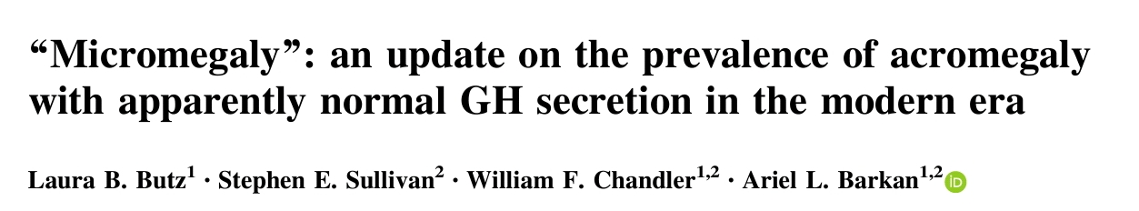

A retrospective chart review was conducted on 157 patients with acromegaly who underwent resection of a confirmed somatotroph pituitary adenoma at the University of Michigan Health System between the dates of 2001- 2015

Slide 17
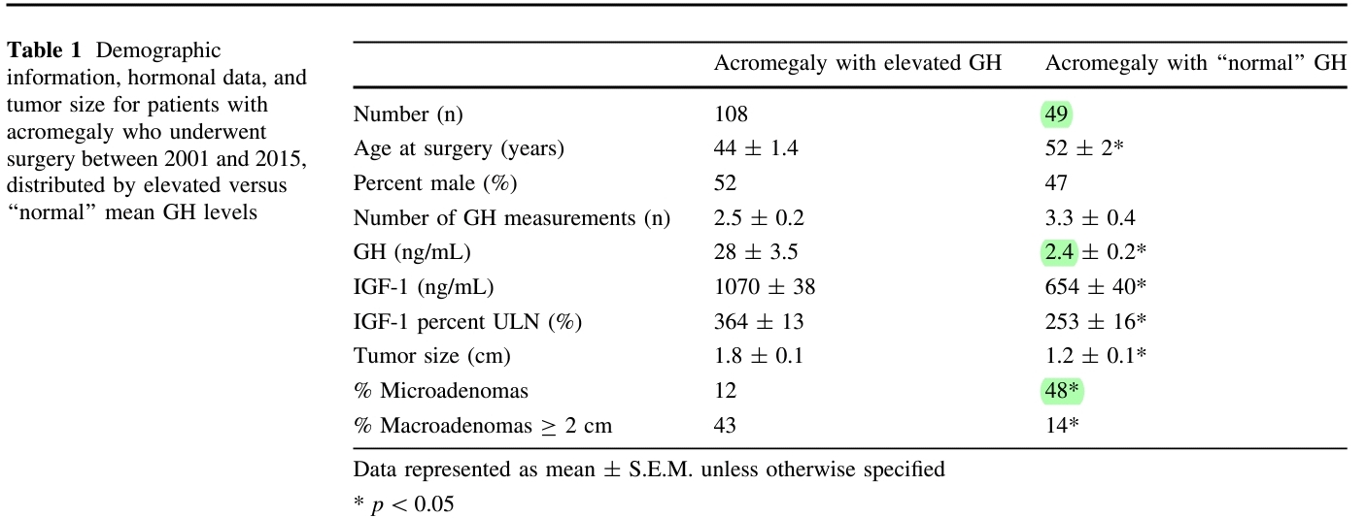

Slide 18
Hormones
GH ng/ml IGF-1 ng/ml
Acro 28.0+- 3.5 1070+-88
Micro 2.4 +-0.2 654+-40 tumors
Max.D (mm) <10 mm >20 mm
Acro 18+-1 13/108(12%) 46/108(43%)
Micro 12+-1 23/49 (48%) 7/49 (14%)

Slide 19
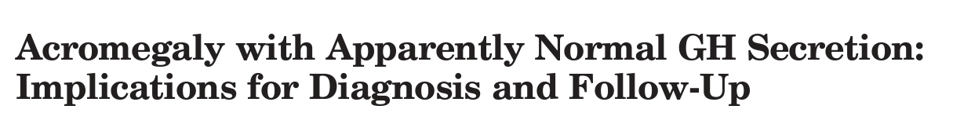

16 patients(6 F,10 M) with clinical symptoms & signs of acromegaly ,elevated plasma IGF-I levels but normal GH level . Ten patients had a microadenoma and five patients had a macroadenoma
Control groups:17 younger men ,10 older men , 8 younger women, and11older women
Plasma GH was measured every 10 min for 24 h (0700–0700 h) Subsequently, fasting morning plasma IGF-I was measured, and 100 g oral glucose was given at 0700 h with GH measured every 10 min

Slide 20
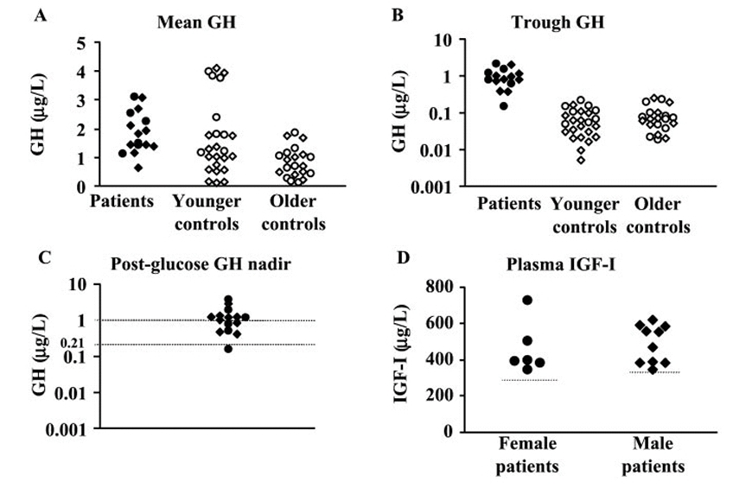
In 8 of 16 patients, plasma GH was suppressed to < 1 g/liter following OGTT.
When the upper normal limit of 0.14 g/liter, and corrected for the assays stanard to 0.21g/liter, was used, one female patient had plasma GH nadir below that value.

Slide 21
In 14 patients underwent TSS ,13 had a pituitary tumor in surgery and histologically
In 12 patients the diagnosis of acromegaly would have been missed if the criterion of 24-h meanplasma GH< 2.5 g/liter was used
Eight patients had both 24-h mean plasma GH < 2.5 g/liter and postglucose GH nadir <1 g/liter. At the same time, all patients had abnormally elevated plasma IGF-I levels
Therefore, the traditional GH-based diagnostic criteria cannot exclude the presence of a somatotroph adenoma. In these patients , plasma IGF-I was the most sensitive and reliable test for the diagnosis of acromegaly

Slide 22
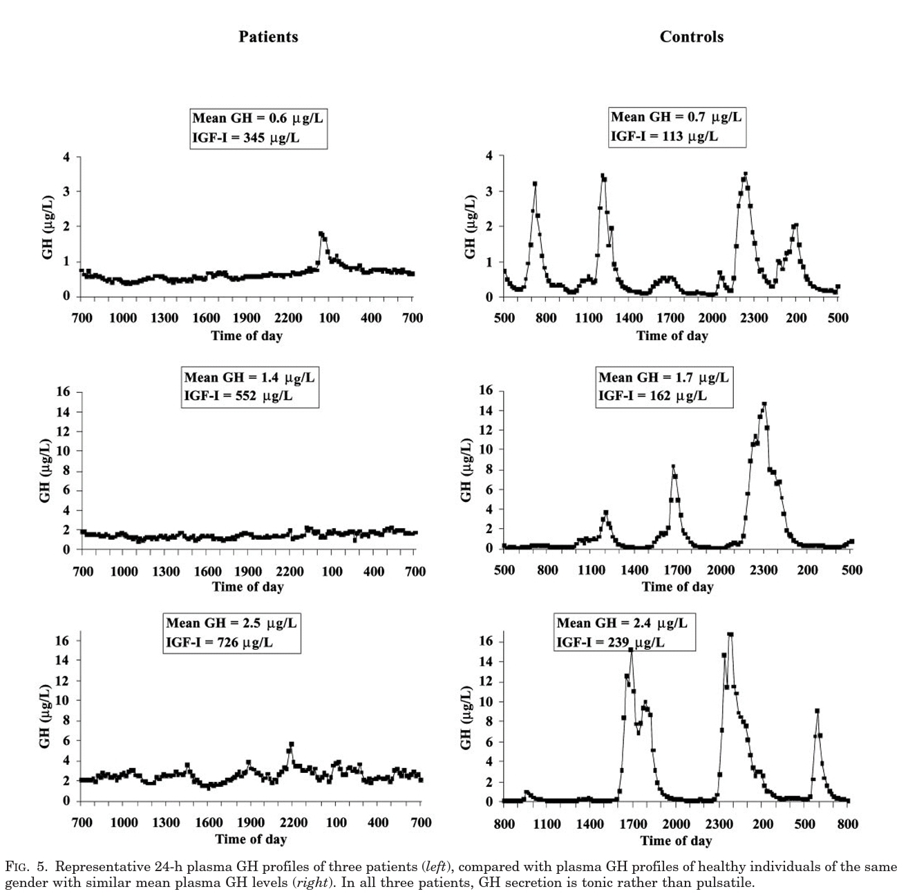

Slide 23
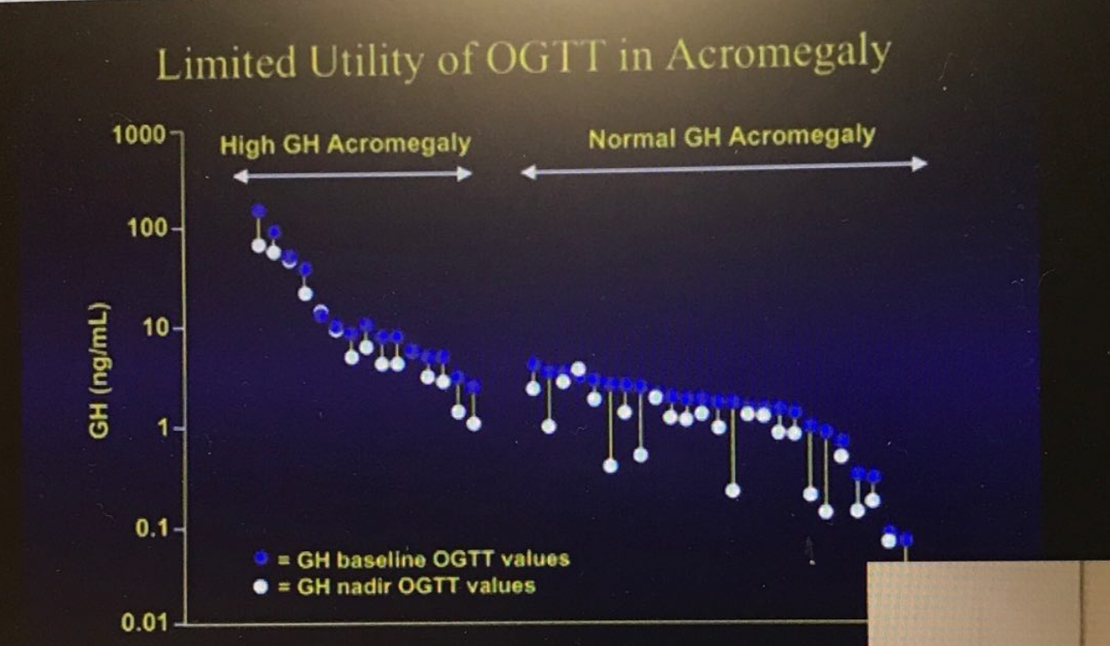

Slide 24
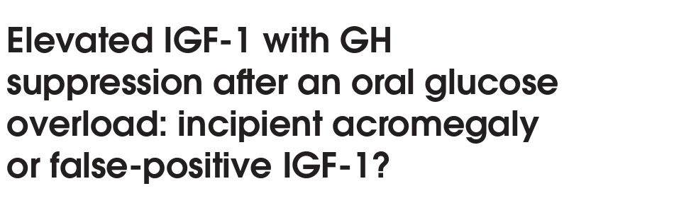
46 patients with a suggestive clinical scenario, who had elevated IGF-1 in two measurements(1.05 to 1.5 times ULN for age ), but
GH < 0.4 µg/L in the OGTT, were selected
Five years after initial evaluation, the patients were submitted to clinical and laboratory (serum IGF-1) reassessment. Patients with persistently elevated IGF-1 were submitted to a new GH suppression test and MRI of the pituitary.

Slide 25
Results
●42 patients continued to show no “typical phenotype” or changes Fifteen of the 42 patients had normal IGF-1
●Among 27 patients with persistently elevated IGF-1,and who
, GH suppression was confirmed in all of them after OGTT
●The last IGF-1 ranged from 1.12 to 1.63 ULN,adjusted by age
●IGFBP-3 was also measured in these 27 patients, and was normal in 17 patients and slightly elevated in 10 ( 1.02 to 1.2 ULN)
●Two patients exhibited a lesion suggestive of microadenoma on pituitary MRI. In our interpretation of the results, acromegaly was ruled out in 40 patients and considered “possible” in only 2

Slide 26
the combination of persistent suppression of GH, absence of the occurrence of phenotypic features and of an increase in IGF-1 after 5 years renders acromegaly highly unlikely in these two cases they do not know whether these individuals are
●normal population that exhibits concentrations outside the reference range
●more sensitive to endogenous GH
●have GH hypersecretion, although not tumoral and suppressive in the OGTT

Slide 27
About this patient…

Slide 28


