Slide 2
NATIONAL HEALTH RESEARCH PHILOSOPHY AND GOVERNANCE: NHRS STRATEGIC ARCHITECTURIN
BY:
SH.ALAMDARI, MD
ASSOCIATE PROFESSOR OF INTERNAL MEDICINE, ENDICRINOLOGY & METABOLISM
SHAHID BEHESHTI UNIVERSITY OF MEDICAL SCIENCES
RESEARCH INSTITUTE FOR ENDOCRINE SCIENCES
alamdari@endocrine.ac.ir

Slide 3
Definitions
National Research System
Research Philosophy
Research Governance
Strategic Architecturing

Slide 4
National Research System
A system for planning, coordinating, monitoring and managing research resources and activities; and for promoting research for effective and equitable national Research development.

Slide 5
Research philosophy
According to Johnson and Christensen (2005), research philosophy is a perspective that is based on the set of shared assumptions, values, concepts and practices.
In other word, philosophy can be defined as a function of how researcher thinks about the development of knowledge.
Research philosophy is a combination of two ideas that are related to the nature of world and the function of researcher.
It helps researcher to conduct the study in an effective manner.

Slide 6
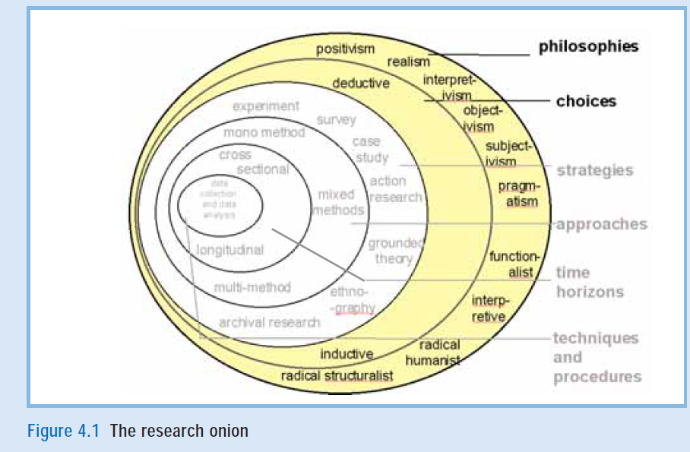

Slide 7
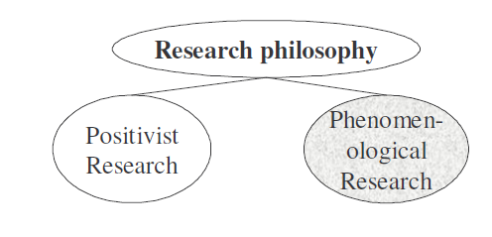

Slide 8
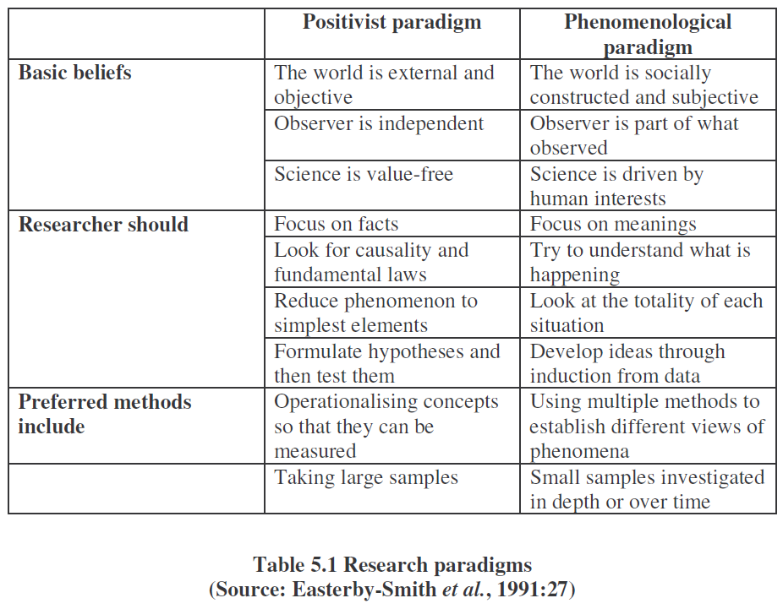

Slide 9
Research governance
There is no widely accepted definition of Research Governance, but broadly it is a process which sets standards in research, defines mechanisms to deliver standards and describes monitoring and assessment arrangements.

Slide 10
Research governance
Research Doctrine & principles
Research Policies (Macro & Micro)
Research Strategies
Research Objectives
Research Projects
Research strategic Control

Slide 11
Strategic Architecturing
A comprehensive and integrated approach to organization leadership and management that includes philosophic bases to operational aspects of an organization and consists of:
Risk map and scenarios,
Philosophy, doctrine, principles and policies of the organization,
Target capabilities and organizational structure,
Strategic fields of the organization and
Supporting parts such as resource management and financial support, research and education, advocating bodies, media and public education.

Slide 12
STRATEGIC ARCHITECTURING
SUPPORTING BOXES
BODY OF THE BUILDING
FOUNDATION OF THE BUILDING

Slide 13
RESOURCE MANAGEMENT & FINANCIAL SUPPORT
ADVOCACY/ LAW/ PARLIAMENT
RESEARCH MANAGEMENT
PUBLIC EDUCATION, MEDIA & NGOs
SPECIAL EDUCATION
STRATEGIC FIELDS: STRATEGIES/ OBJECTIVES/ PROJECTS/ EVALUATION
NHRS VCA
RISK MAP
SCENARIOS
NHRS PHILOSOPHY/ NHRS DOCTRINE & PRINCIPLES/
NHRS POLICIES
NHRS TARGET CAPABILITY LIST
CPGs
PROTOCOLS
PATHWAYS
NHRS ORGANIZATIONAL STRUCTURE:
DICS/ DUCS/ DACS/ DMACS/ DNIMS/ DGIMS

Slide 15
دکترین چیست؟
مجموعه ای از اصول بنیادین است که تمامی منابع، راهبردها، سیاست ها، برنامه ها، واقدامات اجرایی را جهت پشتیبانی اثربخش وکارآمد از اهداف حاکمیت، بسیج، هدایت وبه کارگیری می کند.

Slide 16
شاخص های دکترین موثر
شاخص يكپارچه‌سازي و هم‌افزايي
شاخص هماهنگي و هدايتگري
شاخص هدف محوري
شاخص شفافيت
شاخص مسئوليت‌پذيري راهبردي
شاخص اثربخش‌سازي مديريت
شاخص رويكرد آينده‌گرايانه
شاخص واقع‌گرايي و قابليت تحقق
شاخص مفهوم‌محوري
Notes:
16

Slide 17
بررسی
اسناد بالا دستی
تحلیل سیاسی
راه حلها
مطالعۀ امکان سنجی
تحلیل هزینۀ
راه حلها
بیان مسئله و
تدوین نقشۀ مفهومی
مرور منابع
تحلیل
مسئله
پیشنهاد گزینه ها
مطالعه تطبیقی
و بهینه کاوی
ارزیابی اخلاقی راه حل
تحلیل اجتماعی
و فرهنگی
ارزیابی قانونی
نقد سیاست موجود
پیمایش سیاست
تدوین
سیاست پیشنهادی
ارزیابی
نتایج نهایی سیاست
پیاده سازی سیاست
تصویب سیاست
چکش کاری و مداقه
در سیاست پیشنهادی
راهنمای ارزیابی
نتایج نهایی سیاست
راهنمای
پیاده سازی سیاست

Slide 18
چشم انداز
تحليل دروني و
بروني
موقعيت
راهبردي
}
mission
ماموريت
ماتريس
دروني و بروني
goals
اهداف كلان
Strategies
راهبردها
اهداف عيني
فعاليتها
بودجه ريزي
ارزشها
پايش و ارزشيابي
بازخورد

Slide 19
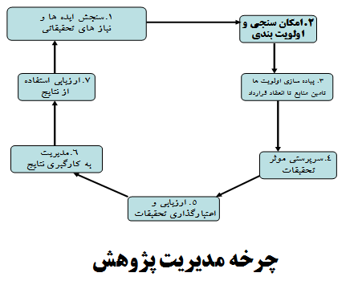

Slide 21
