Slide 1


Slide 2
Weekly GLP1 Receptor Agonists

Slide 3
Major Metabolic Defects in Type 2 Diabetes
Physiopathology of diabetes includes multiple metabolic defects:1-4
Progressive β-cell failure/decreased insulin secretion
Insulin resistance
α-cell dysfunction (hyperglucagonemia)
Increased liver glucose output
Decreased incretin effects
Decreased muscle glucose uptake
Increased glucose renal reabsorption
Increased lypolysis
Schwartz SS. Curr. Med. Res. Opin. 2013;29(7):793-799
2. Nathan DM et al. Diabetes Care. 2009;32(1):193-203
3. Ahrén B. Diabetes Metab. 2013;39(3):195-201
4. DeFronzo RA et al. Diabetes Care. 2013;36 (Suppl2):S127-138

Slide 4
Hyperglycemia in Type 2 Diabetes Results from Major Metabolic Defects

Slide 5
The Incretin Effect and the Role of Incretin Hormones
The incretin effect is the increased insulin release observed after oral glucose ingestion compared with after IV glucose infusion.¹
2 hormones released after food ingestion are responsible:^{2,3}
GLP-1
GIP
Baggio LL and Drucker DJ. Gastroenterology 2007;132:2131-57
Drucker DJ. Diabetes Care 2003;26:2929-40
Thorens B. Diabetes Metab 1995;21:311-8

Slide 6
GLP-1
• Released mostly from L-cells located in ileum and colon
• Sites of action include: pancreatic β- and α-cells, GI tract, CNS, and heart
GIP
Released mostly from K-cells of the duodenum and jejunum
Sites of action include: pancreatic β-cells, adipocytes, and neural progenitor cells ¹
CNS = central nervous system; GI = gastrointestinal; GIP = glucose-dependent insulinotropic polypeptide; GLP-1 = glucagon-like peptide-1; IV = intravenous
1. Nyberg J et al. J Neurosci 2005;25:1816-25

Slide 7
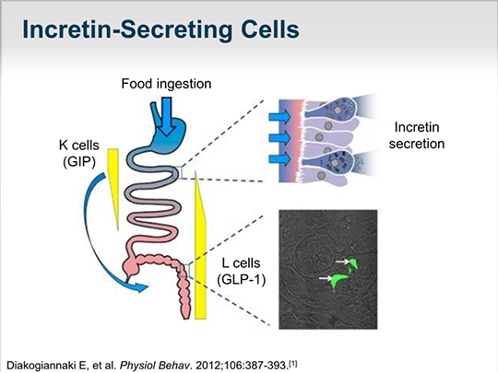

Slide 8
GLP-1 and GIP Are the Two Major Incretins
GLP-1 |  | GIP
Potentiates glucose-induced insulin secretion Upregulates insulin gene expression and all steps in insulin biosynthesis Upregulates expresssion of other genes essential for β-cell function Enhances β-cell proliferation and survival in animal models and isolated human islets |  | Potentiates glucose-induced insulin secretion Upregulates insulin gene expression and all steps in insulin biosynthesis Upregulates expresssion of other genes essential for β-cell function Enhances β-cell proliferation and survival in islet cell linesa
Other effects Suppresses hepatic glucose output by inhibiting glucagon secretion in a glucose-dependent manner Inhibits gastric emptying and appetite; reduction of food intake and body weight |  | Does not inhibit glucagon secretion Minimal effects on gastric emptying; no significant effects on appetite or body weight
Holst et al, FEBS letts 1987; Ørskov et al Endocrinology 1988; Wettergren et al , Dig Dis Sci. 1993 ; Flint et al J Clin Invest 1998 ;
Holst JJ, Physiol Rev 2007; Trümper A et al. Mol Endocrinol. 2001;15:1559–1570; Trümper A et al. J Endocrinol. 2002;174:233–246; Wideman RD et al. Horm Metab Res. 2004;36:782–786.
Notes:
GLP-1 and GIP Are the Two Major Incretins
Incretins are gut hormones released in response to ingestion of a meal, the most important of which are glucagon-like peptide-1 (GLP-1), which is synthesized by
L cells mainly located in the distal gut (ileum and colon), and glucose-dependent insulinotropic polypeptide (GIP), which is secreted by K cells in the proximal gut (duodenum).^{1,2} GLP-1 and GIP are the major incretins that play a role in the insulin response as nutrients are absorbed by the body.¹
In addition to stimulating insulin release when glucose is elevated, GLP-1 also inhibits glucagon secretion.³ These actions are highly glucose dependent.³ In healthy volunteers, administration of GLP-1, at levels surpassing physiologic production, has been shown to exert profound, dose-dependent inhibition of gastric emptying.⁴ In in vitro and in vivo rodent studies and isolated human islets, GLP-1 has been shown to promote the expansion of beta-cell mass through proliferative and antiapoptotic pathways.^{1,5,6}
Whereas GIP also stimulates a glucose-dependent insulin response,² this hormone does not appear to affect gastric emptying.⁷ When given at supraphysiologic doses to patients with type 2 diabetes, the insulinotropic activity of GIP was less than that observed in normal subjects.⁸ GIP does not appear to affect satiety or body weight.¹ In islet cell lines, GIP has been shown to enhance beta-cell proliferation and survival.^{9,10}
References:
1. Drucker DJ. Enhancing incretin action for the treatment of type 2 diabetes. Diabetes Care. 2003;26:2929–2940.
2. Ahrén B. Gut peptides and type 2 diabetes mellitus treatment. Curr Diab Rep. 2003;3:365–372.
3. Drucker DJ. Biological actions and therapeutic potential of the glucagon-like peptides. Gastroenterology. 2002;122:531–544.
4. Nauck MA, Niedereichholz U, Ettler R, et al. Glucagon-like peptide 1 inhibition of gastric emptying outweighs its insulinotropic effects in healthy humans. Am J Physiol. 1997;273:E981–E988.
5. Farilla L, Bulotta A, Hirshberg B, et al. Glucagon-like peptide 1 inhibits cell apoptosis and improves glucose responsiveness
of freshly isolated human islets. Endocrinology. 2003;144:5149–5158.
6. Farilla L, Hui H, Bertolotto C, et al. Glucagon-like peptide-1 promotes islet cell growth and inhibits apoptosis in Zucker diabetic rats. Endocrinology. 2002;143:4397–4408.
7. Meier JJ, Goetze O, Anstipp J, et al. Gastric inhibitory polypeptide does not inhibit gastric emptying in humans.
Am J Physiol Endocrinol Metab. 2004;286:E621–E625.
8. Nauck MA, Heimesaat MM, Ørskov C, Holst JJ, Ebert R, Creutzfeldt W. Preserved incretin activity of glucagon-
like peptide 1 [7-36 amide] but not of synthetic human gastric inhibitory polypeptide in patients with type-2 diabetes mellitus. J Clin Invest. 1993;91:301–307.
9. Trümper A, Trümper K, Trusheim H, Arnold R, Göke B, Hörsch D. Glucose-dependent insulinotropic polypeptide
is a growth factor for beta (INS-1) cells by pleiotropic signaling. Mol Endocrinol. 2001;15:1559–1570.
10. Trümper A, Trümper K, Hörsch D. Mechanisms of mitogenic and anti-apoptotic signaling by glucose-dependent insulinotropic polypeptide in β(INS-1)-cells. J Endocrinol. 2002;174:233–246.

Slide 9
The incretin effect
i.v.
pr. OS
10
Glucose
Up to 70% of post-glucose insulin secretion is due to the effects of incretins
The incretin effect is
due to gut hormones –
the incretin hormones
Glucose (mmol/l)
5
Time (min)
1000
Incretin
Insulin (pmol/l)
500
0
Time (min)

Slide 10
Isoglycaemic iv and oral glucose challenge
in lean patients with 2DM and matched controls
Plasma glucose (mM)
Time (minutes)
Knop et al, Diabetes 2007

Slide 11
Insulin and C-peptide
Knop F et al
Diabetes 2007
CTRL
T2DM
Plasma insulin (pM)
Plasma C-peptide (pM)
Time (minutes)
Time (minutes)

Slide 12
Meal-Stimulated Incretin Secretion is Impaired in Patients with Type 2 Diabetes
20
*
*
*
*
*
15
*
*
AUC, p<0.05 (T2DM vs NGT)
15
GLP-1 (pmol/l)
5
0
NGT
IGT
T2DM
120
90
GIP (pmol/L)
AUC, p<0.05
60
30
0
0
60
120
180
240
Time (min)
meal
T2DM=type 2 diabetes; NGT=normal glucose tolerance; IGT=impaired glucose tolerance
Reprinted from Toft-Nielsen M-B et al. J Clin Endocrinol Metab. 2001;86:3717–3723.
Notes:
GLP-1 Levels in Patients With Type 2 Diabetes and Normal Subjects¹
A clinical study investigated the meal-stimulated GLP-1 and GIP responses in patients with type 2 diabetes (n=54) vs matched subjects with NGT (n=33, controls) and unmatched subjects with IGT (n=15). After an overnight fast following 3 days without antidiabetic medication, subjects consumed a mixed meal and underwent blood sampling periodically for 4 hours.
The slide shows GLP-1 levels in patients with type 2 diabetes vs subjects with NGT. Postprandial GLP-1 concentrations were significantly decreased in patients with type 2 diabetes compared with control subjects with NGT (AUC: 2482 vs 3101 pmol/L • 240 min, p<0.024).
The incremental postprandial GLP-1 response (incremental area under the curve [iAUC], AUC calculated as above basal levels) was even more significantly reduced (AUC: 907 vs 1927 pmol/L • 240 min in controls, p<0.001).

Slide 13
Insulin Responses to Physiological Concentrations of GLP-1 and GIP are Severely Impaired in T2DM
Healthy subjects
15 mM hyperglycaemic clamp +
Patients with T2DM
Saline
GLP-1(0.5 pmol/kg/min)
GIP (1.5 pmol/kg/min)
4000
3000
400
Insulin (pmol/L)
2000
Insulin (pmol/L)
200
1000
0
0
0
30
60
90
120
0
30
60
90
120
Time (min)
Time (min)
Højberg et al. EASD, 2007, Oral Presentation O-249 (Friday 11:00-12:00)

Slide 15
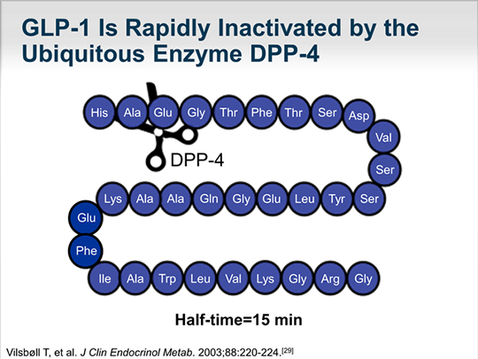

Slide 16
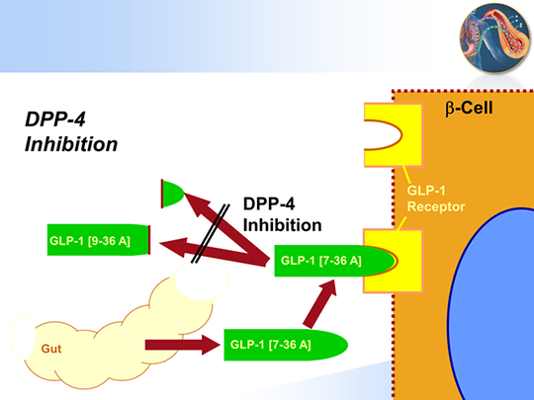

Slide 17
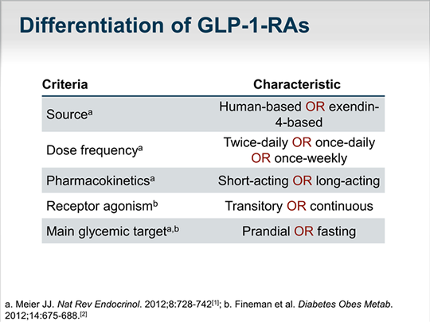
Differentiation of GLP-1-RAs

Slide 18
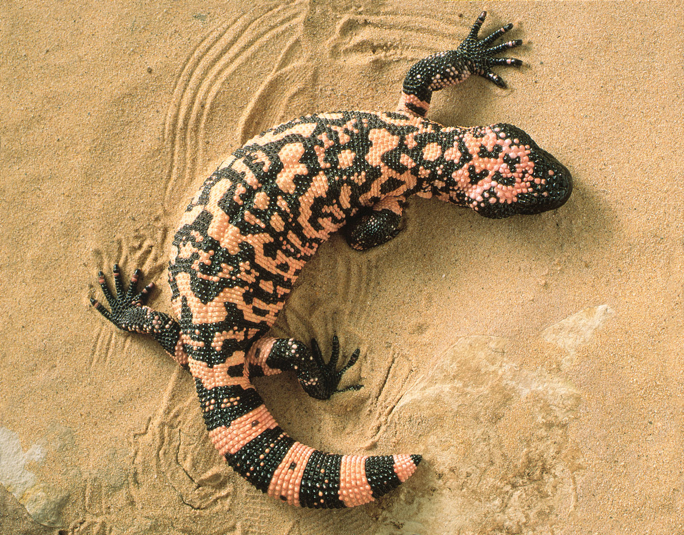

Slide 19
Comparison of GLP-1 Receptor Agonists

Slide 20
ADA/EASD Joint Position Statement: General Therapy Recommendations in Type 2 Diabetes

Slide 22
Dulaglutide
A recombinant GLP-1 Fc fusion protein linking a human GLP-1 peptide analog and a variant of a human IgG4 Fc fragment
Extended plasma half-life (~5 days)
Minimal renal clearance
Once-weekly dosing
Solution injection: no reconstitution needed
Low immunogenic potential

Slide 23
Dulaglutide Clinical Overview

Slide 24
AWARD-1
Key inclusion criteria
Type 2 Diabetes not well controlled on 1, 2, or 3 OAM
HbA1c ≥7.0% (53 mmol/mol) and ≤11.0% (97 mmol/mol) on OAM monotherapy or
HbA1c ≥7.0% (53 mmol/mol) and ≤10.0% (86 mmol/mol) on combination OAM therapy

Slide 25
Baseline Characteristics, AWARD-1 Trials
Variables | AWARD-1 N=976
Female, n (%) | 406 (41.6)
Age (y), Mean (SD) | 55.6 (9.8)
Hb A₁c (%), Mean (SD) | 8.1 (1.3)
BMI (kg/m²), Mean (SD) | 33.2 (5.4)
Diabetes Duration (y), Mean (SD) | 8.8 (5.6)

Slide 26
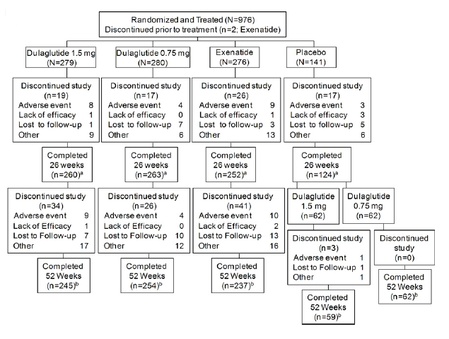
Notes:
Figure 1—Study design (A) and patient disposition (B). All patients underwent a metformin (1,500–3,000 mg/day) and pioglitazone (30–45 mg/day) lead-in period that lasted up to 12 weeks and was continued for the duration of the study; other OAMs were discontinued. Two doses of dulaglutide (1.5 mg and 0.75 mg) were evaluated along with exenatide and placebo. Placebo patients continued until week 26 and were then randomized to dulaglutide 1.5 mg or dulaglutide 0.75 mg. aNumber of patients rescued at week 26: dulaglutide 1.5 mg, 4 (1.4%); dulaglutide 0.75 mg, 12 (4.3%); exenatide, 11 (4.0%); placebo, 22 (15.6%). bNumber of patients rescued at week 52: dulaglutide 1.5 mg, 9 (3.2%); dulaglutide 0.75 mg, 25 (8.9%); exenatide, 24 (8.7%); placebo to dulaglutide 1.5 mg, 1 (1.6%); placebo to dulaglutide 0.75 mg, 3 (4.8%).

Slide 28
Change in HbA1c from baseline at 26 and 52 weeks
Notes:
Figure 2—Efficacy and safety measures through the treatment period. A: Change in HbA1c from baseline at 26 and 52 weeks, ANCOVA LOCF. B: HbA1c
over time, MMRM. C: Percentage of patients achieving HbA1c targets, logistic regression. D: Change in FSG over time, MMRM. E: Baseline and
26-week 8-point SMPG profiles, MMRM (solid lines are baseline, and dashed lines are at 26 weeks). F: Change in weight over time, MMRM.
G: Incidence of nausea up to 26 weeks. Data are LS mean 6 SE. ††P , 0.001, superiority vs. exenatide; ‡‡P , 0.001, superiority vs. placebo; #P ,
0.05 vs. exenatide; *P , 0.05 vs. placebo; ##P , 0.001 vs. exenatide; **P , 0.001 vs. placebo

Slide 29
HbA1c over time, MMRM

Slide 30
Percentage of patients achieving HbA1c targets, logistic regression

Slide 31
Change in FSG over time, MMRM

Slide 32
Baseline and 26-week 8-point SMPG profiles, MMRM (solid lines are baseline, and dashed lines are at 26 weeks)

Slide 33
Change in weight over time, MMRM

Slide 34
Incidence of nausea up to 26 weeks

Slide 35
AWARD-2

Slide 41
Summary and Conclusions
Efficacy
•Compared to glargine:
-Dulaglutide 1.5 mg resulted in significantly greater improvement in A1C, with weight loss and less hypoglycemia
-Dulaglutide 0.75 mg resulted in similar improvement in A1C, with weight loss and less hypoglycemia
Safety and Tolerability
•Dulaglutide had higher rates of gastrointestinal-related adverse events than glargine
•Safety profile similar to GLP-1 receptor agonist class

Slide 42
AWARD-3
Key inclusion criteria
Type 2 Diabetes (≥3 months and ≤5 years)
HbA1c ≥6.5% (≥48 mmol/mol) and ≤9.5% (≤80 mmol/mol)
Treatment-naïve or on 1 OAM (except TZDs) ≤50% of the approved maximum daily dose ≥3 months

Slide 43
Baseline Characteristics, AWARD-3 Trials
Variables | AWARD-3 N=807
Female, n (%) | 454 (56.3)
Age (y), Mean (SD) | 55.6 (10.4)
Hb A₁c (%), Mean (SD) | 7.6 (0.9)
BMI (kg/m²), Mean (SD) | 33.3 (5.5)
Diabetes Duration (y), Mean (SD) | 2.6 (1.8)

Slide 44
HbA1c Reduction Across Trials at Primary Endpoint

Slide 45
Proportion of Patients Achieving HbA1CTarget of <7% at Primary Endpoint

Slide 46
Weight Change from Baseline at Study Endpoint

Slide 48
AWARD-4
Key inclusion criteria
1 or 2 insulin doses/ day (basal, basal with prandial, or premixed insulin) ± OAMs
Insulin dose stable for 3 months
A1C ≥7.0% and ≤11.0%
Body mass index ≥23 and ≤45 kg/m2
Key exclusion criteria
Type 1 diabetes
Signs, symptoms, and/or history of pancreatitis, severe cardiovascular, hepatic, or kidney disease
Glomerular filtration rate ≤30 mL/min/1.73 m2

Slide 53


Slide 54
Summary and Conclusions
Efficacy
•When combined with insulin lispro, once-weekly dulaglutide 1.5 mg and dulaglutide 0.75 mg were superior to glargine, as measured by the reduction in A1C levels at 26 and 52 weeks
•Dulaglutide was associated with statistically significantly less weight gain than glargine
Safety and Tolerability
•Dulaglutide had higher rates of gastrointestinal-related adverse events compared to glargine
•Hypoglycemia risk was lower with dulaglutide 1.5 mg and similar with dulaglutide 0.75 mg as compared to glargine

Slide 55
AWARD-5: An Adaptive, Double-blind Phase 3 Study

Slide 56
Baseline Characteristics, AWARD-5 Trials
Variables | AWARD-3 N=1098
Female, n (%) | 577 (52.6)
Age (y), Mean (SD) | 54.1 (9.9)
Hb A₁c (%), Mean (SD) | 8.1 (1.1)
BMI (kg/m²), Mean (SD) | 31.2 (4.4)
Diabetes Duration (y), Mean (SD) | 7.1 (5.2)

Slide 57
HbA1c Reduction Across Trials at Primary Endpoint

Slide 58
Proportion of Patients Achieving HbA1CTarget of <7% at Primary Endpoint

Slide 59
Weight Change from Baseline at Study Endpoint

Slide 61
AWARD-6
Key inclusion criteria
Type 2 diabetes
Metformin monotherapy ≥1500 mg/day
A1C ≥7.0% and ≤10.0%
Key exclusion criteria
Type 1 diabetes
History of pancreatitis
Elevated serum calcitonin ≥20 pg/ml

Slide 65


Slide 67
Summary and Conclusions
Efficacy
•Once weekly dulaglutide 1.5 mg demonstrated non-inferior glycemic control compared to once daily liraglutide 1.8 mg
•Both dulaglutide and liraglutide had robust A1C reductions with the majority of patients reaching ADA A1C target of <7.0%
•Both treatment groups demonstrated weight loss; liraglutide had statistically greater weight loss (0.7 kg) than dulaglutide
Safety and Tolerability
•Dulaglutide and liraglutide had a similar safety and tolerability profile

Slide 73
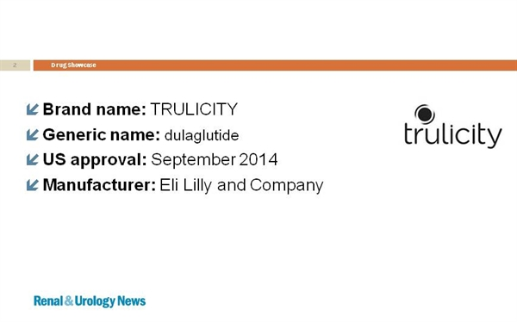

Slide 74
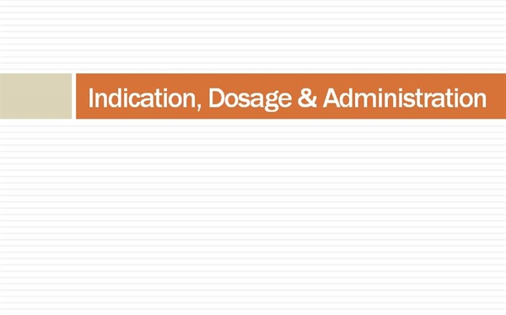

Slide 75
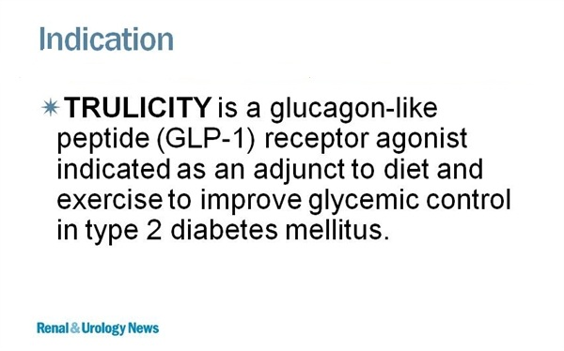

Slide 76


Slide 77
TRULICITY is not recommended as a first-line therapy for patients who have inadequate glycemic control on diet and exercise .
TRULICITY has not been studied in patients with a history of pancreatitis . Consider other antidiabetic therapies in patients with a history of pancreatitis.
TRULICITY should not be used in patients with type 1 diabetes mellitus or for the treatment of diabetic ketoacidosis. TRULICITY is not a substitute for insulin.
TRULICITY has not been studied in patients with severe gastrointestinal disease, including severe gastroparesis. The use of TRULICITY is not recommended in patients with pre-existing severe gastrointestinal disease .
The concurrent use of TRULICITY and basal insulin has not been studied.

Slide 78
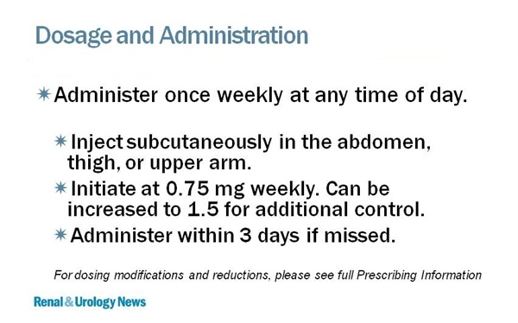

Slide 79
Concomitant Use with an Insulin Secretagogue (e.g., Sulfonylurea) or with Insulin
When initiating TRULICITY, consider reducing the dosage of concomitantly administered insulin secretagogues (e.g., sulfonylureas) or insulin to reduce the risk of hypoglycemia
Dosage in Patients with Renal Impairment
No dose adjustment is recommended in patients with renal impairment including end-stage renal disease (ESRD).
Monitor renal function in patients with renal impairment reporting severe adverse gastrointestinal reactions.

Slide 80
DOSAGE FORMS AND STRENGTHS
• Injection: 0.75 mg/0.5 mL or solution in a single-dose pen
• Injection: 1.5 mg/0.5 mL solution in a single-dose pen
• Injection: 0.75 mg/0.5 mL solution in a single-dose prefilled syringe
• Injection: 1.5 mg/0.5 mL solution in a single-dose prefilled syringe

Slide 81


Slide 82
Medullary Thyroid Carcinoma
TRULICITY is contraindicated in patients with a personal or family history of medullary thyroid carcinoma (MTC) or in patients with (MEN 2)
Hypersensitivity
TRULICITY is contraindicated in patients with a prior serious hypersensitivity reaction to dulaglutide or to any of the product components

Slide 83
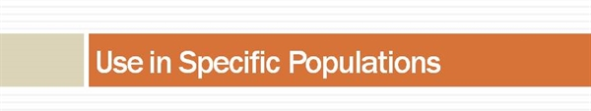

Slide 84
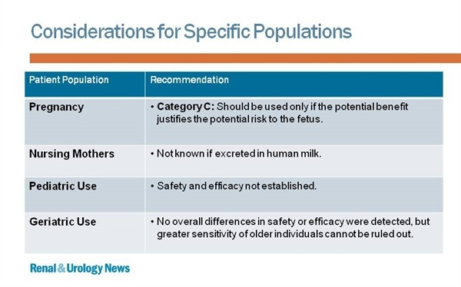

Slide 85
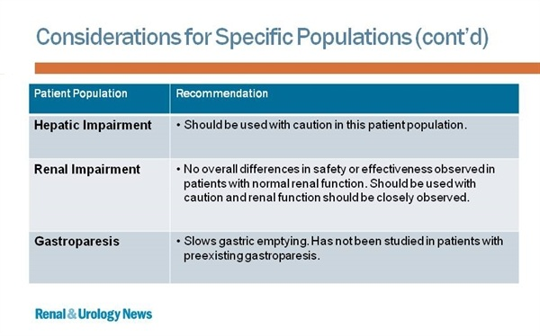

Slide 86


Slide 87
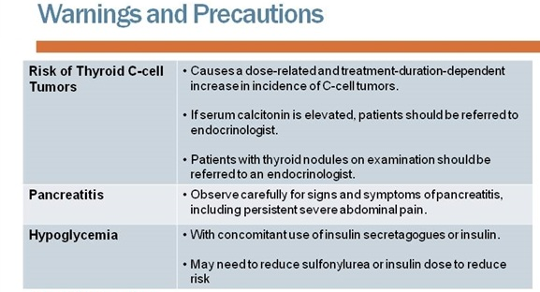

Slide 88
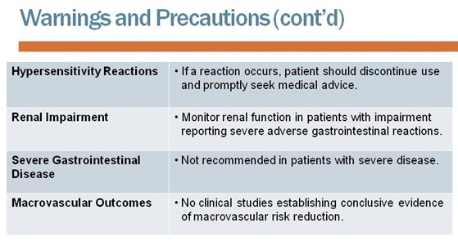

Slide 89
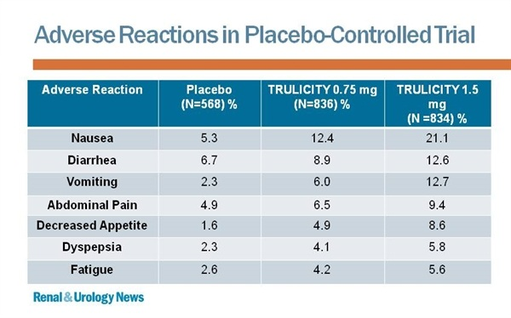

Slide 90
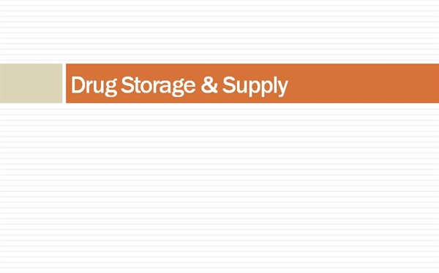

Slide 91
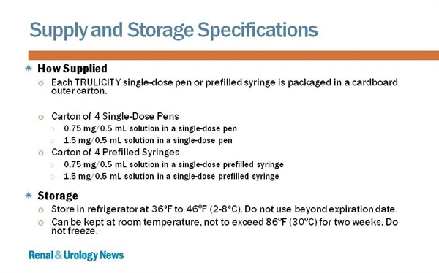

Slide 92

Thank you very much for your attention !

