Slide 1
Diabetic foot
Dr. Mahshid Talebi-Taher, MD, ID.
Infectious Diseases Department
IUMS

Slide 2
The natural history of the diabetic foot can be divided:
• Stage 1: Normal foot
• Stage 2: High-risk foot
• Stage 3: Ulcerated foot
• Stage 4: Infected foot
• Stage 5: Necrotic foot
• Stage 6: Unsalvageable foot

Slide 3
Patients in stages 1 and 2 can be seen in primary care.
Patients in stages 3–5 are best seen in the multidisciplinary diabetic foot clinic.

Slide 4
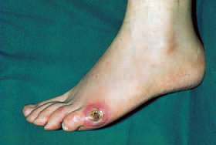
The ulcerated foot:
• Site
• Size
• Appearance of the ulcer and surrounding tissues
• Discharge
• Oedema
• Tenderness
• Smell
• ‘Probe-ability’.

Slide 5
Moist green or yellow slough indicates infection.
Black tissue indicates necrosis
Diffuse redness of the surrounding tissues may indicate infection in both neuropathic and neuroischaemic feet, especially if this is associated with swelling and purulent discharge.

Slide 6
A purplish colour indicates reduced oxygen supply to the tissues, which may result from ischaemia or severe infection or both.
Purulent discharge is indicative of infection.
Increased amounts of clear discharge may be an early indication of infection.

Slide 7
Any smell associated with an ulcer is suggestive of infection.
Oedema around an ulcer is usually suggestive of infection but may be related to ischaemia

Slide 8
Radiography:
1. foreign body
2. clinical signs of infection
3. unexplained pain or swelling
4. the ulcer has been present for longer than 1 month.

Slide 9
Microbiological control:
Bacterial growth in ulcers impedes the wound healing rate.
If the bacterial burden increases there will be bacterial imbalance which may show itself as increased exudate before frank infection develops.
The crucial problem is when to intervene with antibiotics.

Slide 10
Study:
patients with diabetes and clean ulcers associated with peripheral vascular disease and positive ulcer swabs should be considered for early antibiotic treatment.
All swabs taken from diabetic foot ulcers should be deep swabs taken after debridement has been carried out.

Slide 11
curettings and tissue from the base of the ulcer may be a more acceptable microbiological sample compared with the deep ulcer swab.

Slide 12
Cephalexin
Cloxacillin
Clindamycin
Cotrimoxazole
Quinolones

Slide 13
Stage 4 the infected foot:
‘Is’t possible that so short a time Can alter the condition of a man?’
infection can destroy their foot and ruin their life in a remarkably short time.
polymicrobial organisms associated with deep wound infections.

Slide 14
Localized infection
• Spreading infection
• Severe infection

Slide 15
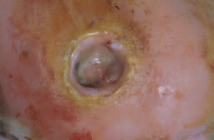
Localized infection
Pain
• Base of the ulcer changes from healthy pink granulations
to yellowish or grey tissue
• Increased friability of granulation tissue
• Increased amount of exudate
• Exudate changes from clear to purulent
• Unpleasant smell
• Sinuses develop in an ulcer

Slide 16
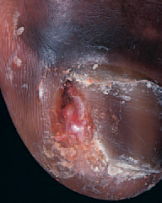
Case study:
A 77-year-old man with type 2 diabetes of 22 years’ duration,
and peripheral vascular
disease
complained of pain

Slide 17
A deep swab was sent for culture and the abscess cavity was irrigated with normal saline and dressed;
Clindamycin were prescribed
wound swab grew Staphylococcus aureus and Streptococcus group B.
The toe healed in 1 month

Slide 18
When the ulcer extends deeply to fascia or tendon:
Ciprofloxacin+clindamycin

Slide 19
Key points
• Pain may be the sole manifestation of infection in the diabetic neuroischaemic foot.
Infection in the neuroischaemic foot may not be associated with swelling.

Slide 20
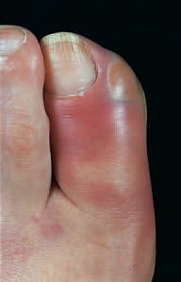
Spreadng infection:

Slide 21
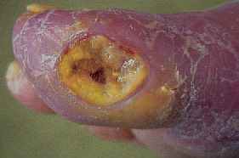

Slide 22
CASE STUDY
A 35-year-old woman with type 2 diabetes of 10 years’ duration treated with insulin, and severe neuropathy presented unwell with nausea and shivering.

Slide 23
She was admitted to hospital and given intravenous ceftazidime 1 g tds+clindamycin.
Ulcer swab grew Staphylococcus aureus and Streptococcus group B
Cloxacillin continued.
Infection resolved within 5 days, and she was discharged for follow-up in the diabetic foot clinic.

Slide 24
Key points
• Lymphangitis is an important sign of spreading sepsis
There may be no pyrexia and no pain in cases of spreading infection of the diabetic foot

Slide 25
Ciprofloxacin and clindamycin
• Piperacillin/tazobactam
• Meropenem
• Imipenem
• Tigecyline

Slide 26
Severe infection
This refers to ulcers with extensive deep soft tissue infection and also infected feet with blue or purple discolouration of tissues.
This stage may also be associated with septicaemia, with the patient presenting with hypotension and organ failure.

Slide 27
These people need intravenous antibiotics, immediate hospital admission and an urgent surgical opinion regarding the necessity of surgical drainage.
Palpation may reveal fluctuance, suggesting abscess formation.

Slide 28
Purple blebs may indicate subcutaneous necrosis.
when a fever is present it usually indicates a severe infection, and the deep spaces of the foot are usually involved with tissue necrosis, severe cellulitis and possible bacteraemia

Slide 29
Severe infections are often polymicrobial and both Gram-positive and Gram-negative organisms are present together with anaerobes.

Slide 30
Severe subcutaneous infection by Gram-negative and anaerobic organisms produces gas, which may be detected by palpating crepitus on the lower limb and can be seen on X-ray.
The presence of gas does not automatically mean that the classical gas gangrene organism Clostridium perfringens is present.

Slide 31
CASE STUDY
A 50-year-old man with type 1 diabetes for 30 years and a renal transplant, suffered a spontaneous rupture of his Achilles tendon and was treated in another hospital in a plaster cast.
He noted staining from discharge within the cast and came up to the diabetic foot clinic.
The cast was removed,

Slide 32
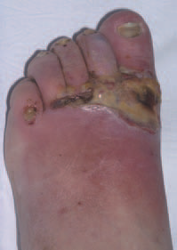

Slide 33
He was admitted for intravenous antibiotics, clindamycin+ceftazidime 1 g tds.
The deep wound swab grew Staphylococcus aureus and the antibiotics were reduced cloxacillin.

Slide 34
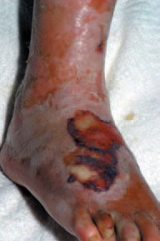

Slide 35
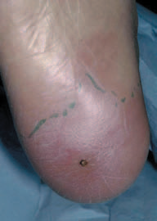
Case study:
Puncture wound in immunocompromised patient.

Slide 36
Key points
• Diabetic patients are immunosuppressed and do not respond appropriately to infection.
This is exacerbated when the patient has other autoimmune diseases or is on immunosuppressant therapy.
Diabetic patients with foot infections in such circumstances demand very close surveillance.

Slide 37
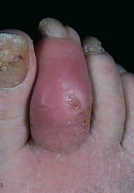
Osteomyelitis
X.Ray
MRI
Bone BX.

Slide 38
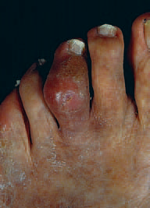

Slide 39
Fusiform swelling (sausage toe) and erythema are frequently associated with osteomyelitis and X-rays are needed to confirm the extent of the infection in the bone and monitor progress.

Slide 40
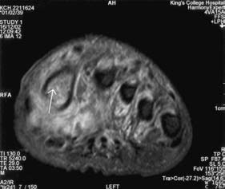
Case study:
Small
collection of fluid between the
extensor hallucis
longus tendon and the metatarsophalangeal
joint/proximal phalanx
of the big toe.

Slide 41
an empirical regimewith good bone penetration should be given such as
Clindamycin 600 mg tds and ciprofloxacin 500 mg bd.
Antibiotics should be given for at least 12 weeks.
if the infected bone is resected then a shorter course of antibiotics such as 4 weeks may be necessary.

Slide 42
MANAGEMENT OF INFECTION:
Which antibiotics should be prescribed?
Will antibiotics alone control the infection or will surgery also be necessary?

Slide 43
Principles of antibiotic treatment:
Infection can be caused by Gram-positive aerobic, and Gram-negative aerobic and anaerobic bacteria, singly or in combination.
When Gram negative bacteria are isolated from a deep ulcer swab or curettings they should not, therefore, be regarded as automatically insignificant.

Slide 44
at initial presentation it is important to prescribe a wide spectrum of antibiotics for three reasons:
Rapid progression
MO?
diabetic patients are immunosuppressed(As Louis Pasteur said: ‘The germ is nothing. It is the terrain in which it grows that is everything’).

Slide 45
The route by which therapy is given will depend on the severity of the infection.
oral therapy for localized infections, intramuscular or intravenous therapy for spreading infections and
intravenous therapy for severe infections. Intestinal absorption is unreliable in these circumstances

Slide 46
Antibiotics used mainly against Gram-positive organisms:
Amoxicillin
Cloxacillin
Co-amoxiclav
Clarithromycin-clindamycin
Doxycycline
Rifampin(should not be given alone because resistance can develop rapidly).

Slide 47
cotrimoxazole
Vancomycin
Teicoplanin
Linezolid(It should not be given for more than 28 days).

Slide 48
Antibiotics used mainly against Gram-negative organisms:
Ciprofloxacin
Ceph 3,4
Ag

Slide 49
Indications for surgery
A large area of infected sloughy tissue
Localized fluctuance and expression of pus
Crepitus with gas in the soft tissues on X-ray
•Blue or purplish discolouration of the skin.

