Slide 1


Slide 2
Mohammad Afkhami-Ardekani MD
Professor of Endocrinology and Metabolism
Shad Sadoughi University of Medical Siences
14 NOV 2018

Slide 3
Neuroendocrine Tumors
(NETs)

Slide 4
Case report 1:
A 47-year-old man, with a past medical history significant for seizure disorder. He denied any epigastric discomfort, weight loss, dysphasia, nausea, emesis, constipation, or diarrhea.
Organomegaly was appreciated with the liver edge to be estimated 8-10 cm below the costal margin.
Ultrasound revealed hepatomegaly with diffusely inhomogeneous echotexture and splenomegaly.

Slide 5
The appearance of the liver was suggestive of extensive metastatic disease.
There was also a large mass extending towards the tail of the pancreas.
A core needle biopsy of the liver was obtained, Mild nuclear pleomorphism was present.
The results showed positivity for chromograninA
A diagnosis of Neuroendocrine carcinoma was made at this time.

Slide 6
Case report 2:
A 70-year-old man complained of left flank pain.
Abdominal computed tomography (CT) revealed a 6.8-cm lobulated solid mass in the liver dome.
He did not have any other symptoms such as jaundice, vomiting, flushing, or diarrhea before admission.
Liver magnetic resonance imaging (MRI) revealed a lobulated mass with mild hypervascularity.

Slide 7
The resected specimen revealed a solid tumor measuring 8.3 cm × 6.5 cm.
The result show postive for Chromogranin A.
A diagnosis of Neuroendocrine carcinoma was made at this time.

Slide 8
Case report 3:
A 61-years old man known with hypertension presented for syncopes , seizure and abdomen discomfort.
Blood Sugar = 41 mg/dl (hypoglycemia).
The cranial computed tomography (CT) did not reveal any damage.
The abdominal CT revealed no pathological changes in the abdomen.
During hospitalization the blood glucose fasting levels were found again between 30 and 50 mg/dl.

Slide 9
The following were determined:
the C peptide, insulin and glycated hemoglobin, which were normal and did not support the diagnosis of insulinoma.
After a month the patient came back for persistent symptoms.
Blood tests showed 39 to 59 mg/dl glucose levels.
decided to perform the abdominal magnetic resonance imaging (MRI) with contrast, and discovered a 21 mm hypervascular tumor of the pancreas.
the patient to reffered the surgery department, tumor was excised.

Slide 10
The pathology showed that the chromogranin A was positive.
A diagnosis of Neuroendocrine carcinoma was made at this time.

Slide 11
Neuroendocrine tumors are a group of nonhomogeneous malignancies arising from different organs.
The tumors secrete wide range of substances.
Some of the clinical and pathologic features of these tumors are characteristic of the organ of origin,

Slide 12
The term “karzinoid” (carcinoma-like) was first described by Oberndorfer in 1907; since then, remarkable advances in understanding and management of these tumors have taken place.
By naming (karzinoide) or cancer like neoplasm, earlier investigators believed that the tumors are not real cancers.

Slide 13
In 1963, Williams and Sandler classified the tumors according to their embryologic site of origin as foregut, midgut, and hindgut tumor.

Slide 14
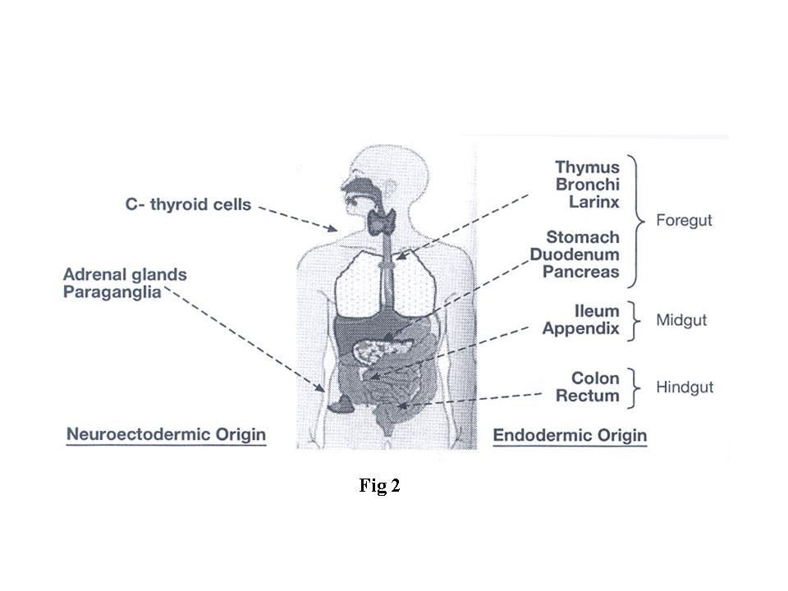
NET distribution.jpg

Slide 15
According to the 2010 WHO classification, neuroendocrine neoplasms were divided into G1, G2, and G3 or neuroendocrine carcinoma based on cell proliferation.
The traditional term carcinoid is still being used for lung NETs.

Slide 16
Grading of the tumor is determined by counting mitotic figures in 10 high power fields(HPF) in combination with presence or absence of necrosis.
Counting mitotic figures is very time consuming and prone to sever inter observer variability, hence Ki67 labeling index was proposed as a substitute.
The classification helped in making estimates on tumor prognosis and clinical course.

Slide 17
According to the criteria, gastro-enter-pancreatic NETs were classified as:
Grade Ki67
G1 <2%
G2 3–20%
G3 > 20%.
The index has emerged as a gold standard and a predictor of prognosis.

Slide 18
In 2015, WHO classified lung tumors as:
Ki67
Typical carcinoid 5% (low grade)
Atypical carcinoid >20% (intermediate grade)
Poorly differ carcinoma 40-100% (high grade)
(Poorly differentiated carcinoma is divided into small cell and large cell carcinoma)

Slide 19
Improved diagnostic tools and increased knowledge about the tumors has led to increased incidence of the neoplasms.

Slide 20
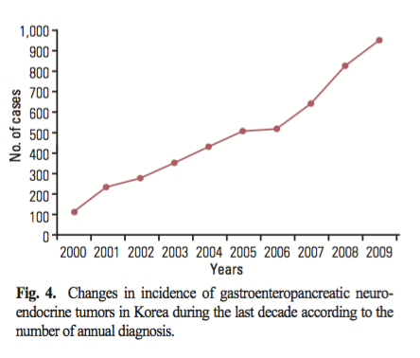

Slide 21
The tumors can be either functional or nonfunctional.
Thirty to 50% of the NETs are functional.
Functioning tumors present with symptoms related to the secretion of hormones.
Nonfunctional tumors may be discovered incidentally or because of the mass effect.

Slide 22
Diagnosis:
The NET patients present with protean pictures.
NET should be kept in mind in clinical scenarios such as:
Flushing, Longstanding GI symptoms, Hemoptysis, Hypercalcemia, Unexplained weight loss, Wheezing, Hypoglycemia, Multiple liver metastases and Skin disorder.

Slide 23
Chromogranin A (Cg A) is elevated in approximately 90% of gut NETs and correlates with tumor burden and recurrence.
CgA is more frequently elevated in well-differentiated tumors compared to poorly differentiated NETs.
Effective treatment is often associated with decrease in CgA levels.
Proton pump inhibitors falsely increase CgA, but levels normalize with therapy cessation.

Slide 24
Selection of the imaging technic is also based on clinical findings.
Computerized tomographic scanning (CT) and MRI are the most preferred technics.

Slide 25
Overexpression of somatostatin receptors by the NETs has been successfully used to image both the primary tumor and the tumor extent, using primarily 111In- labeled-somatostatin analogs or 68Ga-labeled somatostatin analogs.
At present, the use of 68Ga-labeled somatostatin analogs with positron emission tomography and computed tomographic scanning (PET/CT) is the most sensitive imaging modality available for these tumors.

Slide 26
Multi-disciplinary approach is the mainstay in management of neuroendocrine tumors.
Anytime the tumor is resectable, surgical excision is the treatment of choice(Debulking) .
Overall survival after surgery depends upon tumor grade.

Slide 27
Medical management of metastatic or inoperable NETs:
Somatostatin analogues, Octreotide-LAR, Lanreotide.
Serotonin-synthesis inhibitors, Pasireotide.
Tyrosine-kinase inhibitors Sunitinib.
Angiogenesis targeting agents Bevacizumab.
Another treatments: Chemo-embolization.
Peptide radio-receptor-therapy(PRRT)
131I- MIBG, ablation .
.

Slide 28
The drugs act by interfering with different steps of cellular proliferation and prevent tumor growth.
While NETs are highly vascular and express high amounts of vascular endothelial growth factor(VEGF), agents targeting angiogenesis (Bevacizumab) are also promising.

Slide 29
One of the main problems in decision making is the lack of long term control trials with acceptable number of patients.
Due to indolent course of some NETs, it is not easy to differentiate between effects of drugs and natural course of the disease.

Slide 30
Directions for future research:
There are many questions about etiology, pathogenesis and therapeutic strategies of NETs.
These questions will likely be best answered with advancing our knowledge in basic science and also in the setting of large randomized clinical trials with participation of acceptable numbers of patients.

