Slide 2
روش هاي درماني جديد
در ديابت
Highlights from ADA Annual Meeting 2011
دكتر فريدون عزيزي
پژوهشكده علوم غدد درون ريز و متابوليسم
دانشگاه علوم پزشكي شهيد بهشتي
تابستان 1390

Slide 3
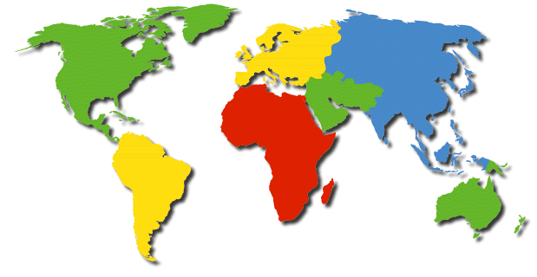
Diabetes: A Worldwide Epidemic
Global Projections 1995-2025
22.0
32.9
50%
62.8
132.3
111%
13.0
17.5
35%
7.3
14.1
93%
12.4
22.5
81%
0.9
1.3
44%
World
1995 = 118 million 2010 = 221 million (Increase 87% )
2025=300 million
(Americas 13.8-42.8, Eastern Med. 13.8-42.8)

Slide 4
Management of Diabetes Mellitus
Although it initially focuses on dietary and lifestyle modification, invariably requires pharmacological intervention and, in the majority of patients, requires combination therapy with two or more antithyperglycaemic drugs with complementary modes of action.

Slide 5
درمـــان ديـــابــت
سال 1378(1999)
سال 1383 (2004)
سال 1390 (2011)

Slide 6
Glycemic Control
There are now some 14 classes of antithyperglycemic agents available for the treatment of type 2 diabetes patients. Appropriate use of these agents in combination with lifestyle measure should allow more patients to achieve glycemic goals with better safety and tolerability.

Slide 7
ســـال 1378 (1999)
سولفانيل اوره ها و متفورمين
ورود Rosiglitazone
Pioglitazone
Repaglinide

Slide 8
Case
A 54-year-old man who comes as a new patient
My doctor told me 2 years ago that I had type 2 diabetes. Not sure exactly why as felt great. He said something about screening I didn’t understand. He told me to diet and exercise. I wasn’t too good at that- and then a few months later said I needed medicine. He gave me glibenclamide 10 mg twice a day. I don’t like it. I’ve gained 4 kg, and I used to feel weak and listless when played football. Now, my doctor says that the medicine isn’t working any more.
Meds: Glibenclamide 10 mg twice daily, enalapril 5 mg once daily.

Slide 9
Case Cont.
FH: Father and 2 brothers have type 2 DM
ROS: Feels OK; reasonable energy; no nocturia, CV or pulmonary complaints, erectile dysfunction, or foot trouble.
SH: Nonsmoker. No formal diet or exercise plan. Does not do HBGM.
PE: Anxious; P 88, BP 154/84 mmHg; wt 90 kg; ht 165 cm; BMI 30 kg/m; waist circumference 108 cm; otherwise unremarkable
Lab:
  HbA1c- 7.9%
  Cr- 1.0 mg/dl
  TC- 231 mg/dl; TG- 340 mg/dl; HDL- 28 mg/dl; LDL- 135 mg/dl
  Normal electrolytes, LFTs, and high-normal uric acid

Slide 10
Case Cont.
Patients asks “I have a lot of questions, do I really have diabetes? I don’t feel bad. Both my brothers with diabetes feel lousy”.
“I glanced at the paperwork from your doctor. His screening 2 years ago showed:
    FBG- 150 mg/dl
    OGT- 2-h blood glucose 247 mg/dl
Also your A1c has been above 7% for awhile, and my testing today is 7.9%.
The criteria to diagnose diabetes was changed a couple of year ago, and yes, you do have diabetes”.

Slide 11
1997 Diagnosis of Diabetes Mellitus
FPG≥126 mg/dL (7 mmol/L)
OR
2-h PG 75 g OGTT ≥ 200 mg/dL (10 mmol/L)
OR
Casual PG ≥ 200 mg/dL (10 mmol/L) PLUS symptoms of diabetes (polyuria, polydipsia, unexplained weight loss)
Confirmation using the same or another criteria

Slide 12
1997 Diagnosis of Diabetes Mellitus
FPG≥126 mg/dL (7 mmol/L)
OR
2-h PG 75 g OGTT ≥ 200 mg/dL (10 mmol/L)
OR
Casual PG ≥ 200 mg/dL (10 mmol/L) PLUS symptoms of diabetes (polyuria, polydipsia, unexplained weight loss)
Confirmation using the same or another criteria
Cutoff for FPG and prediabetes became 100 mg/dL in 2004)
(A1c testing added in 2010 with 5.7% for prediabetes and 6.5 for DM)
Prediabetes 110-125 mg/dL
Prediabetes 140-199 mg/dL

Slide 13
1997 Diagnosis of Diabetes Mellitus
No major risk factor, FPG every 3 years beginning at age 45 years
Any risk factor, screen earlier and more often:
    Overweight- BMI ≥ 25 kg/m2
    1st degree relative with DM
    High risk ethnic group
    Hypertension (≥ 140/90 mm Hg)
    HDL ≤ 35 mg/dl and/or triglycerides ≥ 250 mg/dl
    History of gestaional diabetes or delivered baby > 9 lb
    Polycystic ovary syndrome
    (History of vascular disease)
    (Habitual physical inactivity)

Slide 14
Case Cont.
He then asks “OK, but why do I have to be on medicine? I fell well. And I didn’t like the glibelclamide. Plus he tells me its not working any more. Aren’t there any other chocies?

Slide 15
What therapy you advise?
DC glibenclamide + lifestyle change
DC glibenclamide + start metformin
DC glibenclamide + start glutazone
Replace repaglinide
Add metformin or glutazone

Slide 16
UKPDS
SU and insulin impact on Complications
Lancet. 1998;352:837-853

Slide 17
UKPDS
Weight Gain and Hypoglycemia
Lancet. 1998;352:837-853

Slide 18
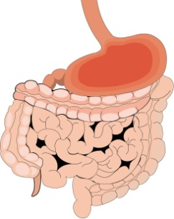
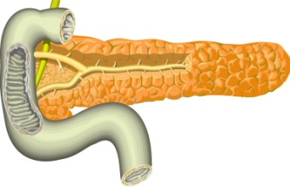
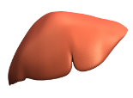
Therapy for Type 2 Diabetes: Sites of Action
Pancreas
Gut
Impaired insulin secretion
Excess dietary carbohydrate
Sulfonylurea
Repaglinide
Nateglinide
Exogenous Insulin
Acarbose
Miglitol
Liver
Muscle
Excess glucose production
Insulin resistance
Metformin
Rosiglitazone
Pioglitazone

Slide 19
Metformin
Works through an unknown mechanism to lower hepatic glucose production
Contraindications:
        Renal: Cr ≥ 1.4 female; ≥ 1.5 male
        High lactate production: CHF, COPD
        Reduced lactate clearance: liver disease, chronic alcohol use
Positives:
    Typically weight-neutral
    Improve metabolic lipid abnormalities
    No hypoglycemia
Side effects:
    Gastrointestinal- dose dependent
    Lactic acidosis- rare if used appropriately

Slide 20
Metformin as Monotherapy
 | Metformin (n=143) | Placebo (n=146)
HbA1c (%) | 8.4 → 7.0 | 8.2 → 8.6
FPG (mg/dL) | 241→ 189 | 238 → 244
Postprandial PG (mg/dL) | 347 → 275 | 337 → 337
Weight (Kg) | - 0.6 Kg | - 1.1 Kg
LDL (mg/dL) | 136 → 123 | 138 → 135
TG (mg/dL) | 209 → 193 | 185 → 191
850 mg three times daily for 24 weeks in newly treated patients.
DeFronzo RA, Goodman AM. N Engl J Med. 1995;333:541-549

Slide 21
UKPDS
Metformin Impact on Complications
Lancet. 1998;352:837-853

Slide 22
UKPDS
Progressive Failure of Monotherapy
9
Overweight patients in the UKPDS – year 1975…
8
Conventional
Median A1C (%)
Glibenclamide
Metformin
7
ADA goal 7%
Insulin
6
Upper limit of normal 6.2%
0
0
2
4
6
8
10
Years from randomisation
UK Prospective Diabetes Study (UKPDS) Group. Lancet. 1998;352:854-865.
Notes:
22
Slide 16
UKPDS METFORMIN SUBSTUDY
Intensive Treatments and A1C
The overweight patients in the United Kingdom Prospective Diabetes Study (UKPDS) who were randomised to the intensive policy group and treated with a sulphonylurea (chlorpropamide or glibenclamide), insulin, or metformin were followed for a median of 10.7 years. All patients in this group experienced an initial decline in median A1C in contrast to patients in the conventional policy group, who experienced a rise in median A1C throughout the study period; no differences in median A1C were observed among patients randomised to different treatments (chlorpropamide, glibenclamide, metformin, or insulin). By year 7 of follow-up, the median A1C among all treatment groups in the intensive policy arm was above the study baseline. By year 10, the median A1C of patients in both conventional and intensive treatment policy arms was above 8%
UK Prospective Diabetes Study (UKPDS) Group. Effect of intensive blood-glucose control with metformin on complications in overweight patients with type 2 diabetes (UKPDS 34). Lancet.1998;352:854-865

Slide 23
Progressive Loss of β-Cell Function in Type 2 Diabetes
At diagnosis patient with T2DM has half the β-Cells as a person without T2DM
100
Time of Diagnosis
?
?
80
?
?
60
?
_______________________________
β-Cell Function (% β)
Pancreatic function
~ 50% of normal
40
20
0
−10
−9
−8
−7
−6
−5
−4
−3
−2
−1
0
1
2
3
4
5
6
Years
Adapted from UK Prospective Diabetes Study (UKPDS) Group. Diabetes. 1995; 44:1249.

Slide 24
Rosiglitazone as Monotherapy
 | Rosiglitazone (n=169) | Placebo (n=158)
HbA1c <7 % | 30% | 5%
FPG (mg/dL) | 220→ 166 | 229 → 210
Weight (Kg) | + 3.5 Kg | - 1.0 Kg
LDL (mg/dL) | 124 → 147 | 121 → 123
TG (mg/dL) | 45 → 46 | 43 → 45
26 weeks 4 mg twice daily vs. placebo
Lebovitz HE, et al. J Clin Endocrinol Metab. 2001;86:280-288

Slide 25
Case Cont
”So it’s not time to stop your medication, or even switch to something else. My best advice is to add metformin or one of the TZDs.”
He says “OK. But I hope this is the end of it. I’m tired of worrying about this diabetes stuff.”
“Unfortunately no. So far we’re only talking about protecting you against the microvascular problems. There’s a lot of talk going on about Syndrome X- some people call it the metabolic syndrome. There’s more and more evidence that we need to also work on weight reduction, exercise, your blood pressure and cholesterol to protect you against heart attacks and strokes.”

Slide 26
Summary- in 1999 (1378), We ….
Had recently redefined how to diagnose and screen for prediabetes and diabetes
Learned from the UKPDS that:
        Drug therapy typically fails, and the reason is the pathophysiology of the disease- β- cell failure
        There is no perfect drug
        BP control is powerful to protect against micro and macrovascular complications
        DM control mostly for microvascular complications- A1c goal 7%
We had SUs and lots of new drugs:
    All with modest effectiveness and troubling side effects
    Diverse sites of action allowed combination drug therapy
Starting to think about the metabolic syndrome and multifactorial theaopy-total protection against DM complications

Slide 27
What would we do in the year 1383 (2004)
What was new as compared to 1999 (1378)
Major advances …
The long-acting insulin analog glargine was introduced to the market in 2000
The treat-to-Target study in 2003 provided evidence for the efficacy of basal insulin replacement provided carful titration was made

Slide 28
Inappropriate Pharmacokinetics of NPH
        Peak effect
        Relatively short duration
            Nocturnal hypoglycaemia
            Fasting hyperglycamia
High variability in SC absorption
    Wide blood glucose fluctuations from day-to-day

Slide 29

Glucose Infusion Rate
4.0
3.0
2.0
1.0
0
sc insulin
n=20 T1DM
Mean ± SEM
24
20
16
12
8
4
0
NPH
mg/Kg/min
mol/Kg/min
Glargine
µ
0 4 8 12 16 20 24
Time (hours)
Lepore M. et al., Diabetes 49: 2142-8, 2000

Slide 30
Clinical Case
Male, 64 years old
T2DM × 15 years
BMI = 30 kg/m2
Hypertension, dyslipidemia
History- IHD; PCI to LAD 1379,
Nephropathy-GFR 38 mL/min; alb/Cr 105 mg/gm
HBA1c = 10.5%
Physical activity moderate
Weight stable

Slide 31
Diabetes Drugs
Glimepiride 4 mg once daily
Metformin 850 mg three times daily
Other drugs:
    ACE-I (Begun 2003)
    Statin
    Aspirin

Slide 32
Treatment Options
Add basal insulin and maintain oral treatment
Add basal insulin and change oral treatment
Discontinue glimepiride and add pre-mix insulin twice daily

Slide 33
24-Hour Plasma Glucose Curve
400
Diabetic
T2
300
Glucose
(mg/dL)
200
Normal
100
0
0600
1000
1400
1800
2200
0200
0600
courtesy of Jay Skyler
adapted from Polonsky et al, N Engl J Med 1988
Time of Day
Notes:
33
Slide 1-22
24-Hour Plasma Glucose Curve: Normal and
Type 2 Diabetic Subjects
This study of 16 untreated type 2 diabetic patients versus 14 matched control subjects showed higher plasma glucose levels for diabetic patients both under fasting conditions and in response to meals.
Both during fasting and in response to meals, the glucose levels were 2.5-fold to 3-fold higher in the diabetic patients than in the nondiabetic control subjects (P<0.0001). The 24-hour glucose level in the control subjects averaged about 110 mg/dL, compared with 282 mg/dL in patients with diabetes (P<0.0001). While the glucose level was significantly higher in diabetic patients, there was no significant difference between the diabetic patients and control subjects with regard to the basal and mean 24-hour insulin and C-peptide levels, as the next slide shows. In the diabetic patients, the pulses of insulin in response to glucose had significantly smaller amplitude and were less frequently in line with the glucose pulse, resulting in higher levels of plasma glucose.
The sluggish and irregular insulin pulse response to glucose in these type 2 diabetic patients suggests that the pathology is primarily a disturbance in the amount and temporal coordination of beta-cell function.
(Polonsky, 1988)

Slide 34
Proof of concept: Treat-to-Target Srudy
Combinination Oral Agents + Glargine vs. NPH

Slide 35
Treatment Options
After 6 months on up-titration of basal insulin with metformin and glimepiride, his FBG on average is 105 mg/dl but his HbA1c is 7.6%

Slide 36
What should be the next step?
Patient is at goal, no further modification is needed
Discontinue basal insulin and initiate Mix insulin twice daily
Initiate bolus insulin

Slide 37
Evolving Insulin Strategy in T2DM
Glulisine
Lispro
Aspart
Insulin Effect
Glargine (OD)
Detemir or NPH
(OD / BID)
meal
meal
meal
bedtime

Slide 38
Intensive Therapy With Pre-Mixes
Inferior to Basal-Bolus Regimen
Baseline
Pre-mixes
End of study
Basal-bolus
Glargine +Glulisine
Fritsche A,et al.Diabetes Obes Metab.2010:12;115-123

Slide 39
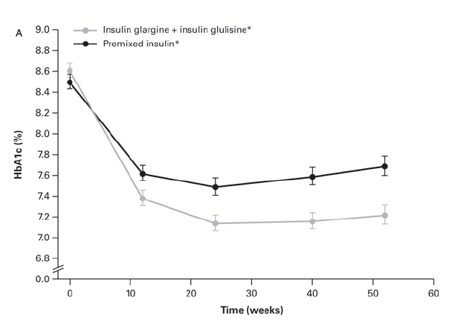
Intensive Therapy With Pre-Mixes
Inferior to Basal-Bolus Regimen
Pre-mixes
Basal-bolus
Glargine +Glulisine
Proportion of subjects with HbA1c < 7.0 %
- Basal-bolus 68 %
- Premixes 43 %
Hypoglycemia
- p=NS between the 2 treatments
Fritsche A,et al.Diabetes Obes Metab.2010:12;115-123

Slide 40
In T2DM
USE INSULIN ….
…. According to the rule of the
5 M’s

Slide 41
In T2DM, USE INSULIN …
More (in more patients)
More Promptly (at diagnosis, or shortly therafter)
More Physiologically (prefer basal insulin first, add prandial later as needed- do not mix …)
More aggressively (treat to target)
and
More safely (minimize hypoglycaemia)

Slide 42
Conclusion
Failure to oral agents is common in T2 DM
Introdution of insulin is effective, but;
Addition of prandial insulin is also effective, but;
Insulin should be introduce very early in T2 DM

Slide 43
Pharmacotherapy:
The retrospective and prospective views
1390
(2011)

Slide 44
عمل آوري سلول هاي بتا براي درمان ديابت
اگرچه از نظر تئوري استفاده از سلول هاي بنيادي و به ويژه سلول هاي بنيادي جنيني ذهن پژوهشگران را به خود معطوف نموده، مطالعه هاي متعددي در دهه ي گذشته انجام شده است، و ادامه تجربه هاي حيواني آن مي تواند اميدوار كننده باشد، اما هنوز به عنوان يك روش درماني براي ديابت نوع 1 در مراحل اوليه بررسي و پژوهش است و به مرتفع شدن بسياي از سئوال ها و اشكال ها نياز دارد. اثر اين روش درماني در عدم نياز بيماران به مصرف انسولين در طولاني مدت هنوز به اثبات نرسيده است و ظرفيت ايجاد عوارض جدي به ويژه تراتوم ها و نيز مسايل اخلاقي متعدد هنوز مورد بحث است كه انجام اين روش را محدود به سطح پژوهش نگه داشته است.
McCall MD, et al. Clinical Sciences 2010; 118: 87-97
عزيزي و زاهدي. مجله غدد درون ريز و متابوليسم ايران؛ دوره 11، شماره 6، صفحات 611-614، سال 1388

Slide 45
Case 1
54-y/o male with T2DM of 4 years’ duration presently taking metformin 500 mg thrice daily
HTN Tx’ed with losartan 100 mg plus hydrocholorthiazole 25 mg daily
Has begun to notice some mild-to-moderate burining in the soles of the feet, worse at night and when on his feet for prolonged periods
Denies swelling of the limbs or other cardiovascular symptomatology
BP 134/82 mmHg

Slide 46
Labs
HbA1c | 7.9%
FPG | 133 mg/dl
LDL- cholesterol | 105 mg/dl
HDL- cholesterol | 38 mg/dl
Triglycerides | 182 mg/dl
Creatinine | 0.9 mg/dl
Urinary albumin/creatinine | 18 mg/g

Slide 47
What to do when metformin alone is insufficient
Add sulfonylurea
Add DPP-4
Add GLP-1 RA
Add Glutazone
Add Basal insulin

Slide 48
Difficulties in Achieving Target A1c values
Challenges
    Late diagnosis and initiation of therapy
    Therapeutic inertia
    Lack of effective lifestyle intervention
    Secondary failure
    Role of posparandial glucose in failure
    Adverse events associated with antihyperglycemic therapies
    Complexity of care

Slide 49
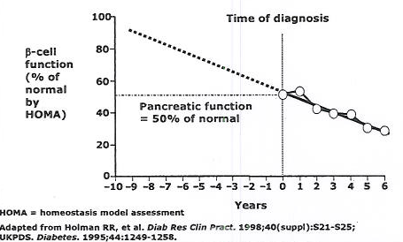
Decline of β-cell Function
Illustrates Progression of Diabetes

Slide 50
Sulfonylureas
Three generations
Differ largely in terms of adverse effects and drug interactions

Slide 51
Insulin Secretagogues:
Sulfonylureas, Meglitinides,
Phenylalanine Derivatives
Increase basal and/or postprandial insulin levels
Depend on functional β-cells
Decrease HbA1c 1%-2%
Dosing:
    Sulfonylureas: 1-2 times daily
    Meglitinides, D-phenylalanine derivatives: three-four times daily
Side effects: weight gain, rare allergy, hypoglycemia

Slide 52
Sulfonylureas and CHD
No benefit in randomized trials
Increased CHD in UGDP
Increased MACE outcomes post-CABG (BARI 2D)
Potential interaction with basal insulin (ACCORD)
In ADVANCE, triple the risk of MACE and mortality with hypoglycemia

Slide 53
Hypoglycemia in ADVANCE
11, 140 patients with high CHD risk
Intensive treatment with gliclazide
Goal HbA1c= 6.5%
Severe hypoglycemia: 2.7% (INT)/1.5% (CON)
Minor hypo (<50 mg/dl or S+S)= 52% (INT) 37% (CON)
RR or severe hypo for MACE= 2.88
RR of severe hypo for CHD mortality and total mortality= 2.69 (p<0.001)
Zoungas S, et al. N Engl J Med. 2010; 363: 1410-1418

Slide 54
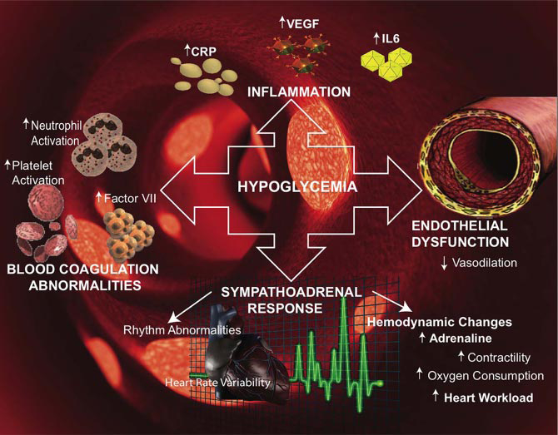
Hypoglycaemia and Cardiovascular Risk
Desouza CV,Bolli GB,Fonseca V. Diabetes Care.2010;33:1389-1394

Slide 55
Patterns of Glucose, Insulin, and Glucagon in Type 2 Diabetes

Slide 56
Incretins System
In vivo, dipeptidyl peptidase (DPP) IV is the enzyme responsible for the initial rapid cleavage of the incretion hormones glucagon-like peptide-1 (GLP-1) and glucose-dependent insulinotropic polypeptide (GIP). GLP-1 and GIP physiologically enhance glucose-stimulated insulin secretion and maintain normal glucose tolerance after a meal.

Slide 57
GLP-1 Receptors are expressed ubiquitously
GLP-1 receptors have been detected in:
  Pancreatic islets
  Heart and endothelium
  Gastric glands
  GI tract
  Central and peripheral
  Nervous system
  Lung
  Kidney
GLP-1 has been shown to have effects on:
  Glucose homeostasis
  Weight homeostasis
  Blood pressure
  Myocardium
  Endothelium
  Water and electrolyte homeostasis

Slide 58
Incretins and Diabetes
In type 2 diabetes, the actions of both incretin hormones are impaired, although exogenous GLP-1 (but not GIP) still possesses its insulinotropic and glucagonostatic effects on the pancreatic islets. Raising GLP-1 concentrations either by using an injectable long-acting GLP-1 receptor agonist or by inhibiting the cleavage and degradation of endogenous GLP-1 with DPP IV inhibitors leads to an improvement in glycemic parameters.

Slide 59
Incretin System
Therapies that target the incretin system have characteristics that provide the potential to address several often unmet treatment needs including:
Improved glycemia
Weight maintence or loss
Low risk for hypoglycemia
Low risk for edema
Reduction of postprandial hyperglycemia.

Slide 60
GLP-1 Based Therapy
Clinical trial evidence supports the use of GLP-1 receptor agonists and DPP-4 inhibitors in combination with existing classes of glucose-lowing agents (eg, metformin, sulfonylureas, and thiazolidinediones). Initial comparative trials have demonstrated that GLP-1 receptor agonists have somewhat greater glucose-lowering efficacy and are associated with decreases in appetite and caloric intake, that lead to weight loss (in contrast to the more weight neutral effects of DPP-4 inhibitors).

Slide 61
GLP-1 Based Therapy
Emerging data also suggest a potential role for GLP-1 receptor agoinists in combination with insulin therapy, although this is still investigational. Sitagliptin is approved to the used in combination with insulin.

Slide 62
Genetic Determinants
The insulinotropic activity of GLP-1 depends on the presence or absence of certain common polymorphisms of the GLP-1 receptor gene. This may predict a better or worse clinical response to incretin-based medications (GLP-1 receptor agonists or incretin mimetics and inhibitors of dipeptidyl peptidase-4 [DPP-4], so-called incretin enhancers) and thus may help select a glucose-lowering drug tailored to the individual needs of a given patient.
Sathananthan A, et al. Diabetes Care. 2010; 33: 2074-2076.

Slide 63
Levels of GLP-1 with Liraglutide Are Pharmacologic and Levels with a DPP-4 Inhibitor are Physiologic

Slide 64
Mean HbA1c Change After Liraglutide or sitagliptin

Slide 65
Mean Body Weight Change With Liraglutide and Sitagliptin

Slide 66
Exenatide + Oral Agents Reduces A1C Level
Study Characteristics | Combination Agent | A1C change exenatide* | A1C change PBO
N= 377, 30 weeks Baseline A1C= 8.6% | SU | -0.9† | -0.1
N= 336, 30 weeks Baseline A1C= 8.2% | Met | -0.8† | -0.1
N= 733, 30 weeks Baseline A1C= 8.5% | SU + Met | -0.8† | -0.2
N= 233, 30 weeks Baseline A1C= 7.9% | TZD ± Met‡ | -0.9† | -0.1
N= 165, 30 weeks Baseline A1C= 8.2% | TZD ± Met | -0.8 | -0.1
* 10 μg twice daily; † p<0.05 vs placeboy ; ‡ 79% of patients on both. PBO, placebo; SU, sutfonylurea; Met, metformin; TZD, thiazxolidinedione. Buse JB et al. Diabetes Care. 2004;27(11): 2628-2635; DeFronzo RA et al. Diabetes Care. 2005;28(5):1092-1100; Liutkus J. Diabetes Obes Metab. 2010; 12(12): 1058-1065.

Slide 67
Case 2
62-y/o female with T2DM of 9.5 years’ duration
Presently taking metformin 500 mg thrice daily and insulin glargine 38 U q AM
Also taking simvastatin 40 mg q AM and an ARB Plus CCB of HTN
Takes her medicines regularly but hates to do blood glucose monitoring since it hurts her fingers and costs a lot
Has no complaints but notices that her sugar is usually high

Slide 68
Labs
HbA1c | 7.6%
FPG | 123 mg/dl
LDL- cholesterol | 83 mg/dl
Creatinine | 0.7 mg/dl
Urinary albumin/creatinine | 45 mg/g

Slide 69
Therapeutic Options
Add mealtime insulin
Add incretin therapy
      Oral DPP-4
      Injectaple GLP-1 analogue

Slide 70
Change in HbA1c When Adding GLP-1-Based Therapies to Insulin and Metformin
Arnolds S, et al. Diabetes Care. 2010;33:1509-1515

Slide 71
Change in Body Weight When Adding GLP-1 Based Therapies to Insulin and Metformin
Arnolds S, et al. Diabetes Care. 2010;33:1509-1515

Slide 72
Incidence of Hypoglycemia
Arnolds S, et al. Diabetes Care. 2010;33:1509-1515

Slide 73
Conclusions
In 2011 (1390)
The problem of hypoglycemia has become a paramount consideration
Weight gain from therapy has become undesirable
Metformin is now nearly universal first-line therapy
Central issue of how best to advance therapy beyond metformin + basal insulin

Slide 74
14 classes of Antihyperglycemic Agents for Treatment of Type 2 Diabetes Mellitus (T2DM)
Class | A1C Reduction | Hypoglycemia | Weight change | Dosing (times/day) | Other safety issues
Metformin | 1.5 | No | Neutral | 2 | GL, lactic acidosis, B12 deficiency
Long-acting insulin | 1.5-2.5 | Yes | Gain | 1, injected
Repid-acting insulin | 1.5-2.5 | Yes | Gain | 1-4, injected
Sutfonylureas | 1.5 | Yes | Gain | 1 | Allergies, secondary failure
Thiasilldinediones | 0.5-1.4 | No | Gain | 1 | Edema, CHF, bone fractures
GLP-1 receptor agonists (short) | 0.5-1.0 | No | Loss | 2, injected | GI, pancreatitis, ARF
Long-acting GLP-1 receptor agonists | ~1.5 | No | Loss | 1, injected | GI, pancreatitis, ?MTC, ?ARF
Repaglinide | 1-1.5 | Yes | Gain | 3
Nateglinide | 0.5-0.8 | Rare | Gain | 3
Alpha-glucosioase inhibitor | 0.5-0.8 | No | Neutral | 3 | GI
Amylln mimetics | 0.5-1.0 | No | Loss | 3, injected | GI
DPP-4 inhibitors | 0.6-0.8 | No | Neutral | 1 | Pancreatitis
Bile acid sequestrant | 0.5 | No | Neutral | 1-2 | GI
Bromocriptine Quick Release | 0.7 | No | Neutral | 1 | GI
Adapted from: Nathan DM et al. Diabetes Care. 2007; 30(3):753-759. Nathan DM et al. Diabetes Care 2006;29(8): 1963-1972. Nathan DM et al. Diabetes Care. 2009; 32(1): 193-203. ADA. Diabetes Care. 2008;31: S12-S54. Welchol PI. 1/2008. Cycloset PI. 5/2009. Buse J et al. Lancet. 2009; 37(9683):39-47.

Slide 75
ADA/EASD Consensus recommendations: Treatment algorithm for T2DM
Lifestyle + Met
+Basal insulin
Lifestyle+ Met
+intensive insulin
At diqgnoises:
Lifestyle
+ Met
Lifestyle+ Met
+SU*
Step 1
Step 2
Step 3
Lifestyle +Met
+Pioglitazone
Lifestyle +Met
+Pioglitazone
+SU*
Lifestyle +Met
+GLP-1 agonist †
Lifestyle +Met
+Basal insulin
Reinforce lifestyle interventions at every visit; check A1C level every 3 mo until A1C level is <7% and then at least every 6 mo. The interventions should be changed if A1C level is ≥7%
Nathan DM, et al. Diabetes Car 2009; 32: 193-203

Slide 76
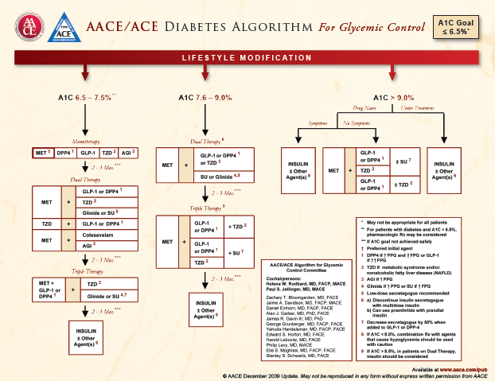

Slide 77


Slide 78
GLP-1 Agonists: Drug interactiosn
Increased risk of hypoglycemia when administered to patients taking sulfonylureas
    - Consider lowering SU dose
Exenatide: Related to slowing of gastric emptying
    Can reduce extent and rate of absorption of orally administered drugs. Should be used with caution in patients receiving oral medications with narrow therapeutic index or that require rapid gastrointestinal absorption
    For oral medications dependent on threshold concentrations for efficacy, such as contraceptive and antibiotics, take those drugs at least 1 hour before exenatide

Slide 79
GLP-1 Agonists: Drug interactiosn
Liraglutide: Related to slowing of gastric emptying
    Caution when oral medications are concomitantly administered in clinical pharmacology trials.
    However, liraglutide did not affect absorption of the tested orally administered medications to any clinically relevant degree.

Slide 80
GLP-1 Agonists: Drug interactiosn
Liraglutide: Related to slowing of gastric emptying
    Caution when oral medications are concomitantly administered in clinical pharmacology trials.
    However, liraglutide did not affect absorption of the tested orally administered medications to any clinically relevant degree.

Slide 81
Exenatide: Dosage and use
Avaliable in 5 and 10 mcg, fixed-dose pen devices
To minimize potential GI effects, start with 5 mcg bid for 30 days
Should be administered 30 min to 1 h before meals, at least 6 hr apart
Change the needle before each use

Slide 82
Mean HbA1c Change After Liraglutide or Sitagliptin
سركار خانم پورزرگر

Slide 83
Liraglutide: Dosage and Use
Avaliable as pen sets
    2 or 3 prefilled, multidose pens per set
    Each individual pen delivers dose of 0.6 mg, 1.2 mg, or 1.8 mg (0.6 mg/ml, 3 ml)
    Disposable pen needles are sold separately (may require Rx)
Once-daily dosing
Inject at any time, independent of mealtimes (preferably the same time each day)
To minimize potential GI effects, start with 0.6 mg daily
After at least 1 week, increase dose to 1.2 mg
    Some patients expected to benefit from increase in dose (1.2 mg to 1.8 mg); based on clinical response after 1 week, dose can be increased to 1.8 mg to further improve glycemic control

Slide 84
Case
A 54-year-old man who comes as a new patient
My doctor told me 2 years ago that I had type 2 diabetes. Not sure exactly why as felt great. He said something about screening I didn’t understand. He told me to diet and exercise- I wasn’t too good at that- and then a few months later said I needed medicine. He gave me glibenclamide 10 mg twice a day. I don’t like it. I’ve gained 10 lbs, and I used to feel weak and listless when played football, not so because the medicine isn’t working any more.
PMH glibenclamide 10 mg twice daily, enalapril 5 mg once daily.

Slide 85
Case 2
62-y/o female with T2DM of 9.5 years’ duration
Presently taking metformin 500 mg thrice daily and insulin glargine 38 U q AM
Also taking simvastatin 40 mg q AM and an ARB plus CCB for HTN
Takes her medicines regularly but hates to her fingers and costs a lot
Has no complaints but notices that her sugar is usually high

Slide 86
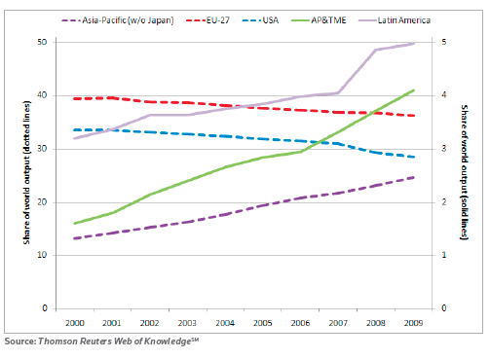
Fig. 1. Regional changes in share (%) of world outputs recorded on Thomson Reuters Web of KnowledgeSM. Note that the left-hand axis for the established regional economies has a scale ten times that for the emerging economies on the right-hand axis.

Slide 87
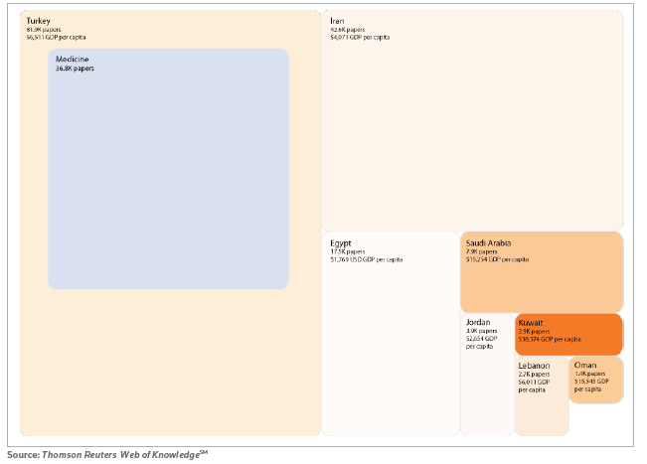
Fig. 2. Countries in the Arabian, Persian & Turkish Middle East scaled according to their five-year publication output (2005-2009) with an indication of their relative wealth as GDP per capita population

Slide 88
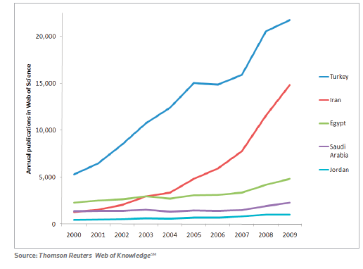
Fig. 3. Annual research publication output of the five most prolific countries in the Arabian, Persian & Turkish Middle East. Turkey and Iran, two of the five countries that produce more than 1,000 papers annually, also show a marked annual growth rate. Egypt, Saudi Arabia and Jordan have a substantial output but this is not growing at the same rate as the two leading countries

Slide 89
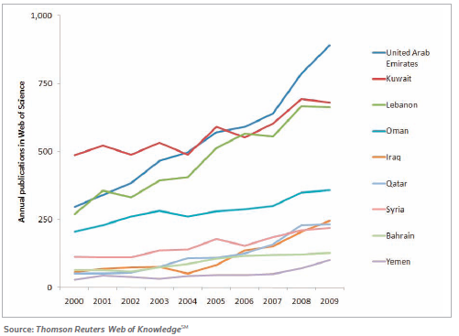
Fig. 4. Annual research publication output of nine less prolific nations in the Arabian, Persian & Turkish Middle East. Although current annual output is below 1,000 papers per year for these countries, growth rates are rising. This is particularly noticeable for the United Arab Emirates

Slide 90
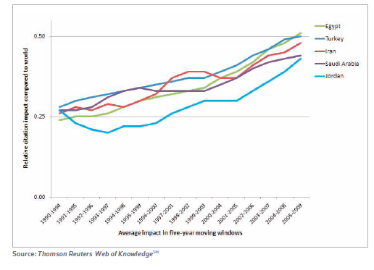
Fig. 5. The Relative Citation Impact of the five most publication-prolific countries in the Arabian, Persian & Turkish Middle East, tracked in five-year overlapping periods since 1990. Although the average citation impact of much of the research in the region remains below world average (which is set at 1.00) it is evident that the impact trend is upwards for all these countries

Slide 91
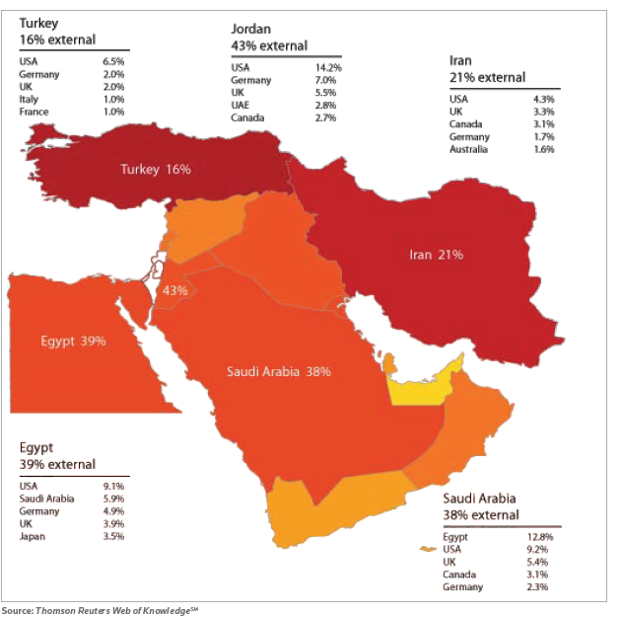
Fig. 6. Top collaborating partners for the five most prolific research publishing nations in the Arabian, Persian & Turkish Middle East. Color intensity reflects research output volume, with deeper colors corresponding to greater output. The numbers in each country refer to the percentage of national output that has an international co-author. Note that the figure of 43%, near the centre of the map, refers to Jordan (table at top of map)

Slide 92
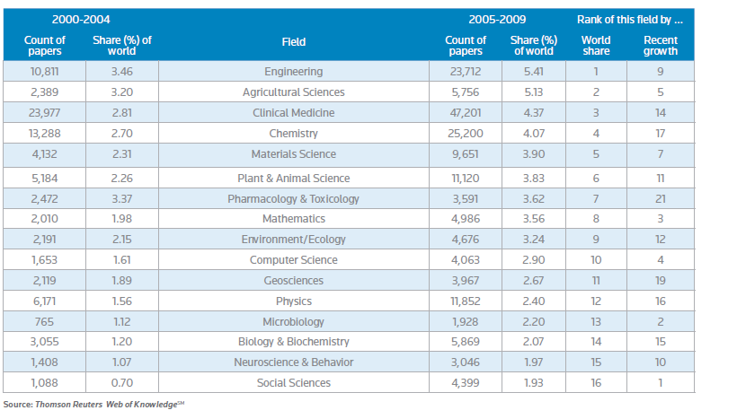
Table 1. Fields of research ranked by global share (% of world output on Thomson Reuters Web of KnowledgeSM) for 2005-2009 held by the group of 14 nations in the Arabian, Persian & Turkish Middle East. Note that growth rates (the difference between the five-year periods 2000-2004 and 2005-2009) are not dependent on the current world share. The research portfolio is dynamic

Slide 93
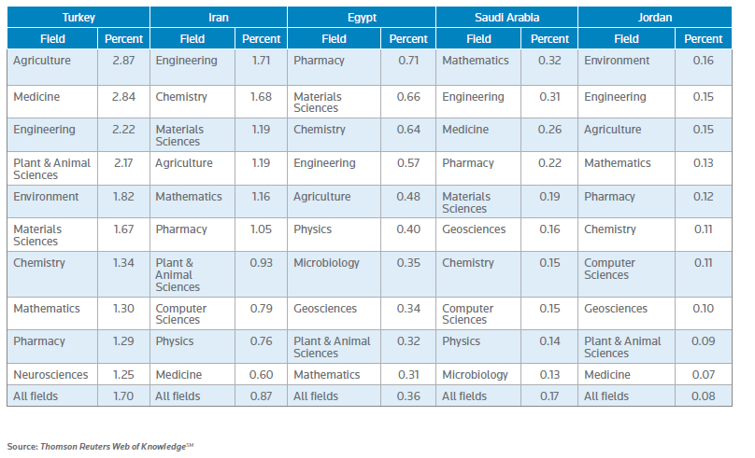
Table 2. Global share of research output (% world papers on Thomson Reuters Web of KnowledgeSM) for the five most research-prolific countries in the Arabian, Persian & Turkish Middle East, analyzing the fields in which they are individually best represented

