Slide 1
In the name of god
Therapeutics of vitamin D
December 12,2022
Ameneh Ahmadi, MD
Research Institute for Endocrine Sciences, Shahid Beheshti University of Medical Sciences

Slide 2
European Journal of Endocrinology (2018)

Slide 3
introduction
The central role of vitamin D in bone health is well recognized.
We aimed to review the definition of hypovitaminosis D, the skeletal and extra-skeletal effects of vitamin D and the available therapeutic modalities.

Slide 4
Questions relating to areas of agreement
Is vitamin D3 superior to D2? – Pharmacokinetics, clinical data.
What is the role for 25-hydroxyvitamin D in replacement and its availability?
Is there a place for active vitamin D metabolites in treating vitamin deficiency?
Is daily dosing of vitamin D preferred to larger weekly, monthly or annual doses?
Does the baseline level of serum 25-hydroxyvitamin D influence the choice and frequency of dose?
Does BMI or race influence the dose or mode of administration?
What is the role of fortification in increasing vitamin D?
How much is too much vitamin D? • What adverse outcomes are important?

Slide 5
Sources and production of vitamin D
Vitamin D is fat-soluble
Vitamin D has more than 50 metabolites
Vitamin D exists in two major forms, vitamin D2 and vitamin D3

Slide 6
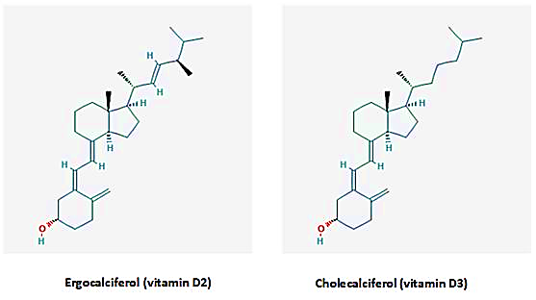
Sources and production of vitamin D

Slide 7
Sources and production of vitamin D
vitamin D2 contributes lower affinity for (VDBP)
vitamin D2 has a limited conversion to 25 hydroxyvitamin D, and an altered catabolism by 24-hydroxyase.
vitamin D3 is more potent at raising serum 25(OH)D concentrations than is vitamin D2.

Slide 8
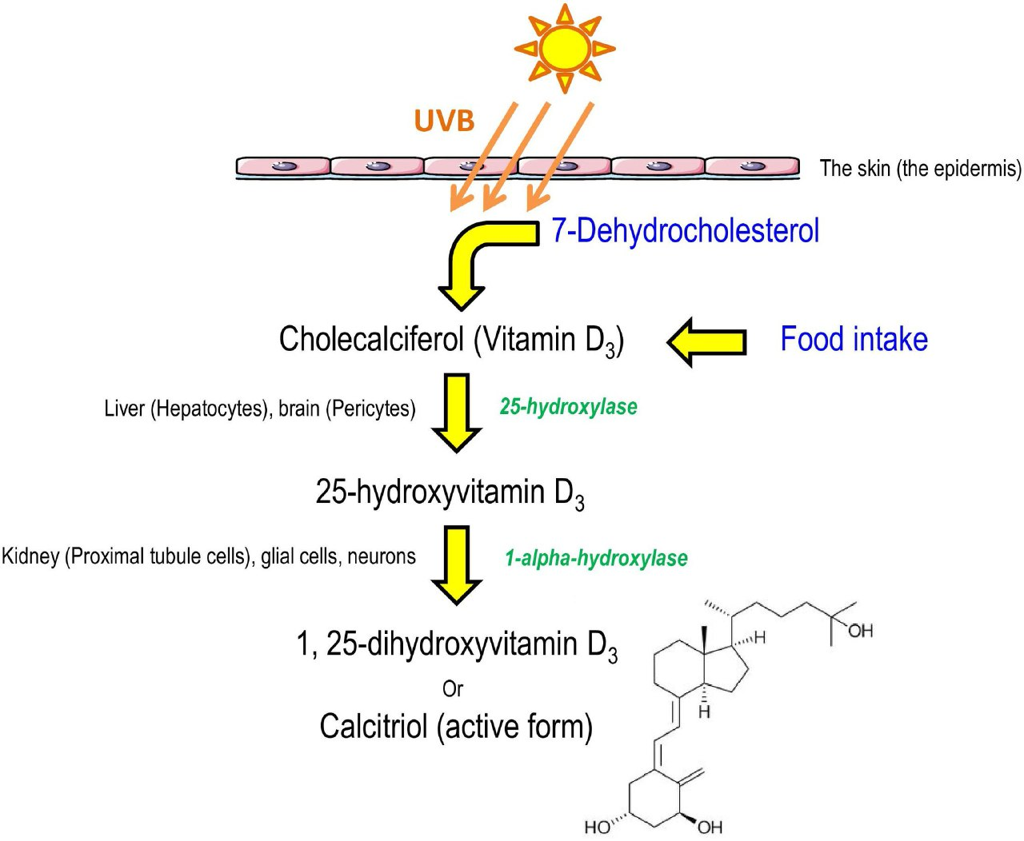
Type and source of vitamin D
Skin is the major source of cholecalciferol in humans,
personal and environmental factors reduce the skin production of vitamin D,
low UVB availability, which is dependent, in part, on latitude, season, time of day and extent of air pollution.

Slide 9
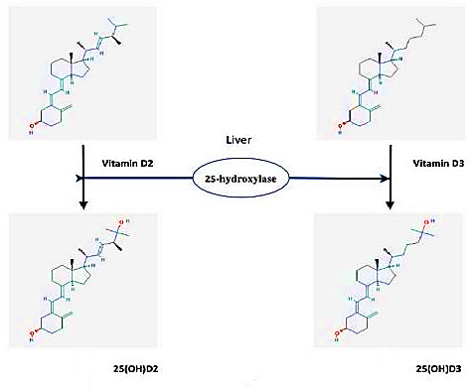
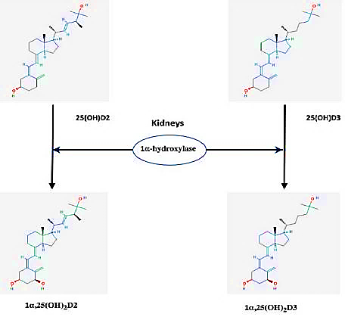
Vitamin D metabolism
first step
second step

Slide 10
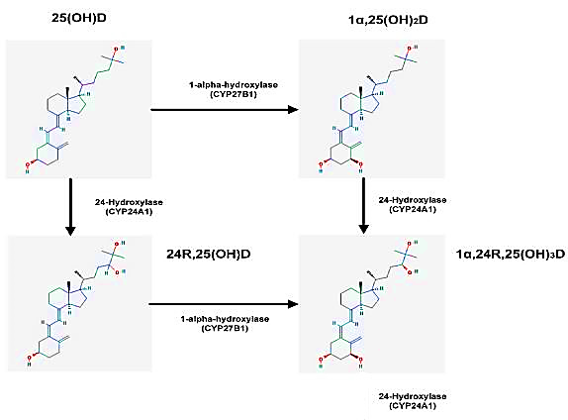
Catabolism

Slide 11
reference ranges for total serum 25-hydroxyvitamin D
Laboratories reference ranges for total serum 25-hydroxyvitamin D
<10 ng/ml | Sever deficiency
10-24 ng/ml | Mild to moderate deficiency
25-80 ng/ml | Optimal
<80 ng/ml | Possible toxicity

Slide 12
Type and source of vitamin D
suggesting either vitamin D2 or vitamin D3
meta-analysis of double-blind RCTs
Vitamin D dose of > 4800 IU/day (D3 23% lowered fractures but D2 not)
vitamin D plus calcium (lowered hip fracture)

Slide 13
Type and source of vitamin D
Conditions in which the administration of calcidiol may be preferable to cholecalciferol
liver disease in whom the hepatic hydroxylation of vitamin D is impaired
in the setting of glucocorticoid induced inhibition of hepatic 25-hydroxylase
CKD
Nephrotic syndrome
in obese patients due to its greater hydrophilic properties
in cases of fat malabsorption
Other conditions (e.g., typeⅠDM, transplant recipients)

Slide 14
Daily needs of vitamin d
Daily vitamin D supplement of 400IU should be provided to all infants and a slightly higher dose (600IU) (for small children; usually up to the age of 4 years).
Similarly, in view of the high prevalence of vitamin D deficiency in older individuals, a daily intake of 600–800IU is recommended.

Slide 15
Dietary reference intakes for vitamin d
Upper level intake u/d | Dietary allowance u/d | Average requirement u/d | Life stage group
1000 | - | - | Infants 0-6 months
1500 | - | - | Infants 6-12 months
- | 600 | 400 | 14-18 yr.old
4000 | 600 | 400 | 19-30 yr.old
4000 | 600 | 400 | 31-50 yr.old
4000 | 600 | 400 | 51-70 yr.old males
4000 | 600 | 400 | 51-70 yr.old females
4000 | 800 | 400 | <70 yr.old
4000 | 600 | 400 | 14-18 yr.old preg/lactation
4000 | 600 | 400 | 19-50 yr.old preg/lactation

Slide 16
Mode of administration and dose
vitamin D increases serum 25-hydroxyvitamin D levels, but the increment depends upon both body weight and the baseline serum 25-hydroxyvitamin D concentration.
Body weight affects the serum 25-hydroxyvitamin D response to both loading and maintenance doses of vitamin D.
Lower baseline serum 25-hydroxyvitamin D levels are associated with larger increases in serum 25-hydroxyvitamin D for a given dose of vitamin D.

Slide 17
Loading doses
At very high loading doses of vitamin D the efficiency of conversion of vitamin D into 25-hydroxyvitamin D is much lower than when more physiologic doses are used.
Total loading dose of 700–1000µg or 30–40 000IU of vitamin D3 should be sufficient to replace near total absence of vitamin D to normal 25-hydroxyvitamin D concentrations (20–30ng/mL; 50–75nmol/L).

Slide 18
Loading doses
treated severely vitamin D-deficient subjects with one of several loading regimens:
25-hydroxyvitamin D levels | Total dose | Loading dose
48.3±13 | 100 000IU | 25000 IU q2 weeks for 8 weeks
63.6±27.5 | 150 000IU | 25000 IU q week for 6 weeks
89.7±26.9 | 200 000IU | 25000 IU q week for 8 weeks
. Earlier, van Groningen et al.

Slide 19
Loading doses
The change in 25-hydroxyvitamin D was significantly related to the dose per kg body weight and is described by the following formula:
∆25-HydroxyvitaminD=0.025× (dose per kg body weight )
However, they recommended that the formula should not be used in subjects with body weights >125kg
No adverse effects in any subject was reported

Slide 20
oral or intramuscular administrations
300000 IU of
D3 or D2
D3
47.8±7.3ng/ml
By oral
15.9±11.3ng/ml
By IM
D2
15.9±11.3
By oral
5±4.4ng/ml
By IM
Romagnoli et al.

Slide 21
Maintenance doses
The serum 25-hydroxyvitamin D responses to maintenance doses of vitamin D are also influenced by body weight.
Gallagher et al. (treated 163 postmenopausal for1yr 0-4800 IU/day)
(BMI ≥30) (25(OH)D =17.8nmol/l lower than normal weight)
(BMI <25)

Slide 22
Maintenance doses
Dose frequency –daily, weekly, monthly
Ish-Shalom et al study.
dose of D3 (equivalent to 1500IU per day)
Binkley et al study.
64 healthy older adults treated with 1600IU daily and 50 000IU per month over a 1-year period.

Slide 23
Maintenance doses
Dietary fat and vitamin D absorption
30% greater when the supplement is taken with a meal containing fat
Variables that influence dosing and levels
Race (in certain races (e.g. blacks))
Culture

Slide 24
Specific therapeutic areas relating to vitamin D
Vitamin D in primary hyperparathyroidism
hypoparathyroidism
Bariatric surgery
Chronic kidney disease

Slide 25
Primary hyperparathyroidism
the best definition of a normal 25-hydroxyvitamin D level, it seems prudent, with some evidence to back it up, that levels should be aimed at >30ng/mL (75nmol/L) in primary hyperparathyroidism

Slide 26
Hypoparathyroidism
Vitamin D metabolism is abnormal in hypoparathyroidism because PTH is an important facilitator of vitamin D activation
daily doses of 1,25-dihydroxyvitamin D (calcitriol) 0.25µg to as much as 4µg.

Slide 27
Bariatric surgery
Bariatric surgery procedures for obesity classified in three groups:
restrictive
malabsorptive
combination of the two
the Roux-en-Y gastric bypass seems to carry the highest risk of vitamin D deficiency
the intramuscular route of vitamin D administration may be effective, especially in obese individuals undergoing malabsorptive procedures.

Slide 28
Chronic kidney disease
The use of calcitriol and active vitamin D analogues should be reserved for use in patients with CKD Grades 4 or 5 with severe and progressive secondary hyperparathyroidism.
CKD grade 5, and requiring PTH-lowering therapy, the guidelines recommend the use of calcimimetics, calcitriol or vitamin D analogues, or their combination.

Slide 29
Recent major and ongoing vitamin D RCTs
A literature search revealed 475 publications from January 1, 2013 to June 12, 2017.
The primary end-points of these published RCTs included the following health outcomes:
Frailty and falls, CVD, maternal and infant health, musculoskeletal diseases, type 2 diabetes mellitus, cancer, critical illness, osteoarthritis of the knee, respiratory diseases, infection and immunity.

Slide 30
Frailty and falls
A 12-month, double-blind trial of 200 ambulatory men and women (mean age 78 years)
24000 IU/month
cholecalciferol
Falls 48%
60000 IU/month
cholecalciferol
Chair stands less improvement
Falls 67%
24000 IU cholecalciferol
+
300µg calcifediol
Falls 66%
Chair stands less improvement

Slide 31
Systolic hypertension
A double-blind, placebo controlled trial of 159 men and women (mean age 77 years) with vitamin D deficiency and baseline systolic blood pressure (SBP) >140mmHg at baseline given 100 000IU cholecalciferol at baseline, and at 3, 6 and 9 months.
The change in SBP was not different (−0.7mmHg ).
There was no difference in pulse wave velocity, blood lipids, inflammatory markers or insulin sensitivity.

Slide 32
CVD
placebo-controlled trial (ViDAL) enrolled 5108 participants (58% male; mean age 65.9 years) treated with a 200000IU loading dose of cholecalciferol followed by monthly 100000IU doses for a median of 3.3 years.
Only ~25% of participants were vitamin D deficient at baseline.
There was no difference in incidence of CVD between groups.

Slide 33
Maternal/infant health
A large double-blind, placebo controlled trial of 1135 women (mean age 30 years) recruited at 14-week gestation were treated with 1000IU cholecalciferol per day vs placebo .
The plasma 25-hydroxyvitamin D increased significantly, by 22.9nmol/L, in the supplementation group, but did not change in the placebo group.
There were no differences in BMC, BMD, lean mass or fat mass in infants at birth.

Slide 34
Musculoskeletal
the ViDAL Study of 5108 participants (58% male; mean age 65.9 years)
treated with a 200000IU loading dose of cholecalciferol followed by monthly 100 000IU doses for a median 3.3 years.
Only ~25% of participants were vitamin D deficient at baseline.
only 17 hip fractures occurred; no calcium supplements were given.
Reported falls were no different: 1312 (52%) vitamin D vs 1326 (53%) placebo.

Slide 35
Musculoskeletal
33 randomized trials (participants aged >50 years)
showed no significant association of either calcium or vitamin D with risk of hip fracture compared with placebo or no treatment .

Slide 36
Body composition
Placebo-controlled trial of 218 postmenopausal women (mean age 60 years)
serum 25-hydroxyvitamin D between 10 and 32ng/mL
were treated with 2000IU cholecalciferol per day vs placebo for 12 months
All participants underwent a diet and exercise weight loss program.
Vitamin D supplementation resulted in greater rates of spinal bone loss and decreases in leg strength.

Slide 37
Diabetes mellitus
A double-blind, placebo-controlled trial was conducted in 275 adults with type 2 diabetes mellitus, serum HbA1c ≤8.0% and stable for 3 months.
No significant differences were seen in other indicators of glycemic control and anthropometric variables.
There was no effect of vitamin D on diabetes control in this short duration trial.

Slide 38
Cancer
In a large double-blind, placebo-controlled trial of 2303 postmenopausal women (mean age 65 years), subjects were treated with 2000IU cholecalciferol per day and 1500mg per day of calcium or placebo for 4 years.
A new diagnosis of cancer was confirmed in 45 (3.9%) in the vitamin D group and 64 (5.6%) in placebo.

Slide 39
Acute respiratory infections
smaller meta-analysis of 15 trials including 7053 individuals did not show an effect of vitamin D in reducing acute respiratory tract infections,
Vitamin D reduced the risk of acute respiratory tract infections (RTIs) among all participants.

Slide 40
Knee osteoarthritis
In a double-blind, placebo controlled trial, 413 adults, aged 50–79 years, were treated with 50 000IU cholecalciferol per month or placebo for 2 years.
Vitamin D supplementation therefore had no effect on either pain score or cartilage volume in patients with knee osteoarthritis.

Slide 41
Knee osteoarthritis
Two recent systematic reviews and meta analyses of the effects of vitamin D supplementation on knee osteoarthritis, in four RCTs involving 1136 patients, showed vitamin D supplementation of more than 2000IU vitamin D3 per day
resulted in small decreases in the WOMAC pain score and function in patients with knee OA.

Slide 42
fracture risk
In a prospective observational study in 1662 elderly men followed over a period of 4 years,
risk of fracture in men with either 25(OH)D values below 36 nmol/L or above 75 nmol/L was increased.
Whether vitamin D, calcium or both supplements together are efective for the primary prevention of fractures is still debated.

Slide 43
fracture risk
In a Cochrane review
vitamin D alone did not prevent hip fractures or any fractures.
the combination of vitamin D and calcium reduced the incidence of hip fractures by 16% based on 9 studies in almost 50,000 patients.

Slide 44
fracture risk
In French study vitamin D and calcium reduced the incidence of hip and of non-vertebral fractures.
In contrast, in an English study did not show a significant decrease in the incidence of fractures at the hip or at other sites.

Slide 45
fracture risk
In the ViDA trial in New Zealand, a monthly administration of 100,000 IU of vitamin D over about 3 years, after a loading dose of 200,000 IU, did not prevent fractures.
Furthermore, an increase in falls and fractures was also previously observed with an annual high bolus of 500,000 IU of vitamin D

Slide 46
fracture risk
Many meta-analyses including various numbers of trials, hence of subjects,
In that of Bolland et al. which included 81 studies but with only 6% of vitamin D-deficient subjects at baseline
supplementation of vitamin D alone was not associated with a reduction of the incidence of total and hip fractures as well as of falls.

Slide 47
fracture risk
In the meta-analysis of Yao et al.
The combination of vitamin D and calcium supplementation, led to a 6% reduction in the risk of any fracture and a 16% reduction of hip fractures.

Slide 48
conclusions
Vitamin D3 treatment results in larger increases in serum 25OHD than does vitamin D2.
Calcidiol is more effective in patients with advanced liver disease.
alfacalcidol is recommended (patients with renal insufficiency and secondary hyperparathyroidism)
avoiding large annual or monthly doses of vitamin D is recommended in the elderly.
Basal serum 25OHD level, BMI and race affect increasing of serum 25OHD.
vitamin D overdosing (e.g. 50 000 IU given per day (25OHD (>250nmol/L)).

Slide 49
conclusions
High doses of vitamin D increases percentage of falls.
Vitamin D supplementation in pregnancy is useful. in women who deliver in winter could improve BMC of the baby.
Vitamin D has no effect on body composition, Diabetes mellitus, Cancer, Systolic hypertension, CVD
Vitamin D reduced the risk of acute respiratory tract infections.
There is currently a lack of evidence to support the use of vitamin D supplementation in preventing the progression of knee OA.
The combination of vitamin D and calcium reduced the incidence of hip fractures by 16% based on 9 studies

Slide 50
Thank You!

