Slide 1
ACTH stimulation tests for the diagnosis of adrenal insufficiency: an update
Azam Erfanifar, MD
Research Institute for Endocrine Sciences
Shahid Beheshti university of medical science
July11, 2016
Tehran

Slide 2
Agenda
Introduction
Review of one Meta_Analysis & systematic review ACTH stimulation tests for the diagnosis of adrenal insufficiency
Review of articles The utility of the corticotropin test to diagnose adrenal insufficiency in critical illness: an update
Brief review of two guidelines: 1) Diagnosis and treatment of primary adrenal insufficiency:An Endocrine Society Clinical Practice Guideline
2)Guidelines for diagnosis and treatment of adrenal insufficiency in adults
Answers to the clinical questions

Slide 3
References
1. Adrenal insuffi ciency
Evangelia Charmandari, Nicolas C Nicolaides, George P Chrousos
Lancet 2014; 383: 2152–67 ,Published Online,February 4, 2014
2.Diagnosis &management of adrenal insufficiency
The lancet diabetes & endocrinology.2015;3(3):216-226
3. Adrenal Cortical Insufficiency—a Life
Threatening Illness With Multiple Etiologies
Marcus Quinkler, Felix Beuschlein, Stefanie Hahner, Gesine Meyer,Christof Schöfl, Günter K. Stalla. Deutsches Ärzteblatt International | Dtsch Arztebl Int 2013; 110(51–52): 882−8
4. Adrenal insufficiency
Wiebke Arlt, Bruno Allolio
THE LANCET • Vol 361 • May 31, 2003 • www.thelancet.com

Slide 4
What is the basic classification of Adrenal Failure?
Basic classification of Adrenal failure (Adreno-Cortical Hypo-function) depends on location of lesion: (Fig. 1)
Primary Adrenal Failure or Primary Adrenal Insufficiency (Addison's Disease) is due to:
Failure of Adrenal Gland due to destruction of Gland;
Cortisol and Aldosterone production may be affected,
Secondary (and terttiary)Adrenal Failure or Secondary Adrenal Insufficiency:
Hypothalamic or Pituitary disease leading to deficiency of ACTH (Corticotrophin) production

Slide 5
Fig. 1: HPA-Axis showing location of lesions

Slide 6
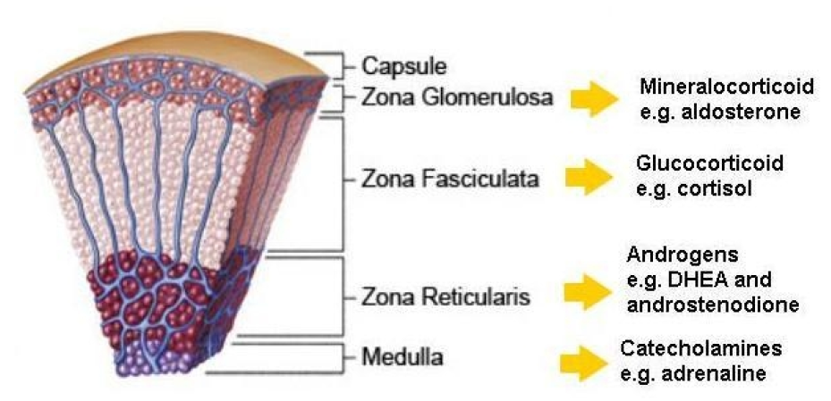

Slide 7
What are some causes of Primary Adrenal Failure?
Several causes including:
Infective (Tuberculosis, Meningococcal, HIV, etc)
Autoimmune Adrenalitis,
Metastasis (from Lung and Breast Carcinomas),
Hemorrhage,
Metabolic failure, insufficient hormone production, caused by:
Congenital Adrenal Hyperplasia (CAH),
Enzyme inhibitors, such as Metyrapone,
Cytotoxic agents (e.g. Etomidate),

Slide 8
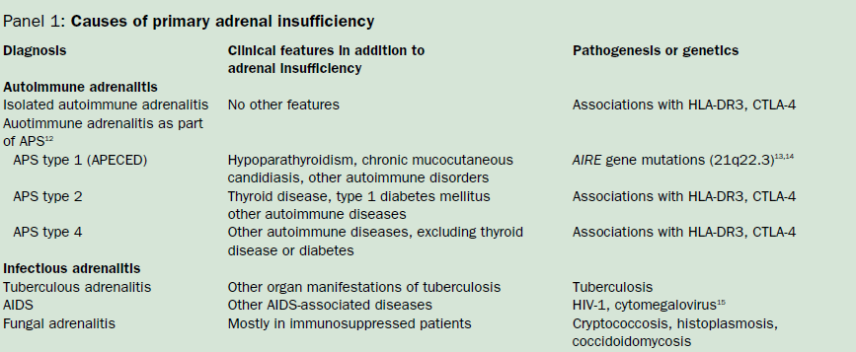

Slide 9
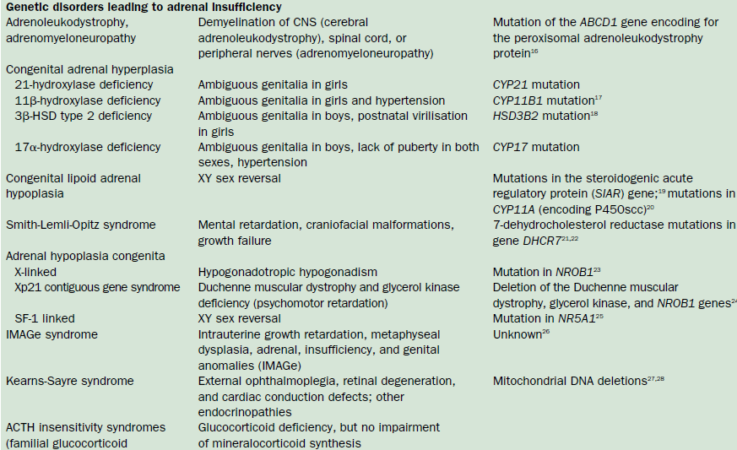

Slide 11
Causes of Secondary &Tertiary Adrenal Insufficiency

Slide 12
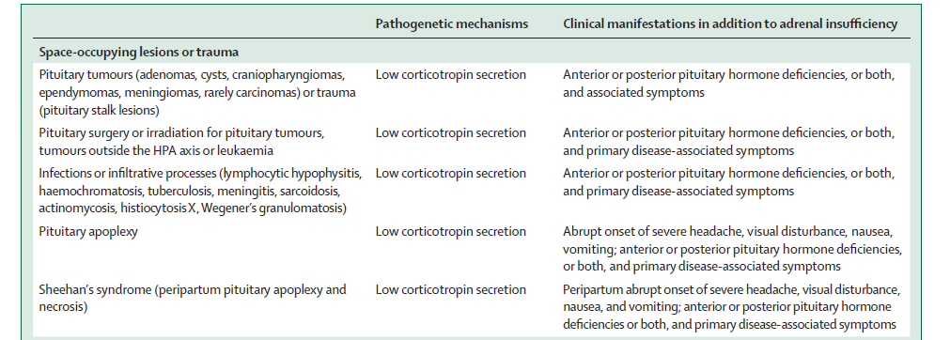

Slide 13
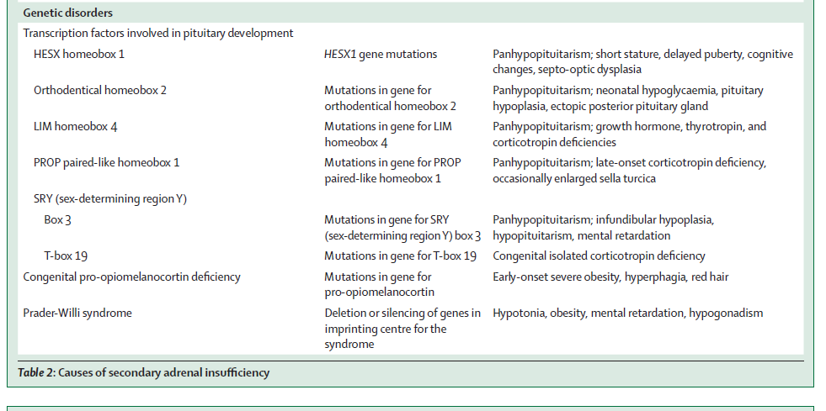

Slide 14
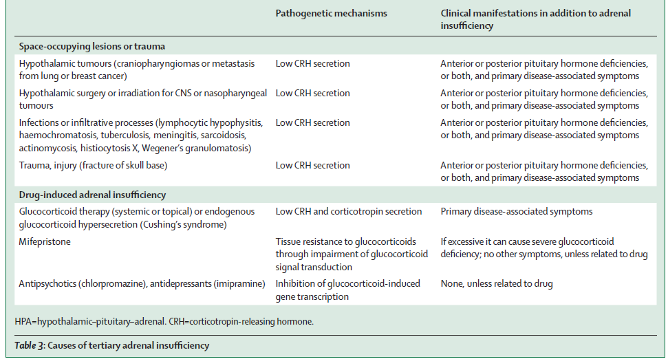

Slide 15
Screening and Diagnostic Tests for Adrenocortical Insufficiency (Adrenal Failure)
What basal lab tests are done on a patient suspected of having Adrenal Insufficiency?
Before the patient is given any medication (Cortisol), blood must be collected for Basal measurements of
Plasma Urea,
Electrolytes,
Glucose,
Serum Cortisol,
Plasma ACTH concentration;

Slide 16
Important points with respect to Cortisol and ACTH measurements
Normal Serum [Cortisol] at 8a.m., or Normal 24-hour Urinary Free Cortisol, does not exclude Primary Adrenocortical Insufficiency (Why?)
Because patient may be able to maintain Normal Basal output of Cortisol but is unableto secrete adequate amounts of Cortisol in response to Stress;
In healthy people, serum cortisol concentrations are highest in the early morning, at 275–555 nmol/L (100–200 μg/L).
A low serum cortisol concentration (<80 nmol/L [30 μg/L]) in a blood sample taken in the
early morning strongly suggests adrenal insuffi ciency.

Slide 17
Diagnosis of Primary Adrenal Failure is unlikely, if Serum [Cortisol] is 550nmol/L or more at 8 a.m. (in absence of Steroid Therapy),
Diagnostic accuracy for Primary Adrenal Failure is greatly improved when Serum [Cortisol] and [ACTH] are measured at the same time; Why?
Because Low Serum [Cortisol] < 200nmol/L, and high Serum [ACTH] ˃2oonmol/l may be diagnostic of Primary Adrenal Failure,

Slide 18
List some Biochemical tests used for Screening and Diagnosis of Adrenal Failure
Short Cosyntropin (Synacthen, Cortrosyn or Tetracosactrin) Test,(standard dose &low-dose)
Depot (Long) Synacthen test,
Prolonged Cosyntropin Stimulation (Rose) test,
Corticotrophin Releasing Hormone (CRH) stimulation test,
Insulin tolerance test(gold standard for DX sAI)
Overnight metyrapone stimulation test

Slide 20
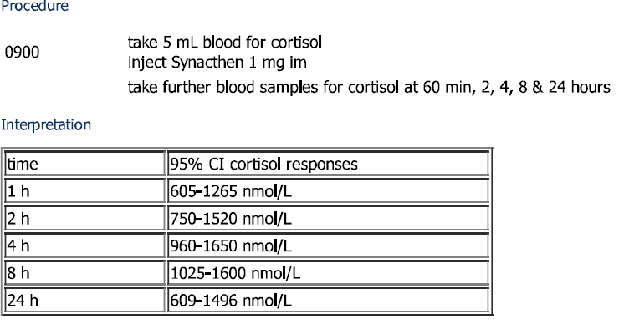
Depot (Long) Synacthen test(1mg/IM)
ug/dl
22.4-47
27.8-56
35.6-61
38-59
22-55

Slide 21
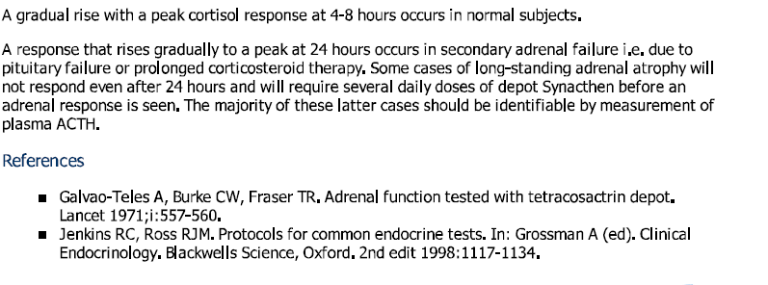

Slide 22
Long acting ampul
Short acting ampul

Slide 23
Agenda
Introduction
Review of one Meta_Analysis & systematic review ACTH stimulation tests for the diagnosis of adrenal insufficiency
Review of articles The utility of the corticotropin test to diagnose adrenal insufficiency in critical illness: an update
Brief review of two guidelines: 1) Diagnosis and treatment of primary adrenal insufficiency:An Endocrine Society Clinical Practice Guideline
2)Guidelines for diagnosis and treatment of adrenal insufficiency in adults
Answers to the clinical questions

Slide 24
ACTH stimulation tests for the diagnosis of adrenal insufficiency: Systematic review and meta-analysis
Naykky Singh Ospina, MD,1,2,3, Alaa Al Nofal, MD,1,4, Irina Bancos, MD,3,Asma Javed, MD,4, Benkhadra Khalid, MD,1,2, Ekta Kapoor, MD,5,Aida N Lteif, MD,4, Neena Natt, MD,3, M. Hassan Murad, MD, MPH1,2
ISSN Print 0021-972X ISSN Online 1945-7197 Printed in US
Copyright © 2015 by the Endocrine Society
Received March 18, 2015. Accepted December 2, 2015.
J Clin Endocrinol Metab

Slide 25
Objective: To determine the diagnostic accuracy of the high (250 mcg) and low (1 mcg) dose ACTH stimulation tests in the diagnosis of adrenal insufficiency.
Methods (Data sources, Study Selection, Data Extraction): We searched 6 databases through February 2014. Pairs of independent reviewers selected studies and appraised the risk of bias. Diagnostic association measures were pooled across studies using a bivariate model.

Slide 26
For secondary adrenal insufficiency, we included 30 studies(obsevational& randomized) enrolling 1,209 adults and 228 children.
For primary adrenal insufficiency, we included 5 studies enrolling 100 patients.
Data were only available to estimate the sensitivity of high dose ACTH stimulation test (92%; 95% CI: 81%–97%).

Slide 27
Materials and Methods
We included observational and randomized
studies that assessed the diagnostic accuracy of high and low dose ACTH stimulation tests for the diagnosis of PAI or SAI when compared to a gold standard.
In cases of PAI the gold standard;clinical features, serum cortisol, serum ACTH levels
and follow up.
In SAI, both the insulin tolerance test and metyrapone test were considered gold standards.

Slide 28
Materials and Methods
Exclusion criteria included :case series (uncontrolled studies), review studies, and
studies that evaluated patients with critical illness; patients with expected secondary adrenal insufficiency due to exogenous steroid use (eg, patients with autoimmune diseases treated with steroids, patients with asthma) or steroid therapy not discontinued before adrenal insufficiency testing (with no restriction regarding time of discontinuation).

Slide 29
Search Results Study selection

Slide 30
Secondary adrenal insufficiency
Supplemental Table 1 and 2 summarize the characteristics of the 30 studies that enrolled adults and children; respectively.
These studies enrolled a total of 1437 patients with a prevalence of SAI of 36%(35% in adults and 38% in children).
Most studies administered ACTH intravenously (IV).

Slide 31
Secondary adrenal insufficiency
The overall analysis for the accuracy of high dose ACTH stimulation test in adults included 29 datasets .
Six studies were included in the analysis of high dose ACTH in adults using 500 nmol/L at 30 minutes as cutoff ;
14 studies used a 500 nmol/L peak serum cortisol value as cutoff(any time after ACTH administration) and
eight a serum cortisol cutoff of 550 nmol/L.

Slide 32
Secondary adrenal insufficiency
The overall analysis for the accuracy of the low dose ACTH stimulation test in adults included 19 datasets (Eleven studies used a 500 nmol/L peak serum cortisol value for
the low dose ACTH stimulation test in adults and
six a peak serum cortisol level of 550 nmol/L as the cutoff value.

Slide 33
Diagnostic performance in SAI
The diagnostic performance for the high dose
and low dose ACTH stimulation test in adults
and children according to three different test
cutoffs are summarized in Table 1 and 2.
Summary receiving operator characteristics
curves are in Figures 2 and 3 for low and high dose; respectively.

Slide 37
Figure 2. Receiver operator curve- High dose ACTH stimulation test for secondary adrenal insufficiency
(1-sp)

Slide 38
Figure 3. Receiver operator curve – Low dose ACTH simulation test for secondary adrenal insufficiency
(1-sp)

Slide 39
Diagnostic performance in SAI
In general, both tests had low sensitivity and high specificity
resulting in reasonable likelihood ratios for a positive test (Adults: High dose 9.1, Low dose 5.9; Children: High dose 43.5, Low dose 7.7),
but a fairly suboptimal likelihood ratio (LR) for a negative test (Adults: High dose 0.39, Low dose 0.19; Children: High dose 0.65, Low dose 0.34).
Both high dose and low dose tests had moderate accuracy overall (Diagnostic odds ratios ranging from 23 to 67) primarily due to the low sensitivity. However, there was no statistically significant difference between accuracy of the high dose and the low dose tests when comparing diagnostic odds ratios.
The analysis was associated with significant heterogeneity; which is common in diagnostic meta-analysis.

Slide 40
Primary adrenal insufficiency
We identified 5 studies investigating the diagnostic performance of the high dose ACTH stimulation test for the diagnosis of PAI.
The characteristics of these studies are summarized in Supplemental Table 3.

Slide 41
Figure 3. Receiver operator curve – Low dose ACTH simulation test for secondary adrenal insufficiency

Slide 42
Diagnostic performance in PAI
Data were insufficient to estimate specificity, likelihood and diagnostic odds ratios.
Only the sensitivity (the rate of a positive test among patients with confirmed PAI) was estimable and was 92%; (95% CI, 81%–97%).

Slide 43
Discussion
This systematic review and meta-analysis aimed at identifying the diagnostic accuracy of ACTH stimulation test in patients with PAI and SAI.
We demonstrated that both high and low dose stimulation tests had similar diagnostic accuracy in SAI.
Both tests in general had moderate accuracy due to low sensitivity.
Therefore, they are more helpful in ruling in the condition, when positive. However, they are not as reliable in ruling out the condition, when negative.

Slide 44
Discussion
Data in PAI are insufficient to estimate diagnostic accuracy and one can only conclude that the high dose test had high sensitivity of 92%.
Many of these PAI patients may have had congenital adrenal hyperplasia, however, the available studies did not provide data to distinguish these patients and allow estimation of diagnostic accuracy measures specific to them.

Slide 45
Discussion
The limitations of the current available literature are
mostly related to significant variability in:
(i) the pretest probability of the diagnosis of adrenal insufficiency in the included populations,
(ii) the use of different cortisol assays (mostly radio-immunoassays in the included studies),
(iii) different cutoff values for the interpretation of the test
results (time of measurement and value) in both the index
test (ACTH stimulation test) and the gold standard (insulin
tolerance test and/or metyrapone test).
In addition,
technical differences should also be considered in future studies in which the diagnostic performance of the different doses of ACTH stimulation tests are evaluated such as the preparation of the 1 mcg dose ofACTHand the length of tubing used for administration .

Slide 46
Discussion
Finally
(1) when considering the diagnosis,physicians should have an understanding of the pretest probability of disease. This is important since the presented likelihood ratios of both the high and low dose ACTH stimulation test, suggest that although helpful, these tests are not perfect and can be misleading in some cases.
(2) knowledge of the limitations of the test and possible responsible factors (cortisol assay used, time and cut off used for interpretation) should be considered during
the medical decision making process.

Slide 47
Discussion
The use of gold standard tests might be needed when the results of the ACTH stimulation tests are equivocal or when the test is negative in the setting of high clinical suspicion.

Slide 48
Discussion
For example,
in a patient with history of pituitary disease
who presents with fatigue and deficiency of
other pituitary hormones, most clinicians
would be highly suspicious of SAI (high risk
for SAI), a negative test in that patient would
not decrease the likelihood of disease to a
level at which most physicians would be
comfortable excluding SAI.

Slide 49
Discussion
Onthe other hand,
in a patient with fatigue without any signs or risk
factors for SAI and an equivocal serum morning
cortisol (3–18 mcg/dL) (low risk for SAI) a negative
result will significantly decrease the probability of disease.
Unfortunately,
there are no validated tools to establish a reliable pretest probability for adrenal insufficiency and this only depends on clinical experience.

Slide 50
Conclusion
Both high and low dose ACTH stimulation tests had similar diagnostic accuracy.
Both tests are adequate to rule in, but not rule out, primary and secondary adrenal insufficiency.
Our confidence in these estimates is low to moderate due to the likely risk of bias, heterogeneity and imprecision.

Slide 51
Agenda
Introduction
Review of one Meta_Analysis & systematic review ACTH stimulation tests for the diagnosis of adrenal insufficiency
Review of articles The utility of the corticotropin test to diagnose adrenal insufficiency in critical illness: an update
Brief review of two guidelines: 1) Diagnosis and treatment of primary adrenal insufficiency:An Endocrine Society Clinical Practice Guideline
2)Guidelines for diagnosis and treatment of adrenal insufficiency in adults
Answers to the clinical questions

Slide 52
R E V IEW A R T I C L E
The utility of the corticotropin test to diagnose adrenal insufficiency in critical illness: an update
Balasubramanian Venkatesh* and Jeremy Cohen†
Clinical Endocrinology (2015) 83, 289–297

Slide 53
Objective
One of the most common dynamic testing procedures for assessment of adrenocortical function is the standard corticotropin or the cosyntropin test.
The aim of this review was to examine the evidence base underlying the corticotropin test in the management of the critically ill patient.

Slide 54
The corticotropin test was originally described in nonstressed subjects, and its applicability and interpretation in the setting of critical illness continues to generate controversy.
Attempting to determine the prevalence of an abnormal corticotropin test in critical illness is complicated by the use of different end-points and different populations.

Slide 55
Moreover,controversy exists with respect to the methodology and the interpretation with respect to the following variables:
dose of corticotropin, end-points for assessment of total or free cortisol, effect of plasma cortisol variability, adrenal blood flow and its equivalence with other tests of adrenocortical function.
Several factors influence the ACTH test result in healthy population. These include the body composition of the individual, serum CBG concentrations and the use of concomitant oral contraceptive pill.
Changes in 30-min cortisol correlate positively with BMI, that is patients with higher fat mass generate a higher cortisol response

Slide 56
Introduction
●The standard corticotropin or the cosyntropin test
used for assessment of adrenocortical function
comprises the measurement of plasma total cortisol
(PTC) concentrations immediately prior to, and at
30- and 60-min intervals after, the intravenous
administration of 250 ug of 1–24 ACTH.
● The normal response in unstressed volunteers is a
rise in serum levels to above 500–550nmol/l.

Slide 57
Introduction
In the setting of critical illness, the
corticotropin test has become the mainstay of
diagnosis for suspected ‘relative’adrenal
insufficiency (RAI) or ‘critical illness-related
corticosteroid insufficiency’ (CIRCI).
Whilst many diagnostic thresholds
have been advocated, the most recent
consensus guidelines suggest
that an increase in measured cortisol of >250 nmol/l in response to the test is diagnostic of RAI.

Slide 58
Diagrammatic representation of the effects of critical illness upon
the hypothalamo–pituitary–adrenal axis. Cytokines may have direct
effects upon CRH and ACTH production, as well as increasing free
cortisol production from bound cortisol by promoting the action of
neutrophil elastase, which cleaves cortisol from CBG. Intracellular
cortisol generation may be increased by action upon the 11-beta HSD
system. Other effects of critical illness that may be mediated by other
means than direct cytokine action include direct effects upon higher
centres, decreased cortisol clearance and variable effects upoFig. 1 n
glucocorticoid receptor expression.

Slide 59
Prevalence of an abnormal corticotropin test in critical illness

Slide 60
Continue Table 1

Slide 61
Prevalence of an abnormal corticotropin test in critical illness
In other populations of critically ill patients, there also appears to be a high incidence of abnormal corticotropin test results.
In a nonselected population of patients requiring
mechanical ventilation for longer than 72 hours, the observed incidence was 75%.
Investigations into patients with multitrauma,
head injury, burns, hepatic failure and pancreatitis have also documented high incidences of abnormal test results by various
definitions.
The clinical implications of these findings, however,are still not clear.

Slide 62
Relationship between cortisol response to corticotropin and severity of stress and organ dysfunction
In summary, there is no consistent relationship between cortisol response to corticotropin and illness severity in critical illness.
These may in part be related to varying time points of assessment, differences in the gender ratios across the various studies,
use of different assays and pharmacological confounders in the various trials.
Most of the data on RAI were published from Europe where etomidate (a known adrenal suppressant) use is high.

Slide 63
Controversies
With widespread use of the test and publication of several studies relating to its use, controversies have emerged in both the conduct and the interpretation of the test.
These are summarized below:

Slide 64
1) Dose of corticotropin
The recommended dose of 250 mcg of corticotropin results in supraphysiological plasma concentrations as high as 60000pmol/l and may override adrenal resistance to ACTH, thus producing a false-negative test with mild secondary adrenal insufficiency.
In contrast, the 250mcg dose tests the maximal secretory capacity of the adrenal.Consequently, a ‘low-dose’ corticotropin test (1 ug) has been suggested which would result in more physiological concentrations (90 pmol/l) similar to that seen in the insulin hypoglycaemia(70–100 pmol/l) and the metyrapone tests.
However, the relative lack of data on the lowdose test in the critically ill population has meant it has not yet gained widespread support. Moreover, technical issues such as
difficulties in dilution and adsorption of the drug to the vial further limit the utility of the low-dose test.

Slide 65
2)End-points
A primary concern is related to the use of cortisol increment,rather than peak cortisol response as the outcome determinant.
The cortisol increment (defined as the peak cortisol concentration at either 30 or 60 minutes subtracted by the baseline) has been shown to be an unreliable index of adrenal function as it may not distinguish normal patients from those with adrenal insufficiency.

Slide 66
3) Free cortisol
The response to corticotropin is assessed by the plasma total cortisol (PTC). However, measuring PTC in these circumstances is questionable, as this does not differentiate between the protein bound and free cortisol.
In healthy volunteers, following corticotropin stimulation, PTC changed by 106%, whilst PFC changed by 263%.
Moreover, CBG and albumin concentrations decline in acute illness resulting in higher PFC levels for the same amount of PTC. Despite the evidence of RAI based on PTC, there were no differences between the groups (RAI vs non-RAI) with respect to PFC.
A recent study by Cohen et al. in patients with septic shock also confirmed these findings, demonstrating that
in response to the corticotropin test the relative increase in PFC was significantly greater than that of PTC.

Slide 67
4) Is the corticotropin test a reliable reflector of the stress
response?
The rationale behind the corticotropin test is that if the adrenal
gland responds well to an exogenous stimulus, it would be
expected to respond in a similar fashion to an endogenous stress
factor.
Previous studies have demonstrated that the total cortisol
response to stress is mirrored by responses to ACTH stimulation.
Christ-Crain et al. examined changes in PTC and PFC following
a standard corticotropin test and during an endotracheal
extubation process. The proportional increase in PFC seen during physiological stress was much higher than what was noted with the ACTH test. On the other hand, PTC levels were not different between the two.
They concluded that the ACTH test does not reliably identify the PFC levels required during severe stress.

Slide 68
5) Effect of plasma cortisol variability
Venkatesh et al. have demonstrated significant fluctuations in plasma total cortisol over a 24-h period.This has significant implications for the interpretation of a random plasma cortisol.
By measuring hourly cortisols in individual patients, they were able to assess maximal hourly fluctuations in PTC.
They were able to demonstrate that maximal spontaneous hourly rises in plasma cortisol exceeded those induced by corticotropin thus raising question marks about the validity of the corticotropin test.

Slide 69
6) Effect of adrenal blood flow
An important determinant of the cortisol output by the adrenal cortex is the ACTH presentation rate to the zona fasciculata which in turn is influenced by adrenal blood flow; the one with the higher blood flow will result in higher cortisol output.
The implication of this is that the final measurement of plasma cortisol following corticotropin is not merely dependent upon the plasma ACTH concentration and the responsiveness of the fasciculata cells but are significantly influenced by other factors such as cardiac output and adrenal blood flow.

Slide 70
7) Reproducibility
The reproducibility of the ACTH test was assessed by Loisa et al. in 60 critically ill patients (20 sepsis, 20 septic shock and 20 nonseptic critically ill patients) by performing two corticotropin tests 24 h apart. Whilst critically ill patients without sepsis demonstrated good concordance between the two tests, those with septic shock had poor correlation and attributed this to rapid changes in cortisol production and secretion.
8) Assay variability
there is a high degree of variability between the various cortisol assays. The CORTICUS investigators recently
reported variability in results when the same sample was assayed in different laboratories, resulting in 27% of patients being classified differently depending on where their sample was assayed.

Slide 71
Alternatives to the corticotropin test
There are several other biochemical tests available to investigate the functioning of the adrenal axis. These include the insulin tolerance test (ITT), the metyrapone test and the glucagon stimulation test.
In summary, there are very little data on the use of these alternative tests in a critically ill population. Moreover, their utility is limited by complexity and the risk of significant adverse effects. Their role in the critically ill patient, if any, remains to be determined

Slide 72
Conclusions
In conclusion, the current available evidence does not support the use of the corticotrophin test in the setting of acute critical illness to assess adrenocortical function nor should it be used to guide steroid therapy in this setting.
Steroid therapy in septic shock remains highly contentious and is currently the subject of investigation in an international randomized controlled trial.

Slide 73
Agenda
Introduction
Review of one Meta_Analysis & systematic review ACTH stimulation tests for the diagnosis of adrenal insufficiency
Review of articles The utility of the corticotropin test to diagnose adrenal insufficiency in critical illness: an update
Brief review of two guidelines: 1) Diagnosis and treatment of primary adrenal insufficiency:An Endocrine Society Clinical Practice Guideline
2)Guidelines for diagnosis and treatment of adrenal insufficiency in adults
Answers to the clinical questions

Slide 74
Diagnosis and Treatment of Primary Adrenal Insufficiency: An Endocrine Society Clinical Practice Guideline
Stefan R. Bornstein (chair), Bruno Allolio, Wiebke Arlt, Andreas Barthel,Andrew Don-Wauchope, Gary D. Hammer, Eystein 5. Husebye,Deborah P. Merke, M. Hassan Murad, Constantine A. Stratakis,and David J. Torpy*
J Clin Endocrinol Metab, February 2016, 101(2):364-389

Slide 75
1.0 Who should be tested and how?
1.1 We recommend diagnostic testing to exclude primary adrenal insufficiency (PAI) in acutely ill patients with otherwise unexplained symptoms or signs suggestive of PA1 (volume depletion, hypotension, hyponatremia, hyperkalemia, fever, abdominal pain, hyperpigmentationor,especially in children, hypoglycemia). (1l⁺⁺⁺⁻)
1.2 We recommend confirmatory testing with the corticotropin stimulation test in patients with clinical symptoms or signs suggesting PA1 when the patient's condition and circumstance allow. (II⁺⁺⁺⁺)

Slide 76
1.0 Who should be tested and how?
1.3 In patients with severe adrenal insufficiency symptoms or adrenal crisis, we recommend immediate therapy with iv hydrocortisone at an appropriate stress dose prior to the availability of the results of diagnostic tests. (11⁺⁺⁺⁻)

Slide 77
Although it is more elaborate and requires endocrinological expertise, the corticotropin stimulation test is a superior diagnostic test with a higher degree of sensitivity and specificity than determination of morning cortisol and ACTH concentrations and is therefore preferred in all patients considered with the differential diagnosis of PA1

Slide 78
Technical remarks on diagnostic recommendations
There are several situations requiring specific consideration because cortisol levels can be expected to be altered by nonadrenal pathologies. These include critical illness and pregnancy.
In addition, reduced CBG levels in
illness and elevated levels in pregnancy may alter the interpretation of cortisol levels.

Slide 79
adrenal insufficiency in pregnancy
The diagnosis of new-onset adrenal insufficiency in pregnancy is challenging because symptoms are nonspecific and often are not different from those commonly present in pregnancy itself, such as fatigue, nausea, and vomiting.
The cosyntropin stimulation test is the test of choice in pregnant women if adrenal insufficiency is suspected.

Slide 80
adrenal insufficiency in pregnancy
In a small cohort of healthy pregnant women, the
peak total cortisol response after ACTH injection was significantly higher in comparison to the nonpregnant state (median, 1000 nmol/L[ 37 ug/dL]) in the second and third trimesters,
their responses returned to prepregnancy levels during the postpartum period (median, 700 nmoL/l [26 ug/dL]) .
Thus, it has been suggested to use higher diagnostic cortisol cutoffs of 700 nmoI/L (25 ug/dL), for the first trimester
800 nmoI/L (29 ug/dL), for the second trimester
and 900 nmoI/L (32 ug/dL) for the third trimester, respectively .

Slide 81
2.0 Optimal diagnostic tests
2.1 We suggest the standard dose (250 µg for adults and children ≥2 y of age,
15 µg /kg for infants,
and 125 µg for children <2 y of age)
iv corticotropin stimulation (30 or 60 min) test over other existing diagnostics tests to establish
the diagnosis of adrenal insufficiency.
Peak cortisol levels below 500 nmol/L (18µg/dL) (assay dependent) at 30 or 60 minutes indicate adrenal insufficiency. (21⁺⁺⁻⁻)

Slide 82
2.0 Optimal diagnostic tests
2.2 We suggest the low-dose (1 µg) corticotropin test for diagnosis of PAI only when the substance itself is in short supply. (21⁺⁺⁻⁻)
2.3 If a corticotropin stimulation test is not feasible, we suggest using a morning cortisol 440 nmol/L (5 µg /dL) in combination with ACTH as a preliminary test suggestive of adrenal insufficiency (until confiatory testing with corticotropin stimulation is available). (21⁺⁻⁻⁻)

Slide 83
2.0 Optimal diagnostic tests
2.4 We recommend measurement of plasma ACTH to establish PAI.
The sample can be obtained at the same time as the baseline sample in the corticotropin test or paired with the morning cortisol sample. In patients with confirmed cortisol deficiency, a plasma ACTH >2-fold the upper limit of the reference range is consistent with PAI. (1I⁺⁺⁺⁻)
2.5 We recommend the simultaneous measurement of plasma renin and aldosterone in PA1 to determine the presence of mineralocorticoid deficiency. (11 ⁺⁺⁺⁻)

Slide 84
2.0 Optimal diagnostic tests
2.6 We suggest that the etiology of PAI should be determined
in all patients with confirmed disease. (For diagnostic workup, see Table etiologies and Figure 1.) (Ungraded best practice recommendation)

Slide 85
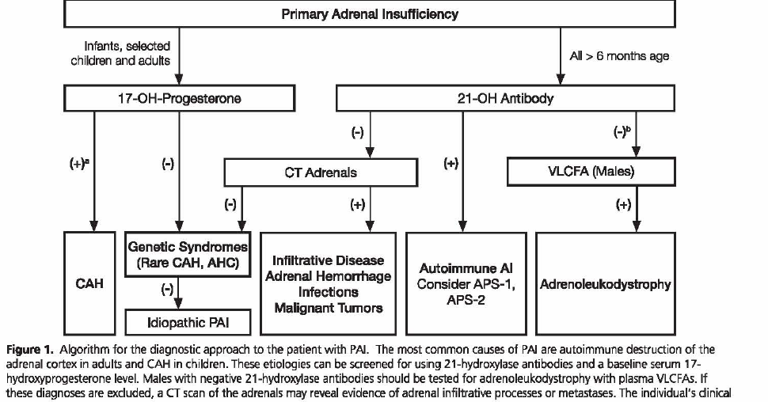

Slide 86
Agenda
Introduction
Review of one Meta_Analysis & systematic review ACTH stimulation tests for the diagnosis of adrenal insufficiency
Review of articles The utility of the corticotropin test to diagnose adrenal insufficiency in critical illness: an update
Brief review of two guidelines: 1) Diagnosis and treatment of primary adrenal insufficiency:An Endocrine Society Clinical Practice Guideline
2)Guidelines for diagnosis and treatment of adrenal insufficiency in adults
Answers to the clinical questions

Slide 87
Guidelines for diagnosis and treatment of adrenal insufficiency in adults
Paz de Miguel Novoaa,*, Elena Torres Velab, Nuria Palacios Garcíac,Manuela Moreira Rodríguezd, Icíar Solache Guerrase,María de los Ángeles Martínez de Salinas Santamaríaf, Anna Aulinas Masóg;representing Knowledge Area Group of Neuroendocrine, SEEN(Grupo Insuficiencia Adrenal)
Endocrinol Nutr. 2014;61(Supl. 1):1-34

Slide 88
The low dose stimulation test may have greater sensitivity for detecting partial or short-lasting SAI,but there is no universal agreement on the subject.
11-deoxycortisol levels higher than 7 ug/dL (190 nmol/L)
eight hours after administration of metyrapone in the
presence of cortisol levels less than 5 ug/dL (138 nmol/L)
are considered normal

Slide 90
Thank you

