Slide 2
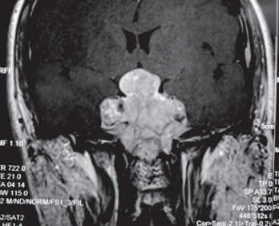
Management Issues in Prolactinoma
During Pregnancy
Malaysian Endocrine
& Metabolic Society
UKM

Slide 3
How Do You Manage Prolactin Secreting Pituitary Tumors In Pregnancy?
Case 1
Ms. D is 24 years old and was seen for inability to conceive. Her initial screen results showed an elevated prolactin level of 64 μg/L (normal level is 2 to 15 μg/L).
A subsequent MRI scan confirmed the presence of a 5mm pituitary adenoma.
She was given Bromocriptine 3 years ago, which normalized her menstruation as well as her prolactin level.
One year ago she asked if she could start Cabergoline instead because of its less frequent dosage. She was switched to Cabergoline 0.5 mg twice a week and her prolactin levels have remained normal.
She called your clinic yesterday to inform you that she was pregnant.
How would you manage this patient?

Slide 4
How Do You Manage Prolactin Secreting Pituitary Tumors In Pregnancy?
Medical management:
Continue current dopamine agonist therapy throughout pregnancy
Discontinue Cabergoline and switch to Bromocriptine due to better safety data
Discontinue dopamine agonist therapy as soon as pregnancy is confirmed
Refer for surgical excision of the tumour
Recommend therapeutic abortion

Slide 5
How Do You Manage Prolactin Secreting Pituitary Tumors In Pregnancy?
Biochemical monitoring:
Continue regular monitoring of serum prolactin during pregnancy
Discontinue monitoring serum prolactin during pregnancy
Measure serum prolactin only if patient complains of new onset headaches and/or vision changes

Slide 6
How Do You Manage Prolactin Secreting Pituitary Tumors In Pregnancy?
Pituitary imaging:
Perform regular pituitary imaging during pregnancy to exclude tumour enlargement
Perform pituitary imaging if serum prolactin is thought to be out of proportion with your clinical judgment
Perform pituitary imaging only if patient complains of new-onset headaches and/or vision changes

Slide 7
How Do You Manage Prolactin Secreting Pituitary Tumors In Pregnancy?
Visual field testing:
Perform regular formal visual field testing throughout pregnancy
Perform formal visual field testing only if patient complains of new-onset headaches and/or vision changes
Never perform formal visual field testing
Only perform informal (clinical) visual field testing

Slide 8
How Do You Manage Prolactin Secreting Pituitary Tumors In Pregnancy?
Case 2 Mrs. S a 37-year-old teacher , had originally presented with milky breast discharge about 5 years ago.
Subsequent investigations revealed an elevated prolactin level of 654 μg/L (normal level is 2-15 μg/L).
Pituitary MRI confirmed a 2.1cm pituitary macroadenoma. Visual field testing revealed a defect in her left superior temporal field. She was started immediately on Cabergoline 1.0 mg twice a week, and within 6 months, her serum prolactin level returned to normal, and her tumor shrank to 1.2 cm. Her visual field test results were normal.
She has been under yearly surveillance and her serum prolactin level has remained normal she is now 4 weeks pregnant.

Slide 9
How Do You Manage Prolactin Secreting Pituitary Tumors In Pregnancy?
Medical management:
Continue current dopamine agonist therapy throughout pregnancy
Discontinue Cabergoline and switch to Bromocriptine due to better safety data
Discontinue dopamine agonist therapy as soon as pregnancy is confirmed
Refer for surgical excision of the tumour
Recommend therapeutic abortion

Slide 10
How Do You Manage Prolactin Secreting Pituitary Tumors In Pregnancy?
Biochemical monitoring:
Continue regular monitoring of serum prolactin during pregnancy
Discontinue monitoring serum prolactin during pregnancy
Measure serum prolactin only if patient complains of new onset headaches and/or vision changes

Slide 11
How Do You Manage Prolactin Secreting Pituitary Tumors In Pregnancy?
Pituitary imaging:
Perform regular pituitary imaging during pregnancy to exclude tumor enlargement
Perform pituitary imaging if serum prolactin is thought to be out of proportion with your clinical judgment
Perform pituitary imaging only if patient complains of new-onset headaches and/or vision changes

Slide 12
How Do You Manage Prolactin Secreting Pituitary Tumors In Pregnancy?
Visual field testing:
Perform regular formal (Goldmann or Humphrey) visual field testing throughout pregnancy
Perform formal visual led testing only if patient complains of new-onset headaches and/or vision changes
Never perform formal visual field testing
Only perform informal (clinical) visual eld testing

Slide 13
How Do You Manage Prolactin Secreting Pituitary Tumors In Pregnancy?
Case 3
Mrs. Wong, a 30-year-old nulliparous realtor, is 10 weeks pregnant. She was told 6 years ago that she had a large prolactinoma and was given Bromocriptine. She last saw her specialist more than 3 years ago. She has been getting her prescription through her family physician and takes her medication intermittently.
Her menstruation has always been irregular and when she started gaining weight 2 weeks ago she did the pregnancy test, which was positive. This was later confirmed by her family physician.
She last took Bromocriptine about 3 months ago. When you examined her, she had bitemporal hemianopia on clinical visual field testing and you requested an urgent MRI which showed a 2.9 cm sellar tumor compressing the optic chiasm. Her serum prolactin level was 2400 μg/L.

Slide 14
How Do You Manage Prolactin Secreting Pituitary Tumors In Pregnancy?
Medical management:
Restart previous dopamine agonist therapy (Bromocriptine) throughout pregnancy
Start Cabergoline due to its better efficacy
Discontinue dopamine agonist therapy as soon as pregnancy is confirmed
Refer for surgical excision of the tumour
Recommend therapeutic abortion

Slide 15
How Do You Manage Prolactin Secreting Pituitary Tumors In Pregnancy?
Biochemical monitoring:
Continue regular monitoring of serum prolactin during pregnancy
Discontinue monitoring serum prolactin during pregnancy
Measure serum prolactin only if patient complains of new onset eadaches and/or further worsening of vision

Slide 16
How Do You Manage Prolactin Secreting Pituitary Tumors In Pregnancy?
Pituitary imaging:
Perform regular pituitary imaging during pregnancy to exclude tumour enlargement
Perform pituitary imaging if serum prolactin is thought to be out of proportion with your clinical judgment
Perform pituitary imaging only if patient complains of headaches and/or further worsening of vision

Slide 17
How Do You Manage Prolactin Secreting Pituitary Tumors In Pregnancy?
Visual field testing:
Perform regular formal (Goldmann or Humphrey) visual field testing throughout pregnancy
Perform formal visual led testing only if patient complains of headaches and/or further worsening of vision
Never perform formal visual field testing
Only perform informal (clinical) visual field testing

Slide 20
Prolactinoma in pregnancy: 2 main issues
i) risk of oestrogen-induced prolactinoma enlargement
ii) dopamine agonist safety for mother and
baby

Slide 22
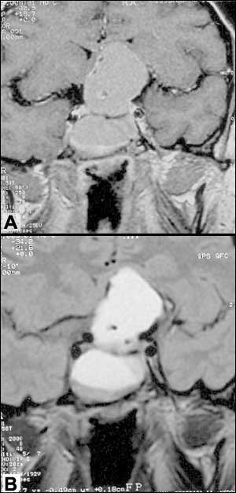
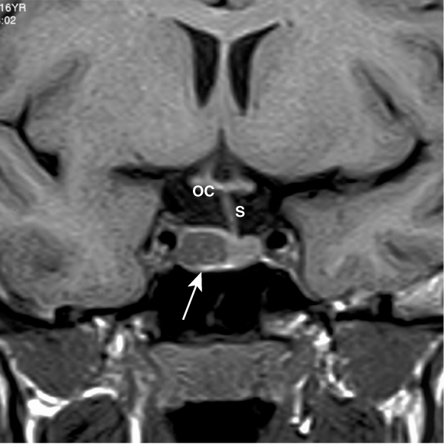
Microprolactinoma
Macroprolactinoma

Slide 23
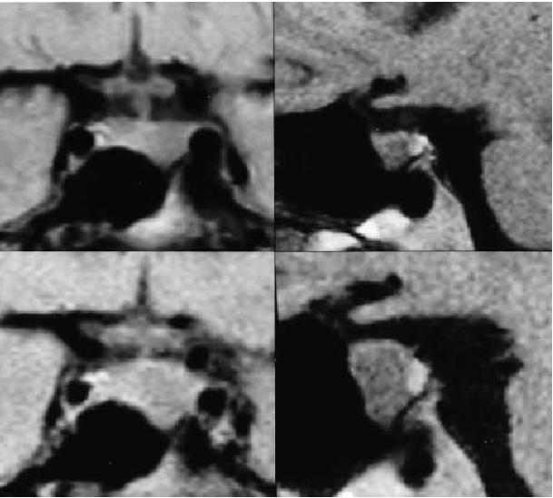
Coronal (left) and sagittal (right) MRI scans of an intra-sellar prolactin-secreting macroadenoma in a patient before conception (above) and at 7 months of gestation (below). Note the marked tumor enlargement at the latter point, at which time the patient was complaining of headaches.

Slide 24
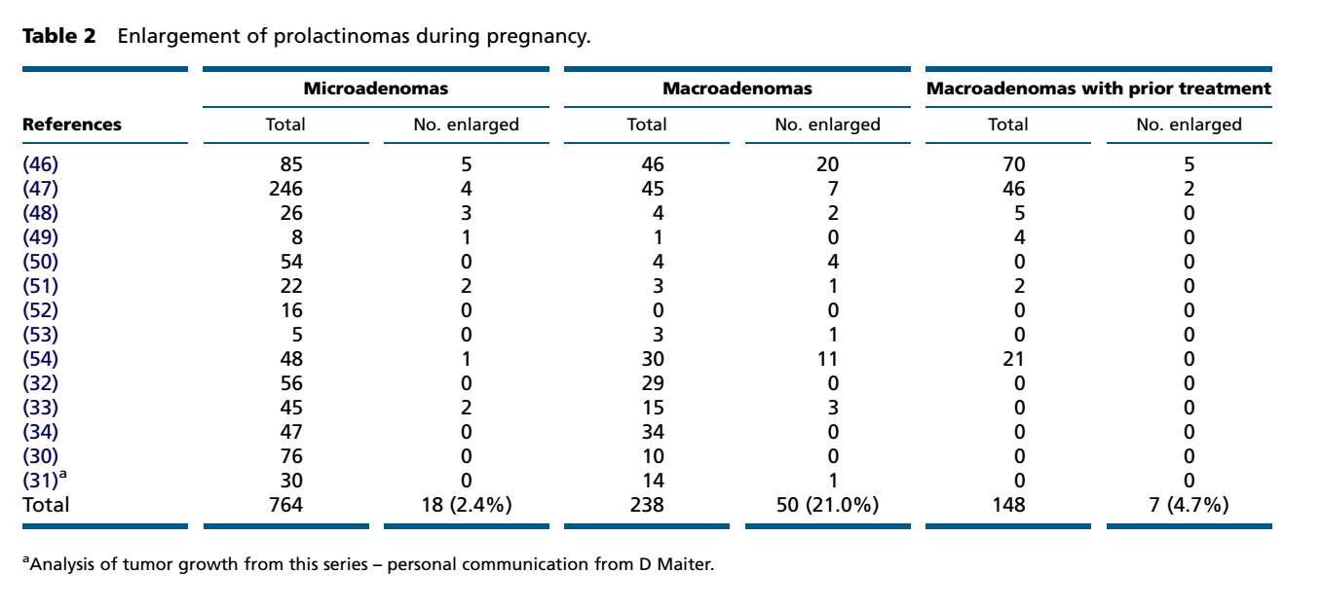
Enlargement of prolactinomas during pregnancy: microadenomas, macroadenomas without and with prior treatment
European Journal of Endocrinology (2015) 172, R205–R213

Slide 26
Monitoring: What will be more appropriate ?
1. Microadenoma
No monitoring
Once symptomatic
VF
2. Macroadenoma
- Monitor with VF (1-2 mthly) vs Monitor only if symptomatic
* No role for prolactin level measurement

Slide 27
Effects of dopamine agonists on the developing fetus (1)
Use of mechanical contraception for the first two to three cycles will give the inter-menstrual interval.
1. Bromocriptine
a. Short-term exposure of 6 weeks (6,000 women)
no increase in spontaneous abortions, ectopic pregnancies, trophoblastic disease, multiple pregnancies or congenital malformations
b. Throughout pregnancy (100 women)
no abnormalities ex undescended testicle(1) and talipes deformity(1)
2. Carbegoline
a. Short-term exposure of 6 weeks (900 women)
no increased of spontaneous abortion, premature delivery, or multiple births. Outcome data in 822 pregnancies, only 2.4% major malformations.
b. Throughout pregnancy (15 women)
healthy term deliveries in 14 , IUD (1) due to preeclampsia at 34 weeks
European Journal of Endocrinology (2015) 172, R205–R213

Slide 28
Effects of dopamine agonists on the developing fetus (2)
3. In 176 pregnancies, quinagolide used for median duration of 37 days,
24 spontaneous abortions,
1 ectopic pregnancy, and
1 stillbirth.
Total of 9 fetal malformations
including spina bifida, Trisomy 13, Down syndrome, talipes, cleft lip, arrhinencephaly, and Zellweger syndrome.
Quinagolide not safe for the fetus in pregnancy.
Webster J. A comparative review of the tolerability profiles of dopamine agonists in the treatment of hyperprolactinaemia and inhibition of lactation. Drug Safety 1996 14 228–238.

Slide 29
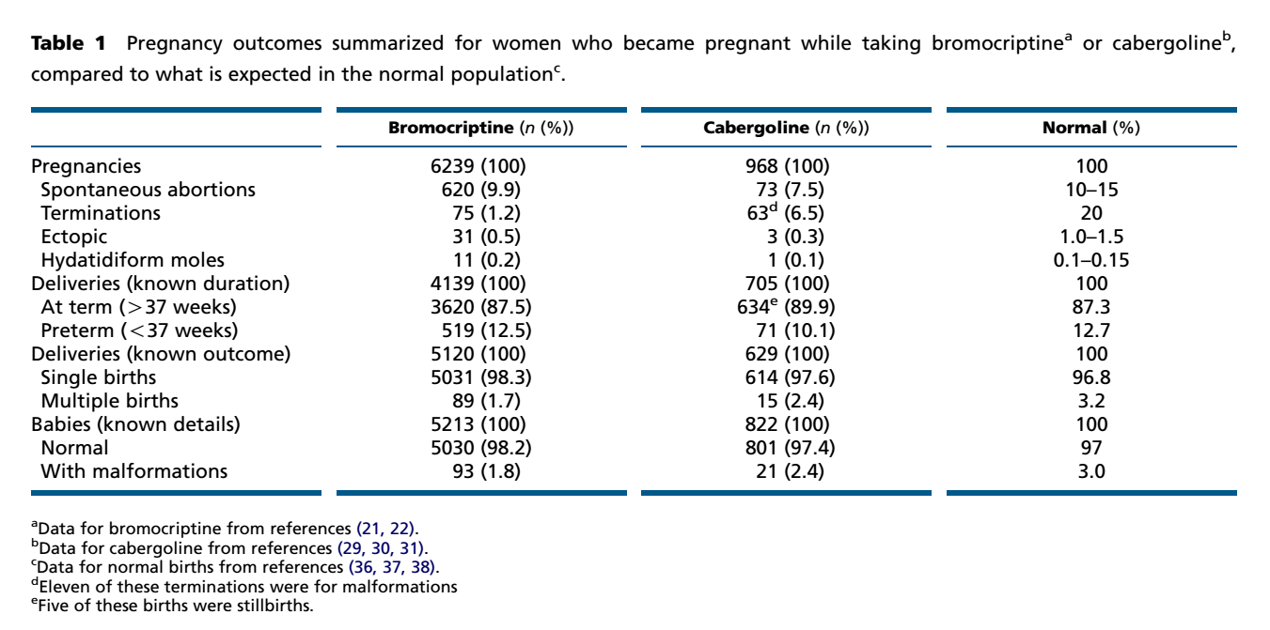
Pregnancy outcomes summarized for women who became pregnant while taking bromocriptine or cabergoline, compared to what is expected in the normal population.
European Journal of Endocrinology (2015) 172, R205–R213

Slide 30
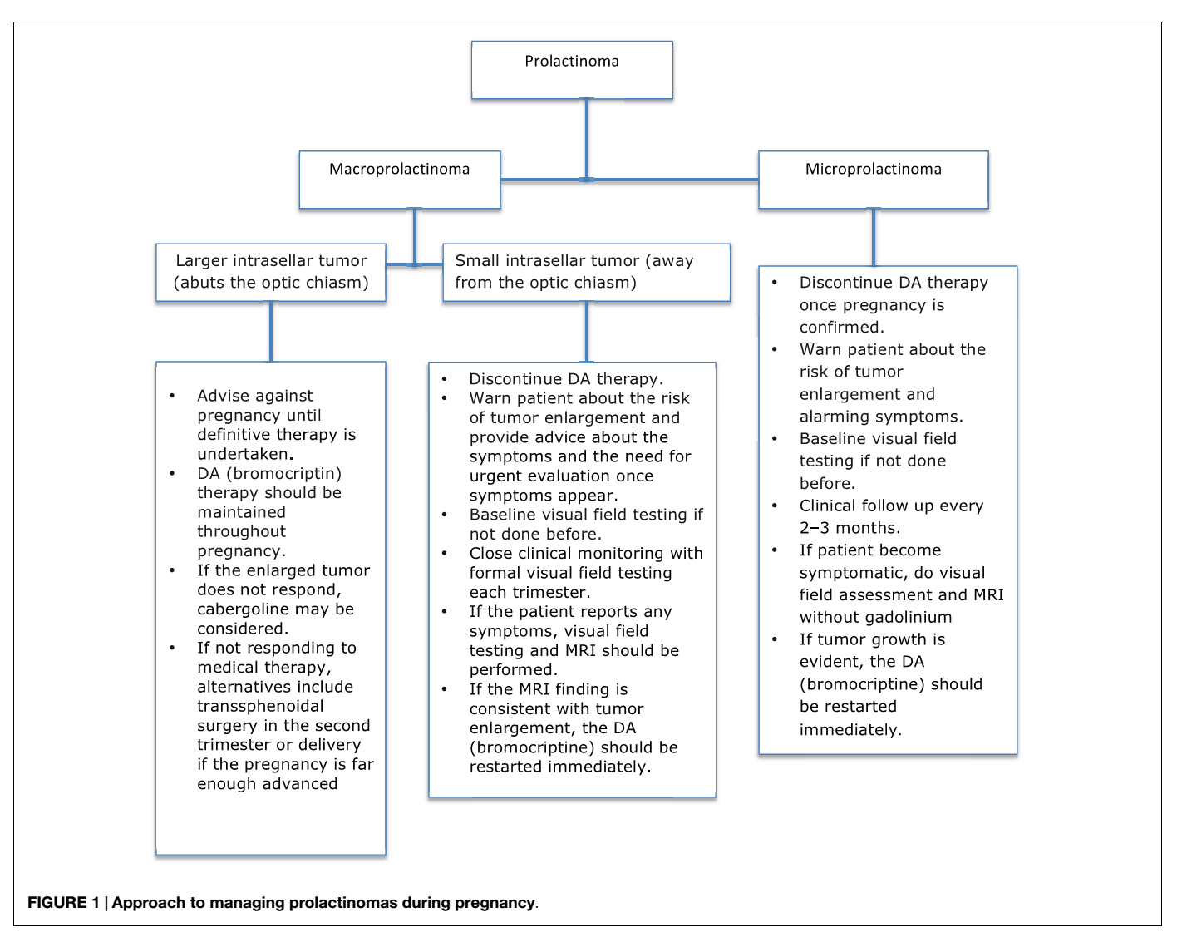

Slide 31
Post partum
In 56 hyperprolactinemic women, 23 had normal PRL levels postpartum, 33 with persistent hyperprolactinemia, 31% had levels decreased by more than 50%.
No need resumption of dopamine agonist.
Lactation does not increase PRL nor headaches or visual disturbances.
Ikegami H, Aono T, Koizumi K, Koike K, Fukui H & Tanizawa O. Relationship between the methods of treatment for prolactinomas and the puerperal lactation. Fertility and Sterility (1987 ) 47 : 867–869

Slide 32
Conclusion 1
1. Risk of significant clinical enlargement;
Microprolactinoma 2%.
Macroprolactinoma ∼20%
DA-responsive tumours treated medically > 6 months before conception ∼10%
Macroprolactinoma treated surgically +/- radiation 2.8%
2. Monitoring if symptomatic with VF
3. DA if clinical evidence (headache, VF)
4. Post-partum 1/3 microprolactinoma remit
5. Lactation doesn’t seem to increase the size of tumour

Slide 33
Conclusion 2
Pregnancy is Beneficial For Prolactinomas

