Slide 1
Insulin Initiation in Type 2 DM
A Amouzegar, MD
Endocrine Research Center, Research Institute For Endocrine Sciences, Shahid Beheshti University, Tehran

Slide 2
Agenda
Rationale for Early Insulin Therapy
Which insulin is appropriate for being initiated?
How to initiate?
Conclusion

Slide 3
“patient-centered” approach
Individualizing therapy and goals for pts With T2DM
The individualized targets should take into account not only clinical conditions, such as relevant comorbid conditions, age, duration of diabetes, and history of severe hypoglycemia, but also the patient-specific psycho-socioeconomic context

Slide 5
Too late!
Based on one recent study, the A1C level that triggers glucose-lowering action is > 9%
Am J Manag Care 9:213–217, 2003

Slide 6
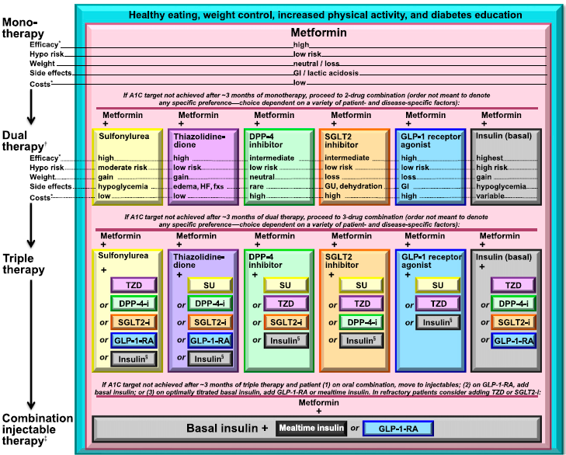
Approaches to Glycaemic Treatment
Taken from the position statement of ADA and EASD
American Diabetes Association. Approaches to glycaemic treatment. Sec. 7. In Standards of Medical Care in Diabetesd2015. Diabetes Care, January 2015;38(Suppl. 1):S41–S48

Slide 7
Treatment of T2DM: IDF Guidelines
IDF
Treatment Algorithm for People with Type 2 Diabetes
Lifestyle measures
Then, at each step, if not to target (generally HbA_{1c} <7.0%)
Consider first line
Metformin
Sulfonylurea
or
α-glucosidase inhibitor
Consider second line
Sulpholynurea
Metformin [if not first line]
α-glucosidase inhibitor or DPP-4 inhibitor or thiazolidinedione
or
Consider third line
Basal insulin or premix insulin
α-glucosidase inhibitor or DPP-4 inhibitor or thiazolidinedione
GLP-1 agonist
or
or
Consider fourth line
= usual approach
Basal + meal-time insulin
Basal insulin or Premix insulin
[later basal + meal-time]
←
= alternative approach
IDF, International Diabetes Federation; DPP-4i, dipeptidyl peptidase-4 inhibitor; GLP-1, glucagon-like peptide-1
IDF Global Guideline for Type 2 Diabetes. http://www.idf.org/global-guideline-type-2-diabetes-2012

Slide 8
Insulin Treatment Patterns: common strategies

Slide 9
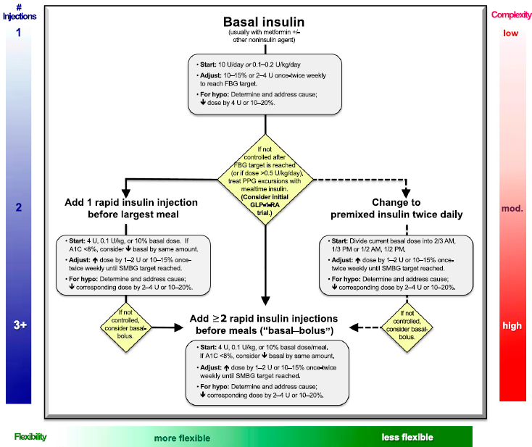
Approach to initiation and intensification of insulin in Type 2 diabetes
American Diabetes Association. Approaches to glycaemic treatment. Sec. 7. In Standards of Medical Care in Diabetesd2015. Diabetes Care, January 2015;38(Suppl. 1):S41–S48

Slide 10
NPH Vs Premix Insulin

Slide 12
BIAsp 30 associated with a significantly lower rate of major hypoglycaemia compared with BHI 30
Trial
Rate ratio [95% CI]
Boehm et al. 2002 (n=187)
0.50 [0.12;1.98], p=0.32
Kilo et al. 2003 (n=93)
0.34 [0.01;8.28], p=0.50
Iwamoto 2003 (n=428)
0.57 [0.16;2.00], p=0.38
1394 (n=292)
0.53 [0.03;8.63], p=0.66
McNally et al. 2007 (n=160)
0.31 [0.06;1.54], p=0.15
3002 bioequivalence trial (n=36)
0.25 [0.01;6.62], p=0.41
Overall
0.45 [0.22;0.93], p<0.05
I²=32%
0.01
0.1
1
10
100
Favours
BIAsp 30
Favours
BHI 30
BIAsp 30, biphasic insulin aspart 30; BHI, biphasic human insulin; CI, confidence interval
Davidson et al. Clin Ther 2009;31:1641–51
Notes:
In this meta-analysis, comparing BIAsp 30 with BHI 30: all published and unpublished, randomised, controlled trials in adult patients with type 2 diabetes (treatment duration ≥ 12 weeks) for which individual patient data were available.
The likelihood of major hypoglycaemia was significantly lower with BIAsp 30 compared with BHI 30 (odds ratio: 0.45; 95% CI: 0.22;0.93; p<0.05).
12

Slide 13
BIAsp 30 is associated with a significantly-lower rate of nocturnal hypoglycaemia than BHI 30
Rate ratios are calculated by the fixed effects model
Trial
Rate ratio [95% CI]
038
0.57 [0.20;1.58], p=0.28
1088
0.89 [0.25;3.16], p=0.86
1234
0.44 [0.22;0.89], p=0.02
1353
1.03 [0.42;2.53], p=0.95
1394
1.03 [0.38;2.76], p=0.96
1466
0.33 [0.21;0.51], p<0.01
1536
0.44 [0.11;1.47], p=0.17
3002
1.05 [0.11;10.09], p=0.97
3006
2.43 [0.31;18.90], p=0.39
Overall
0.50 [0.38;0.67], p<0.01
Test of heterogeneity:
I² = 32%
0.1
0.2
1
10
20
Favours
BIAsp 30
Favours
BHI 30
Overall: all data for all trials combined
Adapted from Davidson et al. Clin Ther 2009;31:1641–51

Slide 14
Initiation
Insulin Basal Vs Premix

Slide 15
EasyMix: similar glycaemic control at week 24
Change in HbA_{1c} (%)
from baseline to week 24
Participants who achieved
HbA_{1c}<7.0%
HbA_{1c} (%)
Participants (%)
Baseline HbA_{1c}
8.1%
Baseline HbA_{1c}
8.2%
Estimated mean difference for HbA_{1c} at end of study:
−0.12% (95% CI: −0.25;0.02)
BIAsp 30
Insulin glargine
BIAsp, biphasic insulin aspart; CI, confidence interval
Yang et al. Curr Med Res Opin 2013;29:1599–608
Notes:
Treatment with BIAsp 30 was non-inferior to insulin glargine with respect to HbA_{1c} (non-inferiority margin: 0.4%).

Slide 16
EasyMix: comparable change in PPG over 24 weeks with BIAsp 30 and insulin glargine
16.0
BIAsp 30
Insulin glargine
14.0
12.0
10.0
Nine-point plasma glucose (mmol/L)
Week 0
8.0
*
*
Week 24
6.0
*
*
4.0
0
BB
B120
BL
L120
BD
D120
BED
2–4AM
BBF
*p<0.05
2–4 AM, between 2.00 and 4.00 am; B120, 2 h after breakfast; BB, before breakfast; BBF, before breakfast following day; BD, before dinner; BED, bedtime; BIAsp, biphasic insulin aspart; BL, before lunch; D120, 2 h after dinner; L120, 2 h after lunch; PPG, postprandial plasma glucose
Yang et al. Curr Med Res Opin 2013;29:1599–608
Notes:
Although reduction in mean nine-point self-measured plasma glucose profile was comparable between BIAsp 30 and insulin glargine, BIAsp 30 showed significantly lower PG levels at three timepoints (all post-meal timepoints), but a higher PG level before dinner compared with insulin glargine (all p<0.05).

Slide 17
EasyMix: comparable rates of hypoglycaemia with BIAsp 30 and insulin glargine
Rate ratio:
1.14 (95% CI: 0.74;1.76)
BIAsp 30
Insulin glargine
Hypoglycaemia rate (episodes/subject-year)
0
Minor hypoglycaemia
Severe hypoglycaemia
Minor hypoglycaemia: plasma glucose <3.1 mmol/L or whole blood glucose <2.8 mmol/L with or without symptoms
Severe hypoglycaemia: an episode requiring assistance of another person to actively administer carbohydrate, glucagon or other resuscitative actions
BIAsp, biphasic insulin aspart; CI, confidence interval
Yang et al. Curr Med Res Opin 2013;29:1599–608
Notes:
Rates of hypoglycaemia were low in both groups and comparable between the two groups.

Slide 18
Conclusion
BIAsp 30 once daily showed similar HbA1c reduction and a similar safety profile to IGlar once daily

Slide 19
INITIATE: significantly more patients met HbA_{1c} targets with twice-daily BIAsp 30 than insulin glargine
p<0.001
BIAsp 30
70
66
Insulin glargine
60
p<0.05
50
42
Patients reaching target at week 28 (%)
40
40
30
28
20
10
0
HbA_{1c}<7.0% (ADA goal)
HbA_{1c}≤6.5% (AACE and IDF goal)
HbA_{1c} target
AACE, American Association of Clinical Endocrinologists; ADA, American Diabetes Association; BIAsp, biphasic insulin aspart; IDF, International Diabetes Federation
Raskin et al. Diabetes Care 2005;28:260–3
Notes:
The INITIATE study demonstrated that significantly more insulin-naïve patients achieved HbA_{1c} targets of <7.0% or ≤6.5% following insulin initiation with BIAsp 30 than with insulin glargine.

Slide 20
INITIATE
At the end of the study, the mean HbA1c values were lower for the BIAsp 70/30 group compared with the glargine group (6.91 ± 1.17 vs. 7.41 ± 1.24%, P <0.01)
The HbA1c reduction was even larger for subjects whose baseline HbA1c values were >8.5%
In subjects with baseline HbA1c ≤8.5%, the absolute HbA1c reductions were less pronounced and were comparable between treatment groups

Slide 21
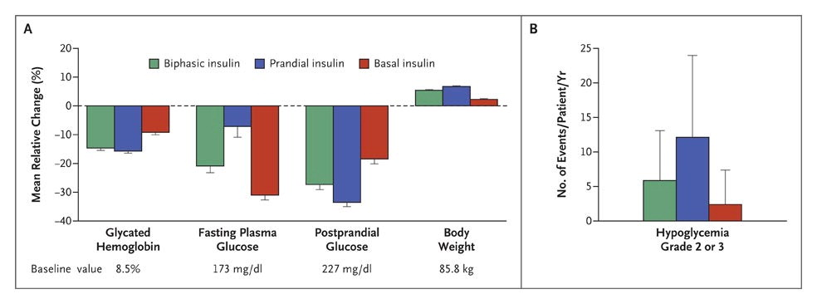
Holman RR et al. N Engl J Med 2007;357:1716-1730.
Mean (±SE) Percentage Change from Baseline to 1 Year in Glycated Hemoglobin, Fasting Plasma Glucose, Postprandial Glucose, and Body Weight (Panel A) and Mean (+SD) Hypoglycemic-Event Rate (Panel B)
Notes:
Figure 3. Mean (±SE) Percentage Change from Baseline to 1 Year in Glycated Hemoglobin, Fasting Plasma Glucose, Postprandial Glucose, and Body Weight (Panel A) and Mean (+SD) Hypoglycemic-Event Rate (Panel B). For all measures, P<0.001, with values adjusted for baseline values (except hypoglycemia), center, baseline glycated hemoglobin level, and oral antidiabetic therapy where appropriate. Missing data were imputed with the use of a multiple-imputation technique.14 To convert the values for glucose to millimoles per liter, multiply by 0.05551.

Slide 22
Swinnen SG, Simon ACR, Holleman F, Hoekstra JB, DeVries JH. Insulin detemir versus insulin glargine for type 2 diabetes mellitus. Cochrane Database of Systematic Reviews 2011, Issue 7

Slide 23
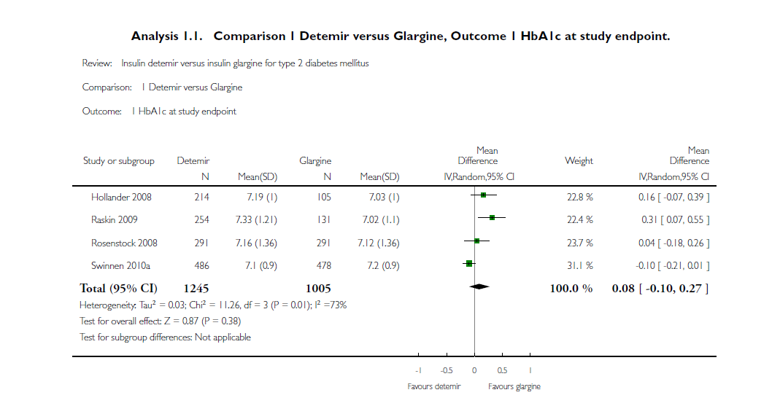

Slide 24
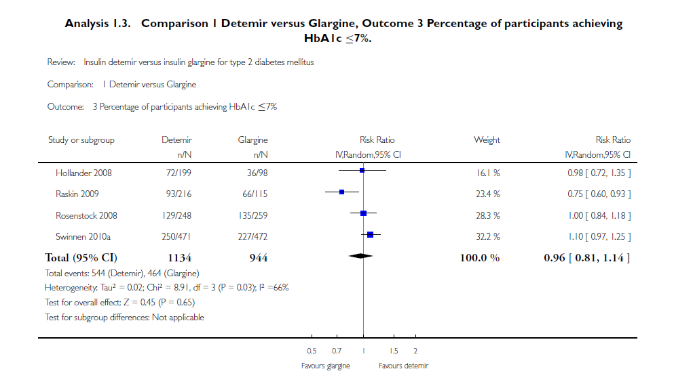

Slide 25
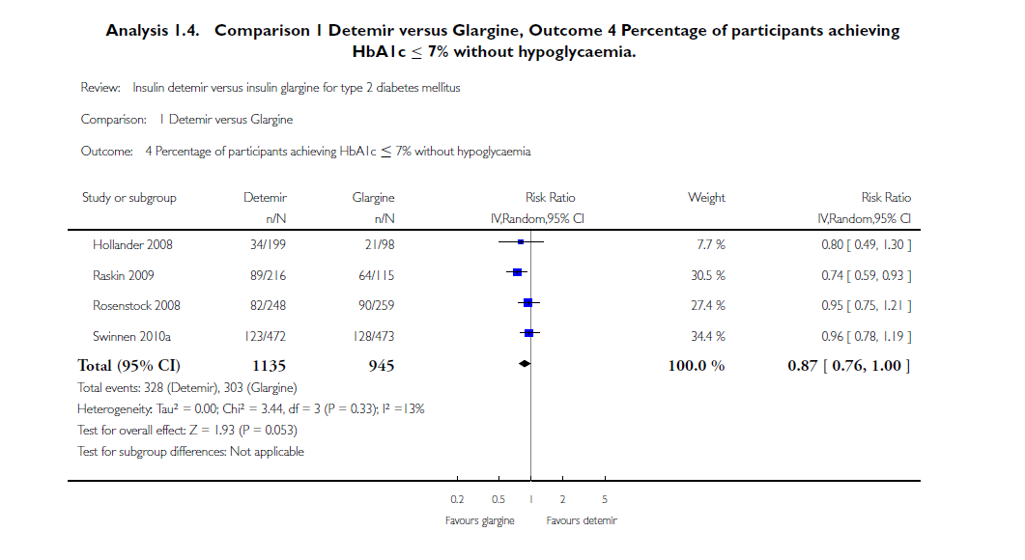

Slide 26
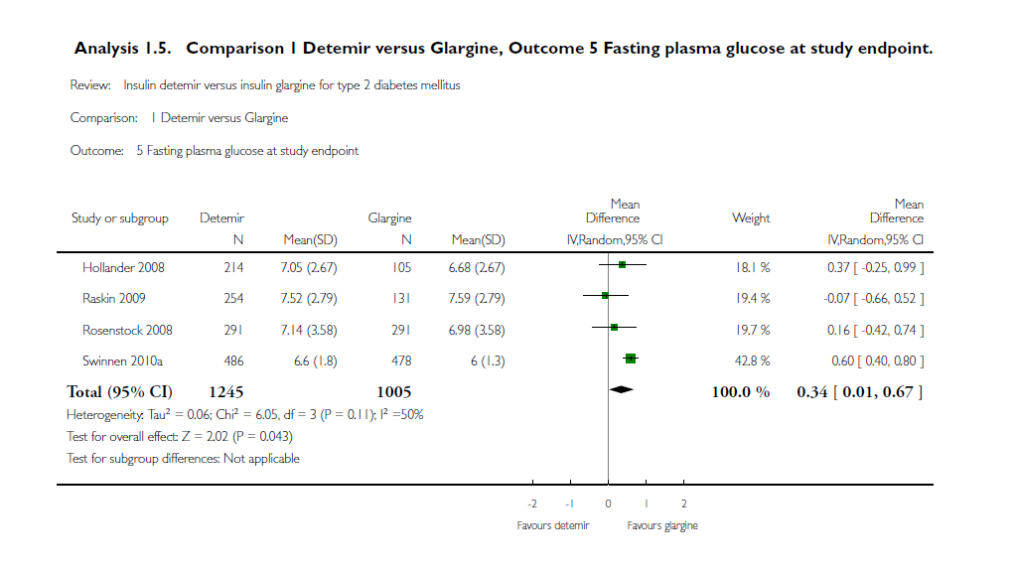

Slide 27
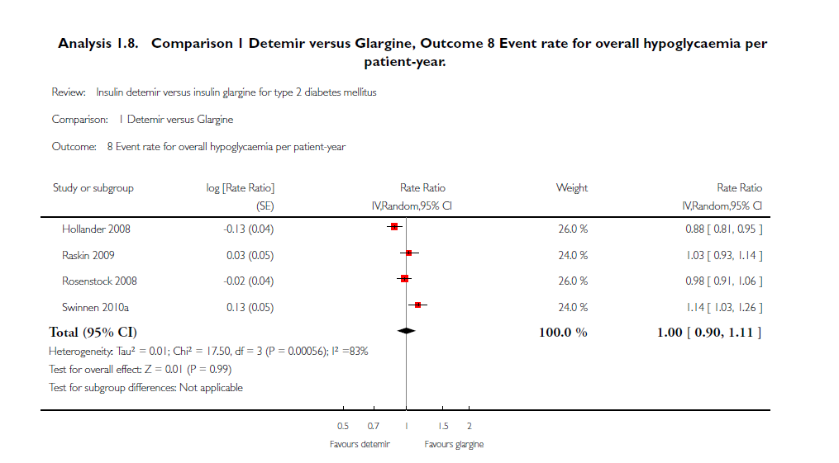

Slide 28
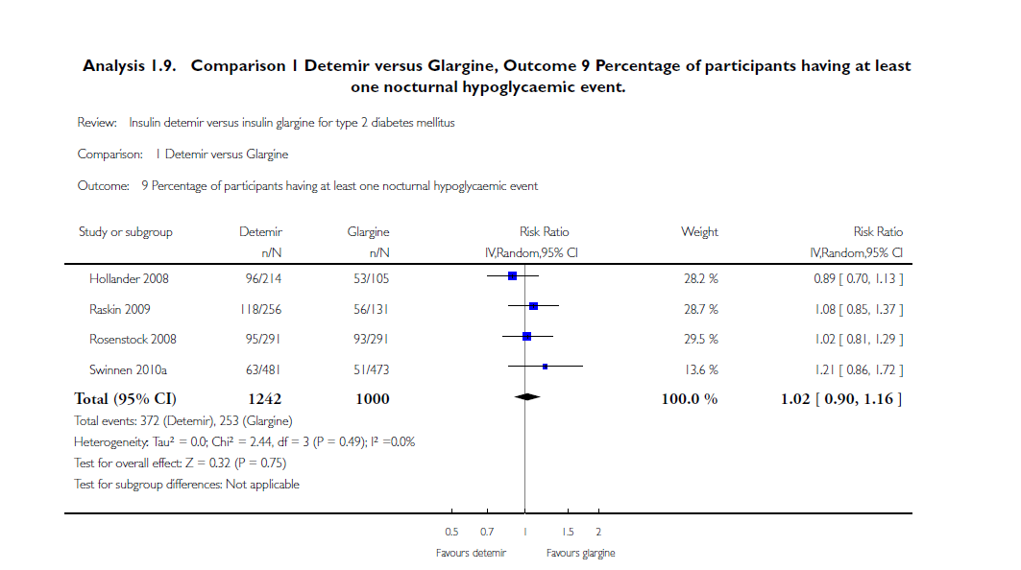

Slide 29
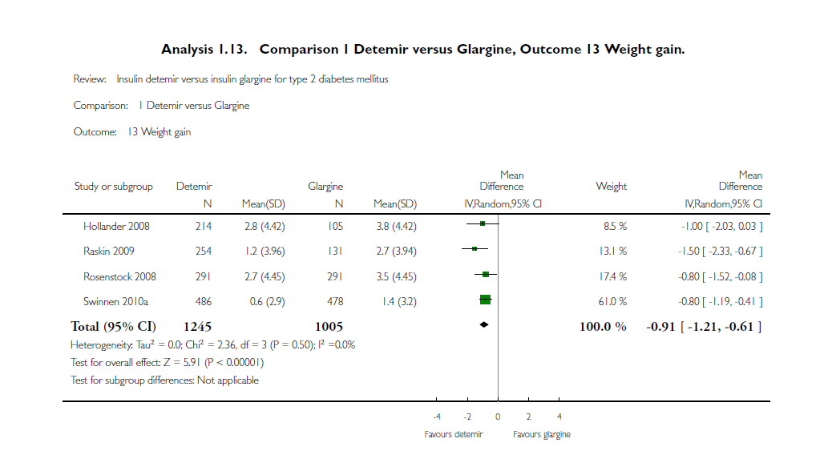

Slide 30
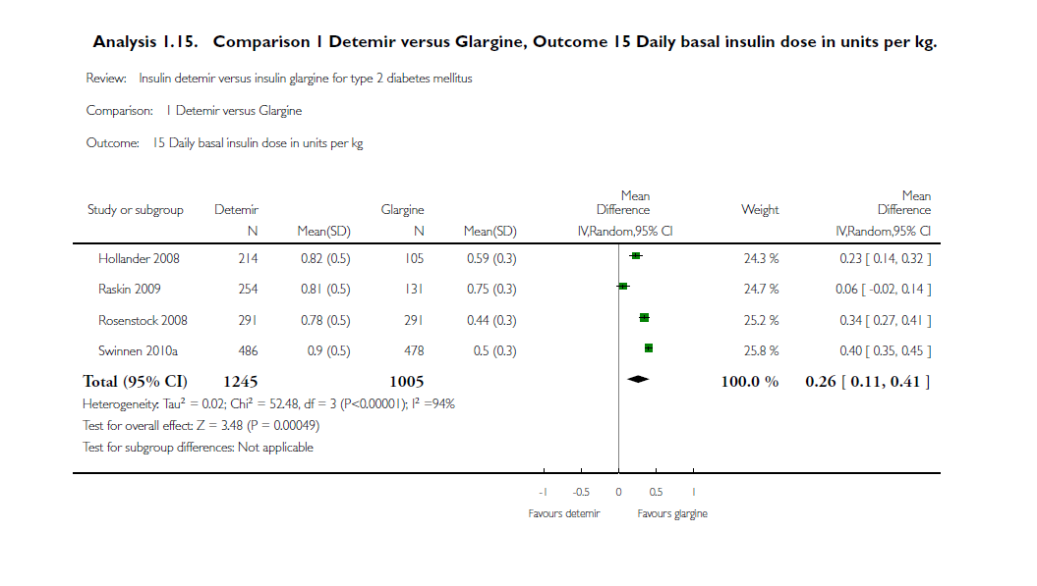

Slide 31
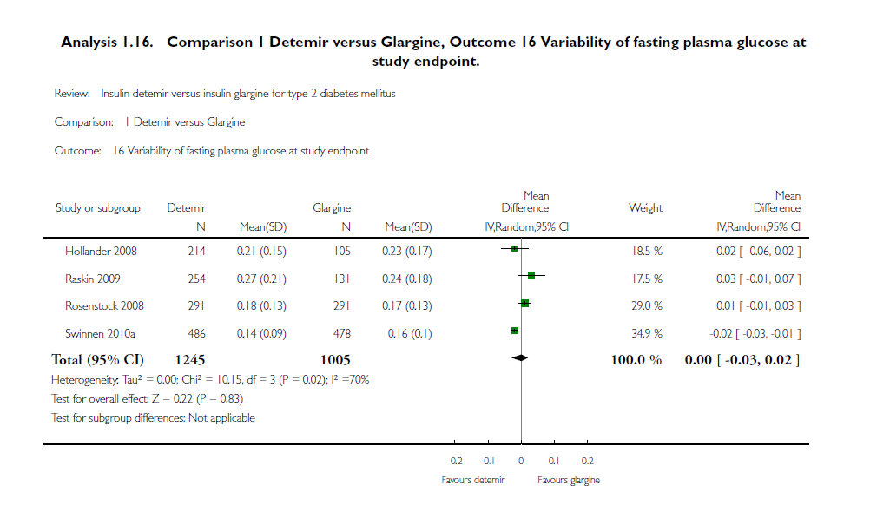

Slide 32
Conclusion
There is no clinically relevant difference in efficacy or safety between insulin detemir and insulin glargine for targeting hyperglycaemia
However, to achieve the same glycaemic control insulin detemir was often injected twice-daily in a higher dose but with less weight gain, while insulin glargine was injected once-daily, with somewhat fewer injection site reactions

Slide 33
Targets for glucose control
The overall aim is to achieve glucose levels as close to normal as possible
This can minimize development and progression of microvascular and macrovascular complications
ADA¹
EASD²
FPG
<130 mg/dL
HbA_{1c}
<7.0 %
PPG
<180 mg/dL
FPG
<115 mg/dL
HbA_{1c}
<7.0 %
PPG
<160 mg/dL
IDF³
1. ADA. Diabetes Care 2014;37:S14–80; 2. Inzucchi et al. Diabetes Care 2012;35:1364–79; 3. IDF. IDF Clinical Guidelines Task Force. 2012
Notes:
33

Slide 34
How to begin: Premix

Slide 35
Start and stay with NovoMix® 30
NovoMix® 30 Summary of Product Characteristics.
Garber A et al. The 1-2-3 study. Diabetes, Obesity and Metabolism 2006; 0: 1–10.
Raskin P et al. On behalf of the INITIATE Study Group. Basal insulin or premix analogue therapy in type 2 diabetes patients. Euro J Int Med 2007; 18: 56–62.

Slide 36
BIAsp 30: dosage regimen
Dose to titrate | Timing of blood glucose measurements used for dose titration
 | BIAsp 30 OD | BIAsp 30 BID | BIAsp 30 TID
Breakfast | – | Pre-dinner | Pre-lunch
Lunch | – | – | Pre-dinner
Dinner | Pre-breakfast | Pre-breakfast | Pre-breakfast
BIAsp, biphasic insulin aspart; BID, twice daily; OD, once daily; TID, three-times daily
Garber et al. Diabetes Obes Metab 2006;8:58–66; Raskin et al. Diabetes Care 2005;28:260–5
Notes:
Dosage regimen of BIAsp 30:
For once daily, the evening dose titration is done based on pre-breakfast blood glucose level.
For twice-daily BIAsp 30, the morning dose is to be titrated based on pre-dinner blood glucose level and evening dose is to be titrated based on pre-breakfast blood glucose level.
If a patient needs further intensification for three-times-a-day BIAsp 30: the morning dose can be titrated based on the pre-lunch blood glucose, midday dose is titrated on pre-dinner blood glucose and evening dose is titrated on pre-breakfast blood glucose.
This algorithm was adapted from a 48-week, open-label, observational study. Enrolled patients (n=100, HbA_{1c} ≥7.5 and ≤10%) were ≥18 years of age, had diabetes ≥12 months and had received a stable antidiabetic regimen for at least 3 months. Patients discontinued prior basal insulin and added one injection of BIAsp 30 (12 U or 70–100% of prior basal insulin dose within 15 min of dinner initiation). Patients self-titrated their BIAsp 30 dose with investigator guidance every 3 or 4 days to achieve pre-breakfast fasting blood glucose (FBG) of 4.4–6.1 mmol/L. At 16 weeks, a pre-breakfast injection of 6 U of BIAsp 30 was added if week 15 HbA_{1c} exceeded 6.5%; the added dose was titrated to achieve pre-dinner BG of 4.4–6.1 mmol/L. After an additional 16 weeks, 3 U of pre-lunch BIAsp 30 was added if HbA_{1c} exceeded 6.5%. This added dose was adjusted based on 2-h post-lunch BG to achieve PPG of 5.6–7.8 mmol/L. Subjects achieving HbA_{1c} ≤6.5 at 15 and 31 weeks completed the study at weeks 16 and 32, respectively.

Slide 37
BIAsp 30: titration algorithm
FBG or pre-dinner SMBG |  | BIAsp 30 dose adjustment
(mg/dL)
<80 |  | –2 U
80–110 |  | –
111–140 |  | +2 U
141–180 |  | +4 U
>180 |  | +6 U
BIAsp, biphasic insulin aspart; FBG, fasting blood glucose; SMBG, self-measured blood glucose
Adapted from Raskin et al. Diabetes Care 2005;28:2811
Notes:
BIAsp 30 offers a simple dose titration based on FBG or pre-dinner SMBG.
This example of the BIAsp 30 titration algorithm is taken from Raskin et al. (2005). This was a 28-week parallel-group study that randomised 233 insulin-naïve patients with HbA_{1c} values ≥8.0% on >1000 mg/day metformin alone or in combination with other OADs. Metformin was adjusted up to 2550 mg/day before insulin therapy was initiated with 5–6 units BIAsp 70/30 twice daily or 10–12 units glargine at bedtime and titrated to target blood glucose (80–110 mg/dL) by algorithm-directed titration.

Slide 38
How to begin Basal
Two accepted approaches for choosing a dose of basal insulin include :
Starting with a fixed dose of 10 units per day
Determining a weight-based dose of 0.1- 0.2 U/kg of body weight (in patients with usual insulin sensitivity and renal and hepatic function/day)
Although larger amounts (0.3–0.4 U/kg/day) are reasonable in the more severely hyperglycemic

Slide 39
Titrations of Basal Insulin
Every 3 days, if the fasting blood glucose is not in the target range of 80–130 mg/dl, the dose of basal insulin can be increased by:
2 units if glucose is relatively close to the fasting target (e.g. if fasting blood glucose is 130–180 mg/dl)
4 units if fasting blood glucose is > 180 mg/dl after 3 days of monitoring
A consensus treatment of the American Diabetes Association and the European Association for the study of diabetes. Diabetes Care 32:193–203, 2009

Slide 40
Titrations of Basal Insulin
If hypoglycemia with blood glucose < 70 mg/dl ocurs, basal insulin should be decreased by 10% or 4 units, whichever yields the larger change
Severe hypoglycemia occur, more drastic reduction in dosing may be warranted
Be aware that the need for prandial insulin therapy will become likely the more if the daily dose exceeds 0.5 U/kg/day, especially as it approaches 1 U kg/day
After the insulin dose is stabilized, the frequency of monitoring should be reviewed
A consensus treatment of the American Diabetes Association and the European Association for the study of diabetes. Diabetes Care 32:193–203, 2009

Slide 41
Basal insulin: The simple way to add insulin
Initiate:
Bedtime or morning long-acting insulin OR
Bedtime intermediate-acting insulin
Daily dose: 10 U or 0.2 U/kg
Initiate insulin with a single injection of a basal insulin, such as insulin Detemir
Check FBG daily
Titrate:
Increase dose by 2 U every 3 days until FBG is 80–130 mg/dL
If FBG is >180 mg/dL, increase dose by 4 U every 3 days
In the event of hypoglycemia or FBG level (<70 mg/dL),
Reduce bedtime insulin dose by ≥4 units, or by 10% if >60 units
Monitor:
Continue regimen and check HbA_{1c} every 3 months
FBG = Fasting blood glucose
Nathan DM, et al. Diabetes Care 2009;32:193–203.

Slide 42
Switch to NovoMix® 30 from self-mix Human Insulin
Patients treated with regular and NPH insulin
with 20/80, 30/70 and 40/60 proportions
Poor glycemic control
History of Hypoglycemia
Good glycemic
control and
no history of
hypoglycemia
Switch to NM30
with 10% increasing dose
(the summation of both
Regular and NPH doses)
Switch to NM30 with
10% decreasing dose
(the summation of both
Regular and NPH doses)
Switch to NM30
with equivalent dose
(the summation of both
Regular and NPH doses)
Khamseh et al, Novin Pezeshki medical journal , 2015; Vol. 589

Slide 43
Continuing of oral agent therapy?
A further issue here concerns continuing of oral agent therapy, or more specifically sulfonylureas, as metformin is usually continued
If a regimen including mealtime insulin is chosen (including premixe more than once daily), sulfonylureas are usually stopped to avoid compounding the hypoglycemia risk, but there is less certainty when beginning basal insulin alone

Slide 44
Cont
If
hypoglycemia does occur on the combination of insulin and a sulfonylurea, clinical experience is that the sulfonylurea should be stopped rather than insulin doses reduced
Thiazolidinediones are also often stopped when starting insulin as the edema and weight gain risks are compounded, but may be worth continuing in the very obese insulin-insensitive individual

Slide 45
Cont
A DPP-4 inhibitor can be continued, although perhaps to little benefit

Slide 46
HbA_{1c} at end of trial: week 24
Change in HbA_{1c} after
24 weeks’ treatment
Mean HbA_{1c} at week 24
Mean HbA_{1c} at week 24 (%)
Mean HbA_{1c} at week 24 (%)
p=0.01
p<0.001
p=0.231
BIAsp 30 BID + met
BIAsp 30 BID + sita + met
BIAsp 30 OD + sita + met
BIAsp, biphasic insulin aspart; BID, twice daily; met, metformin; OD, once daily; sita, sitagliptin
Linjawi et al. Prim Care Diabetes 2014;doi:10.1016/j.pcd.2014.11.001
Notes:
The observed final HbA1c values after 24 weeks were 6.9%, 7.2% and 7.1% for BIAsp 30 BID + sita, BIAsp 30 OD + sita and BIAsp 30 BID, respectively. The estimated change in HbA1c (%) was statistically superior with BIAsp 30 BID + sita compared with BIAsp 30 OD + sita (−1.51 vs. −1.15, difference: −0.36 [95% CI −0.54;−0.17], p<0.001) and compared with BIAsp 30 BID (−1.51 vs. −1.27, difference: 0.24, [95% CI 0.06;0.43], p=0.01). Change in HbA1c was not significantly different between BIAsp 30 OD + sita and BIAsp 30 BID (difference −0.11 [95% CI −0.30;0.07], p=0.231).

