Slide 1


Slide 2
B. Birjandi MD
Shahid Beheshti Medical University
13 November 2017
A 35 years old pregnant female with prolactinoma and Bitemporal Hemianopia

Slide 3
Present illness
A 35 years old married female was referred to endocrinology clinic with galactorrhea and amenorrhea (for 6 month) (95.4 to 95.10)
According to MRI report and prolactin level, Cabergoline (1mg po QOD) advised since 95.10.1

Slide 4
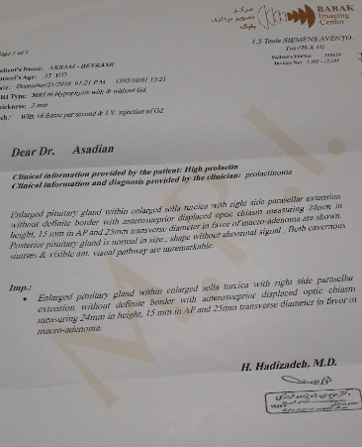
Pituitary MRI
Enlarged Pituitary gland within enlarged sella turcica with right side parasellar extension without definite border with anterosuperior displaced optic chiasma measuring 24 mm in height, 15mm in AP and 25mm transverse diameter in favor of macro adenoma
Posterior pituitary gland is normal in size, shape without abnormal signal. Both cavernous sinuses & visible ant. Visual pathway are unremarkable.

Slide 5


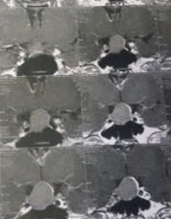
Pituitary MRI

Slide 6
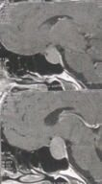
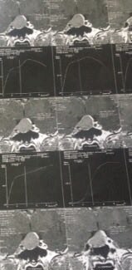
Pituitary MRI

Slide 7
Present illness
Galactorrhea was improved to medication and menstruation occurred 2 months later(95.12.1)
She had continued taking Cabergoline for 3 month until check for Bhcg revealed the patient is pregnant.

Slide 8
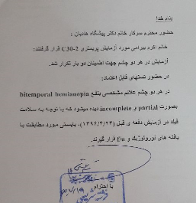
Present illness
Date | Result
96/4/24 | Normal
96/7/18 | Bitemporal Hemianopia
Cabergoline was deseased by her physician. During her pregnancy Perimetry test was checked every 3 month, that as normal until 96.7.18 Visual field showed Bitemporal hemianopia.

Slide 9
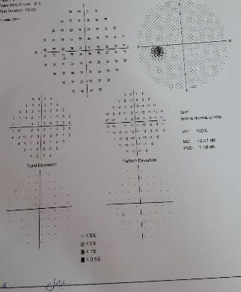
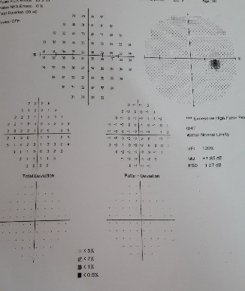
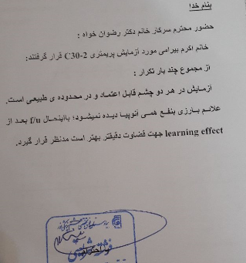
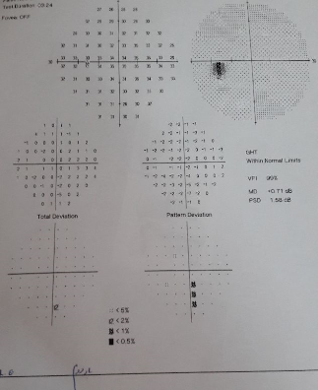
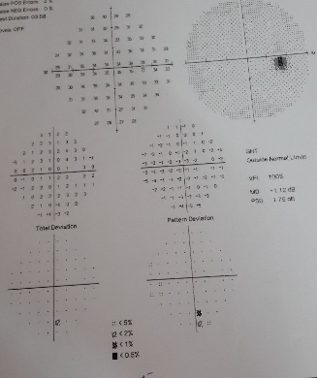
Perimetry Test
96.4.24

Slide 10
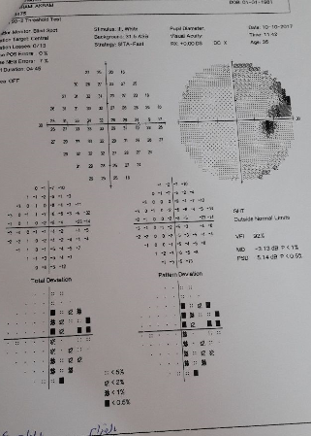
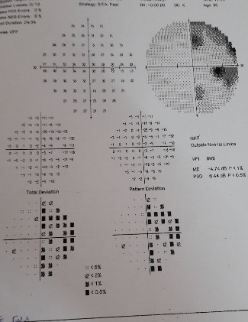
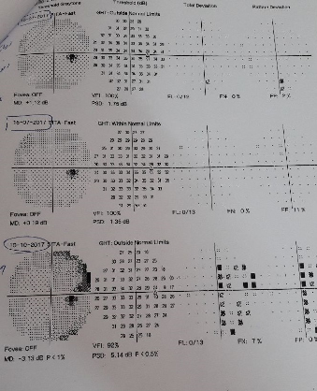
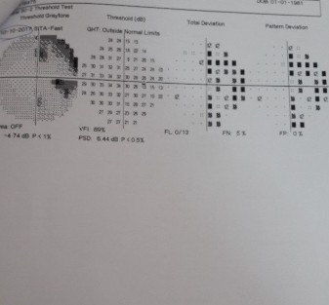
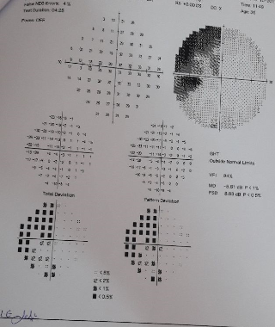
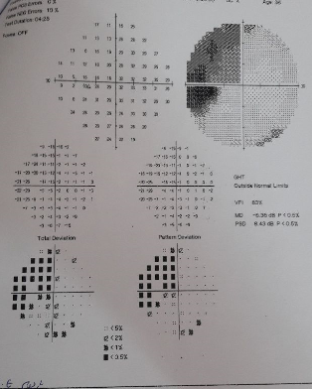
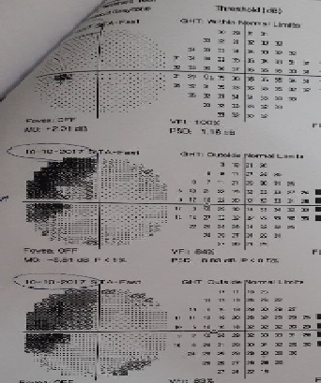
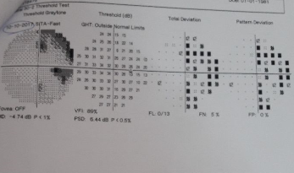
Perimetry Test 96.7.18

Slide 11
Date | Laboratory | Prolactin (ng/ml) | Dilutional Prolactin | TFT | IGF1 (ng/ml) | Cortisol/ACTH
95/9/28 | مرکزی | 1094 | _ | _ | _ | _
96/1/? | میلاد | _ | _ | T4:10.6 TSH:1.1 | _ | _
96/1/21 | مرکزی | _ | _ | TSH:2.5 | 182 | Cortisol:10.88 (6.2-19.4) ACTH: 15.6 (7.2-63.3)
96/2/11 | مرکزی | 28.36 | _ | T4:12.9 TSH:0.27 | _ | _
96/3/31 | مرکزی | 137.5 (6-30) | 127. 13 (6-30) | _ | _ | _

Slide 12
Present illness
At present she has within 38th weeks of pregnancy( G2 L1) and has no any complain such as headache , nausea , vertigo and ..etc except mild transient blurring of vision.

Slide 13
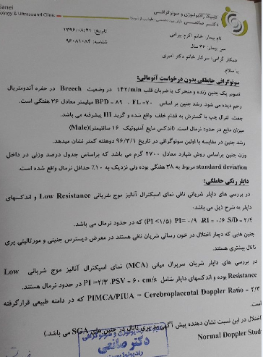
Prenatal sonography

Slide 14
Past Medical History
Hx of irregular menstruation, and amenorrhea (8month) that had been treated by taking Medroxyprogestrone
Hx of Normal Pregnancy & Cesarean section 6 years ago without complication
Hx of BP:140/70(without proteinuria,Headache, Edema etc..) 7 days ago admited in hospital( 3 days) and controlled Bp without any medication

Slide 15
Drug History :
Tab CalciumD Daily
Cap Fefol Daily
Tab prenatal Daily
Pearl Vit D3 50,000 weekly
Tab Cabergoline 1mg twice a week (since 2weeks ago)
Family History : Mother:DM & HTN
Habit History : NL
Allergy History : Neg

Slide 16
Review Of Systems
Negative: Weakness , fatigue , Headache , Vertigo , Anorexia , Nausea , Vomiting , Constipation , Polydipsia , Polyurea , Myalgia ,Depression ,Paresthesia , Bone Pain, etc..

Slide 17
Physical Examination
Weight:58--> 73 ;
Height: 161cm ;
BMI:22.37 --> 27.8 kg/m2
BP :105/70 ;HR:86/min(Regular)
No remarkable finding except positive confrontation test and scar of previous C/S

Slide 18
Problem List
A 35 years old pregnant female
with Hx of prolactinoma (Galactorrhea & Amenorrhea)
and Bitemporal Hemianopia

