Slide 1
Prevention and Treatment of Hypoglycemia
F. Hosseinpanah, M.D.
Obesity Research Center
Research Institute for Endocrine sciences
Shahid Beheshti University of Medical Sciences
July 25th , 2019
Tabriz

Slide 2
Agenda
Definitions
Pathophsiology
Prevalence
Clinical outcomes ( hypoglycemia and CVD)
Prevention
Treatment

Slide 3

Objective: To review the evidence about the impact of hypoglycemia on patients with diabetes that has become available since the past reviews of this subject by the American Diabetes Association and The Endocrine Society and to provide guidance about how this new information should be incorporated into clinical practice
J Clin Endocrinol Metab 98: 1845–1859, 2013

Slide 4
Definition
All episodes of an abnormally low plasma glucose concentration that expose the individual to potential harm
A single threshold value for plasma glucose concentration that defines hypoglycemia in diabetes cannot be assigned because there are varying threshold for symptoms

Slide 5
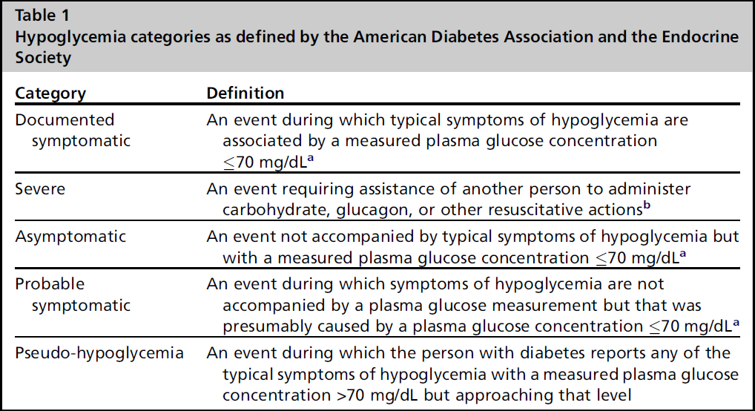

Slide 6
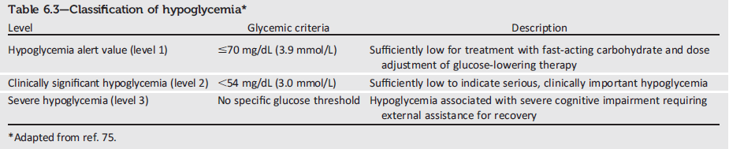
Classification of Hypoglycemia
Glycemic Targets: Standards of Medical Care in Diabetes - 2018. Diabetes Care 2018; 41 (Suppl. 1): S55-S64
International Hypoglycemia Study Group
Notes:
Here is the ADA’s new classification scheme for hypoglycemia, based on recommendations from the International Hypoglycaemia Study Group. Of note, this classification scheme considers a blood glucose less than 54 mg/dL (3.0 mmol/L) detected by SMBG, CGM (for at least 20 min), or laboratory measurement of plasma glucose as sufficiently low to indicate serious, clinically significant hypoglycemia that should be included in reports of clinical trials of glucose-lowering drugs for the treatment of diabetes.
However, a glucose alert value of less than or equal to 70 mg/dL (3.9 mmol/L) can be important for therapeutic dose adjustment of glucose-lowering drugs in clinical care and is often related to symptomatic hypoglycemia.
Severe hypoglycemia is defined as severe cognitive impairment requiring assistance from another person for recovery.
[SLIDE]
6
References
Cryer PE. Hypoglycaemia: the limiting factor in the glycaemic management of Type I and Type II diabetes. Diabetologia 2002;45:937–948
American Diabetes Association. Standards of medical care in diabetes—2014. Diabetes Care 2014;37(suppl 1):S33–S34

Slide 7
ADA 2019
International Hypoglycemia Study Group

Slide 8
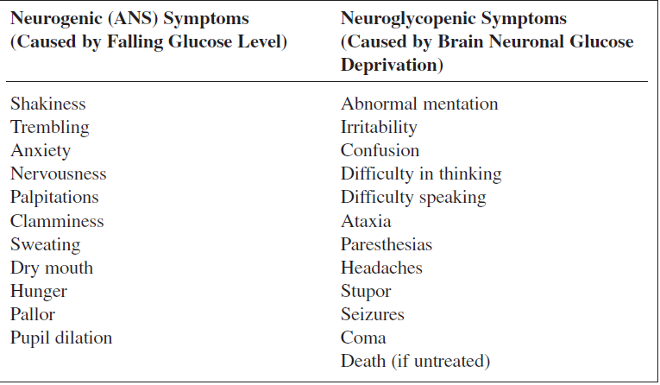
Symptoms of Hypoglycemia

Slide 9
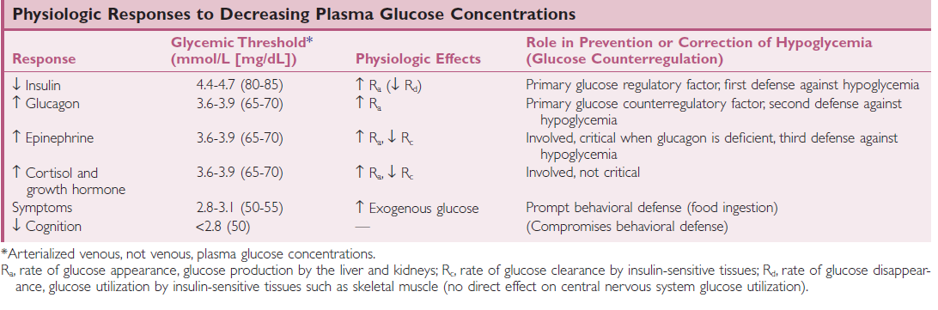

Slide 10

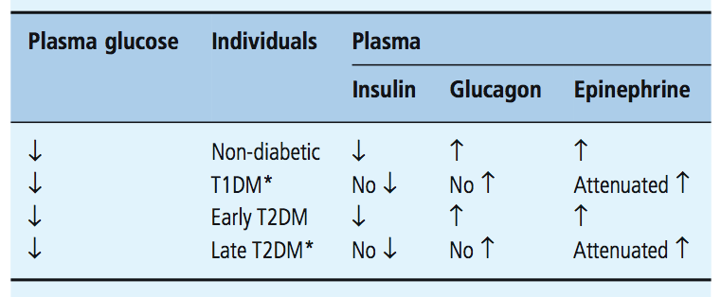
Pathophysiology of glucose counter-regulation
Notes:
The hypoglycemia unwareness is the result of reduced release of the neurotransmitter norepinephrine and acetylcholine
There is evidence of decrease beta-adrenergic sensitivity, specifically reduced cardiac chronotrpic senstivity to isoproterenal

Slide 11
Hypoglycemia-Associated Autonomic Failure
(HAAF)
Reduced counterregulatory hormone responses, which result in impaired glucose generation
Hypoglycemia unawareness, which precludes appropriate behavioral responses, such as eating

Slide 12
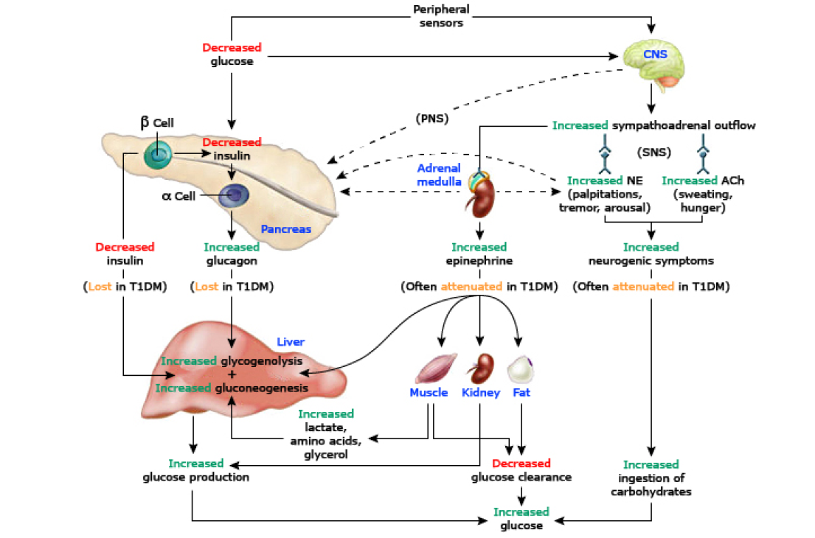

Slide 13
HAAF
Patients with impaired counterregulation have at least a 25-fold increased risk for severe hypoglycemia compared with patients with a defective glucagon response but normal epinephrine responses
  Hypoglycemia unawareness occurs in 20–25% of adults T1DM and is associated with 6-fold increased risk for severe hypoglycemia

Slide 14
Nocturnal hypoglycemia
Longest interprandial period and time between SMBG
Time of maximum sensitivity to insulin
Sympathoadrenal responses are reduced further during sleep

Slide 15
Sleep-Related HAAF
Sleeping patients with T1DM have both increased defective glucose counterregulation (a further reduced epinephrine response, in the setting of absent insulin and glucagon responses) and a form of hypoglycemia unawareness (reduced arousal from sleep), the two components of HAAF in diabetes.
Jones TW, et al. N Engl J Med 338:1657, 1998
Banarer S, et al. Diabetes 52:1195, 2003

Slide 16
HAAF is largely preventable and/or reversible
A little as 2–3 week of scrupulous avoidance of treatment-induced hypoglycemia reverses hypoglycemia unawareness, and improves the reduced epinephrine component of defective glucose counterregulation in most affected patients
Diabetes,1994, 43:1426–1434
Lancet , 1994,344:283–287

Slide 17
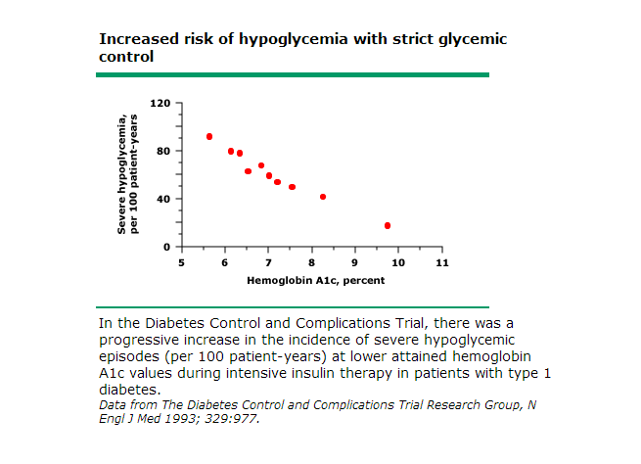

Slide 19
Hypoglycemia is Frequently
Unrecognized by Patients
Many episodes are asymptomatic; CGMS data show that unrecognized hypoglycemia is common in people with insulin-treated diabetes
  In one study, 63% of patients with type 1 diabetes and 47% of patients with type 2 diabetes had unrecognized hypoglycemia as measured by CGMS (n=70)¹
74% of all events occurred at night
CGMS, continuous glucose monitoring system
Chico et al. Diabetes Care 2003;26(4):1153–7
Notes:
Hypoglycemic episodes often go unrecognised by patients
Key message: CGMS data have demonstrated that unrecognised hypoglycaemic episodes are common and often occur at night.
Chico study: This study evaluated the usefulness of a continuous glucose monitoring system (CGMS) for identifying unrecognised hypoglycaemia in patients with T1DM and T2DM. A total of 70 patients were monitored using CGMS, and the frequency of asymptomatic hypoglycaemia detected by the CGMS (glucose values <3.3 mmol/L) was calculated. Unrecognised hypoglycaemia was identified in 63% of patients with T1DM and 47% of patients with T2DM, as measured by CGMS (n=70) — 74% of all events occurred at night.¹
Weber study: CGMS was used for ≥3 days to identify hypoglycaemia in patients with T2DM (n=31). Similar to the Chico study, there were a substantial number of hypoglycaemic episodes that went unrecognised by patients. Hypoglycaemic events were categorised as ≤2.79 mmol/L and borderline events as 2.8–3.9 mmol/L — duration and time of day were also recorded. A total of 83% of hypoglycaemic episodes were recognised by CGMS and unnoticed by patients. Of the total classified hypoglycaemic and borderline events, 54% were nocturnal, and all of these went unnoticed by patients.²
References
Chico A, Vidal-Ríos P, Subirà M, Novials A. The continuous glucose monitoring system is useful for detecting unrecognized hypoglycemias in patients with type 1 and type 2 diabetes but is not better than frequent capillary glucose measurements for improving metabolic control. Diabetes Care 2003;26(4):1153–7.
Weber KK, Lohmann T, Busch K, Donati-Hirsch I, Riel R. High frequency of unrecognized hypoglycaemias in patients with type 2 diabetes is discovered by continuous glucose monitoring. Exp Clin Endocrinol Diabetes 2007;115(8):491–4.

Slide 20
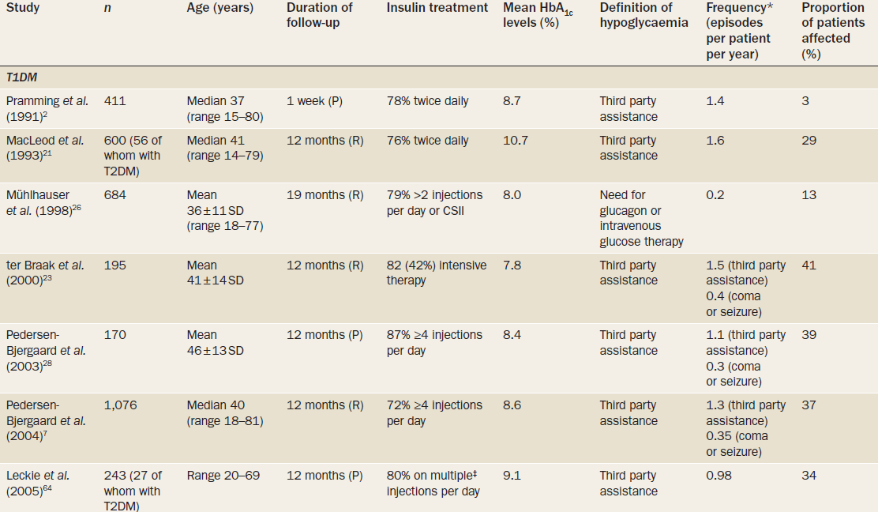

Slide 21
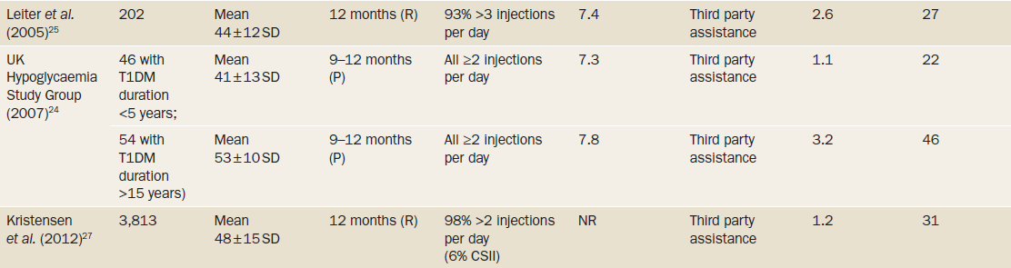

Slide 22
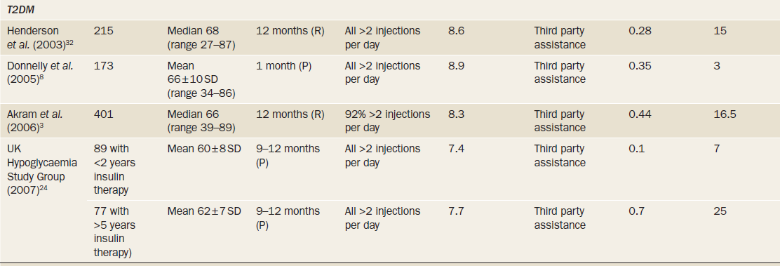

Slide 23
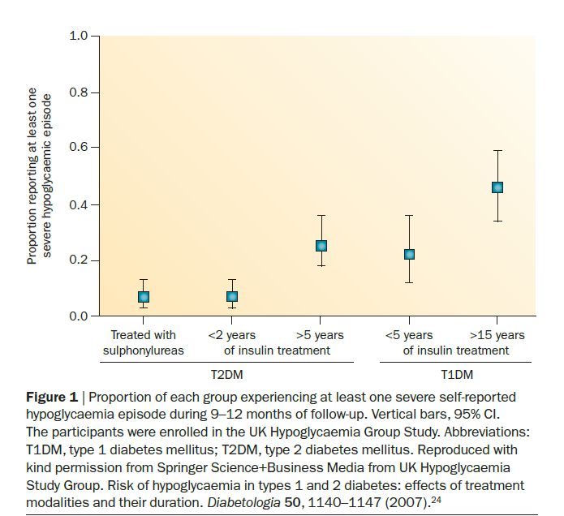

Slide 24
Non-interventional, multicentre, 6-month retrospective and 4-week prospective study using self-assessment questionnaire and patient diaries included 27 585 patients, aged ≥18 years, with type 1 diabetes (T1D; n=8022) or type 2 diabetes (T2D; n=19 563) treated with insulin for >12 months, at 2004 sites in 24 countries worldwide.
Diabetes, Obesity and Metabolism 18: 907–915, 2016.

Slide 25
Results
During the prospective period, 83.0% of patients with T1D and 46.5% of patients with T2D reported hypoglycemia
Rates of any, nocturnal and severe hypoglycemia were 73.3 ,11.3 and 4.9 events/patient-year for T1D and 19.3 ,3.7 and 2.5 events/patient-year for T2D, respectively
HA1c level was not a significant predictor of hypoglycemia

Slide 27
Hypoglycemia was common at all levels of glycemic control. Patients achieving near-normal glycemia (<6%) and those who were poorly controlled (>9%) appeared to be at the
highest risk for severe hypoglycemia
The conventional wisdom that patients with lowest HbA1c levels are at highest
risk of hypoglycemia was not supported by our findings.
Diabetes Care 36:3535–3542, 2013

Slide 28
To determine the association of proximal HbA1C level with first hypoglycemia hospitalization (HH) in adults with incident type 2 diabetes (T2D)
A nested case-control study in England in 1997 to 2014
J Clin Endocrinol Metab 104: 1989–1998, 2019

Slide 29
The U-shaped association between proximal HbA1C
level and first hypoglycemia hospitalization
OR=1.54 (1.12 to 2.11)
OR=1.48 (1.01 to 2.17)
Proximal HbA1c %

Slide 30
For proximal HbA1C level of 4.0% to 6.5%, every additional 0.5% increase in HbA1C was associated with lower first HH risk, with ORs (95% CI) ranging between 0.37 (0.20 to 0.67) and 0.86 (0.76 to 0.98)

Slide 31
For proximal HbA1C level of 8.0% to 11.5%, every additional 0.5% increase in HbA1C was associated with higher first HH risk, with ORs (95% CI) ranging between 1.16 (1.04 to 1.29) and 1.34 (1.18 to 1.52)

Slide 32
The U-shaped association did not exist among current
sulfonylurea users but remained among current insulin users

Slide 34
Severe hypoglycemia is associated with major CV outcomes
In ORIGIN*, severe hypoglycemia was associated with a greater risk for the major CV events, mortality, CV death and arrhythmic death
Severe hypoglycemia
Adjusted HR (95% CI) P value
CV death or nonfatal MI or stroke
Total mortality
CV death
Arrhythmic death
1.58 (1.24–2.02) <0.001
1.77 (1.39–2.19) <0.001
1.71 (1.27–2.30) <0.001
1.77 (1.17–2.67) 0.007
0.5
1.0
1.5
2.0
2.5
3.0
3.5
ORIGIN
IGT, IFG or early T2DM at high CV risk; N=12,537
Randomized to Lantus® (target FPG ≤95 mg/dL [5.3 mmol/L]) vs standard care for 6.2 years
SAGLB.DIA.14.06.0065a / 2014.06
Notes:
34

Slide 35
Aim: To assess the relationship between severe hypoglycemia and the subsequent risks of vascular complications and death among 11,140 patients with type 2 diabetes who participated in
ADVANCE study
N Engl J Med 2010;363:1410-8.

Slide 38
Covariates included sex, duration of diabetes, treatment assignment, presence or absence of a history of macrovascular disease, presence or absence of a history of microvascular disease, and smoking status at baseline. Time-dependent covariates during follow-up included age; level of glycated hemoglobin; body-mass index; creatinine level; ratio of urinary albumin to creatinine; systolic blood pressure; use or nonuse of sulfonylurea, metformin, thiazolidinedione, insulin, or any other diabetes drug; and use or nonuse of antihypertensive agents

Slide 40
Key messages
Severe hypoglycemia was strongly associated with increased risks of a range of adverse clinical outcomes
Neither a close temporal relationship nor a dose–response relationship was observed
It is possible that severe hypoglycemia contributes to adverse outcomes, but these analyses indicate that hypoglycemia is just as likely to be a marker of vulnerability to such events

Slide 41
Lancet Diabetes Endocrinol 2019 Published Online March 26, 2019

Slide 42
Studies linking hypoglycemia to cardiovascular events and mortality

Slide 43
Pathophysiological cardiovascular consequences of hypoglycemia

Slide 44
Conclusions
Emerging evidence suggests that the association between hypoglycemia and cardiovascular events and mortality is likely to be multifactorial
The association is probably partly caused by confounding, with hypoglycemia occurring more frequently in people with comorbidities who are also more likely to die than those without
However, people with type 1 or type 2 diabetes also seem at risk of hypoglycemia-induced cardiovascular effects

Slide 45
Nonsevere nocturnal hypoglycemia event (NSNHE) impacts daily function
International survey of 2,108 patients with T1DM or T2DM who reported a NSNHE in the prior month
Impact on well-being
  10.4% woke up from the NSNHE and did not go back to sleep
  79.3% said the event impacted their functioning the following day
  60.7% reported moderate to severe impact on next day functioning
  63.7% said emotional functioning was impacted
  43.7% said social functioning was impacted
74.2% used insulin
The rest took monotherapy with oral agents
32.1% had several
NSNHE events
The rest did not report experiencing several NSNHE events

Slide 46
Fear of hypoglycemia reduces patient adherence
Proportion of patients modifying insulin dose
to avoid future hypoglycemia
Patients, %
90
T1DM
80
T2DM
70
74.1
78.2
60
50
57.9
40
43.3
30
20
10
0
Following mild episodes
Following severe episodes
Leiter LA et al. Can J Diabetes 2005;29:186-192.
Notes:
46

Slide 47
Strategies to prevent hypoglycemia
Patient education
Individualized glycemic goal
Glucose monitoring
Medication adjustment
Clinical surveillance
J Clin Endocrinol Metab 98: 1845–1859, 2013

Slide 48
Design : Randomized design with participants either attending training immediately (immediate DAFNE) or acting as waiting list controls and attending “delayed DAFNE” training 6 months later
Participants: 169 adults with type 1 diabetes and
moderate or poor glycemic control.
Main outcome measures : HbA1c, severe hypoglycemia, impact of diabetes on quality of life
bmj.com 2002;325:746

Slide 49
DAFNE training significantly improved HbA1C, with no significant increase in severe hypoglycemia

Slide 50
Aim : To determine benefits in routine practice, we collected biomedical and psychological data from all participants attending during a 12-month period
METHOD : HbA1c, weight, self-reported hypoglycemia awareness, severe hypoglycemia frequency, PAID (Problem Areas In Diabetes), HADS (Hospital Anxiety and Depression Scale), and EuroQol Group 5-Dimension Self-Report Questionnaire scores were recorded prior to DAFNE and after 1 year
Diabetes Care 35:1638–1642, 2012

Slide 53
Key message
A structured education program delivered in routine clinical practice not only improves HbA1c while reducing severe hypoglycemia rate and restoring hypoglycemia awareness but also reduces psychological distress and improves perceived well-being

Slide 54
Aims: Bournemouth Type 1 Intensive Education (BERTIE) is a structured education course delivered 1 day a week for 4 weeks for self-management of type 1 diabetes
BERTIE outcomes were analzsed to assess long-term effectiveness: primary outcome assessed impact of BERTIE on glycaemic control, secondary outcomes assessed impact on Problem Area in Diabetes (PAID) scale, severe hypoglycemia and diabetic ketoacidosis incidence
d i a b e t e s r e s e a r c h a n d c l i n i c a l p r a c t i c e 1 4 3 ( 2 0 1 8 ) 2 7 5 –2 8 1

Slide 55
HbA1c was reduced from 8.9 ± 1.6% at baseline to 8.6 ± 1.4%) at 1 year and 8.6 ± 1.3%)at 5 years (p < 0.0001)

Slide 56
Structured education has favorable effect on hypoglycemia

Slide 57
Lancet Diabetes Endocrinol 2017Published Online September 29, 2017

Slide 58
Key outcomes of a selection of the most well-established self management education programmes evaluated in the past 30 years meeting structured education criteria in type 1 diabetes

Slide 59
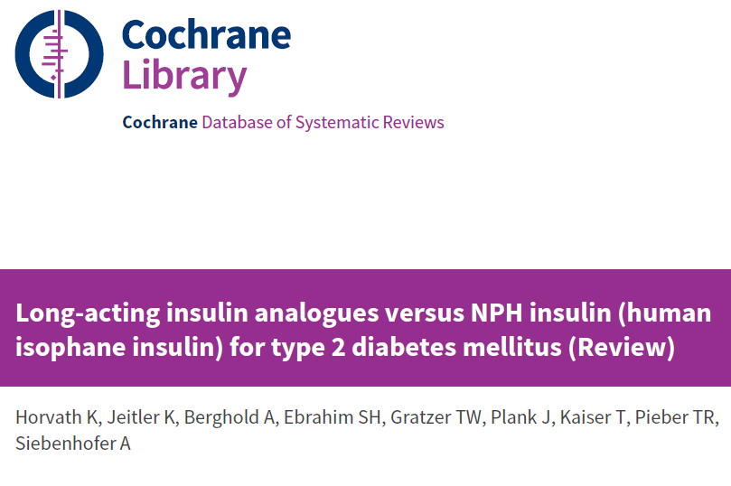
Cochrane Database of Systematic Reviews 2007, Issue 2.

Slide 60
Objectives:
  To assess the effects of long-term treatment with insulin glargine and insulin detemir compared to NPH insulin in patients with type 2 diabetes mellitus.
Selection criteria:
  Randomised controlled trials with duration of at least 24 weeks.
Primary outcomes:
  Number of overall, severe and nocturnal hypoglycemia.
  Glycemic control (HbA1c).
Results:
  6 studies: Glargine vs NPH
  2 studies: Detemir vs NPH
Cochrane Database of Systematic Reviews 2007, Issue 2.

Slide 61
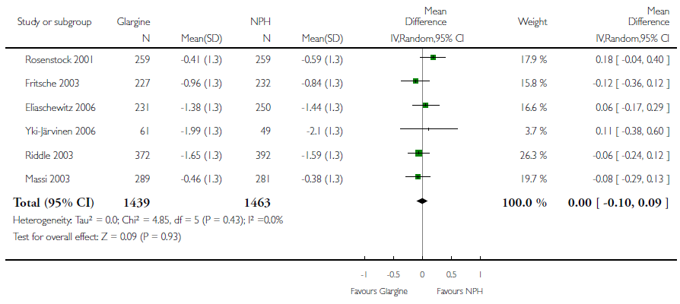
Change in HbA1c: Insulin glargine vs NPH
No difference
Cochrane Database of Systematic Reviews 2007, Issue 2.

Slide 62
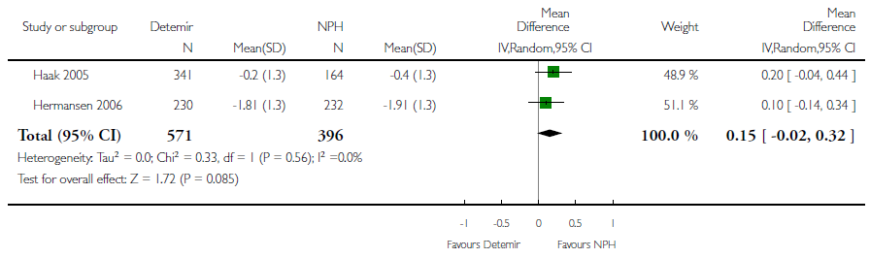
Change in HbA1c: Insulin detemir vs NPH
No difference
Cochrane Database of Systematic Reviews 2007, Issue 2.

Slide 63
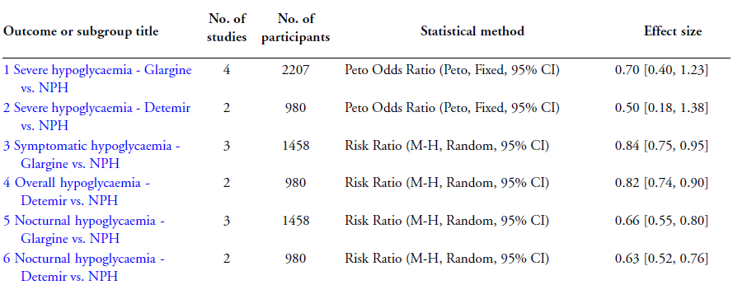
Fewer people experienced symptomatic, overall or nocturnal hypoglycemic episodes with treatment with either insulin glargine or detemir
Cochrane Database of Systematic Reviews 2007, Issue 2.

Slide 64
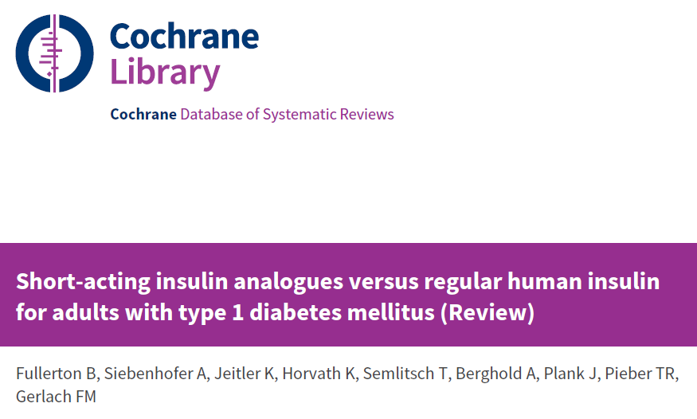
Cochrane Database of Systematic Reviews 2016, Issue 6.

Slide 65
Short-acting insulin analogues versus regular human insulin for adults with type 1 diabetes mellitus
Results:
  9 trials (2693 participants)
  The participants showed some diversity, mainly with regard to diabetes duration and inclusion/exclusion criteria. The majority of the trials were carried out in the 1990s and participants were recruited from Europe, North America, Africa and Asia. None of the trials was carried out in a blinded manner so that the risk of performance bias, especially for subjective outcomes such as hypoglycemia, was present in all of the trials. Furthermore, several trials showed inconsistencies in the reporting of methods and results.
Cochrane Database of Systematic Reviews 2016, Issue 6.

Slide 66
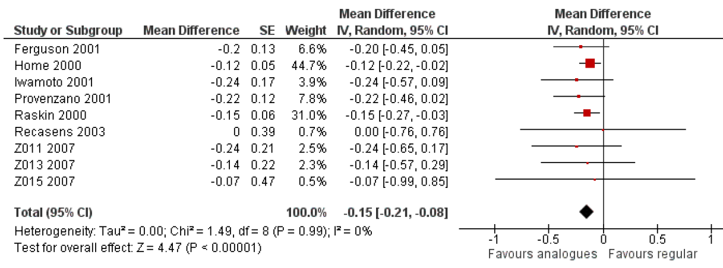
The mean difference in HbA1c was in favor of insulin analogues.
Cochrane Database of Systematic Reviews 2016, Issue 6.

Slide 67
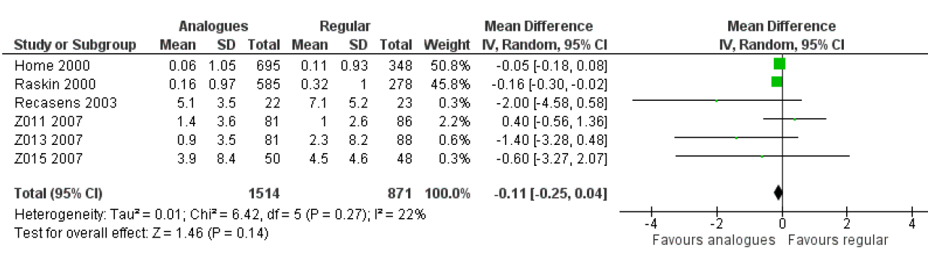
Weight gain
No difference
Cochrane Database of Systematic Reviews 2016, Issue 6.

Slide 68
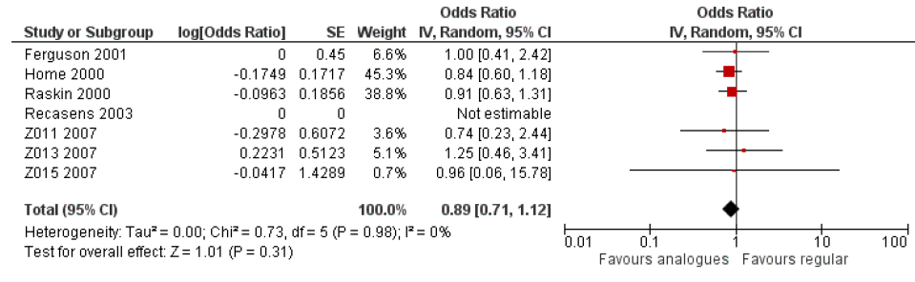
Severe hypoglycemic episodes
No difference
Regarding nocturnal severe hypoglycemic episodes, two trials reported statistically significant effects in favour of the insulin analogue, insulin aspart. (questionable validity)
Cochrane Database of Systematic Reviews 2016, Issue 6.

Slide 69
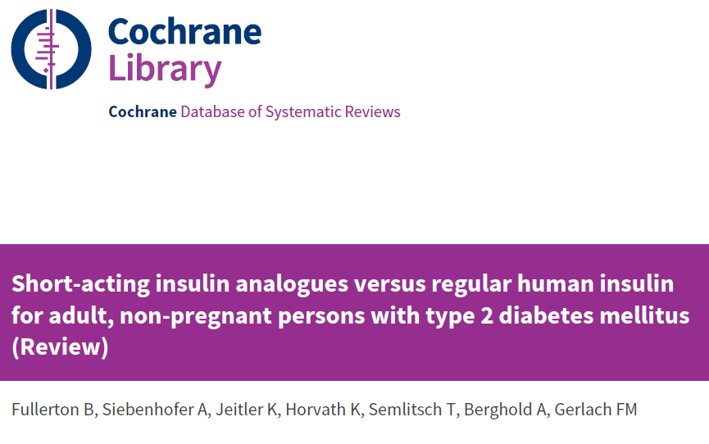
Cochrane Database of Systematic Reviews 2018, Issue 12.

Slide 70
Short-acting insulin analogues versus regular human insulin for adult, non-pregnant persons with type 2 diabetes mellitus
Results:
  10 trials (2751 participants)
  The trial populations showed diversity in disease duration, and inclusion and exclusion criteria. None of the trials were blinded, so the risk of performance bias and detection bias, especially for subjective outcomes, such as hypoglycaemia, was high in nine of 10 trials.
Cochrane Database of Systematic Reviews 2018, Issue 12.

Slide 71
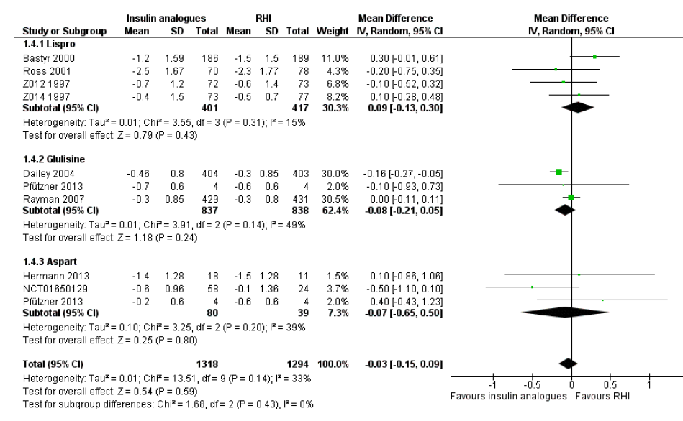
HbA1c change
No difference
Cochrane Database of Systematic Reviews 2018, Issue 12.

Slide 72
Results
None of the included trials defined all-cause mortality as a primary outcome.
Overall, the incidence of severe hypoglycemic events was low, and none of the trials showed a clear difference between the two intervention arms. Meta-analysis could not be done because of different assessments of hypoglycemic events.
The results provided for nocturnal hypoglycemic episodes were of questionable validity. Overall, there was no clear difference between the two short-acting insulin analogues and regular human insulin.
No trial was designed to investigate possible long term effects (all-cause mortality, microvascular or macrovascular complications of diabetes), especially in participants with diabetes-related complications. No trial reported on socioeconomic effects.
Cochrane Database of Systematic Reviews 2018, Issue 12.

Slide 75
Transplant Interventions
….In fact, islet and pancreas transplants are the only approaches to date that confer both sustained recovery from HAAF and restoration of glucose counterregulation (by endogenous glucose production) and, thereby, reliable protection from SH in patients with long-standing(>15 years) T1D….

Slide 77
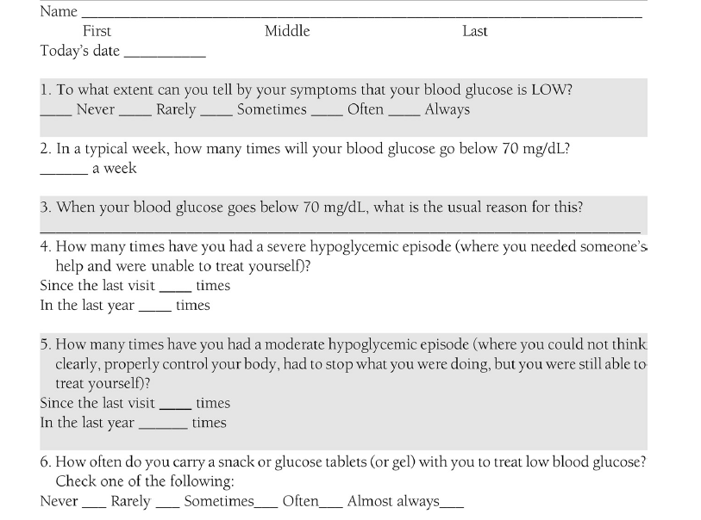
Hypoglycemia Patient Questionnaire

Slide 78
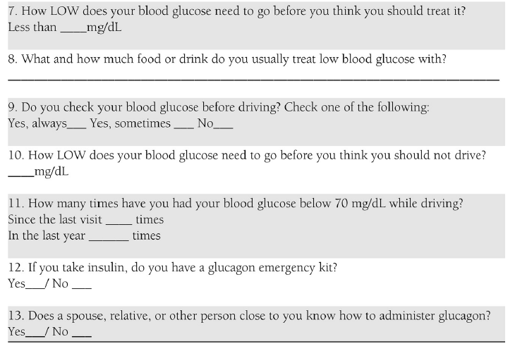
Hypoglycemia Patient Questionnaire

Slide 79
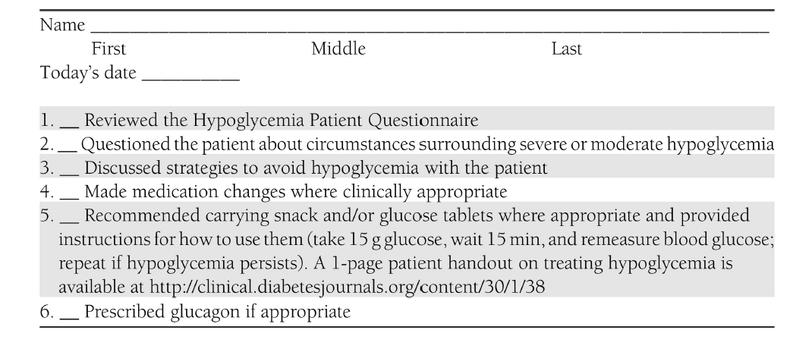
Hypoglycemia Provider Checklist

Slide 81
Hypoglycemia: Recommendations
Individuals at risk for hypoglycemia should be asked about symptomatic and asymptomatic hypoglycemia at each encounter. C
Glucose (15–20 g) is the preferred treatment for the conscious individual with blood glucose <70 mg/dL, although any form of carbohydrate that contains glucose may be used. Fifteen minutes after treatment, if SMBG shows continued hypoglycemia, the treatment should be repeated. Once SMBG returns to normal, the individual should consume a meal or snack to prevent recurrence of hypoglycemia. E
Notes:
Moving on to hypoglycemia recommendations, hypoglycemia is the leading limiting factor in the glycemic management of patients with type 1 and insulin-treated type 2 diabetes.
Individuals at risk for hypoglycemia should be asked about symptomatic and asymptomatic hypoglycemia at each encounter. C [CLICK]
Glucose (15–20 g) is the preferred treatment for the conscious individual with blood glucose <70 mg/dL, although any form of carbohydrate that contains glucose may be used. Fifteen minutes after treatment, if SMBG shows continued hypoglycemia, the treatment should be repeated. Once SMBG returns to normal, the individual should consume a meal or snack to prevent recurrence of hypoglycemia. E
[SLIDE]
81
References
Cryer PE. Hypoglycaemia: the limiting factor in the glycaemic management of Type I and Type II diabetes. Diabetologia 2002;45:937–948
American Diabetes Association. Standards of medical care in diabetes—2014. Diabetes Care 2014;37(suppl 1):S33–S34

Slide 82
Hypoglycemia: Recommendations (2)
Glucagon should be prescribed for all individuals at increased risk of clinically significant hypoglycemia, defined as blood glucose < 54 mg/dL, so it is available if needed. Caregivers, school personnel, or family members of these individuals should know where it is and when and how to administer it. Glucagon administration is not limited to health care professionals. E
Hypoglycemia unawareness or one or more episodes of severe hypoglycemia should trigger reevaluation of the treatment regimen. E
Notes:
Glucagon should be prescribed for all individuals at increased risk of clinically significant hypoglycemia, defined as blood glucose < 54 mg/dL, so it is available if needed. Caregivers, school personnel, or family members of these individuals should know where it is and when and how to administer it. Glucagon administration is not limited to health care professionals. E
A glucagon kit does require a prescription; some patients may want more than one kit, for example, one to keep at school or work and another for home. Care should be taken to ensure that glucagon kits are not expired; its worth reminding patients to check expiration dates upon receipt and perhaps jotting the date down on a calendar. [CLICK]
Hypoglycemia unawareness or one or more episodes of severe hypoglycemia should trigger reevaluation of the treatment regimen. E
[SLIDE]
82
References
Cryer PE. Hypoglycaemia: the limiting factor in the glycaemic management of Type I and Type II diabetes. Diabetologia 2002;45:937–948
American Diabetes Association. Standards of medical care in diabetes—2014. Diabetes Care 2014;37(suppl 1):S33–S34

Slide 83
Hypoglycemia: Recommendations (3)
Insulin-treated patients with hypoglycemia unawareness or an episode of clinically significant hypoglycemia should be advised to raise their glycemic targets to strictly avoid hypoglycemia for at least several weeks in order to partially reverse hypoglycemia unawareness and reduce risk of future episodes. A
Ongoing assessment of cognitive function is suggested with increased vigilance for hypoglycemia by the clinician, patient, and caregivers if low cognition or declining cognition is found. B
Notes:
Insulin-treated patients with hypoglycemia unawareness or an episode of clinically significant hypoglycemia should be advised to raise their glycemic targets to strictly avoid hypoglycemia for at least several weeks in order to partially reverse hypoglycemia unawareness and reduce risk of future episodes. A [CLICK]
And finally, do conduct ongoing assessments of cognitive function, and if low or declining cognition is found, exercise increased vigilance for hypoglycemia.
A large cohort study suggested that among older adults with type 2 diabetes, a history of severe hypoglycemia was associated with greater risk of dementia
Conversely, in a substudy of the ACCORD trial, cognitive impairment at baseline or decline in cognitive function during the trial was significantly associated with subsequent episodes of severe hypoglycemia.
Mild hypoglycemia may be inconvenient or frightening to patients with diabetes. Severe hypoglycemia can cause acute harm to the person with diabetes or others, especially if it causes falls, motor vehicle accidents, or other injury.
[SLIDE]
83
Reference
American Diabetes Association. Standards of medical care in diabetes—2014. Diabetes Care 2014;37(suppl 1):S33–S34

Slide 84
Take-Home Messages
Adults with type 1 diabetes mellitus have nearly 2 episodes of mild hypoglycemia per week; the annual prevalence of severe hypoglycemia is 30%, with several factors, such as long disease duration, increasing its incidence
Adults with insulin-treated type 2 diabetes mellitus experience a lower frequency of mild and severe hypoglycemia episodes than those with type 1 diabetes mellitus, but frequency rises progressively with increasing duration of insulin therapy

Slide 85
Take-Home Messages
Severe hypoglycemia is strongly associated with increased risks of cardiovascular events and mortality
The association is probably partly caused by confounding , indicating that hypoglycemia is just as likely to be a marker of vulnerability to such events
However, people with type 1 or type 2 diabetes also seem at risk of hypoglycemia-induced cardiovascular effects

Slide 86
Take-Home Messages
Prevention of hypoglycemia depends on effective patient education, diet, exercise, frequent glucose monitoring and appropriate adjustment of therapies
New technologies, such as real-time continuous glucose monitoring and insulin pumps, might also help
Islet or a pancreas transplantation as an emerging tool can help Type 1 Diabetes complicated by problematic hypoglycemia

