Slide 1
In the Name of God

Slide 2
Pateint ID
Age:17 y-o girl
Education: High school student
Habitation:Tehran
Marital status: Single

Slide 3
CC:Refered to w/u Hypercalcemia
PI: The patient is a 17 y-o girl that had a physician consult 5 mo ago for GI upset & epigastric pain (which was accelerated after meal & reduced by PPI,no radiation,no concomitant symptoms) in addition to hypermenorrhea(since her puberty & her mother was concerned about anemia)

Slide 4
A complete blood test was done due to patient request;
 | 95/5/1 | 95/5/8
Ca mg/dl | 10.8 (8.4_10.2) | 10.8
Ph mg/dl | 2.8 (2.5_4.8) | 3.1
PTH pg/ml |  | 58.1
ALK_p U/L |  | 51
25 (OH)vitD ng/ml | 16.1
Ionized Ca |  | 5.53 (nl<4.8)

Slide 5
She had no complaint of anorexia, N/V, constipation ,polyuria ,polydipsia, hematuria ,flank pain ,fatigue , muscular weakness, headaches or irritability.
She had anxiety & mood disorder and now she is under treatment
The abdominal pain had been relieved after two weeks w/o any intervention
She had regular menstruation since puberty w/o Hirsutism or Galactorrhea

Slide 6
The patient was referred to an endocrinologist for further study;she received medication for Vit D deficiency & blood test repeated after 3 mo.
C
CCCR:
Ca urine x Cr serum →0.0139
Ca serum x Cr urine
(Cr:0.6 mg/dl)
Prolactin(ng/ml): 12.33
(95/9/18)
U/a 24 h | 95/5/15 | 95/5/22 | 95/9/18
Ca Mg/24h | 127 |  | 174
Cr Mg/24h | 737 |  | 700
Volume Ml/24h | 1100 |  | 1000
Serum ca |  | 10.8 | 10.7
Serum Ph |  | 3 | 3.3
Serum PTH |  | 50.8 | iPTH: 47.7
25 OH Vit D ng/ml |  | 14.2 | 24.7

Slide 7
95/8/13

Slide 8
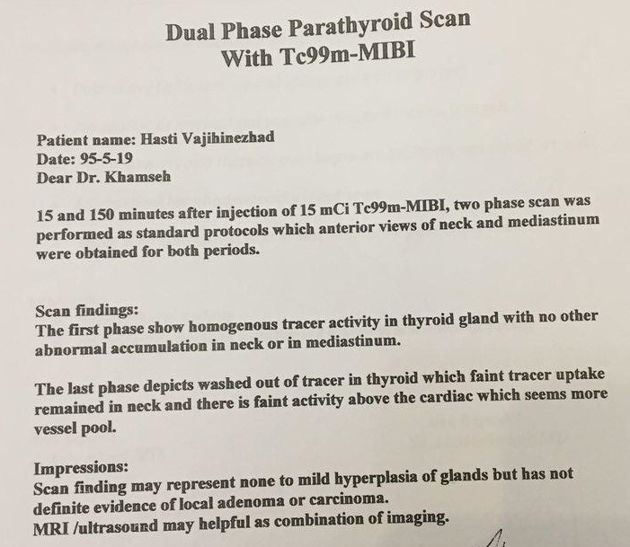

Slide 9
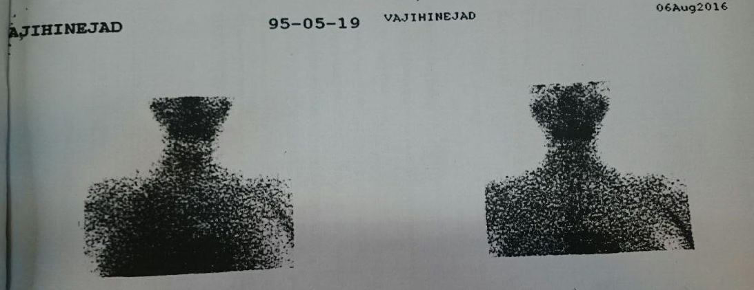

Slide 10
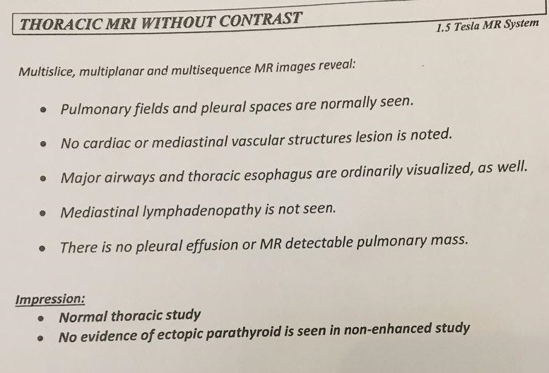

Slide 11
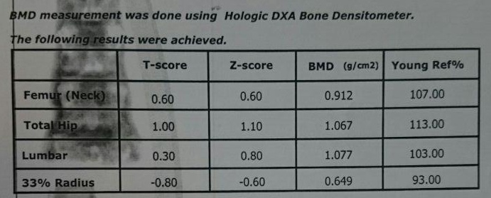
95/9/29

Slide 12
PMH: Obsession disorders treated 4 yr ago
Anxiety and mood disorder since months ago,under treatment
No Hx of pathologic Fx,PUD, chronic diarrhea,nephrolithiasis
No Hx of FTT,hypotonia or skeletal abnormalities in infancy & childhood
DH: Sertraline,Haloperidol,Oxazepam

Slide 13
FH: Hyperthyroidism in father received I therapy
Hypothyroidism & Anti TPO(+) in paternal family members.
Nephrolithiasis in father and uncle,Major depression in her father
No Hx of Hypercalcemia, pathologic Fx,GI surgery in relatives
 | مادر | پدر
Ca | 9.4 | 9.8
Ph | 3.7 | 3.5
Mg | 2
25 hydroxy vit D | 29.1 | 10.7
PTH(pg/ml) |  | 30

Slide 14
PH/E
Ht:176 cm(m'Ht:172,f 'Ht:188) P5B5
BMI:21
BP:90/60 PR:90
Skin: Rash(-) skin tag (-)
H&N: Sclera pale(+)
Thyroid→diffuse enlargement (~25 gr,soft consistency, no nudule)

Slide 15
Chest & Abdomen:NO remarkable physical findings
Extrimities: Muscle force→ NL
Bone tenderness (-) Neurologic Exam→ NL

Slide 16
Problem List:
A 17 y-o girl with hypercalcemia & PTH in Lab data
w/o no sign & symptoms of Hypercalcemia
w/o family Hx of Hypercalcemia.

