Slide 1
Approach to a patient with 46xx DSD without history of medical treatment
s.Jafary nodushan
Fellow of endocrinology

Slide 2
Sex Differentiation
Presence of Y chromosome induces differentiation of bipotential gonads to testes at 6-8 wks gestation.
Remaining internal and external genitalia are also bipotential.
Hormonal regulation
  Dihydrotestosterone (DHT)
  Testosterone
  Anti-Mϋllerian hormone (AMH)

Slide 3
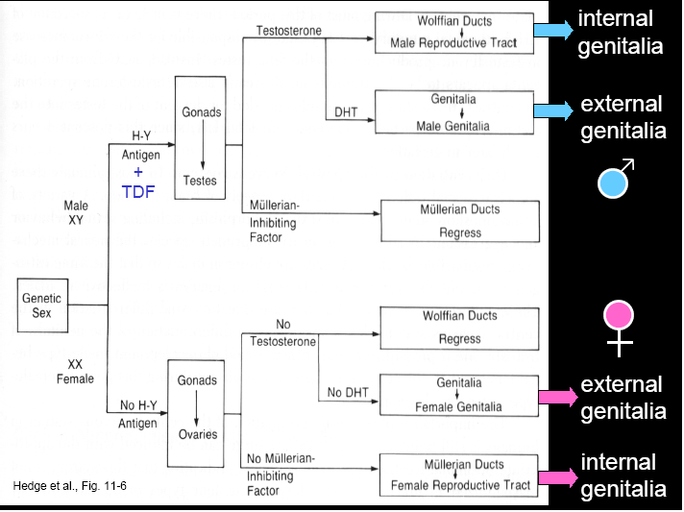

Slide 4
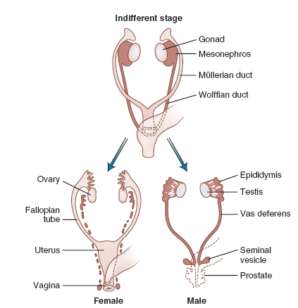
Development of Internal Genitalia

Slide 5
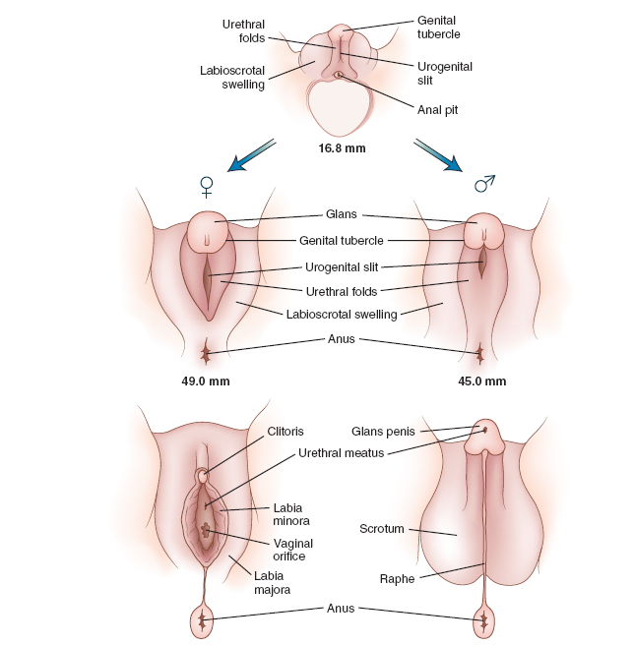
Development of External Genitalia

Slide 6
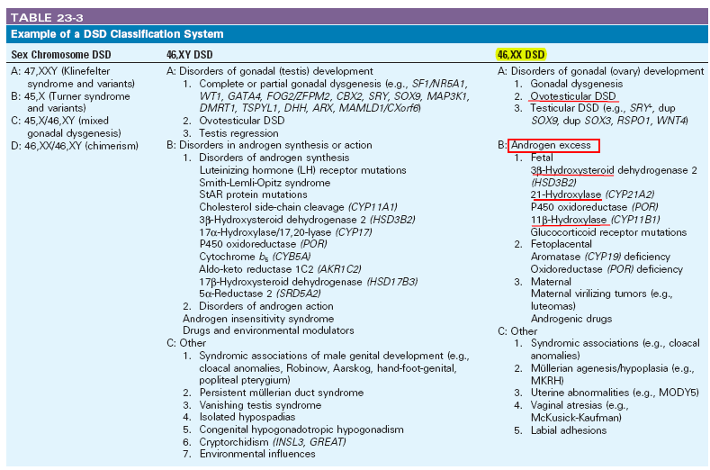
46xx DSD

Slide 7
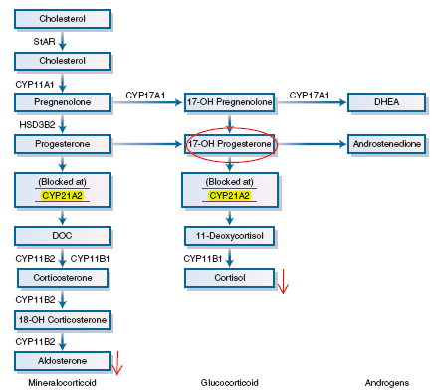
CAH related to 21-hydroxylase deficiency

Slide 8
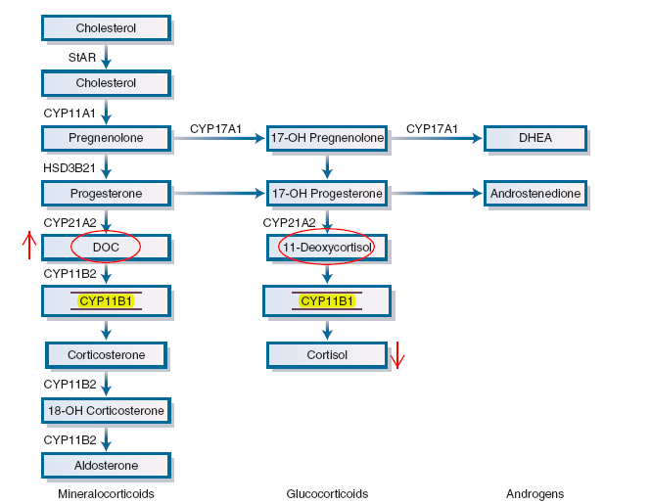
CAH related to 11β-hydroxylase deficiency.

Slide 9
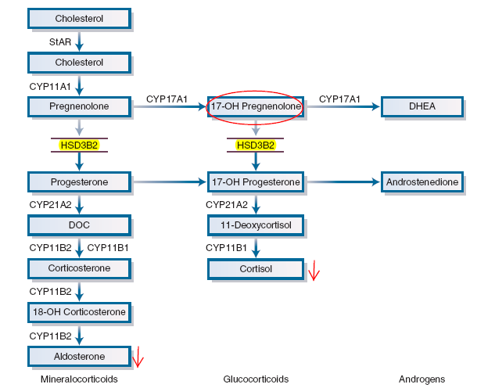
CAH related to 3β-hydroxysteroid dehydrogenase

Slide 10
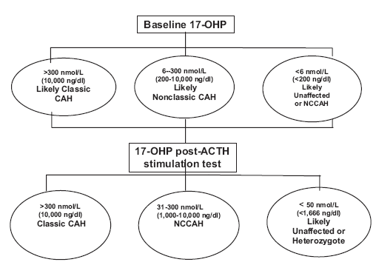
Diagnosis of CAH after infancy

Slide 11
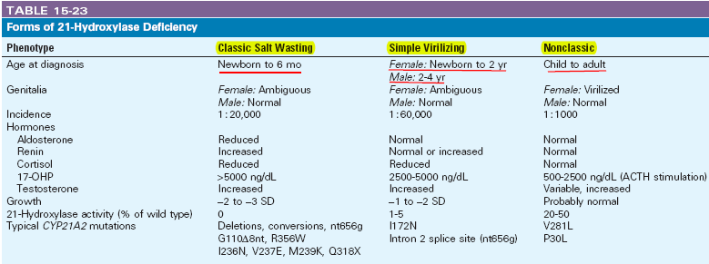
Forms of 21-hydroxylase Deficiency

Slide 12
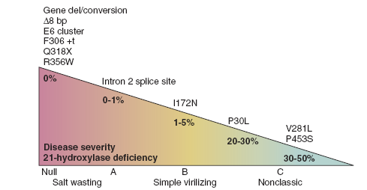
21-hydroxylase Activity

Slide 13
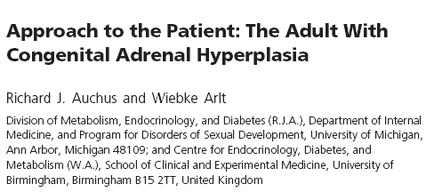

Slide 14
Health problems in CAH
Patients with 21OHD might be at increased risk for other health problems, due both to their underlying disease and to their treatments.
Lifelong glucocorticoid therapy might predispose patients with 21OHD to glucose intolerance,bone loss, and cardiovascular disease, and this risk is likely to be higher than for patients with autoimmune adrenal insufficiency, who do not require glucocorticoid dosing to control of androgen excess.

Slide 15
In contrast to the vulnerability to hypotension as children,the prevalence of hypertension appears to be increased in adolescents and adults
Several studies have shown reduced bone mineral density in adults with 21OHD. Although osteopenia is common, osteoporosis is uncommon
Adults with 21OHD tend to be short and are often obese,which might predispose to the metabolic syndrome and adverse cardiovascular risk
Some studies confirm an increased prevalence of glucose intolerance, obesity, and dyslipidemia in adults with 21OHD

Slide 16
Assessment
Initial visit
Medical history: lapses in medication, recent episodes of adrenal crisis and/or increased glucocorticoids, reasons for switching from hydrocortisone to longer-actin glucocorticoids, a brief sexual history with open-ended questions. And women should be asked about menses and use of depilation methods.

Slide 17
Physical examination
Physical examination should carefully assess signs of iatrogenic Cushing syndrome
In addition to height and weight, blood pressure and heart rate should be obtained in both the seated and standing positions.
Men should have a testicular examination to assess atrophy and presence of TARTs.
Women require an evaluation of androgen-dependent body hair growth and acne.
A brief external genital examination is necessary initially.

Slide 18
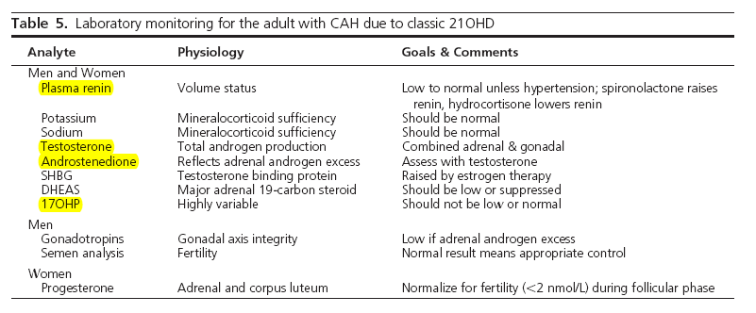
Laboratory testing

Slide 19
Imaging
Most sources recommend annual testicular sonography in males with 21OHD to screen for TARTs
Recommendations for adrenal imaging and for bone densitometry have not been established.
Adrenal Imaging should be considered for patients with a long history of poor control, inconsistent therapy, or difficult-to-control disease
dual-photon x-ray absorptiometry should be considered for patients taking chronic dexamethasone 0.5 mg/d or higher, having Cushingoid stigmata, or following a long period of suppressed 17OHP and androgens.

Slide 20
Therapy
Glucocorticoids:
Some adults with 21OHD are overtreated with 15 mg hydrocortisone daily, whereas others are grossly undertreated with 5–10 mg prednisolone twice daily. This “monogenic disease” with a clearly defined pathophysiology and biochemistry demonstrates the inherently polygenic nature of all diseases and the importance of individualizing therapy based on each patient’s goals and responses.

Slide 21
many adults with 21OHD maintain relatively normal blood pressure and functional capacity without treatment. This observation suggests that either other adrenal-derived steroids substitute for aldosterone and/or cortisol, or that a physiological compensation for low corticosteroid activity at the target organs has occurred over time.

Slide 22
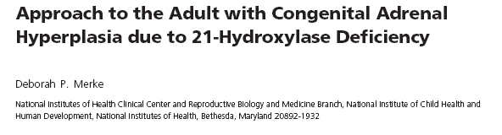

Slide 23
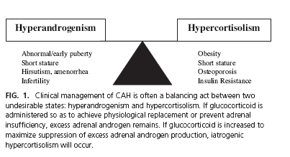

Slide 24
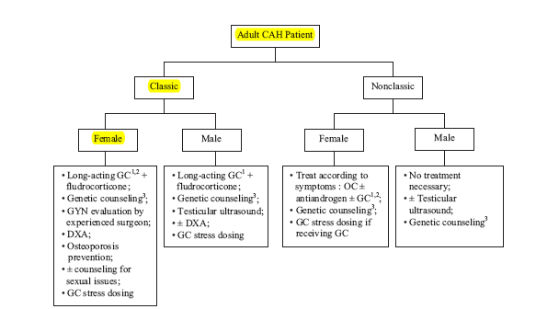

Slide 25
Bone Mineral Density (BMD)
Glucocorticoid overtreatment has been implicated as the cause of decreased BMD in multiple studies
These studies provide compelling evidence that the lowest possible glucocorticoid dose should be used in the treatment of CAH, and lower-dose and/or shorter-acting glucocorticoid may be sufficient in the middle-aged and elderly female when osteoporosis rather than fertility is a main concern.
Osteoporosis prophylaxis such as physical activity and calcium and vitamin D supplementation should be implemented at a young age. Screening dual-energy x-ray absorptiometry (DXA) should be performed in CAH adults.

Slide 26
Quality of Life and Psychological Health
Several studies have shown that classic CAH females, especially salt-losers, have more male-typical childhood play and behavior
However, CAH patients were more often single , were less sexually active, displayed more negative body image, and had more negative self-image in regard to self-confidence, sociability, and social acceptance.
Despite these findings, good physical function, active coping mechanism, and high global satisfaction with life resulted in overall high quality of life.

Slide 27
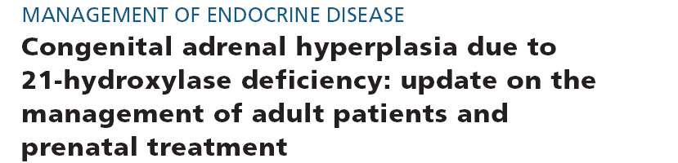


Slide 28
