Slide 1
Endocrine Grand Round “A 43-year-old man with headache”
By:
Dr. Soheila Sadeghi
Presentator:
Dr.sabk ara

Slide 2
Chief Complaint: Headache Present Illness: - 43-year-old-man / From Tabriz/married/has 2 children: 8 years and 6 months - Intermittent episodes of headache in occipital region from 8 years ago with 6month - 1 year intervals - From 4 years ago, the patient has had headache for 1 week of every month.
CC & PI
PMH & DH
FH
Review of Systems
Physical Examination
Work-Up

Slide 3
Accompanying symptoms
Bilateral blurred vision since 2 months ago (starting Cabergoline)
Galactorrhea (-)
Weight change (-)
Libido loss (-)
Hypoglycemia (-)
Nausea and vomiting (-)
Hyper pigmentation (-)
Hair loss (-)
BP change (-)
Diplopia (-)
Polyuria (-)
Polydipsia (-)
Hearing loss (-)

Slide 4
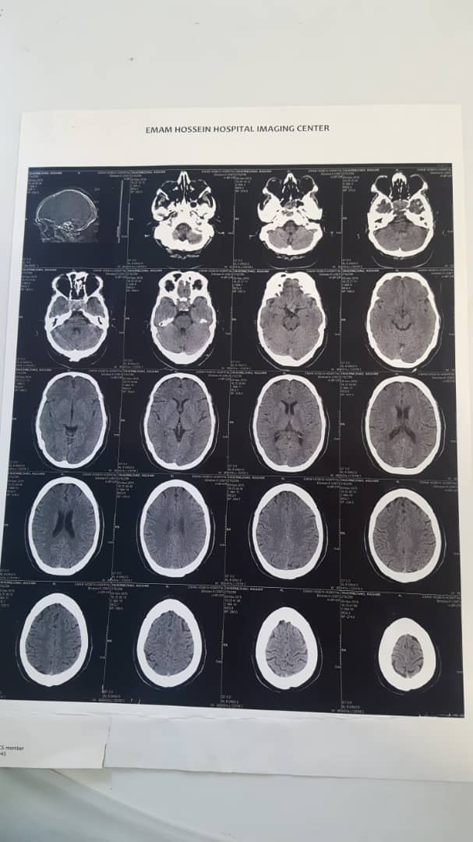
- Work-up was initiated from 2016 when he referred to Imam Hossein hospital and brain CT was taken
medical treatment
( Antibiotic with diagnosis of sinusitis)

Slide 5
Because of persistent headache, in 2017 was referred to Milad hospital
Brain MRI was taken

Slide 6
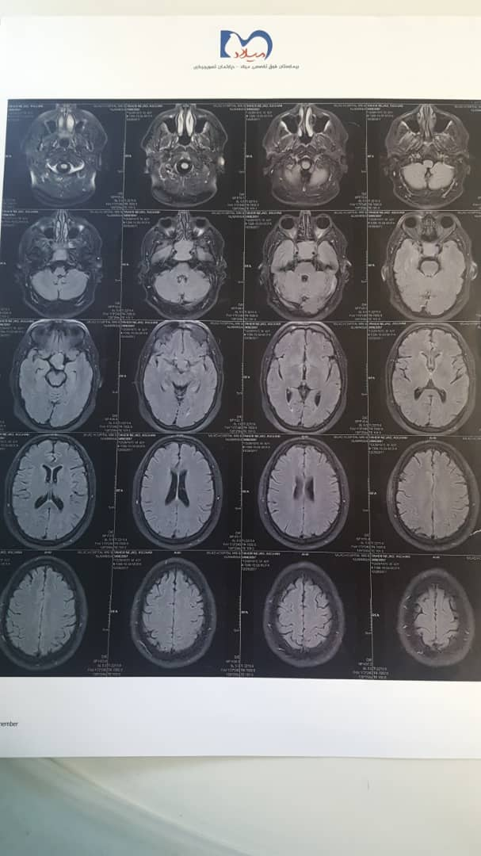
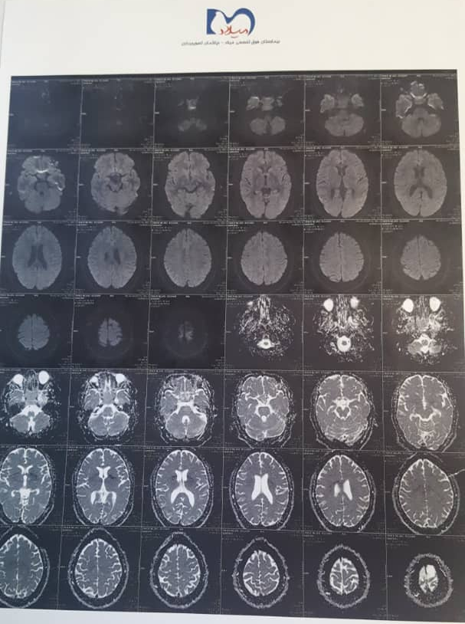

Slide 7
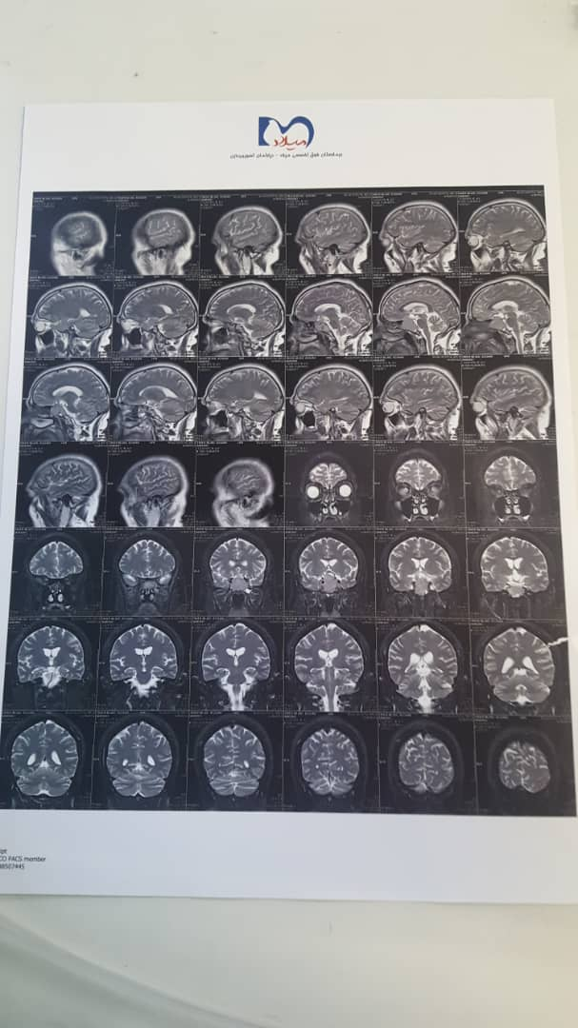
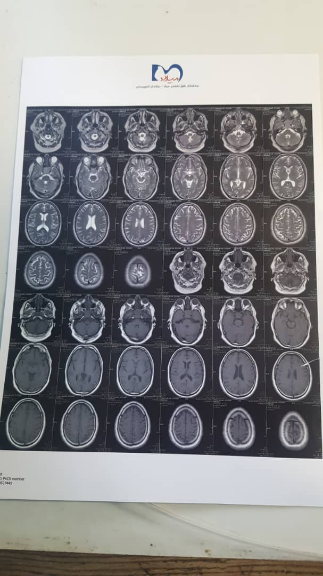

Slide 8
-medical treatment (with diagnosis of migraine)
Report : 8/10/96
Hypo signal area in sella turcica with expansion suggesting bone marrow lesions
No space occupying lesion in other regions of brain
No hydrocephaly

Slide 9
in December 2019(Farvardin 98), referred to a physician in Tabriz because of no improvement in symptoms.
MRI was taken
Laboratory investigation was done.

Slide 10
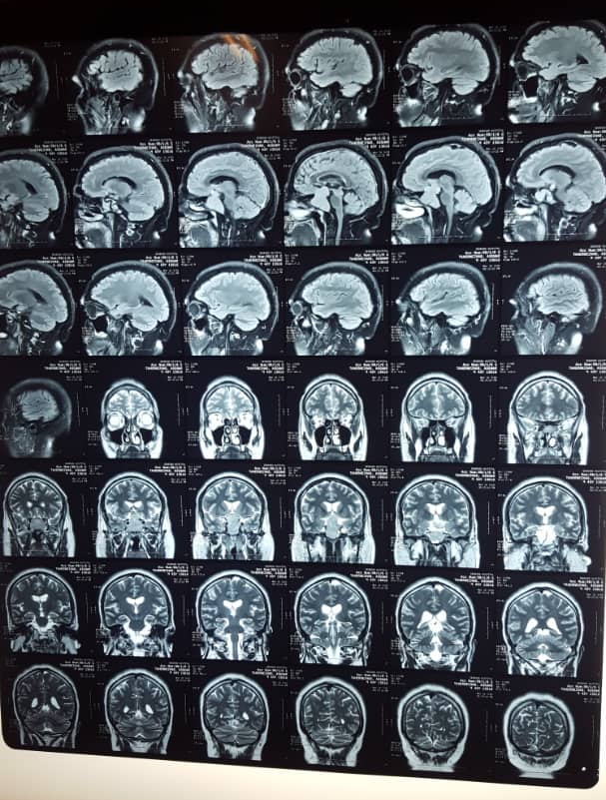

Slide 11
Report : 7/1/98
Iso signal SOL with homogenous enhancement and snowman appearance, measuring about 40*38 mm in sella, causing elevation and compression of optic chiasma and depression of floor of sella.
Enhancement of bilateral cavernous sinuses by the mass.
Pituitary macroadenoma is the most probable diagnosis.
No ischemic sign.

Slide 12
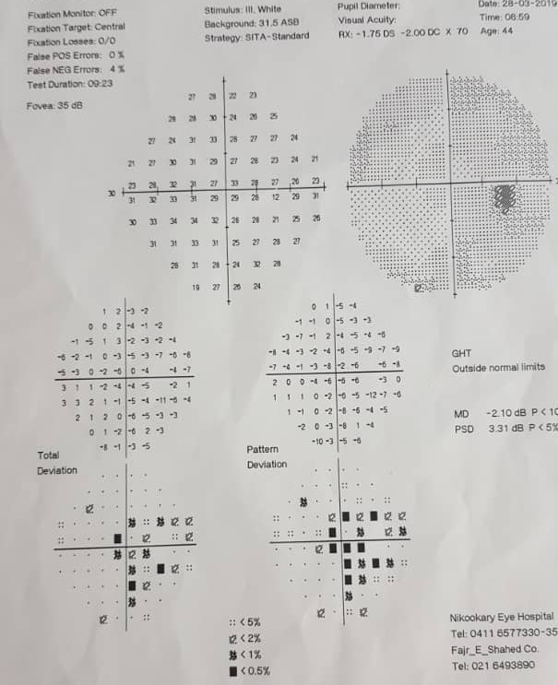
Perimetry 8/1/98 right eye

Slide 13
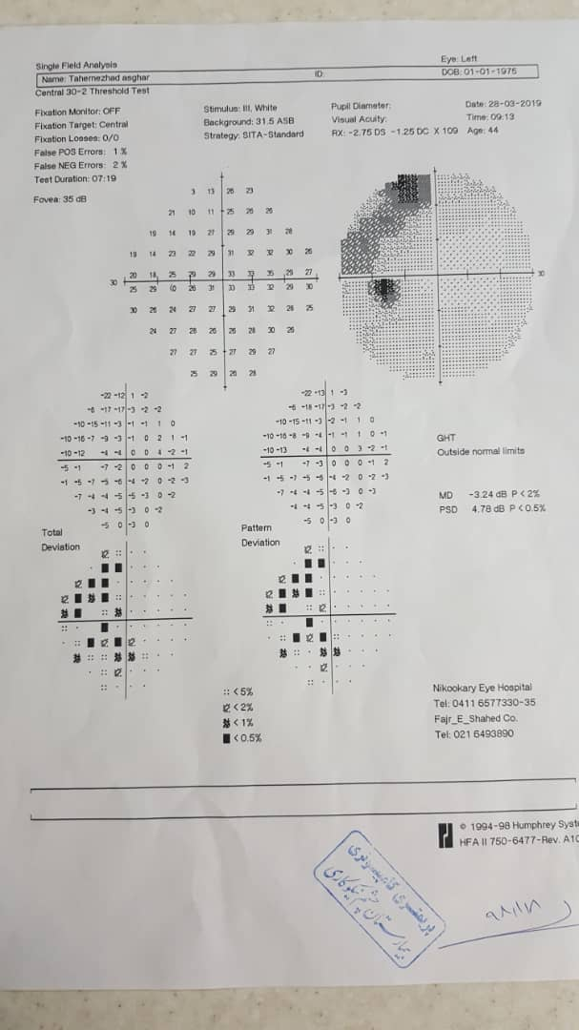
Perimetry 8/1/98 left eye

Slide 14
Lab data in 8/1/98
PRL: 23110 mIU/mL (↑) (NL range: 53-360)
PRL 1/100: 237.9 mIU/ mL (NL range: 53-360)
TSH: 2.9 micIU/U (NL range: 0.3-4.5)
Free T4: 0.92 (NL range: 0.8-1.9)
Cortizole 8AM: 22 micgr/dL (NL range: 5-15)
LH: 3.22 mIU/mL (NL range in adult male: 0.8-7.6)
FSH: 3.89 mIU/mL (NL range in adult male: 0.7-11.1)
Testosterone: 0.9 ng/mL (↓) (NL range in male 20-49 y : 1.6-8.53)
IGF-1: 187.1 ng/mL (NL range in male 20-49 y : 86.4- 227.8)

Slide 15
Biochemistry
FBS: 88 mg/dl (NL range: 60-110)
Cr: 0.86 (NL range: 0.7-1.4)
TG: 192 (NL range: 53-360)
Cholestrol: 197 mg/dl (NL range: < 200)
LDL: 132 mg/dl (NL range < 130)
HDL: 32mg/dl (NL range:>=35)
-cabergoline 3mg/week, testosterone 250 mg IM q2w and prednisolone tablet 5 mg /daily were prescribed.

Slide 16
Lab data on 10.1.98
Prolactine : 4240 mIU/ml (↑) (NL range: 42-375)
PRL 1/100: 322.5 mIU/ ml (NL range: 53-360)

Slide 17
The patient continued cabergolin administration and at 25.1.98 referred to the physician due to progression of headache severity.
Cabergoline dose reduced to 2mg/week
Pituitary MRI was taken again

Slide 18
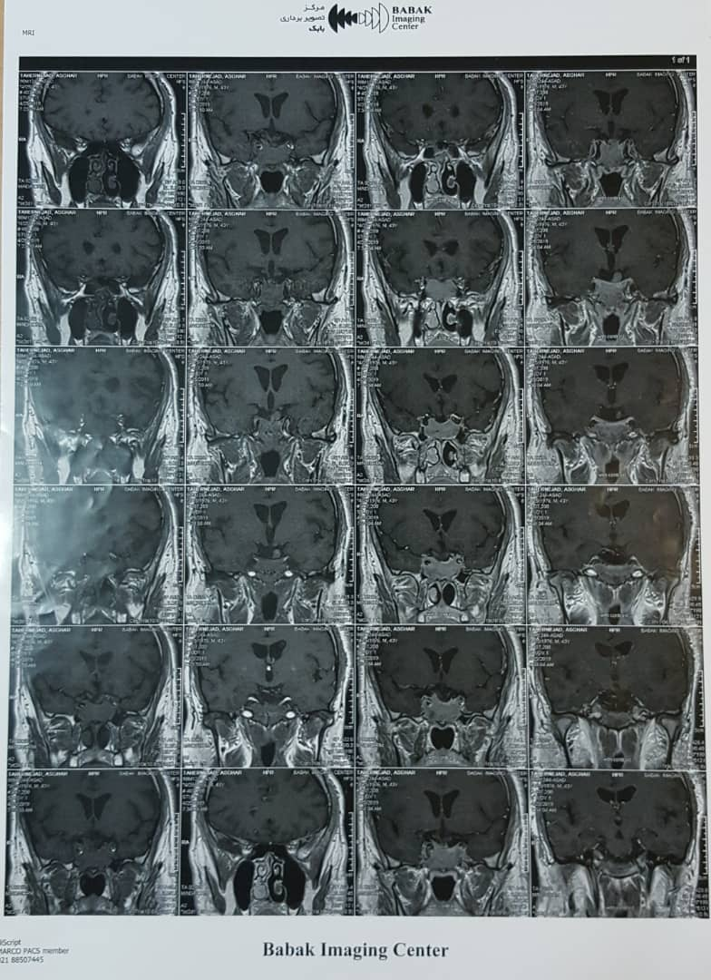

Slide 19
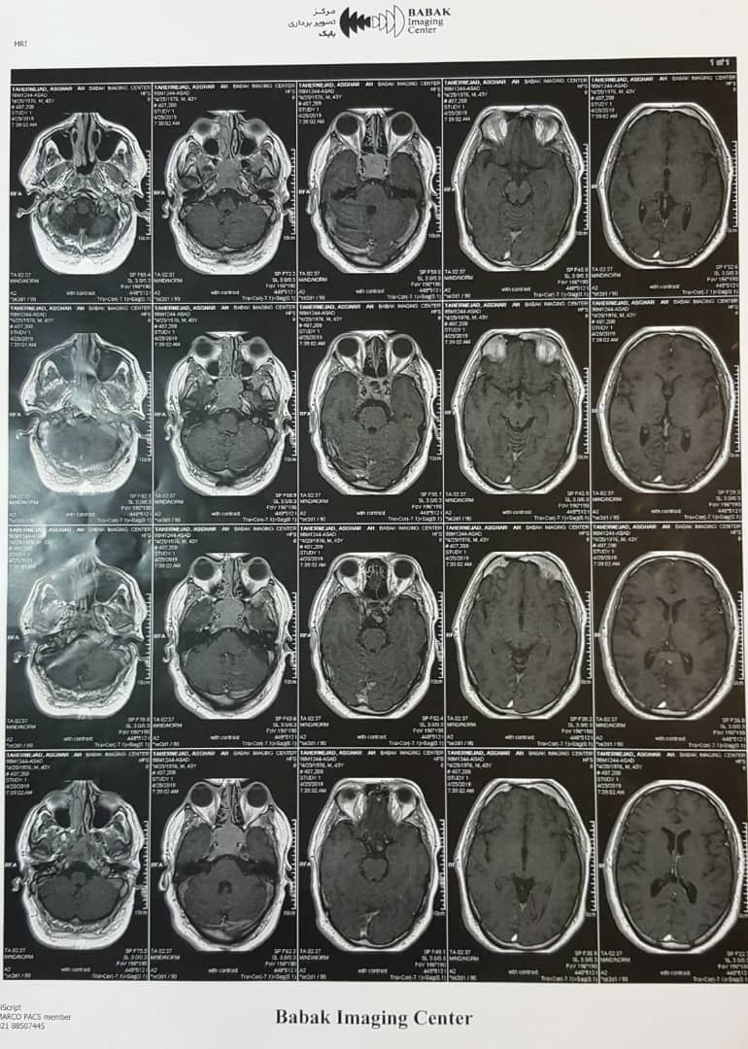

Slide 20
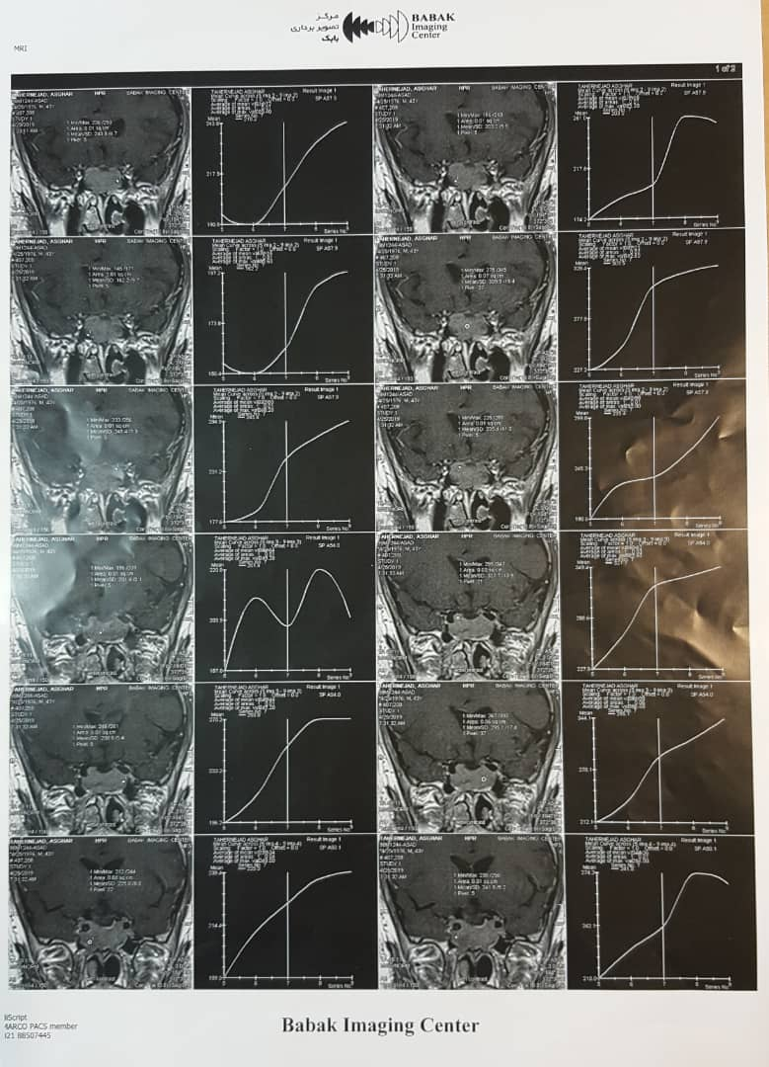

Slide 21
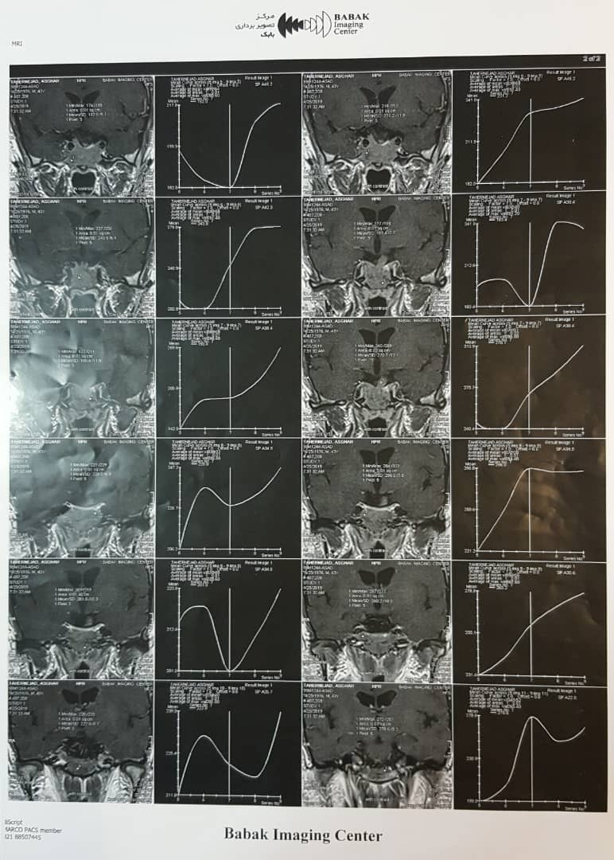

Slide 22
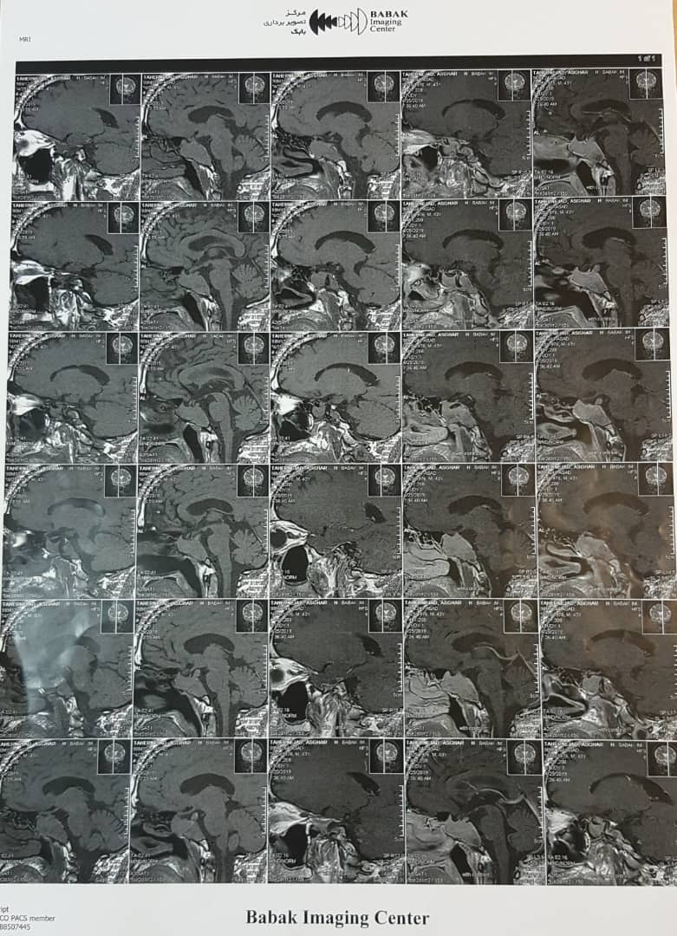

Slide 23
Report : 25/2/98
Large abnormal signal in the region of the body of sphenoid with extension to the clivus and mild parasellar extension without suprasellar extension, without shadow of pituitary gland measuring about 46mm in AP diameter, 14.6 mm in height and 33 mm in transverse diameter iso on T1 and mix mildly high and iso on T2 with homogenous enhancement after IV Gd. Could be due to invasive macroadenoma, however neoplastic lesion of the body of sphenoid such as chondroma could be considered in differential diagnosis.
Overhanging of optic chiasma indicatining insufficiency of sella diaphragm.
Suprasellar chiasma intact. Cavernous sinuses unremarkable.

Slide 24
Lab data on 5/2/98
Prolactine: 22.3 ng/ml(↑) (NL : 2.1 – 17.7)

Slide 25
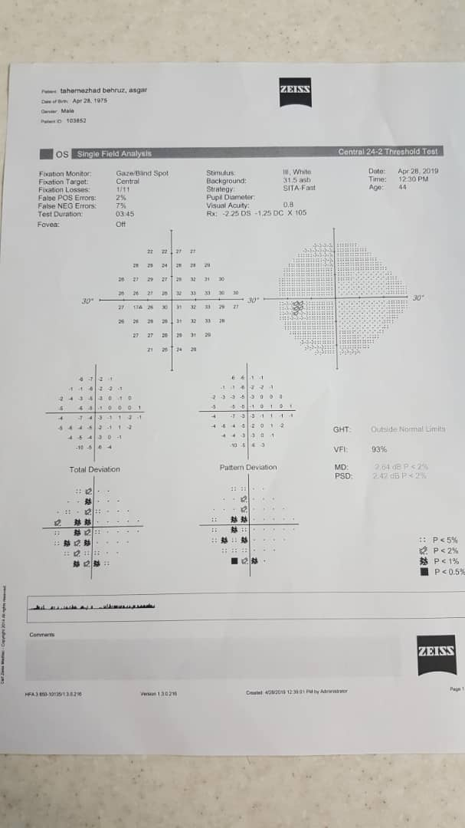
Perimetry 8/2/98

Slide 26
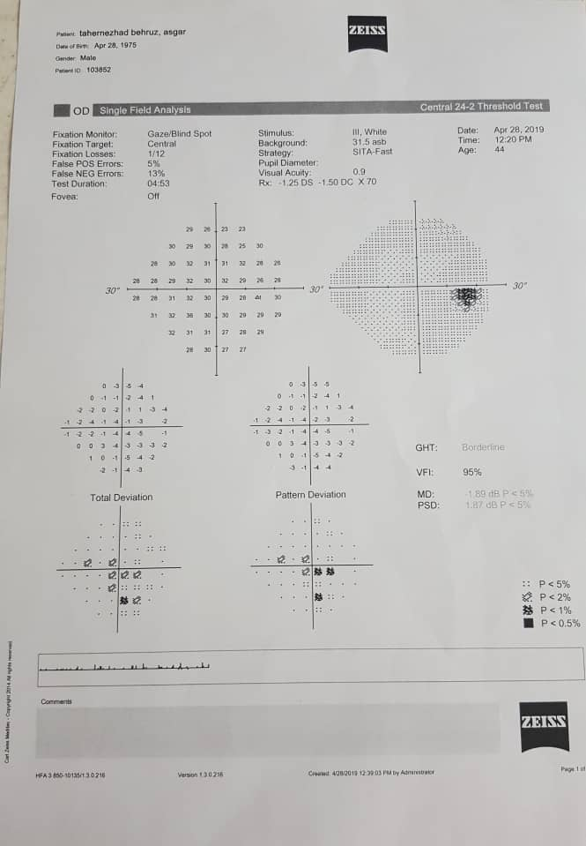
Perimetry 8/2/98

Slide 27
The patient was advised to have a neurosurgeon visit because of no regression in mass size in the last MRI .
He was advised to undergo surgery.
Instead, he referred to Arad hospital (11/2/98). The physician took MRI and CT again and with endocrinology consultation, laboratory investigations done.
Then referred to ENT specialist for sinus tumor biopsy

Slide 28
Lab data 2/3/98
T4: 6.9 mcgr/dl (4.87 - 11.72)
T3: 1.0 ng/ml (0.58 - 1.59)
TSH: 2.3 mIU/ L (0.35 - 4.94)
Free T4: 11.2 Pmol/ L (9 - 19)
FSH: 3.6 mIU/ ml (0.95 – 11.9)
LH: 1.8 mIU/ ml (0.57 – 12)
Prolactine: 5.1 ng/ml (3.46 – 19.4)
Prolactine(after PEG): 4.4 ng/ml (3.4 – 14.14.8)
Testostrone: 0.94ng/ml (↓) (2.4 – 8.7)
Cortizole 8AM: 7.1 mcgr/dl (3.7 – 19.4)
IGF-1: 151.7 ng/ml (79.4 – 216.4)
GH(fast): 0.05 ng/ml (<2.47)
ACTH: 17.9 pg/ml (7.2 - 63)

Slide 29
Lab data on 2/3/98
FBS:90 mg/dl (60 - 110)
Hb A1c: 5.1%
Estimated average glucose: 100mg/dl
BUN: 12 mg/dl
Cr: 0.9 mg/dl

Slide 30
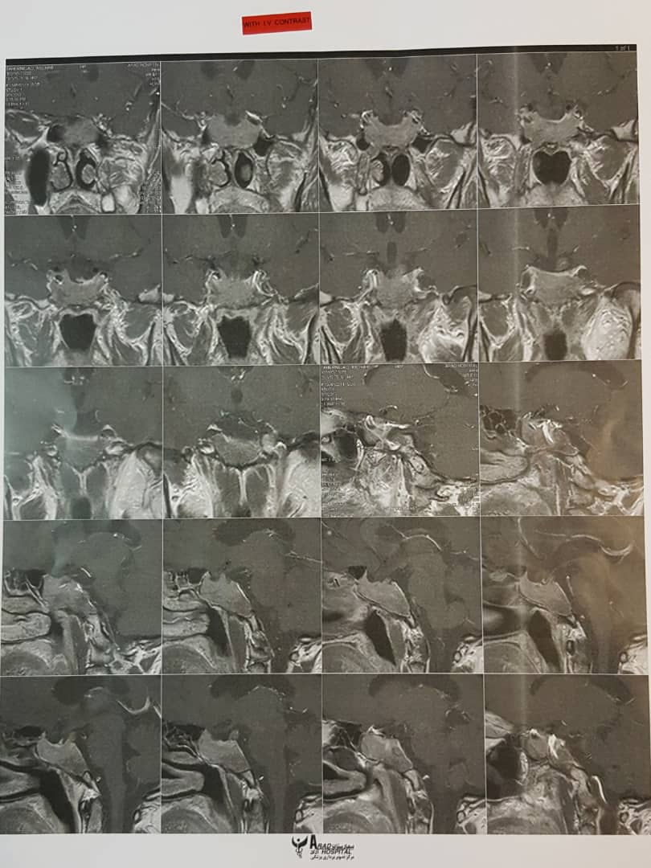

Slide 31
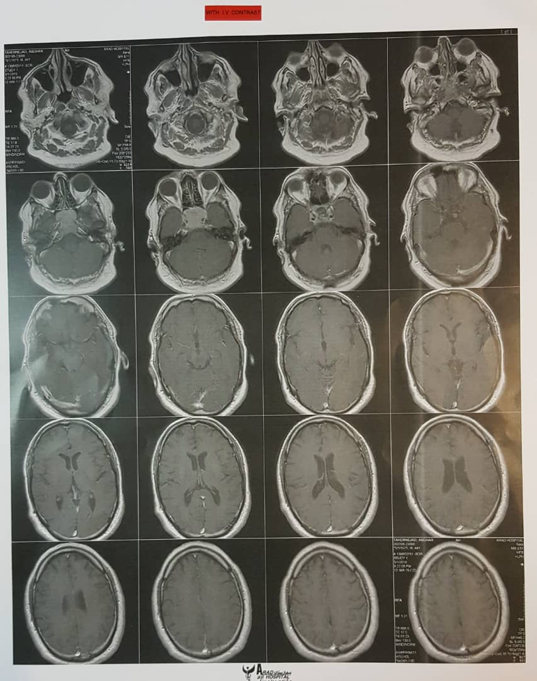

Slide 32
CT Report
Sella is enlarged deep with ballooning associated with destruction of sellar ? Dorsum sella as well as clivus on its anterior aspect with heterogeneously enhancing 3.5*3 cm soft tissue sellar mass protruding into the sphenoid sinuses and occupying the sinuses. No calcification. Neoplasm process originating the sphenoid sinuses and lymphoma are in consideration. Pituitary adenoma confined the Pituitary fossa also with additional process could not be excluded. No brain lesion evident. Chondroma of clivus with sinuses extension maybe in consideration

Slide 33
MRI report
- 41*32*20 mm heterogenous high signal lesion centered in sphenoid sinus with involvement of sphenoid bone and extension of bilateral cavernous sinus in contact with pituitary gland enhancement in post contrast images suggestive of infiltrating tumoral masses such as small cell carcinoma.
In DWI sequences restriction in mentioned lesion in favour of tumoral infiltration noted.
Otherwise study unremarkable.

Slide 34
98/1/8 | 98/1/10 | 98/1/25 | 98/2/5 | 98/3/5
PRL=23110 MIU/ml (53-360) | PRL > 4240 MIU/ml (45-375) |  | PRL=22/3 ng/ml (2.1-17.7) | PRL=5/1 ng/ml (3/46-19/4)
Cabergoline 3ml/per week prescribed |  | Cabergoline dose reduced 2ml/per week | Cabergoline dose reduced 1/5 ml/per week | discontinued

Slide 35
Past Medical History:
Negative
No history of Surgery
No hx of DM, HLP, IHD, thyroid disorders
No hx of smoking
No hx of alcohol drinking
Drug & Social History:
Tab Cabergoline 2 mg / week
Amp. Testostrone 250 mg one injection
Tab. Prednisolone 5 mg /day for 2 w
Tab acetaminophen (no regular dose)
Tab Iboprufen 400 mg (no regular dose)
CC & PI
PMH & DH
FH
Review of Systems
Physical Examination
Work-Up

Slide 36
Review of Systems:
Constitutional symptoms: Negative
Eyes, Ears, nose, mouth, throat: bilateral blurred vision after treatment. Negative (Difficulty with hearing, sinus problems, runny nose, post-nasal drip, ringing in ears, mouth sores, loose teeth, ear pain, nosebleeds, sore throat, facial pain or numbness).
Cardiovascular: Negative (Racing heart, chest pains, swelling of feet or legs, pain in legs with walking).
Respiratory: Negative (Shortness of breath, night sweats, prolonged cough, wheezing, sputum production, prior tuberculosis, coughing up blood).
Gastrointestinal: Negative (Heartburn, constipation, intolerance to certain foods, diarrhea, abdominal pain, difficulty swallowing, nausea, vomiting, blood in stools, unexplained change in bowel habits, incontinence).
Genitourinary: Negative (Painful urination, frequent urination, urgency, bladder problems, decreased libido).
CC & PI
PMH & DH
FH
Review of Systems
Physical Examination
Work-Up

Slide 37
Review of Systems (cont’d):
Musculoskeletal → Negative (muscle soreness following prolonged sitting or walking. Joint pain, joint deformities, back pain).
Integumentary: Negative (Itching, new skin lesion, change in existing skin lesion, hair loss or increase, breast changes).
Neurological: Headache. Negative (Double vision, weakness, change in sensation, problems with walking or balance, dizziness, tremor, loss of consciousness, uncontrolled motions, episodes of visual loss).
Psychiatric: Negative (Insomnia, irritability, depression, anxiety, recurrent bad thoughts, mood swings, hallucinations, compulsions).
Endocrine:Negative (Intolerance to heat or cold, frequent hunger/urination/thirst).
Hematologic/Lymphatic: Negative (Easy bleeding, easy bruising, anemia, leukemia, unexplained swollen areas).
Allergic/Immunologic: Negative (Seasonal allergies, hay fever symptoms, itching, frequent infections).
CC & PI
PMH & DH
FH
Review of Systems
Physical Examination
Work-Up

Slide 38
Physical Examination:
General Appearance: Middle-age male, awake and alert
Wt.=94 kg, Ht.=172 cm, BMI=31.5 kg/m2
V/S →
PR: 78/min,
BP: 120/75 mmHg
RR: 15/min,
OT: 36.5
CC & PI
PMH & DH
FH
Review of Systems
Physical Examination
Work-Up

Slide 39
Physical Examination (Cont’d):
Head & Neck : Negative (Steriae, Moon face, Plethora, Skin tag, Acantosis Nigricans, Supraclavicular fat pad, Hypertricosis, Telangiectasia, Acne).
Chest: No deformity. Normal lung & heart sounds.
Abdomen: Fatty, Negative (Mass, Organomegaly, Stria, Bruit, Tenderness)
Extremities : Normal (Joints, Pulses, Muscle tone, Force)
Neurologic : Normal (Cranial nerves, DTR, Gait, Sensory exams)
CC & PI
PMH & DH
FH
Review of Systems
Physical Examination
Work-Up

Slide 40
Problem List:
A 43-year-old man
Progressive headache
Bilateral blurred vision
High Serum prolactin Level
pituitary mass in MRI
CC & PI
PMH & DH
FH
Review of Systems
Physical Examination
Work-Up

Slide 41
Thanks for your attention

