Slide 1


Slide 2
Difficult Cases in Diabetes
Dr Sara Kazempour MD PhD
Prevention of Metabolic Diseases Research Center
Endocrine Research Center
Shahid Beheshti University of Medical Science

Slide 3
Outline
ESRD & DM
Brittle DM
Corticosteroids & DM
DM in Elderly

Slide 4
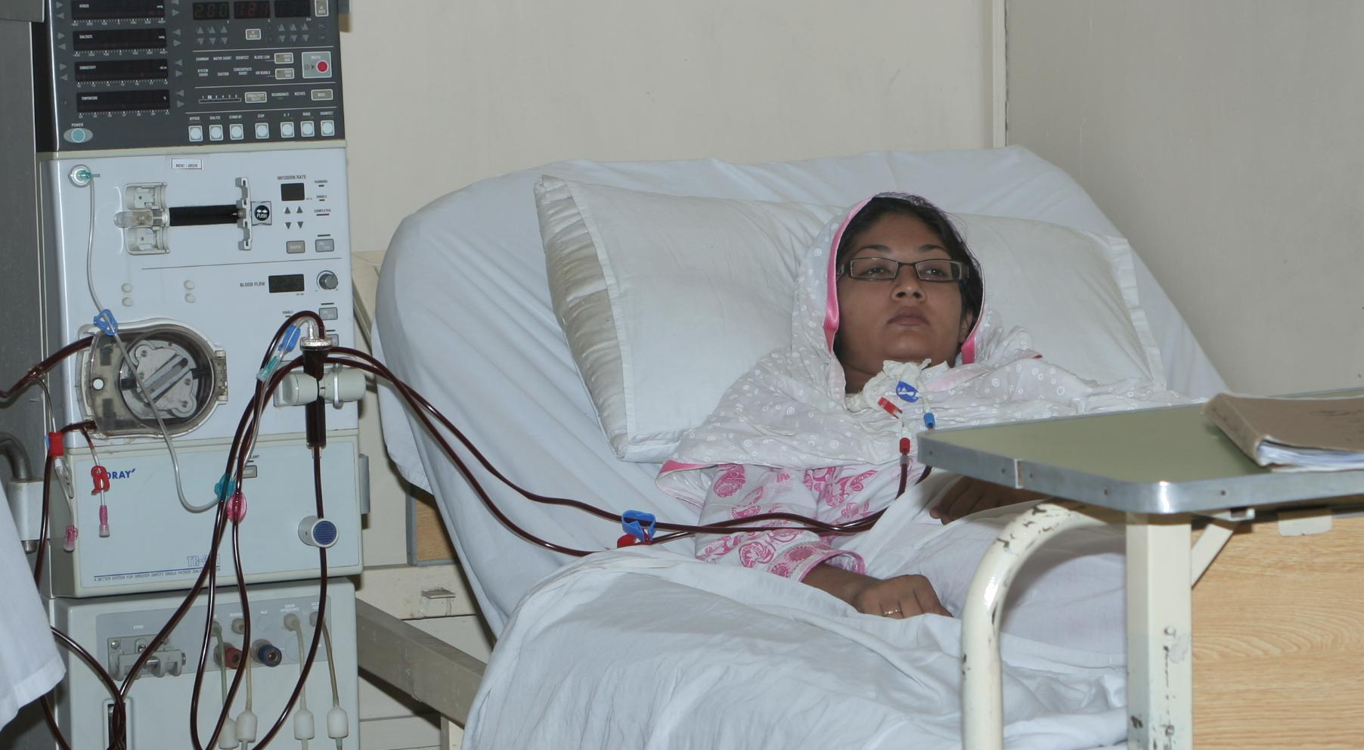
Case 1: ESRD

Slide 5
Case 1: ESRD
76 y/o woman initiated on hemodialysis 4 months ago after presenting with uremic symptoms
Renal failure attributed to both DM and HTN
Glybenclamide and pioglitazone were discontinued and she was started on NPH insulin BD and erythropoietin
Her A1c has fallen to 6.7% but her glucoses have been high, typically 200-300, and very erratic
Management options?

Slide 6
Case 1 - continued
Current mortality rates for MHD pts over 20% in US, 18-20% in Europe
Largely due to CV events
Various and opposing effects of ESRD and MHD can make blood glucose levels fluctuate widely and make control very difficult

Slide 7
Case 1 - continued
In ESRD:
Uremic toxins increase insulin resistance
Metabolic acidosis causes impaired insulin secretion
Insulin clearance is reduced
Renal gluconeogenesis is lost
MHD:
Further alters insulin secretion, clearance and resistance as the result of periodic improvement in uremia, acidosis and phosphate handling

Slide 8
Case 1 - continued
A1c not reliable in these pts
  RBC lifespan
  Iron deficiency
  Carbamylated Hb interference in some assays
SMBG and CGMs best methods of assessment
A1c goal in ESRD pts: 7.5 – 8 %
  FBS<140, peak post-prandial<200

Slide 9
Case 1 - continued
Insulin is the preferred drug
DPP4 inhibitors are increasingly being successfully utilized in these pts: sitgliptin and saxagliptin can be used with dialysis
More recently added: linagliptin and vildagliptin
Glipizide (rapid acting sulfunylurea) can be used in carefully selected pts with ESRD
Best insulin regimen: Basal-Bolus, where basal can be maintained by either glargine or NPH, and any short-acting analog

Slide 10
Case 1 - continued
Dialysate with lower dextrose concentrations are usually used for DM pts, but these may lead to hypoglycemia
Post-dialysis hypoglycemia is present in majority of pts
Pts may need different treatment regimens for on and off dialysis days

Slide 11
Case 1 - Outcome
Pt responded well to sitagliptin and was able to maintain good glycemic control without insulin

Slide 12

Case 2: Brittle Diabetes

Slide 13
Case 2: Brittle Diabetes
A 31 y/o woman presents for management of T1DM (diagnosed at age 12)
Has been on basal-bolus insulin regime since dx
A1c consistently <7%
SMBG 4 x daily, but no diary
Currently: 30u glargine at 10pm, insulin aspart 5u B, 12u L, 15u D, and 5u before bed
Reports headaches and weakness, with low readings on a daily basis
No classic hypoglycemia symptoms

Slide 14
Case 2 - continued
A1C six weeks ago: 5.8%
A1C 3 months ago: 5.9%
BMI: 20.4 kg/m²
SMBG recall ranges:
  Before breakfast: 50-230 mg/dl (5u)
  Before lunch: 75-180 mg/dl (12u)
  Before dinner: 100-220 mg/dl (15u)
  Before bed: 100-320 mg/dl (5u)

Slide 15
Case 2 - continued
Etiologic factors in erratic glucoses:
Erratic insulin administration
Erratic or under-reported eating
Incorrectly stored or expired insulin
Overcompensation of hypoglycemic events
Incorrect carb counting or corrections
Lipoatrophy/lipodystrophy
Gasteroparesis
Mental illness including eating disorders
Occult infection (abcess, osteomyelitis)
Endocrinopathy (Addison disease, hypothyroidism)
Malabsorptive disorders

Slide 16
Case 2 - continued
‘brittle’ diabetes
Can be seen in both type 1 and type 2
Questioning should be targeted at ruling out listed items (previous slide)

Slide 17
Case 2 - continued
Approach:
Education, insight into their condition and reaction to their condition
Appropriate glucose monitoring
Rule out inadvertent interchange of insulins (especially in elderly or cognitively impaired)
Engage mental health professionals when necessary
Patients with gasteroparesis benefit from Regular insulin instead of short-acting insulin analogs
Malabsorptive disorders, particularly celiac disease, cause erratic glucose absorption and initiating a gluten-free diet often curbs dysglycemia

Slide 18
Case 2 - continued
Approach:
Frequent SMBG with written record
Food diary (with times and amounts)
Education: carb counting and treating highs and lows
Avoid overcompensation of hypos: ½ glass of juice is usually enough
If after all of the above, cause is still unknown: CGM; both investigation and treatment

Slide 19
Case 2 - continued
Hypoglycemia unawareness:
No classic symptoms
Reversible
Must allow glucose levels to stay above 40 mg/dl for about 6 weeks
These pts should be warned about dangers of driving and operating heavy machinery

Slide 20
Case 2 - Outcome
Asked to keep SMBG diary
Was re-educated on carb counting
Both Glargine and Lispro doses decreased (20u G, 10-12u L)
Glucagon prescribed for hypoglycemic episodes (to avoid overcompensation)
Snacking was restricted
As A1C rose to 6.9%, hypoglycemia awareness was restored

Slide 21
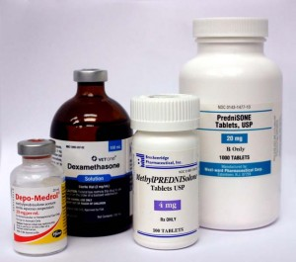
Case 3 - Corticosteroids

Slide 22
Case 3 - Corticosteroids
55 y/o man diagnosed with type 2 diabetes at age 51, also has asthma
At the time, he was obese: BMI = 31.6, A1c = 7.5%
First few months:
  Weight loss: BMI = 29, metformin 1000 mg BD, A1c = 6.2%
2 years later: A1c = 7.3%
  Glibenclamide was added at a dose of 15 mg daily
  A1c = 6.6%, but he gained 5 kg
Now: asthma worsening, needs intermittent prednisolone, up to 40 mg daily
  Cannot exercise, has gained weight, A1c = 8.9%

Slide 23
Case 3 - continued
SMBG:
  Fasting: 94-135 mg/dL
  Post-breakfast: 250-340 mg/dL
  Pre-lunch: 200-300 mg/dL
  Post-lunch: 220-310 mg/dL
  Pre-dinner: 125-180 mg/dL
  Bedtime: 164-234 mg/dL

Slide 24
Case 3 - continued
Glucocorticoids have greatest impact on post-prandial glucose levels
Reducing carbohydrate intake may curb post-meal excursions
Exercise around meal times may also improve post-prandial glucose
But these subjects generally require insulin

Slide 25
Case 3 - continued
This patient: fasting levels OK, highest around midday
May benefit from single premixed or NPH/R insulin dose at breakfast
Basal insulin NOT good choice: may cause nocturnal hypoglycemia in this pt
Sulphonylureas/TZDs: usually NOT effective enough in these patients

Slide 26
Case 3 - continued
Started 20u Novomix 30 at breakfast, 2 weeks later:
  Fasting: 78-122 mg/dL
  Post-breakfast: 190-237 mg/dL
  Pre-lunch: 136-202 mg/dL
  Post-lunch: 124-213 mg/dL
  Pre-dinner: 81-130 mg/dL
  Bedtime: 159-209mg/dL

Slide 27
Case 3 - Outcome
Needs more specific regimen
  14u NPH 14u R with breakfast
  6u R with dinner
2 weeks later:
  Fasting: 75-120 mg/dL
  Post-breakfast: 150-200 mg/dL
  Pre-lunch: 115-164 mg/dL
  Post-lunch: 121-188 mg/dL
  Pre-dinner: 81-125 mg/dL
  Bedtime: 125-164 mg/dL

Slide 28
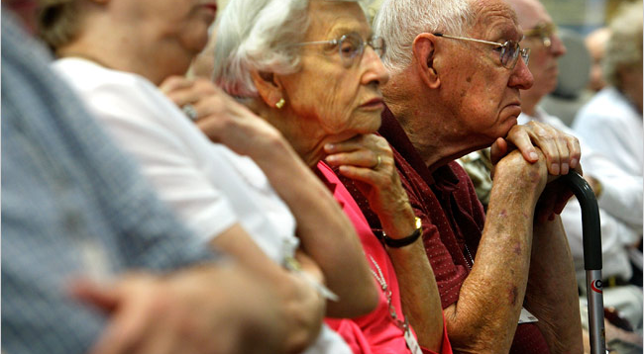
Case 4 - Elderly

Slide 29
Case 4 - Elderly
87 y/o white female resident admitted to LTC facility
Type 2 Diabetes for 20 years
PMH: HTN, dyslipidemia, mild dementia, hypothyroidism, CVA, CHF
Stage 3 CKD (GFR 37, Creatinine 1.0)

Slide 30
Case 4 - continued
Current meds:
Metformin 500 mg BD
Glibenclamide 5 mg BD
Lisinopril 10mg daily
Furosemide 20 mg daily
ASA 75 mg daily
Simvastatin 20mg daily

Slide 31
Case 4 - continued
Lipids adequately treated
BP 142/86
A1C 9.0
What is appropriate for this patient?

Slide 32
Case 4 - continued
Metformin, sulfonylurea NOT good choices >80 y/o, or declining renal function
Metformin NOT good choice with CHF risk or history

Slide 33
Case 4 - continued
BP abnormal-
high risk of recurrent CVA
Lipids- Evidence show benefit of treating to age 85, case by case

Slide 34
Case 4 - continued
A1C = 8.0 appropriate for this age group
-less risk of hypoglycemia vs. lower A1C (demented poor at reporting symptoms)
-better alertness than higher A1C
-less urinary incontinence than higher A1C

Slide 35
Case 4 - continued
BP: Increase Lisinopril to 20mg, monitor creatinine and K+
Lipids: Continue present (patient desired Rx)
DM: ?

Slide 36
Case 4 - continued
Choices for Treatment of DM in elderly
Single injection of basal insulin once daily
OR
Gliptin (sitagliptin or saxagliptin)
Both have low risk of significant hypoglycemia, can be renally dosed, easy to use, few significant drug interactions

Slide 37
Case 4 - continued
Started on basal insulin
(detemir or glargine)
8 units with evening meal (patient likely has little beta cell function)
Metformin stopped
Glibenclamide stopped
A1C 3 months later 8.2

Slide 38
Case 4 - continued
Sulfonylureas and Metformin generally NOT good choices (renal)
TZD’s may be limited by CHF history or risk
DPP-IV inhibitors may be good choice
-renal dosing, hypoglycemia rare
Insulin, particularly basal, may be optimum
Johnson EL Brosseau J et al Clinical Diabetes 2008 (26) 4; 152-156
American Medical Directors Association,2002
American Diabetes Association. Diabetes Care. 2011;34(suppl 1)

Slide 39
Key Message
Patients have different requirements depending on diabetes status
Many choices exist to individualize treatment
Reinforce lifestyle, treat blood sugar, lipids, BP

Slide 40


