Slide 2
تغییرات فیزیولوژیک تیروئید در دوران بارداری
دکتر فریدون عزیزی
پژوهشکده علوم غدد درون ریز و متابولیسم، دانشگاه علوم پزشکی شهید بهشتی
سمپوزیوم ید و بارداری، 18 آذر 1395

Slide 3
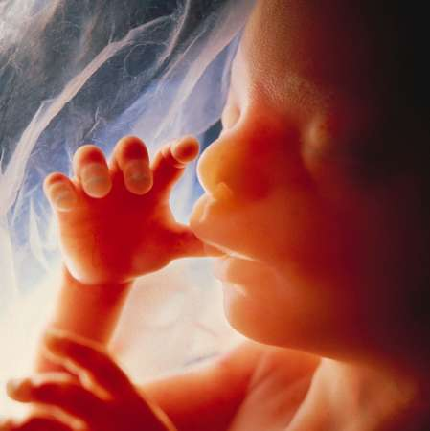
Importance of iodine in brain development
50,000 brain cells produced/second in developing fetal brain
100 billion brain cells in adult
One million billion connections between these brain cells: Determine IQ

Slide 4
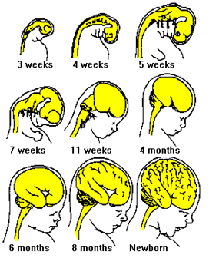
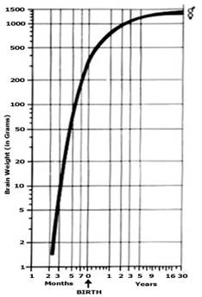
Importance of iodine in brain development
90 % of human brain development occurs between 3rd month of pregnancy & 3rd year of life (Critical period)

Slide 6
Pregnant Women Need More Iodine Intake
Increased Iodine requirement
In mother
Increased maternal T4 production by ~50%
Maternal Iodine transfer to the fetus
Increased maternal renal iodine clearance
Increased
type 3 deiodinase activity

Slide 7
Iodine Requirement in Pregnancy (μg/day)
During pregnancy
Basal 150
40-50 % increased T4 requirements 50-100
Transfer of T4 and I from mother to fetus 50
Increased renal clearance of I 50
Total requirement 250-300
Delange: Int.J. Endocrinol. Metab. 2: 1, 2004

Slide 8
Recommended dietary allowance for iodine for pregnant women (μg/day)
World Health Organization | 200-300
US Institute of Medicine | 220
Endocrine Society | 250

Slide 9
Criteria for Assessing Iodine Nutrition
in Pregnant Women
Median Urinary Iodine (MUI) (µg/L) | Iodine Intake
≥ 500 | excessive
250～499 | More than adequate
150～249 | adequate
＜150 | insufficient
100～150 | marginal insufficient
50～99 | moderate insufficient
＜50 | severe insufficient
2nd ed. Geneva, Switzerland: WHO, 2007
Notes:
7

Slide 10
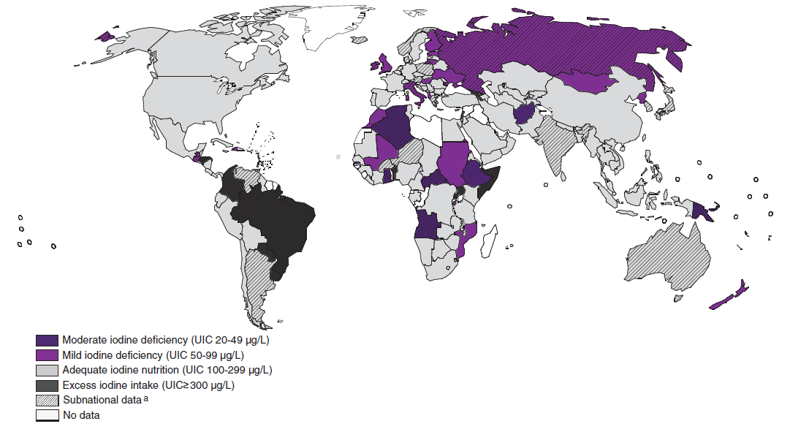
Prevalence of Iodine Deficiency in Pregnancy
60-80%
55.8%
48.8%
Iodine Status in the World in 2013
JCEM 2013;98(9):3694-701.
EN. Pearce, M Andersson, and MB. Zimmermann. Thyroid 2013,23(5):523-528.
Caldwell KL：Thyroid，2013，23：927-937
Endocrinol Nutr. 2009; 56(1):9-12. Thyroid. 2009; 19(2):157-63.
Clin Endocrinol (Oxf). 2009, 70(5):776-80.
J Clin Endocrinol Metab.1992, 75(3):800-805.
Notes:
10

Slide 11
Iodine Status of Early Pregnant Women
in iodine Sufficient Regions
SHEP
School-age children (n=200) MUI 150.8µg/L,
Pregnant women gestational age < 8 wks (n=7190) MUI 152.6 µ g/L
Shi X et al. JCEM 2015 10.1210/jc.2014-3704

Slide 12
افزایش نیاز به ید در بارداری
افزایش اندازه تیروئید در بارداری در مناطقی که کمبود ید دارند حدود 20-40 درصد و در مناطق با تغذیه کافی ید، حدود 10 درصد گزارش شده است.
به دلیل افزایش نیاز، تولید تیروکسین (T₄) و تری‌یدوتیرونین (T₃) تا 50 درصد افزایش می‌یابد.
نیاز به دریافت ید روزانه نیز یک و نیم برابر شده، از 150 میکروگرم به حدود 250 میکروگرم در روز افزایش می‌یابد.
در زن باردار مبتلا به کمبود ید درجات مختلفی از کم‌کاری تیروئید در خود او و در جنین ظاهر می‌شود.
راهنمای تشخیص و درمان بیماری‌های تیروئید در بارداری و پس از زایمان. تهیه شده توسط انجمن غدد درون‌ریز و متابولیسم ایران، انجمن زنان و زایمان ایران، انجمن پریناتولوژی ایران، انجمن آسیب‌شناسی ایران و انجمن علمی دکترای علوم آزمایشگاهی تشخیص جنین ایران، تهران 1395.

Slide 13
How much iodine we get from iodized salt? (numbers in red are daily iodine intake)*
Daily salt intake (gm) | Amount of iodine in table salt
 | 20 ppm | 30 ppm | 40 ppm
2 | 40 | 60 | 80
4 | 80 | 120 | 160
6 | 120 | 180 | 240
240
* Daily requirement of pregnant women: 200-300 μg/day

Slide 14
20
5.0
15
FT4(pmol/L)
FT3(pmol/L)
4.0
10
0
0
1.5
50
40
1.0
TSH (mU/L)
30
hCG (I.Ux1000/L)
20
0.5
10
0
0
10
20
30
40
Postmenstrual age in weeks
Glinoer, Endocr Rev 1997;18:404-433

Slide 15
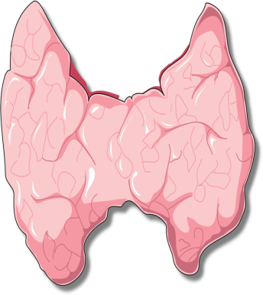
Factors for thyroid stimulation during pregnancy
↑ E
↑ TBG
↑ TSH
↓ FT4
iodine
TPO Ab
↑ HCG
↑ FT4
↑ goiter
↑ Tg
↑ TSH
↓ TSH
↓ T4
↑ TSH
↑ placental DI III
Delange: Int.J. Endocrinol. Metab. 2: 1, 2004

Slide 16
Sample trimester-specific reference intervals for TSH*
Reference | Year | 1st trimester | 2nd trimester | 3rd trimester
Stricker | 2007 | 1.04 (0.09-2.83) | 1.02 (0.20-2.79) | 1.14 (0.31-2.90)
Haddow |  | 0.94 (0.08-2.73) | 1.29 (0.39-2.70)
Panesar | 2001 | 0.80 (0.03-2.30) | 1.10 (0.03-3.10) | 1.30 (0.13-3.50)
Soldin | 2004 | 0.98 (0.24-2.99) | 1.09 (0.46-2.95) | 1.20 (0.43-2.78)
Bocos-Terraz | 2009 | 0.92 (0.03-2.65) | 1.12 (0.12-2.64) | 1.29 (0.23-3.56)
Blatt | 2012 | 1.01 (0.10-2.50) | 1.14 (0.35-2.75) | 1.26 (0.43-2.91)
Azizi | 2013 | 1.7 (0.2-3.9) | 1.9 (0.5-4.1) | 1.8 (0.6-4.1)
* median TSH mIU/L with 5th and 95th centiles or P2.5 and P 97.5 between brackets.
Soldin OP et al. Clin Chem Acta 2004; 349: 181
Haddow JE et al. J Med Screen 2004; 11: 170
Panesar NS et al. Ann Clin Biocliem 2001; 34: 67
Stricker R, et al. Eur J Endocrinol 2007; 157: 509
Bocos-Terraz JP, et al. BMC Res Notes 2009; 2: 237
Blatt AJ, et al. J Clin Endocrinol Metab 2012; 97: 777
Azizi f, et al. Thyroid 2013; 23: 354

Slide 17
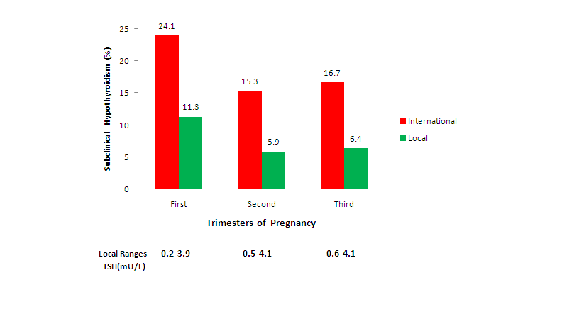
Local versus international recommended TSH references in a iodine sufficient region
Amouzegar A, et al. Hormone Metab Res 2014; 46: 206

Slide 18
Recommendation 26
The pregnancy-specific TSH reference range should be defined as follows:
When available, population and trimester-specific reference ranges for serum TSH during pregnancy should be defined by a provider’s institute / laboratory.
When this is not feasible, pregnancy-specific TSH reference ranges obtained from similar patient populations, and performed using similar TSH assays should be substituted.
If internal or transferable pregnancy-specific TSH reference ranges are not available, an upper reference limit of ~ 4.0mU/l may be used. For most assays, this represents a reduction in the non-pregnant TSH upper reference limit of ~0.5mIU/L.
2016 ATA Guidelines, thyroid, In press

Slide 19
Guidelines for Serum TSH During Pregnancy
Recommendation 1 Trimester-specific reference ranges for TSH, as defined in populations with optimal iodine intake, should be applied
Recommendation 2 If trimester-specific reference ranges for TSH are not available in the laboratory, the following references ranges are recommend: 1st trimester, 0.1-2.5 mIU/L; 2nd trimester, 0.2-3.0 mIU/L; 3rd trimester, 0.3-3.0 mIU/L
Thyroid 2011; 21: 1081-1125
Changed Recommendation 2
0.1 -4.0 mU/L
Thyroid 2016

Slide 20
Problems with FT4 in pregnancy
High TBG concentrations result in higher FT4 values. Low albumin in serum will yield lower FT4 values.
In pregnant women higher concentrations of TBG and NEFA and lower concentrations of albumin relative to sera of non-pregnant
Seven commercial FT4 immunoassays in 23 euthyroid women at term:
Albumin-dependent methods showed marked negative bias with up to 50% of subnormal values
Other methods gave values above their non-pregnant reference values
Herbomes M et al. Clin Chem Lab 2003; 41: 942
Roti E. J Endocrinol Invest 1991; 14: 1-9

Slide 21
Trimesters specific reference intervals for free T4 index in Iranian pregnant women
Free T4 index
Trimester of pregnancy
Azizi F. et al. Thyroid 2013; 23: 354-9.

