Slide 1
Polycystic Ovary Syndrome
Presented by
M. Changaei
M. Javidan

Slide 2
Table of Content
Basic of PCOS
Diagnosis Criteria
Receptivity Markers
Genetic Aspects
Ultrasound
Insulin Resistance
Biopsy
Hysteroscopy
Follicular Maturation arrest
Other Methods
ERA, Fluid aspirate

Slide 3
Basic of PCOS

Slide 4
Diagnostic Criteria and Phenotypes of PCOS
AE-PCOS: Androgen Excess and PCOS Society

Slide 5
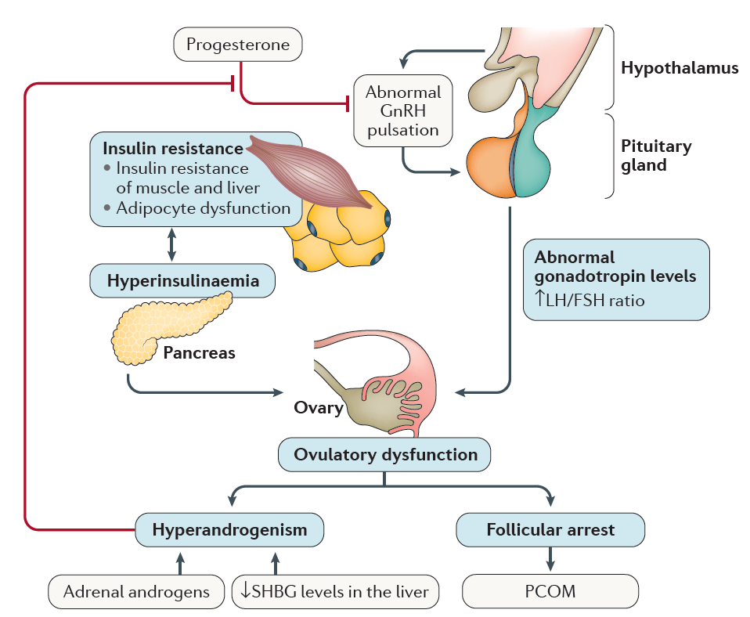
The pathophysiology of PCOS

Slide 6
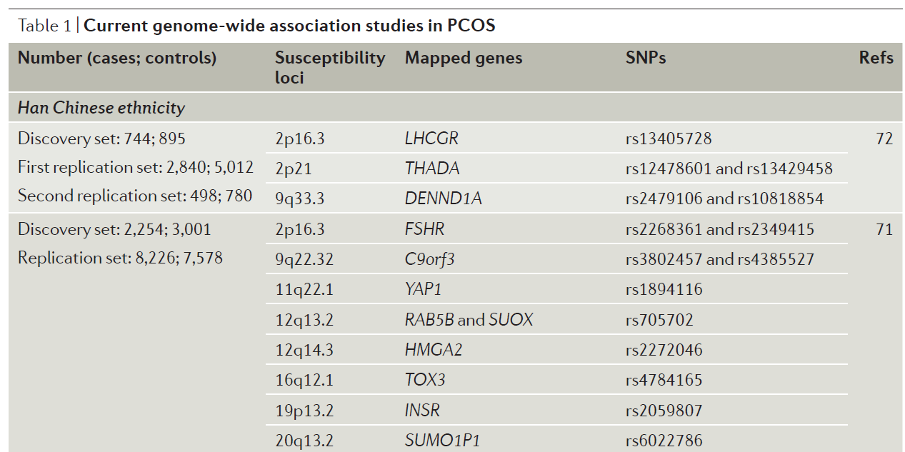
Genetic Aspects of PCOS
Endocrine and Metabolism disturbance

Slide 7
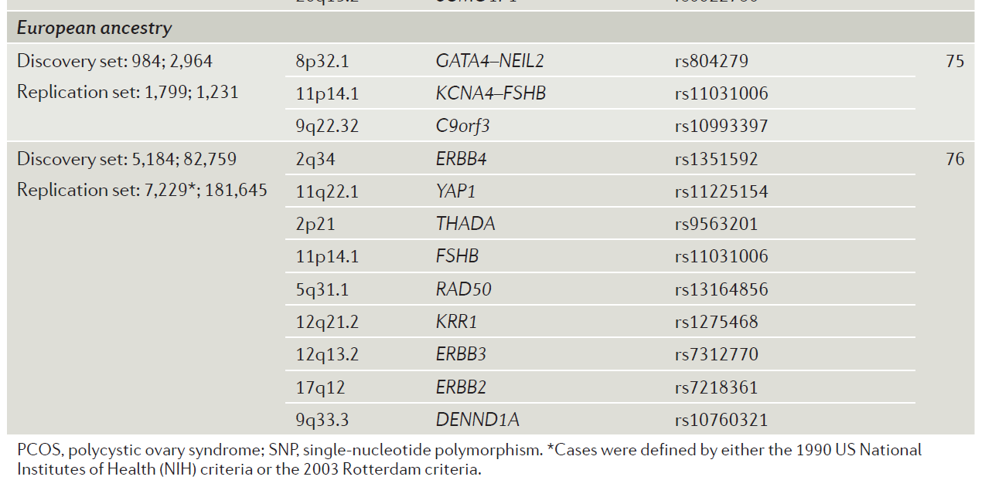
Genetic Aspects of PCOS

Slide 8
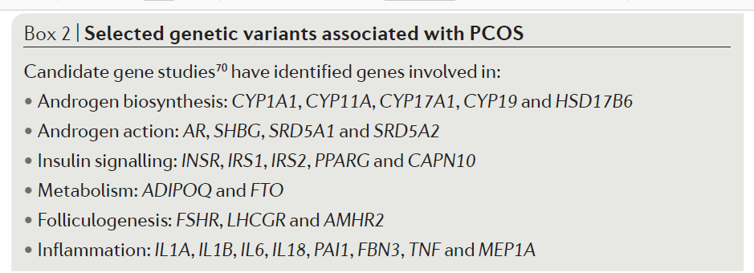
Genetic Aspects of PCOS

Slide 9
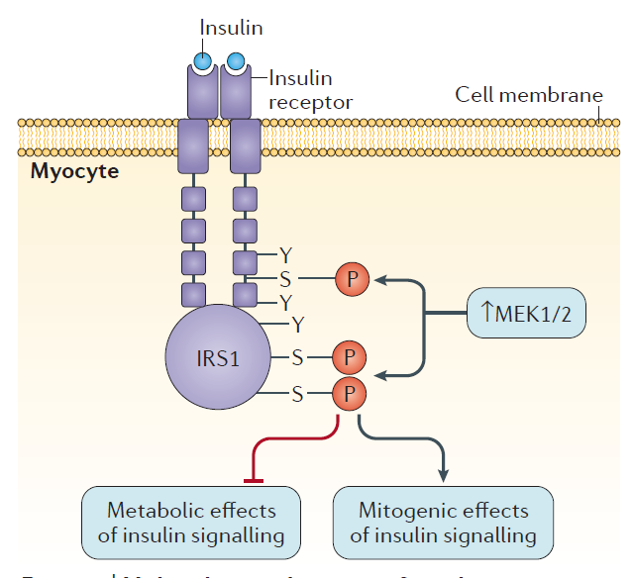
Molecular Mechanisms of Insulin Resistance in Muscle in PCOS

Slide 10
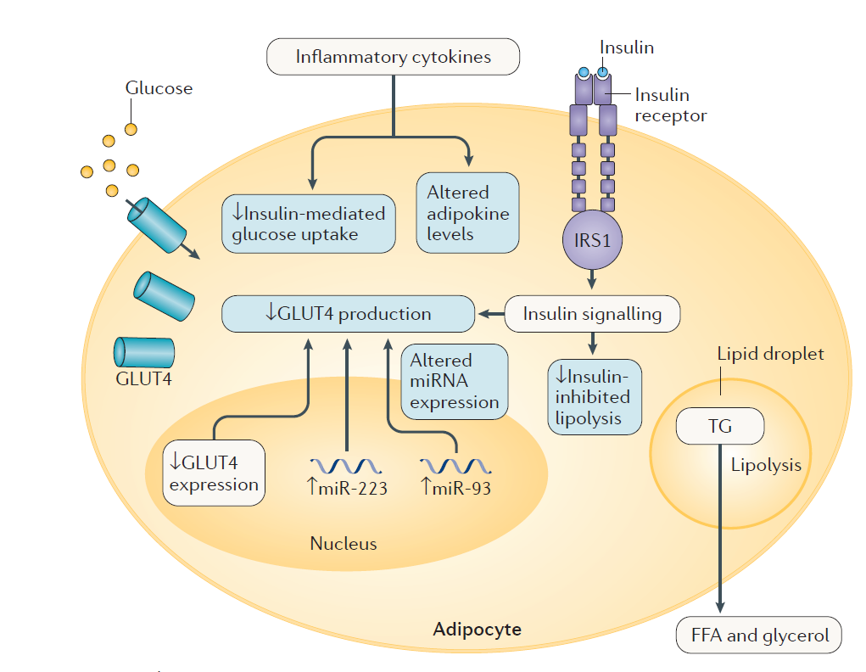
Molecular Mechanisms of Insulin Resistance in Muscle in PCOS

Slide 11
Ovarian Follicular Maturation Arrest in PCOS.

Slide 12
Receptivity Markers

Slide 13
Ultrasound

Slide 14
Biopsy
Author/Year | Criteria | Result
Noyes et al, 1950 | Mid-Luteal
Tuckerman et al, 2007 | Stroma cells positive for CD56 | Decreased percentage of CD56⁺ in women with miscarriage (RSA)
Quenby et al, 1999 | CD4, CD8, CD14, CD16 and CD56 | Higher percentage in women with miscarriage
 | CD45, CD3, CD22, CD57, CD69 | Not significant
Michimata et al, 2002 | CD3, CD16, CD20, CD45, CD56 | Not significant
Liu et al, 2014 | Histology criteria with uNKCs count | No correlation was observed between uNK count and subsequent pregnancy outcome.

Slide 15
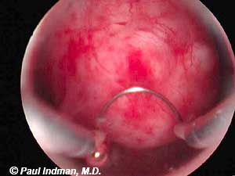
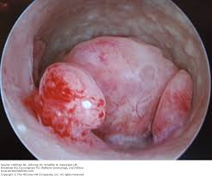
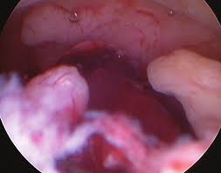
Hysteroscopy
First time: Inafuku et al, 1992.
The mid-luteal endometrium was classified as ‘good’ based on the
ring type aspect of the glandular openings and presence of well
developed varicose-like vessels during hysteroscopic assessment

Slide 16
Endometrial Receptivity Array
Adhesion Molecules |  |  |  | Cytokines
Integrins | Selectins | Cadherins | IgCAMs
a1ꞵ1 | L-Selectin | E-Cadherin | ICAM-1 | LIF→ Evidences for LIF contribution to the implantation process derive from the finding that wild-type embryos failed to implant in the endometrium of female mice homozygous for LIF gene deficiency.
a4ꞵ1 | On the maternal side, the expression of selectin ligands such as MECA-79 or HECA-452, is up-regulated during window of implantation | Studies on mouse embryo implantation have shown that targeted mutations in the E-cadherin gene result in defective preimplantation development | Although ICAM-1 was not shown to be indispensable for the early steps of blastocyst interactions with the endometrium, it could participate interacting with the immune system. | Inducer→ IL-1a, TNF, PDGF, TGF and EGF Inhibitor → IFN-a in culture
aVꞵ3 |  |  |  | Other Cytokines and Modulators
Pos effect: EGF, HB-EGF, P4 Neg effect: 17ꞵ-Estradiol |  |  |  | IL-6
 |  |  |  | IL-1
 |  |  |  | Prostaglandins →Studies in female mice lacking cPLA2 or COX-2 enzymes have established the central role of PGs in implantation

Slide 17
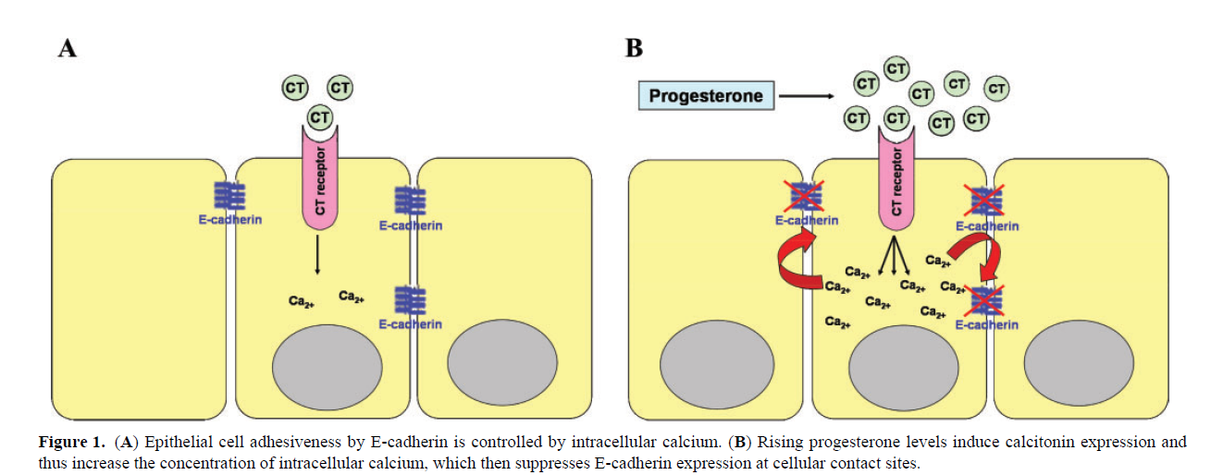

Slide 18
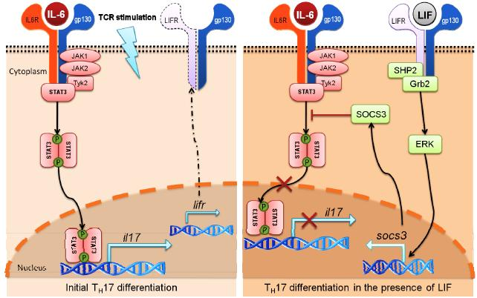
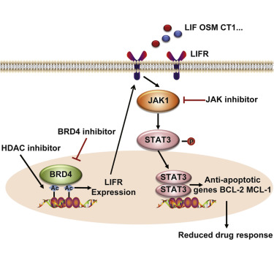

Slide 19
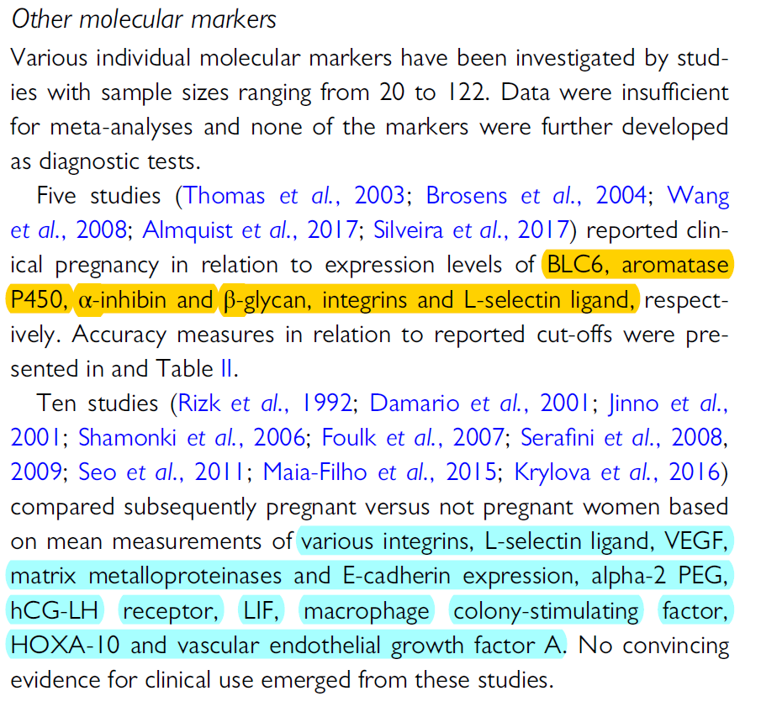

Slide 20
Fluid Aspirate
Markers
hDP : Human Decidua-associated Protein
IL-18
Glycodelin
Isoforms of leucine-reach alpha2-glycoprotein
LIF , TNF
Interfron gamma-induced protein 10
Monocyte chemoattractant proteins

Slide 21
Human
Classification of Studies
Animal
Immunology

Slide 22
Human Studies

Slide 23
Title | Year | Sample | Target | Method | Result
1- Decreased expression of LIF……. | 2019 | Endometrium-Proliferative phase | HOX-A10, HOX-A11, LIF | PCR | HOX-A10 → NS but higher HOX-A11 → Dec LIF → Dec
2-The effect of metformine … | 2019 | Endometrium- Day 21 | CRH, Urocortin | PCR | Group A:No medic,Group B: Met NS in first time
3-Leukemia inhibitory factor … | 2018 | FF Serum | LIF | ELISA | Group A:PCOS → LIF Dec Oestradiol → Inc in FF Group B: IVF
4-Oxidative stress in granulosa… | 2018 | Granulosa cell | ROS NOX2 Inhibitor | PCR WB | Group A: IVF-ET Group B: PCOS: ROS →Inc ROS inhibitor →Dec
5-Effect of hypoxia …. | 2018 | Uterine tissue | HIF1a,VEGF GLUT1 ,GLUT4 | PCR | IVF →
A:PCOS: HIF,VEGF→ Dec
GluT 1 ,4→ NS
B: Ctrl

Slide 24
Title | Year | Sample | Target | Method | Result
6-NFkB expression in the endometrium…. | 2017 | Endometrium tissue→Mid-luteal | NFkB | IHC | Group A: PCOS Nor-Weight Group B: PCOS Over Weight Group C: Non PCOS
7-Endometrial flushing AvB3 … | 2017 | Endometrium tissue→Mid-luteal | aVB3 Glycodelin PGF2A | ELISA | Group A: Pcos: aVb3 →Inc Group B:Myoma: PGF2a →Inc Group C: Endometrioma: aVb3 ,Glycodelin →Incre
8-Fullicular ADAMTS-1 …. | 2017 | FF → PCOS Undergo IVF | ADAMTS-1 Aggrecan | ELISA | ADAMTS-1 → Inc
9-Correlation between expression of … | 2014 | Tissue GCs | GluT 1,3,5,8,13→Express in both GluT 2,7→ not observed GluT4,6,9,10,11,12→different | PCR | Group A:PCOS With IR Group B:PCOS Without IR
Inc

Slide 25
Title | Year | Sample | Target | Method | Result
10-Mesenchymal stem /progenitors … | 2013 | Endometrial tissue | eEP eSF eMSC eEP eEP | PCR IHC | CCL2 ,IL6 ,.. C4a/b,CCL2,.. IL8,ICAM1,… CCL2 CCL2
11-Expression of apoptoticis... | 2012 | Endometrium tissue | FADD → Dec Bcl2 → Inc | IHC TUNEL | Group A : PCOS Group B :Tubal pathological factor with normal menstruation cycle
12-Hox A10 expression is decrease … | 2012 | GC | HOXA10 | IHC | IVF in normal woman with ….→ Hoxa10 decrease
13-Histomorphometric analysis and markers of … | 2014 | Endometrial tissue | Thickness endometrium→ After treatment increase in secretory phase | LM | Time point 1 : before Time point 2: after with progesterone

Slide 26
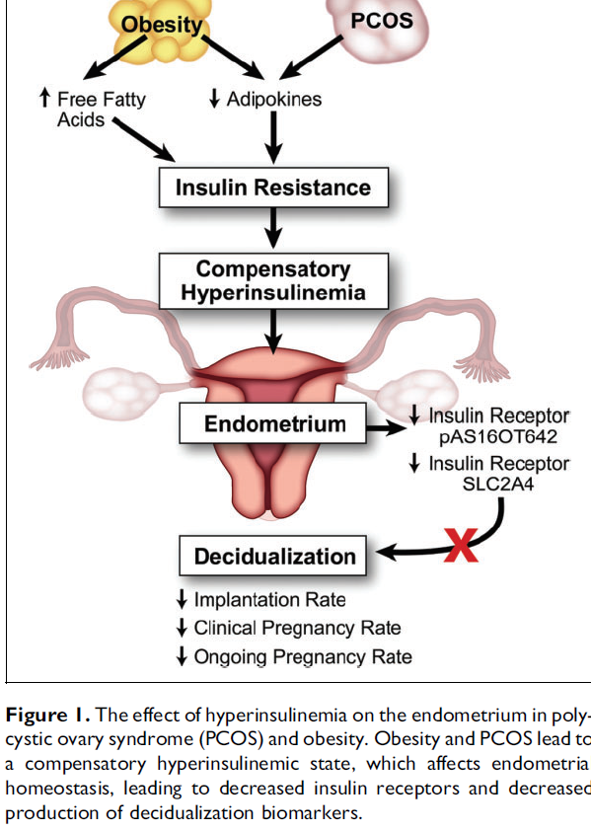
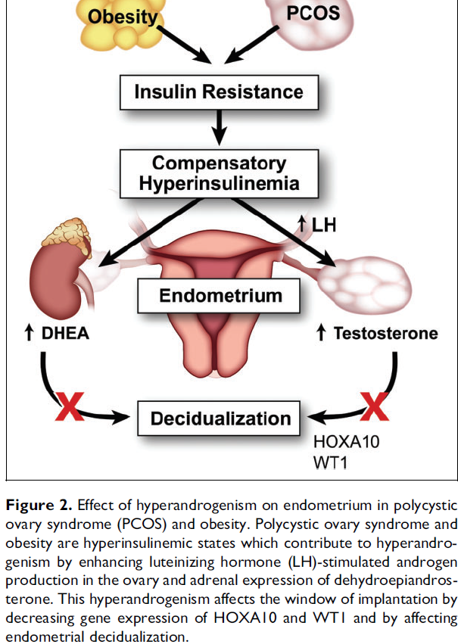

Slide 27
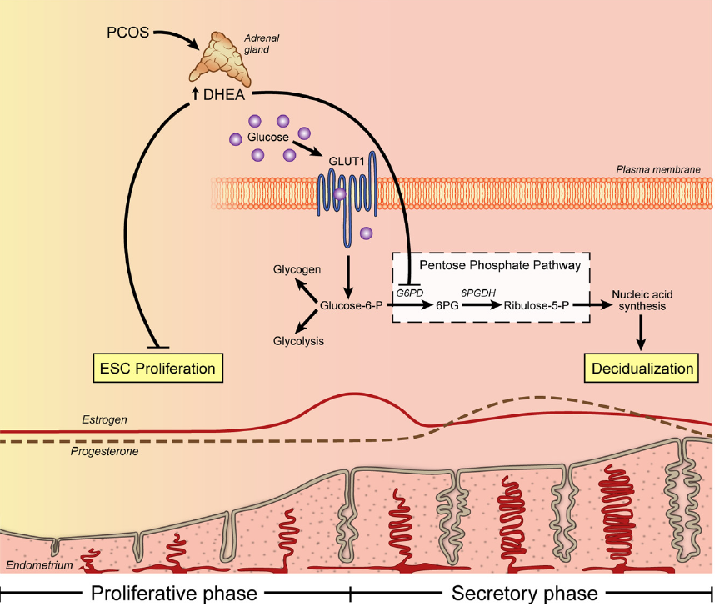
Frolova et al, Mol Endocrinol, August 2011

Slide 28
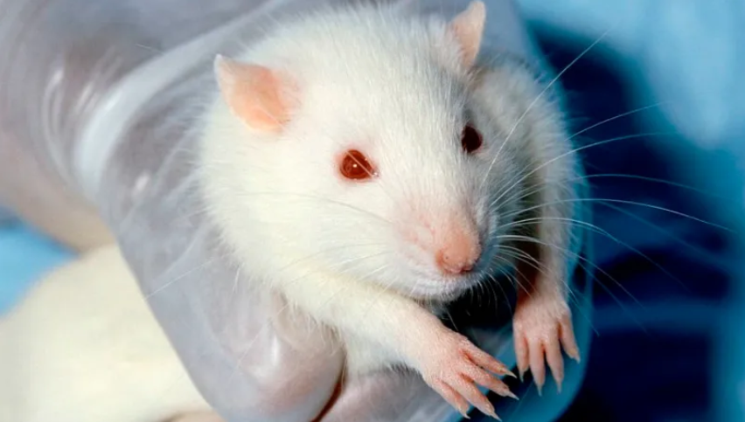
Animal Studies

Slide 29
Title | Year | Sample | Target | Method | Result
1- Effect of irisin on endometrial……. | 2019 | Serum Uterine tissue | T,E2, P, Glu, INS LIF, aVB3 | ELISA ELISA,PCR, IHC | Levels of LIF and integrin αvβ3 were decreased in PCOS group. Irisin may improve endometrial receptivity by promoting expression of LIF and integrin αvβ3.
2- Investigation of the uterine … | 2018 | Serum Uterine tissue | AMH,E2 Ki67,CASP3 | ELISA IHC LM | AMH and E2 →Inc
3-Impaired receptivity and decidualization… | 2016 | Endometrium tissue Serum | STAT3 ,LIF Estrogen | PCR , WB ELISA | Estrogen → Inc LIF , STAT3 → Impaired
4-Expression of anti mullerian hormone …. | 2016
5-Mice endometrium receptivity… | 2016 | Serum Tissue | Ins ,P4 ,E2 Implantation site | H&E Trypan blue PCR WB | ESR1,2→Inc PGR→ NS HoxA10→Inc MTOR→Inc

Slide 30
Title | Year | Sample | Target | Method | Result
6-Impaired receptivity and… | 2016 | Uterine tissue | Ihh→Inc Sgk→Inc Msx→Inc Muc 1→Inc P-Stat 3→Dec Ki67→Inc Hand→Dec | PCR

Slide 31
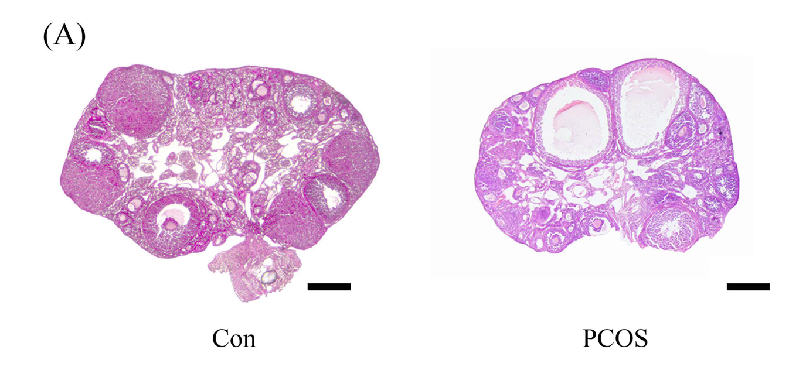
Li et al, Nature/ Scientific reports

Slide 32
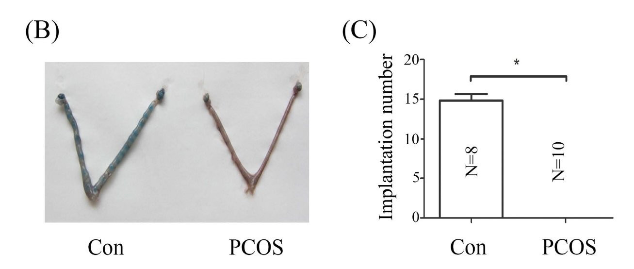
Li et al, Nature/ Scientific reports

Slide 33
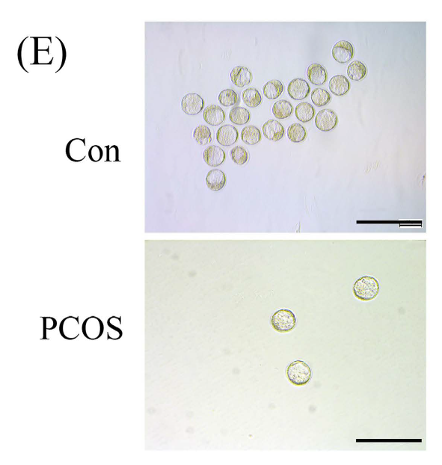
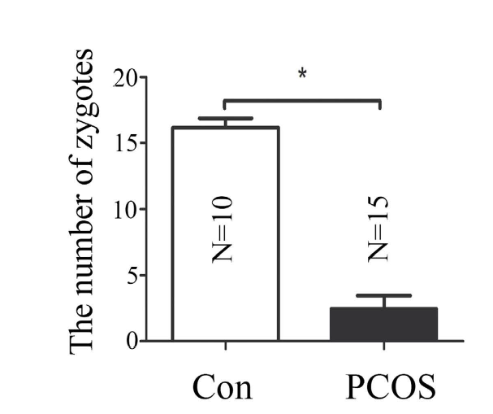
* Morphology of blastocysts collected from
vehicle control group and PCOS group on day 4.
Li et al, Nature/ Scientific reports

Slide 34
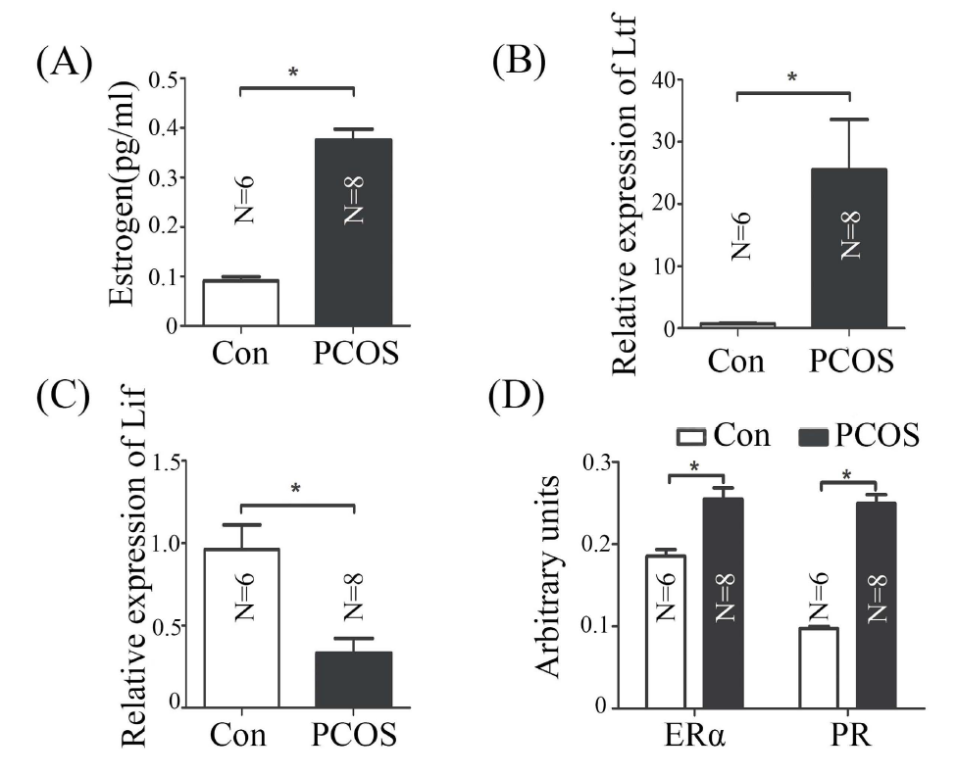
Li et al, Nature/ Scientific reports

Slide 35
Immunological Studies

Slide 36
Title | Year | Sample | Target | Method | Result
1-T helper profiles… |  | PB | IFNG ,IL4,IL17,FoxP3 | Flow | Th1 → Inc T reg → Dec Th2→ Dec
2-TH1/TH2 imbalance … |  | PB | IFNG ,IL4 | Flow | Th 1 → Inc Th 2→ NS FINS→ Inc E 2 / T → Dec
3-The effect of symbiotic .. |  | Serum | SHBG → Inc CRP → Incr NO→ Incr | ELISA | Group A: Synbiotic Group B: PLACEBO
4-Pro anti oxidant balance …. |  | FF | IL6,8,10,TNF TOS ,TAC,MDA | ELISA | IL10 →Dec IL6,8,TNF→ Inc TAC ,Thiol→Dec TOS ,MDA→Inc
5-Detection of DC … |  | FF | TNF ,IL6,Il10,23 HLA DR , CD11C, CD45 | ELISA Flow | IL10 , DC → Dec Other → Inc

Slide 37
Title | Year | Sample | Target | Method | Result
6-CRH and NGF as ….. |  | Serum | CRH, NGF IL1A/B,IL17A,INF-a | ELISA | IL1a/b → Inc CRH , NGF ,IL17a →Dec TNF a→ NS
7-FoxO1 signaling … |  |  | FoxO1 TNF ,IL6 | WB | TLR4→ FOXO1 → Inflammatory cytokine
8-Level of CD40L in obese and … |  | Serum | sCD40L IL6 HS –CRP TNF | ELISA | IL6 , sCD40L→ Inc sCD40L → Dec TNF → ns
9-Enhaned inflammatory transcriptome … |  | Serum FF GC | IL8,6,CCL20.TNF CXCL1,CXCR1 CXCl14,Sema3c ANGPT1… FSHR,CYP11A1 LHCGR,CYP19A1 | PCR

Slide 38
Title | Year | Sample | Target | Method | Result
10-Central leptin resistance … |  | Brain tissue Vaginal smear | STAT3 Socs JAK2 | WB | Increase signaling pathway
11-Cytokine expression profile |  | FF | IFNG ,IL2,IL4,IL10 | Flow | IL2 ,IFNG → Inc IL10 ,4→ NS
12-Metformin and pro inflammatory … |  | PB | VCAM1,ICAM1,IL6,TNF.E-Selectin,NO | ELISA | NO and TNF →

