Slide 1
In the name of GOD

Slide 2
PROBLEM LIST
Course hands and feet
Enlarged nose
Headache
Arthralgia
Bone pain
Bilateral CTS
Increase in facial creases,
Increase in IGF1
GH>1 ng/ml in OGTT test
Partially empty sella with normal pituitary
No evidence of mass lesion in lung or pancreas
Right lung hilum uptake in octerotide scan

Slide 3
can we consider ectopic GHRH producing tumors as acromegaly cause in this patient?
What is the first step in determining acromegaly induced by ectopic secretion of GHRH?

Slide 4
21 patients aged 14–77 yr were identified from 12 French hospitals. Median GHRH was 548 (270–9779) ng/liter.

Slide 5
Median GHRH at diagnosis was 548 (range 270– 9779) ng/liter. The median GHRH values were 1173 (range 382–9779) ng/liter in bronchial secreting tumors and 539 (range 270–2600) ng/liter in pancreatic ones(P 0.10). the threshold of 250 ng/liter appears as a highly specific indicator of an ectopic GHRH secretion in acromegalic patients

Slide 6
How is pituitary MRI in acromegalic patients with ectopic GHRH producing tumor?

Slide 7
Pituitary imaging was available for 20 patients: It was interpreted as normal in 5 patients, as showing a pituitary enlargement without evidence of an adenoma in 8 and a microcystic lesion in 2. Imaging was suggestive of an adenoma in 5 patients

Slide 8
What are the most common responsible tumor for ectopic GHRH secretion ?
The responsible tumors were identified in 20 patients . They were all neuroendocrine tumors.
12 patients had a pancreatic tumor; 5 were single with a median diameter of 70 mm (40–80 mm), and the 7 were multiple pancreatic tumors, measuring between 10 and 80mm in diameter.
7 patients had bronchial carcinoid tumors with a median diameter of 45 mm (range 12–80 mm.2 patients underwent surgical removal of the bronchial carcinoid a few years before the diagnosis of acromegaly, and the GHRH secretion was related to secondary bone and hepatic metastasis.
for 1 patient the responsible tumor was an appendicular well-differentiated endocrine carcinoma.

Slide 9
10 patients (47.6%) had distant metastases at the time of the diagnosis of acromegaly; pancreatic tumors were metastatic in 66.6% of cases (n = 8 of 12) and bronchial tumors in 28.6% (n = 2 of 7). Pancreatic tumors mainly metastasized to the liver and bronchial ones to the liver and bones.

Slide 10
Imaging for localization of the GHRH producing tumor
Thoracic and/or abdominal CT scan was identified the primary tumor and/or metastases in 20 cases
CT scan showed the pancreatic tumor in 9 of the 12 patients. For 2 patients, it showed isolated liver lesions, and the pancreatic tumor was identified only by the SRS and endoscopic ultrasound.
CT scan revealed the bronchial tumor in 5 patients and the liver metastasis in 2 patients whose tumor had been previously surgically removed.

Slide 11
SRS using radiolabeled octreotide, performed for 16 patients, showed the primary tumor and/or secondary lesions in 81%of patients. Ultrasound endoscopy identified a pancreatic tumor in all six patients explored.
Somatostatin receptor scintigraphy had a similar sensitivity to computed tomography scan (81 vs. 86%)
For 1 patient , neither the thoracic and abdominal CT nor the SRS and [18F]fluorodeoxyglucose positron emission tomography scan revealed the tumor

Slide 14
Although a variable size, tumors were large in most cases with a median diameter of 55 mm,
from 63 reported cases, MRI was interpreted as hyperplasic in 38 cases, normal in 12 and adenomatous in 13. Indeed, the distinction between hyperplasia and adenoma may be difficult.

Slide 15
A total of 190 patients with contrast-enhanced MR imaging of the pituitary underwent surgery for suspected GH-secreting adenomas. 6 of these acromegalic patient (3.2%; three males, three females) without imaging evidence of a pituitary adenoma were identified on conventional pituitary MRI

Slide 16
None of the6 patients showed evidence of pituitary adenoma on standard SE T1-weighted MR imaging (with and without contrast) before surgery. 3 patients also underwent a postcontrast volumetric interpolated breath-hold examination (VIBE) MR imaging with thin slices (1.2 mm) Although VIBE imaging in one patient revealed a 4-mm hypointense region that corresponded with a microadenoma discovered at surgery , it did not reveal evidence of an adenoma in the other two patients.

Slide 17
56 year old woman was Evaluated for facial coarsening over the past 6 years
Pituitary MRI was performed twice and no pituitary adenoma or pituitary hyperplasia was visualized .CT scan of the chest revealed a 4.5 by 3.5 cm lobulated soft tissue mass in the subcarinal region, posterior to the left atrium Abdominal CT scan showed a round lesion in the right lobe of the liver consistent with either a metastasis or a hemangioma . Whole body Octreotide scan showed uptake concordant with the mediastinal mass but not with the liver lesion . Final pathologic diagnosis was that of paraganglioma.

Slide 18
Diagnostic criteria for ectopic acromegaly
elevated plasma GHRH
complete recovery after resection of the corresponding tumor
positive GHRH immunostaining,
positive bioassay (the ability of cultured rat pituitary cells to produce GH in response to the tumor extract)
arterio-venous gradient of GHRH across the tumor
detection of GHRH mRNA or GHRH extraction from the tumor tissue

Slide 19
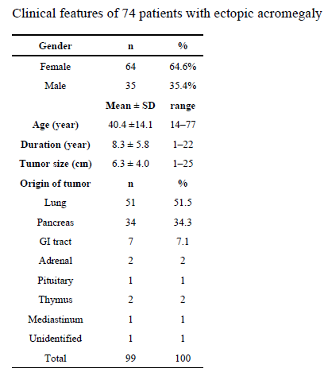
Histopathologic evaluation of reported GHRH secreting tumors confirmed that all except3 were of neuroendocrine origin. One of these was an adenoid cystic carcinoma of the
lung and the other was a pituitary adenoma secreting both GH and GHRH; the
third one was a case of acromegaly with elevated GHRH and normal pituitary MRI in whom no tumor was identified despite extensive work-up. Eighty four were bronchial carcinoid or endocrine pancreas tumors .

Slide 20
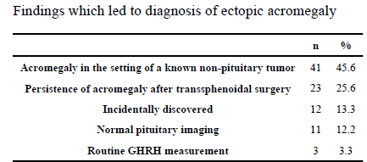
Of the 98 reported cases, 30 patients underwent transsphenoidal resection for presumed GH secreting pituitary adenoma

Slide 21
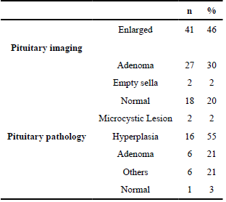
Pituitary enlargement was present in about 75% of cases and 1/3 were diagnosed with a pituitary adenoma. In some cases, normal appearance of the pituitary gland prompted workup for ectopic acromegaly .

Slide 22
In a patient with acromegaly and unremarkable pituitary MR imaging, with no evidence of ectopic GH and GHRH production, transsphenoidal pituitary exploration is a reasonable approach and may result in clinical improvement and biochemical cure in the hand of experienced surgeon. This approach may avoid long term medical treatment with its associated cost.

Slide 24
The empty sella was detected more frequently in 35/159 (22%) patients with a GH-secreting adenoma compared to 8/150 (5.3%) patients in group B or 4/ 50 (8%) in group C (p=.036). A primary intrasellar and/or downward tumor extension (without any suprasellar tumor) was present in 119/159 patients (74.8%) with a GH-secreting adenoma vs. 71/150 (47.3%) in group B (p < 0.001).

Slide 25
We retrospectively reviewed the medical records of patients diagnosed with acromegaly and treated between May 2005 and September 2016
Patients who had undergone prior pituitary surgery, hormone therapy, or irradiation were excluded to eliminate secondary causes of ES
78 patients, newly diagnosed with acromegaly who underwent transsphenoidal surgery were included. ES was defined as the pituitary gland and adenoma occupying less than 50% of the sella turcica on midsagittal MR imaging.

Slide 26
12 patients (15.4%), predominantly female had ES in preoperative MR imaging. ES patients had smaller mean tumor diameter (6.3 mm) than non-ES patients (11.2 mm, p = .001). In preoperative MR imaging, occult adenoma was found in three (25%) ES and three (4.5%) non-ES patients.

Slide 28
What should we do for this patient?
Checking GHRH
Endoscopy and colonoscopy
Repeat dynamic pituitary MRI with volumetric interpolated breath-hold examination (VIBE)
Refer to neurosurgeon for TSS
If the micro adenoma was detected : follow the patient with IGF1 and GH
IF micro adenoma was not detected: Continue LAR, and follow the patient with CT of abdomen and lung and SRS annually

