Slide 1
IN THE NAME OF ALLAH
Shahin nosratzehi

Slide 2
Problem list
A 47-year-old woman
PMH of SLE from 17 years ago
Severe HTN from 3 years ago
Positive FH of hypertension

Slide 3
Clinical question
Dose this patient have primary hypertension?secondary hypertension?
What is the diagnosis?
What is the subtype classification?
How should be tested?
How should be management?

Slide 4
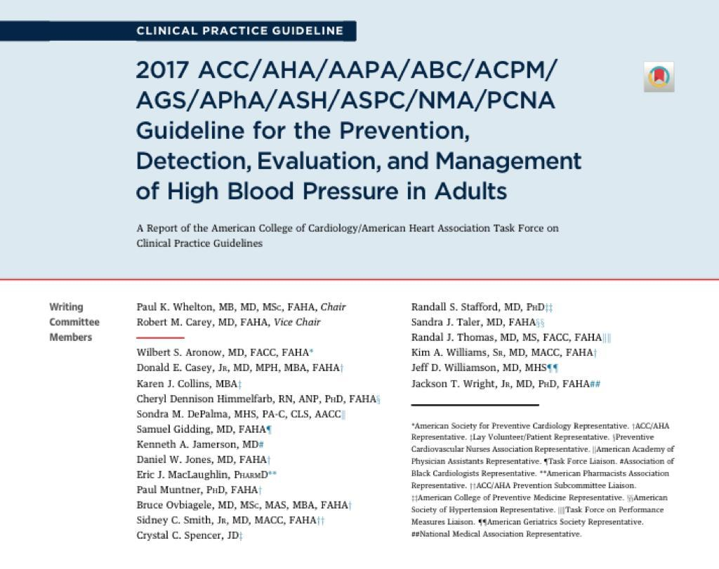

Slide 5
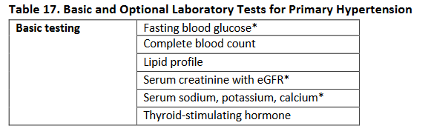
Laboratory Tests and Other Diagnostic Procedures
Laboratory measurements should be obtained for all patients with a new diagnosis of hypertension to facilitate CVD risk factor profiling, establish a baseline for medication use, and screen for secondary causes of hypertension
Optional tests may provide information on target organ damage.

Slide 6
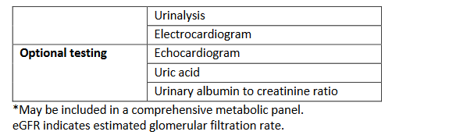
Laboratory Tests and Other Diagnostic Procedures

Slide 7
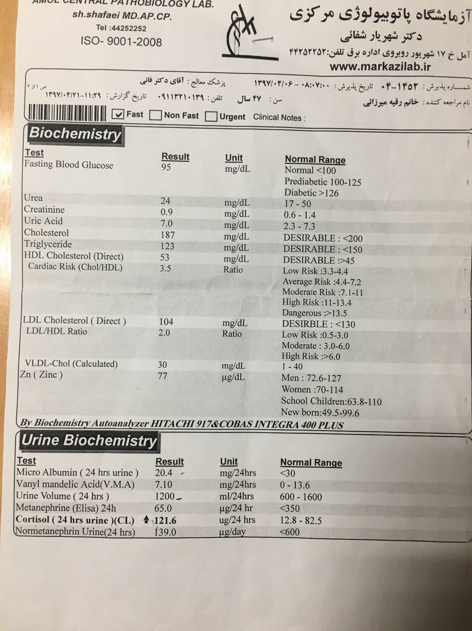
  FBS:95 mg/dl
  CHOL:187mg/dl
  LDL:104mg/dl
  HDL:53mg/dl
  TG:123mg/dL
  Cr:0.9mg/dl Na:142meq/l
  K:3.9meq/l
  Ca:8.8mg/dl

Slide 8
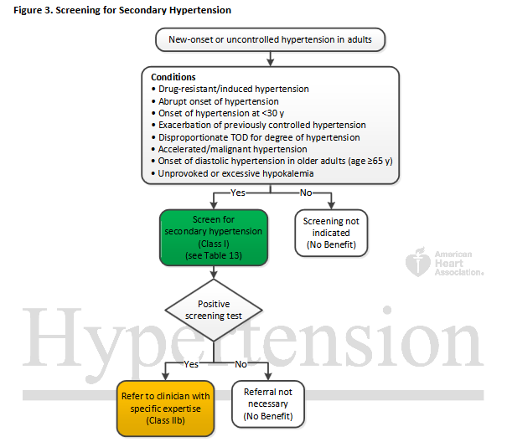
TOD indicates target organ damage (e.g., cerebrovascular disease, hypertensive retinopathy, left ventricular
hypertrophy, left ventricular dysfunction, heart failure, coronary artery disease, chronic kidney disease, albuminuria,
peripheral artery disease)

Slide 9
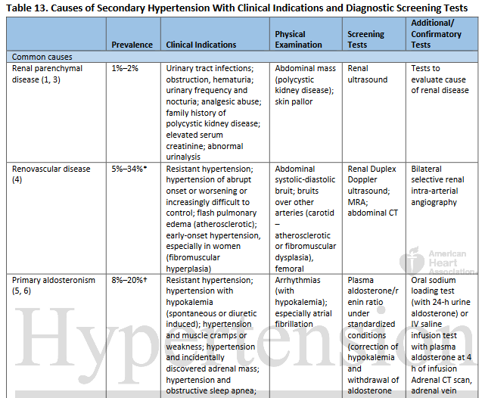
8% in general population with hypertension; up to 20% in patients with resistant hypertension.

Slide 10
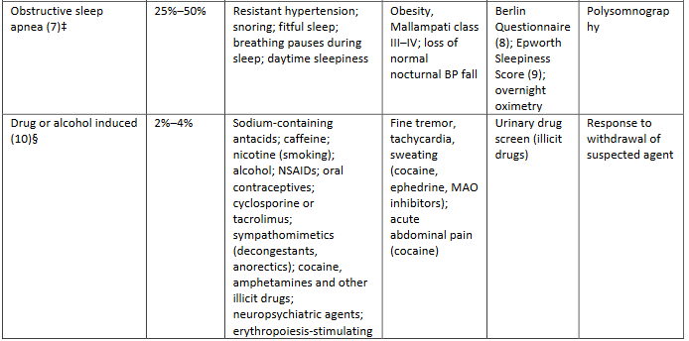

Slide 11
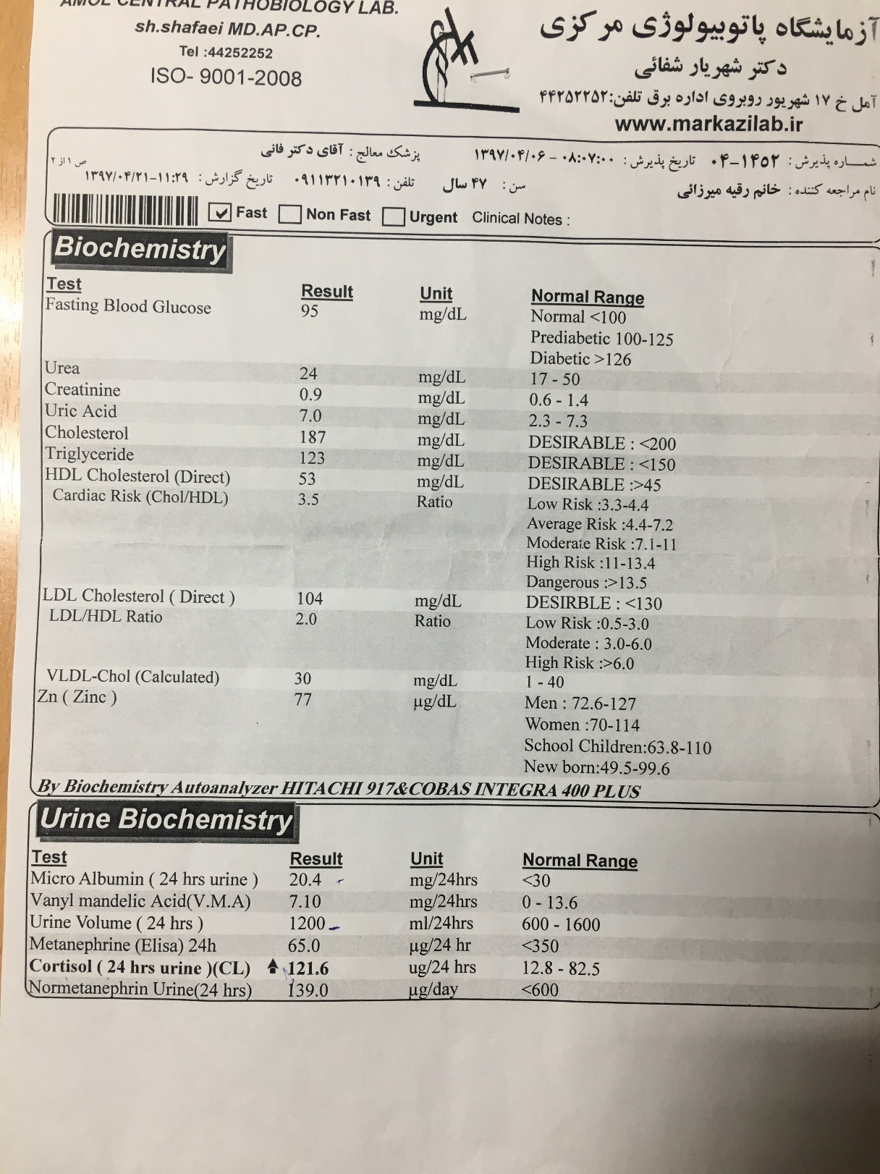
Urin volum(24h):1200cc/24h
Micro Albumin(24h):20.4mg/24h
GFR:76.14

Slide 12
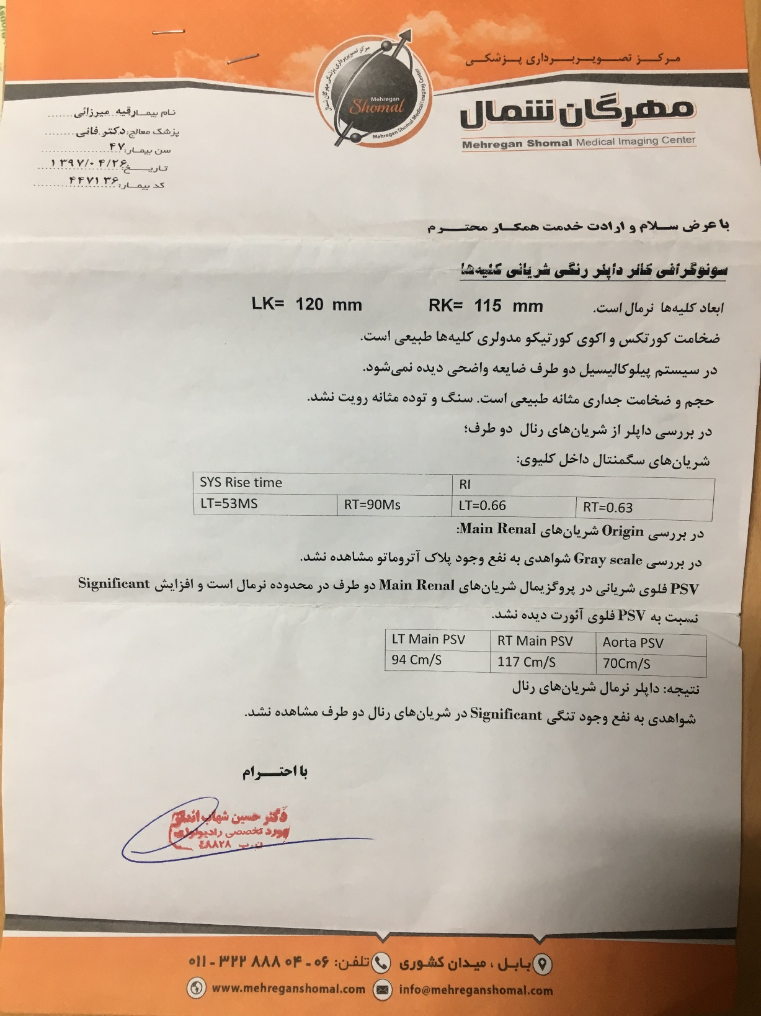

Slide 13
Case detection
patients with sustained blood pressure above 150/100 mm Hg on each of three measurements obtained on different days
hypertension (BP 140/90 mm Hg) resistant to three conventional antihypertensive drugs
controlled BP (140/90 mm Hg) on four or more antihypertensive drugs
hypertension and spontaneous or diuretic-induced hypokalemia
hypertension and adrenal incidentaloma
hypertension and sleep apnea
hypertension and a family history of early onset hypertension or cerebrovascular accident at a young age (40 years)
all hypertensive first-degree relatives of patients with PA.
J Clin Endocrinol Metab, May 2016, 101(5):1889–1916

Slide 14
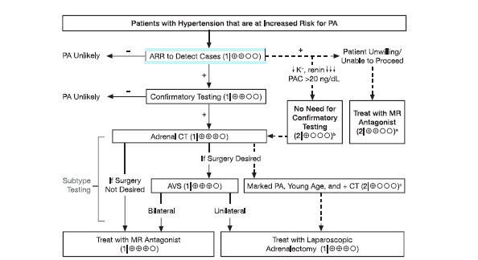
J Clin Endocrinol Metab, May 2016, 101(5):1889–1916

Slide 15
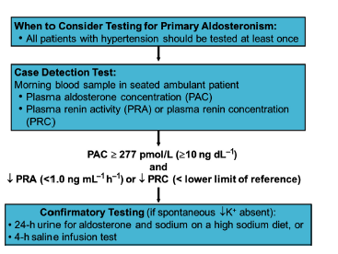
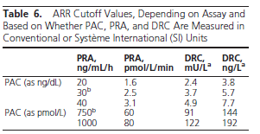
Diagnosis

Slide 16
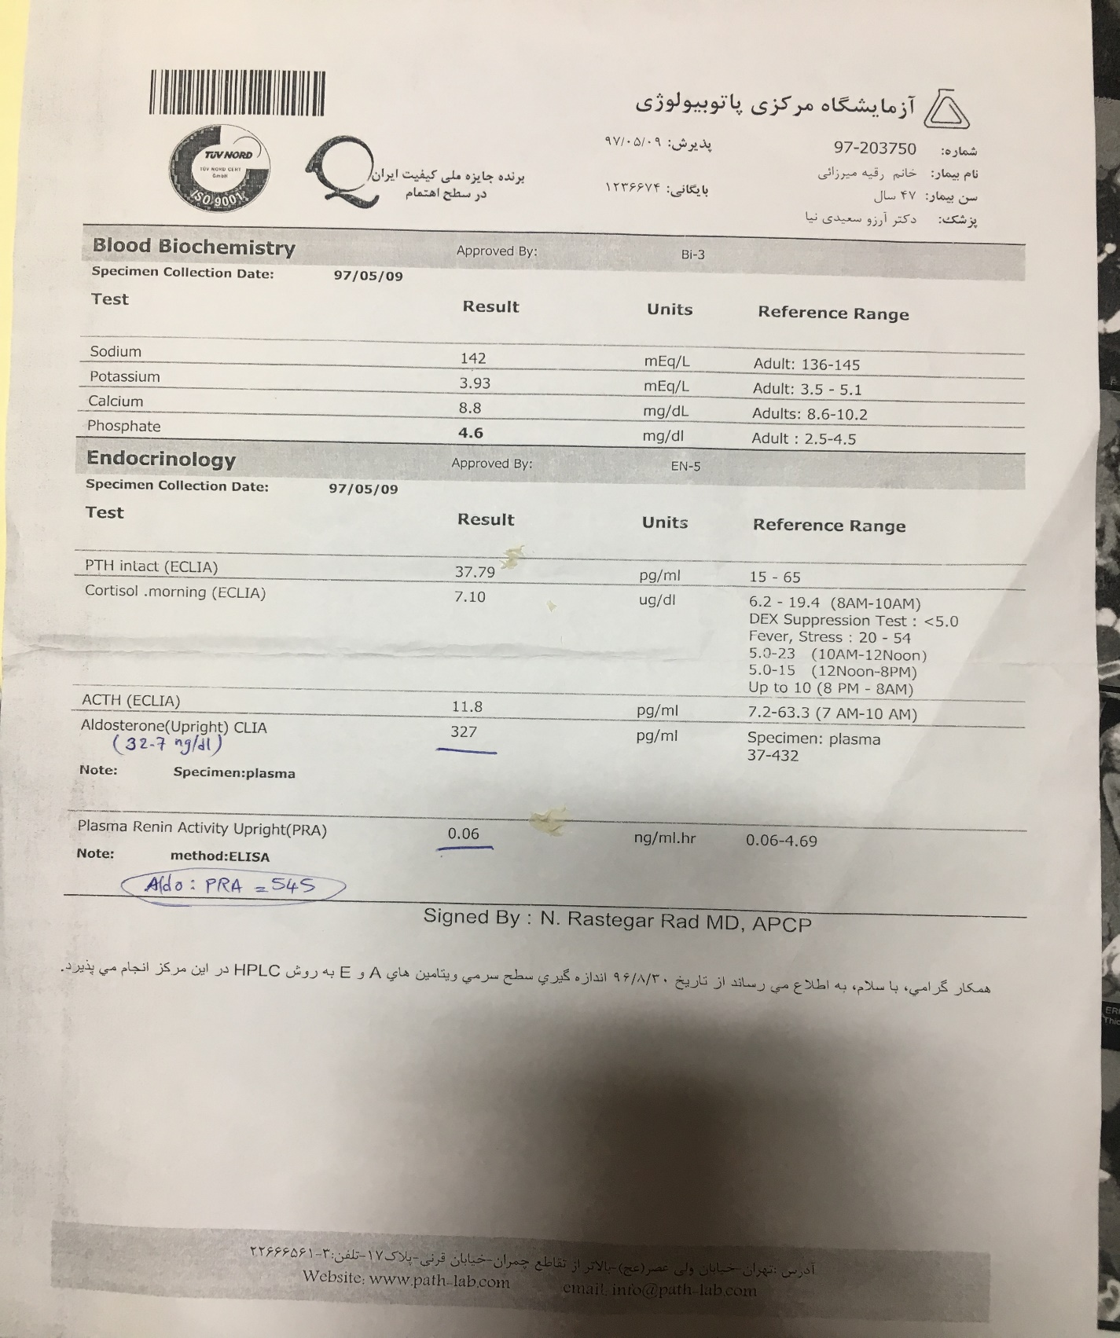
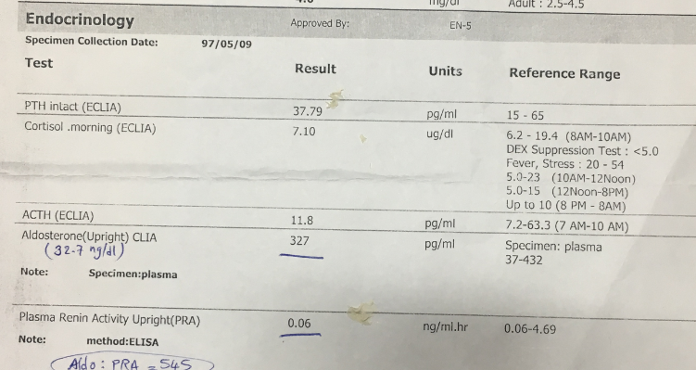
Aldosteron:32.7ng/dl
PRA:0.06 ng/ml.h
ARR:545 ng/dl/ng/ml.h
hyperaldosteronism

Slide 17
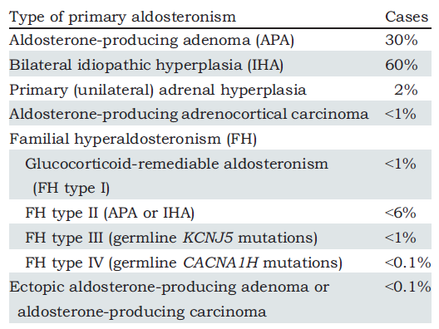
2018 The Association for the Publication of the Journal of Internal Medicine

Slide 18
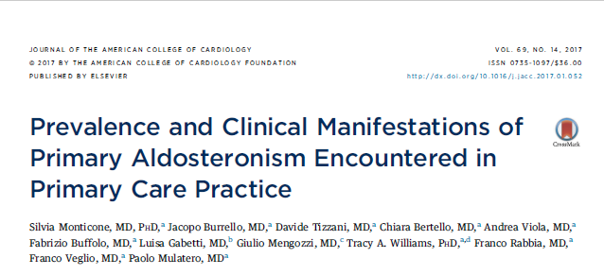

Slide 19
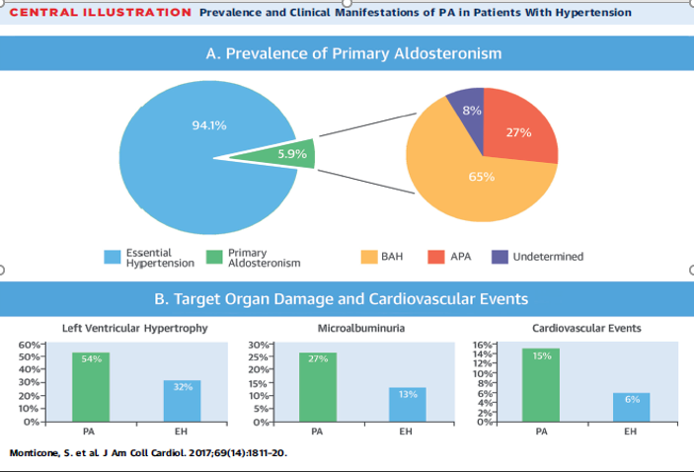
A total of 1,672 primary care patients with hypertension (569 newly diagnosed and 1,103 patients already diagnosed with arterial hypertension) were included in the study. A total of 99 patients (5.9%) were diagnosed with PA and conclusive subtype differentiation by adrenal vein sampling was made in 91 patients

Slide 20
What is the subtype classification?

Slide 21
Subtype Classification
Adrenal CT scan
Adrenal venous sampling (AVS):
If surgical treatment is practicable and desired by the patient
To distinguish between unilateral and bilateral adrenal disease
alternative procedure

Slide 22
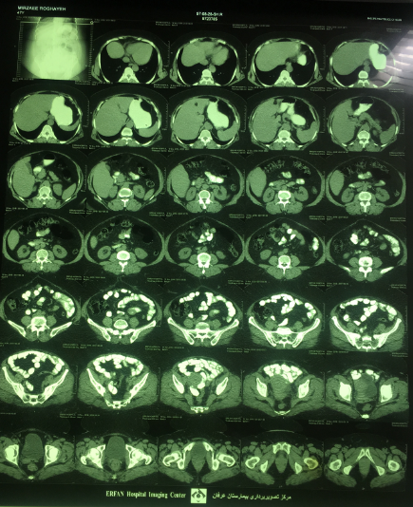

Slide 23
Adrenal CT scan
The sensitivity and specificity of CT is 78% and 75%, respectively
Adrenal carcinoma should be suspected when a unilateral ,large (>4cm)adrenal mass is found on CT in a patient with PA
Bilateral adrenal gland thickening or micronodular change suggests adrenal hyperplasia ,however patients with hyperplasia may also have normal appearing adrenal glands on CT
When a solitary,hypodense, unilateral macroadenoma(>1cm) and normal contralateral adrenal morphology are found in a young patient(<35y)with vigorous primary aldostronism
J Clin Endocrinol Metab, May 2016, 101(5):1889–1916

Slide 24
Adrenal CT scan
Adrenal CT has several limitations
Radiologists might interpret small APAs incorrectly as “IHA” on the basis of normal-appearing adrenals.
Bilateral lesions are not diagnostic of hyperplasia(some patients with an aldostronoma in one adrenal gland have a non functioning adrenal nodule in the other, especially in older patients (age >35 years)
UAH may be visible on CT, or the UAH adrenal may appear normal on CT
J Clin Endocrinol Metab, May 2016, 101(5):1889–1916

Slide 25
Adrenal CT scan
In one study of 203 patients with PA who were evaluated with both CT and AVS
CT was accurate in only 53% of patients
On the basis of CT findings, 42 patients (22%) would have been incorrectly excluded as candidates for adrenalectomy
48 (25%) might have had unnecessary or inappropriate surgery.
systematic review of 38 studies with 950 patients with PA, CT and MRI
misdiagnosed the cause of PA in 37.8% of patients
J Clin Endocrinol Metab, May 2016, 101(5):1889–1916

Slide 26
Subtype Classification
Adrenal CT scan
Adrenal venous sampling (AVS):
If surgical treatment is practicable and desired by the patient
To distinguish between unilateral and bilateral adrenal disease
alternative procedure

Slide 27
AVS
AVS is the “gold standard” test to distinguish unilateral (APA or UAH) from bilateral (IHA) disease in patients with PA
The sensitivity and specificity of AVS (95 and 100%, respectively) for detecting unilateral aldosterone excess are superior to that of adrenal CT (78 and 75%, respectively)
Clin Endocrinol Metab, May 2016, 101(5):1889–1916

Slide 28
AVS
Indications
For patients who would like to pursue surgical management (unilateral adrenalectomy) of their primary aldosteronism,
we suggest AVS to confirm unilateral disease if the CT scan is normal
shows bilateral abnormalities
shows a unilateral abnormality but the patient is over age 35 years
jClin Endocrinol Metab, May 2016, 101(5):1889–1916

Slide 29
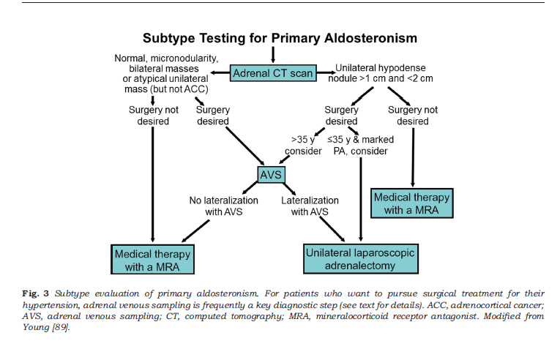
2018 The Association for the Publication of the Journal of Internal Medicine

Slide 30
AVS
Procedure : cosyntropin infusion (50 mcg per hour started 30 minutes before sampling of the adrenal veins and continued throughout the procedure) for the following reasons:
To minimize stress-induced fluctuations in aldosterone secretion during AVS, which could potentially confound the interpretation of lateralization data.
To maximize the gradient in cortisol from adrenal vein to inferior vena cava (IVC) and thus confirm successful sampling of the adrenal vein.
To maximize the secretion of aldosterone from an APA
jClin Endocrinol Metab, May 2016, 101(5):1889–1916

Slide 31
AVS
Confirming successful catheterization
With cosyntropin infusion, the adrenal vein to IVC cortisol ratio is typically more than 10:1
a ratio of at least 5:1 is required to be confident that the adrenal veins were successfully catheterized
However, when cosyntropin infusion is not used, an adrenal vein to IVC cortisol gradient of more than 3:1 is recommended
Cortisol-corrected ratios —cutoff for the cortisol-corrected aldosterone ratio from high-side to low-side of more than 4:1

Slide 32
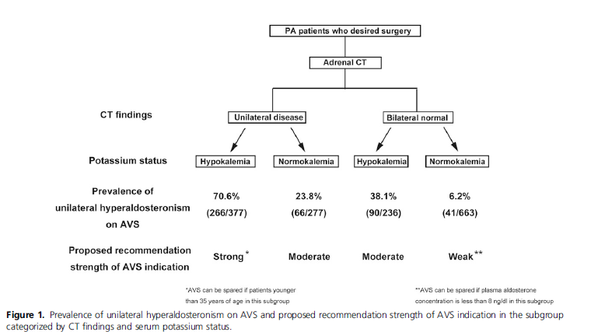
J Clin Endocrinol Metab, March 2018, 103(3):900–908

Slide 33
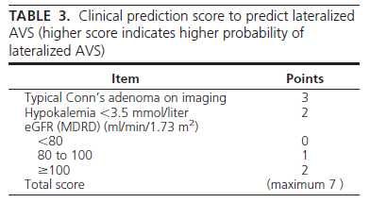
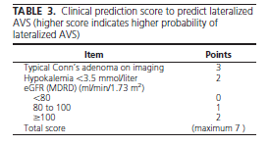
Our patient:0 score
J Clin Endocrinol Metab, October 2012, 97(10):3530–3537

Slide 34
Posture stimulation test
Typically , APA showed diurnal variation and was relatively unaffected by changes in angiotensin II levels
are unresponsive to angiotensin 2 and a falll in aldosterone over 2 hours is observed in parallel with reduced circadian ACTH and cortisol release.
In IHA upright posture stimulates renin secretion ->rise aldosterone
accuracy:85%
jClin Endocrinol Metab, May 2016, 101(5):1889–1916

Slide 35
18-OH-corticosterone
Patients with an APA typically have elevated supine plasma 18-hydroxycorticosterone levels at 8 AM (>100 ng/dL), while patients with bilateral IHA do not
However, the accuracy of the test is low, and it does not help with localization
jClin Endocrinol Metab, May 2016, 101(5):1889–1916

Slide 36
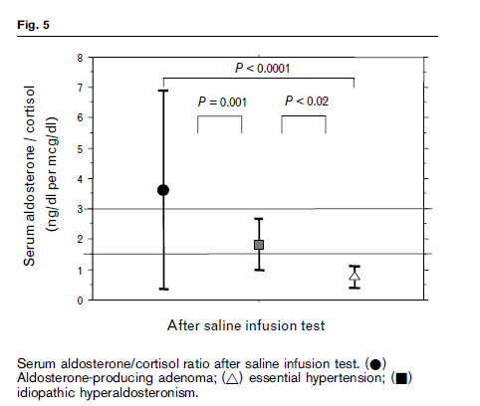
Journal of Hypertension 2006, 24:737–745

Slide 37
How should be management?

Slide 38
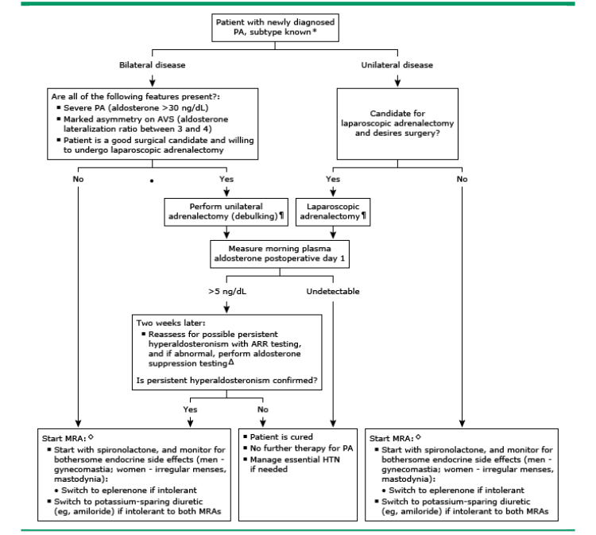

Slide 39
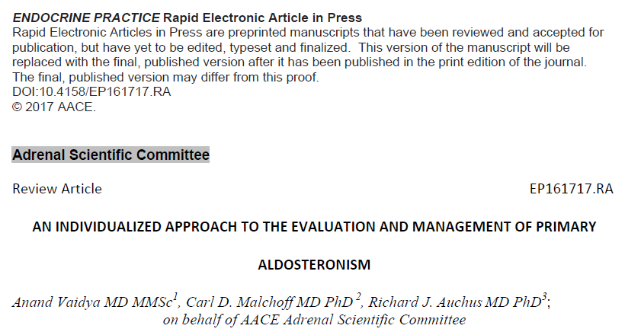

Slide 40
Management
The ideal goal of treatment is to :
cure hyperaldosteronism
cure or improve hypertension
and resolve hypokalemia if applicable.
DOI:10.4158/EP161717.RA © 2017 AACE.

Slide 41
Management
Surgery is the preferred therapeutic intervention when PA is localized to a unilateral source(APA-UAH)
Anterior laparoscopic surgery is commonly practiced, while specialized centers may also offer retroperitoneoscopic approaches that afford even shorter recovery times.
more recent option that is becoming available is radiofrequency ablation of adrenal adenomas
DOI:10.4158/EP161717.RA © 2017 AACE.

Slide 42
Management
in certain instances of bilateral PA where blood pressure and/or
potassium balance is difficult to control with maximal MR antagonist
therapy, unilateral surgery may be effective, especially if there is
substantial asymmetry observed on AVS
DOI:10.4158/EP161717.RA © 2017 AACE

Slide 43
Management
In most cases of bilateral PA, the initial treatment of choice is medical therapy with MR antagonists.
The two most commonly available options are spironolactone and eplerenone
Spironolactone has approximately twice the potency of eplerenone at equivalent doses and is generally cheaper.
DOI:10.4158/EP161717.RA © 2017 AACE.

Slide 44
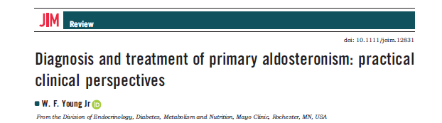

Slide 45
Management
the initial dosage is 12.5– 25 mg per day and increased to 400 mg day if necessary to achieve a high–normal serum potassium concentration.
During the first 6 weeks of treatment, serum potassium and creatinine should be monitored frequently (e.g. weekly).
Concomitant therapy with salicylates should be avoided as they decrease the effectiveness of spironolactone.
Spironolactone increases the half-life of digoxin, and the digoxin dosage may need to be adjusted when treatment with spironolactone is started.

Slide 46
Management
Hypokalemia responds promptly, but hypertension can take as long as 4 to 8 weeks to be corrected.
After several months of therapy, the dosage of spironolactone often can be decreased to as little as 25 to 50 mg/day with food; dosage titration is based on a goal serum potassium level in the high-normal range.
Due to antagonism at the androgen receptor, spironolactone at dosages of
more than 50 mg per day may result in painful gynaecomastia
Agonist activity at the progesterone receptor may result in menstrual irregularity in women

Slide 47
Management
Eplerenone, a competitive and selective MRA, Compared with spironolactone, eplerenone has 0.1% of the binding affinity to androgen receptors and less than 1% of the binding affinity to progesterone receptors.
Eplerenone s available as 25- and 50-mg tablets and should be administered twice daily because of its short half-life
maximum dose approved by the FDA for hypertension is 100 mg per day, potency studies have shown that eplerenone is 25–50% less potent compared with spironolactone.

Slide 48
Management
Until such data becomes available, one individualized approach is to
first titrate MR antagonists to achieve a normal serum potassium and a rise
of plasma renin activity to greater than 1 ng/mL/h
When MR antagonists alone are insufficient to normalize blood pressure, the use
of other anti-hypertensives should be considered. Calcium channel blockers and alpha-
and beta adrenergic antagonists are obvious choices.
When hypokalemia remains a persistent problem, ENaC inhibitors such as amiloride can
be effective add-ons
DOI:10.4158/EP161717.RA © 2017 AACE.

Slide 49
Management
Our patient:
Discontinue other hypertensive medication
start Spironolactone 50mg/d→100 mg/d
The day after the discharge she had found skin lesion and referred to a dermatologist and Discontinue Spironolactone

Slide 50
Dermatologic adverse reaction:1-10%
Alopsia
Erythematous maculopapular rash
Pruritus
Urticaria
Steven-Johnson syndrome
Toxic epidermal necrolysis
DRESS:(long latency)*after 2-6w

Slide 52
