Slide 1
case

Slide 2
CASE
A 56-year-old woman with a history of osteoporosis.
She referred after a recent DXA scan showed a significant decline in spine bone mineral density.
She had appropriate adherence to alendronate, 70 mg weekly, for the last 3 years.
The bone mineral density of her hips is in the osteopenic range and has remained stable.
Her last menstrual period was 5 years ago.
She has had 2 fractures before the initiation of therapy, both of which were trauma related.
Family history: her mother has osteoporosis and a history of a hip fracture and her maternal grandmother sustained a hip fracture in her 80s

Slide 3
The patient's most recent DXA scan is shown, and this was compared with her previous DXA scan performed 2 years earlier .
The findings in the spine are consistent with osteoporosis and Compared with the previous study, the lumbar spine bone density has decreased by 6%, representing a significant change.

Slide 4
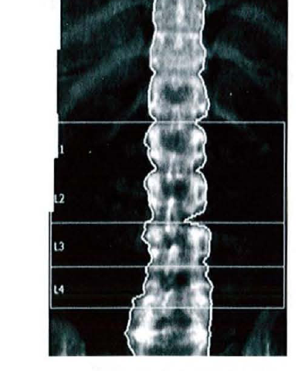
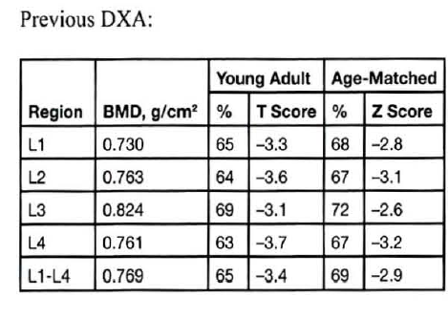
2012

Slide 5
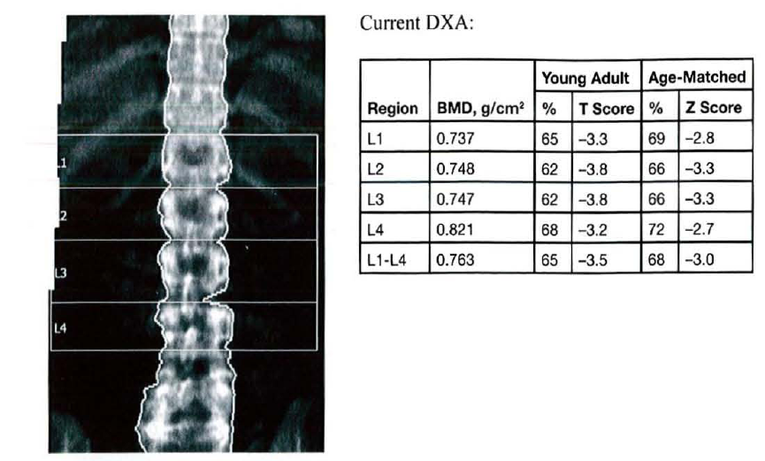
2014

Slide 6
Laboratory test results:
Total calcium = 9.7 mgldL (8.2-10.2 mgldL)
vitamin D = 31 nglmL (25-80 nglmL
Phosphorus = 3.5 mgldL (2.3-4.7 mgldL) PTH = 35 pglmL (10-65 pglmL)
Creatinine = 0.6 mgldL (0.6-1.1 mgldL)
Albumin = 3.4 gldL (3 .5-5.0 gldL)
TSH = 1.6 mlU/L (0.5-5.0 mIUlL)
Urinary N-Ielopeplide = 8 nmol BCE/mmol creal (6.2- 19.0 nmol BCE/mmol creal)

Slide 7
In addition to calcium and vitamin D supplementation and a resistance-training program, which
of the following additional recommendations should you make?
A. Discontinue the oral bisphosphonate and prescribe intravenous zoledronic acid
B. Discontinue the oral bisphosphonate and prescribe a weekly combined estrogen-progestin patch
C. Discontinue the oral bisphosphonate and prescribe teriparatide
D. Recommend a drug holiday and follow-up DXA scan in 3 to 5 years
E. Continue the oral bisphosphonate and order another DXA scan

