Slide 1
IN THE NAME OF GOD

Slide 2
Problem list
Recurrent hypoglycemia
Surgery : Insulinoma 1386
Surgery :nesidiodysplasia 1390
Sleeve gastrectomy:1397
Hypoglycemia High insulin level,high C peptide,positive urine sulfonylurea test
LUQ pain

Slide 3
AGENDA:
DDX
Malignant insulinoma
NIPHS or Insulinoma
Nasidioblastosis in adults
Concurrent Insulinoma and Nesidioblastosis
Hypoglycemia after sleeve gastrectomy or Bariatric surgery
Factitious hypoglycemia

Slide 4
DDX
Malignant insulinoma
NIPHS or Insulinoma
Nasidioblastosis in adults
Concurrent Insulinoma and Nesidioblastosis
Hypoglycemia after sleeve gastrectomy or Bariatric surgery
Factitious hypoglycemia

Slide 5
DDX:
Recurrence of insulinoma
Factitious hypoglycemia
NIPHS(non insulinoma pancreatogenous hypoglycemia syndrome)
Post gastric bypass hypoglycemia

Slide 6
Insulinoma/nesidioblastosis
Insulin level,Cpep,
octreotide scan
CT: peripancreatic LAP 17mm
Factitious hypoglycemia
Positive Urine sulfonylurea test
Psychologic consult
Desire to surgery, opium dependency

Slide 7
DDX
Malignant insulinoma
NIPHS or Insulinoma
Nasidioblastosis in adults
Concurrent Insulinoma and Nesidioblastosis
Hypoglycemia after sleeve gastrectomy or Bariatric surgery
Factitious hypoglycemia

Slide 8
Malignant Insulinoma
Spectrum of Unusual Clinical Features
Published 2005 by the American Cancer Society
DOI 10.1002/cncr.21179
We identified 10 patients with metastatic insulinoma
6 had liver metastasis and 4 had lymph node metastasis.
None of the patients had evidence of the multiple endocrine neoplasia syndrome.

Slide 11
Four patients (Patients 7, 8, 9, and 10) who met the diagnostic criteria for insulinoma underwent laparotomy for removal of the neuroendocrine tumor.
No evidence of metastatic disease was found at the time of initial operation but for each patient, a neuroendocrine tumor metastasis was found in lymph nodes removed with the specimen.
These four patients have now been followed for 15–26 years with no further treatment and no evidence of recurrent disease.
Malignant Insulinoma
Spectrum of Unusual Clinical Features
Published 2005 by the American Cancer Society
DOI 10.1002/cncr.21179

Slide 12
Prolonged Interval between Primary Tumor Removal and Evidence of Metastatic Disease
Four patients (Patients 1, 3, 4, and 5) met the diagnostic criteria for insulinoma and underwent laparotomy.
In 3 of these four patients, a neuroendocrine tumor was enucleated from the pancreatic head and in the fourth patient the tumor was removed from the body of the pancreas by distal pancreatectomy.
In each of the patients there was no additional evidence of macroscopic or microscopic disease.

Slide 13
All 4 patients remained asymptomatic for 4 years.
In all 4 patients there has been recurrence of hypoglycemia over a 4 – 6-year period, and in each patient, recurrent disease was found in the liver.
In two of these patients the liver metastasis was manifested only by very small superficial lesions found on the surface of the liver.
Malignant Insulinoma
Spectrum of Unusual Clinical Features
Published 2005 by the American Cancer Society
DOI 10.1002/cncr.21179

Slide 14
Malignant Insulinoma/Hirshberg et al. CANCER July 15, 2005 / Volume 104 / Number 2

Slide 15
Malignant or metastatic insulinoma is a rare condition.
Only 5–12% of reported cases of insulinoma are malignant.
Most patients with malignant insulinoma have lymph node or liver metastasis and only rarely other sites such as bone involvement.
In spite of therapies in these patients that have been used with some short term benefits including surgery, chemotherapy, embolization, radiofrequency ablation, and somatostatin analogs , the prognosis of these patients is relatively poor with a median survival period of approximately 2 years.
Malignant Insulinoma Spectrum of Unusual Clinical Features
Published 2005 by the American Cancer Society
DOI 10.1002/cncr.21179

Slide 16
The 10 patients who form the basis of the current report are clearly different in their clinical behavior.
They have had a prolonged survival from the time of diagnosis or a prolonged interval between the excision of the initial pancreatic tumor and appearance of hepatic metastasis.
only a few patients (approximately 2%) diagnosed with benign insulinoma will later present with metastatic disease
Malignant Insulinoma Spectrum of Unusual Clinical Features
Published 2005 by the American Cancer Society
DOI 10.1002/cncr.21179

Slide 17
All other modalities of therapy are, therefore, palliative and usually of short-term value.
Diazoxide therapy for control of hypoglycemia has had the greatest long-term benefit.
Somatostatin and its analogs are usually not helpful in malignant insulinoma and may make the situation worse by suppressing glucagon and growth hormone.
Of all the approaches available, embolization may have the greatest benefit next to Diazoxide.
Aggressive secondary therapies such as chemoembolization or radiofrequency ablation should only be used to control hypoglycemia.
Malignant Insulinoma Spectrum of Unusual Clinical Features
Published 2005 by the American Cancer Society
DOI 10.1002/cncr.21179

Slide 18
DDX
Malignant insulinoma
NIPHS or Insulinoma
Nasidioblastosis in adults
Concurrent Insulinoma and Nesidioblastosis
Hypoglycemia after sleeve gastrectomy or Bariatric surgery
Factitious hypoglycemia

Slide 19
Islet Hyperplasia in Adults: Challenge to Preoperatively Diagnose Non-Insulinoma Pancreatogenic Hypoglycemia Syndrome
World J Surg (2006) 30: 670–679
we describe 11 patients with non-insulinoma Pancreatogenic hypoglycemia syndrome and address the possibility of preoperative differentiation between patients with NIPHS and patients with single insulinomas by means of a combined oral glucose tolerance test followed by a prolonged fast for up to 72 hours.
These mostly female patients (2 men and 9 women) suffered from not only postprandial hypoglycemia (7 out of 11 patients) but also fasting hypoglycemia (8 out of 11 patients).

Slide 20
These 11 patients were younger(median age 41 years, range: 18–66 years), mostly non obese(median BMI: 22.2 kg/m2; range 19–39 kg/m2), and presented with a higher basal HbA1c level (median 5.2%, range 4.0–5.7%), compared with the patients with insulinoma.
The biochemical data of a 6-hour OGTT and a standard supervised fasting test for up to 72 hours were compared with available complete data sets from 70 patients with a proven benign insulinoma and 70 patients in whom a diagnosis of hypoglycemia could not be made.
Islet Hyperplasia in Adults: Challenge to Preoperatively Diagnose Non-Insulinoma Pancreatogenic Hypoglycemia Syndrome
World J Surg (2006) 30: 670–679

Slide 21
Islet Hyperplasia in Adults: Challenge to Preoperatively Diagnose Non-Insulinoma Pancreatogenic Hypoglycemia Syndrome
World J Surg (2006) 30: 670–679
The lower serum insulin levels in patients with NIPHS compared with patients with single insulinomas were highly significant.

Slide 22
DDX
Malignant insulinoma
NIPHS or Insulinoma
Nasidioblastosis in adults
Concurrent Insulinoma and Nesidioblastosis
Hypoglycemia after sleeve gastrectomy or Bariatric surgery
Factitious hypoglycemia

Slide 23
Metastatic insulinoma in an adult patient with underlying nesidioblastosis
J. Rosman, R. Bravo-Vera, A. Sheikh, and A. Gouller Endocrinol. Invest. 30: 521-524, 2007
A 34-yr-old man presented in 1992 with symptoms of recurrent hypoglycemia. Laboratory and imaging findings were consistent with insulinoma. After enucleation of the tumor, his symptoms resolved.
In 1998 hypoglycemia recurred and biochemical work-up was consistent with endogenous hyperinsulinism.
Imaging for recurrent or metastatic insulinoma revealed no mass.
He underwent a distal pancreatectomy and pathology revealed
islet cell hyperplasia, or nesidioblastosis.

Slide 24
the patient reported minimal symptomatic improvement. He was started on Diazoxide but was poorly compliant and ate frequently to avoid hypoglycemic symptoms.
In 2003 he presented with hypoglycemia-induced seizure activity. Imaging showed hepatic and pulmonary lesions, but no pancreatic mass.
An octreotide scan revealed increased hepatic uptake and fine needle aspiration of a liver lesion confirmed metastatic insulinoma.
Arterial-stimulation venous sampling revealed increased insulin output from the liver and normal insulin output from the pancreas.
Metastatic insulinoma in an adult patient with underlying nesidioblastosis
Endocrinol. Invest. 30: 521-524, 2007

Slide 25
After failure of medical therapy, radiofrequency ablation of hepatic lesions was performed with subsequent improvement in clinical symptoms.
Although this patient had nesidioblastosis, his recurrent hyperinsulinism was most likely secondary to metastatic insulinoma.
Radiofrequency ablation was successfully used for palliative purposes in managing metastatic insulinoma refractory to medical therapy.
Metastatic insulinoma in an adult patient with underlying nesidioblastosis
Endocrinol. Invest. 30: 521-524, 2007

Slide 26
DDX
Malignant insulinoma
NIPHS or Insulinoma
Nasidioblastosis in adults
Concurrent Insulinoma and Nesidioblastosis
Hypoglycemia after sleeve gastrectomy or Bariatric surgery
Factitious hypoglycemia

Slide 27
An Unusual Case of Concurrent Insulinoma and Nesidioblastosis
J Pancreas (Online) 2008; 9(5):649-653.
A 35-year-old female presented with a primary episode of acute psychosis during which her serum glucose level dropped to 0.7 mmol/L (reference range: 3.5-5.5 mmol/L). Following correction of hypoglycaemia her psychiatric symptoms resolved.
During a supervised 72-hour fast she developed a hypoglycaemic episode with a serum glucose of 2.1 mmol/L, serum insulin of 52 pmol/L (reference value: greater than 36 pmol/L) and C-peptide of 340 pmol/L (reference value: greater than 200 pmol/L).
CT,MRI, an octreotide scan, EUS failed to identify an insulinoma.

Slide 28
Initial selective venous sampling of the splenic, superior mesenteric and portal veins was inconclusive with only one slightly elevated insulin level of 679 pmol/L in the proximal portal vein .
Repeat venous sampling six months later demonstrated one grossly elevated insulin level of 1,670 pmol/L within the proximal splenic vein suggestive of insulinoma, but not conclusive .
An extended glucose tolerance test produced five readings below 3 mmol/L between 180-300 min, with a final reading of 2.1 mmol/L. Proinsulin levels were elevated at 133 pmol/L (reference range: 0-10 pmol/L) and a screen for sulfonylureas was negative.
An Unusual Case of Concurrent Insulinoma and Nesidioblastosis
J Pancreas (Online) 2008; 9(5):649-653.

Slide 29
Having considered all the investigative findings, a tentative diagnosis of adult nesidioblastosis was made and the patient underwent an 85% distal pancreatectomy.
However, because of the grossly elevated insulin level within the splenic vein (on the second set of venous sampling) a high index of suspicion for the presence of an insulinoma was maintained.
A thorough macroscopic examination of the pancreas together with intra-operative ultrasound were therefore performed and an 8 mm lesion within the postero-inferior aspect of the pancreatic tail was identified.
Intra-operative frozen section confirmed that this was an insulinoma .
Further post-operative pathological analysis of the complete pancreatic resection specimen confirmed beta cell hyperplasia within enlarged pancreatic islets, containing pleomorphism and prominent nuclei consistent with nesidioblastosis and concurrent insulinoma of the pancreatic tail .
Thirty months post-operatively the patient remains asymptomatic, with normal plasma glucose levels and has been discharged from follow-up.

Slide 30
Insulinoma remains the most common cause of hyperinsulinaemic hypoglycaemia in adults.
Nesidioblastosis is a well recognised cause of persistent hyperinsulinaemic hypoglycaemia in infancy but is rarely reported in adulthood.
Recently, adult onset nesidioblastosis has become incorporated into the description of non-insulinoma pancreatogenous hypoglycaemic syndrome (NIPHS) and there are 71 cases of adult nesidioblastosis in the literature with a reported prevalence between 0.5 and 5% .
Characteristically beta cell hypertrophy with enlarged and hyperchromatic nuclei in a lobulated islet cell arrangement are identified. Islet cells budding off exocrine ducts (ductuloinsular complexes) with neoformation of islets from ducts are also described .
An Unusual Case of Concurrent Insulinoma and Nesidioblastosis
J Pancreas (Online) 2008; 9(5):649-653.

Slide 31
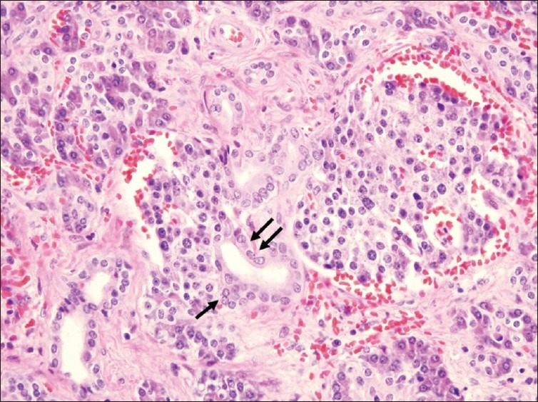
Ductal insular complex. Islet cells (single arrow) entering into the duct (double arrows)
Hypoglycemia due to an adult-onset nesidioblastosis, a diagnostic and management dilemma
J Med. 2012 Apr-Jun; 2(2): 45–47

Slide 32
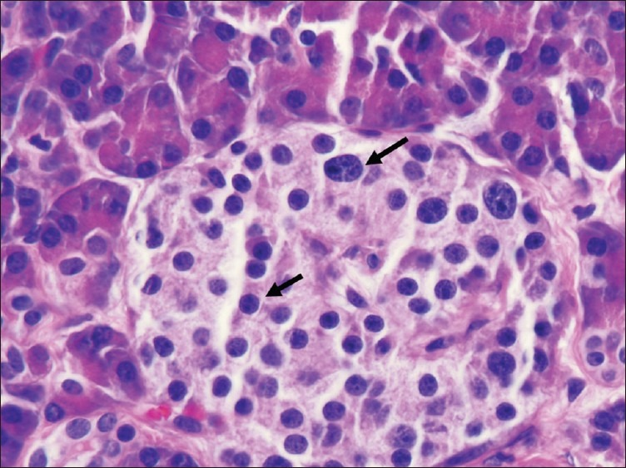
Islet cell pleomorphism. Marked difference in size of cells within same islet
Hypoglycemia due to an adult-onset nesidioblastosis, a diagnostic and management dilemma
J Med. 2012 Apr-Jun; 2(2): 45–47

Slide 33
Clinical and biochemical differentiation between nesidioblastosis and insulinoma is problematic.
Most patients have hypoglycaemic episodes occurring with fasting or exercise during which inappropriately high insulin and C peptide levels are recorded.
The best diagnostic test for the detection of endogenous hyperinsulinaemia in adults is a supervised 72-hour fast.
The presence of post-prandial hypoglycaemic episodes has been suggested as diagnostic for nesidioblastosis .
An Unusual Case of Concurrent Insulinoma and Nesidioblastosis
J Pancreas (Online) 2008; 9(5):649-653.

Slide 34
When conventional radiological methods fail to confirm a diagnosis interventional approaches can be employed.
Traditionally transhepatic venous sampling has been shown not only to confirm the presence of an insulinoma but is also able to locate tumours by demonstrating the elevation of insulin in samples obtained at specific sites along the portal, splenic and superior mesenteric veins.
An Unusual Case of Concurrent Insulinoma and Nesidioblastosis
J Pancreas (Online) 2008; 9(5):649-653.

Slide 35
In one study of ten patients with insulinoma, Cho et al. [8] reported that tumours in the pancreatic head produced abnormal insulin elevation in venous samples obtained from the superior mesenteric and portal veins.
Insulinomas in the pancreatic neck caused a step-up in the insulin concentration in the splenic vein near the confluence with the portal vein and superior mesenteric vein,
whilst those occurring in the body and tail of the pancreas resulted in increased insulin levels within the splenic veins.
An Unusual Case of Concurrent Insulinoma and Nesidioblastosis
J Pancreas (Online) 2008; 9(5):649-653.

Slide 36
A review of the limited literature identified two previous cases of patients having diagnoses of both insulinoma and nesidioblastosis at separate intervals, but no cases of concurrent insulinoma and nesidioblastosis. One of the patients had histologically proven nesidioblastosis within the pancreatic body resected followed nine years later by enucleation of two insulinomas (5 and 15 mm) [10],
whilst the second patient presented with recurrent symptoms of hyperinsulinaemic hypoglycaemia six years after enucleation for insulinoma, and subsequent distal pancreatectomy revealed nesidioblastosis [11].
An Unusual Case of Concurrent Insulinoma and Nesidioblastosis
J Pancreas (Online) 2008; 9(5):649-653.

Slide 37
DDX
Malignant insulinoma
NIPHS or Insulinoma
Nasidioblastosis in adults
Concurrent Insulinoma and Nesidioblastosis
Hypoglycemia after sleeve gastrectomy or Bariatric surgery
Factitious hypoglycemia

Slide 38
Insulinoma After Bariatric Surgery: Diagnostic Dilemma and Therapeutic Approaches
Springer Science+ Business Media New York 2016
Hypoglycemia is a rare but underappreciated complication of bariatric surgery and can be observed following both Roux-en-Y gastric bypass (RYGB) and sleeve gastrectomy
Typically, hypoglycemia does not appear immediately postoperatively, but rather more than 1 year later, and usually occurs 1–3 h after meals.
While rare, insulinoma has been reported after bariatric surgery.
hypoglycemia presenting shortly after gastric bypass or with a dominant fasting pattern should be fully evaluated to exclude insulinoma.

Slide 40
Functional increases in insulin secretion occur post-RYGB as a result of increased glucose sensitivity of the β-cell and increased fasting and postprandial secretion of GLP1 and other incretins .
In addition, rapid delivery of nutrients to the small intestine due to accelerated gastric emptying or bypass or loss of pyloric function can also increase the stimulus for postprandial insulin secretion .
Initial reports suggested that increased islet mass might contribute to excessive insulin secretion in some patients; however, subsequent analyses indicated no increase in β-cell mass, indicating dominance of functional dysregulation of insulin secretion .
Insulinoma After Bariatric Surgery: Diagnostic Dilemma
and Therapeutic Approaches
Springer Science+Business Media New York 2016

Slide 41
Although no data are available to address the required extent of pancreatectomy in patients with post-RYGB hypoglycemia, we suggest that partial pancreatectomy may be preferred over enucleation to permit evaluation of diffuse β-cell hyperplasia.
Insulinoma occurring in patients who have had gastric surgery raises the possibility that the postoperative hormonal environment could contribute to increased β-cell proliferation in susceptible individuals.
Insulinoma After Bariatric Surgery: Diagnostic Dilemma
and Therapeutic Approaches
Springer Science+Business Media New York 2016

Slide 42
For example, the incretin hormone GLP1 is associated with islet proliferation in rodents , and the combination of high plasma levels of GLP1 and abundant GLP1 receptors in insulinoma tissue could promote increased insulin secretion, increased islet growth, and potential clonal expansion and eventual development of autonomy in susceptible patients.
Assessing prevalence of insulinoma is not possible due to reporting bias (both incomplete and excessive when condition is rare), while diagnostic evaluation for hypoglycemia in the post-gastric surgery patient may result in increased diagnoses of insulinoma.
Insulinoma After Bariatric Surgery: Diagnostic Dilemma
and Therapeutic Approaches
Springer Science+Business Media New York 2016

Slide 43
Given that estimated population prevalence of insulinoma is four cases per one million person-years ,one would predict 0.78 cases among the 193,000 bariatric surgical patients in the US annually . While this perspective is somewhat reassuring, future longitudinal studies will be required to evaluate prevalence of insulinoma in this population.
Insulinoma After Bariatric Surgery: Diagnostic Dilemma
and Therapeutic Approaches
Springer Science+Business Media New York 2016

Slide 44
DDX
Malignant insulinoma
NIPHS or Insulinoma
Nasidioblastosis in adults
Concurrent Insulinoma and Nesidioblastosis
Hypoglycemia after sleeve gastrectomy or Bariatric surgery
Factitious hypoglycemia

Slide 45
Factitious Hypoglycemia Caused by a Unique Pattern of Drug Use: A Case Report
Int J Endocrinol Metab. 2018 ; 16(1):e62591
A 46-year-old man with frequent symptomatic hypoglycemic episodes during the day, with a blood glucose level below 40 mg/dL.
FH: DM in his mother, (metformin and glyburide).
the 72-hour fasting protocol was applied for the patient.
The insulin-secreting tumor was suspected considering the high plasma concentrations of insulin and C-peptide in symptomatic hypoglycemia .

Slide 46
The patient’s blood and urine samples were collected during a hypoglycemic episode :the results were found to be negative .
Abdominal CT, MRI, and EUS did not show any abnormal lesions.
The patient was scheduled for exploratory laparotomy
Intraoperative sonography was normal,and finally,distal pancreatectomy was performed.
Histopathological examination of pancreatic tissues revealed no evidence of nesidioblastosis or insulinoma.
similar episodes recurred after 5 months.
Factitious Hypoglycemia Caused by a Unique Pattern of Drug Use: A Case Report
Int J Endocrinol Metab. 2018 ; 16(1):e62591

Slide 47
The plasma concentrations of insulin and C-peptide were different in each hypoglycemic episode, suggesting endogenous hyperinsulinism (high insulin and C-peptide levels)
The plasma and urine sulfonylureas were negative in all episodes .
Spiral CT scan and MRI of the abdomen only showed postoperative changes.
The EUS demonstrated multiple small hypoechoic lesions (maximum size, 8 mL × 7 mL) in the head and body of the pancreas, suggesting multiple insulinomas, which further complicated the patient’s clinical course.
Because of a history of major surgery, EUS-guided fine-needle aspiration of the pancreatic lesion was performed before proceeding to any other surgeries; however, it only revealed blood.

Slide 48
Considering various biochemical patterns during hypoglycemia and lack of evidence supporting other differential diagnoses, we suspected factitious causes.
Frequent history-taking from the patient and his family members, including his wife and children, did not reveal any psychiatric problems, and they denied any conflicts.
Incidentally, we discovered that the patient had asked one of his roommate’s visitors to buy him glyburide. The serum and urine levels of sulfonylureas were assessed in each hypoglycemic episode, which became positive .

Slide 50
in a secret search of the patient’s room, we found an insulin pen (NovoRapid) hidden in the water closet.
Close observation revealed that the patient had intermittent glyburide consumption and analog insulin injections (insulin aspart or insulin glargine); however, he denied any drug use.
Finally, an interview with the patient’s mother revealed that he had a marital conflict and had produced hypoglycemic symptoms to attract attention.
The patient received several psychiatric consultations. After psychiatric and forensic pathology confirmation, he was discharged with quetiapine (25 mg/day) and outpatient psychiatric visits.
4 months later, he was found unconscious in a hotel room and died in spite of cardiopulmonary resuscitation. The exact cause of his death is unidentified

Slide 51
Factitious hypoglycemia is a very challenging diagnosis.
common methods for sulfonylurea and meglitinide detection in the human plasma and urine are of low diagnostic value .
Several methods have been developed for the detection of antidiabetic drugs in the human plasma and urine.
Some of these methods include micellar electrokinetic capillary chromatography, high-performance liquid chromatography (HPLC)

Slide 52
In our case, we sent the patient’s serum and urine samples to a clinical laboratory in Iran, where the LC-MS/MS method is used for sulfonylurea detection.
Despite high insulin and C-peptide levels in 2 serum and urine samples , sulfonylureas were negative. However, the results turned positive after several checks , which may be due to the lower drug concentration in the samples (lower than the sensitivity limit of the method).
As LC-MS/MS has been only recently applied in Iran for the detection of antidiabetic drugs, laboratory error is another possible explanation considering the manual design and complexity of this technique .
Due to the lack of any definitive laboratory findings, clinical suspicion is the best strategy for diagnosis .

Slide 53


