Slide 1
ANDROGEN PRODUCING TUMORS
AMIRAHMAD NEJAT
2018

Slide 2
PREVALENCE
ETIOLOGY
OVARIAN TUMORS
ADRENAL TUMORS
DIAGNOSIS
CLINICAL
BIOCHEMICAL
DIAGNOSTIC APPROACH

Slide 3
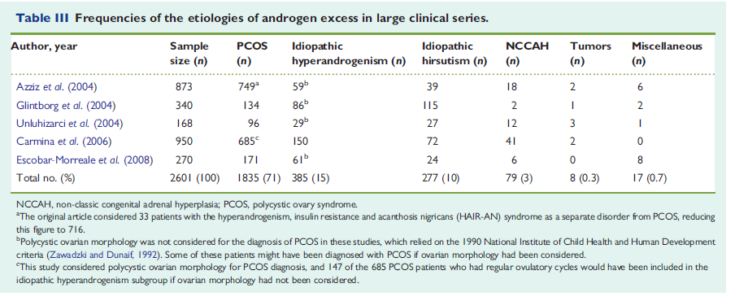
PREVALENCE
Rare cause of hyperandrogenism
Different reports of prevalence in studies
Half are malignant

Slide 4
ETIOLOGY
OVARIAN TUMORS
ADRENAL TUMORS

Slide 5
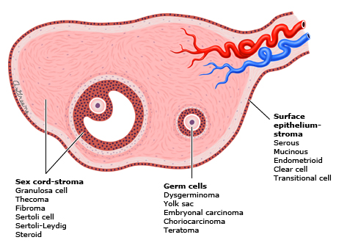
OVARIAN TUMORS

Slide 6
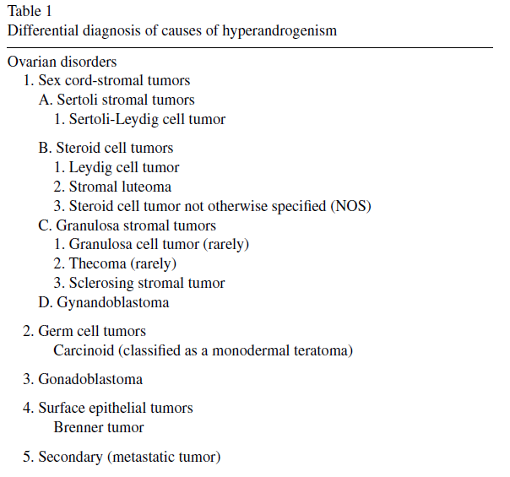
OVARIAN TUMORS

Slide 7
OVARIAN TUMORS SEX CORD-STROMAL TUMORS
SEX CORD
STROMAL CELLS
Differentiates from primitive sex cords coelomic epithehium
Includes:
granulosa cells (normal ovary)
Sertoli cells (testis, ovarian tumors).
Derive from the genital ridge mesonephros mesenchyma, which forms undifferentiated gonad ,include
fibroblasts,
theca cells,
Leydig cells.(hilus cells)
Major source of androgens in postmenopausal women.
Commonly appear as a secondary component in other sex cord-stromal tumors

Slide 8
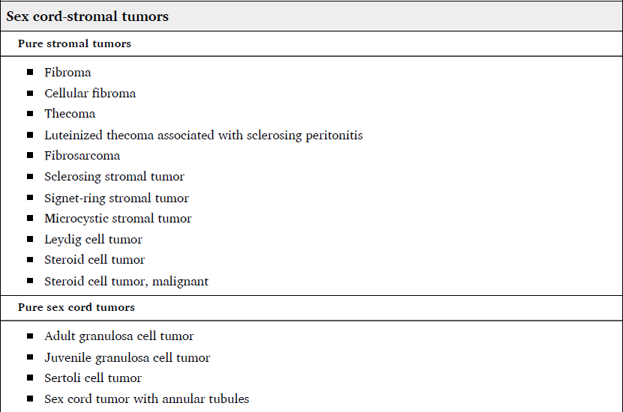
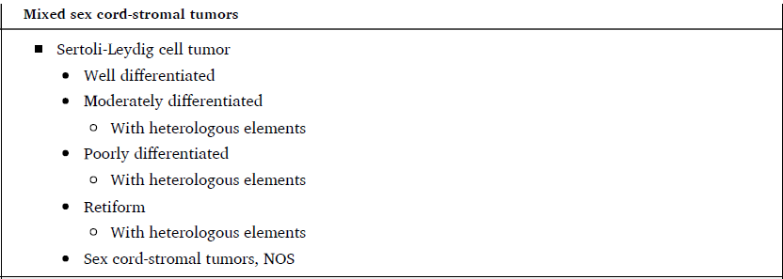

Slide 9
SEX CORD-STROMAL TUMORS GENERAL
rare (overall incidence 0.2 /100,000 women)
Malignant neoplasms
1.2% of all ovarian malignancies
Often diagnosed at an early stage (confined to ovary in 57 % of women)
generally considered to be low-grade malignant neoplasms.
Average age at diagnosis is 50 years (compared with 61 years for epithelial cancer)
12 % were younger than 30 years
57 % were between ages 30 to 59.

Slide 10
SEX CORD-STROMAL TUMORS GENERAL
May display
nonepithelial differentiation (cartilage or skeletal muscle) or epithelial differentiation ("heterologous elements").
associated with a poorer prognosis
Definite diagnosis only with histologic evaluation
staging system
same as other primary ovarian cancers

Slide 11
SEX CORD-STROMAL TUMORS Sertoli-stromal cell tumors
Tumors with components of Sertoli cells, Leydig cells, and fibroblasts in varying combinations
androblastomas and arrhenoblastomas older synonyms
less than 0.5 %of ovarian neoplasms
benign or malignant , )due to degree of differentiation(
75 %occur in women <40 years (mean 25)
most common virilizing ovarian tumor
50% Nonfunctional

Slide 12
SEX CORD-STROMAL TUMORS Sertoli-stromal cell tumors
Most are
unilateral,
confined to the ovary,
large (average 16 cm in maximal diameter)

Slide 13
SEX CORD-STROMAL TUMORS Sertoli-stromal cell tumors
Clinical findings:
Abdominal pain or increasing abdominal girth
2 to 3 % have demonstrable extraovarian spread at diagnose
less than 20 % display malignant behavior (ie, metastasize or recur)
Sometimes associated with
Production of either inhibin or alpha-fetoprotein, renin,
Peutz-Jeghers syndrome.

Slide 14
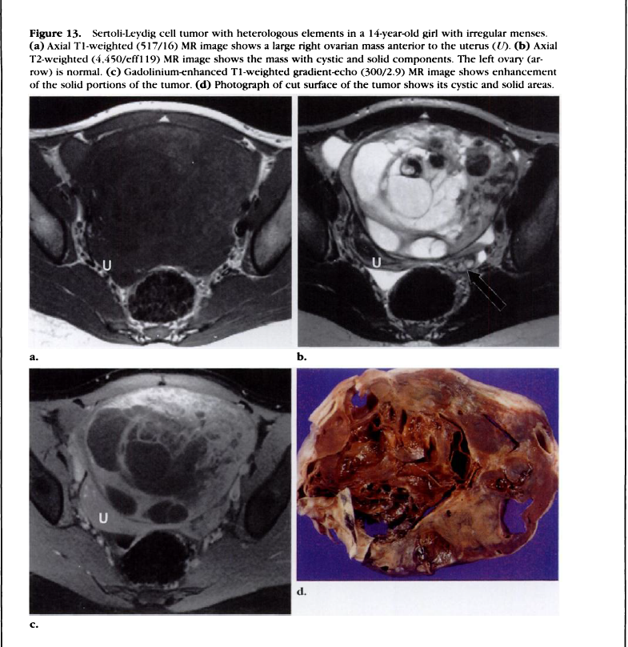

Slide 15
SEX CORD-STROMAL TUMORS Tumors with granulosa and Sertoli-Leydig elements
SEX CORD TUMOR WITH ANNULAR TUBULES
Intermediate between Sertoli cell and granulosa cell tumors.
30% associated with (PJS)
Produce estradiol
Gynandroblastoma
No longer an entity in the 2014 WHO classification (very rare)
Both Sertoli-Leydig and Granulosa cell differentiation
Causing either virilization or hyperstrogenism (less commonly)

Slide 16
SEX CORD-STROMAL TUMORS STEROID CELL TUMORS
Three types are recognized:
stromal luteoma,
Leydig (or hilus) cell tumor,
steroid cell tumor not otherwise specified(NOS)
0. 1%-0.2% of all ovarian tumors
Usually in the 5th or 6th decade
Usually small (<3-cm) nodules
virtually always unilateral.
majority are virilizing,
rarely associated with Cushing syndrome
40%
60%

Slide 17
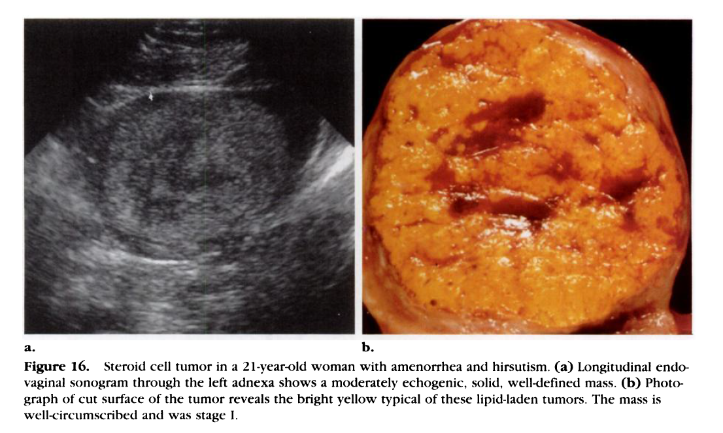

Slide 18
SEX CORD-STROMAL TUMORS HILUS CELL TUMOR
Hilus cells
Homologous with Leydig cells
located in the hilar stroma (adjacent to mesovarium)
Closely associated with large hilar venous spaces and lymphatics
Steroid-producing cells, (androstenedione)
Histogenesis uncertain
Hilus cell tumours
Small (usually 4 mm),
Unilateral
Benign
80% present with features of virilization

Slide 19
OVARIAN TUMORS Tumors with Functioning Stroma
Tumors with Functioning Stroma
60 reported ovarian tumors with androgenic stroma,
1/3 metastatic ovarian tumors,
Mostly of gastric origin
1/5 primary mucinous cystic tumors.
Others:
Brenner tumors,
Teratomas ,
Carcinoids
Paracrine stimulation of stromal (steroidogenic) cells by ectopic secretion of b-hCG(?)
Stromal hyperplasia

Slide 20
OVARIAN TUMORS IMAGING(TVUS)
Study of choice
Adnexal masses suspicious for malignancy
Solid component
Not hyperechoic
Nodular or papillary
Septations,
irregularly thick (>2 to 3 mm)
Flow in the solid component in Color Doppler
Presence of ascites
Peritoneal masses,
Enlarged nodes
Matted bowel

Slide 21
OVARIAN TUMORS IMAGING(TVUS)
Majority of virilizing ovarian tumors:
Solid or mostly solid (69%)
Isoechoic(82%)
Infrequent finding:
Hypoechoic(18%)
Ascites(23%)
Calcification(14%)
In hyperandrogenic tumors:
PPV &NPV of 71 and 73% respectively
SN 80% & SP 93%

Slide 22
OVARIAN TUMORS IMAGING(MRI)
May be used if further characterization is needed
More sensitive and specific
Highest PPV and NPV (78 and 100%)

Slide 23
Adrenal hyperandrogenism

Slide 24
Adrenal hyperandrogenism
Adenomas
Carcinoma
Bilateral macronodular adrenal hyperplasia

Slide 25
ADRENAL TUMORS (ADENOMA)
Benign neoplasms of adrenocortical cells
Can secrete steroids independently from (ACTH) or RAA system
Can produce syndromes of
Hypercortisolism
Hyperaldosteronism
Virilization or feminization(rarely)
Discovered incidentally(incidentalomas)or due to symptoms of hormonal excess

Slide 26
ADRENAL TUMORS (CARCINOMA)
Rare
incidence
Approximately 1 to 2 per million population per year
Higher in children(1.3% of all childhood cancers as opposed to 0.02% to 0.2% of adult cancers)
Bimodal age distribution
disease peaks < 5 and in the 4th to 5th decade of life
More aggressiveness and progressive in adults
More common in women than men (1.5 to 2.5:1)
Genetic predisposition
No risk factors have been firmly established

Slide 27
ADRENAL TUMORS (CARCINOMA)
ACC:
More common cause of hyperandrogenism than ACA
60% hormonally active
Cushing's syndrome alone (45%)
Mixed Cushing's and virilization syndrome (25%)
Virilization alone (<10%) [better prognosis]
Testosterone most consistently elevated androgen (8.5Xnormal)
Children
Almost all are functional
usually present with virilization (84%)
Isolated glucocorticoid excess much less common (6%)
palpable abdominal mass
metastatic disease at the time of diagnosis,

Slide 28
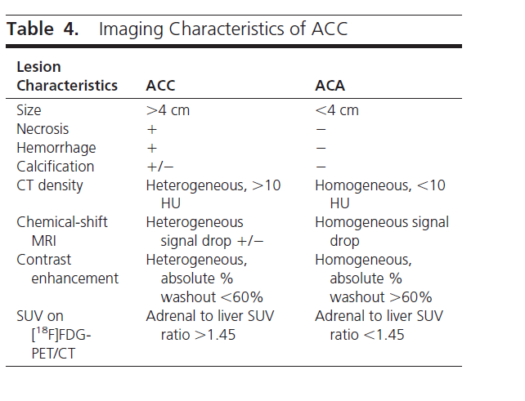
ACC Vs ACA

Slide 29
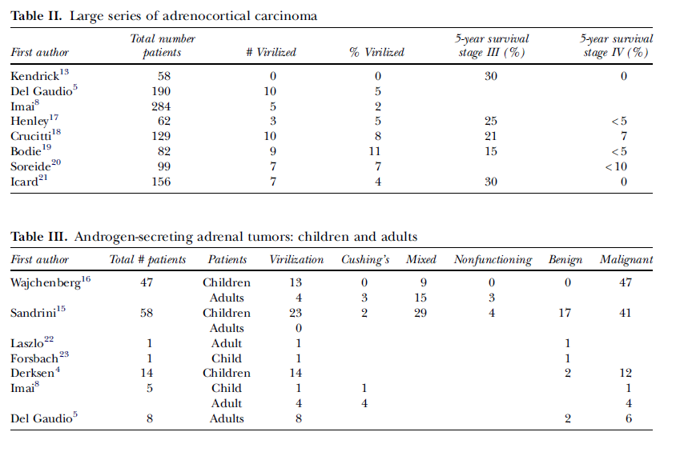
1060
42(4%)
134
23
(17%)
111
(83%)

Slide 30
ACC Vs ACA

Slide 31
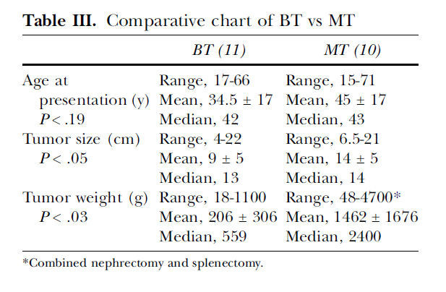
ACC Vs ACA

Slide 32
ACC Vs ACA
CT 100%SN,100%SP IN HYPERANDROGENIC tumors

Slide 33
DIAGNOSIS

Slide 34
DIAGNOSIS CLINICAL
Recent onset of severe hirsutism,
Sudden progressive worsening of hirsutism,
Symptoms or signs of virilization:
Frontal balding,
Clitoromegaly
clitoral length >10 mm
clitoral index (length times width>35 mm²
Increased muscle mass,
Deepening of the voice
Breast atrophy
T>1.4 ng/ml

Slide 35
DIAGNOSIS CLINICAL
Lack of premenopausal hyperandrogenic symptoms
Symptom onset after menopause

Slide 36
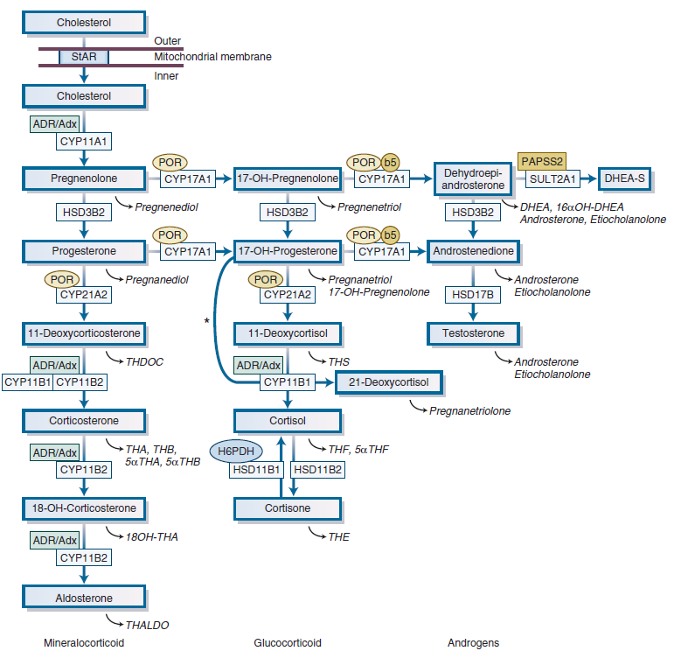
DIAGNOSIS BIOCHEMICAL

Slide 37
DIAGNOSIS BIOCHEMICAL
OVARIAN TUMORS
ADRENAL TUMORS
Te>2ng/ml
DHEAS>700μg/dl

Slide 38
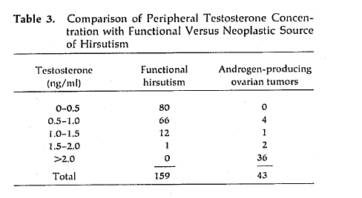
DIAGNOSIS BIOCHEMICAL
Meldrum DR,. Obstet Gynecol 1979; 53:36.

Slide 39
DIAGNOSIS BIOCHEMICAL
Te:0.8ng/ml
Te:2ng/ml
NPV100%,PPV15%
SN100%,SP53%
SN41%,SP 100
SN SP
In advancing age the SP of high TE rises

Slide 40
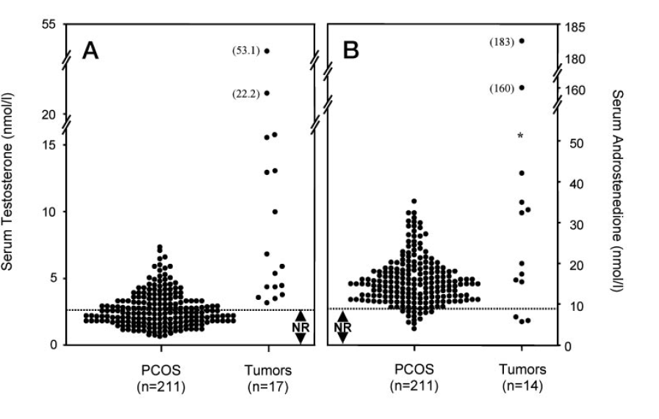
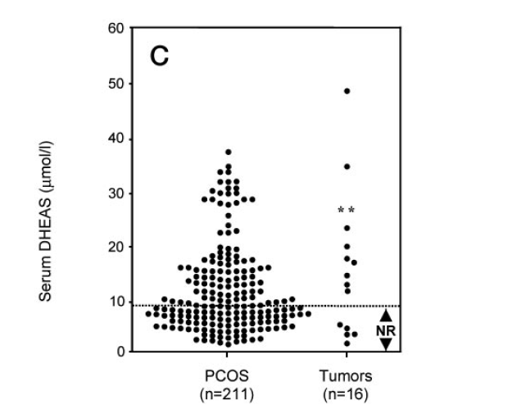
DIAGNOSIS APPROACH

Slide 41
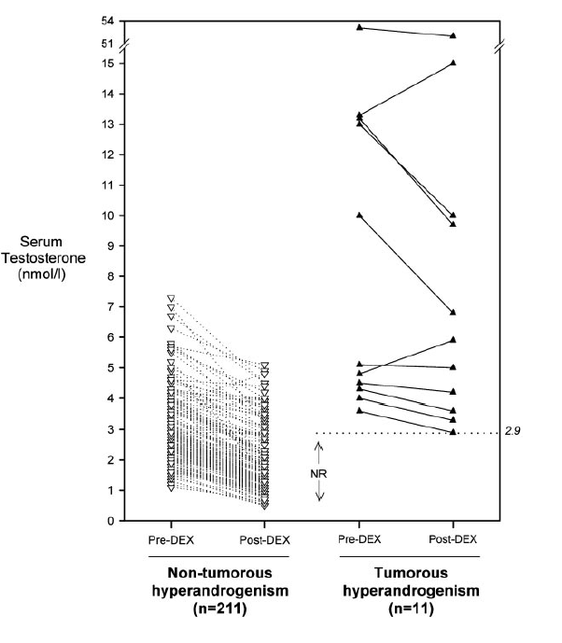
DIAGNOSIS APPROACH
SN100% ,SP88%

Slide 42
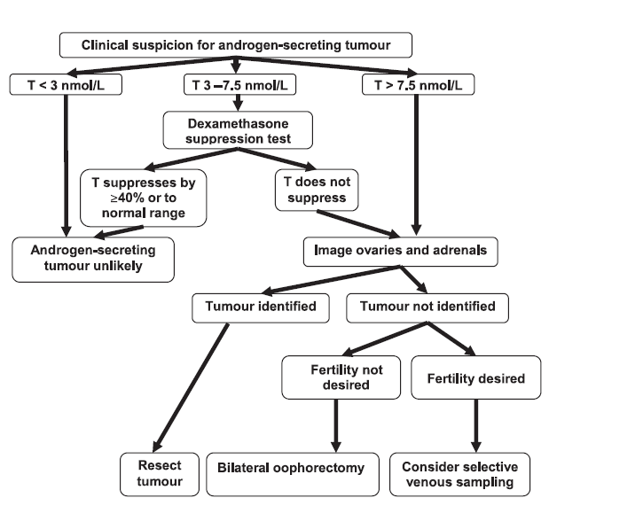
DIAGNOSIS APPROACH

Slide 43
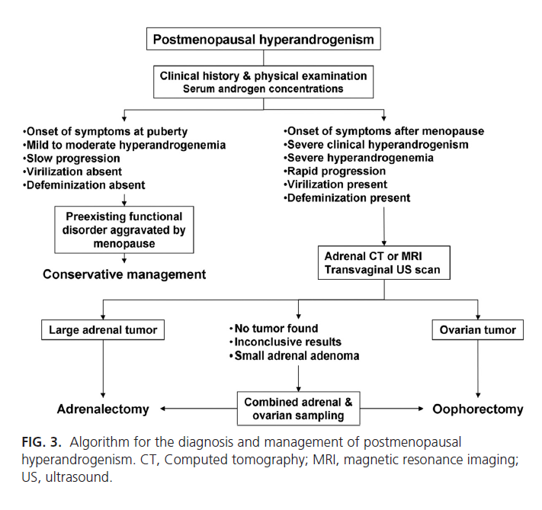
DIAGNOSIS APPROACH

Slide 44
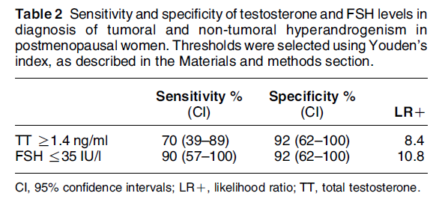
DIAGNOSIS APPROACH

Slide 45
DIAGNOSIS APPROACH
POSTMENOPAUSAL
PREMENOPAUSAL

Slide 46
Thank you for your attention

