Slide 1
به نام یکتای هستی

Slide 2
Triglyceride and cardiovascular disease
Bita mirzaei MD
Research Institute for Endocrine Sciences Shahid Beheshti University of Medical Sciences
Aban 93

Slide 3
Agenda
Introduction
Role of triglycerides as a CHD risk factor (observational studies & review article)
Effect of triglyceride reduction on cardiovascular outcomes (clinical trials)
Guidelines
Conclusions

Slide 4
a common clinical problem
A healthy 45-year-old man is found on routine screening to have hypertriglyceridemia.
He is a nonsmoker
exercises regularly
He takes no medications. No hx of premature CVD
BP is normal, his body-mass index :is 28, and his waist circumference is 96 cm.
fasting triglyceride level is 400 mg per deciliter
total cholesterol230 mg deciliter, LDL:120 mg per deciliter, and
HDL cholesterol 30 mg per deciliter. His fasting blood glucose level is 90 mg per deciliter.
Thyroid and renal function are normal.
Hypertriglyceridemia N Engl J Med 2007;

Slide 5
How should his case be assessed and managed?

Slide 6
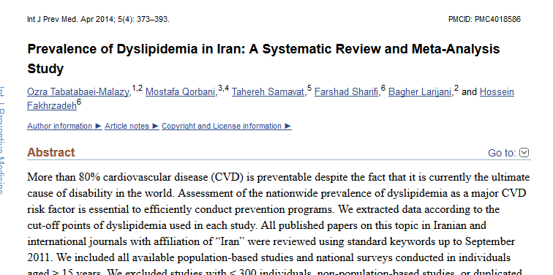

Slide 7
Prevalence of Dyslipidemia in Iran
hypercholesterolemia (≥200 mg/dl): 41.6% hypertriglyceridemia (≥150 mg/dl): 46.0%
high levels of LDL-C [≥ 130 mg/dl] : 35.5%
low levels of HDL-C <40 mg/dl in males, <50 mg/dl in females): 43.9%
among both sexes and in both rural and urban areas. Hypercholesterolemia, high LDL-C and low HDL-C were more prevalent in women, whereas hypertriglyceridemia was more prevalent in men

Slide 8
Hypertriglyceridemia ?
Hypertriglyceridemia the accumulation of triglyceride-rich lipoproteins(Remnant cholesterol)
chylomicrons
VLDL
IDL

Slide 9
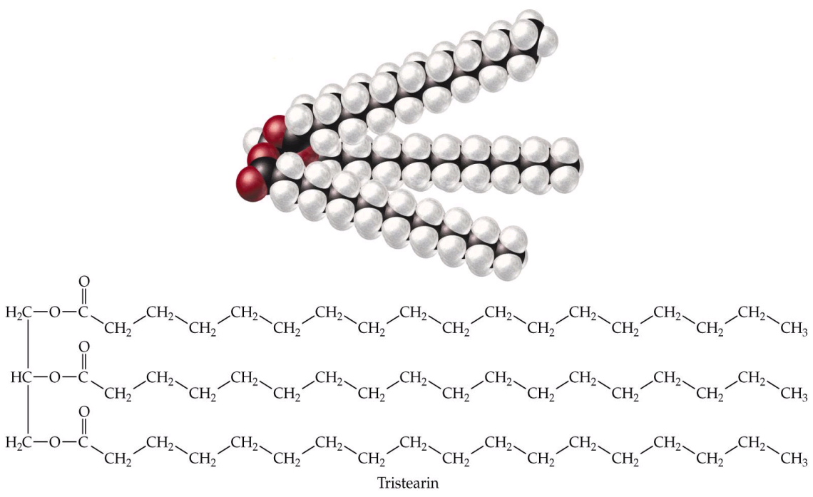
What are Triglycerides?
Chylo
Three
Fatty
Acids
Glycerol
VLDL
Chylo
Remnant
VLDL
Remnant
IDL
prof Hosseinpanah
TG Rich LP

Slide 10
Since triglyceride-rich lipoproteins also transport cholesterol
Hypercholesterolemia of varying severity often accompanies hypertriglyceridemia

Slide 11
Remnant cholesterol = non-fasting total cholesterol - HDL cholesterol - LDL cholesterol

Slide 12
Triglycerides and Atherogenesis
by contrast with LDL, remnants can be taken up directly by macrophages leading to foam cell formation entrance into the intima

Slide 13
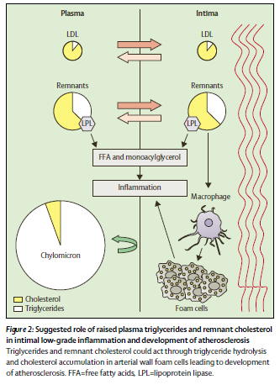
lifelong raised remnant cholesterol causes: leads to: low-grade inflammation, foam cell formation, atherosclerotic plaques, and ultimately cardiovascular disease and increased mortality

Slide 14
in elevated concentrations (triglycerides >50 (4400 mg/dl )mmol/L triglyceride lipoproteins are too large to enter into the arterial intima and therefore cannot lead to development of atherosclerosis.
By contrast, at mild–to–moderately raised triglyceride concentrations (2–10 mmol/L),lipoproteins are small enough to enter into the arterial wall and thus have the potential to accumulate and cause atherosclerosis.

Slide 15
Associated Abnormalities
Low levels of HDL-C
The presence of small, dense LDL particles
The presence of atherogenic triglyceride-rich lipoprotein remnants
Insulin resistance
Increases in coagulability and viscosity

Slide 16
Mechanism of low HDL and small dense LDL?
Higher VLDL triglyceride output activates cholesteryl ester transfer protein (CETP), which results in triglyceride enrichment of LDL and HDL
The triglyceride content within these particles is hydrolyzed by HTGL, which results in small, dense LDL and HDL particles.

Slide 17
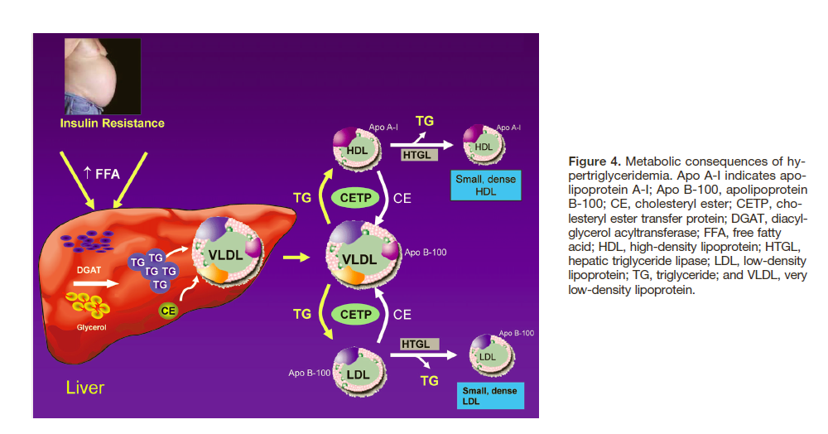
Triglycerides and Cardiovascular Disease Circulation 2011
Triglycerides and Cardiovascular Disease
Circulation 2011

Slide 18
Experimental studies suggest that hypertriglyceridemia HDL may be dysfunctional, that small, dense LDL particles may be more susceptible to oxidative modification
Triglycerides and Cardiovascular Disease Circulation 2011

Slide 19
Role of triglycerides as a CHD risk factor?

Slide 20
the largest and most comprehensive epidemiological 2007 report of two large prospective studies involving over 3500 CHD cases and 44,000 middle-aged women and men, plus a meta-analysis of 27 prospective population-based studies involving a total of over 10,000 incident CHD cases and 260,000 participants
(Circulation. 2007;115:450-458.)

Slide 21
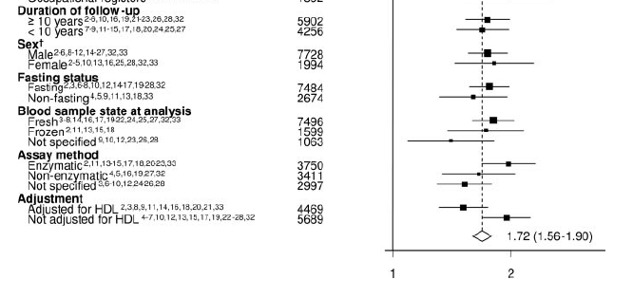
The combined adjusted odds ratio for CHD comparing individuals in the top third of serum triglyceride levels with those in the bottom third was 1.7 (95% CI 1.6-1.9).
N = 262,525
Sarwar N, et a Circulation. 2007;115:450-458 l. Circulation. 2007;115:450-458
CHD RisCHD Risk Ratio* (95% CI)
CHD Risk Ratio* (95% CI)

Slide 22
Although hypertriglyceridemia had been thought to be more predictive of CHD risk in women, the relative risks appeared similar in men and women in the meta-analysis.
(Circulation. 2007;115:450-458.)

Slide 23
Key message
prospective studies in Western populations consistently indicate moderate and highly significant associations between triglyceride values and coronary heart disease risk
adjustment for established coronary risk factors, especially HDL cholesterol, substantially attenuated the magnitude of this association, but still remained significant
.

Slide 24
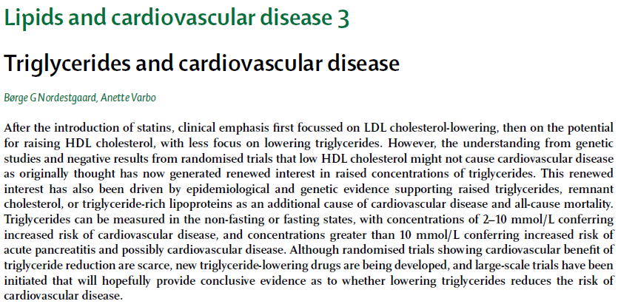
Lancet 2014; 384: 626–635

Slide 25
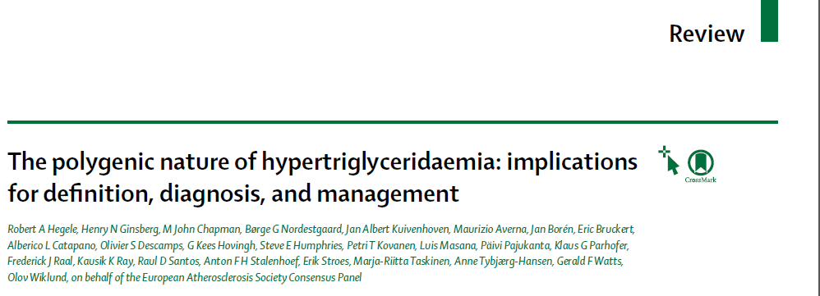
Lancet Diabetes Endocrinol 2014; 2: 655–66

Slide 26
The evidence that raised concentrations of remnant cholesterol, marked by raised triglycerides, are an additional causal risk factor for cardiovascular disease and all-cause mortality, is increasing.
Triglycerides and cardiovascular disease, lancet 2014

Slide 27
important question
whether lowering triglycerides reduces the risk of cardiovascular disease?

Slide 28
a controlled trial with 555 consecutive post-myocardial infarction patients given both fibrate and niacin
showed that all-cause mortality was reduced by 26%, and ischaemic heart disease mortality was reduced by 36%

Slide 29
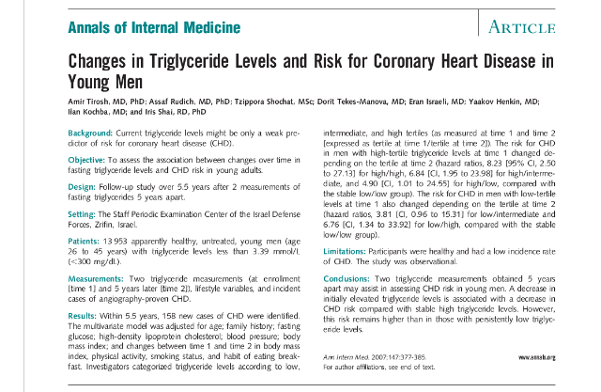

Slide 30
Study design
To assess the association between changes over time in fasting triglyceride levels and CHD risk in young adults.
13,953 apparently healthy, untreated, young men (age 26 to 45 years) with triglyceride levels less than 3.39 mmol/L (<300 mg/dL).
Follow-up study over 5.5 years after 2 measurements of fasting triglycerides 5 years apart.
Ann Intern Med. 2007 Sep 18;147(6):377-85.

Slide 31
Result:
Triglycerides were strongly and independently associated with CHD risk when comparing those in the highest quintile to those in the lowest ( multivariate HR :4.1)
Change in the triglyceride levels between the initial and the second measurement was positively associated with change in CHD risk.
The lowest CHD risk occurred when triglyceride levels remained low.

Slide 32
Key message
A decrease in elevated triglyceride levels is associated with a decrease in CHD risk compared with stable high triglyceride levels
this risk reduction remains higher than in those with persistently low triglyceride levels.

Slide 33
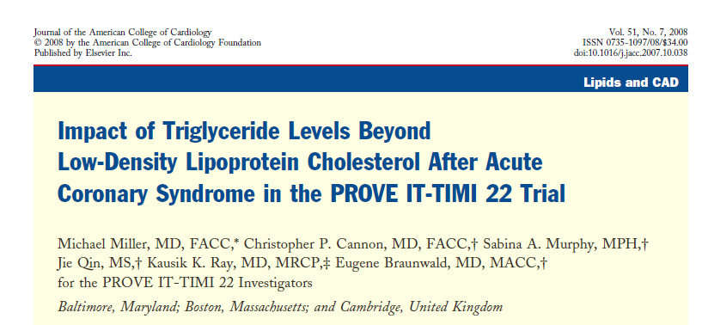

Slide 34
Study design
Objectives :The purpose of this study was to assess the impact of on-treatment triglycerides on CHD risk after an ACS
The PROVE IT-TIMI 22 trial evaluated
4162 patients hospitalized for ACS and randomized to atorvastatin 80 mg or pravastatin 40 mg daily.
The relationship between on-treatment levels of TG and LDL-C and the composite end point of death, MI, and recurrent ACS were assessed 30 days after initial presentation.
mean follow-up : 2 years

Slide 35
Low on-treatment TG (150 mg/dl) was associated with
reduced CHD risk compared with higher TG in univariate analysis HR 0.73, 95% CI 0.62 to 0.8
For each 10-mg/dl decline in on treatment TG, we observed a 1.6% lower risk of the end point after adjustment for LDL-C and other covariates

Slide 36
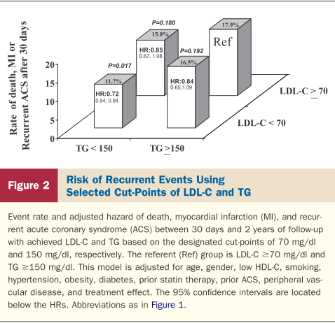
Compared with LDL-C ≥70 mg/dl and TG ≥150 mg/dl (referent), lower CHD risk was observed with low on- treatment TG (<150 mg/dl) and LDL-C (<70 mg/dl)
(HR 0.72, 95% CI 0.54 to 0.94; p = 0.017)

Slide 37
Key message
Among patients receiving statin therapy after ACS, on treatment TG 150 mg/dl was associated with a lower risk of recurrent CHD events independently of the level of LDL-C.
These data lend support to that
achieving both a low LDL-C and a low TG may be
important therapeutic parameters in patients following ACS.

Slide 39
Study design
Eighteen trials providing data for 45 058 participants, including 2870 major cardiovascular events, 4552 coronary events, and 3880 deaths were pooled
Outcomes : major cardiovascular events, coronary events, stroke, heart failure, coronary revascularization, all-cause mortality cardiovascular death, non-vascular death, sudden death, new onset albuminuria, and drug-related adverse events.

Slide 40
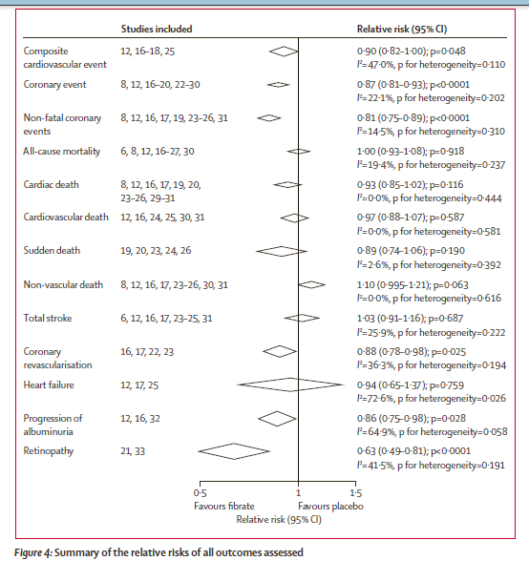

Slide 41
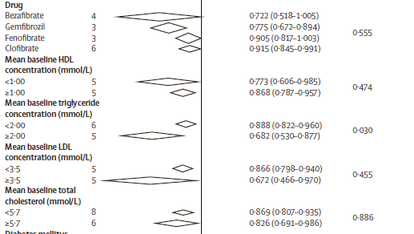
Subgroup analyses for the effects of fibrates on coronary events

Slide 42
Key message
Fibrates can reduce the risk of major cardiovascular events predominantly by prevention of coronary events.
individuals with high average baseline triglyceride concentrations reported signiﬁcantly greater proportional risk reductions

Slide 44
Study design
Sample size: RCT with 9795 participants with Type 2 diabetic aged 50–75 years
Primary outcome: coronary events (coronary heart disease death or non-fatal myocardial infarction)
with a total-cholesterol concentration of 116–251 mg/dl} and a total-cholesterol/HDL-cholesterol ratio of 4·0 or more or plasma triglyceride of mmol/L 89–444 mg/dl
Prespeciﬁed subgroup analyses : total cardiovascular events (the composite of cardiovascular death, myocardial infarction, stroke, and coronary and carotid revascularisation)
Follow up : 5 years

Slide 45
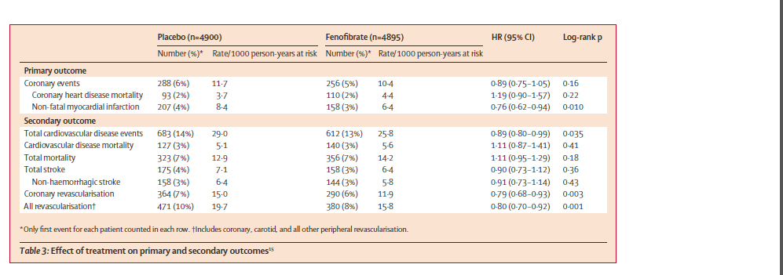

Slide 46
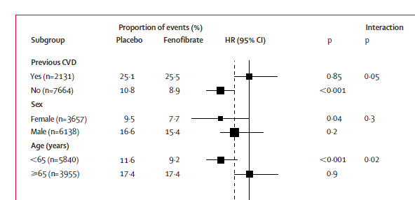
post-hoc subgroup analysis on the primary outcome
`of coronary heart disease events; showed
a reduction in coronary heart disease events in the subgroup of patients with no previous cardiovascular disease but not in those with previous cardiovascular disease

Slide 47
Key message
Fenofibrate did not significantly reduce the risk of the primary outcome of major coronary events.
fenofibrate did reduce the risk of total cardiovascular disease events, particularly through the prevention of non-fatal myocardial infarctions and coronary revascularizations.

Slide 48
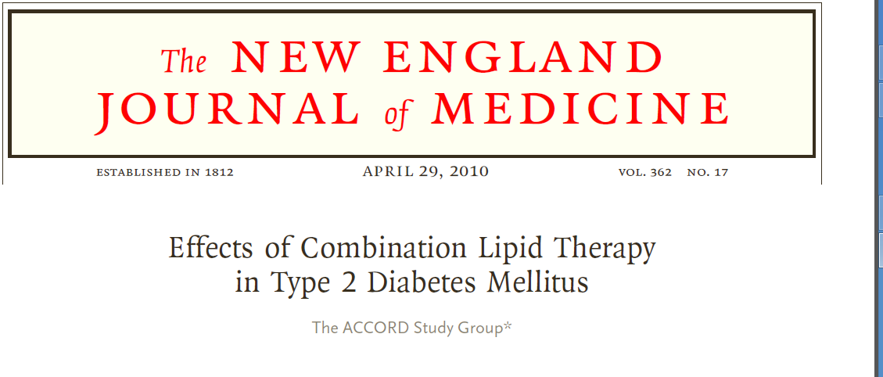
/0p.

Slide 49
Study design
Randomized, placebo-controlled, double-blind clinical trial
5518 patients with type 2 diabetes who were being treated with open-label simvastatin to receive either fenofibrate or placebo.
The primary outcome was the first occurrence of nonfatal myocardial infarction, nonfatal stroke, or death from cardiovascular causes.
The mean follow-up was 4.7 years.

Slide 50
Conclusion:
The combination of fenofibrate and simvastatin did not reduce the rate of fatal cardiovascular events, nonfatal myocardial infarction, or nonfatal stroke, as compared with simvastatin alone.
ACCORD Lipid trial do not support the routine use of combination therapy with fenofibrate and simvastatin to reduce cardiovascular risk in the majority of high-risk patients with type 2 diabetes

Slide 51
a meta-regression analysis of the effect of triglyceride-lowering in fibrate trials showed
0·1 mmol/L decrease in triglycerides caused a 5% (95% CI 1–10) reduction in coronary events, with the largest risk reduction in those with baseline triglyceride concentrations of at least 2 mmol/L.(175mg/dl)
Triglycerides and cardiovascular disease, lancet 2014

Slide 52
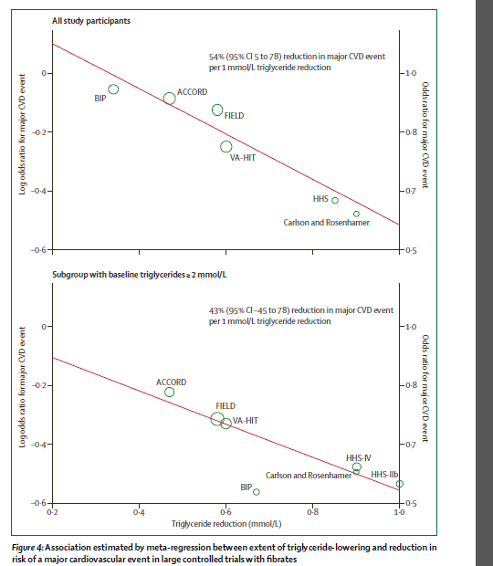
In fibrate trials that included post-hoc subgroup analyses for participants with
baseline triglycerides of at least 2: 1 mmol/L reduction in triglycerides reduced coronary events by 54% overall and by 43% in those with high triglycerides
Triglycerides and cardiovascular disease, lancet 2014

Slide 53
guideline

Slide 54
Treatment of hypertriglyceridaemia has two distinct objectives:
immediate prevention of pancreatitis in patients with severe hypertriglyceridaem
reduction of global cardiovascular disease risk in patients with mild to moderate hypertriglyceridaem
.

Slide 55
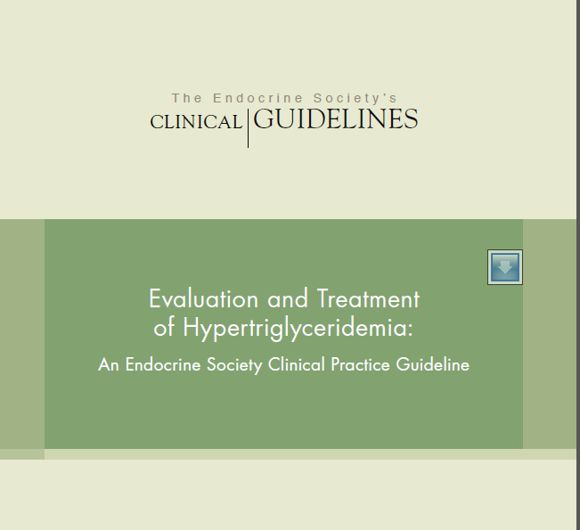
The Endocrine Society, 2012

Slide 57
J Clin Endocrinol Metab, September 2012, 97:
2969–2989.

Slide 58
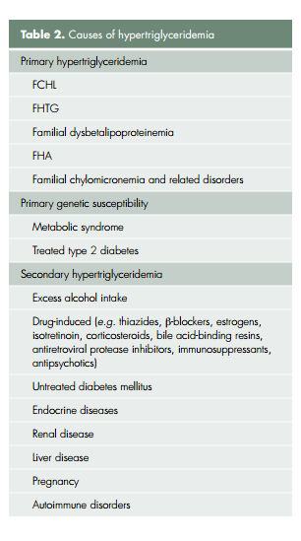

Slide 60
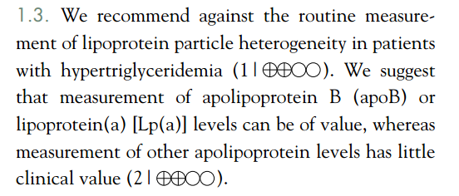

Slide 69
Because hypertriglyceridaemia is characterised by increased concentrations of remnant triglyceride-rich lipoproteins
non-HDL cholesterol or APOB are secondary treatment targets, after LDL cholesterol
The polygenic nature of hypertriglyceridaemia: implications
for defi nition, diagnosis, and management lancet 2014

Slide 70
APO B?
An alternative estimation of atherogenic lipoprotein
concentrations uses APOB as a substitute for non-HDL
cholesterol.
APOB can be reliably measured in the presence of hypertriglyceridemia and under non fasting conditions.
Some expert have recommended APOB as a secondary target in individuals wit hypertriglyceridemia.
APOB concentrations of more than 1·2 g/L identify individuals at high risk of cardiovascular disease, and the desirable concentration is less than 0·8 g/L.

Slide 71
For individuals at very high risk, an APOB target of less than 0·7 g/L might be appropriate

Slide 72
The desirable concentration of non-HDL cholesterol is less than 2·6 mmol/L (<100 mg/dL) in high-risk individuals, and less than 3·4 mmol/L (<130 mg/dL) in low-risk individuals
The polygenic nature of hypertriglyceridaemia: implications
for defi nition, diagnosis, and management lancet 2014

Slide 73
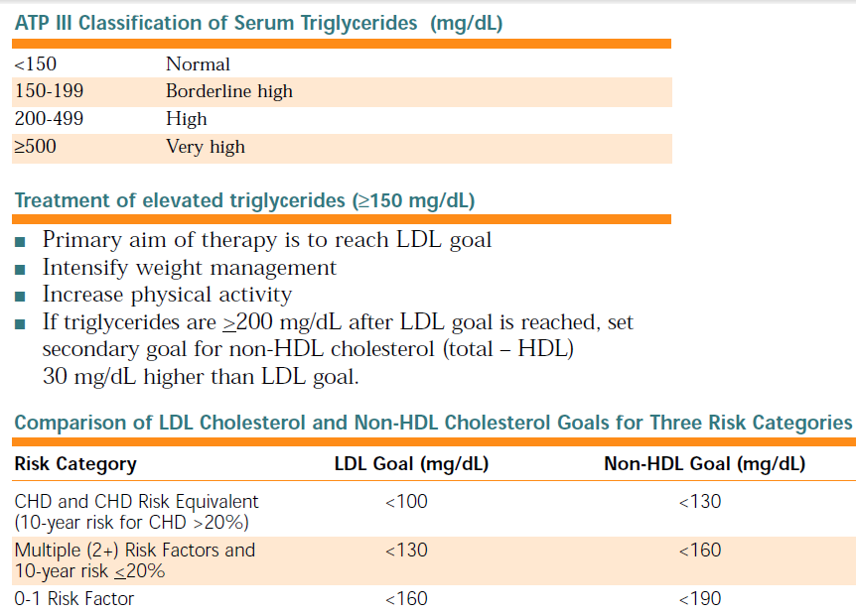

Slide 74
Newengland case treatment?
.

Slide 75
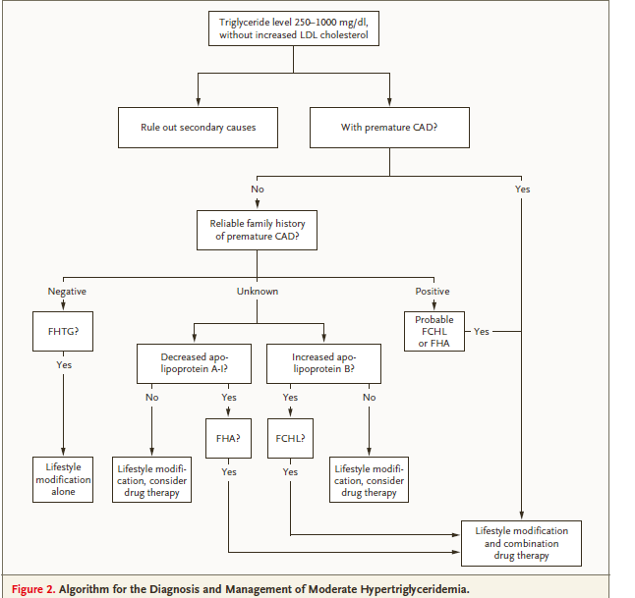
N Engl J Med 2007;357:1009-17.
n engl j med 357;10 www.nejm.org 1014 september 6, 2007

Slide 76
Although the optimal therapy is uncertain, in such cases I would favor combined treatment with nicotinic acid and a statin

Slide 77
conclusion
Even slight increases in triglyceride are usually associated with increased risk of cardiovascular disease
Triglycerides were strongly and independently associated with CHD risk
Fibrates reduce the risk for major cardiovascular
Events especially in those without prior cardiovascular disease with no effect on mortality

Slide 78
Conclusion……
ATP III guidelines support combination therapy with a statin and a fibrate in high-risk individuals with elevated triglycerides or low HDL cholesterol
Trials with fenofibrate have failed to demonstrate clear benefit on clinical outcomes in patients with type 2 diabetes.

Slide 79
Thank you

