Slide 1
Initiation of Insulin therapy in Type2 Diabetes
Saeid Kalbasi
Ass. Prof. of Endocrinology and metabolism
Loghman Hospital

Slide 2
Agenda
ADA-EASD Guideline
Why Basal?
Selection of Initial Insulin Regimens
Basal plus
Dosing and Titration

Slide 3
ADA-EASD Guideline

Slide 4
Modulation of the intensiveness of glucose lowering therapy in T2DM
Diabetes Care 2015;38:140-149; Diabetologia 2015;10.1077/s00125-014-3460-0
Notes:
This is a depiction of the elements of decision-making used to determine the intensivenss of efforts to achieve glycemic targets. Greater concerns about a particular domain are represented by increasing height of the ramp. Thus, characteristics/predicaments towards the left justify more stringent efforts to lower HbA1c, whereas those towards the right are compatible with less stringent efforts. In general, most patients should be targeted to <7%, but as previously discussed, tighter targets may benefit younger patients whereas in older individuals, a more conservative approach is necessary.
Where possible, such decisions should be made in conjunction with the patient, reflecting his or her preferences, needs and values.
This ‘scale’ is not designed to be applied rigidly but to be used as a broad construct to help guide clinical decisions.
(Adapted with permission from Ismail-Beigi et al, Ann Intern Med 2011;154:554-559.)

Slide 5
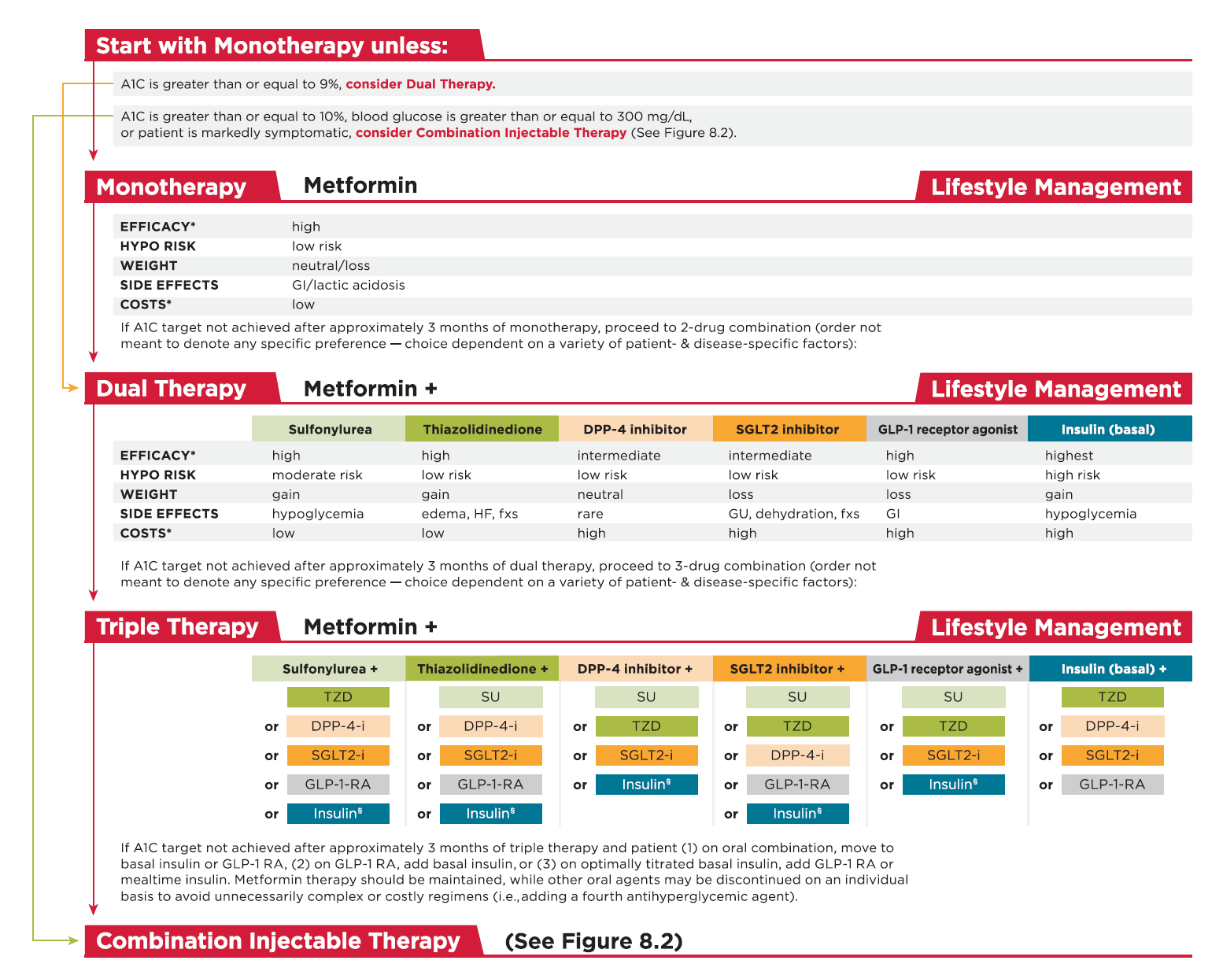

Slide 6
Insulin Therapy Indications
HbA_{1c} ≥10%or BS >300 mg/dl
Symptomatic (e.g., sudden persistent weight loss, ketosis)
When multiple non-insulin therapies fail to achieve targets

Slide 7
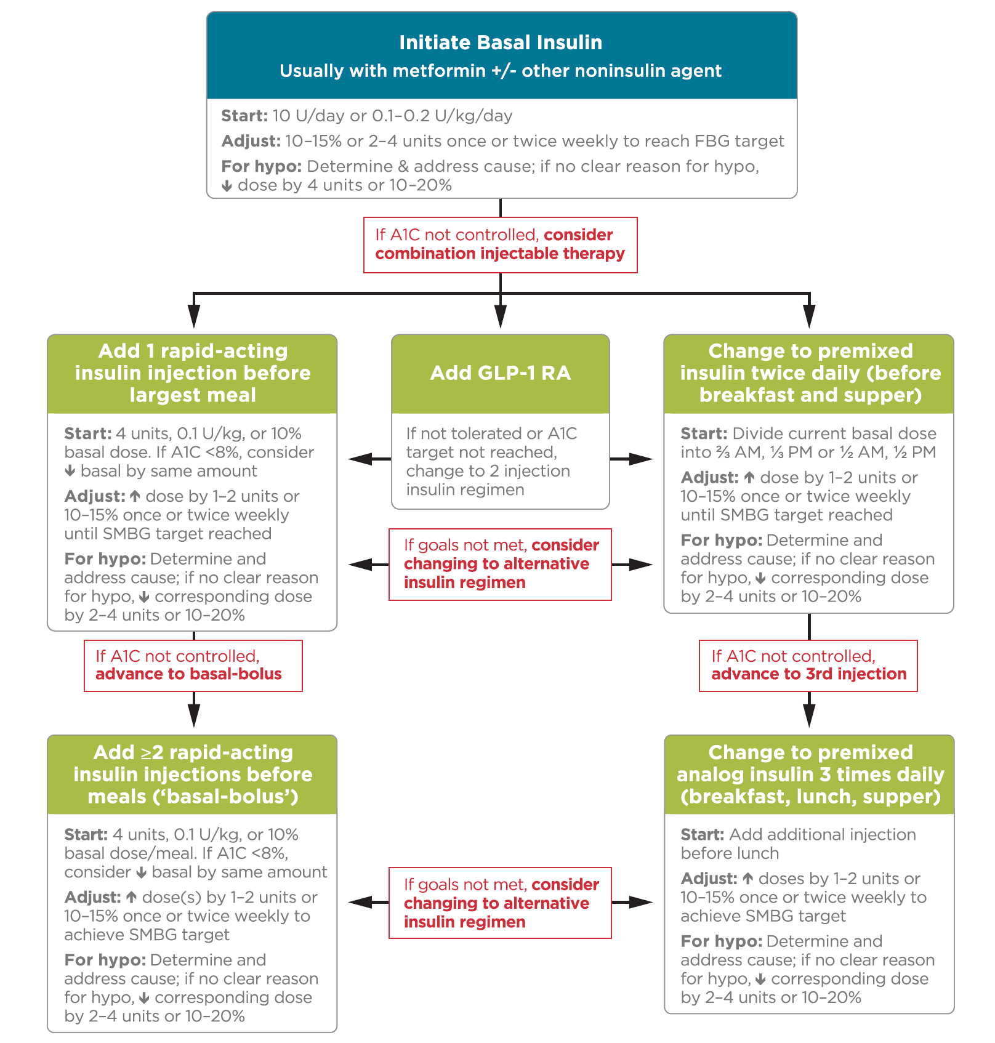

Slide 8
Why Basal?

Slide 9
In T2DM contribution of fasting hyperglycaemia to overall glycaemia increases with worsening diabetes
290 patients with T2DM treated with diet or OHAs
Baseline (normal) PG defined as 6.1 mmol/l (110 mg/dl) ― threshold defined by ADA as the upper limit of normal PG at fasting or preprandial times
100
70%
Relative contribution (%)
50
Fasting
30%
0
<7.3
7.3―8.4
8.5―9.2
9.3―10.2
>10.2
HbA_{1c} (%) quintiles
ADA=American Diabetes Association; OHA=oral hypoglycaemic agent; PG=plasma glucose.
Adapted from Monnier L, et al. Diabetes Care 2003;26:881―5.
Notes:
This study analysed the diurnal glycaemic profiles of 290 patients with T2DM investigated at different levels of HbA_{1c}. The patients were treated with diet or oral hypoglycaemic agents (not acarbose).
Plasma glucose (PG) concentrations were determined at fasting and during postprandial and post absorptive periods.
The areas under the curve above fasting PG concentrations and >6.1 mmol/l (110 mg/dl) were calculated for further evaluation of the relative contributions of postprandial and fasting PG increments to the overall diurnal hyperglycaemia. The value of 6.1 mmol/l (110 mg/dl) was chosen because this threshold has been defined as the upper limit of normal PG at fasting or preprandial times by the American Diabetes Association. The data were compared over quintiles of HbA_{1c.}
The main contributor to overall hyperglycaemia in patients with poorly controlled T2DM was found to be fasting hyperglycaemia. Fasting hyperglycaemia was the dominant factor in patients who were furthest from HbA_{1c} target.
Monnier L, et al. Diabetes Care 2003;26:881―5

Slide 10
Treating fasting hyperglycaemia lowers the entire 24-hour plasma glucose profile
400
Type 2
diabetes
20
300
15
200
Hyperglycaemia due to increase in fasting glucose
Plasma Glucose (mg/dL)
10
Plasma Glucose (mmol/L)
100
5
Normal
0
Meal
Meal
Meal
0
6
10
14
18
22
2
6
Time of Day (h)
Comparison of 24-hour glucose levels in control subjects vs patients with diabetes (p<0.001).
Adapted from Hirsch I, et al. Clin Diabetes 2005;23:78–86.

Slide 11
Selection of Initial Insulin

Slide 12
4-T study: Optimal Insulin Treatment in
Type 2 Diabetes
Inclusion criteria
Study design
Exclusion criteria
≥18 years
Type 2 DM ≥ 12 month
HbA1c 7-10%
Metformin & SU
History of insulin
History of TZD
Cr ≥1.47 mg/dL
Unstable angina, MI, CHF
N=708
Biphasic insulin
twice daily
n=235
Prandial insulin
thrice daily
n=239
Basal insulin
once daily
n=234
双相门冬胰岛素
餐时门冬胰岛素
基础地特胰岛素
2x/day
n=235
3x/day
N=239
1x/day
N=234
Primary outcome at year 1
+ prandial insulin
+ basal insulin
+ prandial insulin
Primary outcome at year 3
Notes:
the 4-T study, in which, patients who had inadequate glycemic control while receiving metformin and sulfonylurea were randomly assigned to receive biphasic aspart 30, prandial insulin aspart, or basal detemir during the first year. Starting with the second year, sulfonylureas were replaced by an additional type of insulin if the glycated hemoglobin level exceeded 6.5%. Basal insulin was added to the prandial regimen, prandial insulin was added three times daily to the basal regimen, and prandial insulin was added at midday to the biphasic regimen

Slide 13
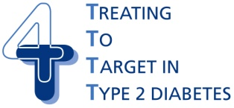
4-T Study
Year 1
Comparison of 3 single insulin regimens, added to OADs*
Years 2 and 3
If A1C > 6.5%, stop sulfonylurea and add a second insulin formulation
Add biphasic insulin
twice a day
Add prandial insulin
at midday
708
T2DM
on dual OAD
R
Add prandial insulin
three times a day
Add basal insulin
before bed
Add basal insulin
once (or twice) daily
Add prandial insulin
three times a day
*Intensify to a combination
insulin regimen in year one
if unacceptable hyperglycemia
Holman RR et al. N Engl J Med. 2007;357:1716-1730.

Slide 14
4-T Study - Overview of Main Results
 | Biphasic | Prandial | Basal
HbA_{1c} targets achieved | + | ++ | ++
Mean SMBG level achieved | + | ++ | ++
Fewer hypoglycemic episodes | ++ | + | +++
Less weight gain | + | + | ++
Less increase in waist circumference | + | + | ++
N Engl J Med, 2009;361:1736-47

Slide 15
Is it really necessary to cover every meal with an insulin bolus as soon as basal insulin therapy fails?

Slide 16
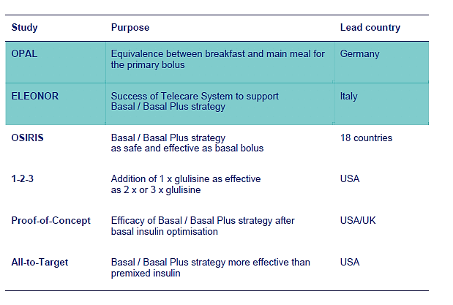
Six clinical trails supporting the Basal Plus strategy in T2DM

Slide 17
OPAL Study
Oral Plus Apidra and Lantus

Slide 18
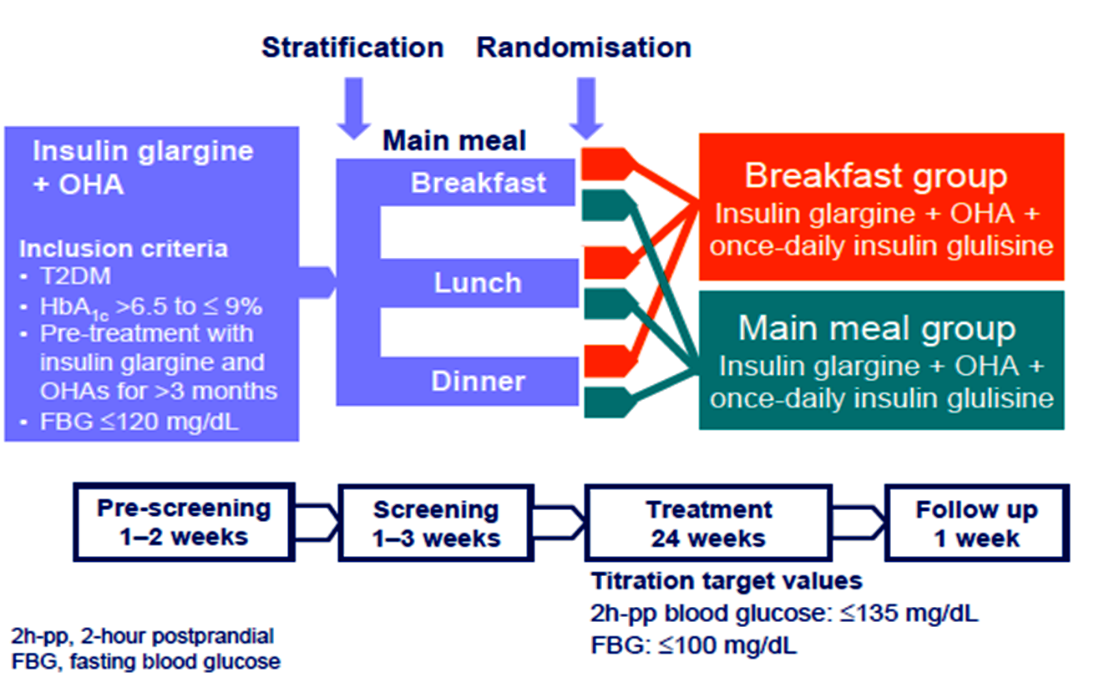
OPAL: Study Design the 1st study supporting the Basal Plus approach
Lankisch M, et al. Diabetes Obes Metab 2008

Slide 19
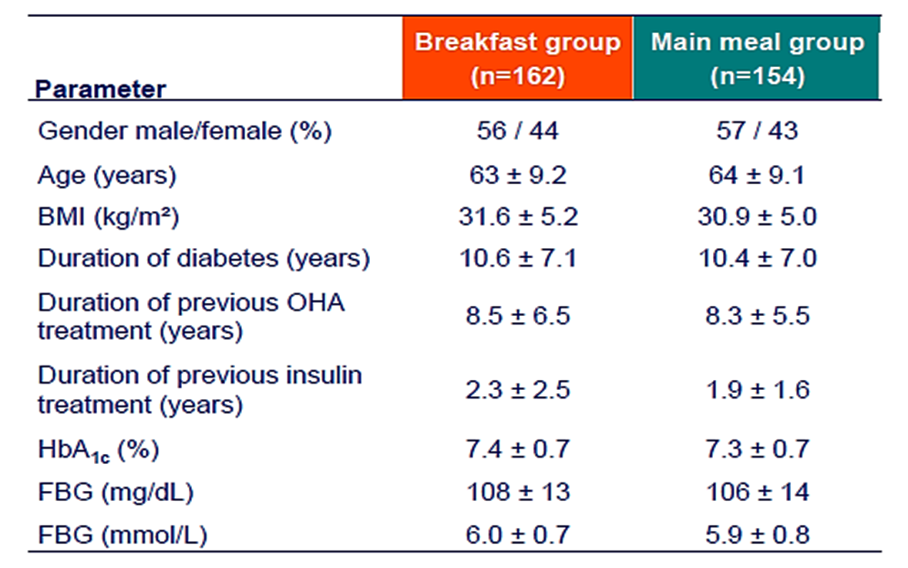
OPAL: Basal Characteristics
Lankisch M, et al. Diabetes Obes Metab 2008

Slide 20
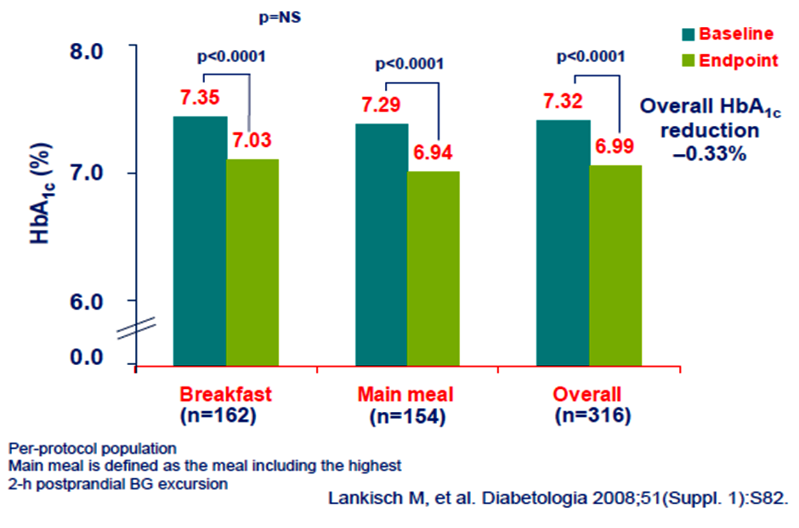
OPAL: Efficacy Data

Slide 21
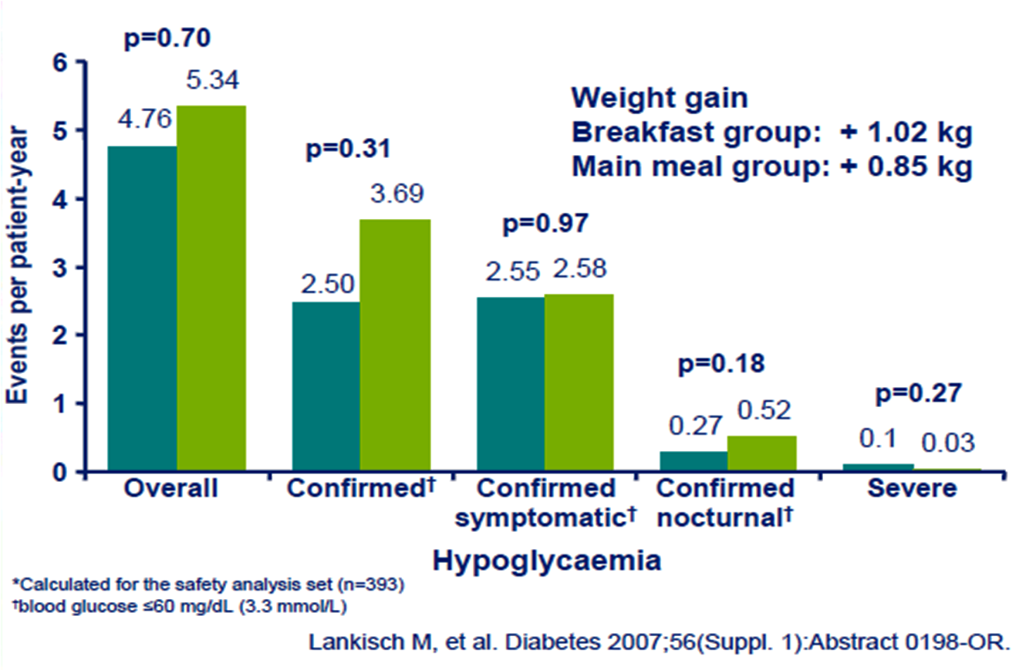
OPAL: Safety Data

Slide 22
OPAL: Main findings
A single bolus of insulin glulisine added to once-daily basal insulin glargine results in an improvement of both HbA1c and PPBG levels.
The change in HbA1c is independent of the time of insulin glulisine administration, ie. Breakfast or main meal .
  Slightly better responder rate in main meal group
Low risk of hypoglycemia in both groups
No major weight gain with a Basal Plus approach

Slide 23
1.2.3 Study

Slide 24
1.2.3 study: insulin glargine with addition of one, two or three daily doses of glulisine
Subjects:
Insulin naïve (785 entered study, 343 randomized) with type 2 diabetes
(HbA_{1c} ≥8.0%)
Receiving 2 or 3 OHAs for ≥3 months (OHAs continued except sulfonylurea)
Additional insulin glulisine once daily (n=115)
Randomization (subjects with HbA_{1c} >7.0%, n=434)
Insulin glargine
(n=785)
Additional insulin glulisine twice daily (n=113)
14 weeks
Mean study entry values:
HbA_{1c} (%): 9.8
BMI (kg/m²): 35.0
Additional insulin glulisine three times daily (n=115)
24 weeks
Davidson MB, et al, Endocr Pract 2011
Notes:
The aim of the 1.2.3 study was to show non inferiority of glycemic control between 3 regimens that used glargine plus glulisine (once-, twice- or three-times daily).
This open-label, multicenter trial (conducted in the US), enrolled subjects with T2D who had been receiving 2 or 3 different OHAs for ≥3 months and had HbA_{1c} ≥8.0%. At randomization, subjects were receiving sulfonylurea/metformin (~63%), sulfonylurea/thiazolidinedione (~8%), thiazolidinedione/metformin (~20%), or thiazolidinedione/metformin/sulfonylurea (~8%).
785 subjects entered a 14-week glargine run-in: 442 subjects were excluded because they achieved the HbA_{1c} goal (<7%). Subjects with HbA_{1c} >7.0% after run-in were randomized to have insulin glulisine added either once (n=115), twice (n=113) or three times daily (n=115) for 24 weeks. The meals chosen for glulisine administration in the once-daily and twice-daily arms were those that produced the greatest glycemic excursions.
Subjects had a fairly high BMI and a high HbA_{1c} level at baseline meaning that they would have been fairly resistant to insulin and difficult to treat.
The design reflects the stepwise treatment approach recommended by guidelines: subjects received glargine, and if they did not achieve target HbA_{1c} they received additional glulisine.
Sanofi-aventis data on file (1.2.3 study)

Slide 25
1.2.3 study: insulin glargine with addition of one, two or three daily doses of glulisine
Responders in the whole population (n=785)
Evolution of HbA1c in the randomized population (n=343)
Glargine
(alone)
Glargine plus glulisine
(patients with HbA_{1c} >7%)
80
10.19
10.19
10.16
All subjects
(n=785)
10.0
Additional
subjects who achieved
HbA_{1c} <7.0%
with glulisine added to
glargine
Glulisine 1x
Glulisine 2x
Glulisine 3x
60
23%
9.0
40
% achieving HbA_{1c} <7.0
HbA_{1c} (%)
37%
7.44
7.40
7.29
Subjects who achieved HbA_{1c} <7.0% with glargine during run in
8.0
20
0
7.0
Run in
Randomization
Wk 8
Wk 16
Wk 24
HbA_{1c} in all subjects (n=785) = 9.8 at run in and 7.3 at randomization
Davidson MB, et al, Endocr Pract 2011
Notes:
Glargine was started at 10 U/day (target FBG <110 mg/dL), with adjustments based on mean 2-day FBG as shown below:
2 day FPG (mg/dl) Dose adjustment
>250 Increase at investigator discretion
110-250 Increase 2 U
100-109 Increase 0-2 U at investigator discretion
70-99 No change
<70 Decrease 2-4 U at investigator discretion
Glulisine dose was based upon prelunch and predinner BG targets of 70-109 mg/dL, and bedtime target of 70-129 mg/dL. Dose adjustments made weekly based upon whether preprandial BG values were low or high
Mealtime dose, U Low PPBG values High PPBG values
≤10 Decrease by 1 U Increase by 1 U
11-20 Decrease by 2 U Increase by 2 U
>20 Decrease by 3 U Increase by 3 U
After run-in, about 37% of subjects achieved HbA_{1c} <7%. At study end an additional 39.5, 43.0, and 58.2% in the glulisine 1x, 2x and 3x groups, respectively had achieved HbA_{1c} <7%. Thus, adding glulisine to glargine enabled another 23% of patients to achieve target; around 60% of patients in total achieved target HbA_{1c}.
At study end, HbA_{1c} reduction from randomization was 0.46, 0.48 and 0.56% in the glulisine 1x, 2x and 3x groups, respectively. Thus, harder-to-treat subjects received glargine plus glulisine, a substantial proportion went on to achieve HbA_{1c} target.
Sanofi-aventis data on file (1.2.3 study)

Slide 26
1.2.3 study: insulin glargine with addition of one, two or three daily doses of glulisine
p=NS for all other pairwise comparisons
5
20
0.35
p=0.043
0.30
4
15
17.1
0.30
3.8
3.9
0.25
0.26
3.7
3
12.9
0.20
Confirmed symptomatic hypo
(event/patient-year)
Severe or serious hypo
(event/patient-year)
Mean body weight change
from baseline (kg)
10
12.2
2
0.15
5
0.10
1
0.10
0.05
0
0
0.00
x1
x2
x3
x1
x2
x3
x1
x2
x3
Glulisine
Glulisine
Glulisine
Sanofi-aventis data on file (1.2.3 study)
Notes:
Subjects in the insulin glulisine once-daily, twice-daily and three times daily groups gained a mean of 3.7kg, 3.8kg and 3.9kg, respectively, in body weight.
The rates of confirmed symptomatic hypoglycemia were 12.2, 12.9 and 17.1 events/patient-year in the glulisine 1x, 2x and 3x groups daily groups, respectively.
The rates of severe or serious hypoglycemia were 0.10, 0.30 and 0.26 events/patient-year in the glulisine 1x, 2x and 3x groups daily groups, respectively.
At study end, the mean insulin dose (glargine + glulisine) was 84 +27, 80 + 50 and 81 + 66 U/day in the glulisine x1, x2 and x3 groups, respectively.
Sanofi-aventis data on file (1.2.3 study)

Slide 27
1.2.3 Study: Conclusion
Once- and twice-daily insulin glulisine were non-inferior to insulin glulisine administered three times daily.

Slide 28
Stepwise Basal-Plus vs.
Basal-Bolus?
Which Insulin Regimen?

Slide 29
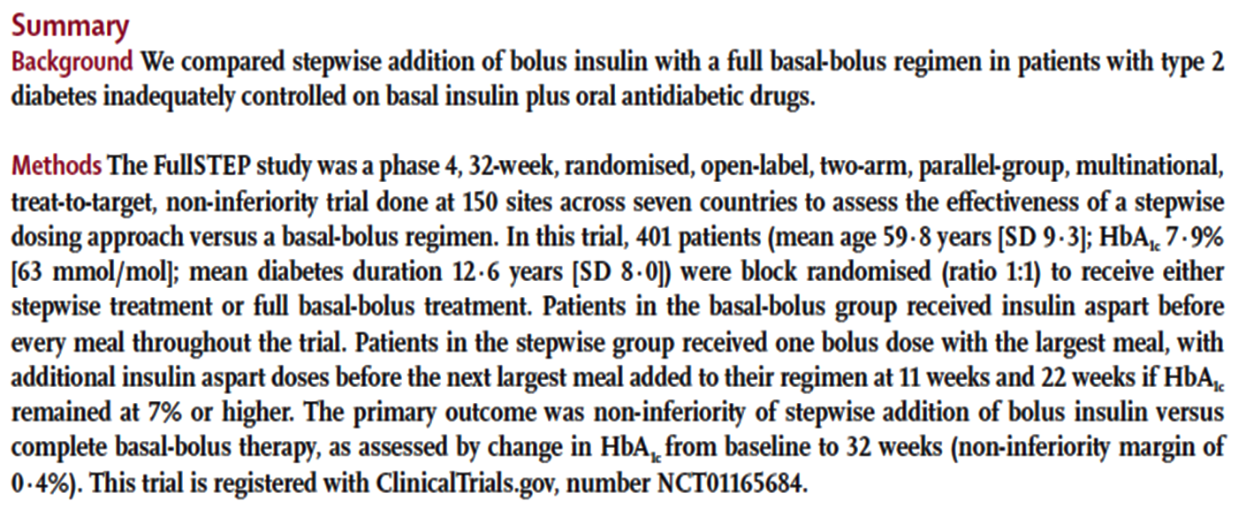
FullSTEP Study
Treatment intensification with stepwise addition of prandial insulin aspart boluses compared with full basal-bolus therapy
A randomised, treat-to-target clinical trial
Rodbard HW, et al. The Lancet Diabetes & Endocrinology 2014; 2 (1): 30-37.

Slide 30
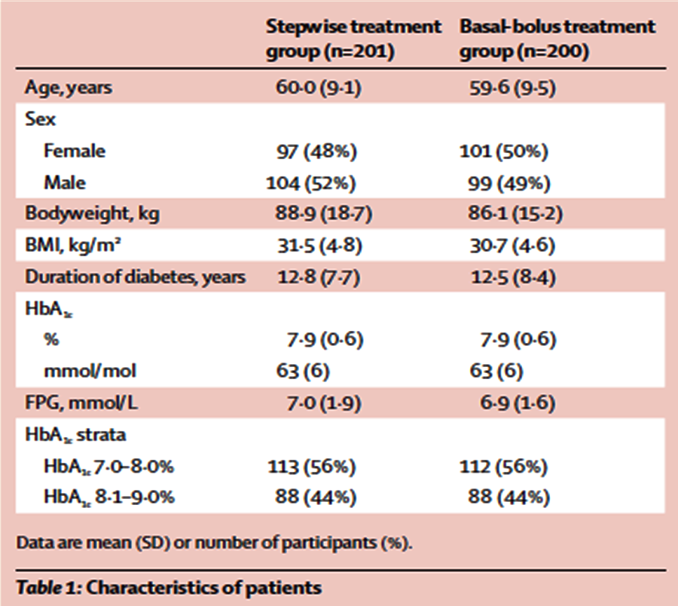
FullSTEP Study:
Demographics & Characteristics
Rodbard HW, et al. The Lancet Diabetes & Endocrinology 2014; 2 (1): 30-37.

Slide 31
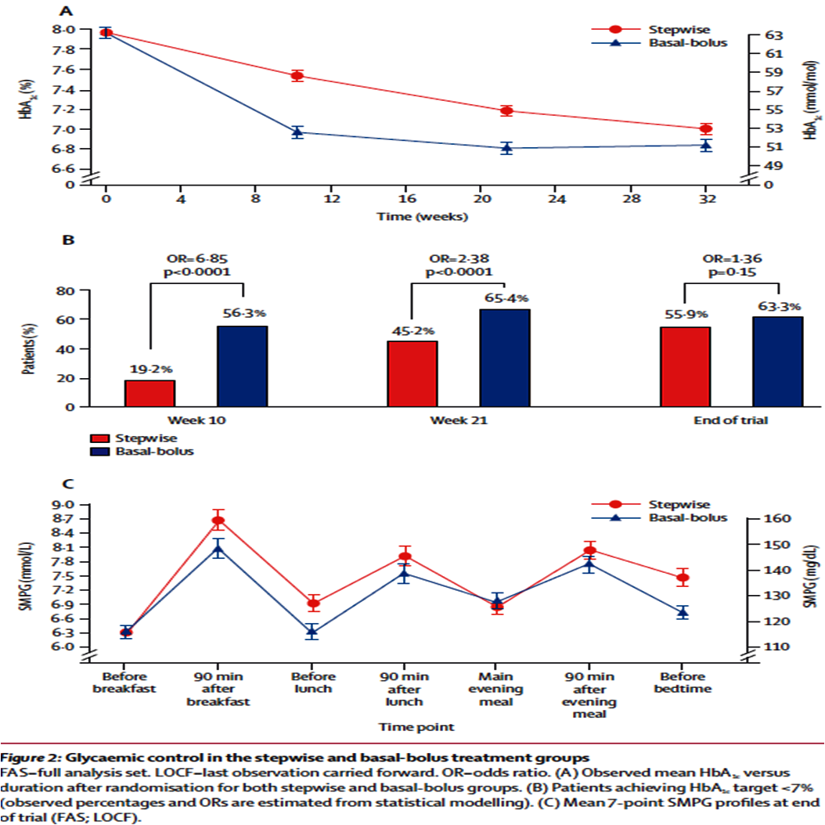
FullSTEP Study
Rodbard HW, et al. The Lancet Diabetes & Endocrinology 2014; 2 (1): 30-37.

Slide 32
Patient vs.
Physician
Who should titrate the insulin dosage?

Slide 33
The START Study
(Self-Titration with Apidra to Reach Target)
Diabetes self-management is universally regarded as a foundation of diabetes care.
In a randomized non-inferiority trial, we determined whether comparable glycemic control could be achieved by self-titration vs. physician titration of a once-daily bolus insulin dose in patients with T2DM who are unable to achieve optimal glycemic control with a basal insulin.
Harris et al. Diabetes Care. 2014; 37(3):604-10.

Slide 34
START Study: Conclusions
In stable patients with T₂DM who are receiving doses of basal insulin glargine who require bolus insulin, a simple bolus insulin patient-managed titration algorithm is as effective as a physician-managed algorithm.
Harris et al. Diabetes Care. 2014; 37(3):604-10.

Slide 35
Simple algorithm vs.
Carbohydrate counting
How to titrate the insulin dosage?

Slide 36
Basal Bolus therapy delivers comparable good efficacy whatever the titration algorithm used
3.1 3502 (CHO) study
100
8.5
p=NS
8.16
Simple algorithm
CHO counting
80
8.0
8.16
60
73
69
7.5
% achieving HbA_{1c} <7.0
HbA_{1c} (%)
40
7.0
ADA/EASD target
6.70
20
6.5
6.54
0
p=NS
6.0
Simple
algorithm
CHO
counting
Baseline
2
6
12
18
Endpoint
Weeks
Bergenstal RM, et al. Diabetes Care 2008;31:1305–10
Notes:
At study start, glargine dose was calculated to provide 50% of patients’ total daily insulin dose before randomization: glargine was titrated weekly using the mean of the last 3 days’ fasting SMBG (below).
3 day FPG (mg/dl) Dose adjustment
>180 Increase 8 U
140-180 Increase 6 U
120-139 Increase 4 U
95-119 Increase 2 U
70-94 No change
<70 Decrease based upon glulisine dose, or by up to 10% of glargine dose
The remaining 50% of patients’ total daily pre-randomization insulin was given as glulisine, adjusted weekly based on prelunch/dinner and bedtime BG patterns from the previous week as below:
Mealtime dose Mealtime BG <target Mealtime BG >target
≤10 units Decrease by 1 unit Increase by 1 unit
>11–19 units Decrease by 2 units Increase by 2 units
≥20 units Decrease by 3 units Increase by 3 units
Mealtime dose Mealtime BG <target Mealtime BG >target
1 unit/20 g Decrease to 1 unit/25 g Increase to 1 unit/15 g
1 unit/15 g Decrease to 1 unit/20 g Increase to 1 unit/10 g
1 unit/10 g Decrease to 1 unit/15 g Increase to 2 units/15 g
2 units/15 g Decrease to 1 unit/10 g Increase to 3 units/15 g
3 units/15 g Decrease to 2 units/15 g Increase to 4 units/15 g
Dose adjustments in the CHO group were based upon insulin-to-carbohydrate ratio.
Three daily doses of glulisine added to once daily glargine provides good HbA_{1c} control in subjects with late-stage T2D, and efficacy is unaffected by the dose adjustment algorithm used.
Bergenstal RM, et al. Diabetes Care 2008;31:1305-10
Glulisine dosing
CHO group
Glulisine dosing SMBG group

Slide 37

The most precise and flexible prandial coverage is possible with “basal-plus/bolus” therapy
HbA_{1c} > target
FPG on target
PPG > target
Basal bolus Basal +
3 prandial
Basal plus
Basal +
2 prandial
HbA_{1c} > target
FBG > target
Basal plus
Basal +
1 prandial
Basal insulin
once daily
(treat-to-target)
± 2nd/3rd
Drug
Lifestyle
±
Metformin
HbA_{1c} > target
Progressive deterioration of β-cell function
Adapted from Raccah et al. Diabetes Metab Res Rev 2007; 23:257.

Slide 38
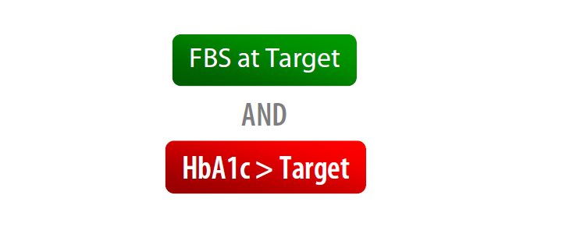
When to add the first prandial insulin

Slide 39
Dosing and Titration

Slide 40
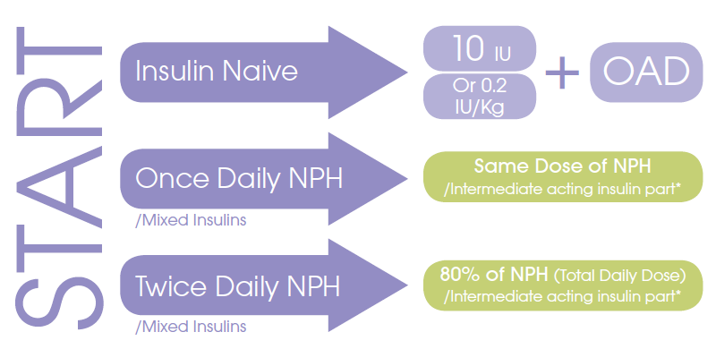
Dosing

Slide 41
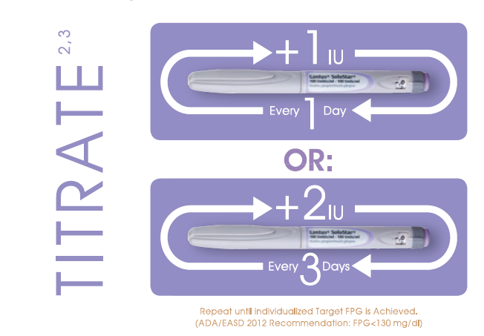
Titration

Slide 42

Key Message
Individualization of therapy is key, incorporating the degree of hyperglycemia needing to be addressed and the overall capacities of the patient.

Slide 43
Conclusion
Any insulin will lower glucose and HbA1c.
A timely insulin therapy in type 2 diabetes could protect β-cell function and facilitate effective glycemic control.
No insulin is working by itself alone
All insulins are associated with some weight gain and some risk of hypoglycemia.
Effective dose titration is required to optimise insulin therapy.
  First, Basal insulin and after that, the Prandials.

Slide 44
So, why not to do!
Start Insulin At The Right Time!
Adjust
&
Follow!

