Slide 1


Slide 2
How to submit?
Golaleh Asghari
Nutrition and Endocrine Research Center, Research Institute for Endocrine Sciences, Shahid Beheshti University of Medical Scinces

Slide 3
There are 7 stages in your journey
Choose your topic
Research your topic
Plan a program of research
Choose the journal
Prepare your paper
The journal responds…
Starting again on another topic

Slide 4
Stage 5
Prepare your manuscript
Adopt the journal’s style
Reference their authors
Have two or three points and focus on them
Simplify, simplify, simplify
Write your abstract--then rewrite it at the end
Get help from a copy editor and your friends

Slide 5
Internet-based manuscript submission systems
The internet based systems in place now enable the peer review process to more streamlined.
Authors submit their manuscripts online, entering the meta-data traditionally entered by the journal's staff. The manuscript is automatically assigned an identification number, and is entered into the database, from where it is immediately available to editors.
The editor views the manuscript online and makes in immediate decision or suggests peer reviewers.
Staff contact the peer reviewers through the web system to ask if they are willing to review the article.

Slide 6
Internet-based manuscript submission systems
5. Reviewers access the reviewer's area of the website and review the paper, submitting their comments via an electronic review from available online.
6. Once all comments have been received, the paper and comments are immediately available to the editors, ready for them to make a decision.
7. The editor's decision is emailed to the corresponding authors.

Slide 7
Author benefits
Removing the need for “snail mail”. Manuscripts can no longer be lost or delayed in the post
Approving the article. Authors can carry out a final check of the paper before submission.
Linked references. Some systems will convert the references of the manuscripts into hyperlinked to Medline or the abstract or full text of the online article. The references must be in the exact format specified by the journal for optimum linkage.
Supplemental data. Most web based systems allow authors to upload supplemental data as well as the article and images. This can be anything from appendices, published articles, questionnaires, and extraneous data.
Interrogation of the system. Most systems allow authors to view the status of their article as it moves through the peer review process.

Slide 8
Author benefits
6. Contacting the journal. Email links available throughout the system give authors and easy opportunity to contact journal staff of associate.
7. Reviewer's comments available online. As soon as the editors sends a decision, the reviewer's comments are available online to authors.
8. Author history. Authors retain a record on the system of all manuscripts submitted to the journal, including the article itself, the editor's decision letter, and reviewer's comments.
9. Personal information. Authors can update their personal detail and expertise terms at any time.
10. Reduced turnaround times. Perhaps most importantly, turnaround times can be dramatically reduced.

Slide 9
Important points to remember
Although most web based systems are reasonably self-explanatory errors do sometimes occur.
Authors have not properly read the journal's instruction for submission.
They often contain essential journal requirements as well as guidance on submission.
This is particularly important when dealing with images
Most systems in use accept the standard graphic formats: .tif, .jpg, and .eps.

Slide 10
Your submission letter - Cover letter
It’s worth noting that you should always send a cover letter with the manuscript.
Tell the editor briefly why your article fits in the journal
Suggest reviewers
  People you respect
  NOT people with whom you have a relationship
  If there are people who will not like this paper, let the editor know

Slide 11
Your submission letter - Cover letter
The contributing author should also include his or her telephone number, email, fax number in the cover letter or on the title page of the manuscript.

Slide 12
Your submission letter - Cover letter
Manuscripts without cover letters pose immediate problems:
  If there are several authors, which one should be considered the submitting author, at which address?
  A manuscript perhaps misdirected by a reviewer or an editor?

Slide 17
Most journals send out an “acknowledgment of receipt” form letter when the manuscript is received.
Most journal editors, at least the good ones, try to reach a decision within 4 to 6 weeks or, if there is to be further delay for some reason, provide some explanation to the author.

Slide 18
Always read the instruction for authors before submission and take careful note of journal requirements.
All systems adopt a strict security system that is based on a user identification and password system. This prevents unauthorized access to manuscripts and personal information, and it allows authors to track their manuscript through the process.
Some systems encrypt passwords for further security and con not be obtained by journal staff or the software supplies.
If the manuscript is accepted, the original word processing and image files may be requested if the files uploaded to the web based system are not suitable for publication.
If in any doubt, contact the staff of the editorial office, who will always be happy to help.

Slide 19
Guidelines for author submission
Terminology and required items may be slightly different depending on the system the journal uses.
The terms are usually similar and easily identifiable, however, the individual journal's “instructions for authors” should always be read before submission.
Access the website via the URL by using a unique user identifier and password
Enter the author submission area
Choose the “ submit a new manuscript” link

Slide 20
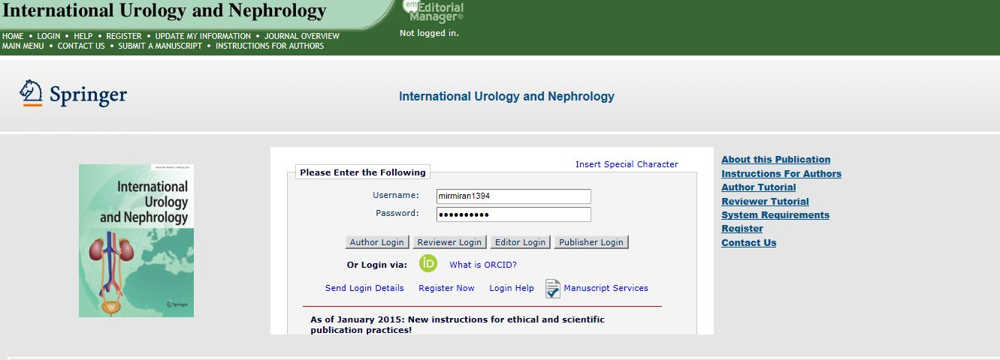

Slide 21
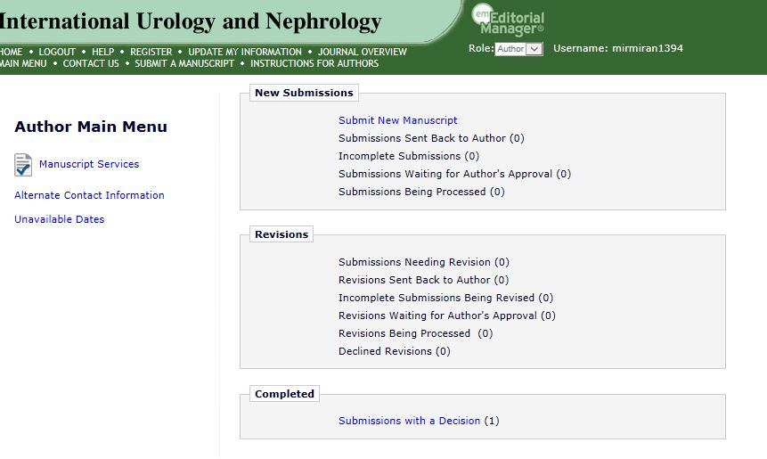

Slide 22
Guidelines for author submission
4. Enter the manuscript meta-data:
  number of authors,
  type of article,
  title,
  manuscript keywords,
  abstract,
  cover letter to the editors,
  author details,
  suggested reviews' names,
  word count.
Most journals ask for extra information, but this is usually explained in the instructions for authors and on the submission pages.

Slide 23
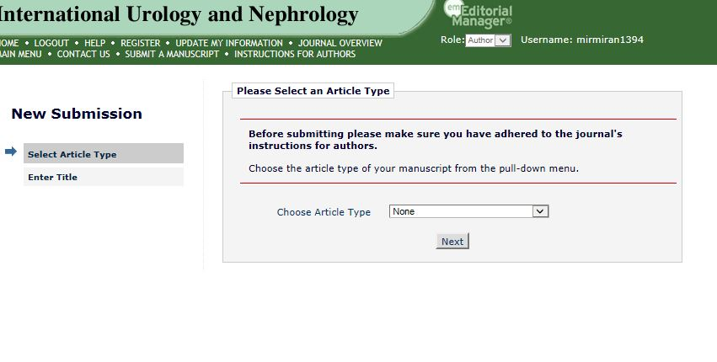

Slide 24
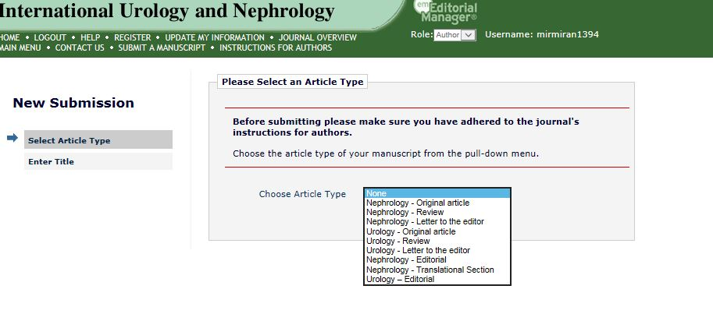

Slide 25
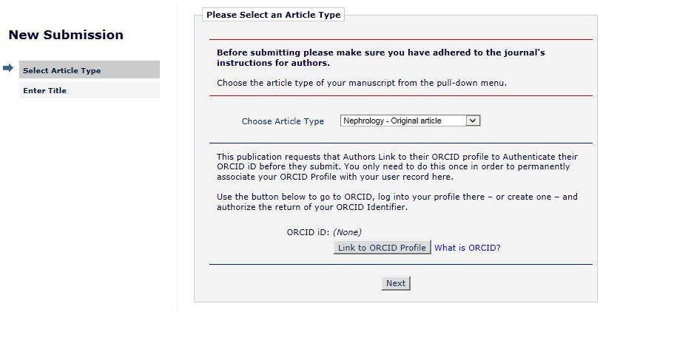

Slide 26
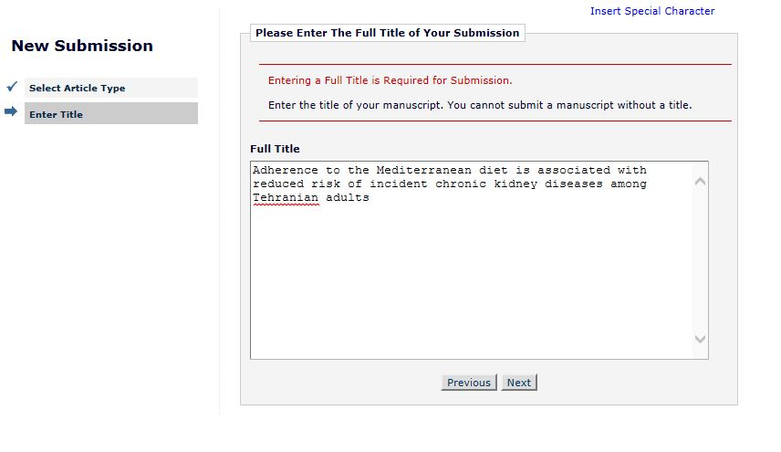

Slide 27
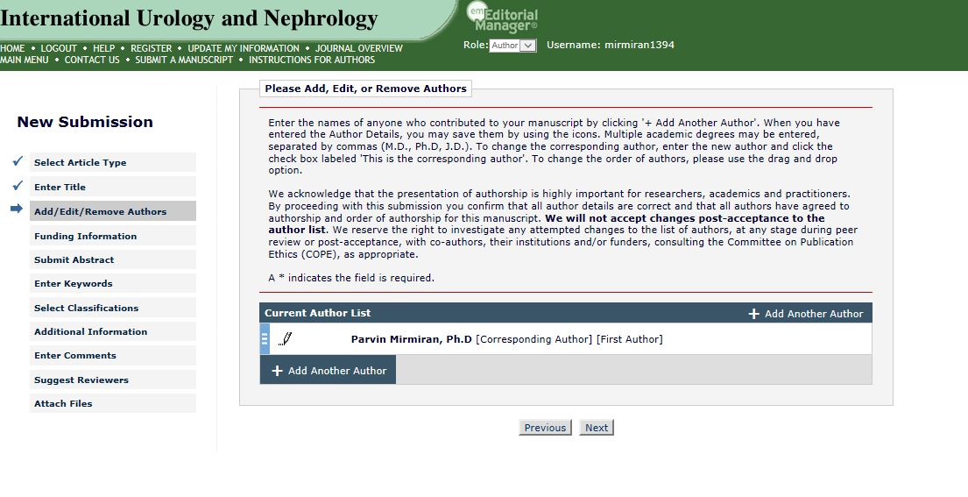

Slide 28
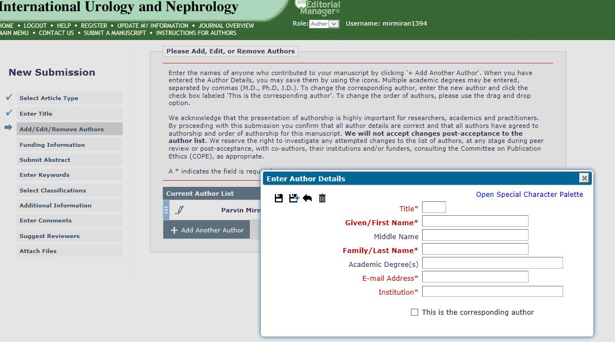

Slide 29
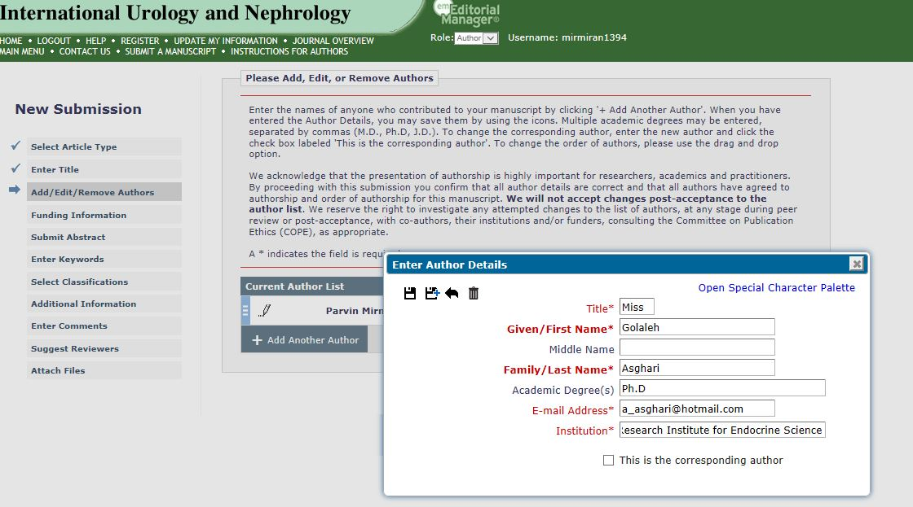

Slide 30
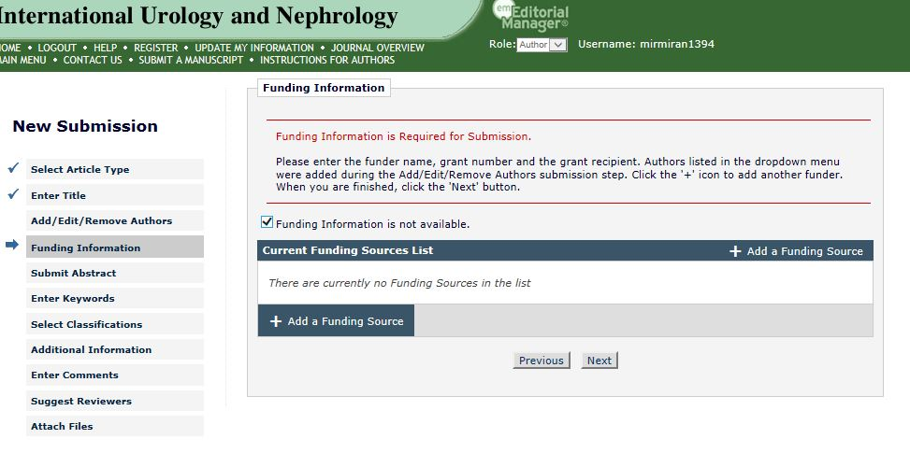

Slide 31
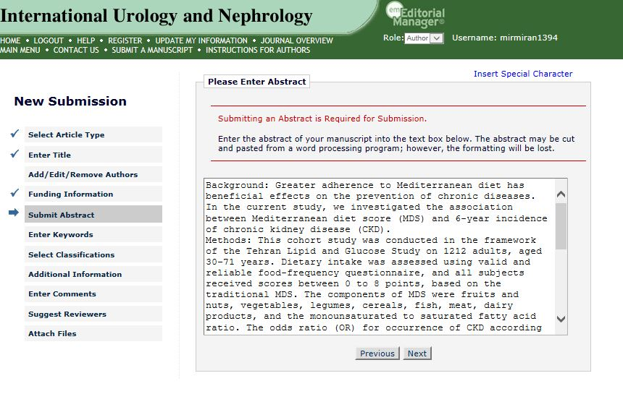

Slide 32
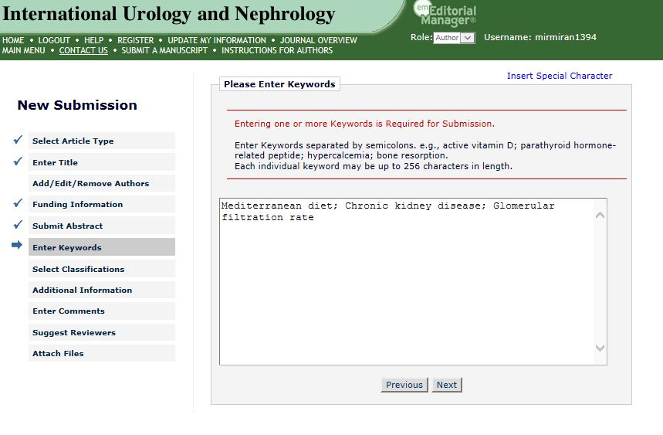

Slide 33
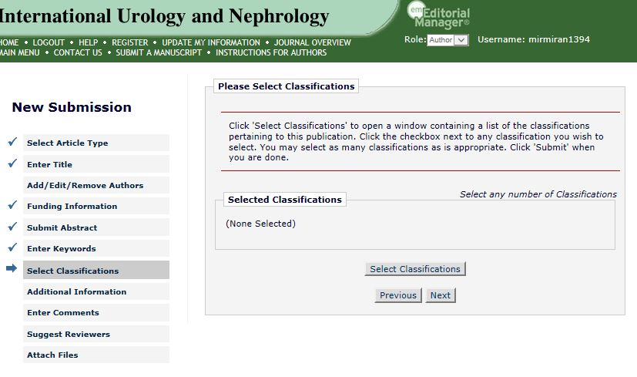

Slide 34
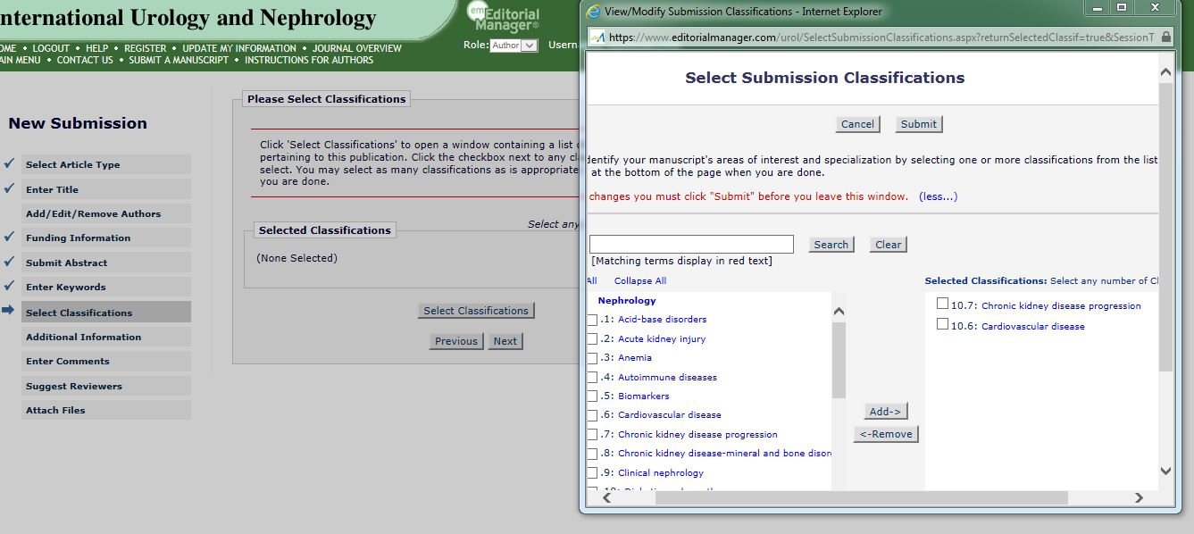

Slide 35
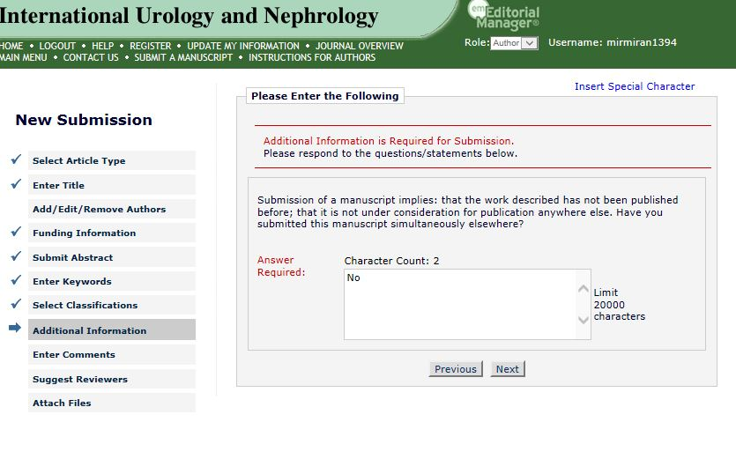

Slide 36
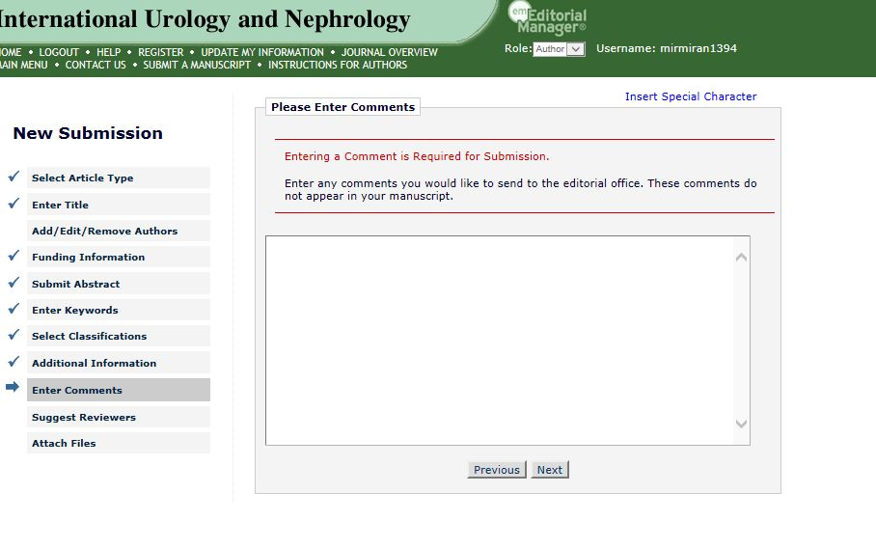

Slide 37
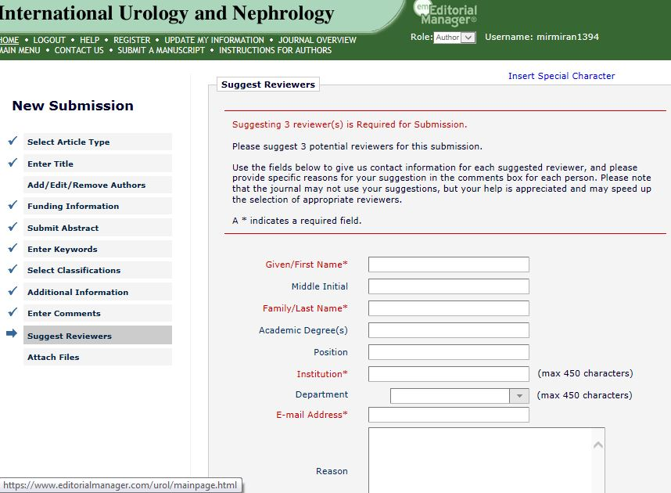

Slide 38
Guidelines for author submission
5. Enter the number of files you are uploading. This consists of one file for the actual article plus the number of image files associated with the manuscript.
6. Search on your computer for your manuscript files and enter the pathway into the appropriate field for example: c:/my documents/manuscript title)
7. Follow the system's guidance to “upload” the article to the website.

Slide 39
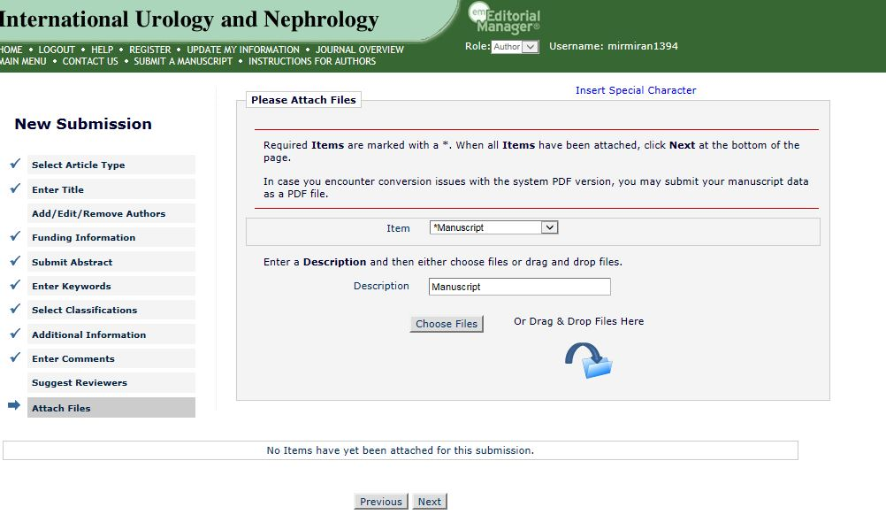

Slide 40
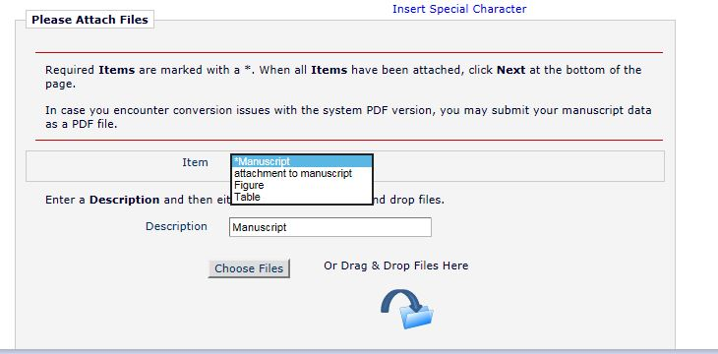

Slide 41
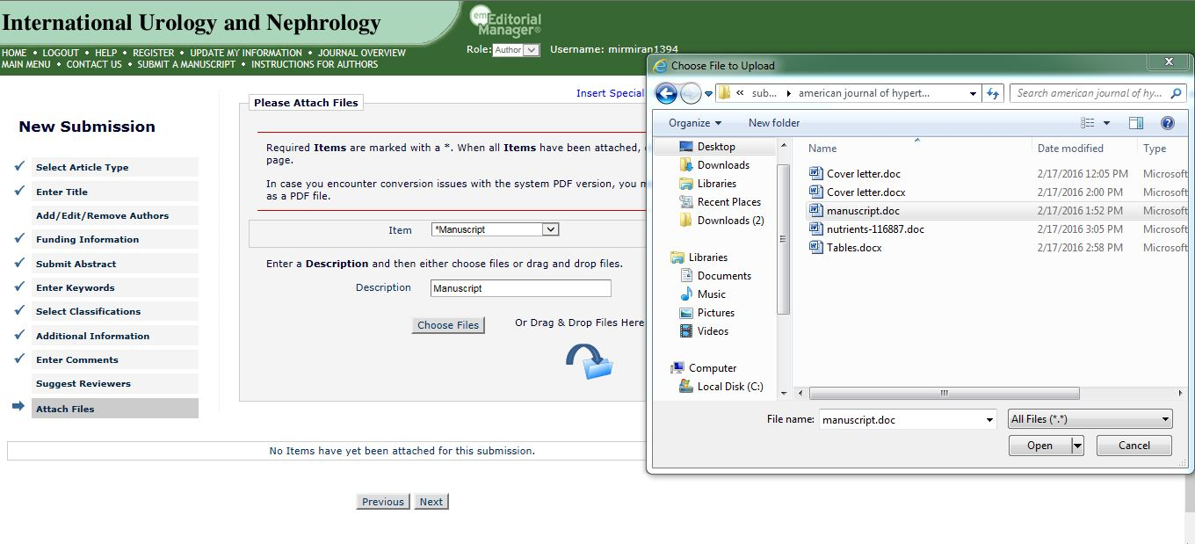

Slide 42
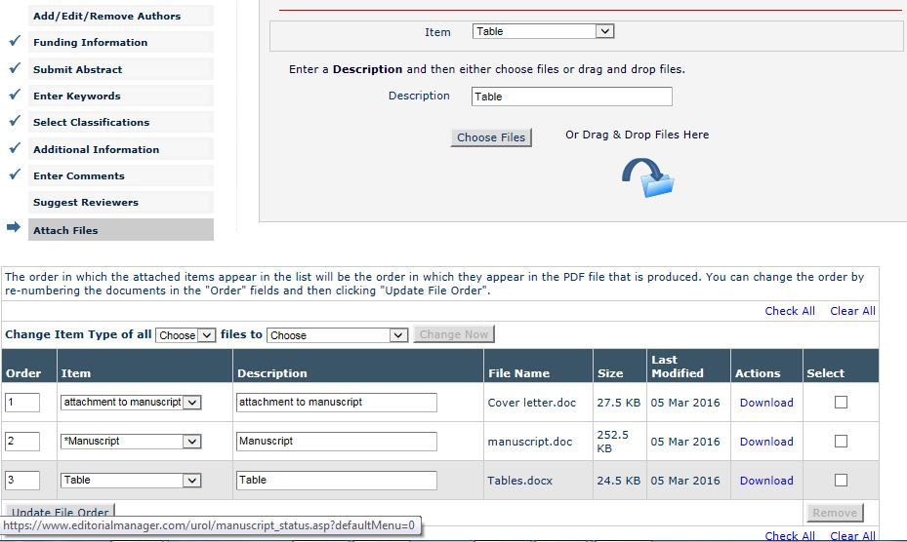

Slide 43
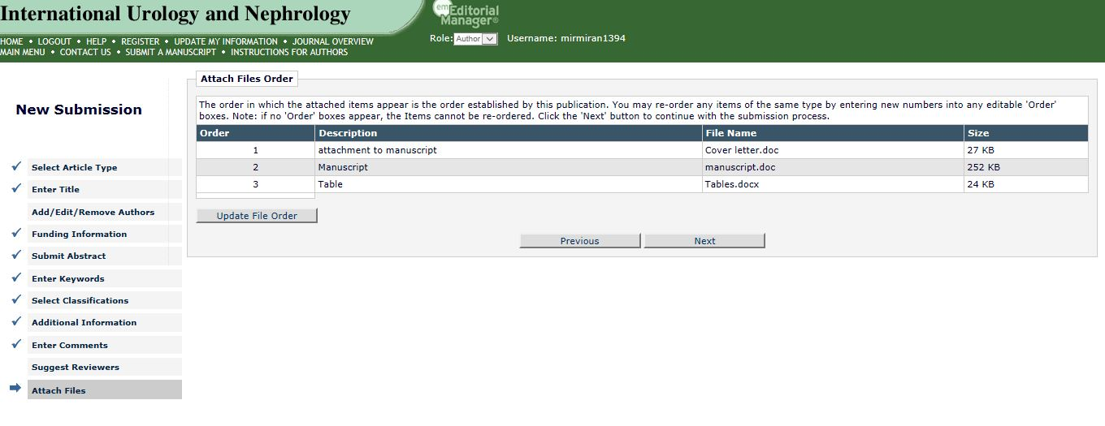

Slide 44
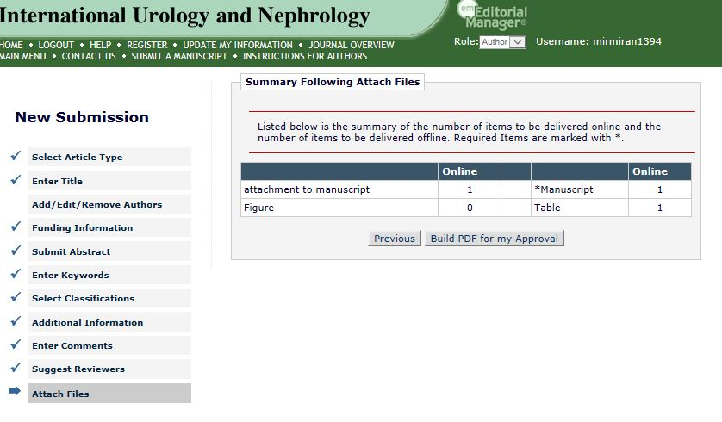

Slide 45
Guidelines for author submission
8. The article is converted automatically into a pdf. This is mainly for reviewing purposes and accessibility issues. The pdf file size is smaller than standard word processing and image files, and the software required to view it is a standard piece of software easily obtained free of charge from the web( http://www.adobe.com).
9. You then have the opportunity to view your submission before it is submitted formally to the journal. This allows you to make sure that what you are submitting is correct and of peer review standard.
Once approved, the article is then considered to be a formal submission.

Slide 46
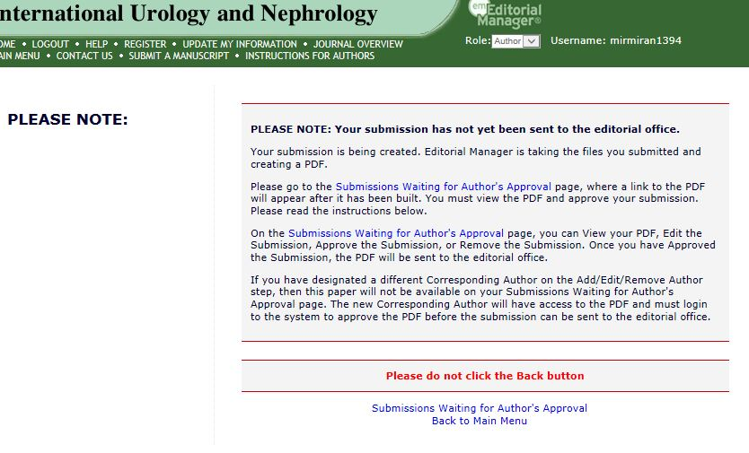

Slide 47
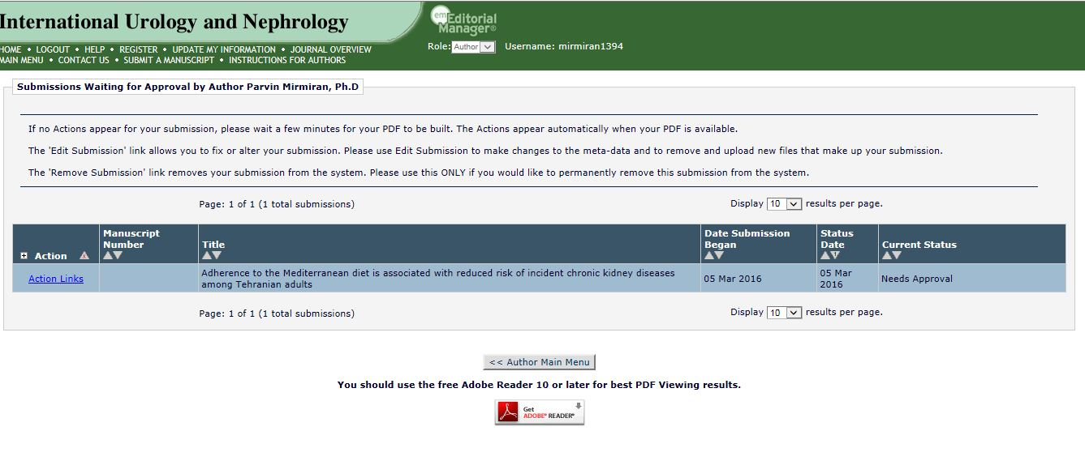

Slide 48
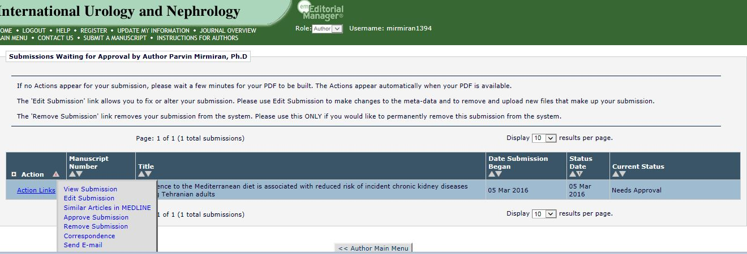

Slide 49
House style
The journal to which you submit your manuscript may supply, or have available on its website, a style sheet that sets out some basic decisions the editors have made to get consistency in layout, punctuation, capitalization, terminology, and so on throughout the journal. For example, guidance in the BMJ's “Essentials of style” (http://bmj.com/advice/ stylebook/basics.shtml) includes:
Minimal hypertension – use hyphens only for words with non-, -type, and for adjectival phrases that include a preposition (one-off event, run-in trial). Not using hyphens will help you to avoid noun clusters.
Minimal capitalization. Use capitals only for names and proper nouns. Do not capitalize names of studies.
Quotation marks- please use double, not single, inverted commas for reported speech. Full stops and commas go inside quotation marks.

Slide 50
House style
4. Sex. Avoid “he” as a general pronoun. Make the nouns (and pronouns) plural, then use “they”; if that's not possible, use “he or she”
5. English, not American spelling: aetiology, oestradiol, anaemia, haemorrhage, practice (noun), practise (verb). Foetus and fetus are both acceptable in English: the BMJ uses fetus.
6. Drugs should be referred to by their approved non-proprietary names, and the source of any new or experimental preparations should be given.

Slide 51
House style
The style book used by the BMJ's technical editors elaborates on these, and similar, points. It also contains a plethora of specific decisions that have had to be made – and revised- over many decades: antimalaria drugs or antimalarial drugs? Capitalize job titles, or not-the Director general? When are abbreviations allowed? Beta- carotene or B carotene? Moslem or Muslim, Myanmar or Burma?
Some of principles of house style are standards of good writing; others are admittedly arbitrary, but these provide consistency throughout the publication and help to give a journal its identity.

Slide 52
BMJ approach I
    Read covering letter.
    Pay small attention. This is a sell.

Slide 53
BMJ approach II
    Look for signs that this is a totally unsuitable paper
    Written by hand
    Typed on an ancient typewriter.
    Full of spelling mistakes.
    Biblical quotations.
    A cure for schizophrenia or cancer
    The answer to SIDS.
    Incomprehensible first two paragraphs.

Slide 54
BMJ approach III
    Read title page
    Is this an original study or some other kind of contribution?
    Are these authors where the study is likely to be sound?
    Don’t get too carried away by the authors. “Unknown” authors regularly produce great work. “Known” authors sometimes produce dreadful papers.

Slide 55
BMJ approach IV
    Do not read ‘TWIBS’ or ‘What this paper adds’
    These are what the authors would like the paper to say rather than what it does say
    Remember that if we do publish this study we need to sort this out

Slide 56
BMJ approach V
    Read structured abstract
    Have you got a clear fix on what the paper is about and how it is structured?
    If you haven’t, it’s looking bad
    Try to make sense of what the paper is about from the introduction
    If you can’t, reject it

Slide 57
BMJ approach VI
    Continuing with the structured abstract
    Have the authors asked a question that we want to know the answer to?
    We may not for the following reasons:
    Too specialist.
    Too inconsequential
    Too far removed from patient care or public policy
    Too well known – but remember that lots of things that are well known have no evidence to support them.

Slide 58
BMJ approach VII
    Don’t reject papers that ask an interesting question but get a “negative” answer
    The question is more important than the result

Slide 59

Thank you

