Slide 1
Role of Molecular Markers in Well Differentiated Thyroid Cancer From Bench to Bedside
Mohammad E. Khamseh
Institute of Endocrinology and Metabolism
Iran University of Medical Sciences
04/02/1396

Slide 2
Conflict of Interest
No apparent or real conflict of interest for this presentation

Slide 3
Agenda
Introduction
BRAF Mutation and risk estimates in PTC
TERT Mutation and risk estimates in PTC
Novel Treatment Strategies

Slide 4
What is the most common genetic mutation in PTC?
TERT
BRAF
TP53
PIK3

Slide 5
Genetic Mutation and Thyroid Cancer
PTC: 88% of thyroid cancer cases
5-year survival: 98%
Recurrence: 5%-20%
Locoregional:79%, Distant: 21%
Distant recurrences: 10-yr survival decrease to 40%
BRAF-V600E mutation: 45% of PTC
TERT Mutation: 7%-22% of PTC
TP53: 3.5%
Mark Yarchoan. et.al, J. Clinical Onc, 33, 1, 2015.

Slide 6
The MAP Kinase and PI3K Pathways

Slide 7
MAPK/ERK pathway
Ras-Raf-MEK-ERK pathway is a chain of proteins in the cell that communicates a signal from a receptor on the surface of the cell to the DNA in the nucleus
The signal produces some change in the cell, i.e. cell division
The pathway includes many proteins, including MAPK (mitogen-activated protein ), originally called ERK, extracellular signal-related, which acts as an "on" or "off" switch

Slide 8
The MAP Kinase pathway in Thyroid Cancer

Slide 9
B-type Raf kinase
BRAF is located in chromosome 7
A well recognized proto-oncogene
The most potent activator of the MAPK pathway
The most common hotspot mutation in the BRAF gene is a thiamine transversion to adenine (T1799A) in exon 15
This causes a conversion of valine to Glutamine in the BRAF protein
Ralph P. et.al, Medicine, 91, 5, 2012.

Slide 10
The PI3K pathway in Thyroid Cancer

Slide 11
Genetic Alterations in the MAP Kinase and PI3K Pathways
PTC
MAPK
MAPK
MAPK
MAPK
Thyroid Cell
PDTC
ATC
PI3K-AKT
PI3K-AKT
PI3K-AKT
PI3K-AKT
FTA
PI3K-AKT
F FTC
Xing M., Nature Reviews Cancer, 2013

Slide 12
Telomerase Reverse Transcriptase
Telomerase expression plays a role in cellular senescence
By lengthening telomeres, telomerase extends cellular life-span or even induces immortalization
Deregulation of telomerase expression in somatic cells may be involved in oncogenesis
TERT gene: encoding the core catalytic component of telomerase, is a novel mechanism to activate telomerase in cancer
TERT mutation: lengthen telomeres to immortalize cell lines
Genes, 2016 Jul; 7(7): 38

Slide 13
In PTC, poorer clinical prognosis is associated with:
1. BRAF-V600E
2. TERT Promoter
3. BRAF+TERT
4. PIK3

Slide 14
Prognostic Value of BRAF Mutation in Thyroid Cancer

Slide 16
Association between BRAF Mutation and Clinicopathological Characteristics
 | BRAF + | BRAF - | p Value
Number | 107 | 112
Age (yr.) | 43 (35-56) | 45 (38-55) | 0.41
Gender, male | 29 (27%) | 29 (26%) | 0.84
Tumor size (cm) | 2.0 (1.4-3.0) | 2.4 (1.5 - 3.5) | 0.009
Multifocality | 45 (42%) | 42 (38%) | 0.49
Extrathyroidal invasion | 44 (41%) | 18 (16%) | <0.001
Lymph node metastases | 58 (54%) | 24 (21%) | <0.001

Slide 17
Association between BRAF Mutation and Clinicopathological Characteristics
 | BRAF + | BRAF - | p Value
Tumor Stage, III/IV | 31 (30%) | 16 (14%) | 0.007
Tumor recurrence | 23 (25%) | 9 (9%) | 0.004
Number of I-131 Tx |  |  | 0.69
0 | 19 (22%) | 26 (28%)
1 | 68 (77%) | 67 (71%)
2 | 1 (1%) | 1 (1%)
Total I-131 dose (mCi) | 32-100 | 0-101 | 0.96
Follow-up (months) | 16.5)5-30) | 14.0) 2-28) | 0.40

Slide 19
Disease Recurrence–Free probability in patients with: B) Conventional PTC C) Follicular-variant PTC

Slide 24
BRAF: a more prognostic factor for PTC recurrence than mortality
Insufficient evidence to support widespread use
Subgroups that might benefit:
Conventionally low-risk PTC ( recurrence: 12.1% vs. 7.3% ) ?
PTC patients who fall between clear recurrence-risk categories ?
Advanced metastatic radioactive iodine refractory disease !

Slide 25
JAMA, April 10, 2013—Vol 309, No. 14 1

Slide 26
BRAF-
BRAF-
1,849 PTC
patients
BRAF+
1,233 PTC
patients
BRAF+

Slide 27
Eur J Clin Invest 2016; 46 (2): 146–157

Slide 30
63 studies of 20,764 patients
Extra thyroid extension: 2.04 ( 1.75, 2.37)
Advanced TNM Stage: 1.82 ( 1.53, 2.17 )
LN Metastasis: 1.45 ( 1.24, 1.69 )
Recurrence: 2.2 ( 1.57, 3.09 )
Risk of death: 4.61 ( 2.69, 7.90 )
Distant Metastasis: 1.05 ( 0.65, 1.68 )

Slide 32
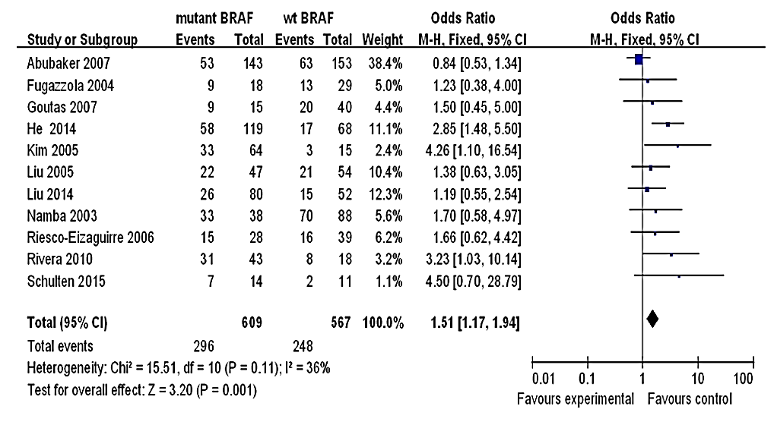
Fixed effect model of the ORs with 95% CIs of the patients age ≥45 years
associated with the BRAF V600E mutation

Slide 33
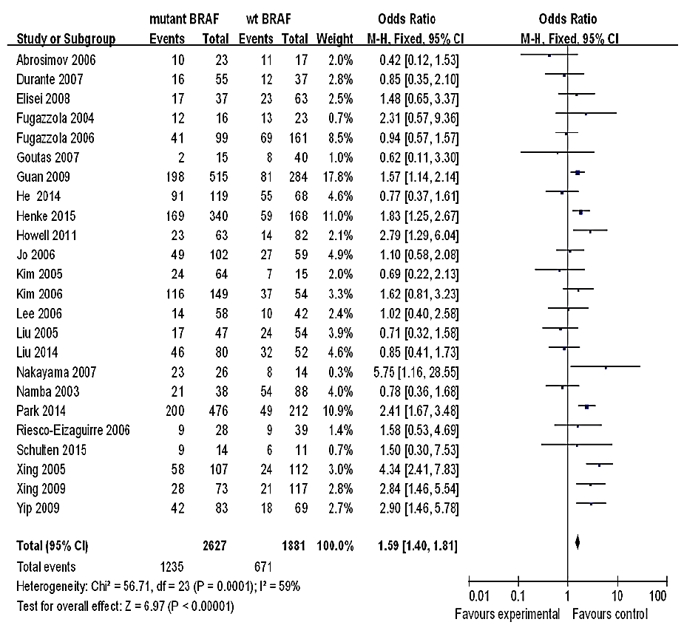
Random effect model of the ORs with 95% CIs of the presence of lymph node metastasis associated with the BRAF V600E mutation

Slide 34
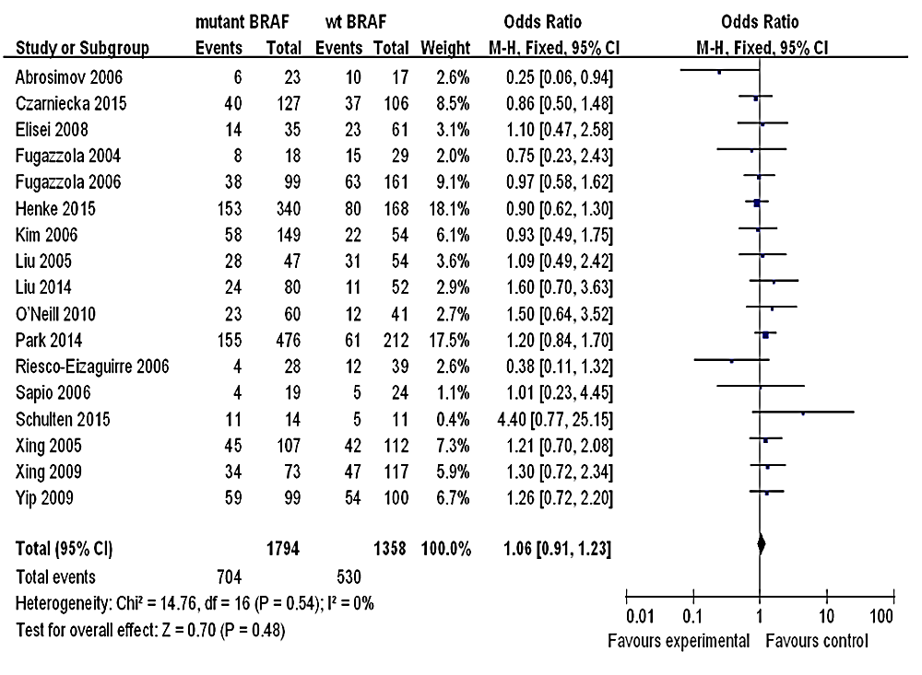
Fixed effect model of the ORs with 95% CIs of the presence of multiplicity
associated with the BRAF V600E mutation

Slide 35
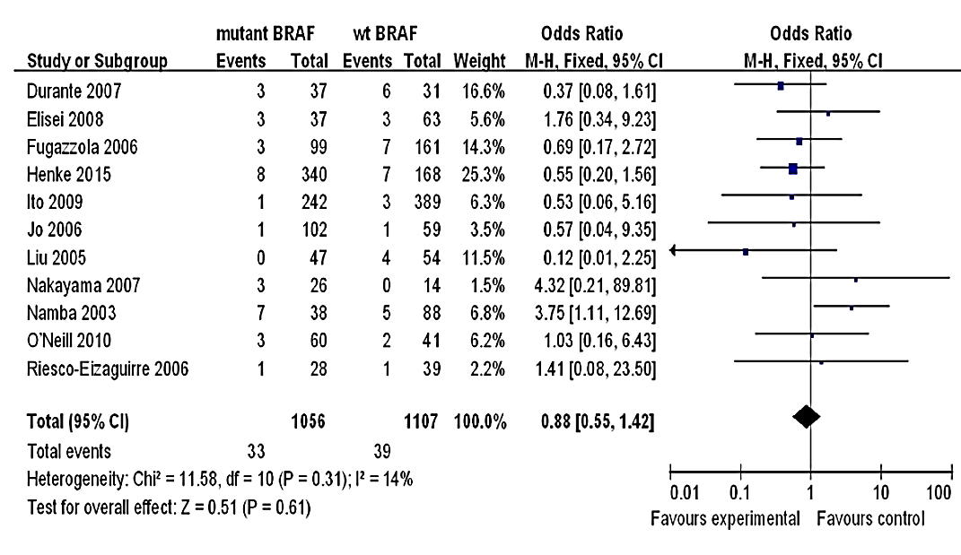
Fixed effect model of the ORs with 95% CIs of the presence of distant metastasis associated with the BRAF V600E mutation

Slide 36
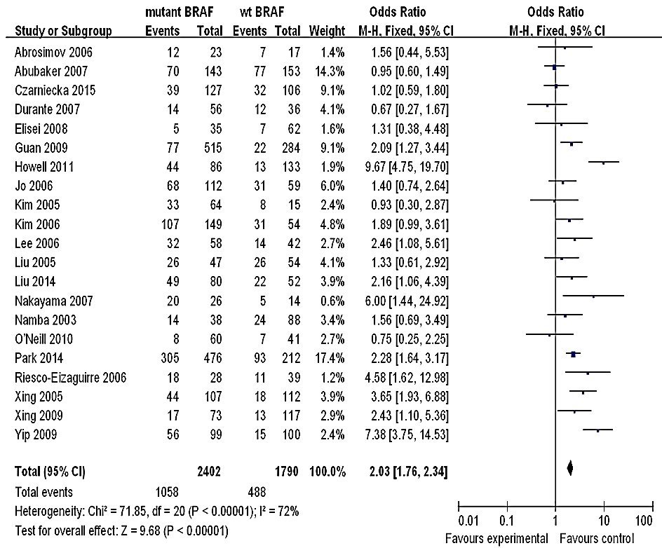
Random effect model of the ORs with 95% CIs of the presence of an extrathyroidal invasion associated with the BRAF V600E mutation

Slide 37
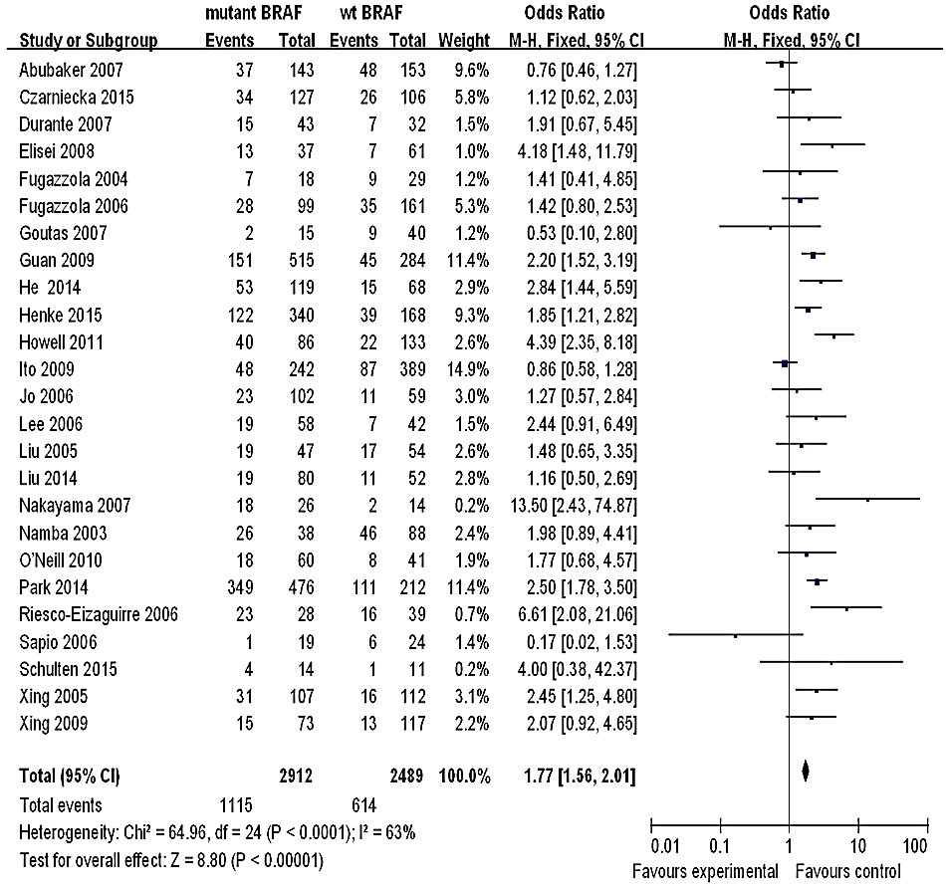
Random effect model of the ORs with 95% CIs of the presence of an advanced stage (III and IV) associated with the BRAF V600E mutation

Slide 38
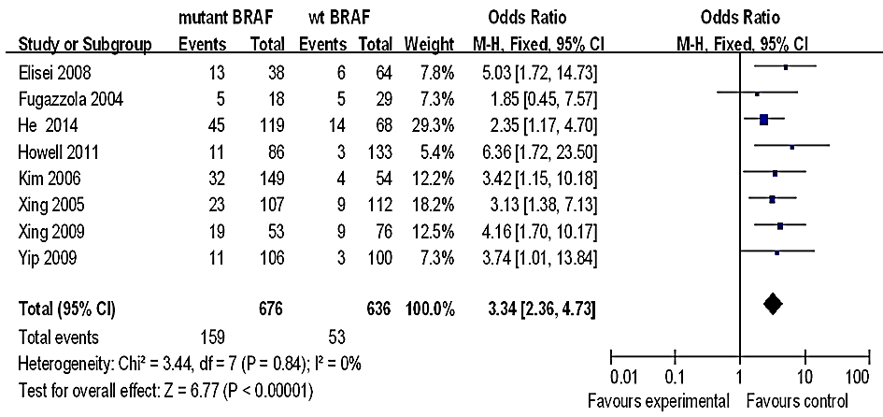
Fixed effect model of the risk ratios with 95% CIs of the recurrent and persistent disease associated with the BRAF V600E mutation

Slide 39
Coexisting BRAF and TERT Promoter Mutations

Slide 41
Impacts of BRAF V600E and TERT mutations on disease-free survival: PTC of all types

Slide 42
Impacts of BRAF V600E and TERT mutations on disease-free survival: conventional variant PTC only

Slide 43
Impacts of BRAF V600E or TERT C288T alone or their coexistence on DFS A: PTC of all types B: Conventional Variant PTC

Slide 44
BRAF and/or TERT mutations increase cancer specific death
BRAF: 3.08 death/1000 person yrs.
TERT Promoter: 6.62
BRAF + TERT: 29.86
PTC without either mutations: 0.8
Nature reviews, Clinical Oncology, sep. 2016

Slide 45
Endocrine Connections (2017) 6, R8–R17

Slide 46
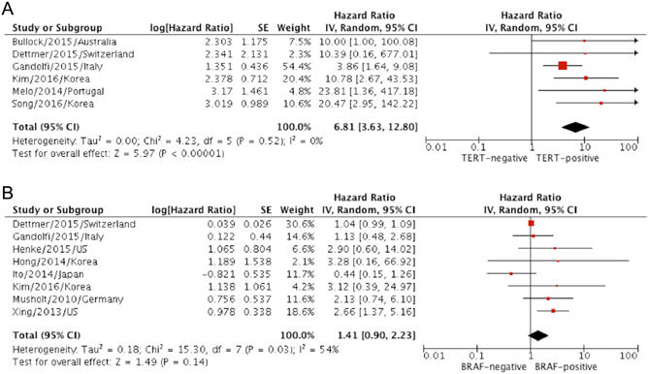
Forest plots of effects of TERT promoter (A) and
BRAF mutations (B) on DSS

Slide 47
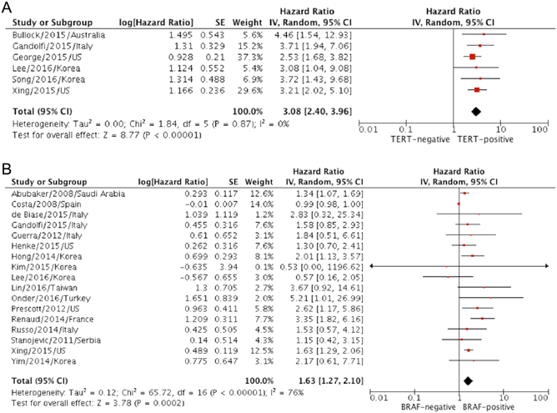
Forest plots of effects of TERT promoter (A) and
BRAF mutations (B) on DFS

Slide 49
December 30, 2014

Slide 50
Ten patients with BRAF V600Emutant iodine-refractory PTC
Dabrafenib pre-treatment before TSH stimulated iodine-131 WBS
Dabrafenib can stimulate radioiodine uptake in patients with metastatic BRAF V600E-mutant iodine-refractory PTC, representing a potential new therapeutic approach for these patients.

Slide 51
Lancet Oncol 2016

Slide 54
Take Home Messages
BRAF mutation in isolation is not sufficient to risk stratification in most cases
Not routinely recommended for post-operative risk stratification
TERT mutation: more unfavorable outcomes
more often in PTC with BRAF mutation
Combination of TERT and BRAF: higher risk of recurrence and mortality
Genetic screening for TERT promoter mutations could aid predictions of mortality and recurrence in high risk DTC
Kinase inhibitors: potential new treatment option for high risk patients

