Slide 1
Combinations of Insulin with Other Hypoglycemic Agents
Hengameh Abdi
Endocrine Research Center
Research Institute for Endocrine sciences
Shahid Beheshti University of Medical Sciences
10 August 2017

Slide 2
Outlines
Background
Insulin monotherapy versus insulin plus
Sulphonylurea
Metformin
Pioglitazone
Gliptins (DPP4 inhibitors)
Insulin combined with sodium-glucose co-transpoprter 2 inhibitors
Insulin combined with glucagon-like peptide 1 agonists
Conclusions

Slide 3
Background
Since the natural course of type 2 diabetes causes progressive decline of the ß-cell function, finally oral hypoglycemic agents will not suffice and exogenous insulin may be required.
Insulin therapy can be given either in monotherapy or in combination with other hypoglycemic agents.

Slide 4
Learning objectives
To learn about the effects of different combinations of insulin regimens with other hypoglycemic agents in type 2 diabetes patients.
Outcome measures:
Glycemic control
Required insulin dose
Adverse events
Hypoglycemia, weight gain, gastrointestinal symptoms
Diabetes-related morbidity
Micro- and macrovascular complications
Health-related quality of life and patient satisfaction
Mortality

Slide 5
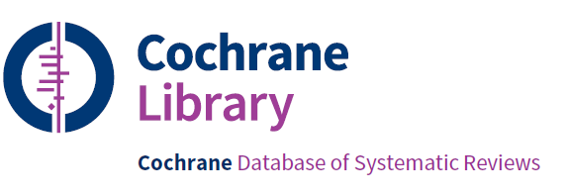

Slide 6
Insulin monotherapy
versus
insulin plus sulphonylurea

Slide 7
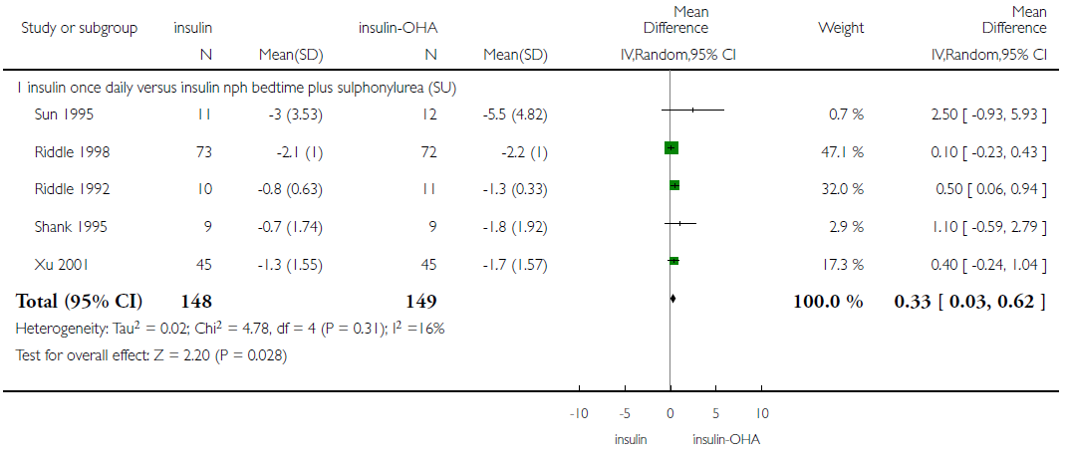
Insulin monotherapy versus insulin plus sulphonylurea in insulin-naïve patients Change in HbA1c (%)
Goudswaard AN, et al. Cochrane Database Syst Rev. 2004;4: Art. No.:CD003418.
Notes:
Twenty RCTs (mean trial duration 10 months) including 1,811 participants, with mean age 59.8 years and mean known duration of diabetes 9.6 years.
All, human insulin except one for Lispro.

Slide 8
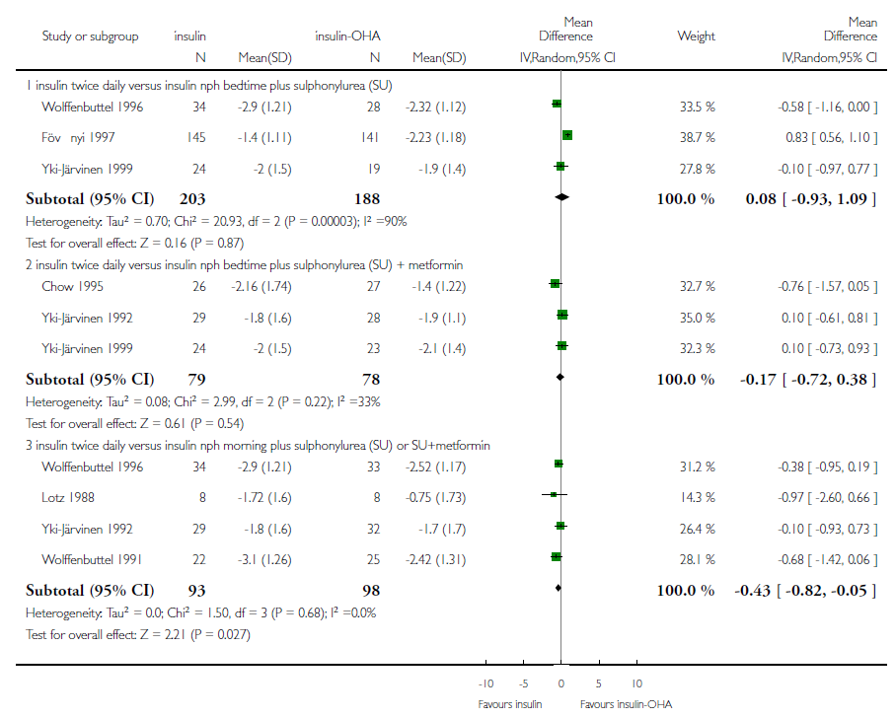

Slide 9
Summary
Insulin-sulphonylurea (± metformin) combination therapy vs insulin monotherapy in insulin-naïve patients:
Comparable glycemic control.
43% relative reduction in total daily insulin requirement.
No significant difference in the frequency of symptomatic or biochemical hypoglycemia.
No significant differences with respect to weight gain.
No significant differences in quality of life related issues (based on 2 studies).

Slide 10
Insulin monotherapy versus insulin plus sulphonylurea in patients already on insulin
17 comparisons: glibenclamide = 11, glipizide = 2, tolazamide = 2, gliclazide = 1, glimepiride = 1; low-quality evidence
Outcome | Insulin monotherapy | Insulin-SUR
Mean difference in HbA1c (%) | 0 | -1 (-1.6 to -0.5)
Mild hypoglycemic episodes per participant | 2.0 to 2.6 | 2.2 to 6.1
Additional weight gain (kg) | 0 | 0.4 to 1.9
Vos RC, et al. Cochrane Database Syst Rev. 2016;9: Art. No.: CD006992.

Slide 11
A comment!
The additional effect of the combination of insulin with oral glucose-lowering agents on glycemic control in insulin-naive patients was small.
The effectiveness of adding oral glucose-lowering agents to insulin therapy is differential depending on whether they are administered in insulin-naive patients or in patients who are already on insulin therapy.

Slide 12
Insulin monotherapy
versus
insulin plus metformin

Slide 14
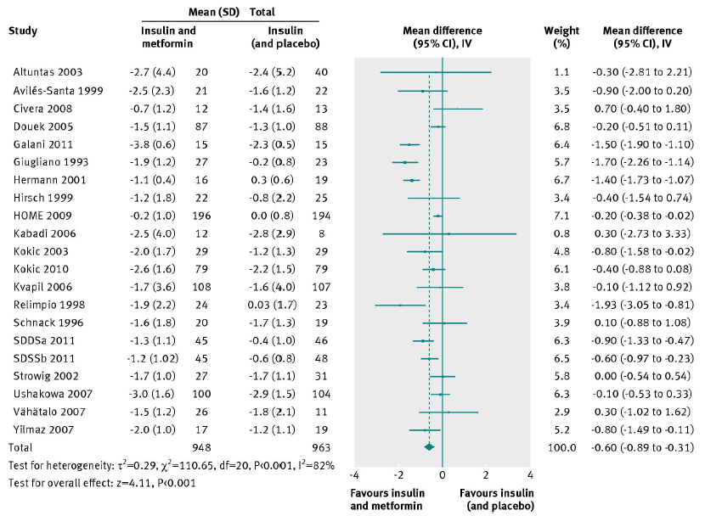
Metformin and insulin resulted in reduced HbA1c, compared with insulin alone [-0.6% (-0.89 to -0.31)].
Hemmingsen B, et al. BMJ 2012;344:e1771.
Notes:
26 randomised trials with 2286 participants, of which 23 trials with 2117 participants could provide data. All trials had high risk of bias.

Slide 15
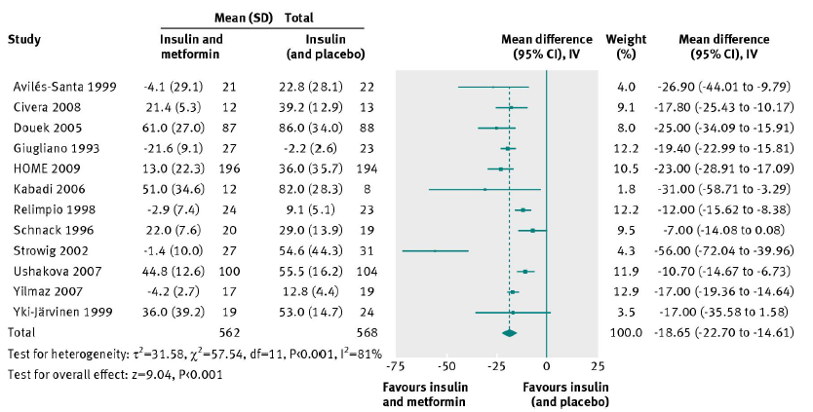
Metformin and insulin resulted in reduced insulin dose, compared with insulin alone [-18.65 U/d (-22.7 to -14.61)].
Hemmingsen B, et al. BMJ 2012;344:e1771.

Slide 16
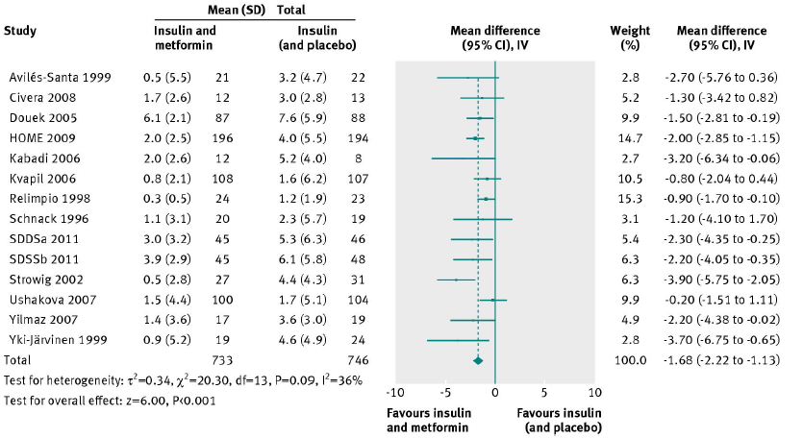
Metformin and insulin resulted in reduced weight gain, compared with insulin alone [-1.68 kg (-2.22 to -1.13)].
Hemmingsen B, et al. BMJ 2012;344:e1771.

Slide 17
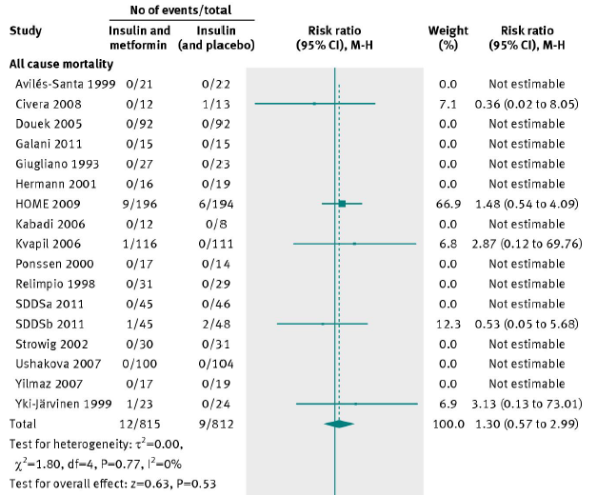
Metformin and insulin versus insulin alone did not significantly affect all-cause and cardiovascular mortality.
Hemmingsen B, et al. BMJ 2012;344:e1771.

Slide 18
Summary
Insulin-metformin therapy vs Insulin monotherapy:
Sufficient evidence for a HbA1c reduction of 0.5%, lower weight gain of 1 kg, and lower insulin dose of 5 U/day.
No significant difference in the frequency of severe or mild hypoglycemia.
No significant difference in other adverse events.
No significant differences in quality of life (3 trials).
Taking into account the sparse data regarding micro- and macrovascular complications also mortality outcome, no significant difference was detected with respect to these hard outcomes.
Hemmingsen B, et al. BMJ 2012;344:e1771.

Slide 19
Summary
Findings of the recent Cochrane systematic review regarding insulin-metformin therapy vs insulin monotherapy were in agreement with the BMJ systematic review except about gastrointestinal (GI) adverse effects:
Users of metformin-insulin experienced more GI adverse effects
(7-67% versus 5-16%).
Vos RC, et al. Cochrane Database Syst Rev. 2016;9: Art. No.: CD006992.

Slide 20
Insulin monotherapy
versus
insulin plus pioglitazone

Slide 21
Data from 4 comparisons (low-quality evidence)
Vos RC, et al. Cochrane Database Syst Rev. 2016;9: Art. No.: CD006992.

Slide 22
Summary
Insulin-pioglitazone combination therapy vs insulin monotherapy:
Comparable glycemic control.
Small reduction in total daily insulin requirement.
More mild to moderate hypoglycemic episodes.
More weight gain [3.8 kg (3.0 to 4.6)].
More cases of edema (fluid retention) and heart failure (dose-dependent).
Vos RC, et al. Cochrane Database Syst Rev. 2016;9: Art. No.: CD006992.

Slide 23
Insulin monotherapy
versus
insulin plus DPP-4 inhibitors

Slide 24
Data from 3 comparisons (vildagliptin, sitagliptin, saxagliptin) (low-quality evidence)
Vos RC, et al. Cochrane Database Syst Rev. 2016;9: Art. No.: CD006992.

Slide 25
Summary
Insulin-DPP-4 inhibitors combination therapy vs insulin monotherapy:
Slightly better glycemic control; mean difference in HbA1c: -0.4% (-0.5 to -0.4)
No significant difference in total daily insulin requirement.
Heterogeneous data regarding hypoglycemic episodes; however, in favor of lower rates of hypoglycemia.
No significant differences with respect to weight gain.
Vos RC, et al. Cochrane Database Syst Rev. 2016;9: Art. No.: CD006992.

Slide 26
Insulin plus
sodium-glucose co-transpoprter 2 (SGLT2) inhibitors

Slide 27
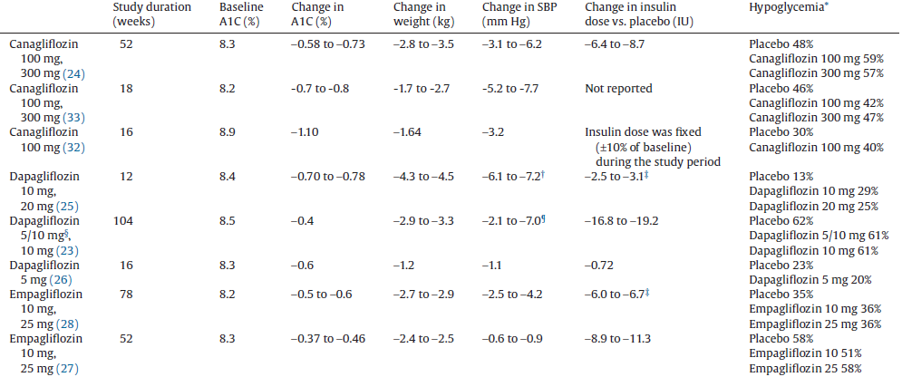
Trials evaluating the efficacy and safety of SGLT2 inhibitor add-on in individuals treated with insulin.
Woo VC, et al. Can J Diabetes. 2017 In press.

Slide 28
Summary
SGLT2 inhibitors when used with insulin can lead, not only to improved glycemic control, but also to weight reduction or limited weight gain and can diminish the daily insulin requirement.
In some studies, this combination resulted in elevated incidence of hypoglycemia.
Woo VC, et al. Can J Diabetes. 2017 In press.

Slide 29
Insulin plus
glucagon-like peptide 1 agonists

Slide 30
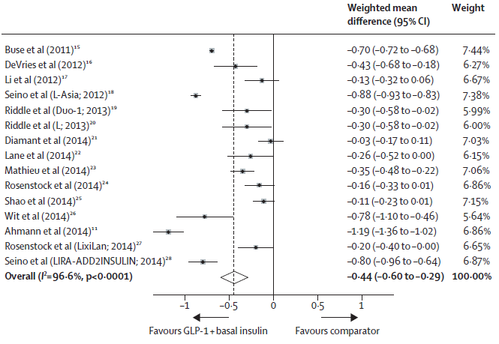
In a pooled analysis of 15 trials, the combination of GLP-1 agonist and basal insulin led to a mean greater reduction in HbA1c than with any other treatment strategy.
Eng C, et al. Lancet. 2014;384:2228-34.

Slide 31
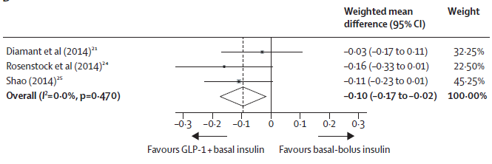
Compared to basal-bolus insulin regimens, the combination of GLP-1 agonist and basal insulin led to a mean greater reduction in HbA1c but no benefit regarding proportion of participants achieving HbA1c ≤ 7%.
Eng C, et al. Lancet. 2014;384:2228-34.

Slide 32
Summary
Compared with other anti-diabetic treatments, GLP-1 agonist and basal insulin combination treatment yielded:
Improved mean reduction in HbA1c of -0.44% (-0.60 to -0.29),
Improved likelihood of achieving the target HbA1c ≤ 7%,
No increased relative risk of hypoglycemia (0.99; 0.76 to 1.29),
Mean reduction in weight of -3.22 kg (-4.90 to -1.54).
Furthermore, compared with basal-bolus insulin regimens, the combination treatment yielded:
Mean reduction in HbA1c of -0.1% (-0.17 to -0.02),
Lower relative risk of hypoglycemia (0.67, 0.56 to 0.80),
Reduction in mean weight (-5.66 kg; -9.8 to -1.51).
Eng C, et al. Lancet. 2014;384:2228-34.

Slide 33
Insulin and GLP-1 Receptor Agonist Combination Therapy in Type 2 Diabetes: A Systematic Review and Meta-analysis of Randomized Controlled Trials
To compare GLP-1 agonists alone or as titratable fixed-ratio plus basal insulin with other injectable antidiabetes treatments.
26 RCTs, lasting 12–52 weeks, and involving 11,425 patients.
High heterogeneity and a significant publication bias.
Maiorino MI, et al. Diabetes Care. 2017;40:614-624.

Slide 34
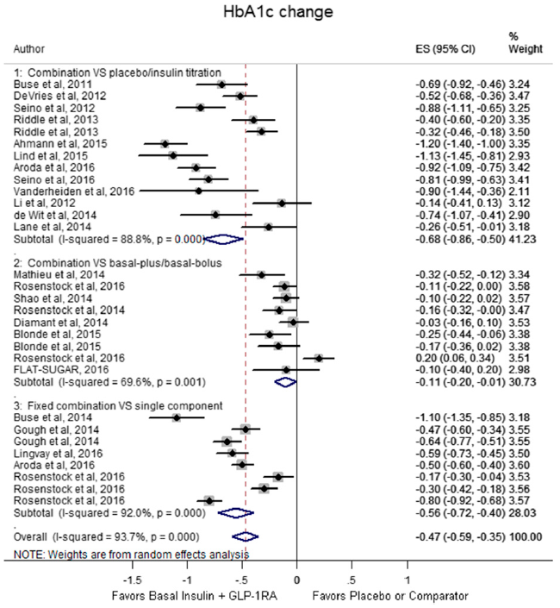
Maiorino MI, et al. Diabetes Care. 2017;40:614-624.

Slide 35
Summary
Insulin plus GLP-1 agonists versus other injectable antidiabetes treatments:
Reductions in HbA1c (WMD = -0.47%, -0.59 to -0.35),
More patients at HbA1c target (RR = 1.65, 1.44-1.88),
Similar hypoglycemic events (RR = 1.14, 0.93-1.39),
Reduction in weight (WMD = -2.5 kg, -3.3 to -1.7).
Compared with basal-bolus insulin regimens, combination treatment was associated with:
Comparable glycemic control,
Less hypoglycemia (RR = 0.66, 0.46-0.93),
Reduced weight (WMD = -4.7 kg, -6.9 to -2.4).
Maiorino MI, et al. Diabetes Care. 2017;40:614-624.

Slide 36
Learning objectives
To learn about the effects of different combinations of insulin regimens with other hypoglycemic agents in type 2 diabetes patients.
Outcome measures:
Glycemic control
Required insulin dose
Adverse events
Hypoglycemia, weight gain, gastrointestinal symptoms
Diabetes-related morbidity
Micro- and macrovascular complications
Health-related quality of life and patient satisfaction
Mortality

Slide 37
Concluding remarks Effects of addition of different glucose lowering agents to insulin regimens
Outcome | Glycemic control | Required insulin | Hypoglycemia | Weight gain | Other adverse effects
Sulphonylureas | =/+ | + | =/- | =/-
Metformin | + | + | + | + | GI
Pioglitazone | = | + | - | - | Edema, HF
DPP-4 inhibitors | + | = | =/+ | =
SGLT2 inhibitors | + | + | =/- | +
GLP-1 agonists | +/= | + | + | +
+, in favor of benefit of combination therapy.
-, in favor of harm of combination therapy.
=, no difference.
GI, Gastrointestinal; HF, Heart failure

Slide 38
Concluding remarks:
Conclusion is difficult when quality of evidence is low.
It is important that clinicians meticulously weight the advantages of combination therapy against possible negative effects in every individual patient.

Slide 39
Thanks for your patience.

Slide 40
Case Discussion
A 64-year-old man with 12-year history of T2DM is referred to you. He is taking metformin 2000 mg and injects glargine insulin 32 U at 9 pm daily. In the past few months, his fasting glucose levels have ranged from 110-140 mg/dl. He suffers from a mild background retinopathy. He fears from hypoglycemia and doesn’t follow a regular dietary pattern. He has no financial problems.
BMI: 35 kg/m², HbA1c: 8.2%, Cr: 0.8 mg/dl.
In addition to lifestyle modification, which therapeutic approach would you recommend to him?
Add one rapid acting insulin before the largest meal
Titrate insulin glargine
Add a glucagon like peptide 1 agonist (Victoza)
Change glargine insulin to twice daily premixed insulin

Slide 41
Case Discussion
A 57-year-old woman with 10-year history of T2DM is referred to you. She is taking metformin 2000 mg and gliclazide MR 160 mg daily. She complains of increased hypoglycemic episodes over 3 past months. She has history of coronary artery disease.
BMI: 32 kg/m², HbA1c: 9.1 %, Cr: 0.7 mg/dl, no albuminuria.
In addition to lifestyle modification, which therapeutic approach would you recommend to her?
Discontinue gliclazide and change metformin to sitagliptin/metformin 50/1000 mg daily
Discontinue gliclazide, initiate basal insulin and change metformin to sitagliptin/metformin 50/1000 mg daily
Add a glucagon like peptide 1 agonist (Victoza)
Add pioglitazone 30 mg daily

